Slide 1
VANGUARD ROBOTICS 2026
Github / Sourcetree Setup/usage guide and
File sharing procedures

Slide 2
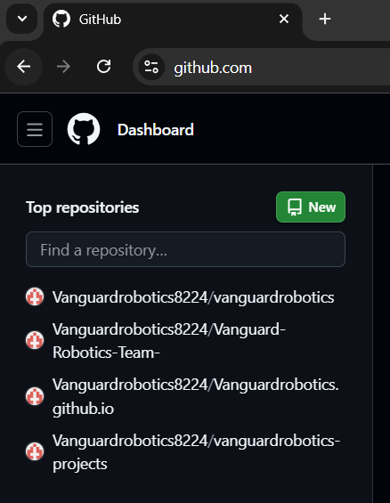
Sign in to github.com
Note the repositories:
vanguardrobotics
website –do not use
Vanguardrobotics.github.io
website –do not use
vanguardrobotics-projects
sample coding projects
Vanguard-Robotics-Team
main code base
Click on Vanguard-Robotics-Team

Slide 3
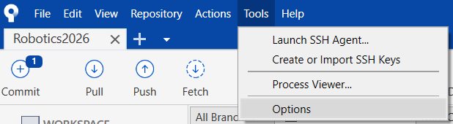
Set up SourceTree
Open SourceTree. This assumes you signed in to your bitbucket account earlier.
Go to Tools
> Options

Slide 4
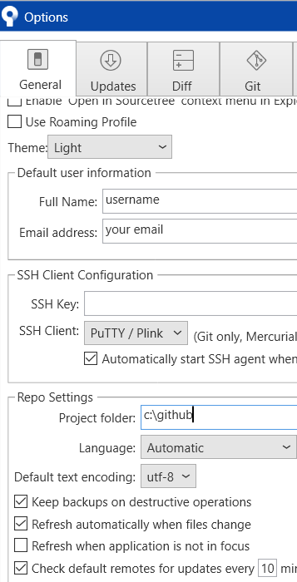
Set up SourceTree
Full Name
Your name
Email address
Your email address
Project Folder
C:\github

Slide 5
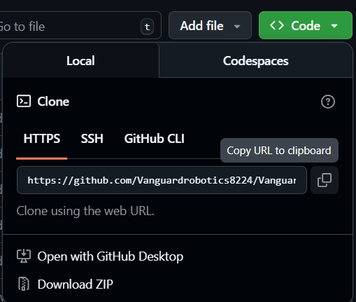
Clone a Repository step 1 -github
Click the green Code button
Select the copy button
This will copy the url for the github repository to your computer’s clipboard

Slide 6
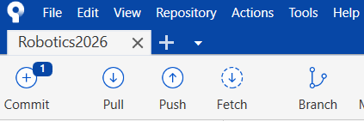
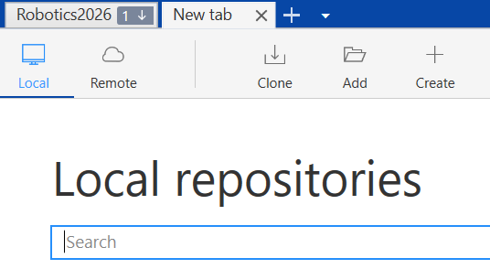
Clone a Repository step 2 -SourceTree
Click the + button
Select Clone

Slide 7
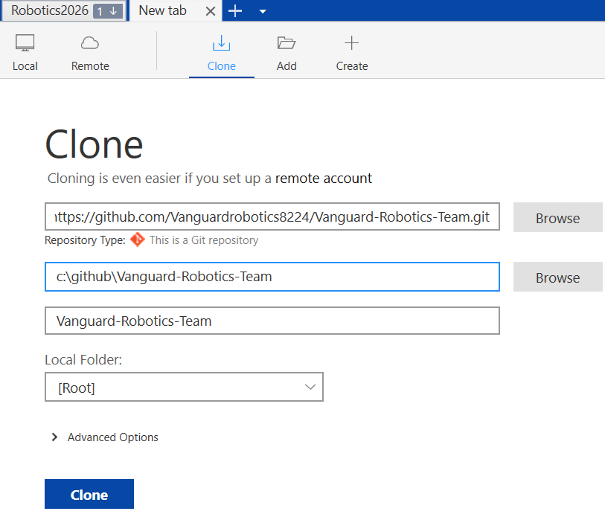
Clone a Repository step 2 -SourceTree
Paste the github repository url here
The other fields should update automatically
Click Clone

Slide 8
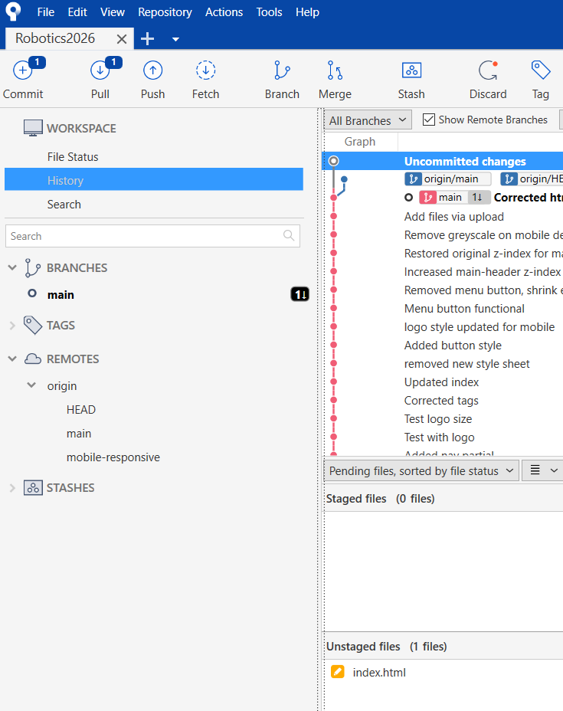
Working with SourceTree
1
2
Buttons used most often
Different views of window 4
Shows all the branches in github or on your laptop
List of all commits (changes) made
List of files changed on your laptop
List of files ready to commit
1
4
2
4
3
3
4
5
6
6
5

Slide 9
Working with SourceTree
1
A commit is a group of files saved to github at the same time
Fetch
Will ensure the list of commits is up to date. If there are changes in github, a small number will appear beside the Pull button.
Pull
Will “pull” files from github to your laptop
Push
Will “push” committed files from your laptop to github
Branch
Before making changes, create a new branch with a unique name (eg: feature/rateupdates). This ensures no files are merged into the main branch without proper review.

Slide 10
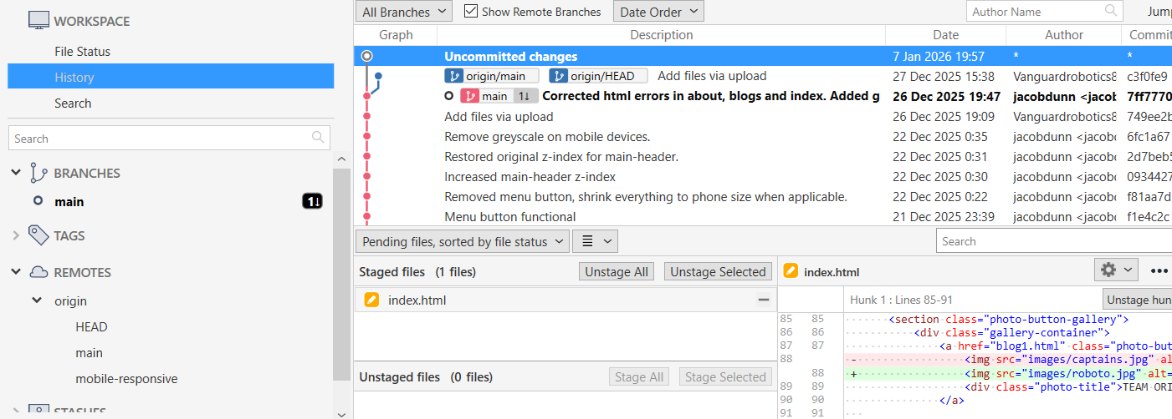
4
6
5
7
In the Workspace, select History
4 List of commits made for this repository with relevant comments, the person who made the commit, and the date of the commit
5 List of files that are different between your computer and the github branch
- files can be staged (ready to commit) by clicking the Stage Selected button
6 List of files that are ready to commit
- files can be removed from the commit by clicking the Unstage Selected button
7 Changes made to the selected file
- red: code removed
- green: code added
4
5
6
7

Slide 11
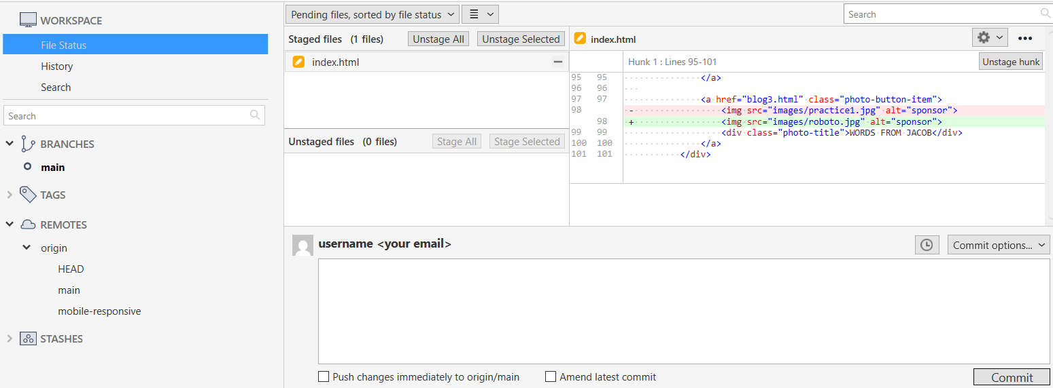
6
7
5
8
In the Workspace, select File Status
5 List of files that are different between your computer and the github branch
- files can be staged (ready to commit) by clicking the Stage Selected button
6 List of files that are ready to commit
- files can be removed from the commit by clicking the Unstage Selected button
7 Changes made to the selected file
- red: code removed
- green: code added
8 Type a relevant comment here, them press the Commit Button
5
6
7
8

Slide 12
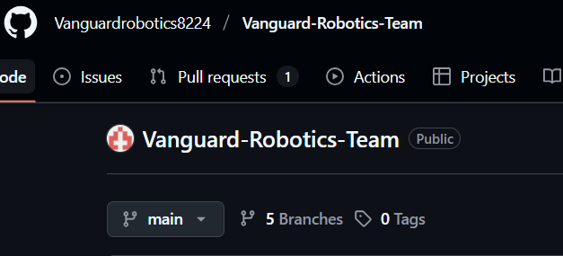
Basic Procedure
Get the code: SourceTree
Select the working branch (usually main)
Click the Fetch button
If your laptop is out of date, click the Pull button to synchronize with github
Create a new branch (use the Branch button): call it your name
Start coding: VSCode!
See Karina’s examples
Put changes in github: SourceTree
Stage files (check changes first!)
Write a short description of the changes
Commit the files
Push the commit to github
(you can verify they are there by
going to your branch in github)

Slide 13
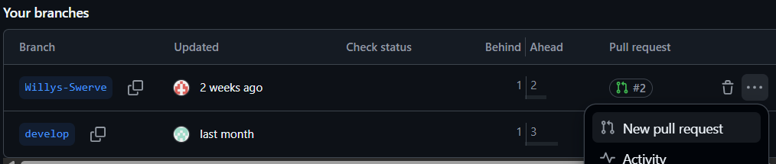
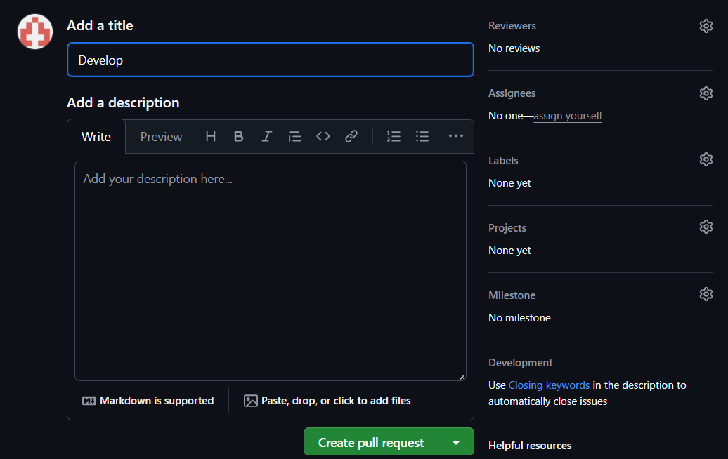
Ask for a code review “correcting your homework”
Select the new branch
Click on the three dots, then New Pull Request
Add a title and description
Select reviewers to check your changes
Click on the
Create pull request
button

Slide 14
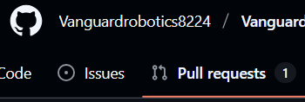
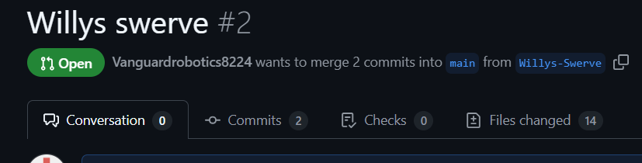
Reviewing a Pull Request –do not review your own work
Select Pull requests
Select the pull request to review
Select Files changed. A list of the new/deleted/changed files will appear

Slide 15
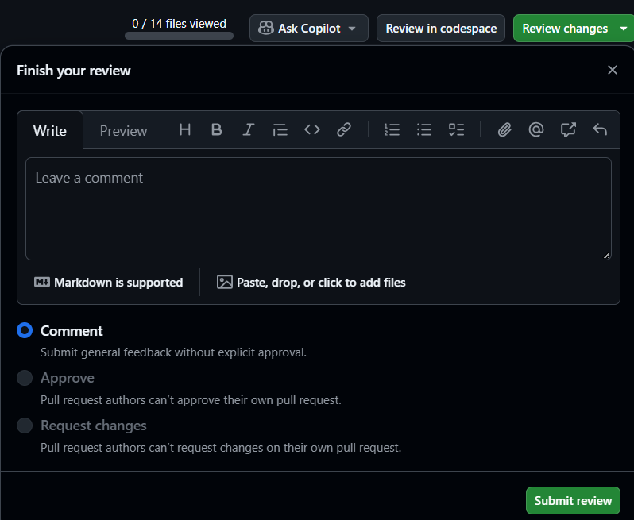
Reviewing a Pull Request
Select Review changes
There are three choices
Leave a comment
Approve the changes
Request changes (make the request in the comment box)
Select Submit review

Slide 16
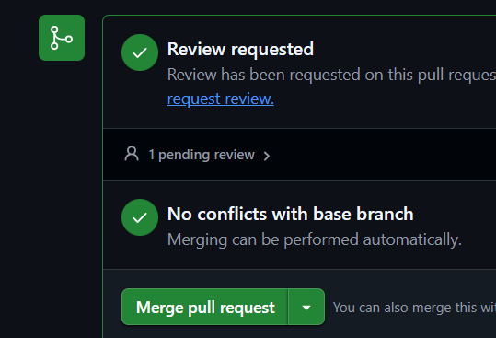
Merging a Pull Request
After your pull request has been approved by a reviewer:
If there are conflicts, they must be resolved before you can merge
If there are no conflicts, click Merge pull request
Your pull request will be merged into the main branch
Delete your branch
Congratulations!

