Slide 1
Receipt & INVOICE DIGITIZER
A Beginner's Guide to Building Intelligent Expense Managers

Slide 2
PROBLEM STATEMENT
Managing receipts manually is time-consuming and error-prone.
Users often lose bills or fail to track expenses accurately.
There is a need for an automated system that can:
Digitize receipts
Extract important information
Analyze spending patterns

Slide 3
PROJECT OBJECTIVE
The objective of this project is to:
  Digitize receipts and invoices using AI
  Extract structured expense data automatically
  Store expenses securely
  Provide clear spending analytics

Slide 4
SYSTEM OVERVIEW
Frontend
Brain
Memory
Design
Built using Streamlit.
Provides an interactive web-based dashboard.
Allows users to upload receipts and navigate analytics easily
Uses Google Gemini AI for reading receipt images
Extracts structured data such as merchant name, date, and total amount
Ensures consistent output using strict JSON formatting
Uses SQLite database for persistent storage
Stores receipt details and categorized expenses
Enables long-term expense tracking and analysis
Clear separation between UI, AI processing, and data storage
Scalable design suitable for future enhancements

Slide 5
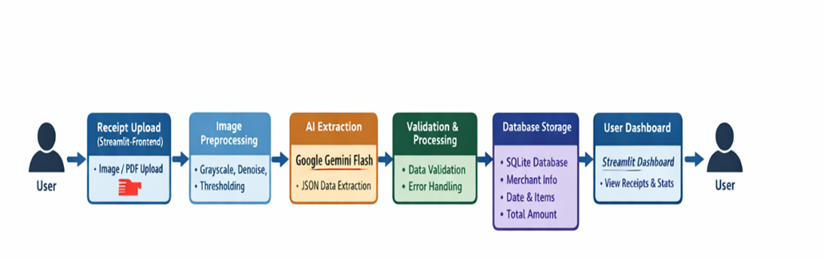
SYSTEM ARCHITECTURE

Slide 6

FRONTEND
(USER INTERFACE)
The frontend of the system is implemented using Streamlit, providing a user-friendly web interface. It allows users to upload receipts, view stored records, and access expense analytics. The tab-based layout ensures easy navigation and efficient interaction with the application.

Slide 7

AI EXTRACTION
& IMAGE PREPROCESSING
The system uses Google Gemini 2.5 Flash to extract key receipt details such as merchant, date, total amount, and currency. Image preprocessing techniques like grayscale conversion and auto-contrast enhancement are applied to improve text clarity and ensure accurate, structured JSON output.

Slide 8
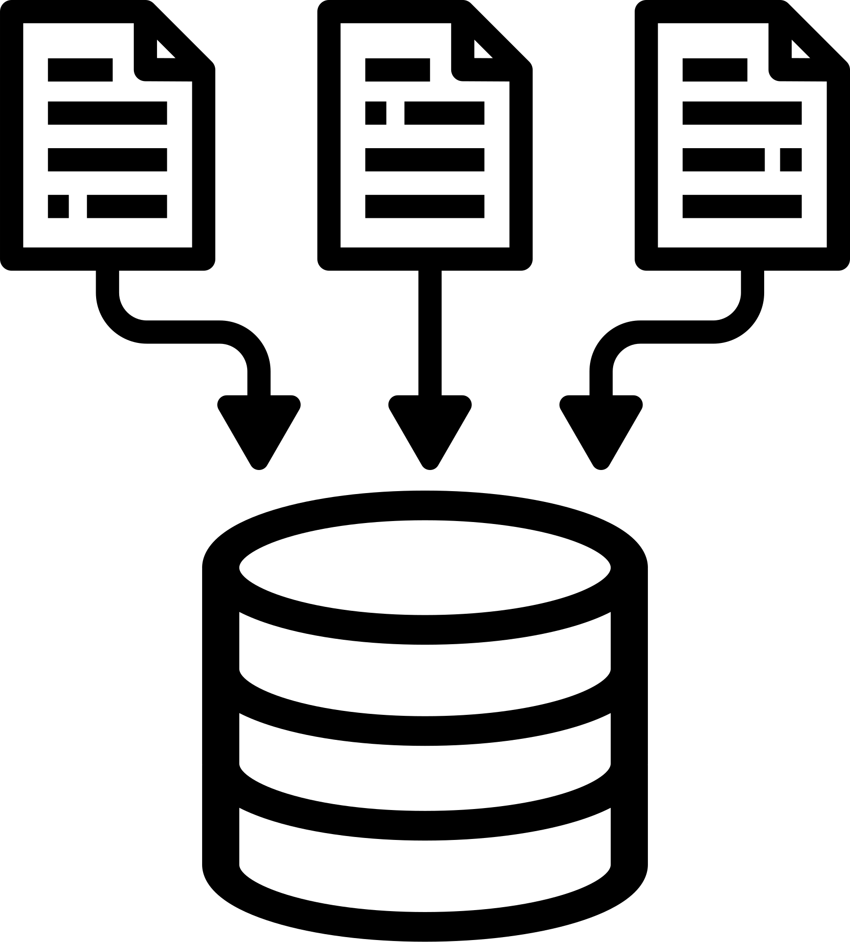
DATABASE STRUCTURE
The system uses a SQLite database.
Each receipt record stores:
  Merchant name
  Date of purchase
  Total amount
  Expense category
  id of bill

Slide 9

DUPLICATE RECEIPT DETECTION :
To prevent duplicate bills:
  A hash is generated from the uploaded file
  The hash is checked before storing the receipt
If a duplicate is detected, the receipt is not saved.
EXPENSE CATEGORIZATION :
Receipts are automatically classified into categories:
  Groceries
  Medical
  Restaurant
  Travel
  Utilities
  Other
Categorization is done using merchant name keywords.

Slide 10
ADVANCED RECEIPT & INVOICE PARSING
Regex
NLP
Identifies invoice date, totals, taxes (GST, CGST, SGST, IGST), currency, invoice numbers.
Handles multiple formats and variations across vendors.
Detects merchant names and contextual keywords.
Differentiates subtotal, tax, and total amounts.
Extracts line items and associates prices with products.
Resolves ambiguities in numeric values.

Slide 11
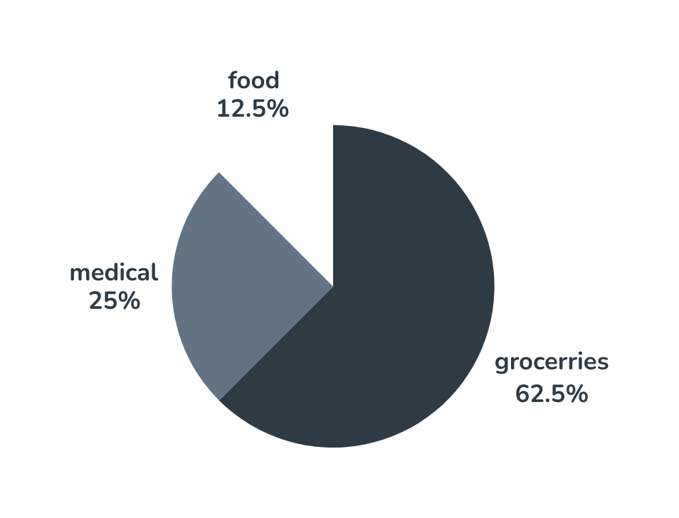
ANALYTICS DASHBOARD
The analytics dashboard presents category-wise total spending to provide a clear overview of expenses. Bar charts and pie charts are used to compare spending across different categories and visualize expense distribution. This helps users easily understand where their money is being spent.

Slide 12
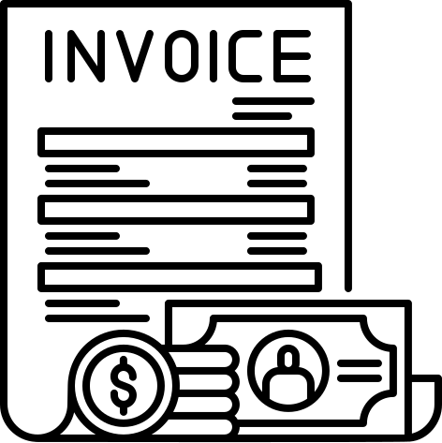
CATEGORY DRILL-DOWN
Users can:
  Select a category
  View all receipts under that category
  Analyze detailed spending records
This improves transparency and usability.
HISTORY VAULT
The History tab:
  Displays all stored receipts
  Allows users to review past expenses
  Supports clearing all records when required

Slide 13
The Receipt & Invoice Digitizer automates expense tracking using AI.
It reduces manual effort, improves accuracy, and provides meaningful insights.
The project demonstrates practical application of AI in real-world financial management.
CONCLUSION

Slide 14
Thank You

