Slide 1

MINI PROJECT-1
COFFEE HOUSE

Slide 2
ABSTRACT
Coffee house is a place where you can have any refreshments and beverages of your choice.
The process of managing the menu ,consumption and payments becomes quite challenging.
The main aim of the project is to provide a complete solution for the problems faced in coffee sales system.
It displays the menu, takes orders , displays the bill and maintains a record of all this.

Slide 3
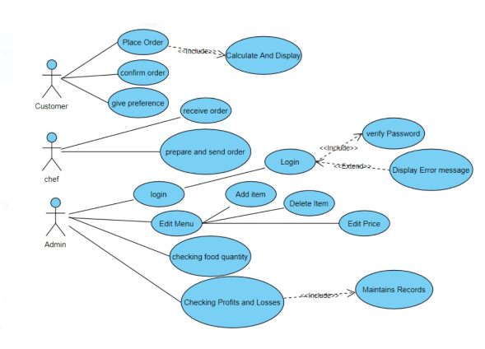
USE CASE DIAGRAM

Slide 4
TECHNOLOGY USED
All computer software needs certain hardware components and also other software resources to be present, in order for computers to be used efficiently. These pre-requisites are known as System Requirements. System Requirements are of two types – Software Requirements and Hardware Requirements.
SOFTWARE REQUIREMENTS
Software requirements deal with defining the software resource requirements and prerequisites that need to be installed on a computer to provide optimal functioning of an application. These preconditions are generally not included in the software package and need to be installed separately. In order to use our Coffee House project, one should have the following software requirements:
Operating system: windows 7 and above
C compiler: GNU Compiler Collection (GCC).
Editor: Any text editor that supports C language
HARDWARE REQUIREMENTS
Hardware requirements refer to the common set of requirements defined by any operating system or software application and are usually the physical computer resources. In this we look into the architecture, processing power, memory, secondary memory, display adapter and peripherals.
In order to use our Coffee House project, one should have the following hardware requirements:
Processor: intel core I5 and above
Memory: 4 GB RAM and above

Slide 5
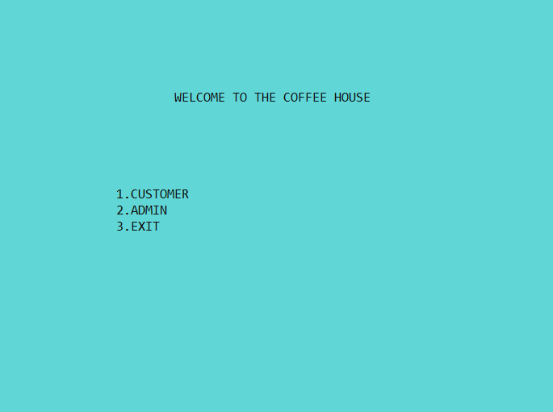
RESULTS:

Slide 6
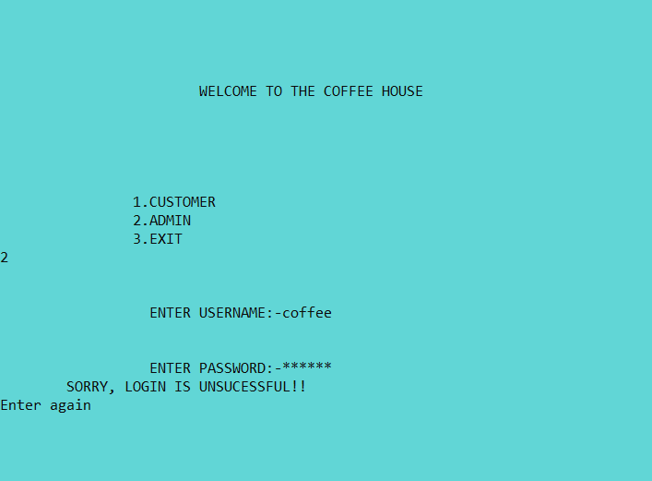

Slide 7
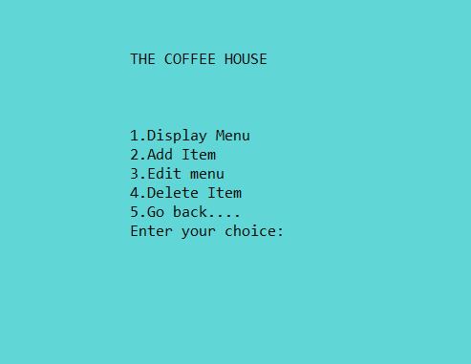

Slide 8
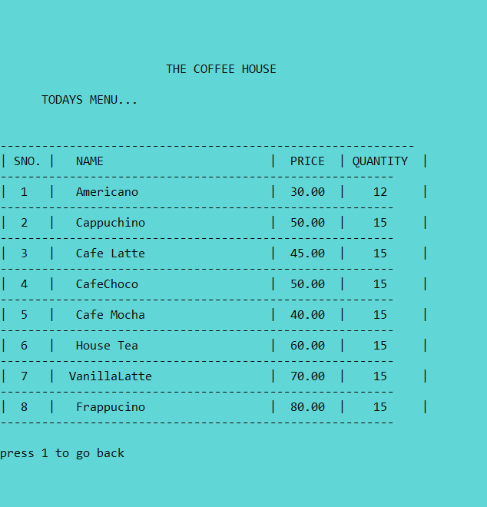

Slide 9
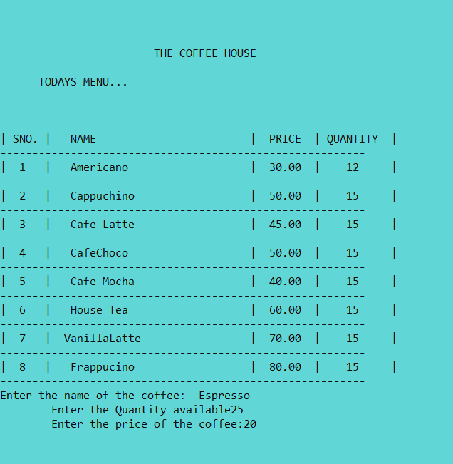

Slide 10
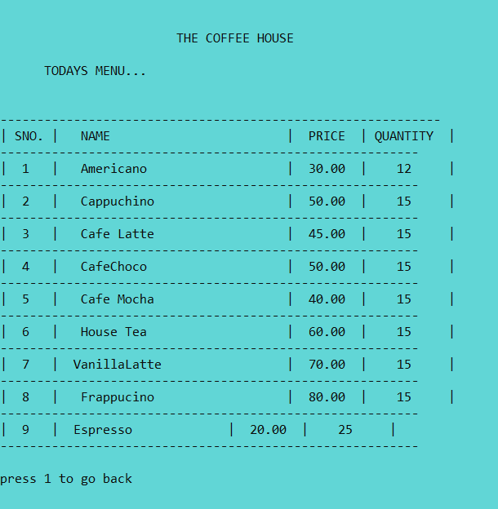

Slide 11
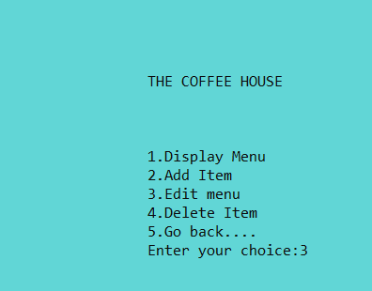

Slide 12
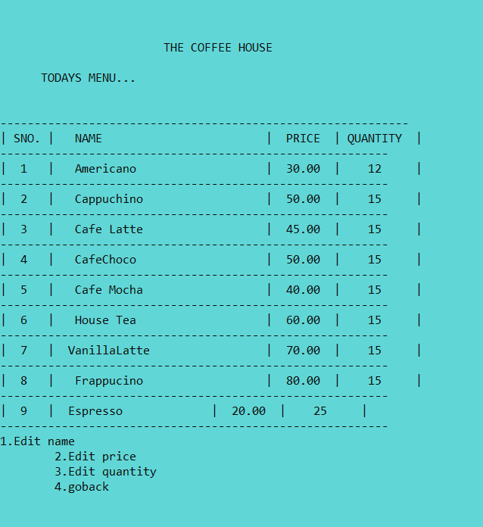

Slide 13
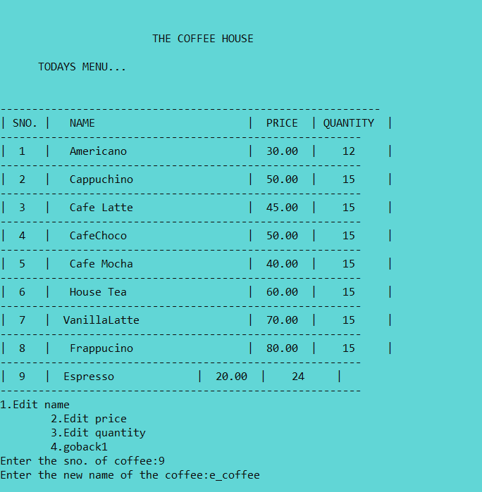

Slide 14
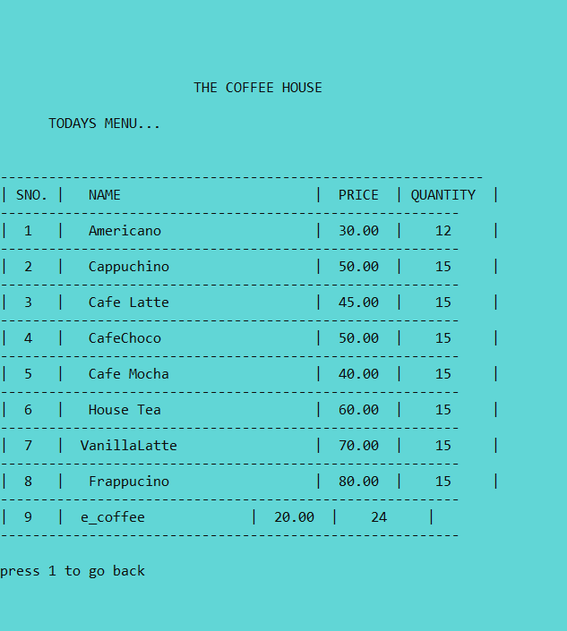

Slide 15
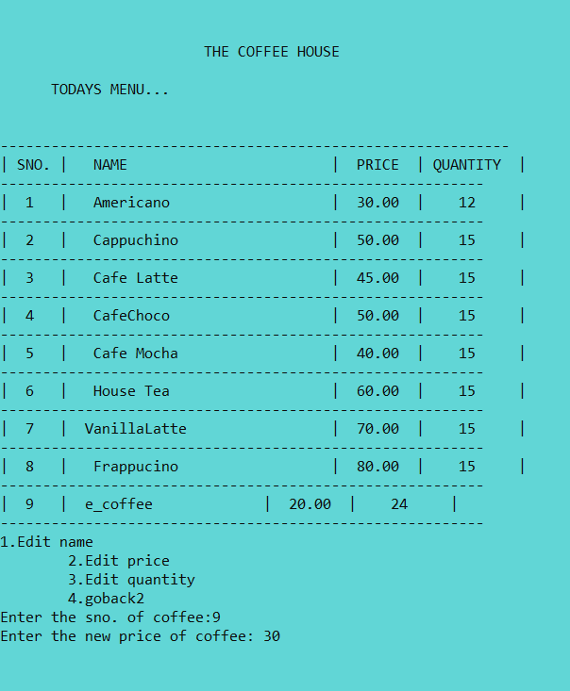

Slide 16
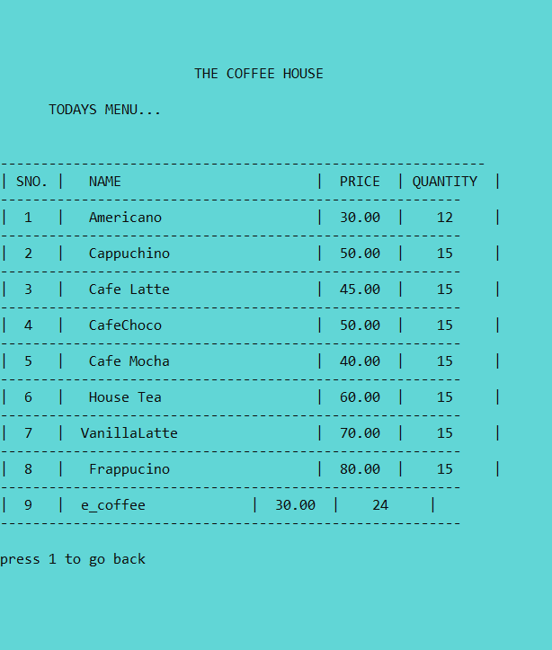

Slide 17
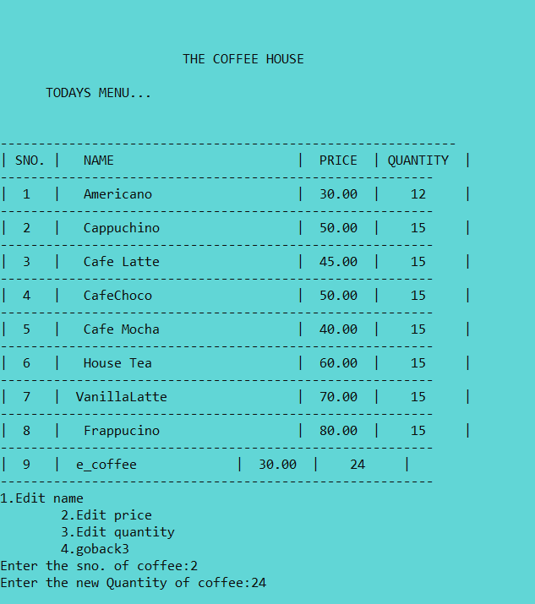

Slide 18
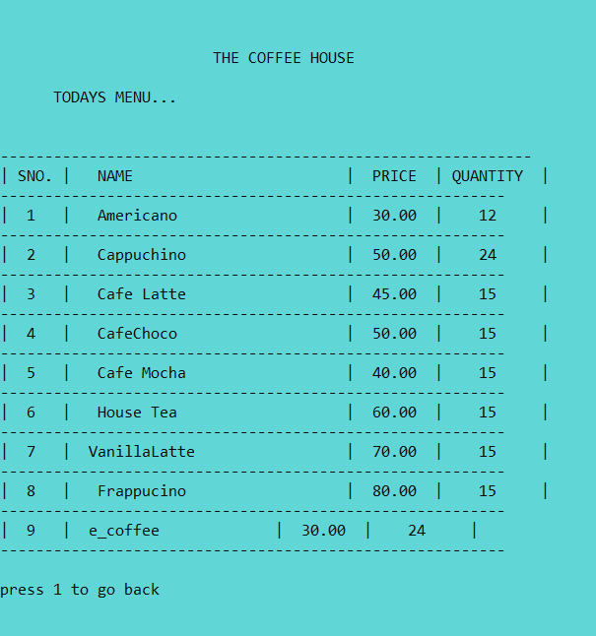

Slide 19
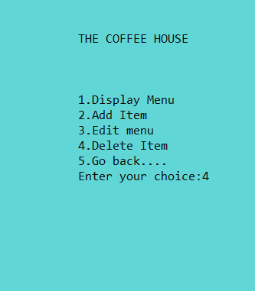

Slide 20
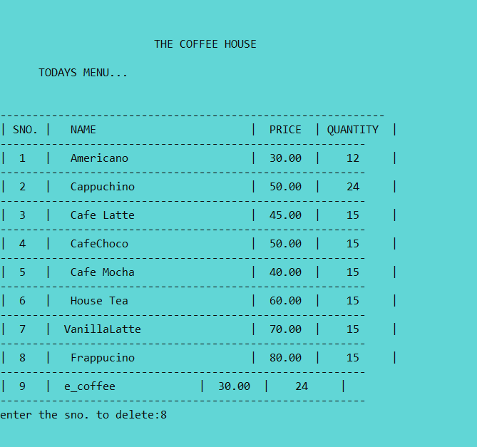

Slide 21
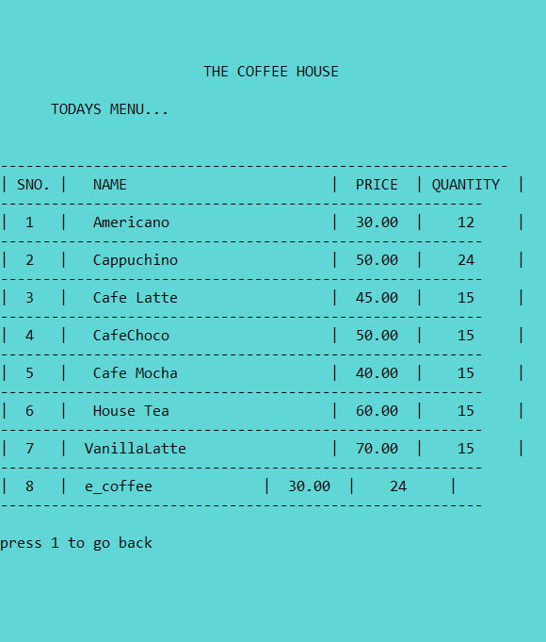

Slide 22
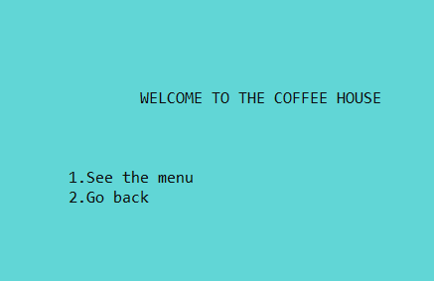

Slide 23
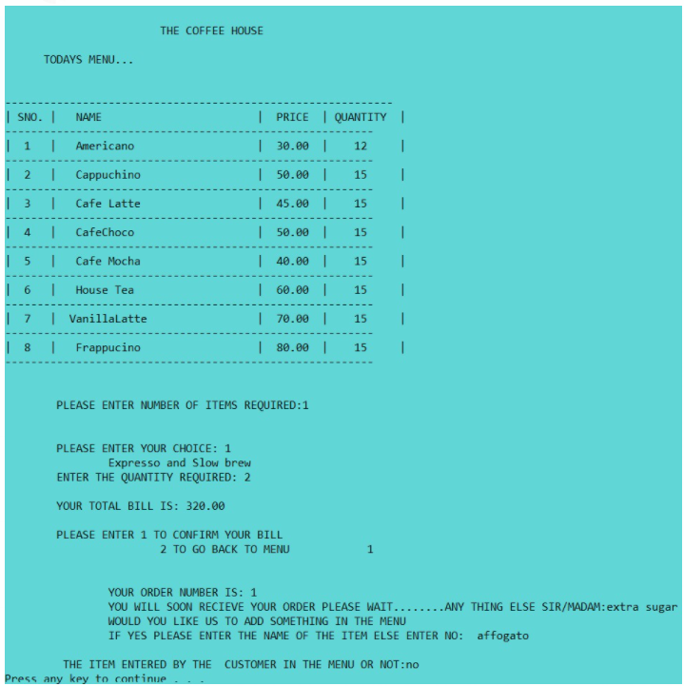

Slide 24
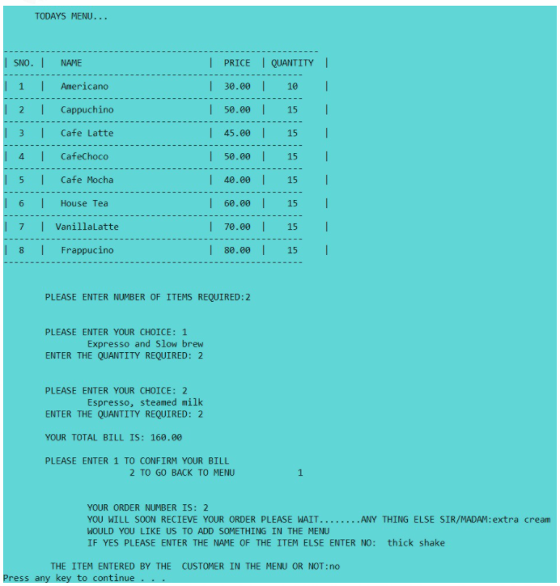

Slide 25
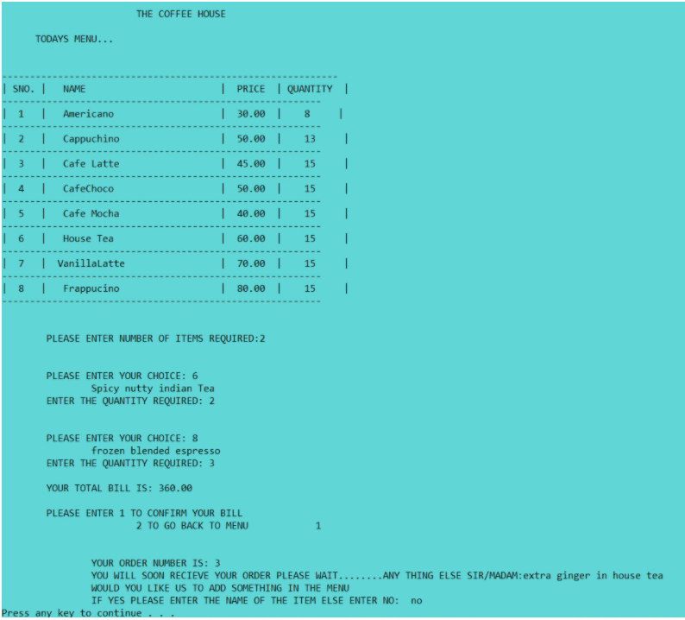

Slide 26
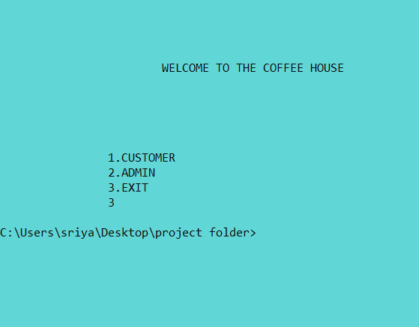

Slide 27
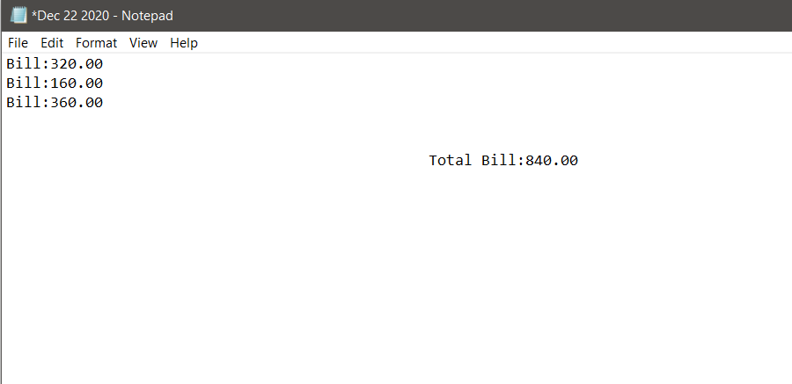

Slide 28
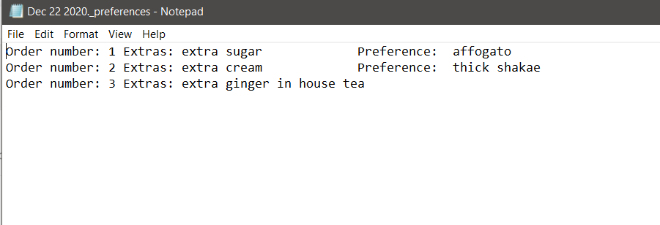

Slide 29
CONCLUSION AND FUTURE WORK
We conclude that our project “COFFEE HOUSE” offers a software that provides food service to the customers and an password protected admin panel for the owner to plan different menus for different occasions by editing the menu. The project creates a user friendly environment. It increases the efficiency and saves time. The program saves the bills and preferences given by the customer in a file with the date for easier calculation of money inflow into the coffee house.
We can enhance this system by including more facilities like online booking, regular customer record. Further requirements and improvements can easily be done since the coding is mainly structured or modular in nature. Changing the existing modules or adding new module can append improvements.

Slide 30
By: V SWETHA 1602-19-737-106 KVS SRIYA 1602-19-737-115

