Slide 1

ILMARI
Azure IIoT Digital Twins — Smart Building Telemetry
A reference implementation for Industrial IoT using Azure Digital Twins,
IoT Hub, and serverless event processing.
https://github.com/VanhanenJLA/Ilmari

Slide 2
What is Ilmari?
An Azure-based IIoT scaffold for smart-building Digital Twins
Simulates a building with rooms, HVAC units, and environmental sensors
Ingests telemetry from IoT Hub into Azure Digital Twins
Monitors the sensor data against set rules on a timer
Publishes threshold breaches to Service Bus topics (alerts)
Fully automated deployment with Bicep IaC

Slide 3


IIoT & Digital Twins — Why It Matters
Industrial IoT (IIoT)
Digital Twins
IIoT connects physical assets — sensors, HVAC systems, equipment — to cloud platforms for real-time monitoring, analytics, and automated control. Building management is a prime use case: tracking temperature, CO₂, occupancy, and energy use across spaces.
A Digital Twin is a live virtual replica of physical infrastructure. Azure Digital Twins (ADT) provides a graph of typed models (DTDL) that mirror real assets. Telemetry patches keep the graph in sync, enabling queries, alerting, and spatial analytics.

Slide 4




Key Azure Services Used
IoT Hub
Digital Twins
Azure Functions
Device connectivity and message routing (S1 tier)
DTDL-typed twin graph with query API
Serverless event-driven compute (.NET 8 isolated)
Service Bus
App Insights
Alert topic + dead-letter queue for reliability
Telemetry logging and KQL workbook dashboards

Slide 5
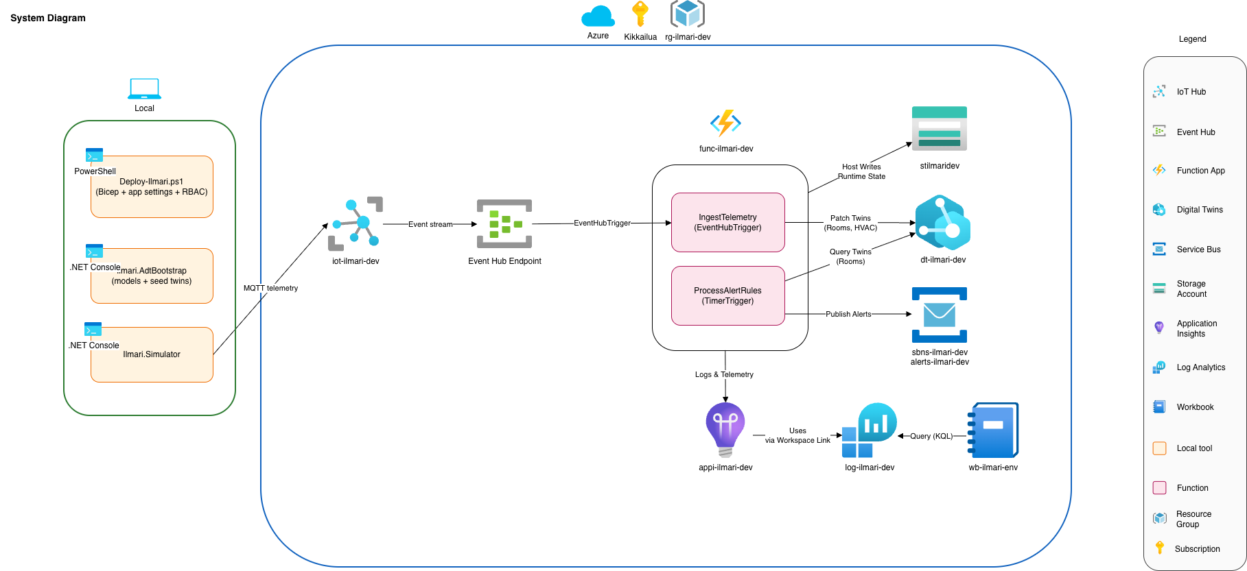
Architecture Overview

Slide 6


Project Structure
Ilmari.AdtBootstrap
Ilmari.Functions
Ilmari.Simulator
Uploads DTDL models and seeds a sample twin graph.
Building
→ Floor
→ Rooms
→ HVAC + Sensors
Azure Functions isolated worker app.
Has two triggers:
IngestTelemetry (EventHub)
ProcessAlertRules (Timer)
.NET console app.
Generates per-room telemetry based on hardcoded scenarios.
Sends via MQTT.

Slide 7

Telemetry Overview
Telemetry Ingestion Path
Simulator
IoT Hub
IngestTelemetry
Digital Twins
Room telemetry
(MQTT)
Device gateway
(Event Hub endpoint)
Azure Function
(Event Hub trigger)
ADT graph
(DTDL models)
Alert Processing Path
ProcessAlertRules
Service Bus
Timer trigger (10s)
Query ADT rooms
Alert topic
(threshold breaches)

Slide 8
Telemetry Pipeline
1
Device Simulation
Ilmari.Simulator generates per-room JSON events: temperature, humidity, CO₂, occupancy, and HVAC state. Sends via MQTT to IoT Hub.
2
IoT Hub Routing
IoT Hub receives device-to-cloud messages and exposes them via its built-in Event Hub-compatible endpoint for downstream consumers.
3
IngestTelemetry Function
An Azure Function with Event Hub trigger parses each telemetry event and patches the corresponding Room and HVAC twins in ADT.
4
ADT Graph Update
Digital Twins graph reflects real-time state. Room twins store tempC, co2Ppm, humidityPct. HVAC twins store mode, setpointC, powerKw.

Slide 9
Alert Engine
Active Rules
How It Works
Rule | Min | Max | Severity
TempOutOfRange | 18 °C | 24 °C | 2
Co2OutOfRange | — | 1000 ppm | 2
ProcessAlertRules function runs on a 10-second timer trigger
Queries all Room twins from ADT via the query API
Evaluates each room against defined rules
Breaches are published as structured messages to a Service Bus topic

Slide 10
Device Simulator
Simulation Scenarios
The .NET console app generates realistic telemetry with deterministic scenario logic:
1
Occupancy Transitions
Rooms switch between occupied/unoccupied states
2
Comfort Drift
Temperature gradually moves outside 18-24°C range
3
CO₂ Drift
CO₂ levels rise above 1000 ppm threshold
4
HVAC Variation
Mode/setpoint/power changes in response to conditions

Slide 11
Infrastructure as Code
Azure Bicep (ilmari.bicep)
Declarative IaC template compiled to ARM JSON.
Deploys all resources with a single PowerShell script.
Supports dev/prod environments with parameterized naming.

Slide 12
Deployment Flow
1
Deploy Infrastructure
./Deploy-Ilmari.ps1 -Env dev -ProjectName ilmari -Location northeurope
Bicep template creates all Azure resources
2
Bootstrap ADT
./Deploy-Ilmari.ps1 ... -RunAdtBootstrap
Upload DTDL models and seed twin graph
3
Provision Simulator
./Deploy-Simulator.ps1 -Env dev -ProjectName ilmari
Register IoT device and get connection string
4
Run Simulator
dotnet run --project ./Ilmari.Simulator/...
Start sending telemetry to IoT Hub
5
Deploy Functions
func azure functionapp publish func-ilmari-dev-xxxxx
Or run locally with Azure Functions Core Tools

Slide 13


Known Gaps & Next Steps
Current Gaps
Ideas for Future
No alert deduplication or cooldown windows
No recovery events when values return to normal
No historical time-series data sink (only live state in ADT)
Run an actual physical sensor along the digital
Implement alert deduplication and cooldown logic
Add recovery messages when metrics normalize
Introduce persistence (a database)
Add automated tests

Slide 14

Thank You
Questions & Discussion
Ilmari • Azure IIoT Digital Twins Reference Implementation

