Slide 1
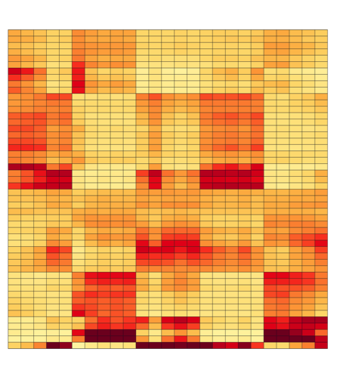


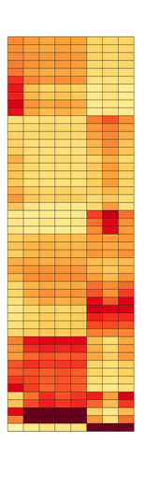
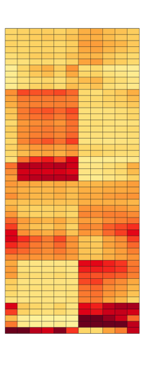




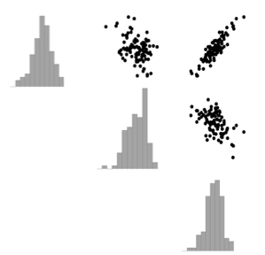



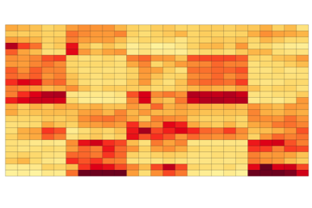
a
ENCODING
Simultaneous
Orthogonal Matching Pursuit
genes
transcriptional programs
- annotated (e.g. GO bio. processes, KEGG pathways)
- user defined
training samples
predicted TPM
gene/tr. program
marker 2
b
DECODING
PC₁ of each gene set
c
marker 1
predicted transcriptional program expression
Multivariate-Normal layer
measured markers
new samples
10
marker 1
0
10
marker 2
TPM
Inference of transcriptional program expression
Transcripts per Million (TPM)
Latent abundances
0
high
Inference of TPM abund. transcriptome wide
0
Continuous Poisson Layer
gene set score
10
gene/tr. program
-
0
+
0
Sample
Notes:
colorscale on precision
OMP plot

Slide 2
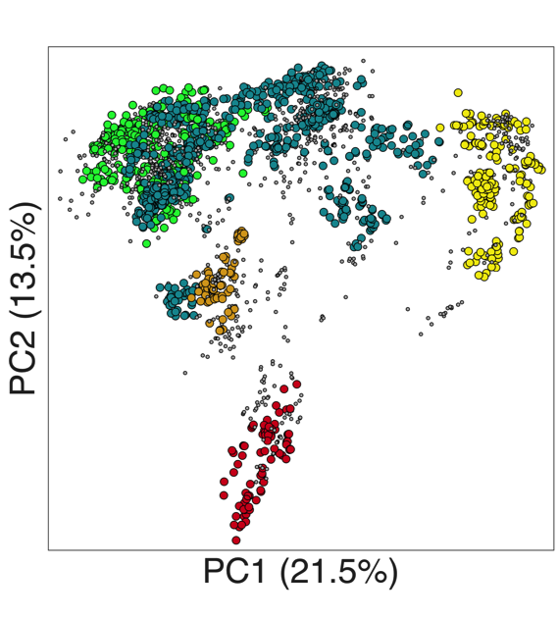
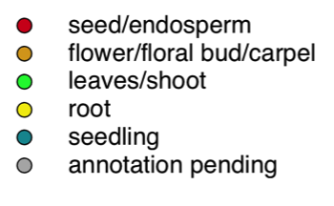
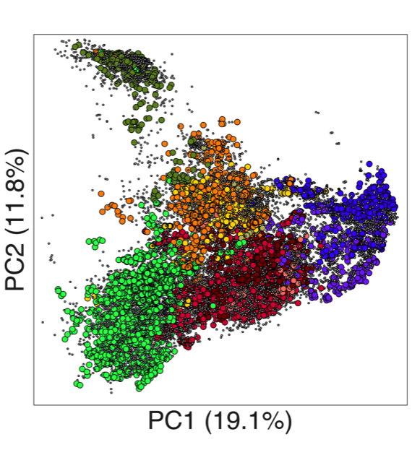
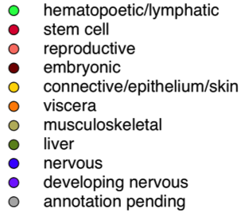
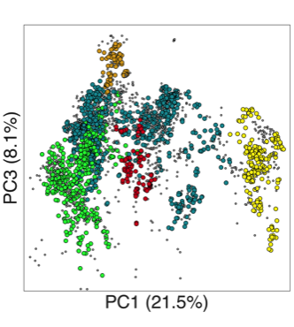
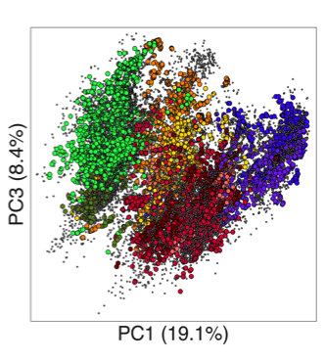
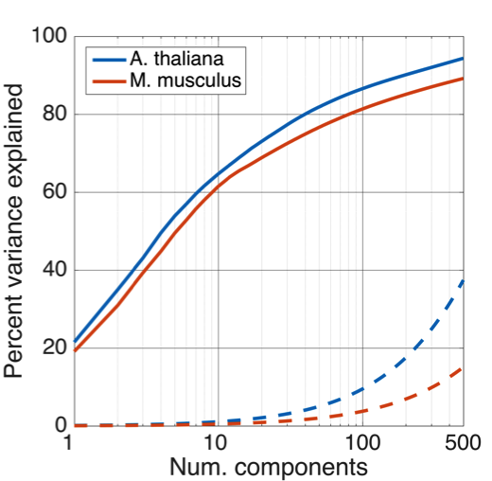
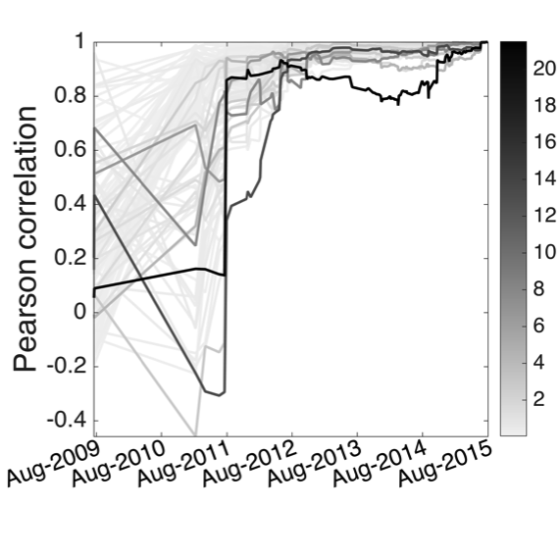
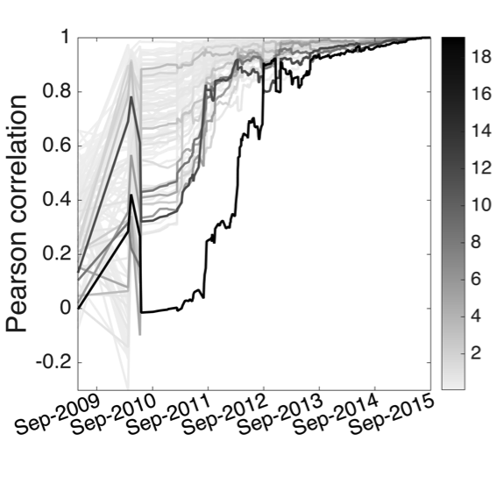
a
A. thaliana
b
M. musculus
c
d
A. thaliana
e
M. musculus
Percent variance explained
Percent variance explained
Notes:
N available?

Slide 3
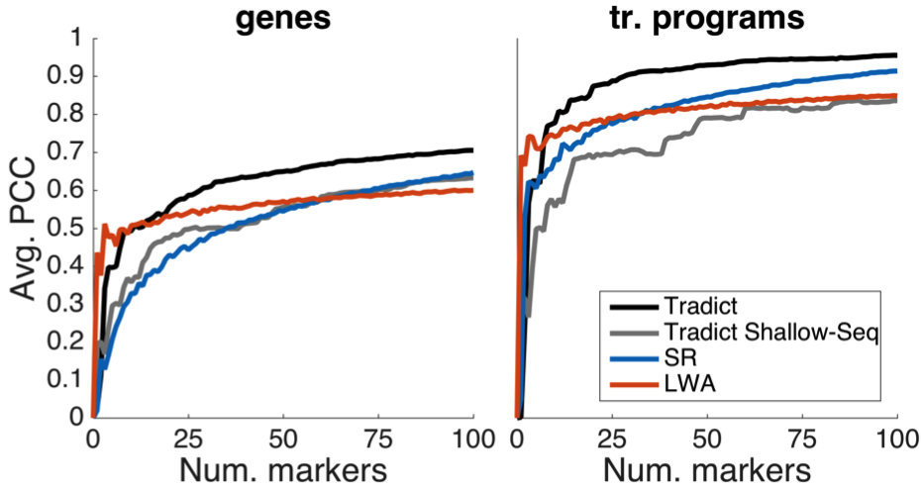
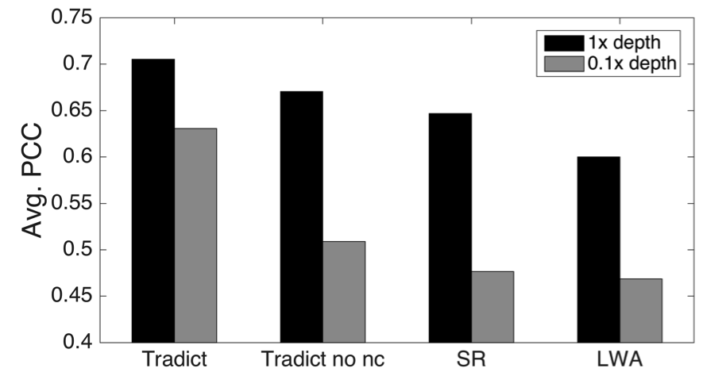
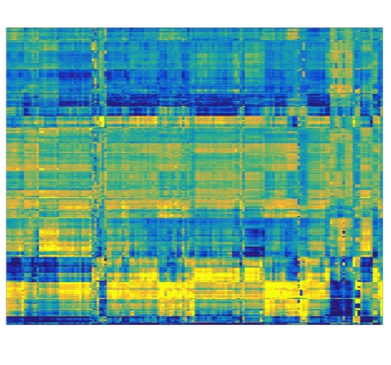
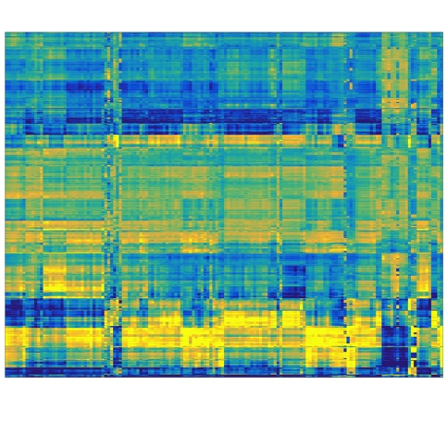
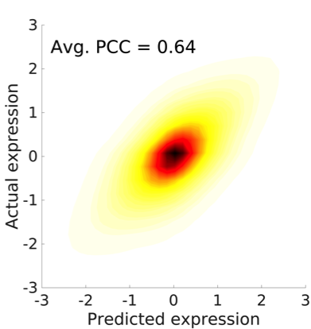
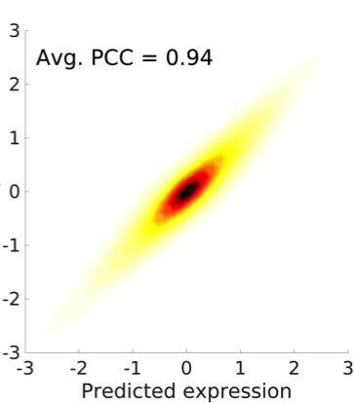
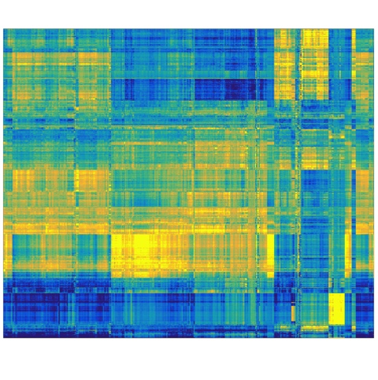

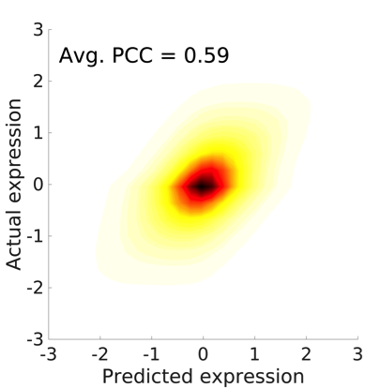
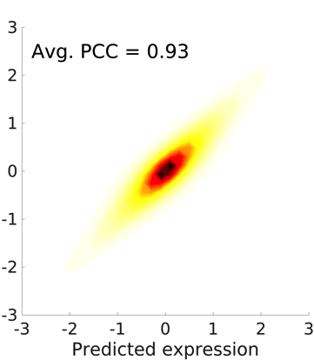
a
b
c
Actual
Predicted
d
genes
tr. programs
A. thaliana
2,597 transcriptomes
e
150 tr. programs
f
M. musculus
20,847 transcriptomes
368 tr. programs
gene set z-score
relative density
-2
0
2
0
1
Notes:
“expression vs. score” for pathway x,y-label.

Slide 4
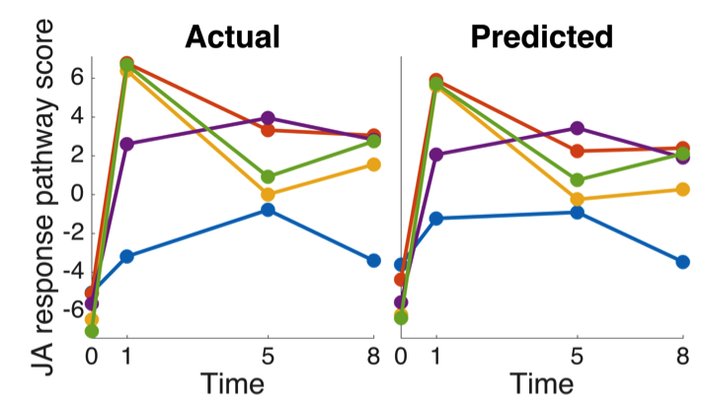
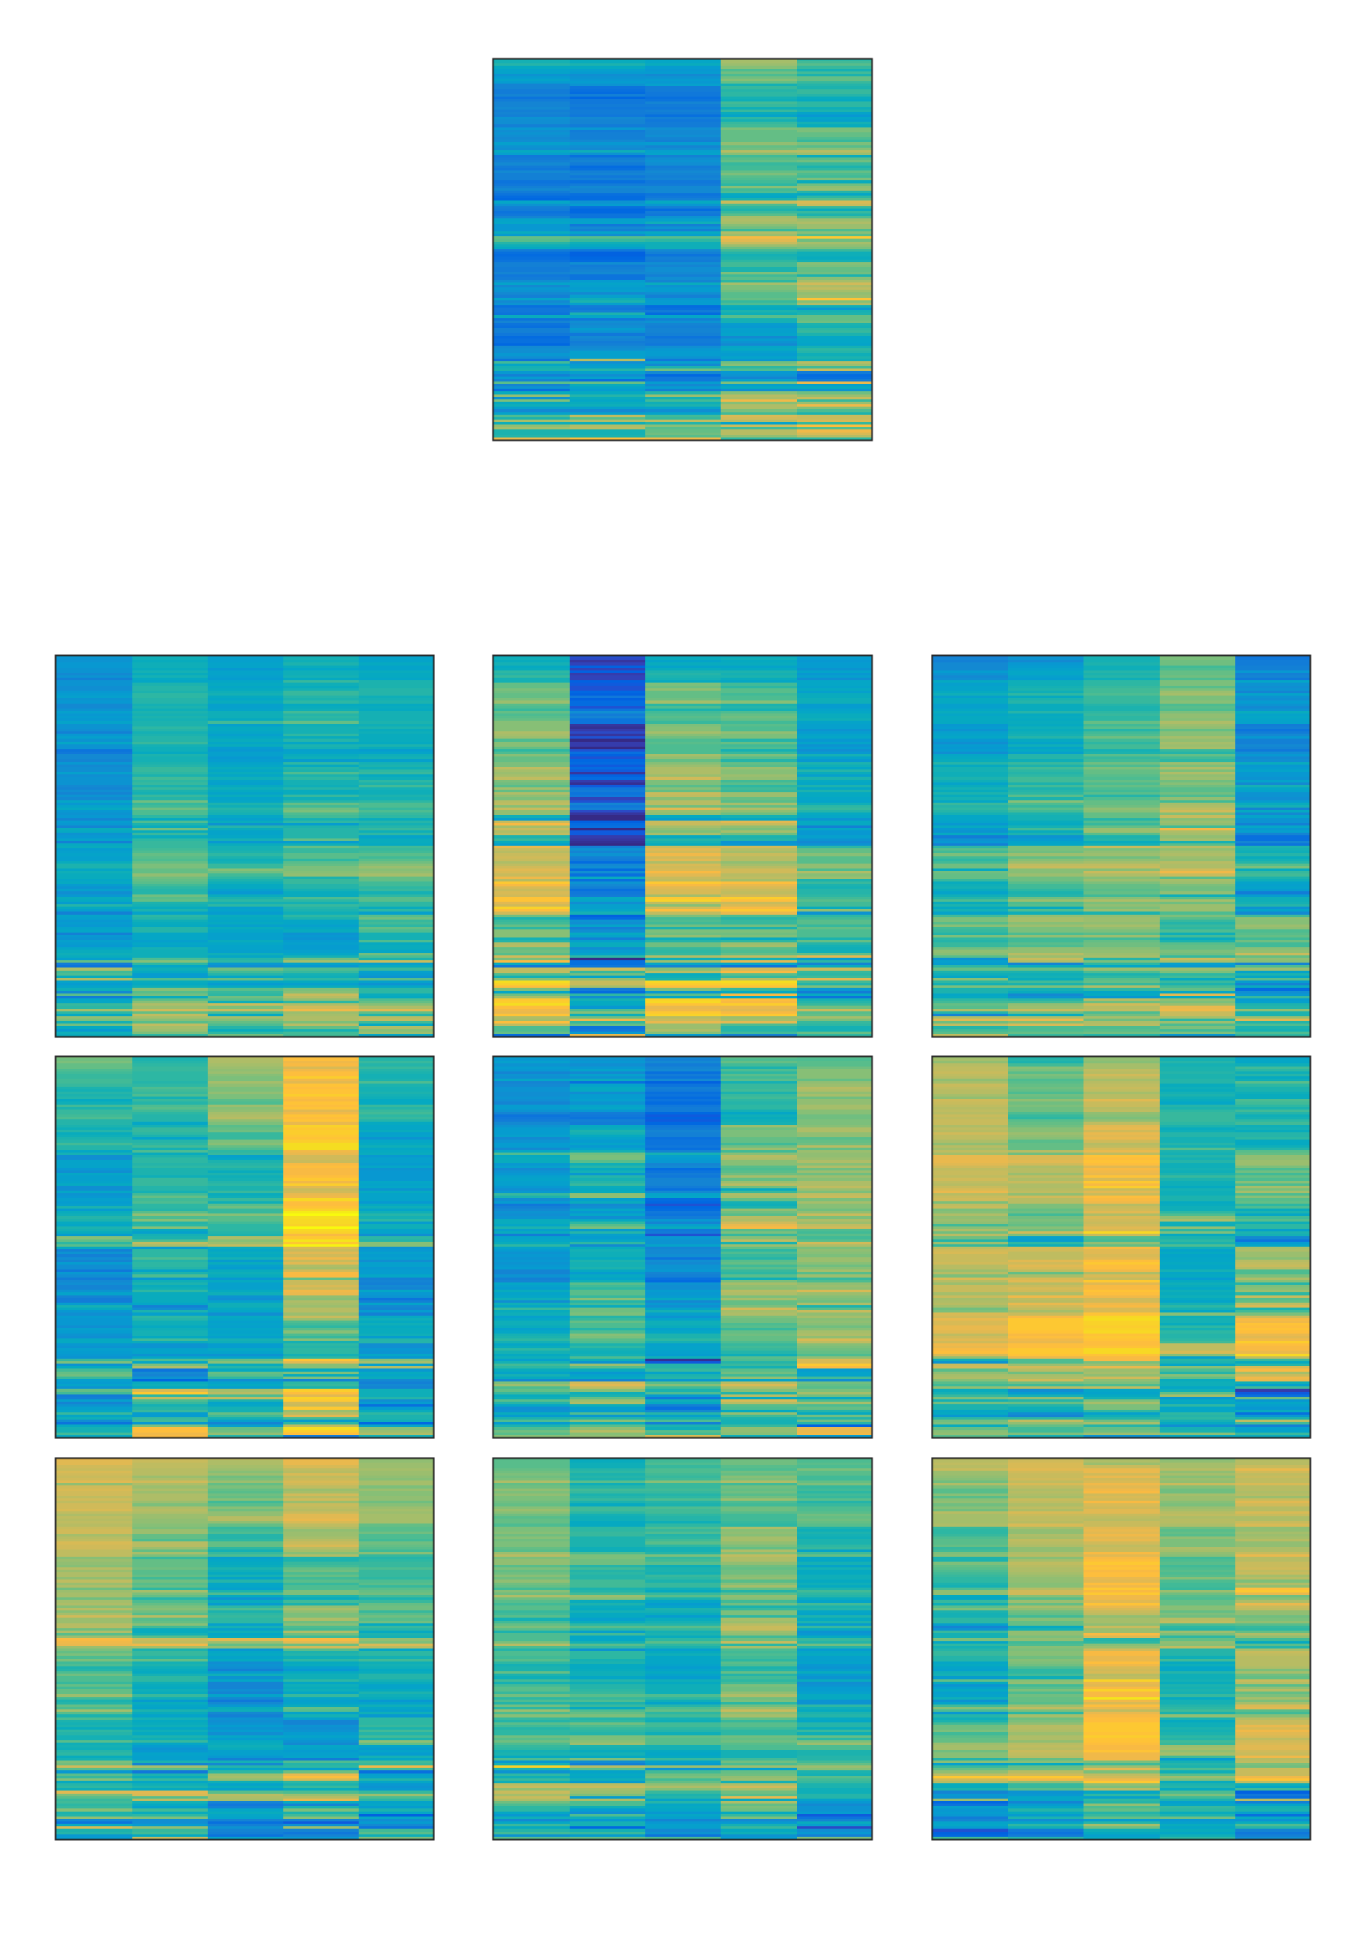
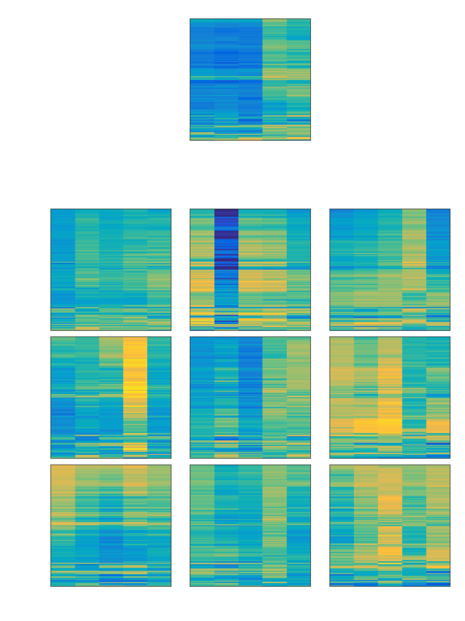
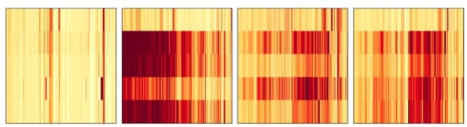
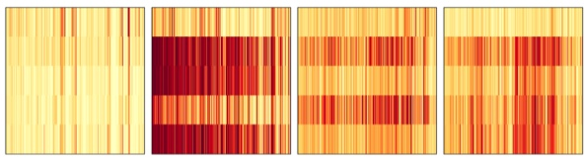
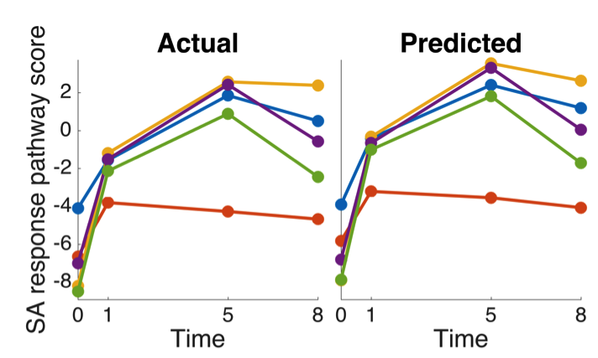
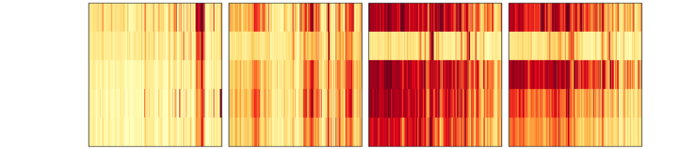
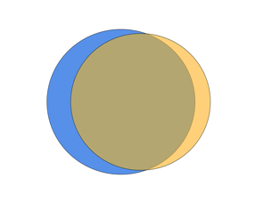
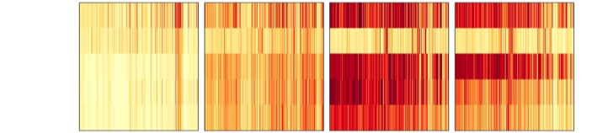
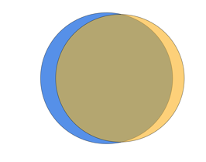
a
eds16-1
35S::HopBB1
Col-0
npr1-1
coi1-16
TPM z-score
eds16-1
35S::HopBB1
Col-0
npr1-1
coi1-16
b
-1
3
i
0 hr
gene set z-score
0 hr
-3
0
3
eds16-1
35S::HopBB1
Col-0
npr1-1
coi1-16
eds16-1
35S::HopBB1
Col-0
npr1-1
coi1-16
eds16-1
35S::HopBB1
Col-0
npr1-1
coi1-16
eds16-1
35S::HopBB1
Col-0
npr1-1
coi1-16
untreated
untreated
1 hr
ii
Actual
5 hr
coi1-16
npr1-1
Col-0
35S::HopBB1
eds16-1
8 hr
Predicted
coi1-16
npr1-1
Col-0
35S::HopBB1
eds16-1
Mock
MeJA
BTH
Mock
MeJA
BTH
Actual
Predicted
0 hr
1 hr
5 hr
8 hr
c
coi1-16
npr1-1
Col-0
35S::HopBB1
eds16-1
PCC = 0.91
Actual
d
MeJA responsive
i
ii
coi1-16
npr1-1
Col-0
35S::HopBB1
eds16-1
2
7
1
Predicted
BTH responsive
coi1-16
npr1-1
Col-0
35S::HopBB1
eds16-1
12
66
8
0 hr
1 hr
5 hr
8 hr
Notes:
PCC = 0.6985 for genes globally
PCC = 0.7249 for JA genes in MeJA treatment
PCC = 0.7629 for SA genes in BTH treatment
Rotate and flip genotype labels on (a)
Col-0 italicized
MeJA t0 separate.
myc2
mark MeJA treated/BTH treated.
SAND gene → stable.
genesets for paulo.
Change “Pathways” → gene sets in text.

Slide 5
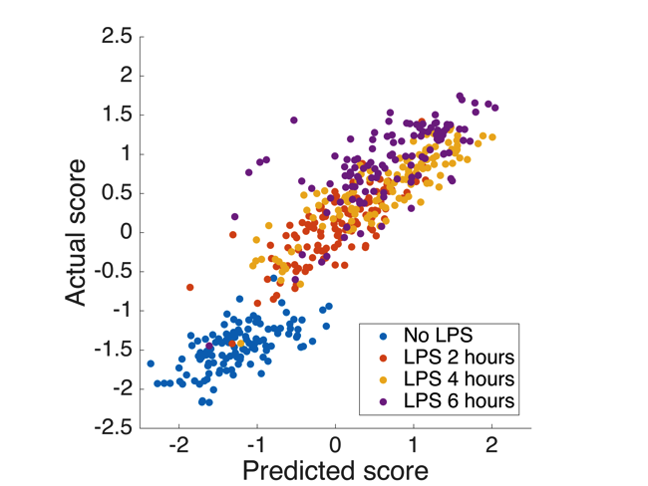

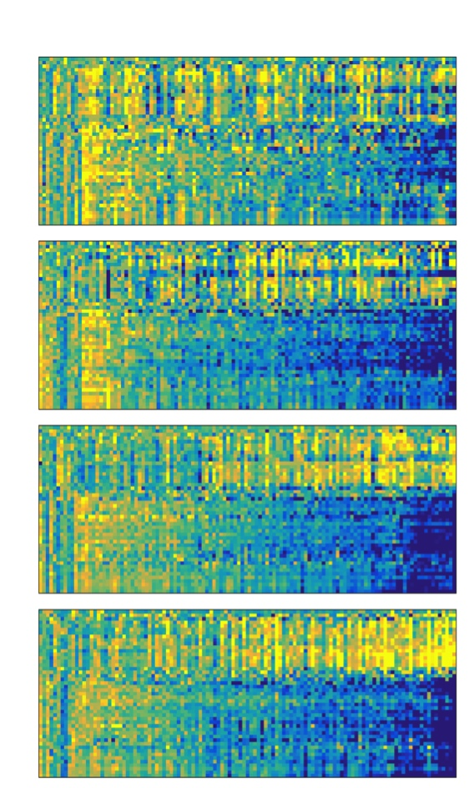
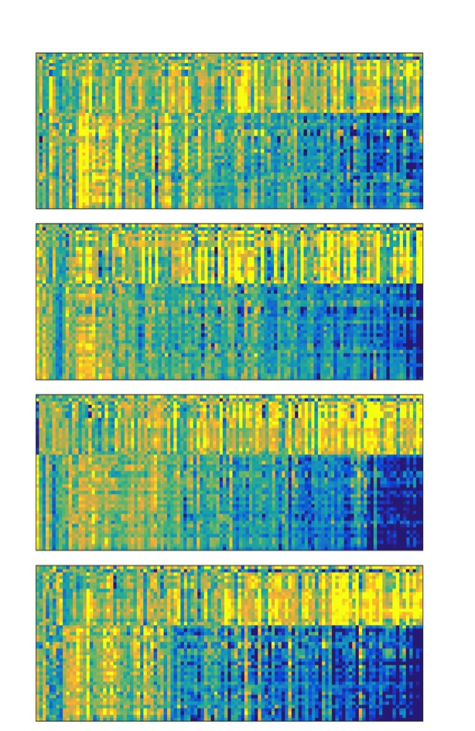
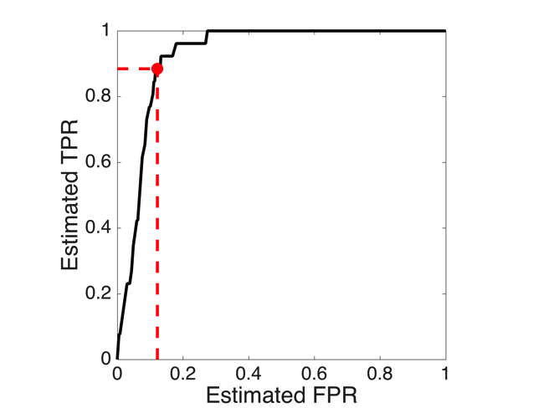
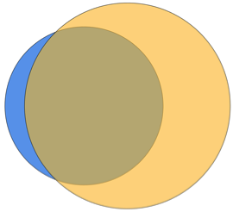
a
Response to LPS
c
Actual
Predicted
0 hr
2 hr
b
4 hr
3
23
21
6 hr
actual DE
control guides
control guides
innate immunity
predicted DE

Slide 6
Input
query table
output directory
Sailfish index
ascp SSH key
Start
Take next query (SRA sample)
Does the query meet all of the following criteria?
Sequenced using Illumina technology?
Has not already been processed?
Has sufficient number of reads?
no
Download query SRA using ascp fasp transfer program
yes
Unpack SRA using sra-toolkit’s fastq-dump program
Does the unpacked query FASTQ files have too large a number of reads (or read pairs)?
subsample reads (or read pairs) to the tolerated maximum number of reads
yes
no
Quantify transcripts using Sailfish, and save results

Slide 7
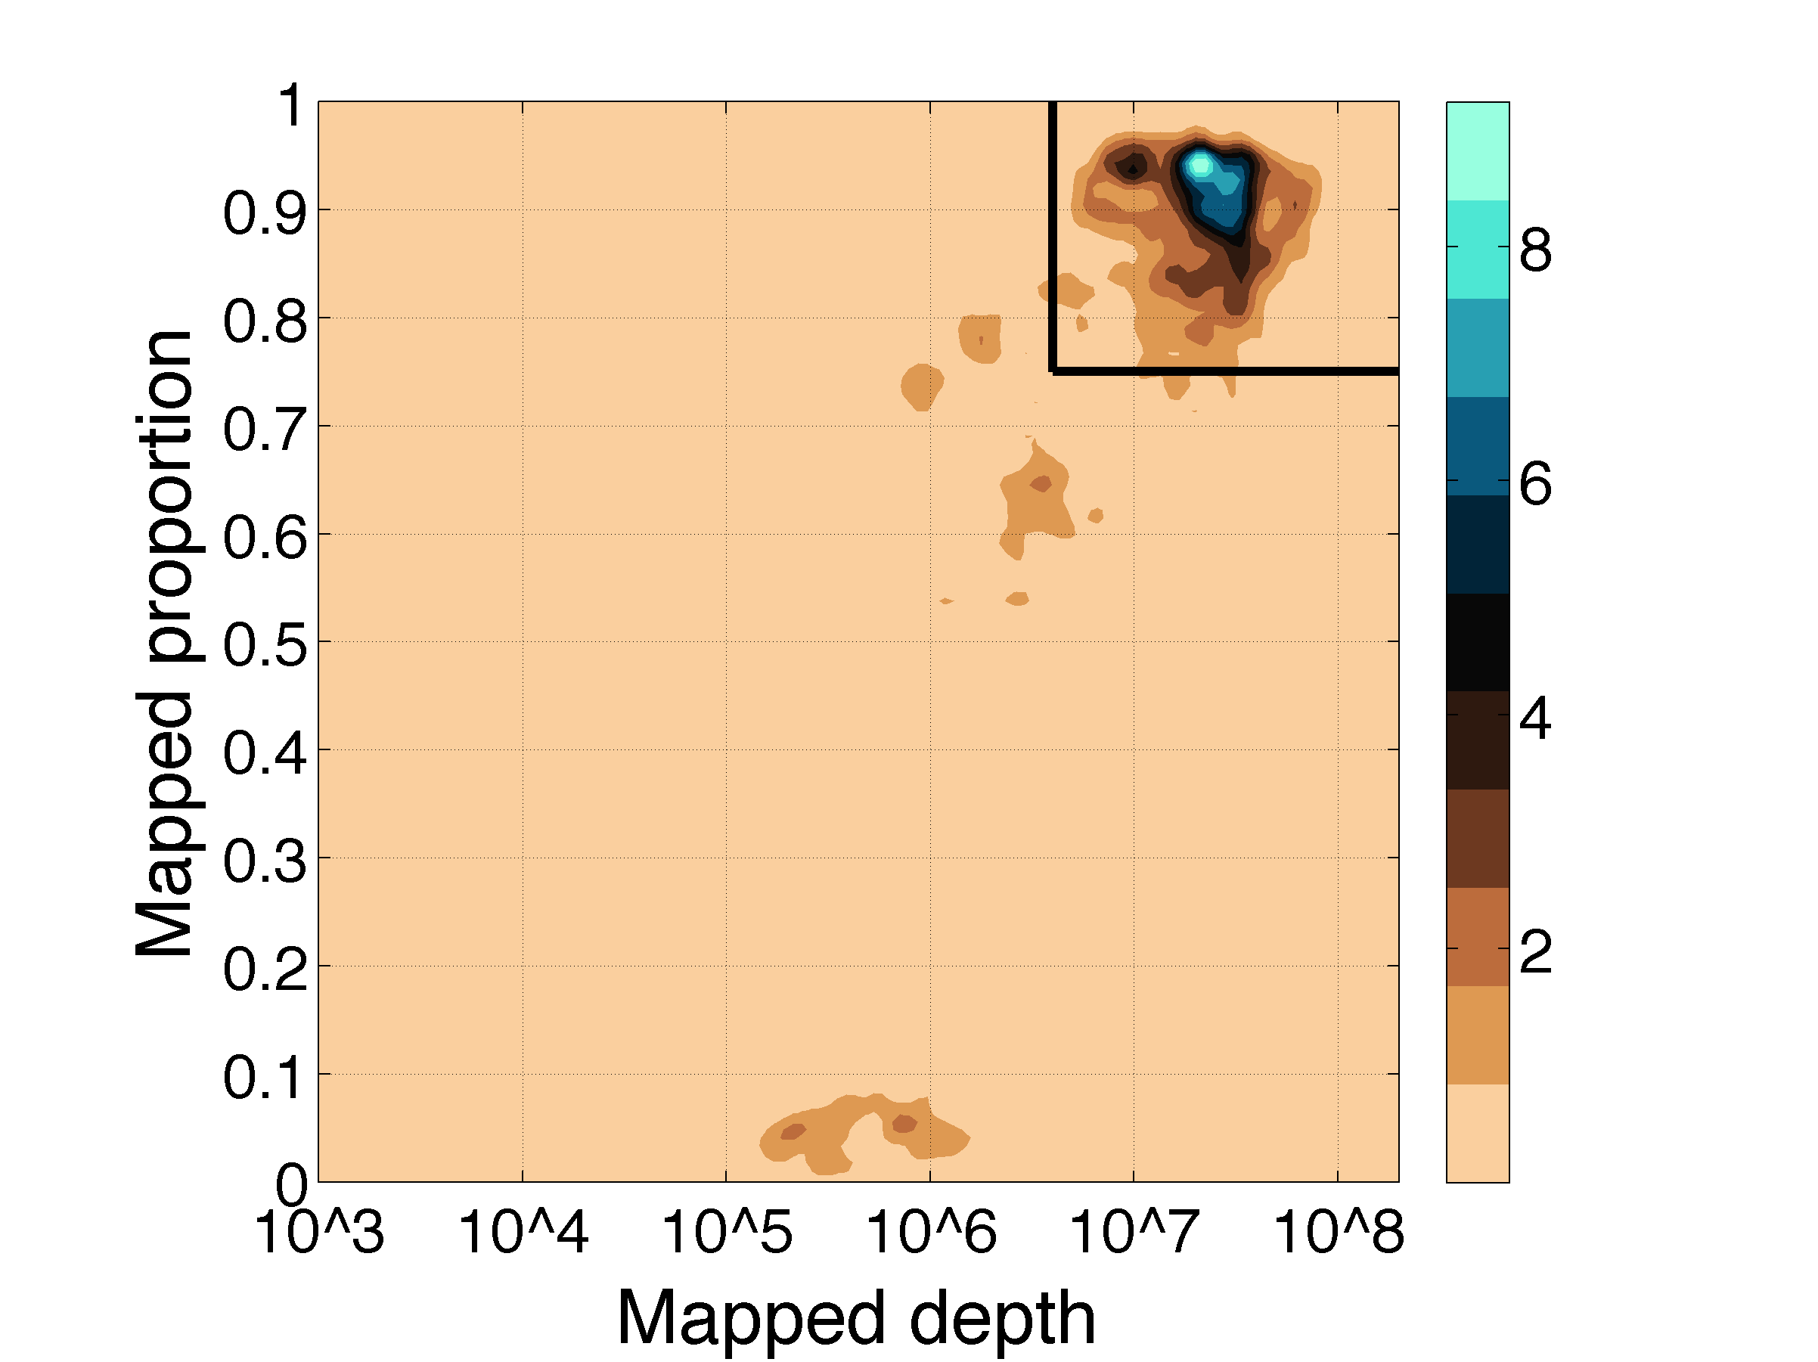
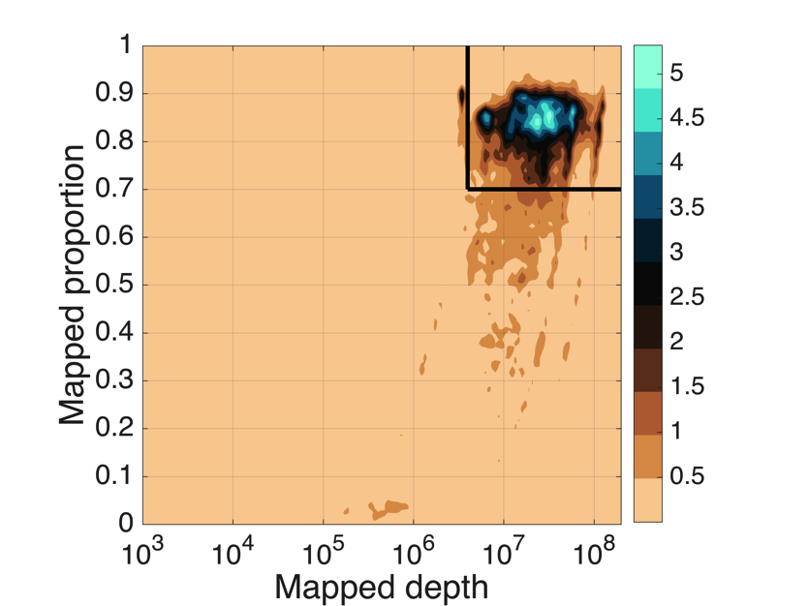
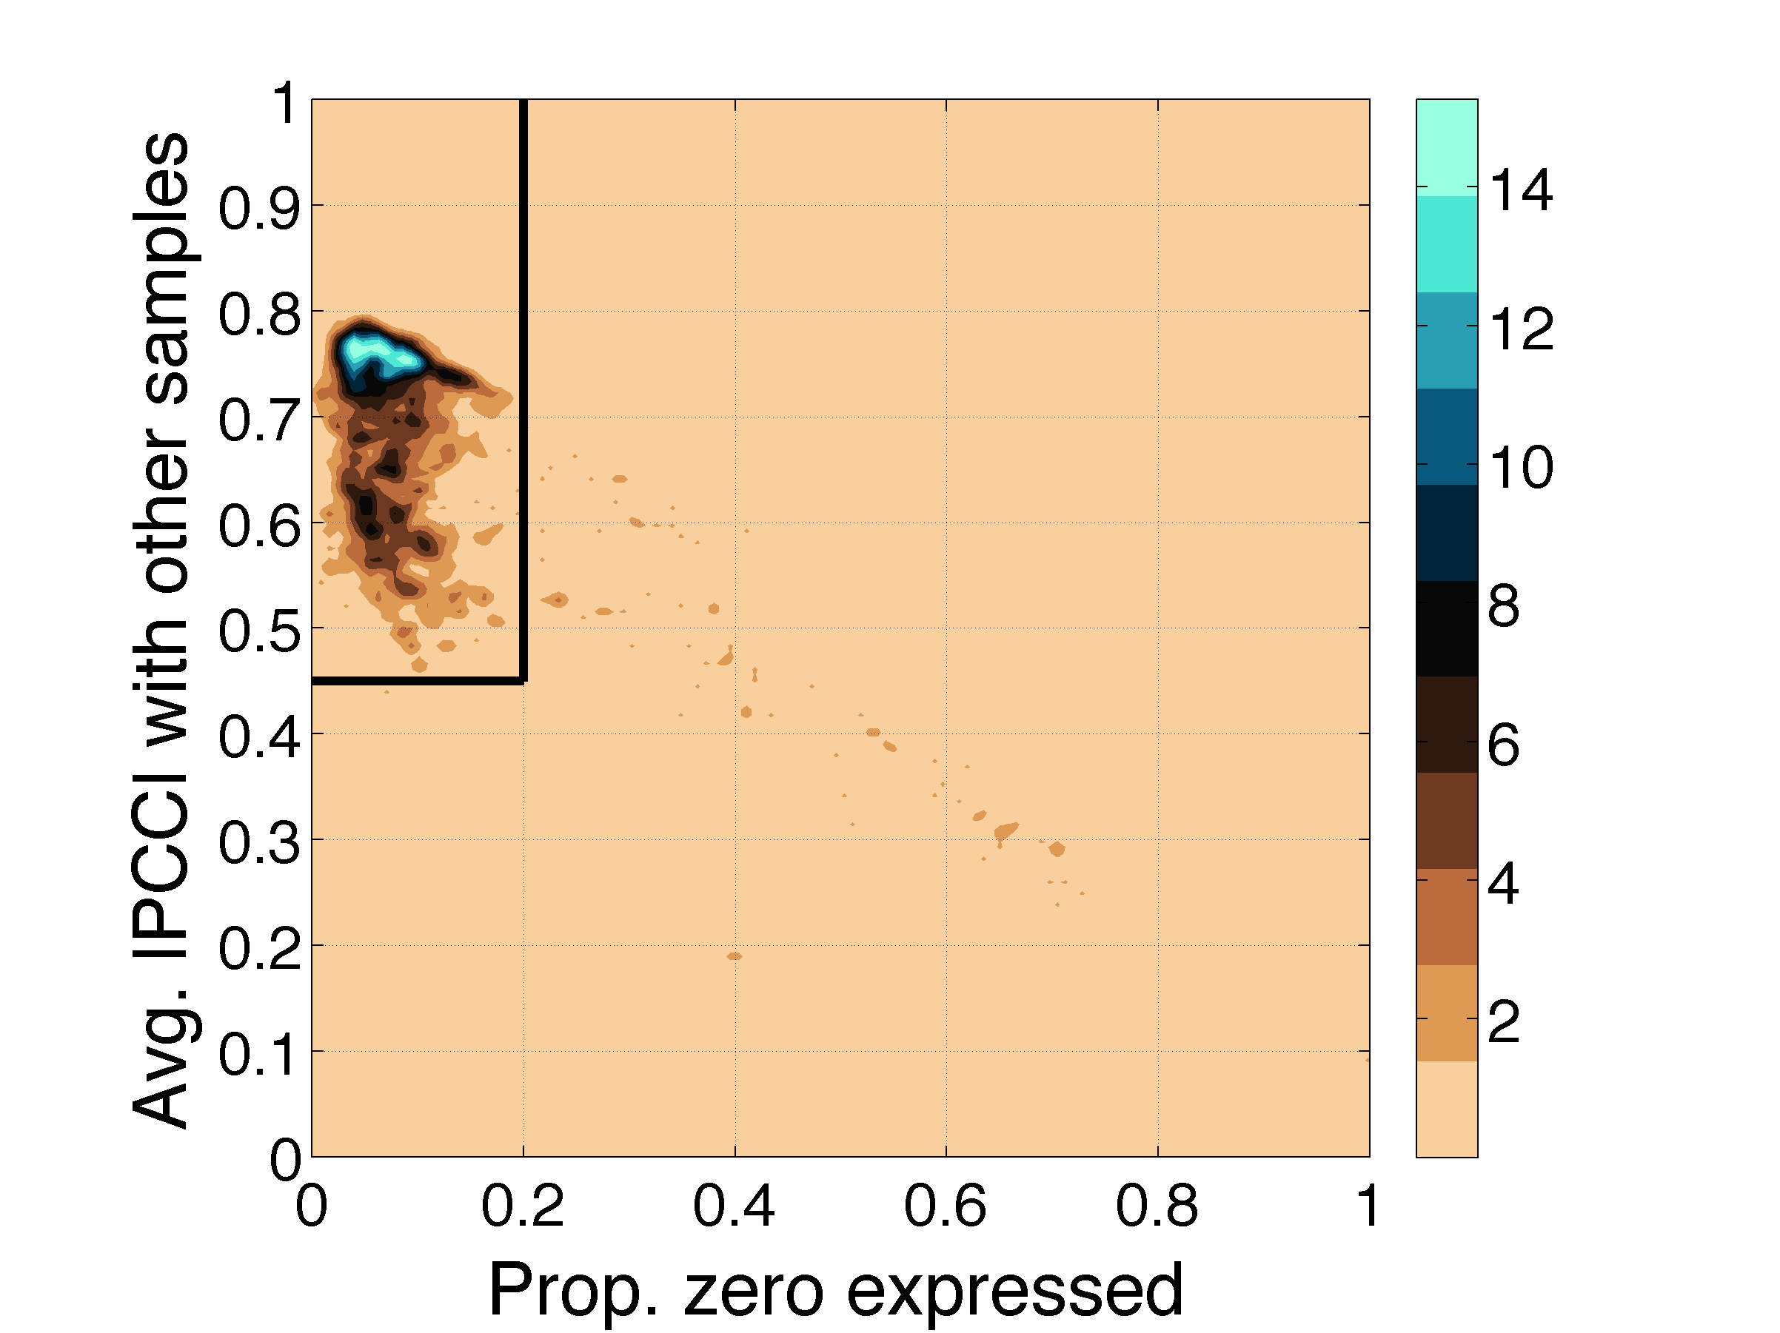
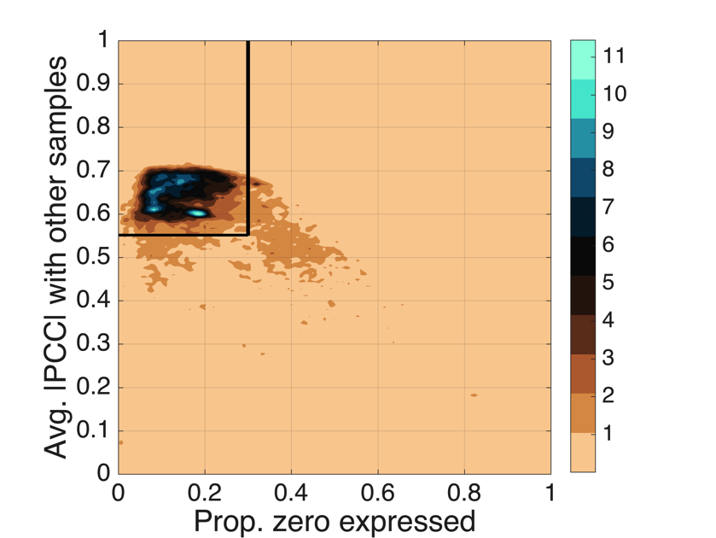
a
A. thaliana
b
M. musculus
density
density
c
d
density
density

