Slide 1

DRIVER DROWSINESS DETECTION SYSTEM
TEAM MEMBERS
1.ROAHIYAA T -CB.SC.U4AIE24043
2.SHIVANANDANA A -CB.SC.U4AIE24049
3.SRINITHI K -CB.SC.U4AIE24055
4.VANI SHREE S -CB.SC.U4AIE24059

Slide 2
INTRODUCTION
Driver Drowsiness Detection Using CNN and YOLOv8 aims to develop an advanced system that accurately detects yawning and eye closure to prevent drowsy driving accidents.
Drowsiness is a leading cause of road accidents, making real-time driver monitoring essential for road safety.
This project utilizes a Convolutional Neural Network (CNN) to classify yawning and eye closure, while YOLOv8 is used for real-time face, eye, and mouth detection.
By integrating both models, the system ensures high accuracy and efficiency in detecting drowsiness.
The ultimate goal is to deploy this technology in vehicles to provide real-time alerts, reducing accident risks and improving driver safety.

Slide 3
OBJECTIVES
Develop a real-time driver drowsiness detection system by integrating YOLOv8 for face & mouth detection and CNN for classification of eye state & yawning.
Improve road safety by providing an early warning system for drowsy drivers.
Achieve high accuracy & efficiency through deep learning models.
Minimize false alerts by using multi-feature detection (eyes + yawning instead of just one feature

Slide 4
METHODOLOGY
Data Collection and Preprocessing
Dataset:
Mouth images (Yawning vs. No Yawning)
Eye images (Open vs. Closed)
Preprocessing Steps:
Image resizing (64x64 pixels)
Normalization (scaling pixel values between 0 and 1)
Train-test split (80% training, 20% validation)
One-hot encoding for labels (Binary classification: 0 or 1)

Slide 5
CNN Model Architecture
Input Layer: 64x64x3 (RGB image input)
Convolutional Layers:
Conv2D (32 filters, ReLU activation) + MaxPooling2D
Conv2D (64 filters, ReLU activation) + MaxPooling2D
Conv2D (128 filters, ReLU activation) + MaxPooling2D
Fully Connected Layers:
Flatten layer
Dense (128 neurons, ReLU activation)
Dropout (0.5 for regularization)
Output Layer: Dense (2 neurons, Softmax activation)
Compilation:
Optimizer: Adam
Loss function: Categorical Crossentropy
Metric: Accuracy

Slide 6
Model Training and Evaluation
Training Configuration:
Epochs: 20
Batch Size: 32
Validation Split: 20%
Performance Metrics:
Accuracy Score
Loss Score
Model Evaluation on Validation Data

Slide 7
Model Deployment and Prediction
Trained Model is Saved in Keras Format (.keras file)
Prediction Pipeline:
Load the trained model
Preprocess the input image
Predict class probabilities
Output the detected label (Yawning/Not Yawning, Open/Closed Eye)

Slide 8
YOLO INTEGRATION
Implement YOLOv8 for real-time face, eye, and mouth detection.
Integrate YOLOv8 with CNN to classify detected eyes and mouth.
Optimize real-time processing for embedded systems.

Slide 9
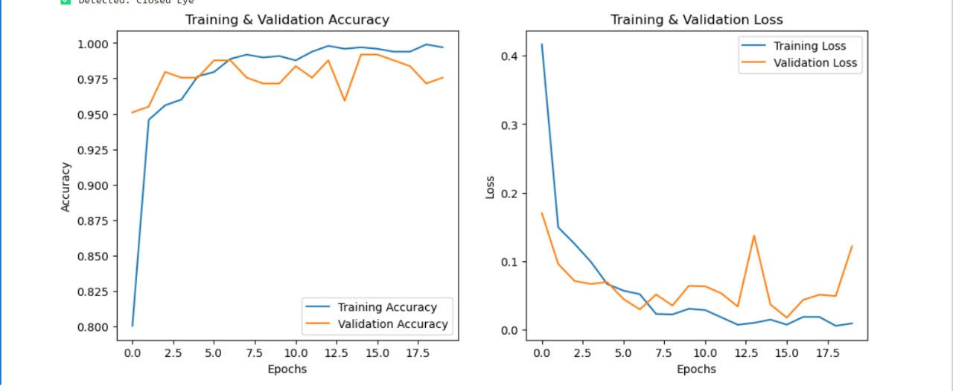
RESULT ANALYSIS
Training & Validation Accuracy (Left Graph)
High accuracy (~98%) suggests a well-trained model
Training & Validation Loss (Right Graph)
Low loss values indicate the model is making correct predictions.

Slide 10
Time Line
WEEK 1: Collecting the research papers and studying exsiting drwsiness detection techniques.
WEEK 2: Dataset preparation and understanding YOLO and CNN integration.
WEEK 3: Train CNN on cropped eye image and mouth images.
WEEK 4: Annotate bounding boxes for YOLO(face and mouth detection) and train YOLOv8 on annotated full face images.
WEEK 5 :Model Integration (YOLO + CNN Pipeline) ,Combine YOLO for detection & CNN for classification.
WEEK 6 :Test the real-time performance. Reduce false positives/negatives with threshold adjustments.
WEEK 7 : Conduct accuracy testing on real-world scenarios.Prepare project report & PowerPoint presentation.

Slide 11
THANK YOU!

