Slide 1


FINA 2303 Financial Management
Veronique LAFON-VINAIS
Associate Professor of Business Education, Dept of Finance
Spring 2017

Slide 2
Important Notice
This course is a required foundation course for all FINA majors and the basic course for Finance Major selection
As such, the course follows a standardised format as required by the department of Finance
The textbook (Berk/DeMarzo/Harford) and accompanying website My Finance Lab are selected by the department of Finance and apply across all sections of the course; both are required for this course
Evaluations and exams are standardised across all sections of the course
FINA 2303 - Introduction

Slide 3
Course Objectives
This course aims to introduce students to key basic financial concepts and theories, and show students how to apply them in real life.
It also provides important foundations in finance for those who plan to study intermediate and advanced-level courses in finance covering areas such as corporate finance and investments.
This is an introductory course for the core concepts and analytical techniques in corporate finance. It covers topics including time value of money, financial statement analysis, capital budgeting decisions, bond & stock valuation, risk & return relationship, and cost of capital.
FINA 2303 - Introduction

Slide 4
Course Outline
Part I: Introduction and Basics of Interest Rates
Introduction (chapter 1)
Basics of Interest Rates (chapters 3, 4 and 5)
Introduction to Financial Statements Analysis (chapter 2)
Investment Decisions Rules (chapter 8)
Part II: Basics of Valuation, Risk & Return
Fundamentals of Capital Budgeting (chapter 9)
Bonds and Stocks (chapters 6 and 7)
Stock Valuations (chapter 10)
Risk and Return (chapters 11 and 12)
Cost of Capital (chapter 13)
FINA 2303 - Introduction

Slide 5
Detailed Course Agenda – Part I
Week 1 - Feb 1 (L1)/Feb 3 (L2): Chapter 1: Corporate Finance and the Financial Manager (exclude 1.2)
Week 2 – Feb 6, 8/10: Chapter 3: Time Value of Money: An Introduction
Week 3 - Feb 13, 15/17: Chapter 4: Time Value of Money: Valuing Cash Flow Streams
Feb 20 – Online Quiz 1, chapters 1, 3, 4
Week 4 – Feb 20, 22/24: Chapter 5: Interest Rates (exclude 5.3)
Week 5 - Feb 27, Mar 1/3: Chapter 8: Investment Decision Rules (exclude 8.6 and MIRR)
Week 6 - Mar 6, 8/10: Chapter 2: Introduction to Financial Statement Analysis (exclude 2.5)
Mar 13 : Midterm exam, chapter 1, 2, 3, 4, 5, 8
FINA 2303 - Introduction

Slide 6
Detailed Course Agenda – Part II
Week 7 - Mar 15/17: Chapter 9: Fundamentals of Capital Budgeting (exclude 9.4,9.5, 9.6, and MACRS)
Week 8 - Mar 20, 22/24: Chapter 6: Bonds (exclude 6.5)
Week 9- Mar 27, 29/31: Chapter 7: Stocks
Week 10 - Apr 3, 5/7: Chapter 10: Stock Valuation: A Second Look (exclude 10.4 and 10.5)
Apr 10 – Online Quiz 2, chapters 6, 7, 9, 10
Week 11 - Apr 10, 19/21: Chapter 11: Risk and Return in Capital Markets
Week 12 - Apr 24, 26/28: Chapter 12: Systematic Risk and the Equity Risk Premium
Week 13 – May 5(L2), May 8 : Chapter 13: Cost of Capital
Final Exam (day TBA): All chapters (1-13)
FINA 2303 - Introduction

Slide 7
Grading
Assessment:
The final grading will be determined as follows:
Participation | 4%
2 Online Quizzes | 6%
Homework on MFL | 15%
Exam I (mid-term) | 30%
Exam II (final) | 45%
FINA 2303 - Introduction
Notes:
7

Slide 8
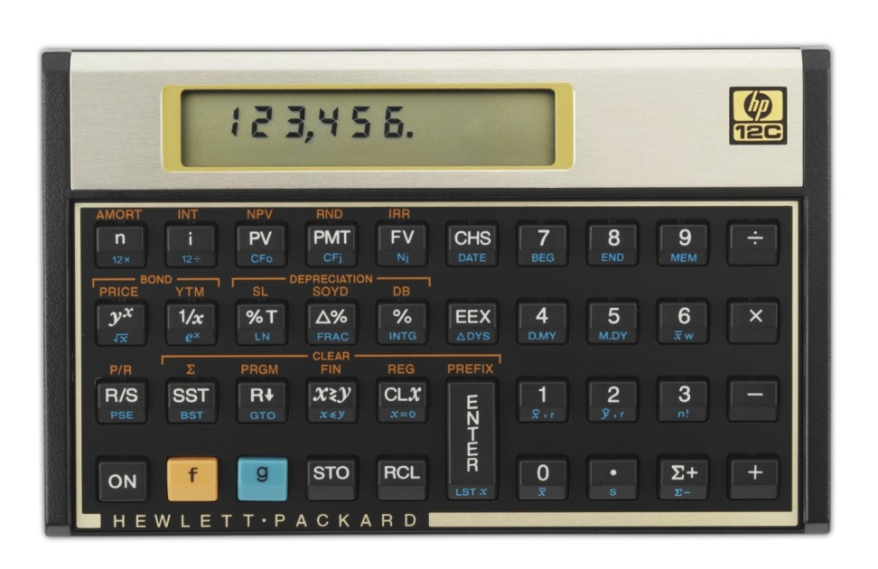
Financial Calculator
Financial calculators have built-in functions that save time in solving time value of money problems, and their use is permitted in examinations. We will also work on examples using financial calculators in lectures.
It is recommended that you buy a financial calculator and become proficient in using its time value of money functions before we start the chapter on time value of money. You should refer to the user manual for instructions.
Financial calculator: recommended models – TI BA II Plus or HP 12C
NOTE: Programmable calculators and calculators with text display functions are NOT allowed during examinations. All HKEAA approved calculators are allowed during examinations.
FINA 2303 - Introduction

Slide 9
Online Quizzes
Are designed to check that you have mastered the key concepts from the class
Will help prepare you for the exams
Will be spaced out through the course
Will be taken online in a limited time
Will cover materials covered in class
Will take the form of MCQ and T/F questions
Represent 6% of the grade (3% each)
FINA 2303 - Introduction

Slide 10
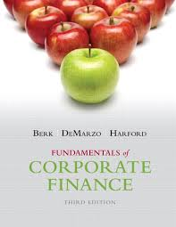
Required Textbook
Fundamentals of Corporate Finance by Berk, DeMarzo and Harford, Pearson International Edition, 3rd Ed. is the required textbook for this course per Department of Finance requirements.
This book will be used extensively in the course. You should also read the assigned chapters in the textbook thoroughly because the lectures will only focus on the core and more difficult concepts instead of every detail in the textbook.
Note: This textbook contains information about U.S. financial markets, institutions and corporate finance practices. These chapters (14-23) are not covered in this course and will not be covered in examinations.
The textbook offers a My Finance Lab (MFL) option that offers students the option to practice and study independently. Per Department of Finance requirements students are required to register for the MFL.
FINA 2303 - Introduction

Slide 11
My Finance Lab – required
Per Finance Department requirements, each student is required to have an individual Access Code to register for My Finance Lab, a web-based homework and tutorial system accompanying the required textbook.
It can be either purchased bundled with the textbook at a special discount price, or separately if you own a used copy of the textbook, at the campus bookstore.
Note: number of standalone cards is limited and may be sold out quickly.
IMPORTANT: You must have your MFL account properly set up before 5pm on the last day for add/drop period
My Finance Lab (MFL) contains a number of tutorial tools and learning aids that give you hands-on guidance with a hint and partial credit system when working on the end-of-the-chapter problems.
We will not post the solutions to end-of-chapter problems because you will get detailed solutions in STUDY PLAN during your own practices.
FINA 2303 - Introduction

Slide 12
Homework: My Finance Lab (MFL) Assignments
There will be 10 assignments, each pertaining to specific chapters in the textbook.
MFL Assignments will count for 15% of your final grade in total.
All questions are equally weighted. This implies that assignments with higher number of questions will have higher weights.
Late submission is not allowed.
You may seek help from the TA and discuss concepts and computation methods with others while doing the practice problems in the Study Plan.
Lecture notes, textbook, and other references are allowed when you are working on the assignments.
The Homework assignments are individual assessments and you must work on the problems by yourself without assistance from any other people. Violation will result in penalty for plagiarism.
FINA 2303 - Introduction

Slide 13
Participation
Despite the large class size I intend to make this course as interactive as possible
I expect students to engage actively in class and online with each other and with me and our TA.
Participation represents 4% of the grade
Points will be awarded based on active involvement in class, quality participation in online board discussions, and participation in class through PRS.
FINA 2303 - Introduction

Slide 14

Personal Response System (PRS)
We will be using a clicker (PRS) in every class so you can participate in class exercises and earn participation credit
You can use iPRS app on your smartphone or check out a PRS handset from the ITSC Service Desk.
Make sure you bring it to class every time, as participation counts!
FINA 2303 - Introduction

Slide 15
Exams
There will be 2 exams, one on 13 March 2017(Monday) evening and one at the end during the final exam period.
Time and venue for the exams will be scheduled by the school. Please do not plan to travel during the exam periods as there will be no make ups
Make yourself familiar with the exam rules of the school and HKUST. Be reminded that academic integrity is taken extremely seriously at HKUST.
The mid-term will represent 30% of the grade and the final exam 45%. Exams will include MCQ and T/F questions.
FINA 2303 - Introduction

Slide 16
Some Important Rules
Attendance: you are normally expected to attend all the lectures.
Punctuality: please be on time. Late arrival is disruptive to everyone.
No food in classroom please
PC/tablets: students who wish to bring their PC/tablet in the classroom for note-taking are welcome to do so subject to appropriate behavior (e.g. NO online shopping, video gaming, etc…)
Participation and discussion: there will be plenty of opportunities for you to participate actively in class…but unrelated blabber is not welcome!
One last warning: I am DEAF! Please SPEAK UP when you ask or answer a question. If I make you repeat, it is NOT personal…
FINA 2303 - Introduction

Slide 17
Copyright Issues
The lectures may be recorded by HKUST
Videos will be made available on CANVAS and are subject to copyright; students are not allowed to copy, duplicate or disseminate the videos without prior written consent
No other recording or taping is allowed
The lectures notes are provided to you for single use. You may not copy or distribute all or any part of the notes without the written consent of the Lecturer.
Please be aware of intellectual property issues in all your work and presentations. Take care to indicate the source of your quotes and include a reference list at the end of your presentations.
Plagiarism is not tolerated at HKUST. Plagiarism software may be used in evaluating homework and clear cases of plagiarism will impact your grade significantly.
FINA 2303 - Introduction

Slide 18

Contact Info
Instructor: Prof. Veronique Lafon-Vinais
Email HKUST: vlafon@ust.hk
Telephone: 9042-6753 (if emergency only)
Mail to: Department of Finance, HKUST
Meeting by appointment only
What’s an Emergency?
FINA 2303 - Introduction
Notes:
My office on campus is in room 2445 (2 floor, close to lifts 25/26). If you need to contact me, the best way is by email, as I will be checking my email account daily. If you need to see me, I will generally be available after class, or you can make an appointment to see me (to avoid disappointment).
In case of emergency only, you can call me on my mobile.
For practical and UST related questions, please contact the MBA office or the Department of Finance staff.
Teaching Assistant: Mr. Siming TIAN Email: simingtian@ust.hk; Room 3392 (Lifts 17-18) Phone: 2358 7689
Office Hours: Tue 10:00-12:00, Wed 10:00-11:00 and by appointment
Mail: address to Department of Finance at HKUST, clearly indicating course reference and instructor’s name.

Slide 19

Ask Questions
Definitions, terminology & jargon
Never take anything for granted
Nothing new under the sun
No stupid questions
No one has all the answers …not even me!
FINA 2303 - Introduction
Notes:
Some terminology index will be provided.

Slide 20
Part I - CHAPTER 1
CORPORATE FINANCE AND THE FINANCIAL MANAGER

Slide 21
Chapter 1 Outline
1.1 Why Study Finance?
1.3 The Financial Manager
1.4 The Financial Manager’s Place in the Corporation
1.5 The Stock Market
1.6 Financial Institutions
Copyright ©2015 Pearson Education, Inc. All rights reserved.
FINA 2303 – Chapter 1 - Outline

Slide 22
Learning Objectives
Grasp the importance of financial information in both your personal and business lives
Understand the important features of the four main types of firms and see why the advantages of the corporate form have led it to dominate economic activity
Explain the goal of the financial manager and the reasoning behind that goal, as well as understand the three main types of decisions a financial manager makes
Know how a corporation is managed and controlled, the financial manager’s place in it, and some of the ethical issues financial managers face
Understand the importance of financial markets, such as stock markets, to a corporation and the financial manager’s role as liaison to those markets
Recognize the role that financial institutions play in the financial cycle of the economy
Copyright ©2015 Pearson Education, Inc. All rights reserved.
FINA 2303 – Chapter 1 – Learning Objectives

Slide 23
1.1 Why Study Finance?
Individuals are taking charge of their personal finances with decisions such as:
When to start saving and how much to save for retirement
Whether a particular stock is a good investment
How to evaluate the terms of a home mortgage
In your business career, you may face such questions such as:
Should your firm launch a new product?
Which supplier should your firm choose?
Should your firm produce or outsource production?
Should your firm issue new stock or borrow money instead?
How can you raise money for your start-up firm?
Copyright ©2015 Pearson Education, Inc. All rights reserved.
FINA 2303 – Chapter 1 – Why Study Finance

Slide 24

Your Turn! (PRS, please)
Why are you sitting here?
Duh, I don’t have a choice, it’s a required course
I need a place to rest for a while
I take it because I need some credits
I’m interested in the topic in general
I want to learn about finance for my investments
I want to learn about finance for my business
Other reason (e.g. this TA is great…)
FINA 2303 – Chapter 1 – Why Study Finance

Slide 25
Quick reminder on types of firms
When setting up a business, you have to decide which type of legal structure to use
This choice is important because it has consequences on the survival of the business, possibility to raise additional capital, taxation implications etc…
The choices available to you depend on the country of incorporation’s legal system.
For example, Hong Kong’s legal system is based on English law and is quite different from the US which has both federal law and different state laws
New York law is different from Delaware law, for example
FINA 2303 – Chapter 1 – Types of Firms

Slide 26
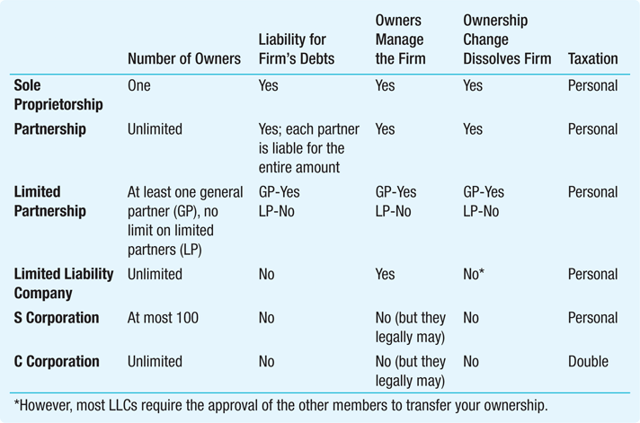
Table 1.1 Characteristics of the Different Types of Firms (US specific)
Copyright ©2015 Pearson Education, Inc. All rights reserved.
FINA 2303 – Chapter 1 – Types of Firms

Slide 27
1.3 The Financial Manager
The financial manager has three main tasks:
Make investment decisions
The financial manager must weigh the costs and benefits of each investment or project
They must decide which investments or projects qualify as good uses of the stockholders’ money
Make financing decisions
The financial manager must decide whether to raise more money from new and existing owners by selling more shares of stock or to borrow the money instead
Manage cash flow from operating activities
The financial manager must ensure that the firm has enough cash on hand to meet its obligations at each point in time
This job is also known as managing working capital
Copyright ©2015 Pearson Education, Inc. All rights reserved.
FINA 2303 – Chapter 1 – The Financial Manager

Slide 28
1.3 The Financial Manager
The Goal of the Financial Manager
The overriding goal of financial management is to maximize the wealth of the stockholders
Not everyone agrees! And when a company has a very diverse shareholder base, which shareholder should get priority?
Copyright ©2015 Pearson Education, Inc. All rights reserved.
FINA 2303 – Chapter 1 – The Financial Manager

Slide 29
1.4 The Financial Manager’s Place in the Corporation
Stockholders own the corporation but rely on financial managers to actively manage the corporation
The board of directors and the management team headed by the CEO possess direct control of the corporation
The Corporate Management Team
Board of Directors
A group of people elected by shareholders who have the ultimate decision-making authority in the corporation
Chief Executive Officer (CEO)
The person charged with running the corporation by instituting the rules and policies set by the board of directors
Copyright ©2015 Pearson Education, Inc. All rights reserved.
FINA 2303 – Chapter 1 – The Financial Manager

Slide 30
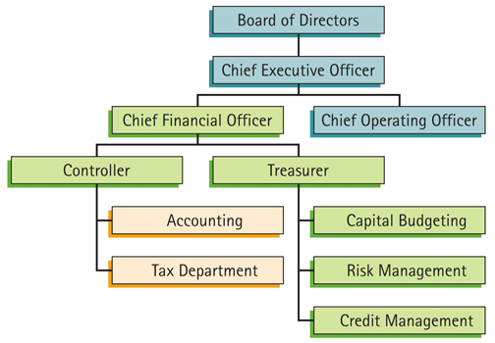
Figure 1.2 The Financial Functions Within a Corporation
Copyright ©2015 Pearson Education, Inc. All rights reserved.
FINA 2303 – Chapter 1 – The Financial Manager

Slide 31
1.4 The Financial Manager’s Place in the Corporation
Ethics and Incentives in Corporations
Agency Problems
When managers put their own self-interest ahead of the interests of those shareholders (principal-agent problem)
The CEO’s Performance
When the stock performs poorly:
The board of directors might react by replacing the CEO
A corporate raider may initiate a hostile takeover
But who really appoints the directors to the Board? The shareholders, or the CEO?
Copyright ©2015 Pearson Education, Inc. All rights reserved.
FINA 2303 – Chapter 1 – The Financial Manager

Slide 32
1.5 The Stock Market
Corporations can be private or public
A private corporation has a limited number of owners and there is no organized market for its shares
A public corporation has many owners and its shares trade on an organized market, called a stock market
In fact, shares can be LISTED but not actively TRADED on a particular stock market. This may be because there is limited demand for the shares or because there are very few shares available to trade (the “float”)
Copyright ©2015 Pearson Education, Inc. All rights reserved.
FINA 2303 – Chapter 1 – Stock Market

Slide 33
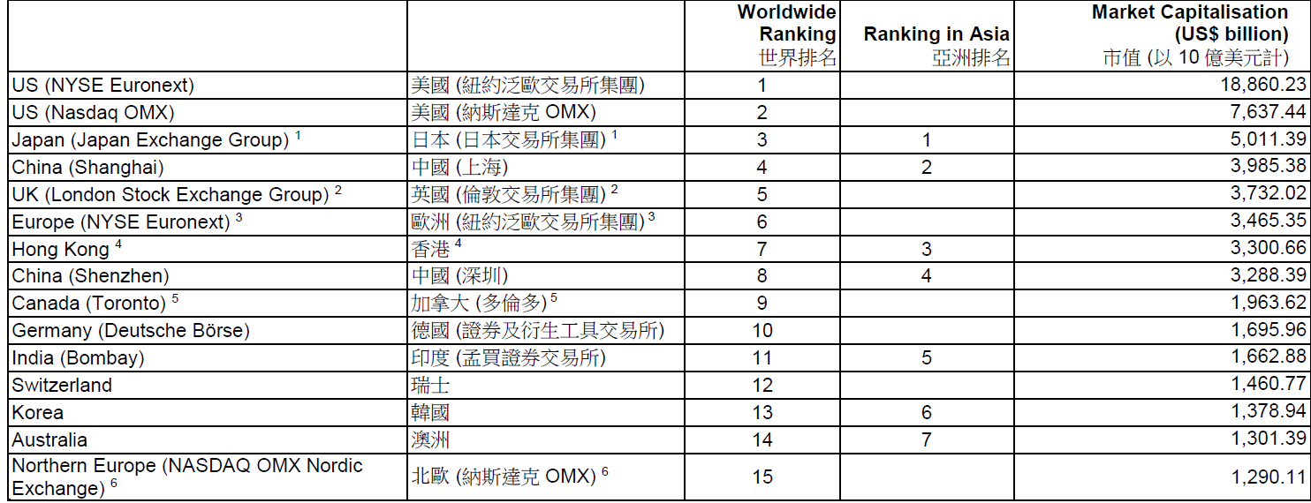
Market capitalisation of top global stock exchanges (as of Sept 16)
Source: SFC
http://money.visualcapitalist.com/all-of-the-worlds-stock-exchanges-by-size/
FINA 2303 – Chapter 1 – Stock Market
Notes:
Source: http://www.sfc.hk/web/EN/files/SOM/MarketStatistics/a01.pdf

Slide 34
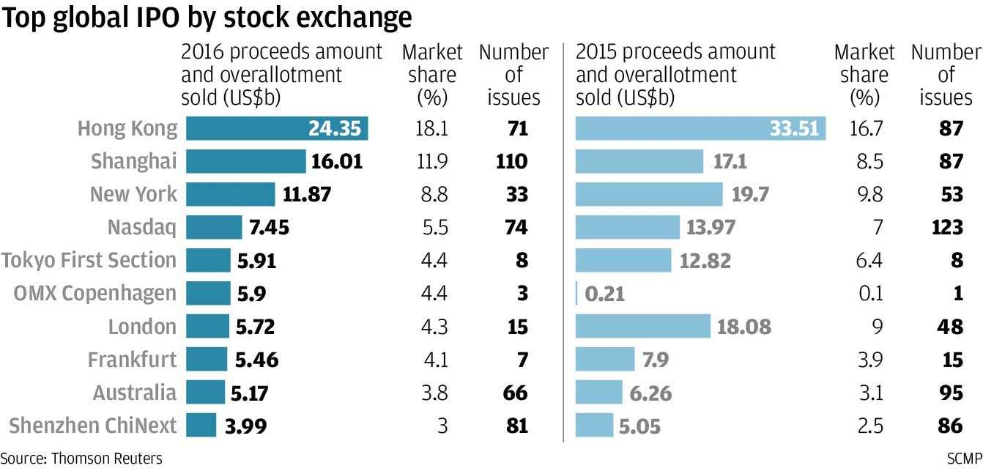
Top IPO markets
FINA 2303 – Chapter 1 – Stock Market
Notes:
Source: SCMP http://www.scmp.com/business/companies/article/2057428/hong-kong-tops-global-ipo-markets-despite-total-funds-raised

Slide 35
1.5 The Stock Market
Capital Markets; Primary & Secondary Markets
Companies issue securities (equity securities or debt securities) to raise capital (equity or debt financing) in primary markets
Securities are negotiable, tradable financial instruments
Securities are traded in capital markets : ECM= Equity Capital Market ; DCM = Debt Capital Markets
Capital markets include primary and secondary markets
Primary: where a corporation issues new shares and sells them to investors
Secondary: where investors buy and sell securities to each other without the involvement of the corporation
An Initial Public Offering (IPO) is how a company issues securities for the first time in capital markets
FINA 2303 – Chapter 1 – Stock Market

Slide 36
Primary v. Secondary Markets
Primary Market
Investor
A
Borrower/
Issuer
Secondary
Market
Investor
B
Capital
Market
FINA 2303 – Chapter 1 – Stock Market
Notes:
36
Primary & secondary markets:
Q to Ss: anyone can give me a definition?
A: classification a/c to sequence (go to Chart 1)
Primary: New security issues sold to initial buyers
Secondary: Securities previously issued are bought and sold
This distinction applies to both debt and equity markets as well as loan markets.
Primary markets: where issuers initially sell securities
Secondary markets : after debt or equity securities have been initially sold, they are traded in the secondary market.
The secondary markets can be auction markets (exchanges) or dealer markets (OTC).
Primary Markets
markets for issue of new securities to raise money for consumption or investment purposes
Include issue of both primary and indirect securities
Markets in non-negotiable instruments are entirely primary markets
Secondary Markets
Markets in which previously issued financial claims are traded
Differ in terms of breadth/depth/liquidity
Important
Functions of secondary markets:
Assist primary markets by providing investors with reversibility/marketability/liquidity
Provides the basis for price determination on new issues
Registers market conditions rapidly
Enables investors to adjust portfolios (size, risk, return, liquidity and maturity)
Enables central bank to influence liquidity in financial markets through open-market operations

Slide 37
Exchanges vs. Over-the-Counter (OTC)
Exchanges
Over-the-counter (OTC)
One centralized “location”
2 types: stock exchanges and derivatives exchanges
Can be auction markets or dealer markets
Not localized
Dealer markets
Examples: bond market
FINA 2303 – Chapter 1 – Stock Market
Notes:
The Nasdaq vs. The NYSE
(Source: http://i.investopedia.com/inv/pdf/tutorials/electronic_trading.pdf )
From a glance, the difference between the New York Stock Exchange (NYSE) and Nasdaq may not be marked. The NYSE lists household names like Coca-Cola, Wal-Mart, Citicorp, and General Electric, whereas the Nasdaq is home to many of the tech giants such as Microsoft, Cisco, Intel, Oracle and Sun Microsystems. Besides the heavy tech weighting, the fundamental difference between the two exchanges is in the way securities are traded.
NYSE
The NYSE is an auction market that uses floor traders to make most of its trades. Each stock on the NYSE has a specialist; this is a person who oversees and facilitates all of the trades for a particular stock. If you wish to buy a stock that trades on the NYSE, your broker will either call your order to a floor broker, or enter it into the DOT system (which we will discuss later on).
Nasdaq
The Nasdaq, on the other hand, is not a physical entity. The Nasdaq might be known for its fancy MarketSite Tower and broadcast studio in Times Square, but very little is done there. The Nasdaq is an over-the-counter (OTC) market and it relies on market makers rather than specialists to facilitate trading and liquidity in stocks. For each stock, there is at least one market maker, (large stocks such as Microsoft have several), whose duties we will discuss later on. Rather than being an auction market, the Nasdaq is a communications network between thousands of computers. Instead of brokers calling out orders, market makers place their names on a list of buyers and sellers, which is then distributed by the Nasdaq in a split second to thousands of other computers. If you wish to buy a stock that trades on the Nasdaq, your broker will either call up a market maker with the information of your trade or enter your order into a Nasdaq-sponsored online execution system

Slide 38
1.5 The Stock Market
Physical Stock Markets
Auction Market
Example: NYSE
Market Makers
Specialists
Bid-Ask Spread
Bid price
Ask price
Transaction Cost
Over-the-Counter Stock Markets
Dealer Markets
Example: NASDAQ
FINA 2303 – Chapter 1 – Stock Market

Slide 39
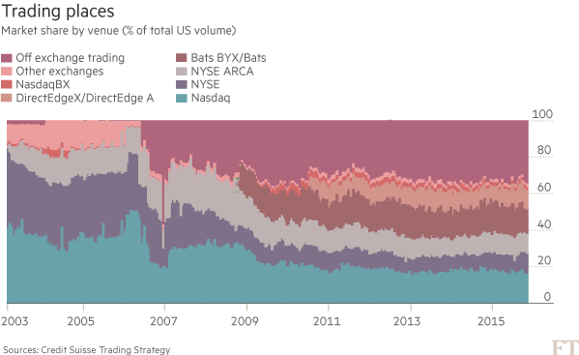
Trading venues in the US
Source: FT 8 March 2016
FINA 2303 – Chapter 1 – Stock Market
Notes:
Source: FT 8 March 2016 https://next.ft.com/content/f809ab30-e21c-11e5-9217-6ae3733a2cd1?ftcamp=crm/email//nbe/Analysis/product

Slide 40

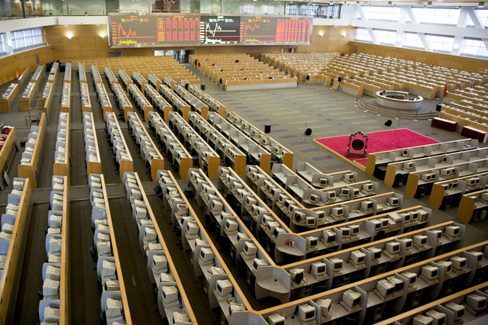

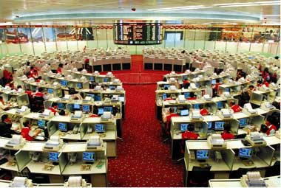
Game: Identify these Asian securities exchanges
3
1
2
4
FINA 2303 – Chapter 1 – Stock Market
Notes:
Shanghai Stock Exchange
HKEx (HK Stock exchange)
SGX (Singapore Stock Exchange (before floor trading stopped)
Tokyo stock exchange

Slide 41
Current issues related to market organization
The advent of electronic trading
Will open outcry disappear?
Demutualization and listing of exchanges
Mergers and consolidation
Dark pools and private exchanges
Advent of High Frequency Trading (HFT)
Regulators push to move OTC onto exchanges
Impact?
FINA 2303 – Chapter 1 – Stock Market
Notes:
As recently as December 2005, the floor was home to 1,244 equity members — specialists, now called “designated market makers,” and brokers — and 2,087 clerks, according to the exchange. Today there are 442 equity members and 627 clerks. The number of independents has fallen to fewer than a dozen from 50 or more two decades ago. The floor is a victim of technology. Electronic exchanges such as longtime rival Nasdaq Stock Market and recent upstart BATS Exchange have siphoned off much of the activity from the floor by creating ultrafast trading networks. The NYSE responded to the pressure in 2006 by acquiring an electronic exchange of its own, Archipelago Holdings; the following year it snapped up Euronext, the multinational European exchange that had itself gone largely electronic, to create holding company NYSE Euronext. Now, of the roughly 6.5 billion shares of U.S.-listed stocks that change hands each day, the NYSE handles only about a third of the total, according to industry estimates. Even for NYSE-listed stocks, the exchange has a market share of just 42 percent, according to its most recent statistics. A substantial percentage of the volume that does make it to the floor, moreover, is executed via a single click on NYSE Arca without the need for two human beings — a floor broker and a specialist — to interact. Floor brokers accounted for just 5 percent of overall volume in April, exchange data show. Source: NYSE technology threatens survival of floor traders, II 06 July09

Slide 42
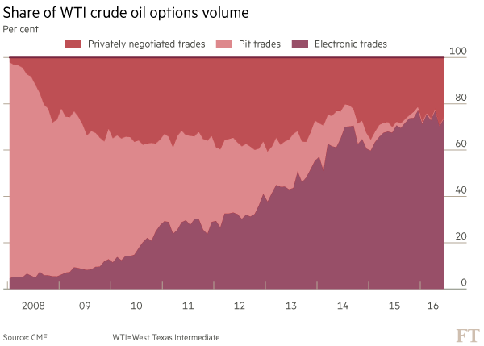
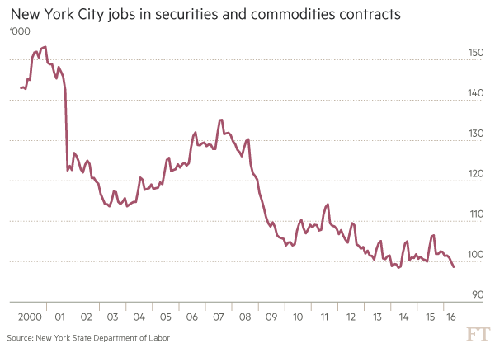
The rise of e-trading and loss of jobs
Source: FT 6 July 2016 “What happened when the pit stopped”
FINA 2303 – Chapter 1 – Stock Market
Notes:
Source: FT 6 July 2016 “What happened when the pit stopped” https://next.ft.com/content/4d221b22-3dfb-11e6-8716-a4a71e8140b0?ftcamp=crm/email//nbe/Analysis/product

Slide 43
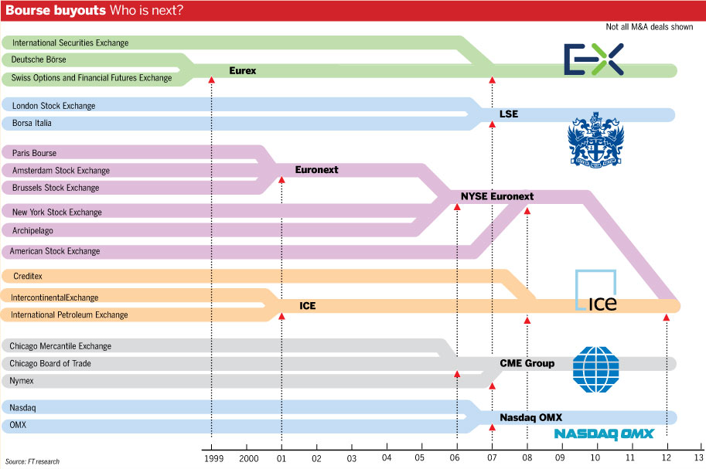
Source: FT“ICE and NYSE Euronext go where other exchanges have struggled” 3 October 2013
FINA 2303 – Chapter 1 – Stock Market
Notes:
Source: FT“ICE and NYSE Euronext go where other exchanges have struggled” 3 October 2013
http://www.ft.com/intl/cms/s/0/c6c899fc-2b56-11e3-bfe2-00144feab7de.html?ftcamp=crm/email/2013104/nbe/GlobalBusiness/product#axzz2hC887RHW

Slide 44
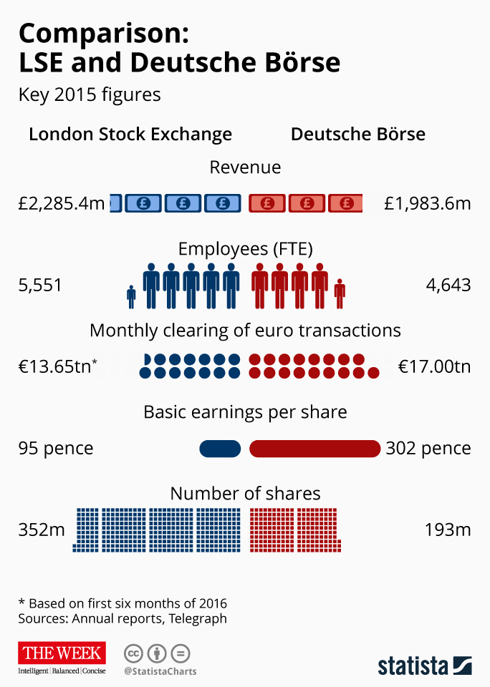
The next merger: DB-LSE?
FINA 2303 – Chapter 1 – Stock Market

Slide 45
Your Turn! (PRS please)
Is an IPO (initial public offering) a primary market or secondary market transaction?
Primary
Secondary
If you buy shares from another investor, is it primary market or secondary market transaction?
Primary
Secondary

Slide 46
1.5 The Stock Market
Listing Standards
Outlines of the requirements a company must meet to be listed on a specific exchange
Exchanges have their own specific listing requirements
For example, NYSE has different standards than NASDAQ – many tech companies prefer to list on NASDAQ https://www.youtube.com/watch?v=A7OLStn1Lh0
The difference between listing rules/requirements of different exchanges creates interesting dilemmas for companies seeking an IPO – example ALIBABA: https://www.youtube.com/watch?v=6z3ufQfGPAo
FINA 2303 – Chapter 1 – Stock Market

Slide 47
1.5 The Stock Market
Other Financial Markets
Bond Market
mainly OTC, but most bonds are LISTED on recognized exchanges
Foreign Exchange (currency) Market
mainly OTC for spot and forward, but there are listed currency options and futures
Commodities Market
Both exchanges (NYMEX, LME…) and OTC
Derivative Securities
Both exchanges (futures, options) and OTC
Futures are derivatives contracts which are exchange-specific – they are ONLY traded on exchanges
FINA 2303 – Chapter 1 – Stock Market

Slide 48
1.6 Financial Institutions
Financial Institutions
Entities that provide financial services, such as taking deposits, managing investments, brokering financial transactions, or making loans
Copyright ©2015 Pearson Education, Inc. All rights reserved.
FINA 2303 – Chapter 1 – Financial Institutions

Slide 49
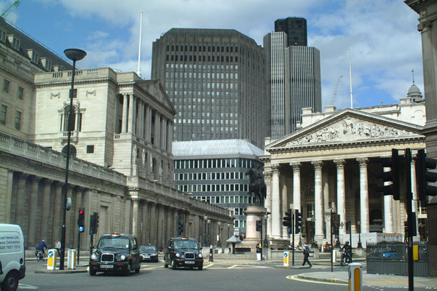
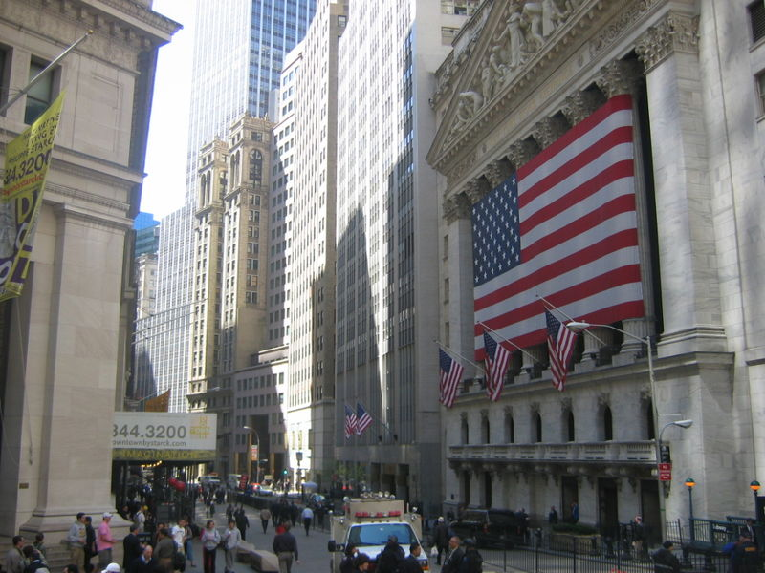
Role of financial institutions
Financial services industry links organizations needing capital with those able to provide it
Major contributor to economy in UK, US, HK….
City of London, the Square Mile
Source: www.freefoto.com
NYSE and Wall Street
Source: Wikipedia
FINA 2303 – Chapter 1 – Financial Institutions

Slide 50
1.6 Financial Institutions
Role of Financial Institutions
Financial institutions:
Move funds from savers to borrowers
Move funds through time
Help spread out risk-bearing
Copyright ©2015 Pearson Education, Inc. All rights reserved.
FINA 2303 – Chapter 1 – Financial Institutions

Slide 51
Financial System
Surplus
of
Funds
Financial
Intermediaries
Shortage
of
Funds
Indirect Finance
Financial
Markets
Direct Finance
FINA 2303 – Chapter 1 – Financial Institutions
Notes:
In the financial system funds flow from those who have a surplus of them to those who have a shortage of them, either through direct, market-based financing or by indirect, bank-based finance
The optimal financial system should include both direct and indirect finance.
Basic role of financial markets = channeling savings into productive investments

Slide 52
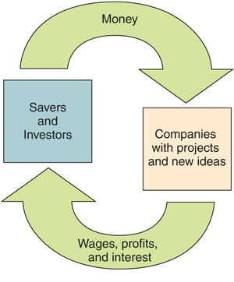
1.6 Financial Institutions
The Financial Cycle
In the financial cycle:
People invest and save their money
Through loans and stock, that money flows to companies who use it to fund growth through new products, generating profits and wages
The money then flows back to the savers and investors
Copyright ©2015 Pearson Education, Inc. All rights reserved.
FINA 2303 – Chapter 1 – Financial Institutions

Slide 53
1.6 Financial Institutions
Types of Financial Institutions (in the US)
Banks and Credit Unions
Insurance Companies
Mutual Funds
Pension Funds
Hedge Funds
Venture Capital Funds
Private Equity Funds
Types of Financial Institutions
Financial conglomerates/financial services firms combine more than one type of institution
Copyright ©2015 Pearson Education, Inc. All rights reserved.
FINA 2303 – Chapter 1 – Financial Institutions

Slide 54
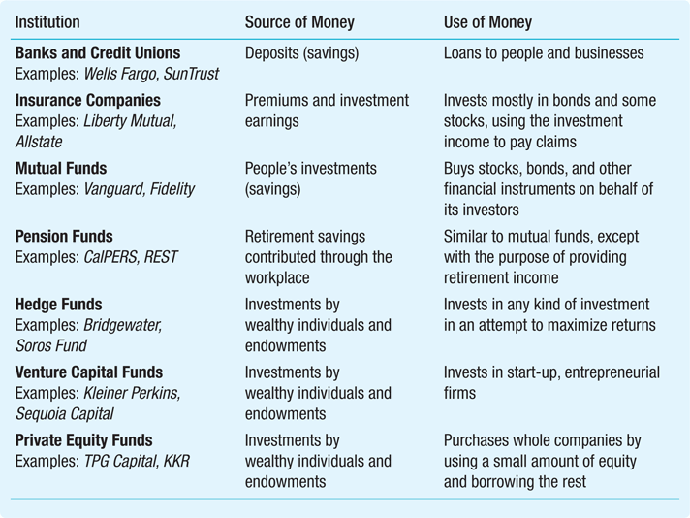
Table 1.2 Financial Institutions and Their Roles in the Financial Cycle
FINA 2303 – Chapter 1 – Financial Institutions
Copyright ©2015 Pearson Education, Inc. All rights reserved.

Slide 55
Types of Financial Institutions
Financial Intermediaries
Other Financial Institutions
Depository
Institutions
Commercial Banks
Credit Unions
Mutual/Savings Banks
Building Societies
….
Other Financial
Intermediaries
Insurance Companies
Pension Funds
Mutual Funds
Money Market Funds
Finance Companies
Securities Firms
Brokers
Dealers
Investment Banks
……
Issue checkable
deposits
Issue financial claims
FINA 2303 – Chapter 1 – Financial Institutions

Slide 56
Chapter Quiz
What are the advantages and disadvantages of organizing a business as a corporation?
What are the main types of decisions that a financial manager makes?
How do shareholders control a corporation?
What is the importance of a stock market to a financial manager?
What are the three main roles financial institutions play?

