Slide 1
Ping - pong
-Pulkit Aggarwal (19xj1a0554)
Yuvraj Mishra (19xj1a0576)

Slide 2
PROBLEM STATEMENT
Creating the classic ‘Ping - Pong’ game using GUI programming in JAVA.
Objective
To create the game as close as the classic Ping – Pong game that we used to play in our childhood.

Slide 3
Features
With all the functionalities of the classic game we also added features like : -
Ball Colour Adjustment.
Bat Thickness Adjustment.
Bat length Adjustment.
The speed of the ball increases after every hit.
The action of ball changes after every hit.

Slide 4
Member Roles
Pulkit Aggarwal
Designing Main Menu
Designing Settings Menu
Sliders
Buttons, Radio Buttons
Colour Chooser
Designing Help Menu
Linking Settings Elements with the game
Yuvraj Mishra
Designing Game
Creating Game
Game Physics
Graphics Rendering
2. Linking Settings Elements with the game

Slide 5
Limitation of Work
The Toolkit.getDefaultToolkit().sync() feature (to prevent game from flickering) is not working properly in Windows Environment but it is working fine in Linux Environment.
Extension of Work
In future Updates we would add more features like : -
Mouse support for bat control.
More in game customizations.

Slide 6
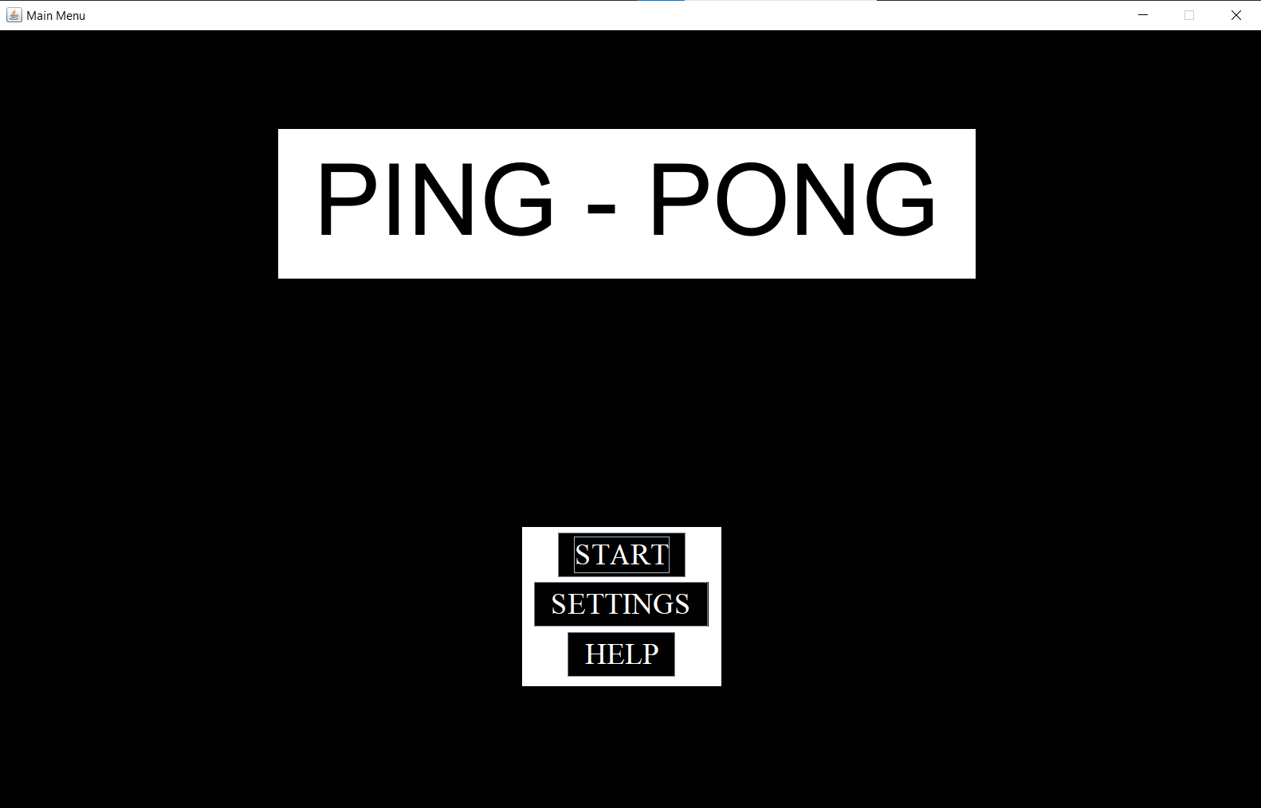
Main Menu

Slide 7
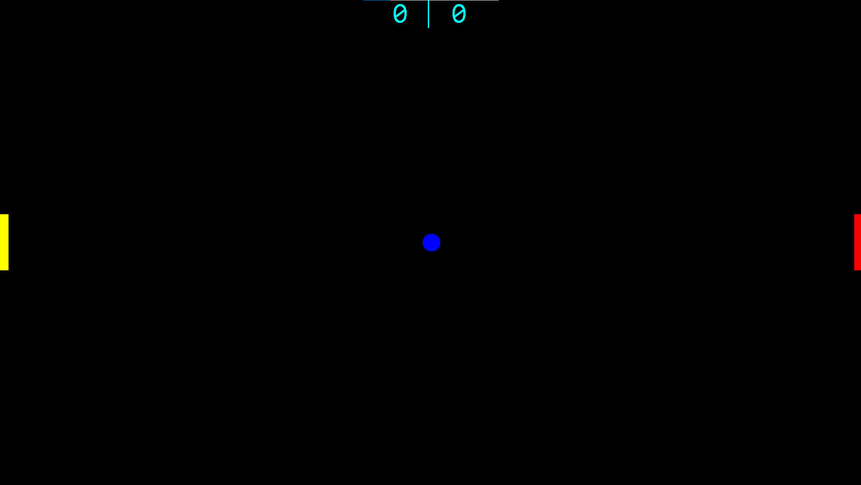
Start Game

Slide 8
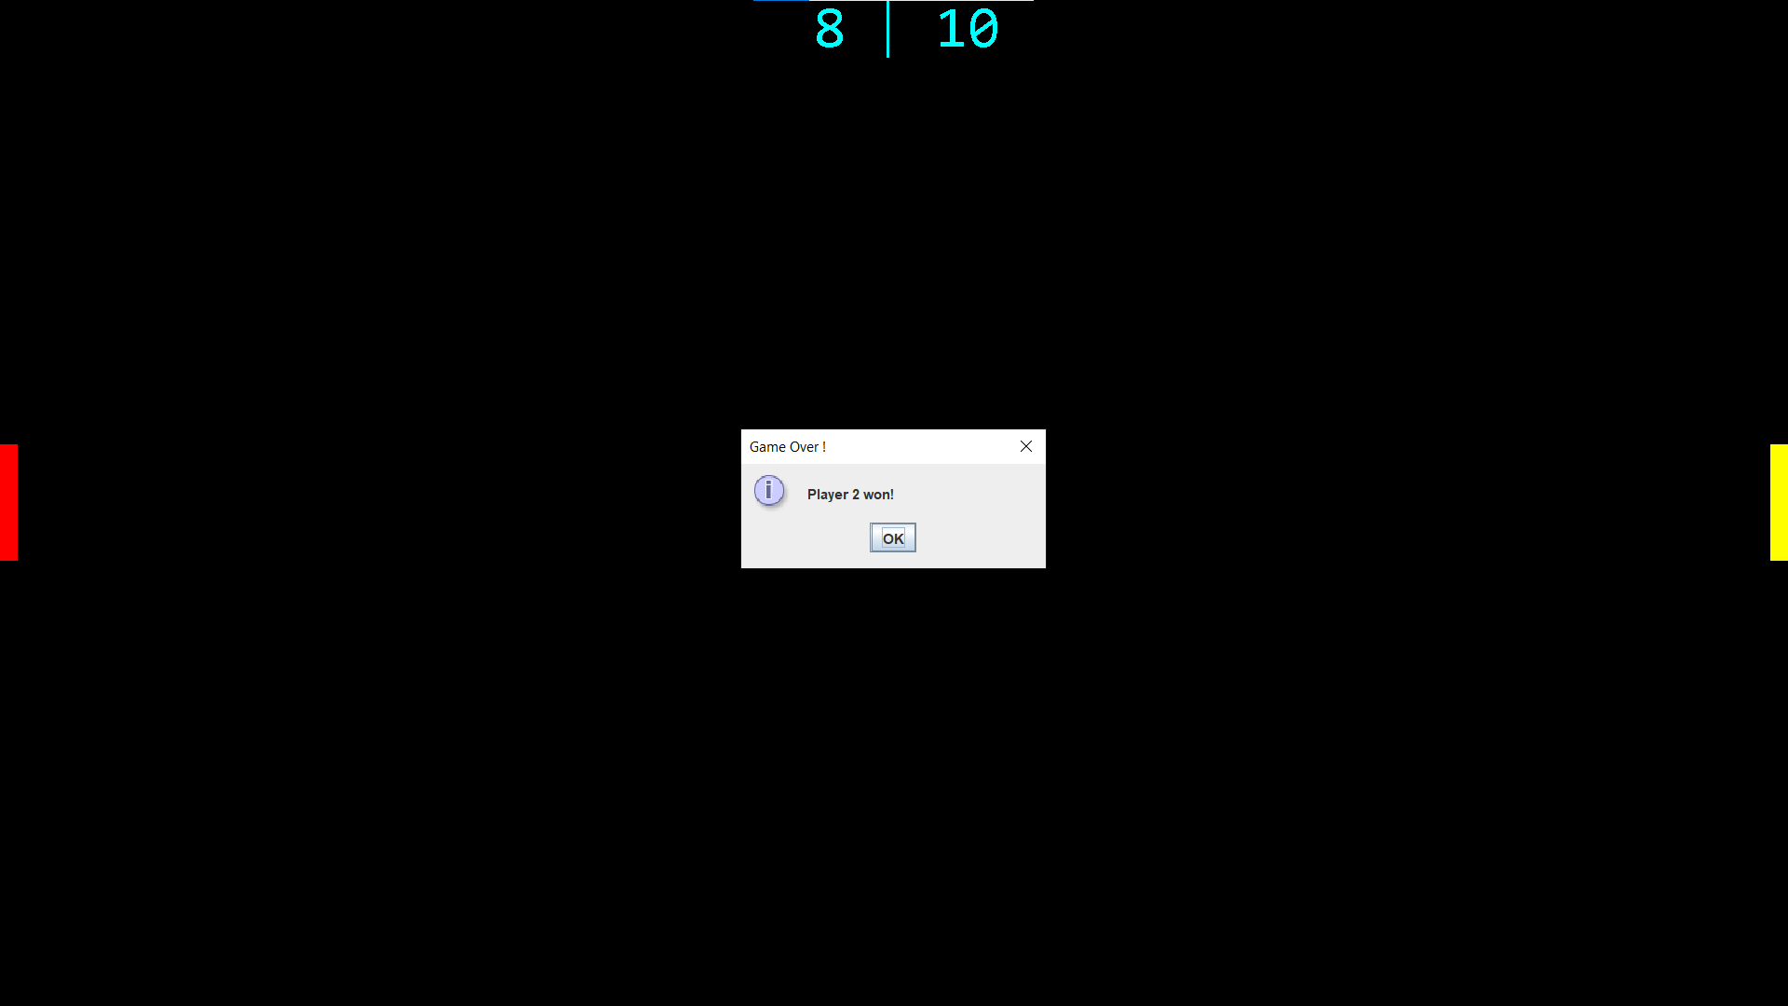
Game Over

Slide 9
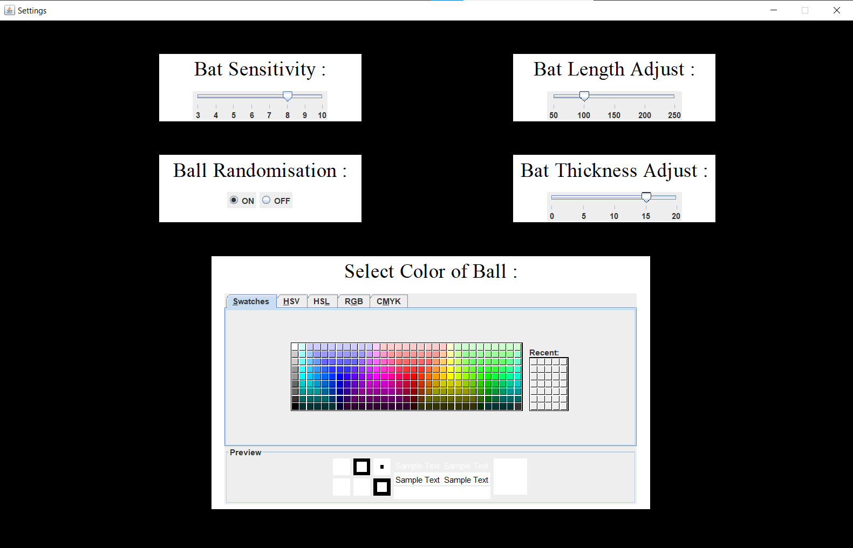
Settings Menu

Slide 10
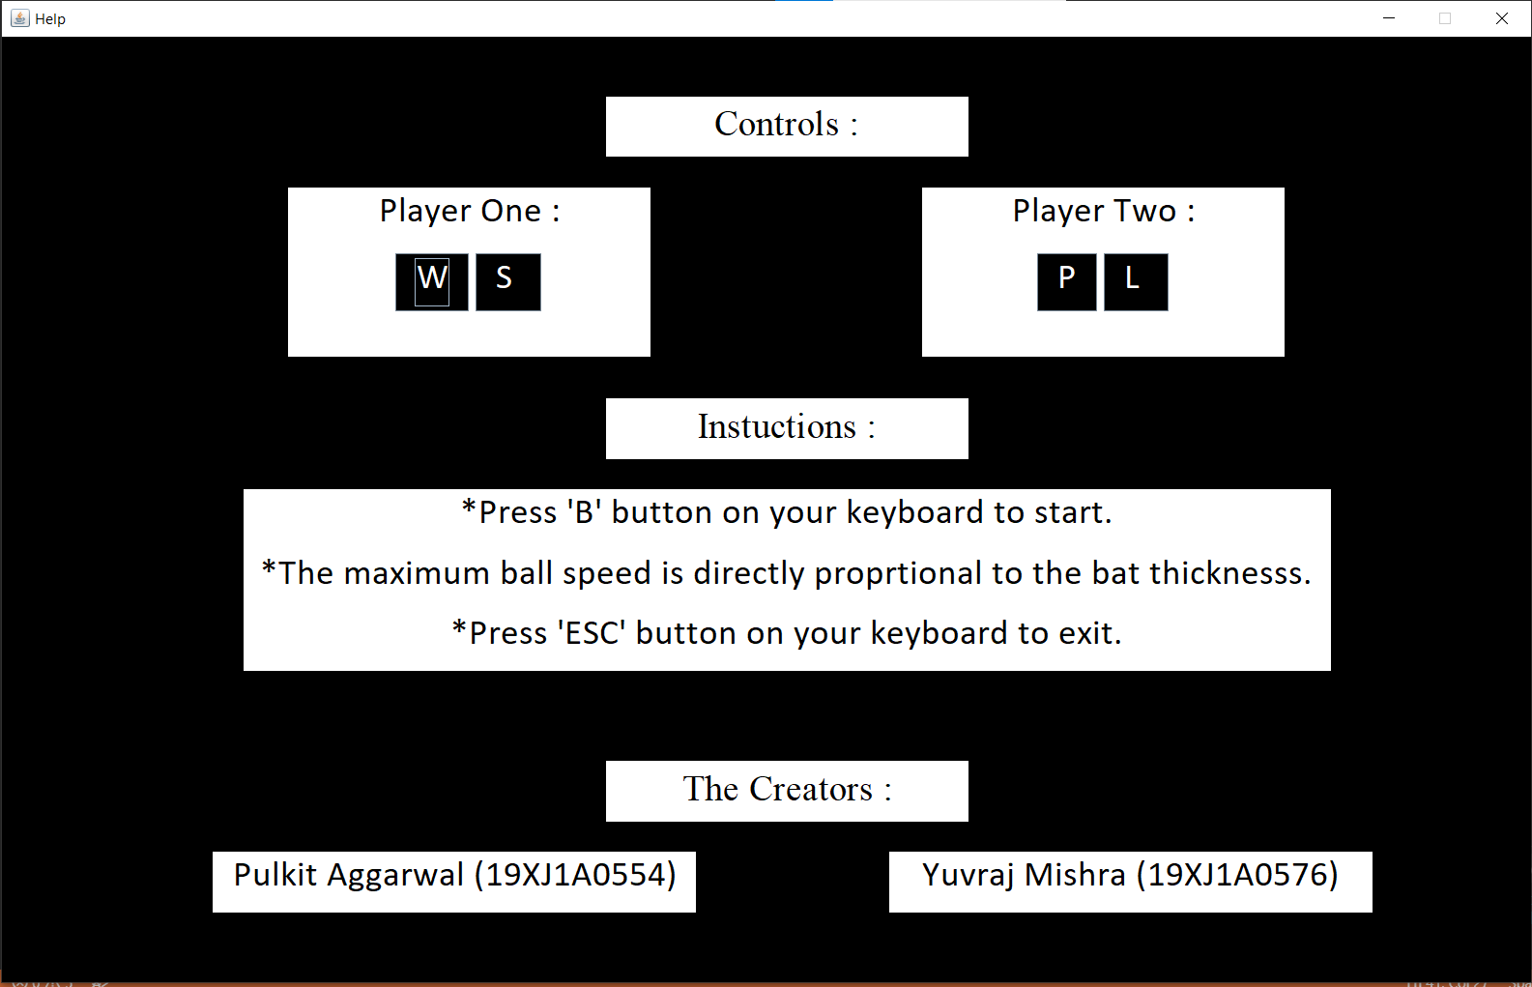
Help Menu

Slide 11
Conclusion
Increased overall understanding of how applications work in general.
Learnt a lot about how games are made and how graphics are processed in games.
Understood how to write the code in modules so that they can be linked later.
All in all it was a great experience. Creating something that was close to our hearts in our childhood gave us an extremely rewarding feeling.

