Slide 1

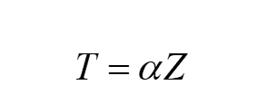
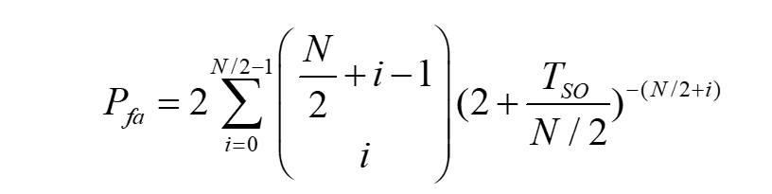
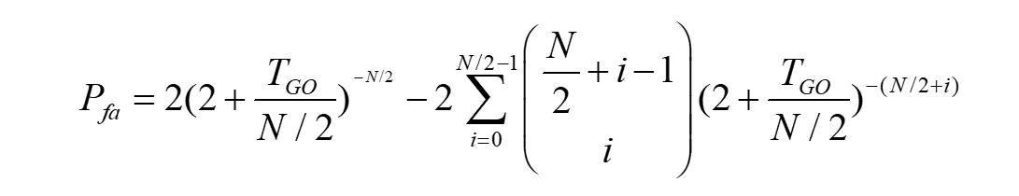
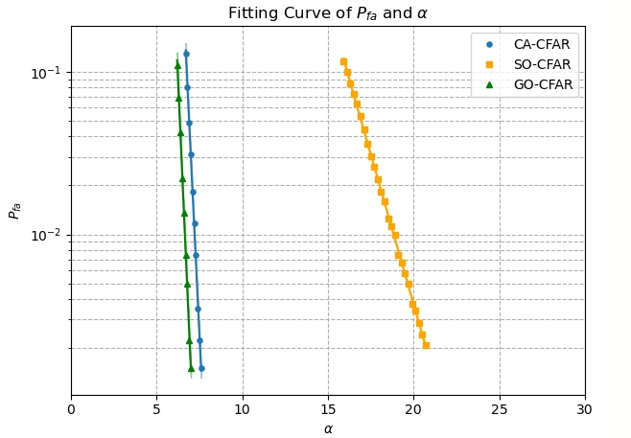
Since the formula hard to be derived, conduct Monte-Carlo experiments for fitting.
Algorithm | alpha
CA | 7.21
SO | 18.9
GO | 6.66

Slide 2
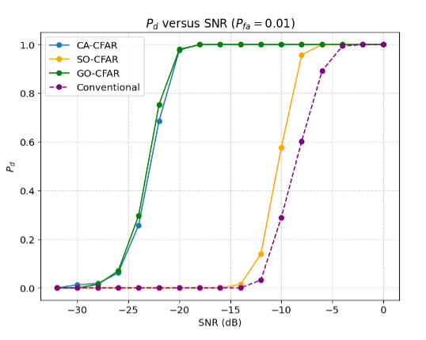
The point at which begins to decline.
Algorithm | SNR
CA | -18
SO | -8
GO | -18
Conventional | -6

Slide 3
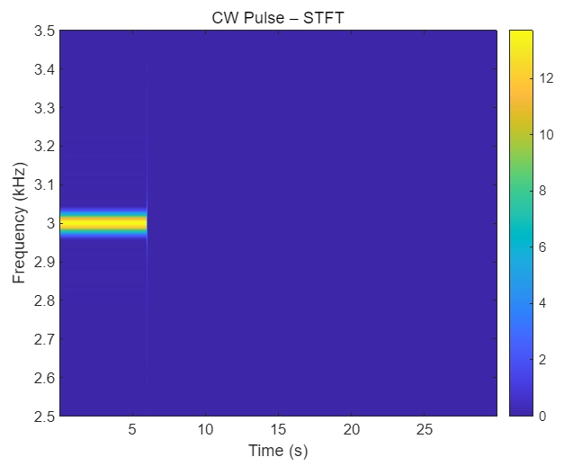
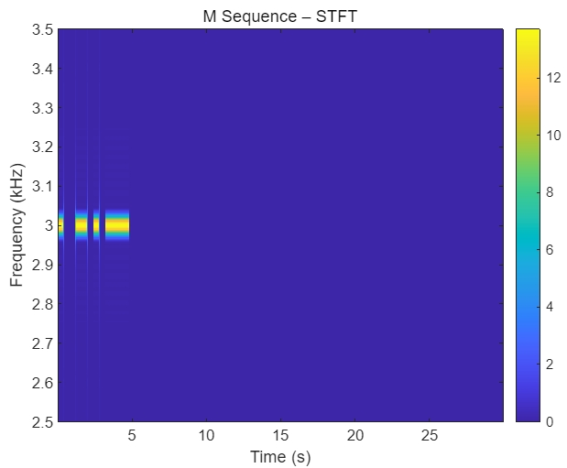
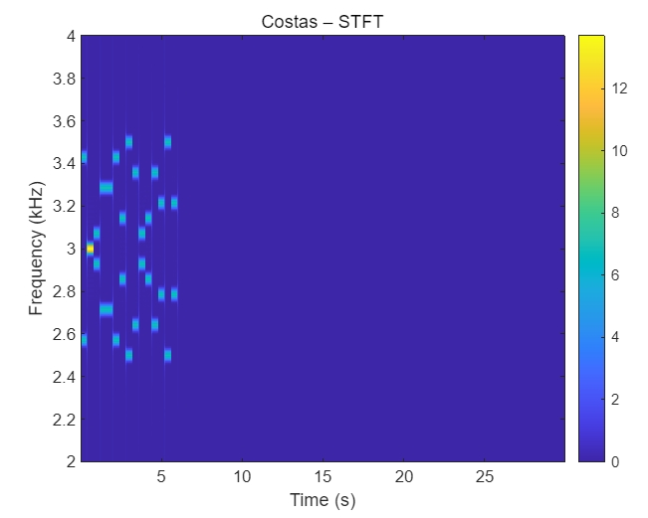
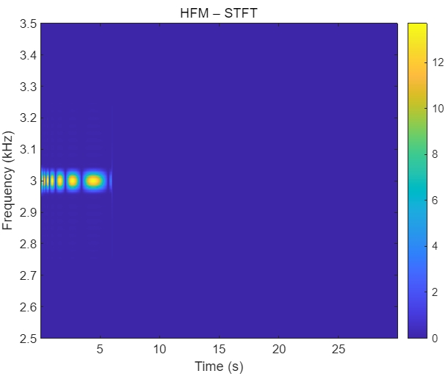
Params
Sample rate | 144kHz
Carrier Frequency | 3kHz
Pulse width | 6s
Pulse Interval | 24s

Slide 4
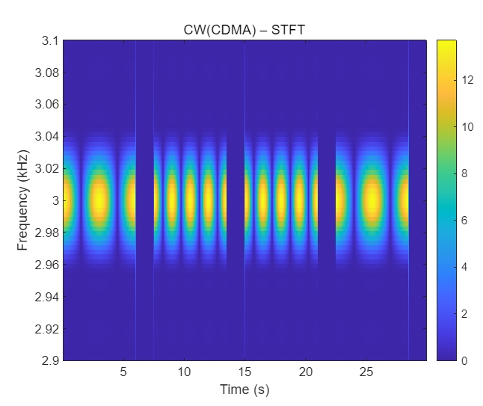
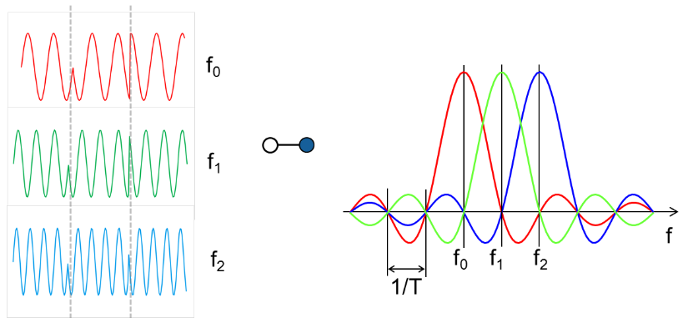
How about OFDM?

Slide 5
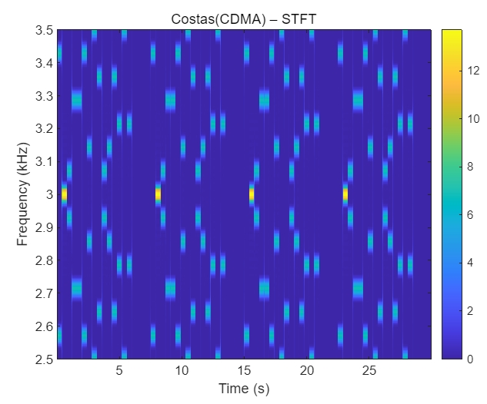
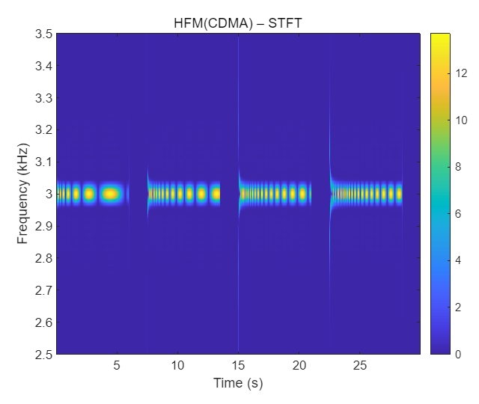
Params
Sample rate | 144kHz
Central Frequency | 3kHz
Pulse width | 6s
Pulse Interval | 1.5s
Broadening？

Slide 6
