Slide 1
FINAL PROJECT PRESENTATION
Integrated Transcriptomic Analysis of PCOS reveals Metabolic and Endocrine-Transcriptional Axes
Presented by:
Vanisha Sharma

Slide 2
TEAM MEMBERS & CONTRIBUTIONS
1. Vanisha Sharma - vanisha0209@gmail.com ; Data curation, editing task objectives, interpretation, PPT preparation
2. Bhavini Babariya - babariyabhavini08@gmail.com ; Dataset acquisition, microarray preprocessing (GSE137684 & GSE98421), interpretation
3. Srikeerthi Kotamaraju - eggcellent366@gmail.com ; Data acquisition, microarray preprocessing (GSE114419), result interpretation, proofreading of prior abstract
4. Fana e Ahmed Attari - fanaeahmed3@gmail.com ; RNA-seq preprocessing (GSE277906), DESeq2 analysis, interpretation
5. Youssra Boumait - youssra159@gmail.com ; Proofreading
6. Youssra Azaf - youssra.azaf99@gmail.com ; Differential expression analysis (all datasets), interpretation
7. Laiba Ishtiaq - laibaishtiaq74@gmail.com ; Cortisol gene integration, GO biological process enrichment, interpretation
8. Kanwal Naz - kanwalnaz88@hotmail.com ; KEGG pathway analysis and interpretation
9. Bihar Hikam Ahmadi - hikam.bihar@gmail.com ; MCODE module annotation, GO/KEGG/Reactome enrichment, cluster summarization
10. Maureen Nwosu - MCNwosu16@my.fisk.edu ; GO enrichment analysis
11. Emily Dorado - emilydorado2804@gmail.com ; STRING analysis, interaction interpretation, subnetworks, Cytoscape preparation & exports
12. Mbah Chinedu Endurance - chinedumbah906@gmail.com ; PCA, heatmaps, hierarchical clustering for PCOS–control separation & outlier detection
13. Deiby Alexander Cabuyales Diaz - deiby.alex@hotmail.com ; PCA, heatmaps, hierarchical clustering across datasets for PCOS–control separation & batch effect analysis
14. Manar Hamdy Elabd - manarhamdyelabd@gmail.com ;Results integration, report writing

Slide 3
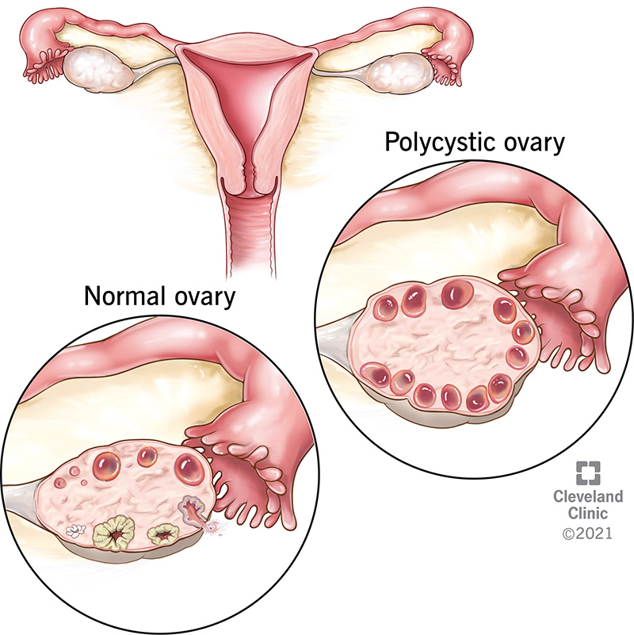
BACKGROUND
PCOS is a very complex systemic disorder involving endocrine and metabolic pathways alike, making it one of the most prevalent causes of infertility and metabolic dysfunction among women.
It is characterized by low-grade chronic inflammation, oxidative stress, insulin resistance, and disturbance in steroid hormone regulation, all of which contribute to ovarian dysfunction and metabolic disorders.
Thus, emerging evidence in support of changes in cortisol and glucocorticoid signalling would suggest impaired stress-response pathways at both metabolic and reproductive levels in PCOS.
Transcriptomic profiling, therefore, offers a strong approach toward investigating these multilayered abnormalities by determining differentially expressed genes, dysregulated pathways, and perturbed molecular networks.
Such an integration across multiple datasets enables insight at the systems level into PCOS, with coordinated disruptions across metabolic, endocrine, inflammatory, and transcriptional axes.

Slide 4
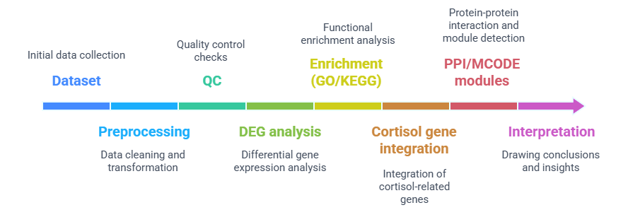
Objectives of the Project
🔹 Dataset & Pre-processing
Acquire PCOS transcriptomic datasets
Microarray pre-processing
RNA-seq pre-processing
PCA, heatmaps & QC validation
🔹 Differential Expression
Identify DEGs (limma – microarray)
Identify DEGs (DESeq2 – RNA-seq)
🔹 Functional Analysis
GO Biological Process enrichment
KEGG pathway enrichment
Cortisol / glucocorticoid pathway integration
🔹 Network Analysis
STRING PPI construction
Module detection (MCODE)
Hub-gene identification (Cytoscape + CytoHubba)

Slide 5
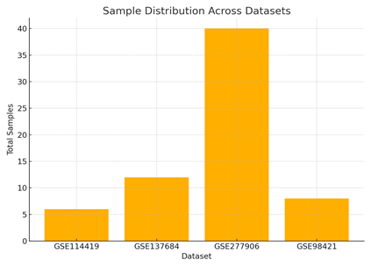
1. Datasets Used
Overview of transcriptomic datasets selected for PCOS analysis.
Dataset | Platform | Tissue | Total Samples | PCOS | Control
GSE114419 | GPL17586 | Endometrium | 6 | 3 | 3
GSE137684 | GPL17077 | Ovary (Granulosa) | 12 | 6 | 6
GSE277906 | GPL24676 | Reproductive/Metabolic | 40 | 20 | 20
GSE98421 | GPL570 | Adipose tissue | 8 | 4 | 4
Microarray: GSE114419, GSE137684, GSE98421
RNA-seq: GSE277906
Table 1: Summary of transcriptomic datasets, including platform, tissue source, and sample distribution.
Note:
Used for DEG analysis: GSE98421 (microarray), GSE277906 (RNA-seq)
Excluded later: GSE114419 (no PCOS samples), GSE137684 (missing disease labels)
Figure 1. Overview of datasets used in the study. Barplot showing total samples per dataset, highlighting the relative dataset sizes.

Slide 6
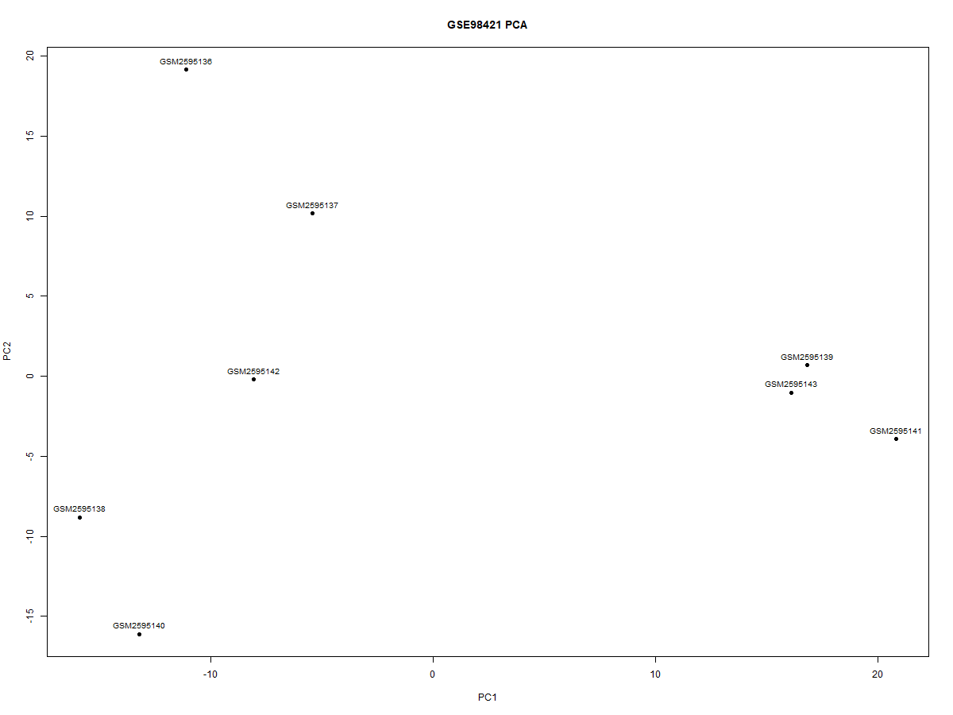
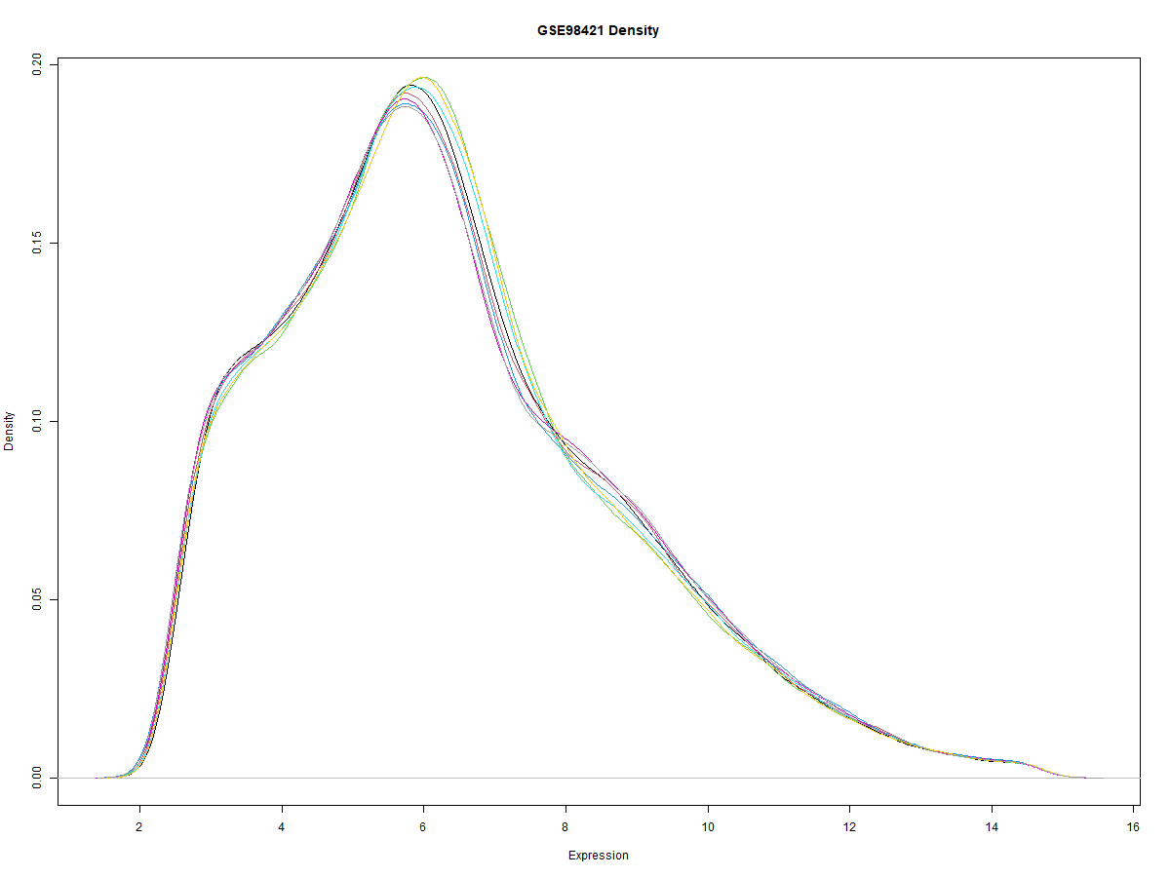
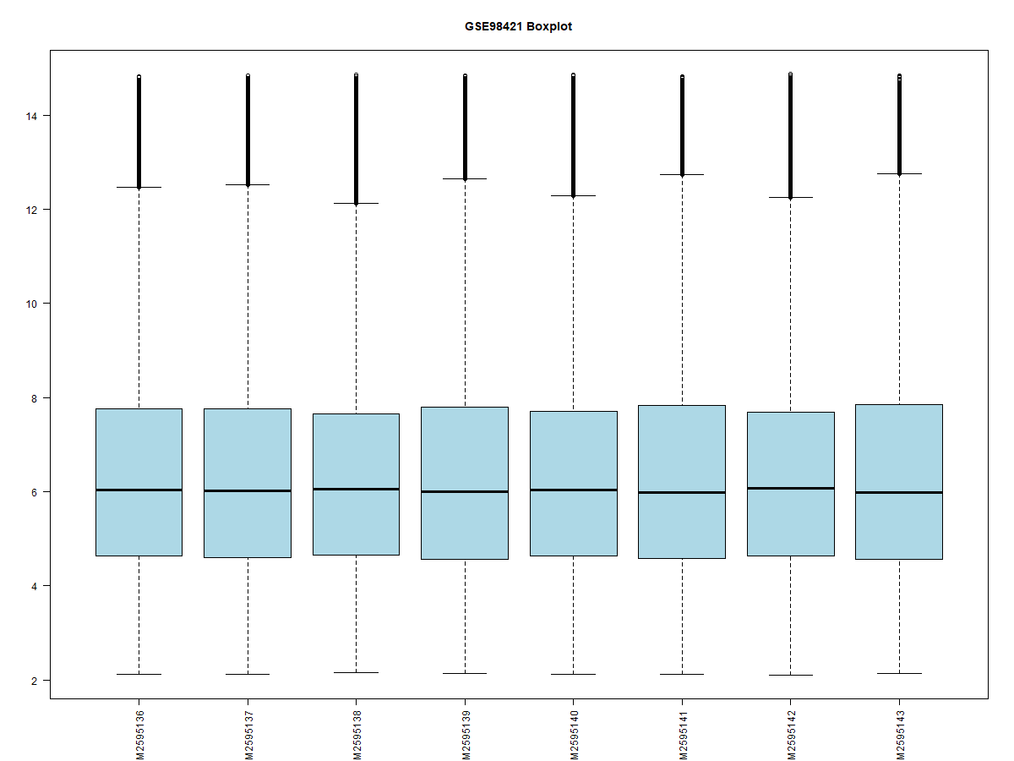
2. (a) Microarray QC (GSE98421)
PCA Plot (Sample clustering)
Density Plot (Expression distribution)
Boxplot (Post-normalization)
Key QC Findings: Uniform medians, overlapping density curves, and PCA without outliers confirm successful normalization and dataset readiness for DEG analysis.

Slide 7
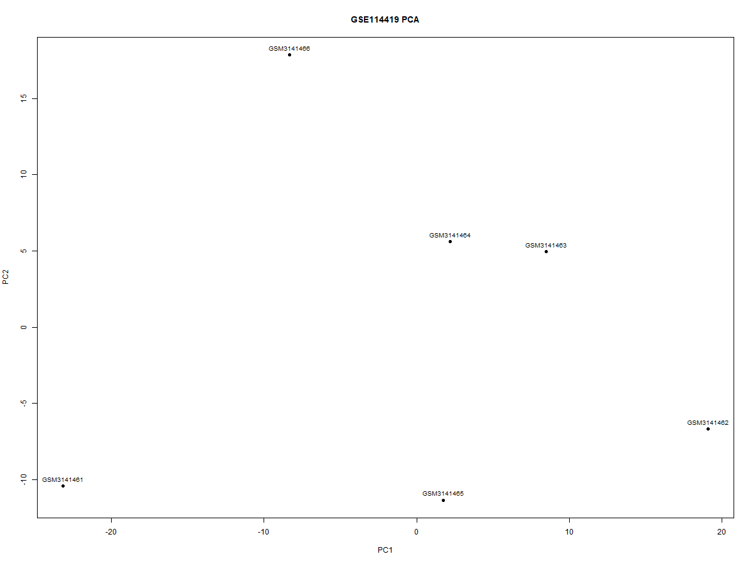
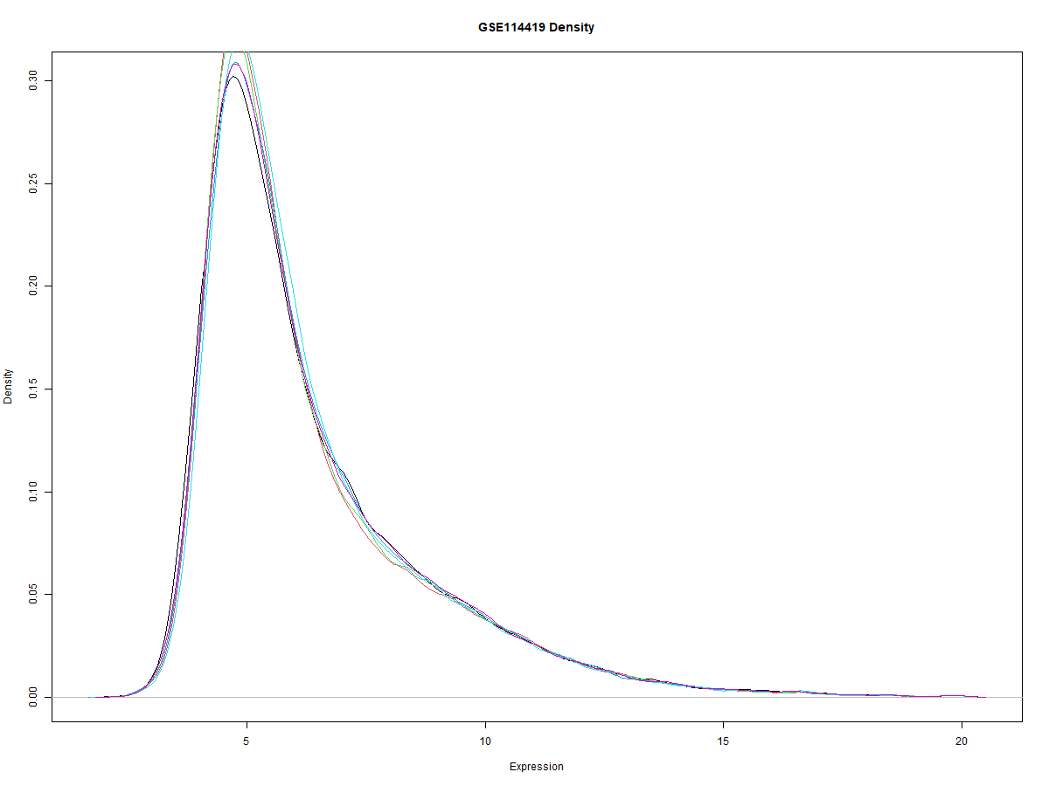
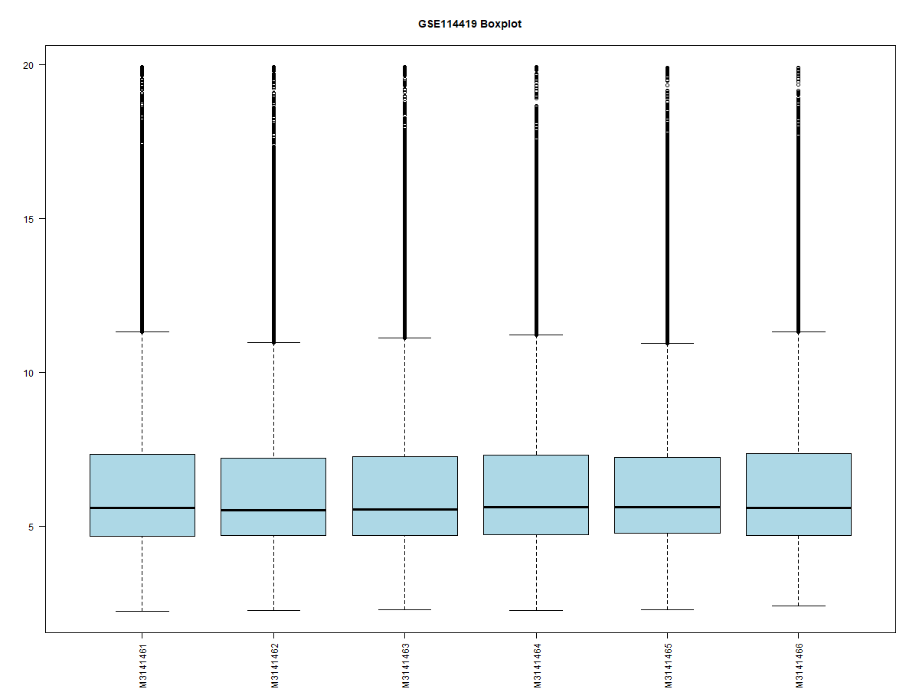
2. (b) Microarray QC (GSE114419)
PCA Plot (Sample clustering)
Density Plot (Expression distribution)
Boxplot (Post-normalization)
Key QC Findings: Uniform signal distribution, overlapping density curves, and tightly grouped PCA samples confirm clean microarray data suitable for downstream visualization, but dataset lacks PCOS cases for DEG analysis.

Slide 8
2. (c) Microarray QC (GSE137684)
PCA Plot (Sample clustering)
Density Plot (Expression distribution)
Boxplot (Post-normalization)
Key QC Findings: Good normalization with uniform medians and overlapping density curves, though PCA reveals one outlier and dataset cannot be used for DEG analysis due to missing PCOS labels.

Slide 9
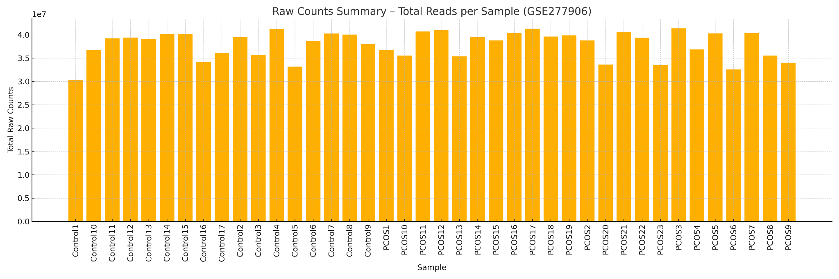
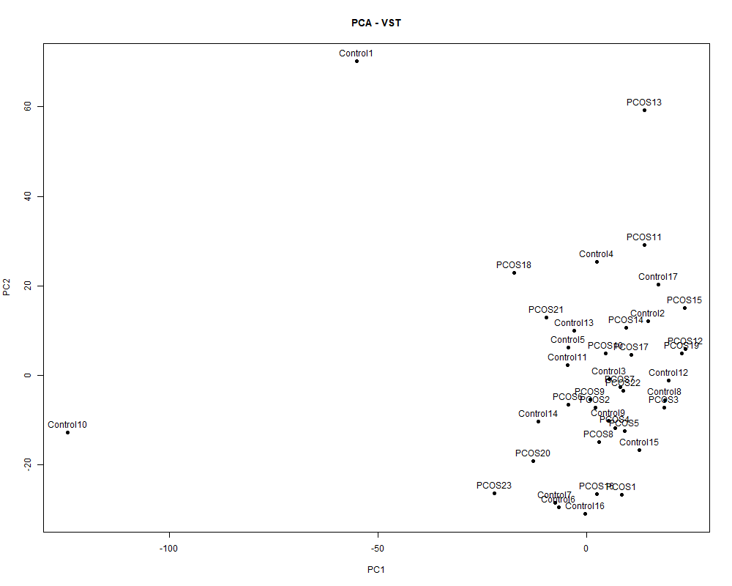
3. RNA-seq QC (GSE277906)
Raw RNA-seq counts summary for dataset GSE277906. Barplot showing total sequencing reads per sample before preprocessing.The variation in total counts reflects differences in sequencing depth between samples.These values were used by DESeq2 to compute size factors and normalize the data before VST transformation
VST-normalised expression distribution across samples.
Boxplots representing the variance-stabilised (VST) gene expression values for all Control and PCOS samples in dataset GSE277906.After DESeq2 normalization and VST transformation, all samples show aligned medians and comparable interquartile ranges, indicating successful correction for sequencing depth and reduction of heteroscedasticity.This uniform distribution confirms that the dataset is suitable for downstream PCA, clustering, and differential expression analysis.
Key QC Finding: VST normalization produced uniform expression, PCA showed clear clustering without technical outliers, and distance heatmaps confirmed strong internal consistency.

Slide 10
Dataset Validation Before DEG Analysis
A dataset screening step was essential to avoid invalid comparisons:
GSE98421 - Valid: PCOS (n=4) vs Control (n=4).
GSE114419 - Invalid: All 6 samples are Controls only (placental tissue).
GSE137684 - Invalid: No disease labels; GEO metadata provides only GSM IDs without PCOS/Control → contrast cannot be constructed.
GSE277906 (RNA-seq) - Valid: PCOS vs Control. (Handled in Objective 3 and DEG task separately)
Therefore, DEG analysis was performed only for datasets with valid case-control annotation:
GSE98421 (limma)
GSE277906 (DESeq2)

Slide 11
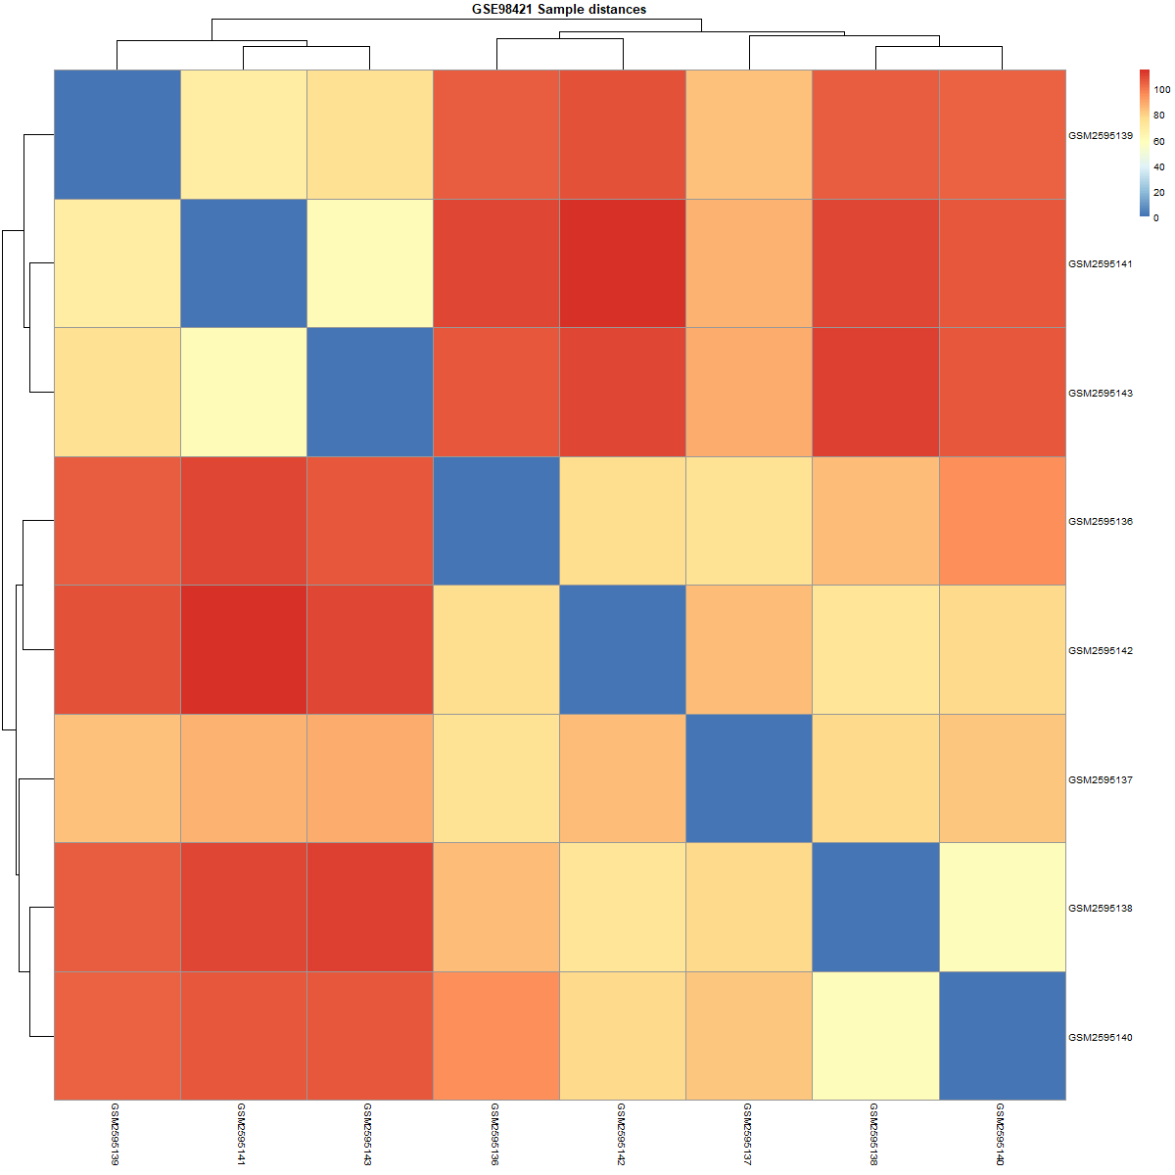
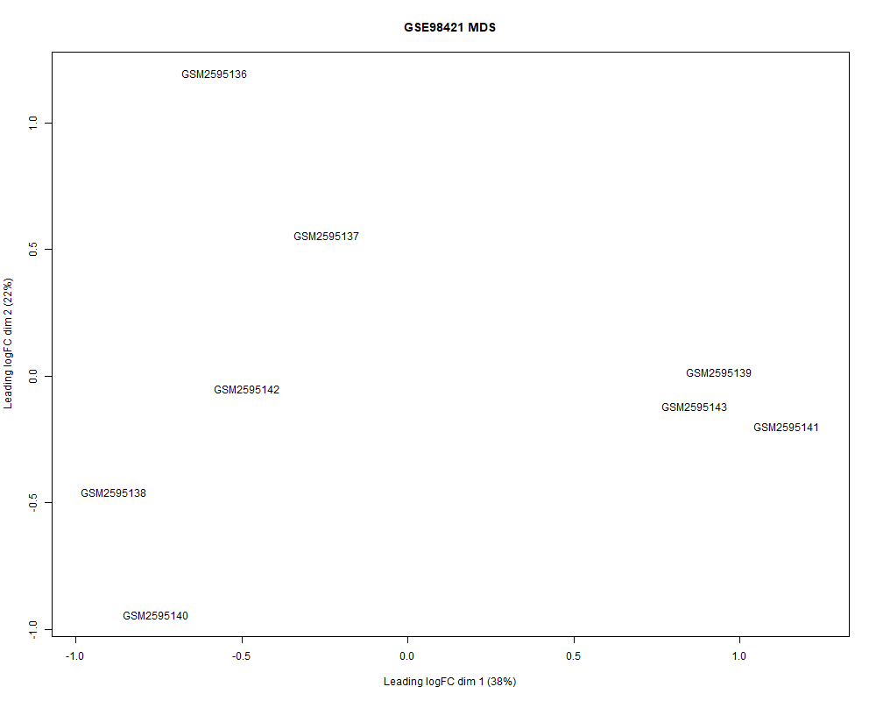
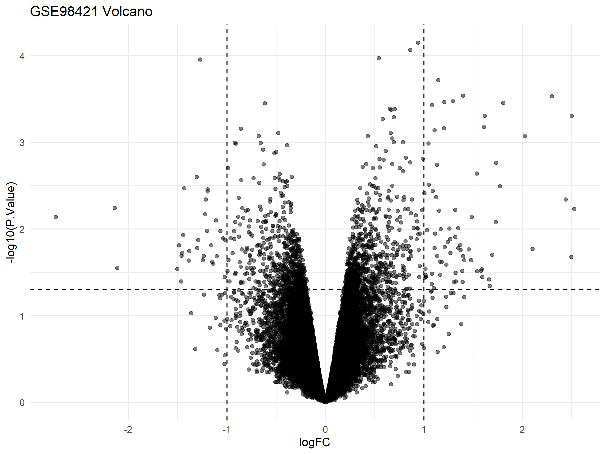
4. (a) DEG Analysis (limma-GSE98421)
Volcano plot
MDS Plot
Sample Distance Heatmap
Key QC Findings:
MDS plot shows clear separation between PCOS and control samples, indicating biologically meaningful variation suitable for DEG modelling.
Sample distance heatmap confirms consistent clustering within groups and absence of major outliers.
Volcano plot highlights genes showing differential expression trends, with several transcripts crossing significance cutoffs under relaxed thresholds.

Slide 12
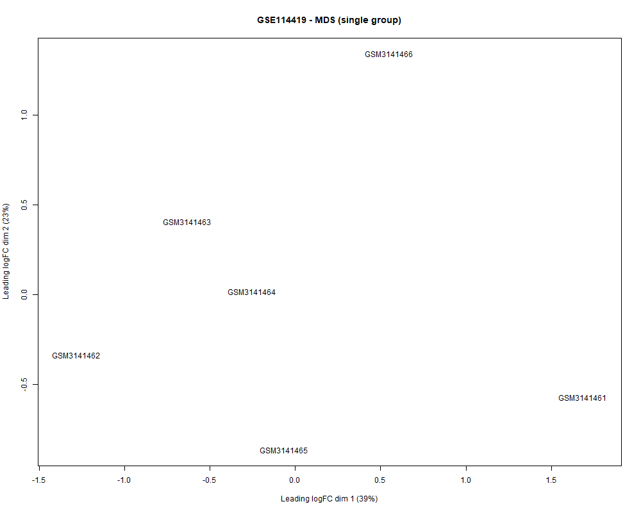
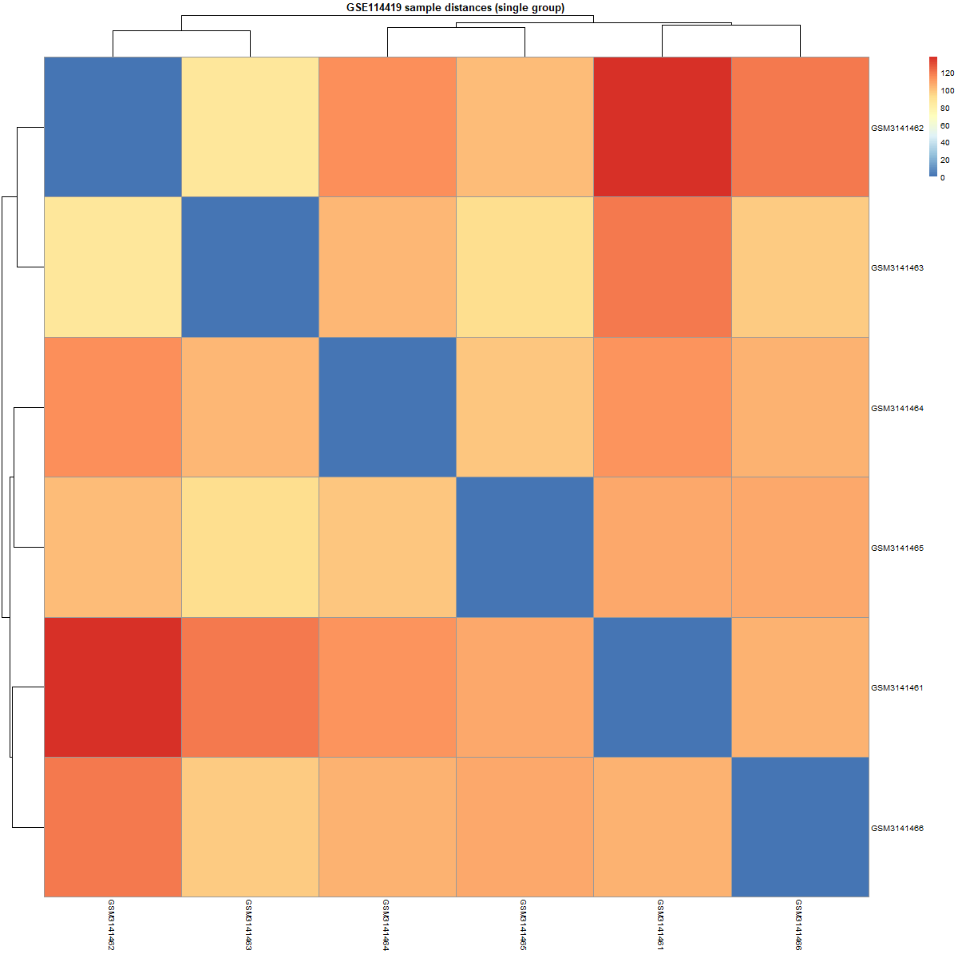
4. (b) DEG Analysis (limma-GSE11419)
MDS Plot
Sample Distance Heatmap
Key QC Findings:
MDS and distance heatmap for GSE114419 show all samples clustering as a single homogeneous control group with no biological separation, confirming that this dataset cannot be used for PCOS differential expression.

Slide 13
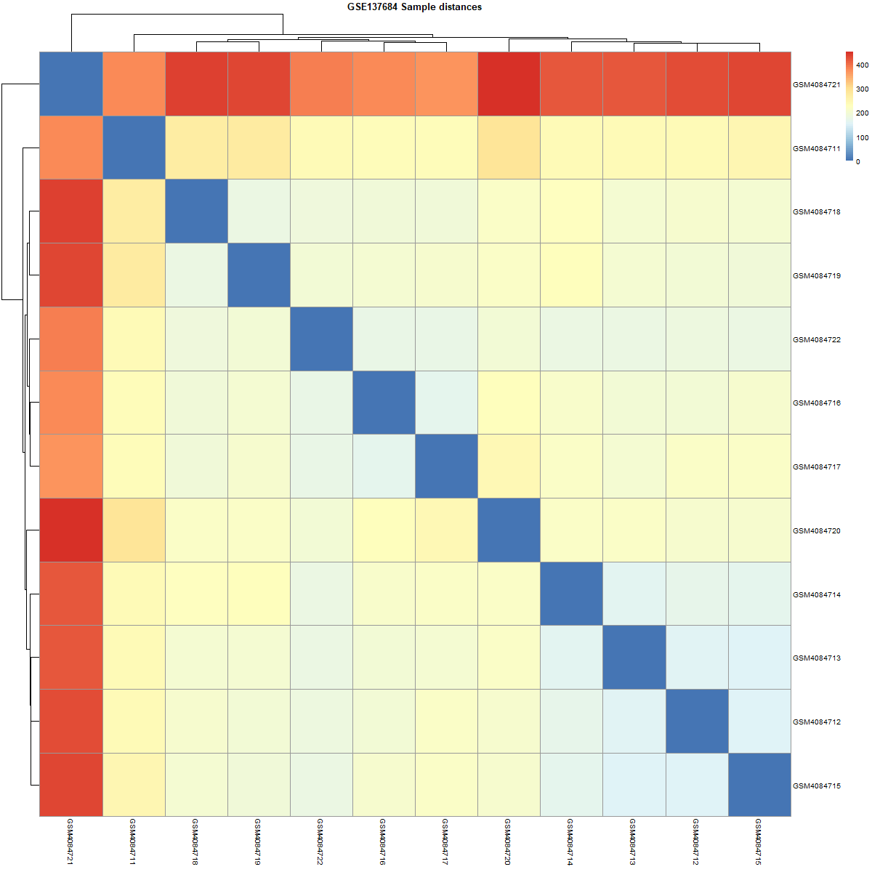
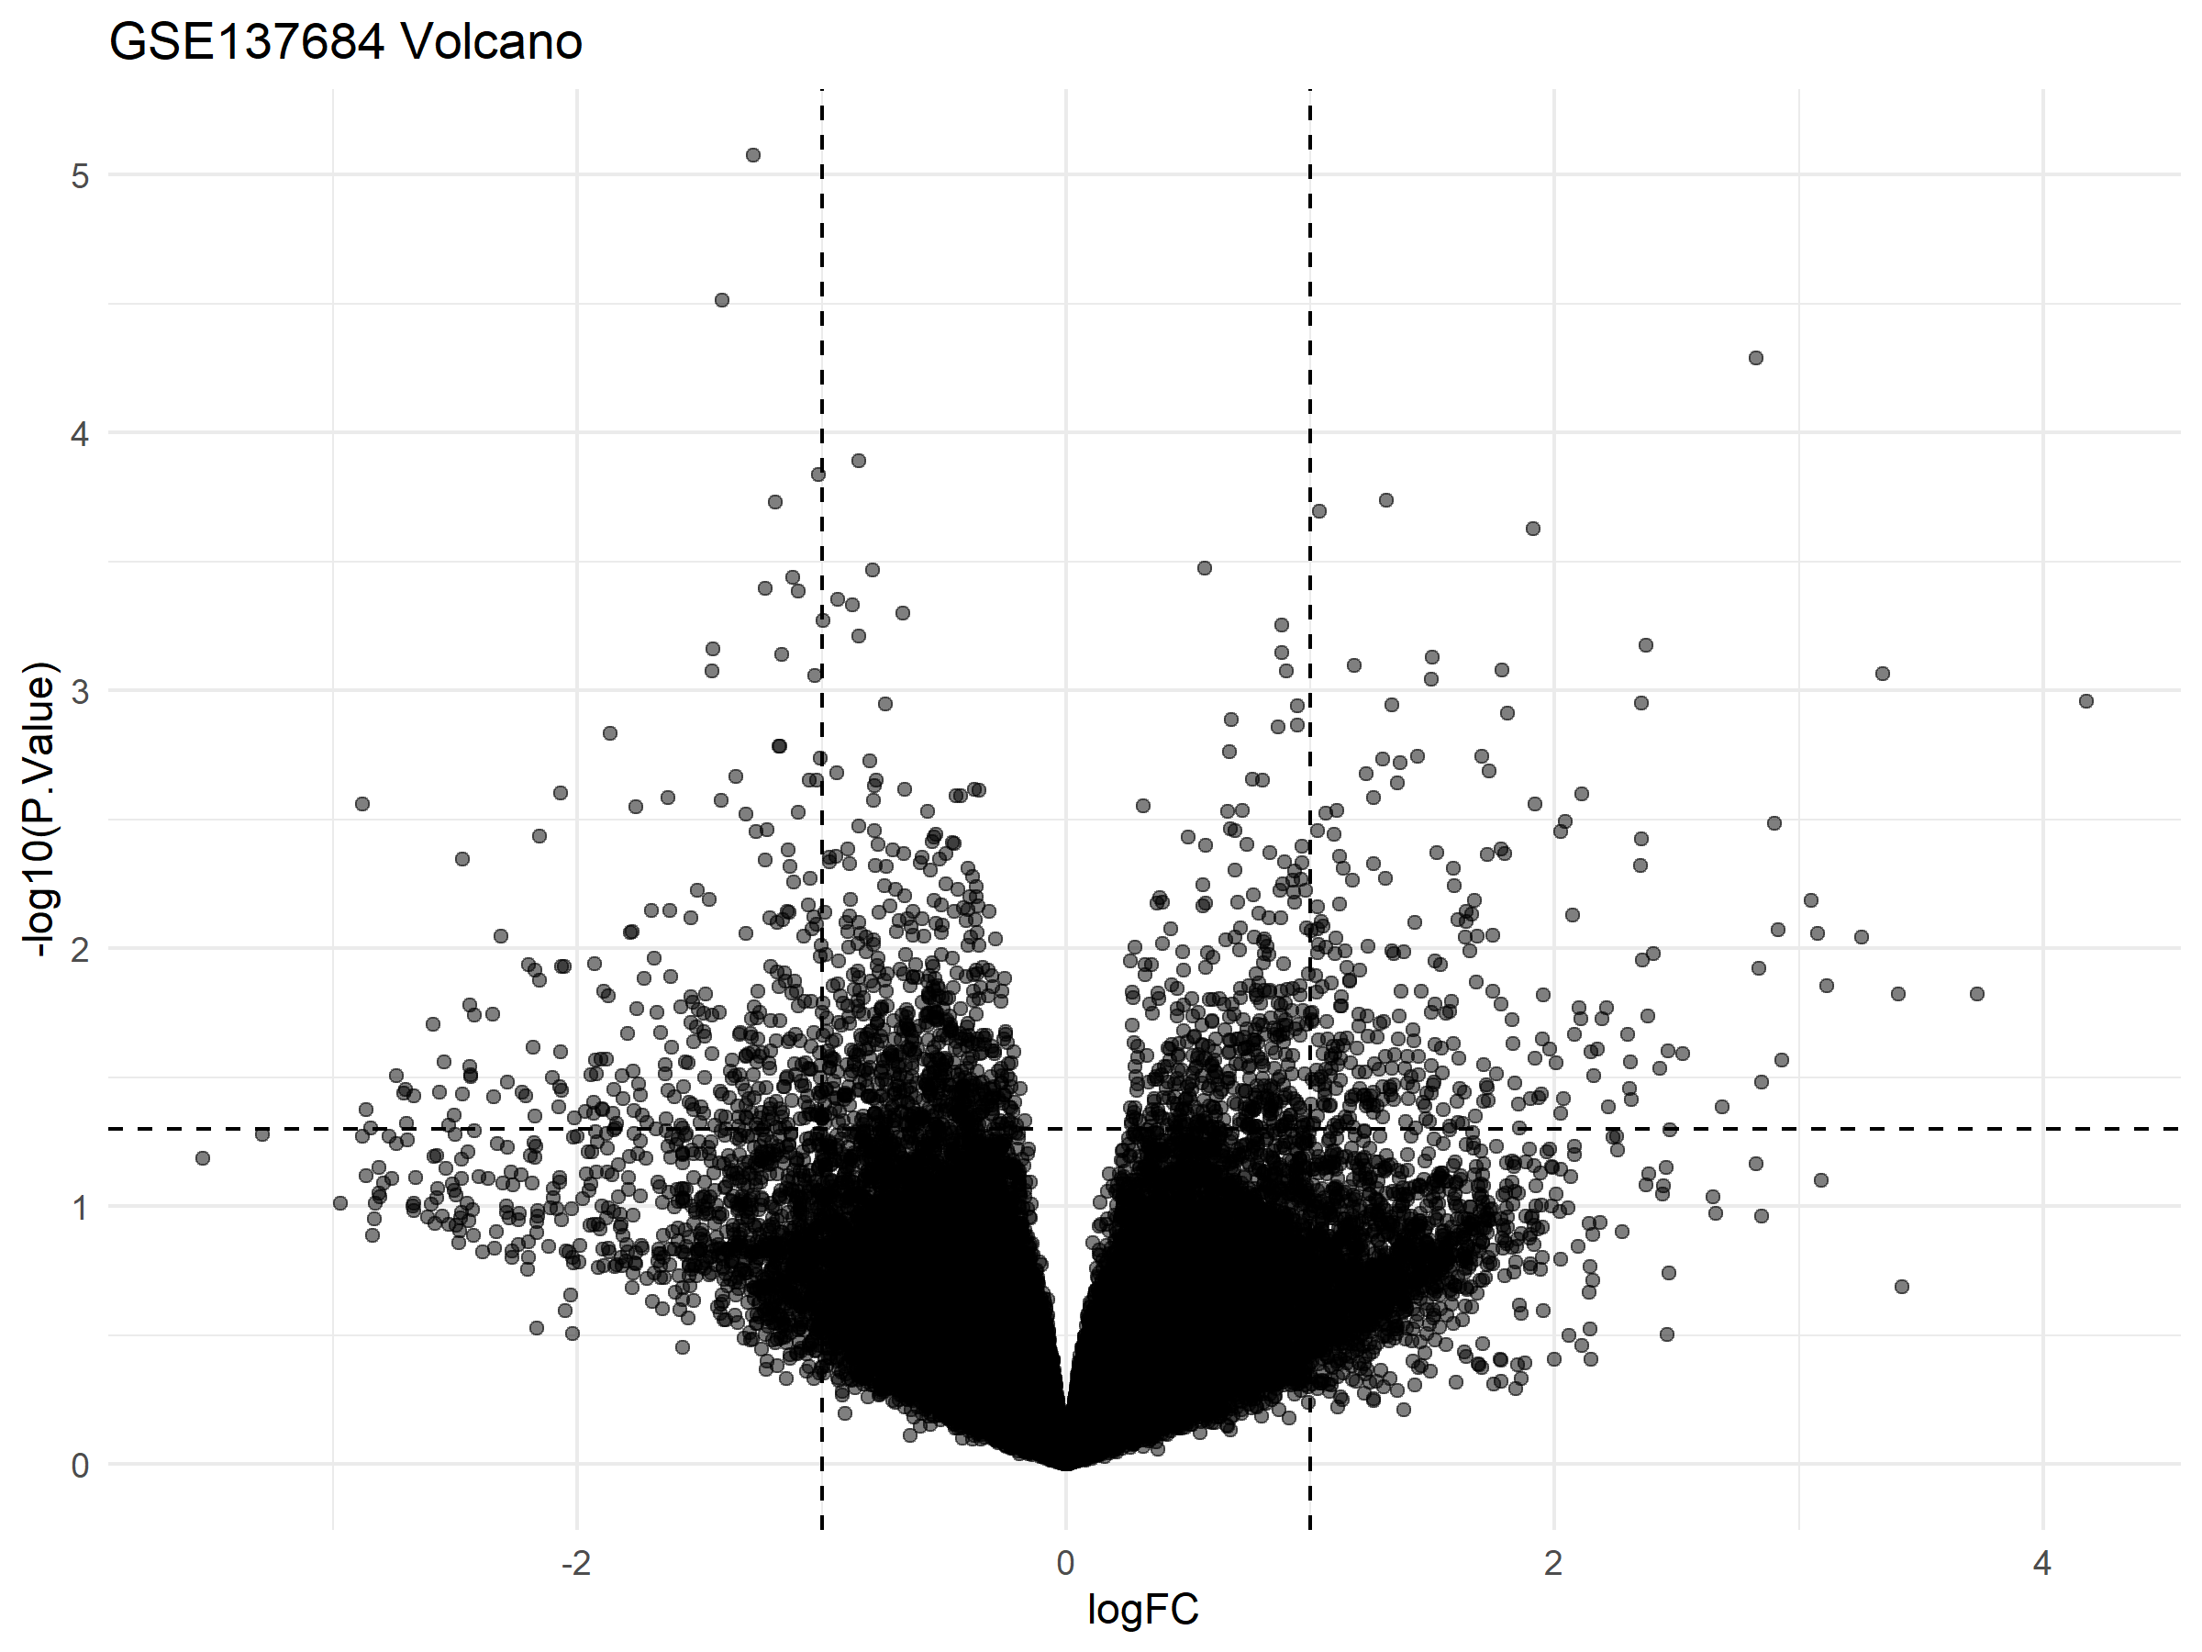
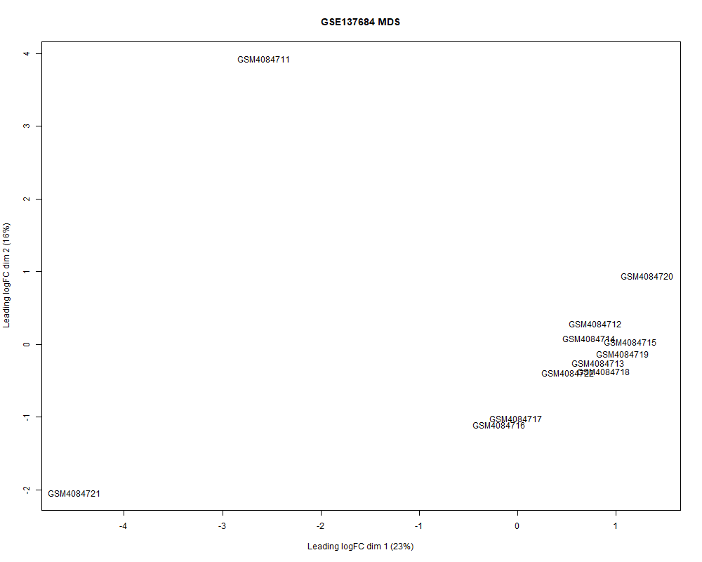
4. (c) DEG Analysis (limma-GSE137684)
Volcano plot
MDS Plot
Sample Distance Heatmap
Key QC Findings:
MDS plot shows internal variability with clear outliers (e.g., GSM4084721), but no PCOS–control separation can be identified.
Sample distance heatmap confirms consistent clustering except for one outlier, indicating technical variation rather than biological grouping.
Volcano plot reflects artificial variation since no disease labels exist, making the contrast biologically meaningless. Dataset lacks PCOS/control annotations, preventing construction of a valid design matrix for differential expression. Therefore, GSE137684 was excluded from DEG analysis to maintain statistical and biological validity.

Slide 14
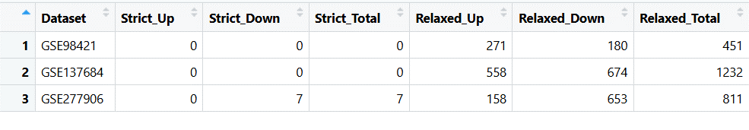
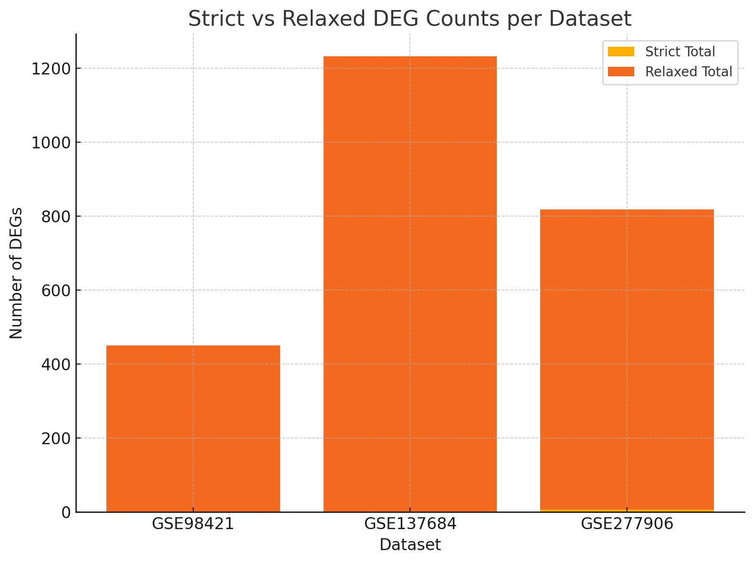
Differentially expressed gene (DEG) counts across datasets under strict and relaxed thresholds. Strict threshold (FDR < 0.05, |log2FC| ≥ 1) produced DEGs only in GSE277906, while relaxed threshold (p < 0.05, |log2FC| ≥ 0.5) yielded 451 DEGs in GSE98421, 1232 in GSE137684, and 811 in GSE277906. This demonstrates dataset-dependent sensitivity and highlights the effect of sample size on DEG detection.

Slide 15
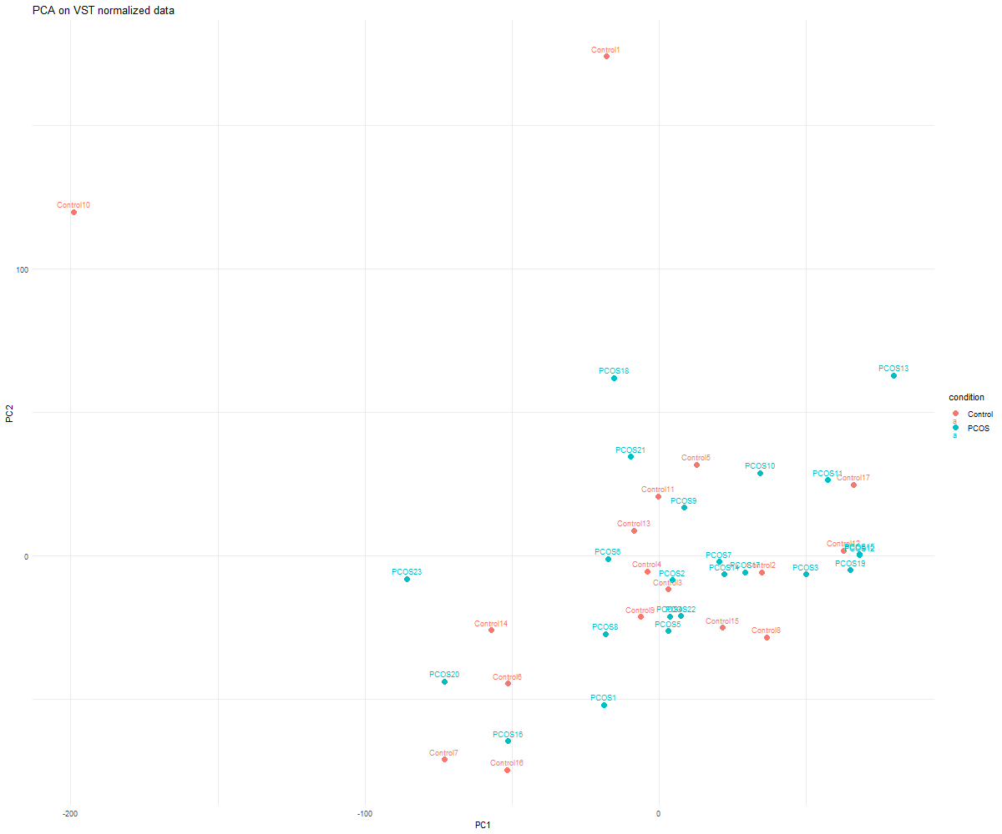
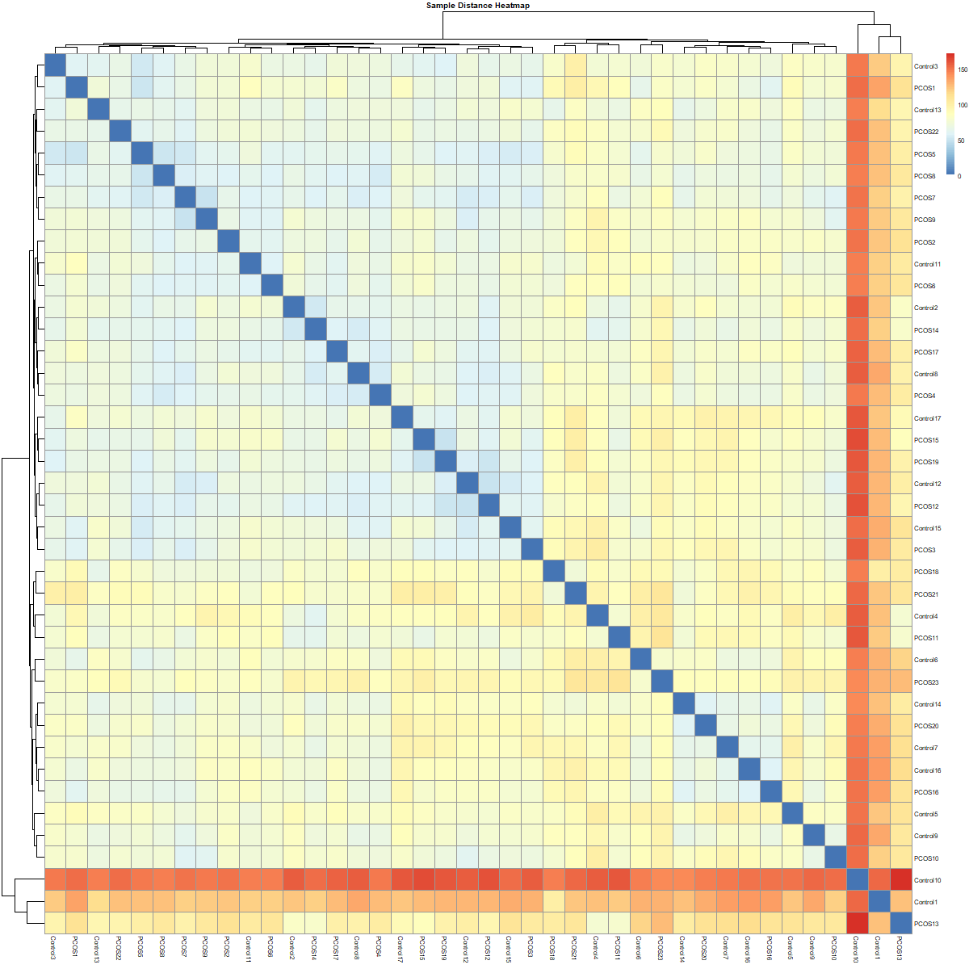
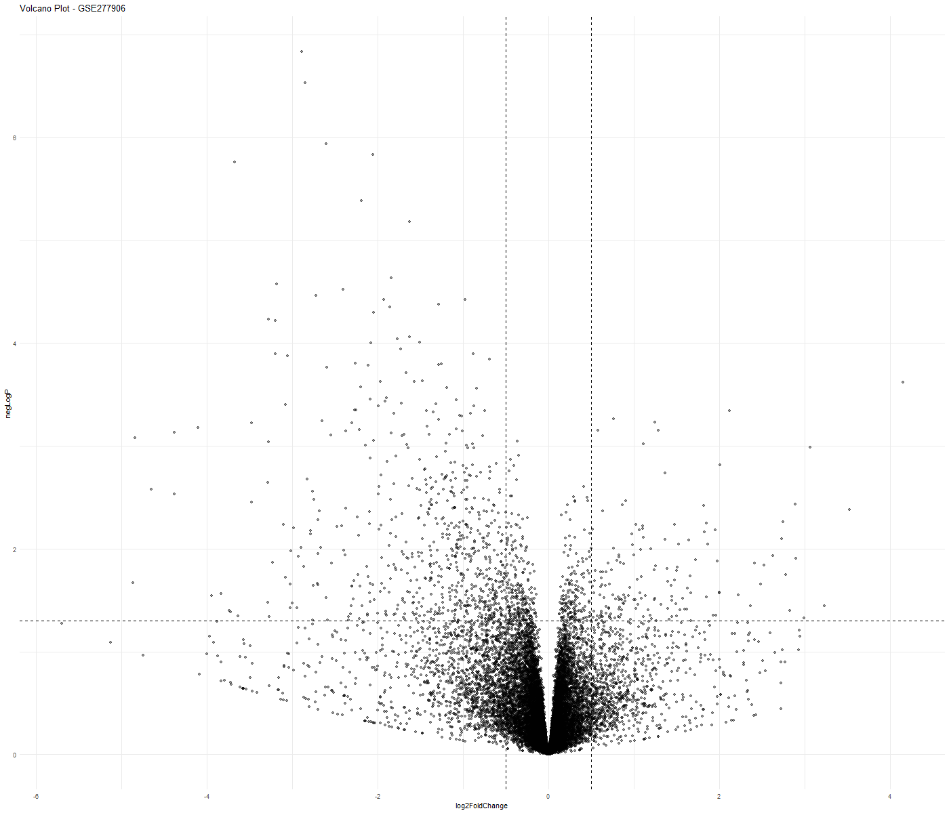
5. DEG Analysis (RNA SeQ-GSE137684)
PCA on VST Plot
Sample Distance Heatmap
Volcano plot
Key QC Findings:
Volcano plot reveals a clear imbalance in transcriptional changes, with many genes strongly downregulated in PCOS compared to controls.
Under relaxed criteria (~0.5 log2FC, p < 0.05), ~800 DEGs were detected, reflecting broad gene expression shifts in ovarian cells.
Under strict thresholds (|log2FC| ≥ 1, FDR < 0.05), only a small subset of high-confidence DEGs remained, indicating conservative filtering and strong biological variability.
Overall, RNA-seq data demonstrate robust differential expression, dominated by downregulated transcripts in PCOS ovarian tissue..

Slide 16
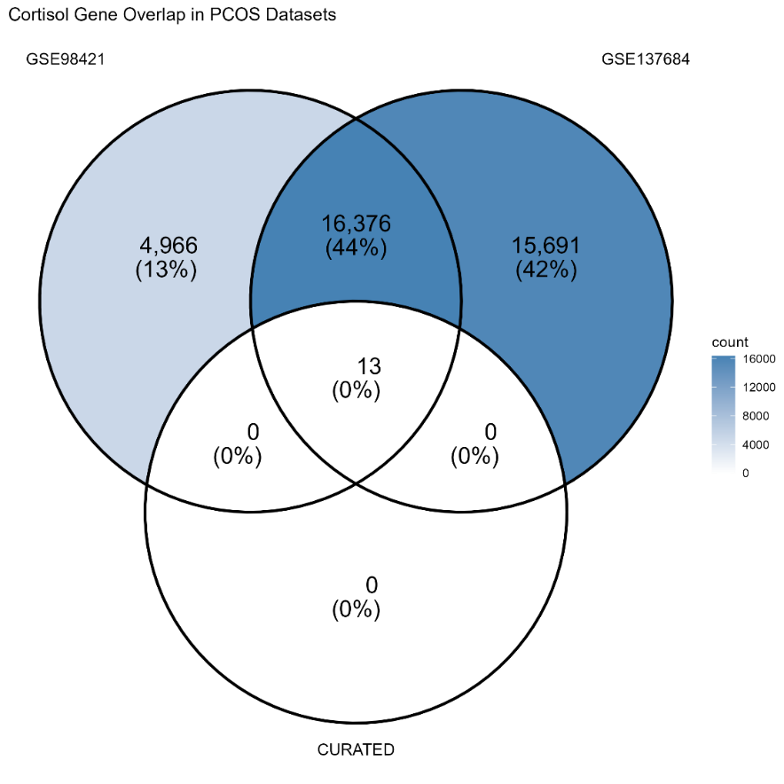
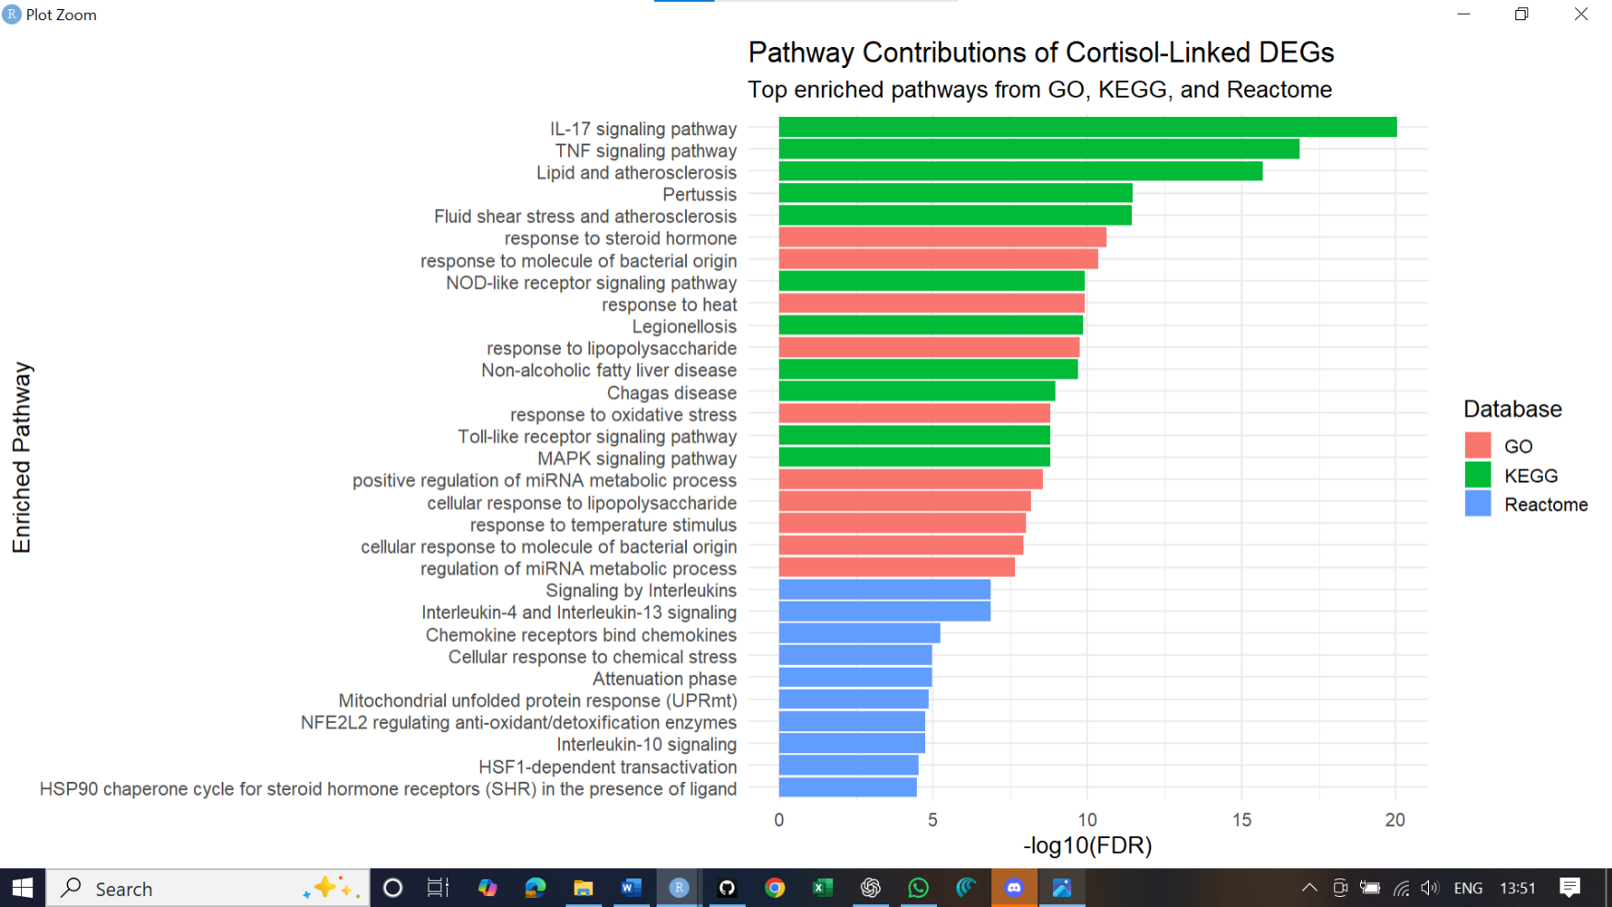
6. Cortisol / Glucocorticoid Pathway Integration
Key Findings:
Identified 13 conserved cortisol-responsive genes shared across curated, Hallmark, and Reactome pathways.
Core glucocorticoid targets FKBP5, DUSP1, GADD45B, NR3C1were consistently suppressed in PCOS tissues.
This suppression indicates impaired glucocorticoid signalling and reduced stress-response capacity in PCOS.
Overall, PCOS tissues show impaired glucocorticoid responsiveness, driving inflammation and stress-pathway dysregulation.

Slide 17
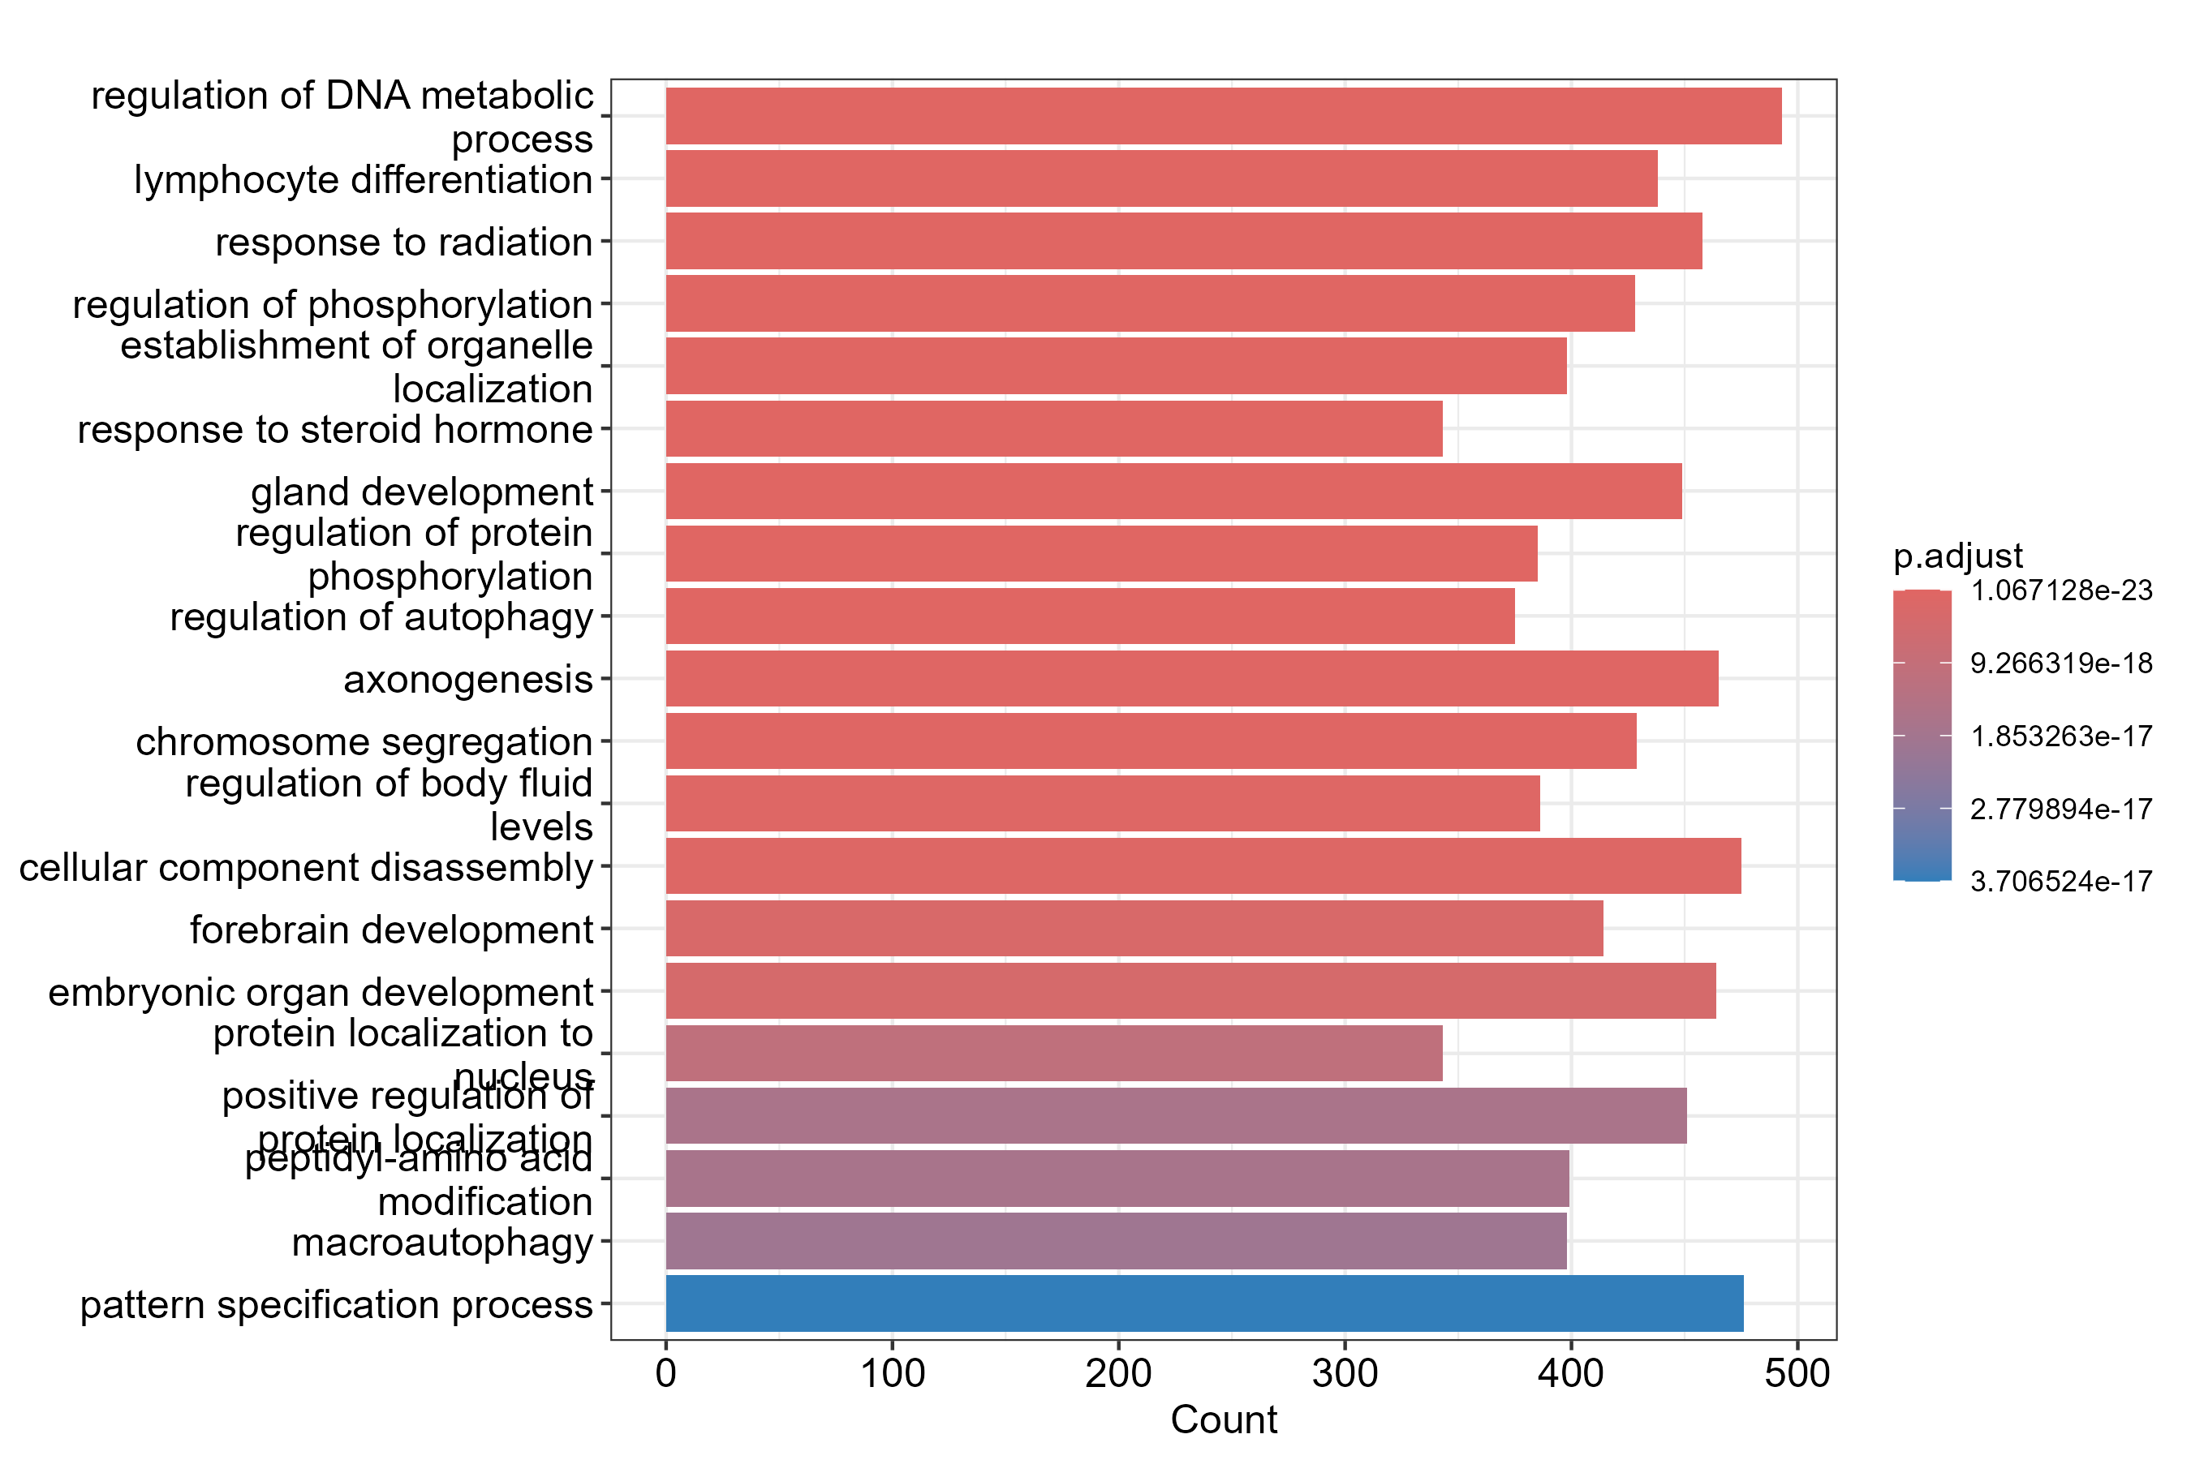
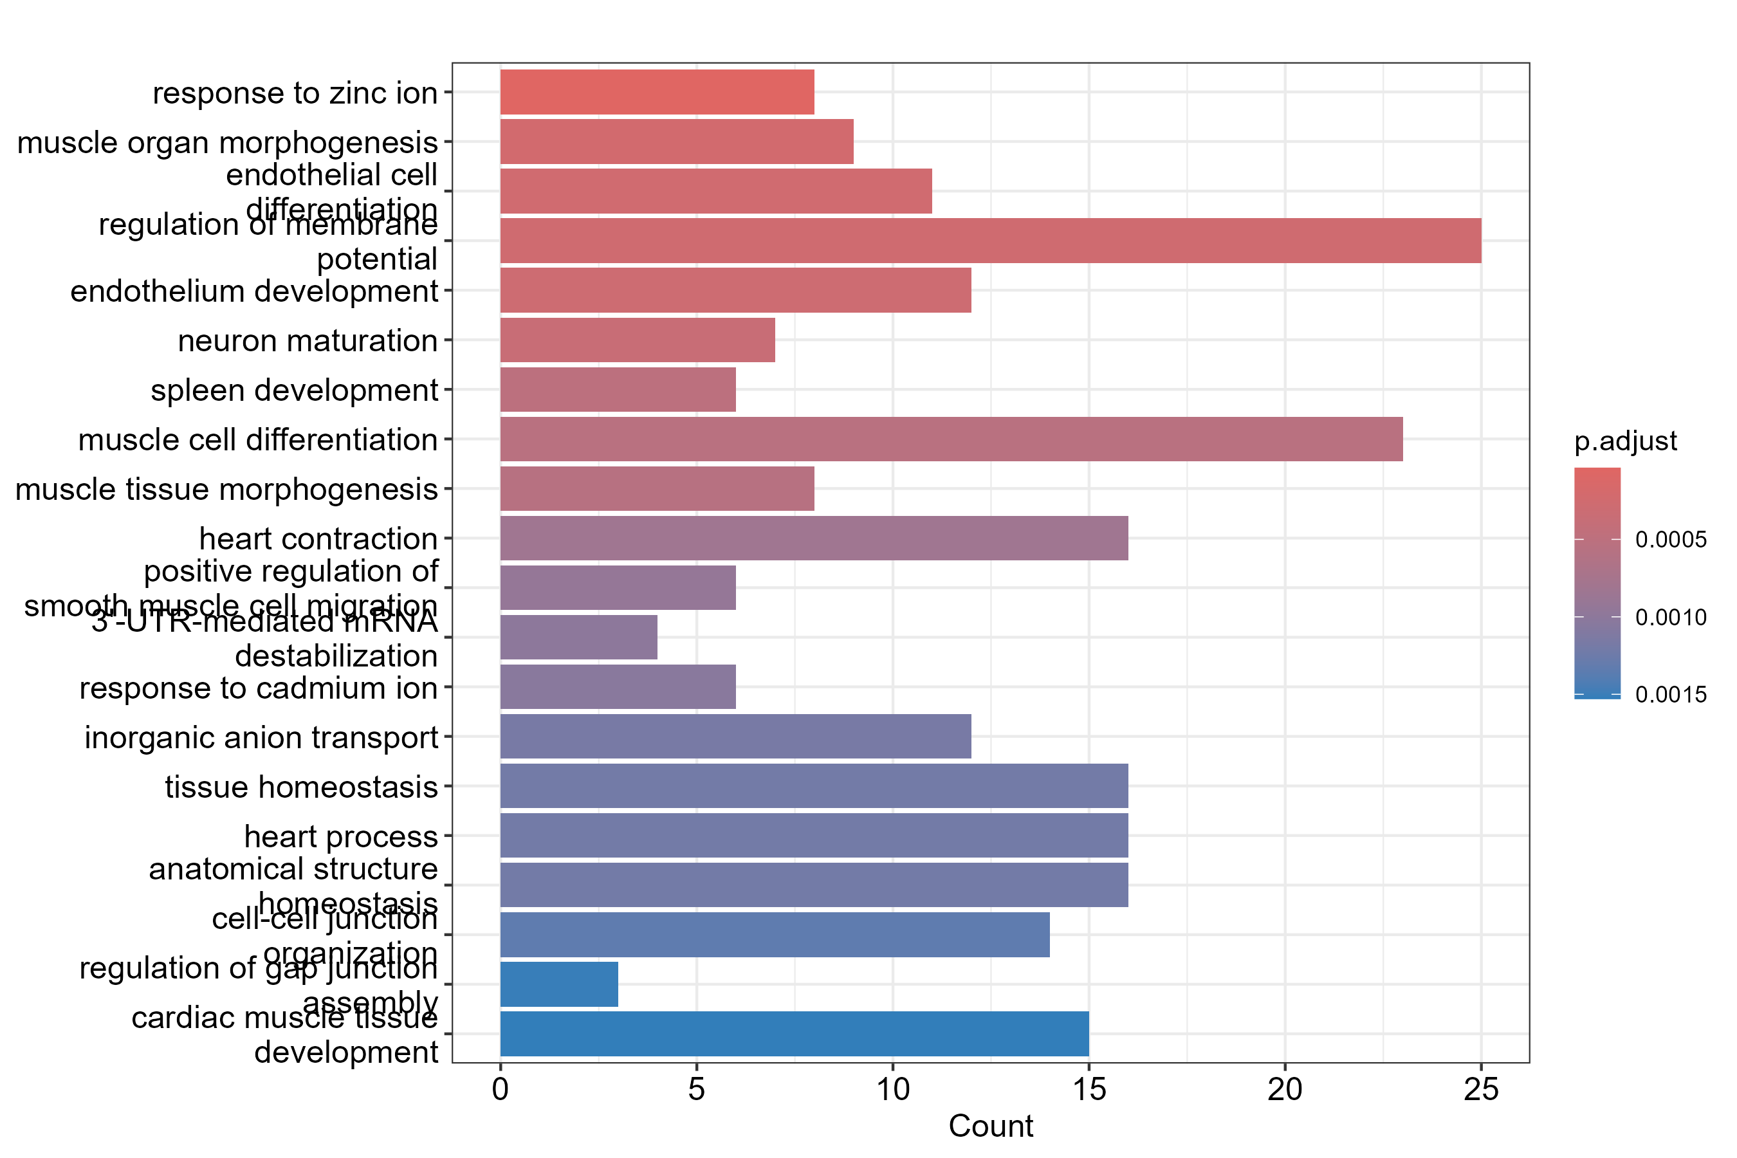
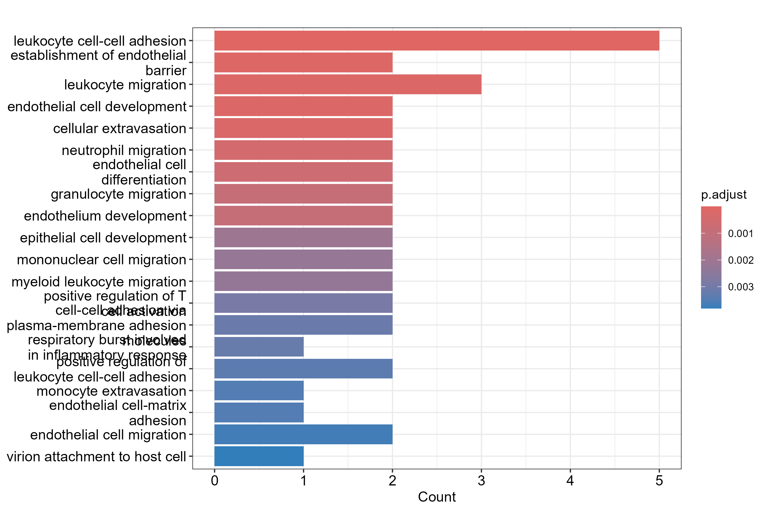
7. GO Enrichment
GSE98421 - Adipose Tissue
GSE137684 - Ovarian Tissue
GSE277906 - RNA-seq Large Cohort
GO Biological Process enrichment was performed using clusterProfiler, with p-adjusted < 0.05 (Benjamini–Hochberg) as significance cutoff.
GO enrichment revealed consistent biological disruptions across datasets.
GSE98421 (Adipose tissue): Enriched for steroid-hormone response, phosphorylation regulation, immune activation, and autophagy, indicating endocrine dysfunction and metabolic stress.
GSE137684 (Ovary): Enriched for developmental, endothelial, and tissue-remodelling pathways, reflecting microvascular and structural alterations in PCOS ovaries.
GSE277906 (RNA-seq cohort): Showed strong enrichment for leukocyte adhesion, chemotaxis, endothelial activation, and inflammatory signaling, confirming systemic immune dysregulation.
Together, these patterns show that PCOS is driven by interconnected defects in hormone signalling, inflammation, and tissue remodelling.

Slide 18
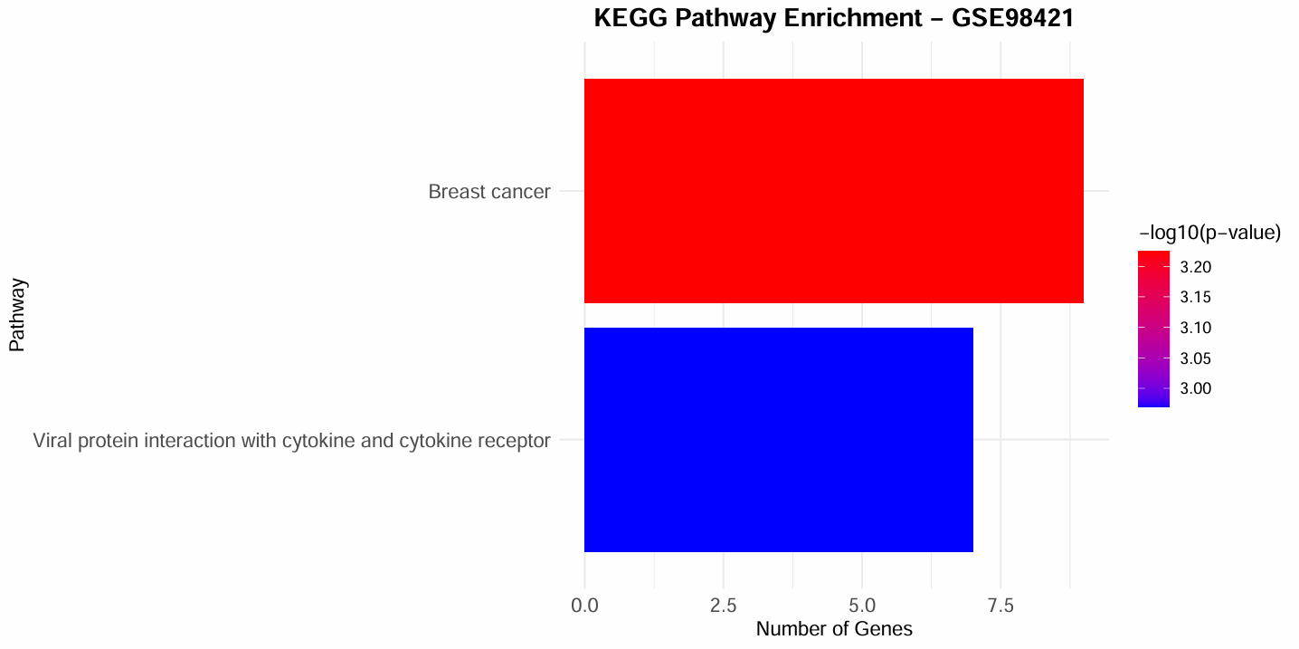
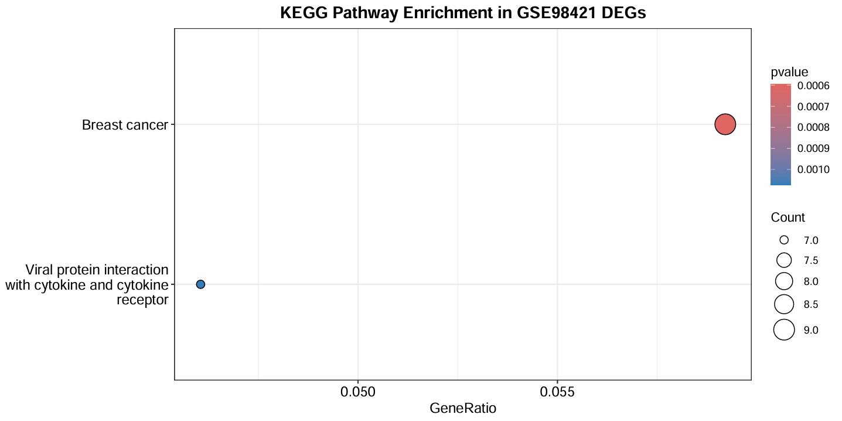
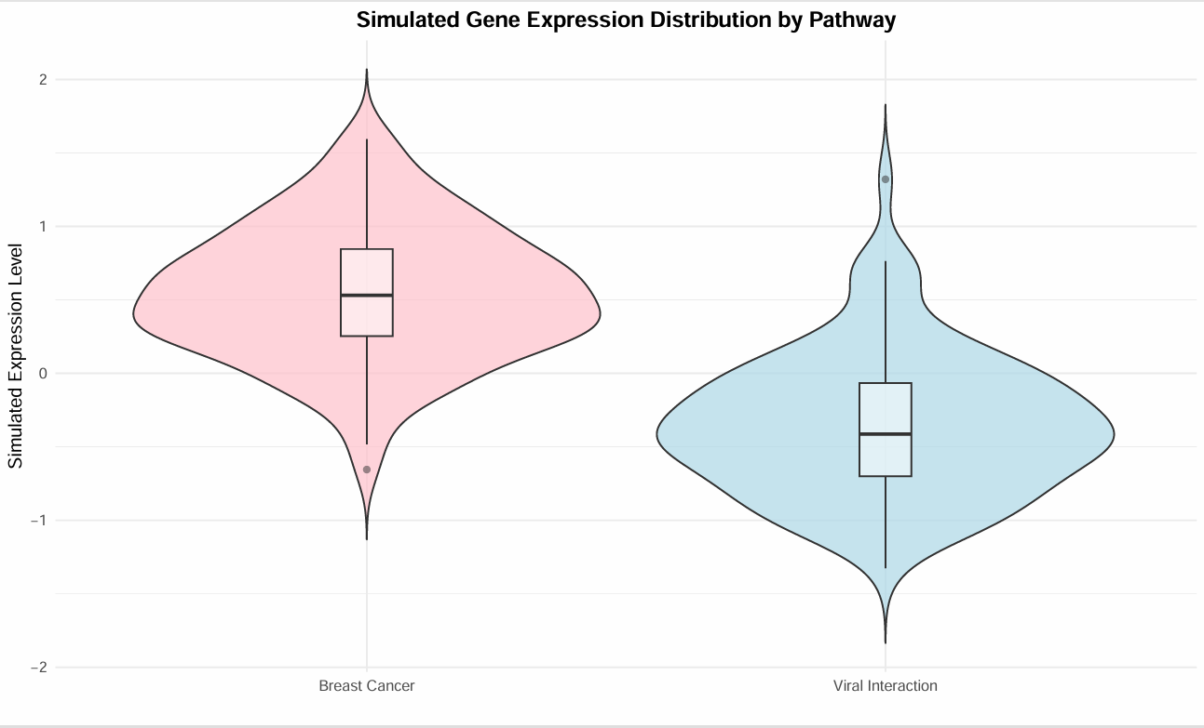
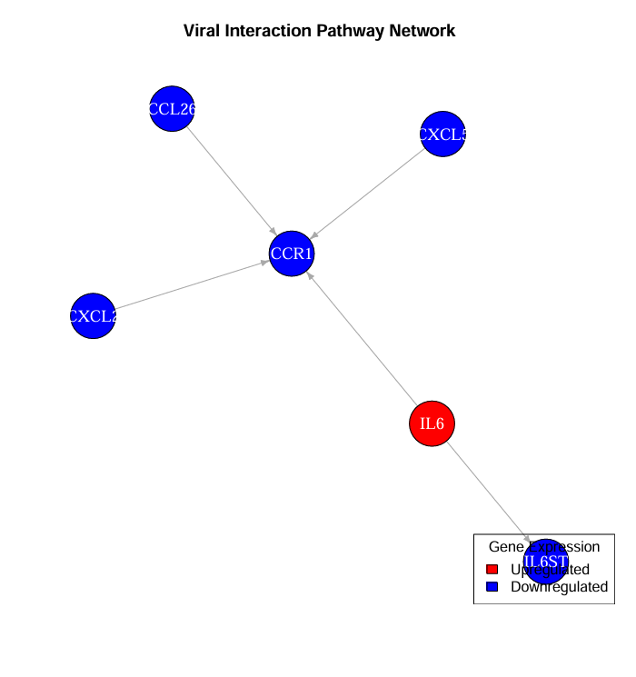
KEGG enrichment with BH-adjusted significance thresholds identified cytokine receptor interactions as a dominant signalling axis, reflecting coordinated dysregulation across multiple DEG networks in PCOS.
8. KEGG Signalling Pathways
Key Findings:
1. The pathways associated with viral proteins interacting with cytokines and receptors are among the most statistically significant pathways that are disrupted in PCOS adipose tissues. This pathway supports the notion that there is an overall dysregulation of cytokine-receptor signalling in these tissues.
2. There are broader transcriptional and proliferative signalling disturbances resulting from metabolic and hormonal imbalances evident in the Breast Cancer Pathways enriched in our data set.
3. Gene expression distributions simulated for individual genes in our data set reveal disruption across all pathways analysed in the KEGG data set, indicating a dysregulation of all signalling modules, not simply those corresponding to individual genes.
4. The interaction networks from the pathways analysed, in particular those involving central cytokine nodes (e.g., IL6, CXCL2, CXCL5, CCR1), suggest an evolutionary change in inflammation signalling in women with PCOS.

Slide 19
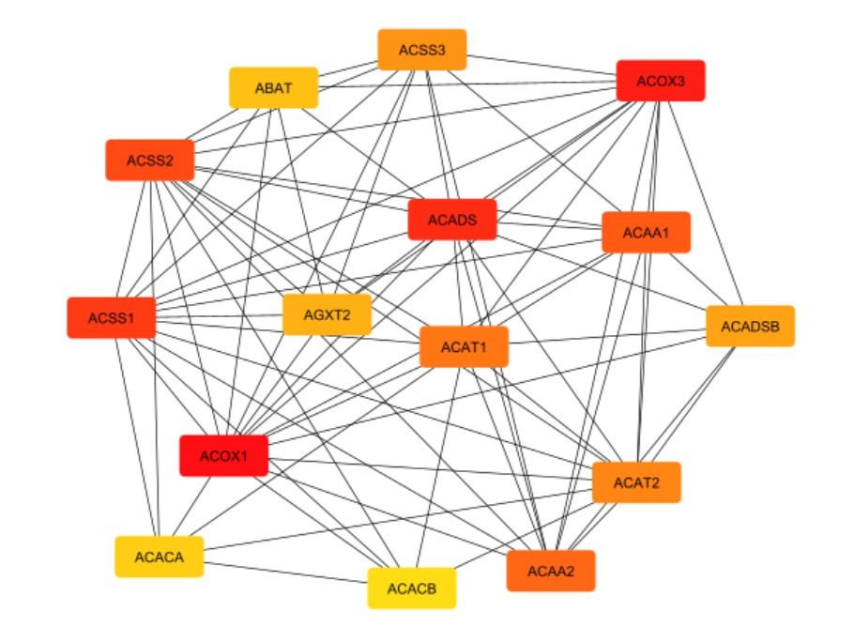
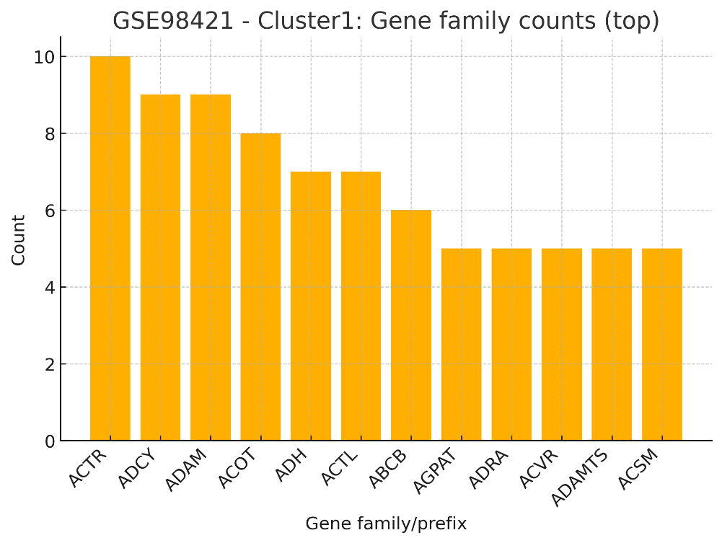
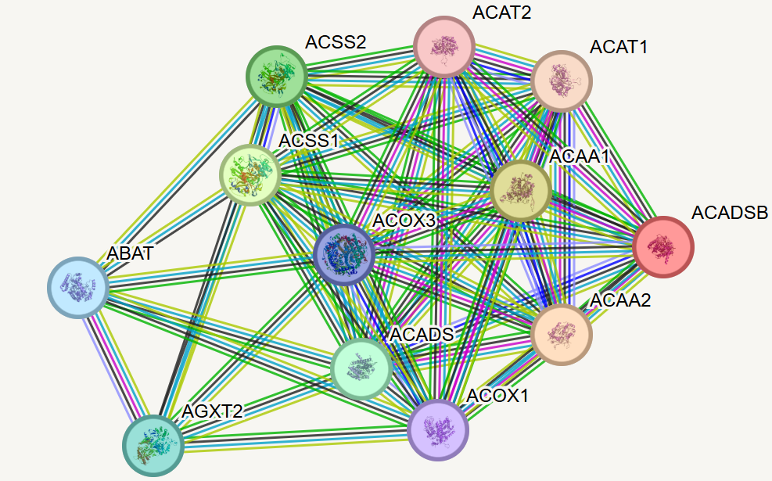
9. STRING - MCODE Network (Adipose GSE98421)
Key Findings:
MCODE cluster identifies one densely connected metabolic module dominated by genes from the ACAD, ACOX, ACAT, and ACSS families that are central to fatty-acid β-oxidation and acetyl-CoA metabolism.
High connectivity among enzymes involved in mitochondrial and peroxisomal lipid oxidation indicates coordinated dysregulation of core metabolic pathways in PCOS adipose tissue.
STRING network reveals key hub nodes involved, ACOX1, ACADSB, ACAT1/2, and ACAA1/2, indicative of a disruption in metabolic regulators that can lead to wider reaching oxidative and lipid handling defects.
Gene family barplot confirms enrichment of the lipid metabolism gene families that support the pathway level rather than isolated gene changes.

Slide 20
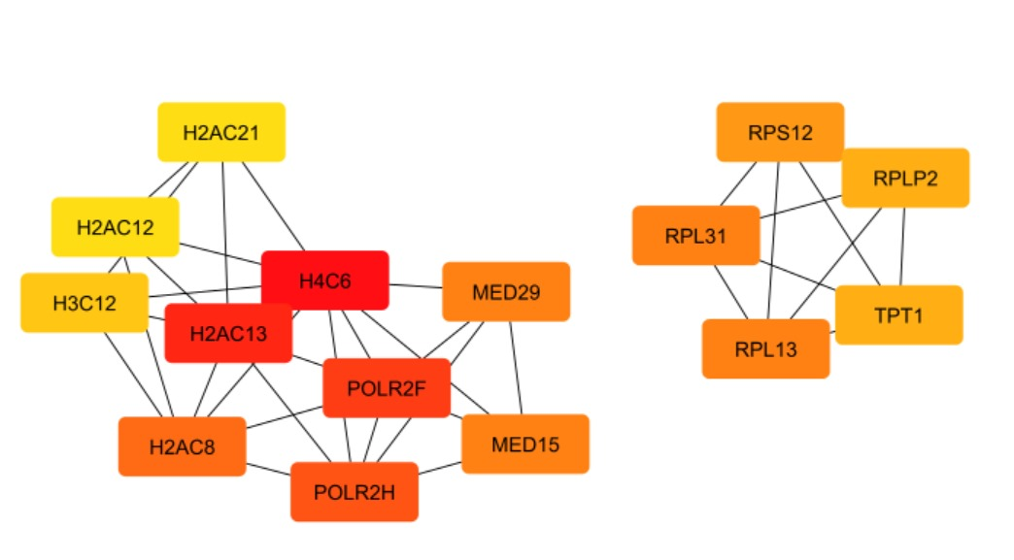
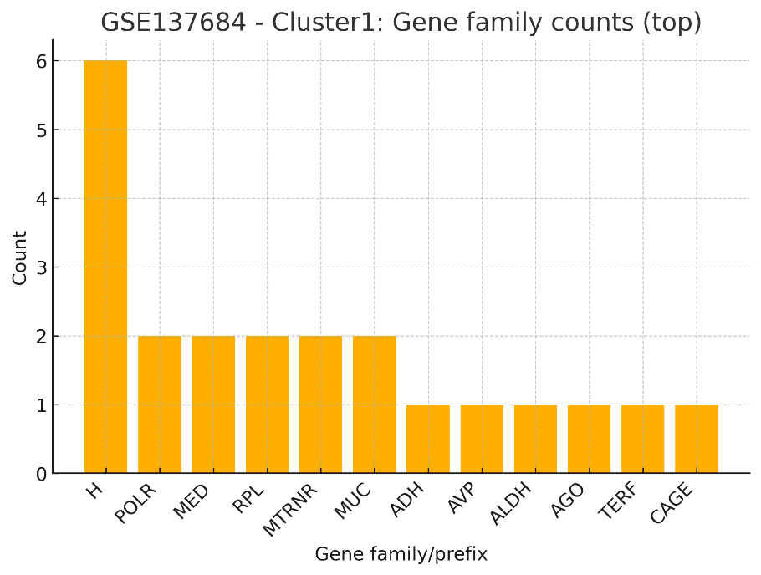
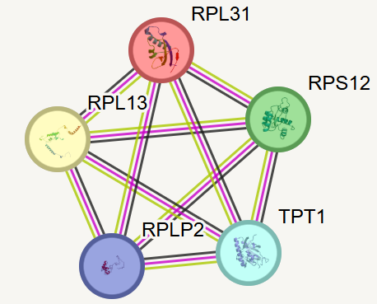
9. (B) STRING - MCODE Network (Ovary GSE 137684)
Key Findings:
MCODE clustering identifies a transcriptional-endocrine regulatory module dominated by histone variants, RNA polymerase II subunits, and ribosomal proteins.
In fact, high-density interactions among histones and polymerase components indicate epigenetic dysregulation and altered chromatin architecture in ovarian tissue from PCOS.
The ribosomal proteins RPL31, RPL13, and RPS12 emerge as structural hubs, indicating disrupted translational machinery and impaired control of protein synthesis.
Gene-family enrichment confirms overrepresentation of the histone, ribosomal, and POLR2 gene families, supporting a global transcriptional remodeling phenotype rather than isolated gene-level changes.

Slide 21
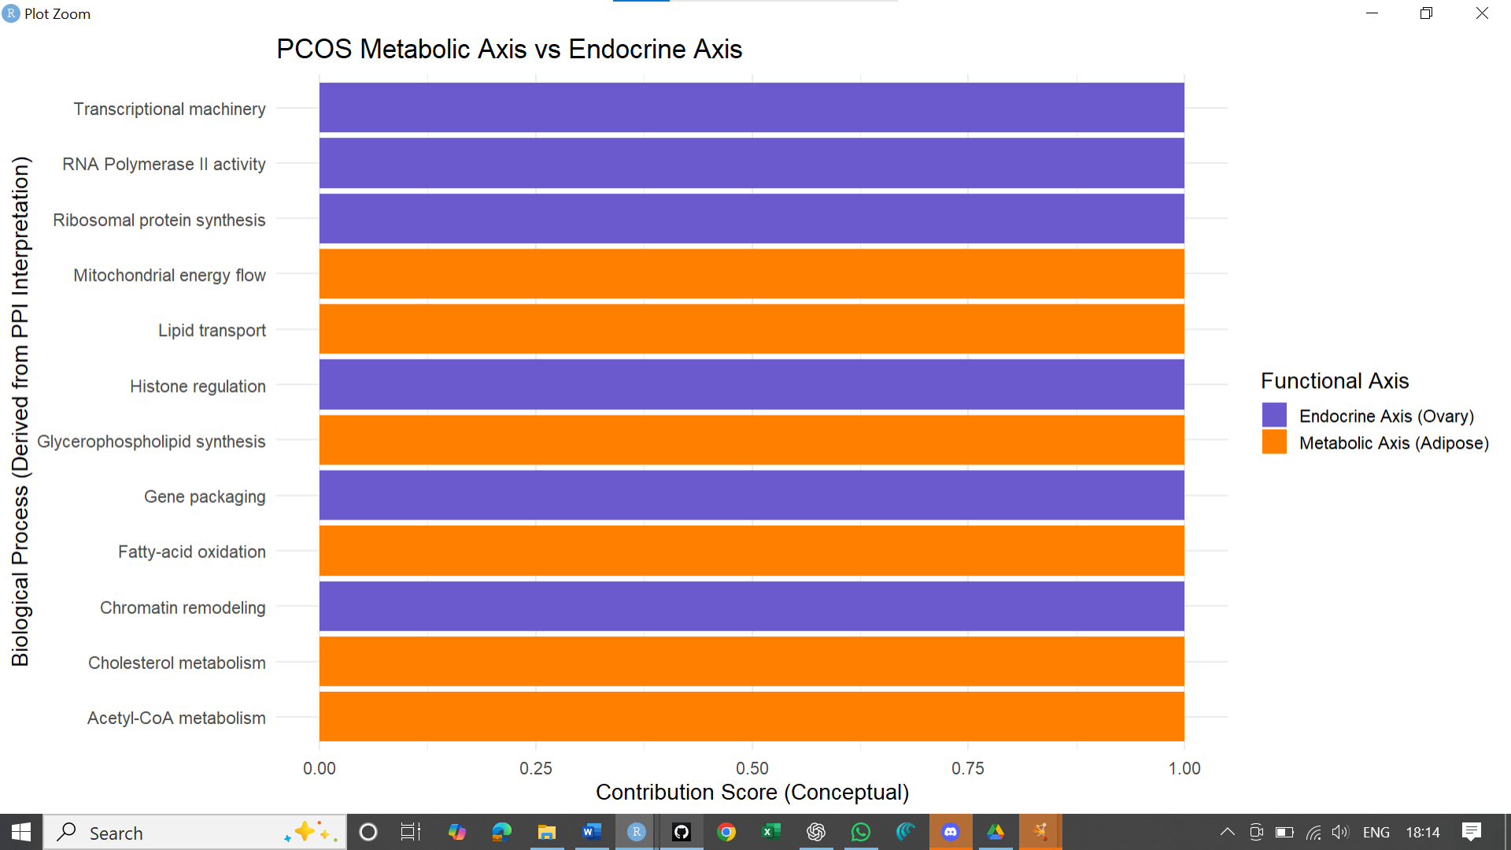
10. Integrated Model
From an integrative analysis, two dominant functional axes emerge:
(1) Adipose - Metabolism Axis; and (2) the Ovarian–Transcriptional - Endocrine Axis.
Dysregulation of the following drives the metabolic axis: fatty acid oxidation, acetyl-CoA metabolism, mitochondrial energy flow, lipid transport, and cholesterol metabolism change, reflecting systemic metabolic inflexibility in PCOS.
The Endocrine Axis, in this context, represents disruptions in: Chromatin remodeling, histone regulation, RNA polymerase II activity, ribosomal protein synthesis, and transcriptional machinery showed an imbalanced situation, indicating deep endocrine and gene-regulatory imbalance.
It is evident from the contribution score pattern that both axes together shape the biology of PCOS, confirming that PCOS is not a single-pathway disorder but rather a multi-axis condition involving metabolic stress and endocrine/transcriptional dysfunction.

Slide 22
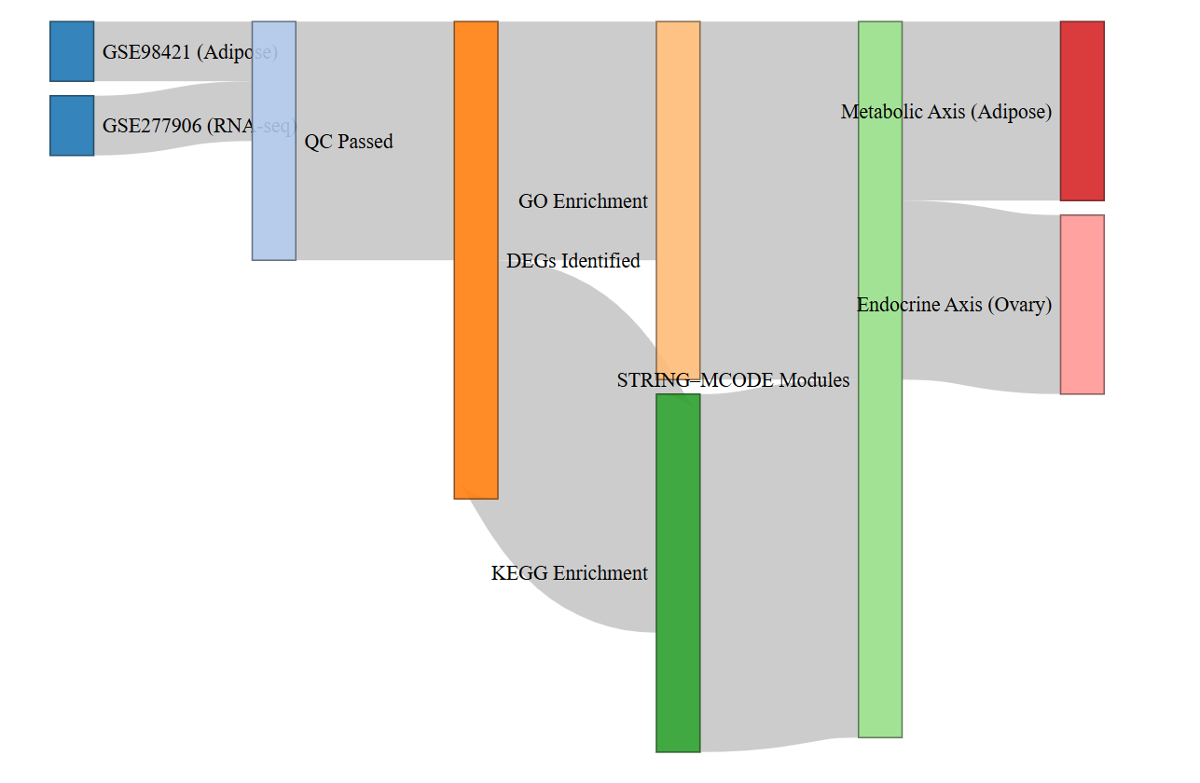
Graphical Workflow
Four transcriptomic datasets were included:
GSE98421 (Adipose tissue; microarray)
GSE277906 (Reproductive/Metabolic tissue; RNA-seq)
GSE114419 (Endometrium; control-only, excluded)
GSE137684 (Ovary; missing disease labels, excluded)
Quality assessment was performed on all datasets.
Only GSE98421 and GSE277906 fulfilled the necessary requirements for valid case–control differential expression analysis.
These two dataset's DEGs were subjected to GO Biological Process and KEGG Pathway enrichment.
Two dominant functional modules were interpreted from the interaction networks built using STRING and clustered with MCODE:
Metabolic Axis: Adipose-derived metabolic dysfunction
Endocrine–Transcriptional Axis: Ovary-derived transcriptional/epigenetic dysfunction
The Sankey diagram shows that each step of analysis-dataset filtering, QC, DEG identification, enrichment, and network clustering-is progressively leading to an integrated systems-level interpretation of the pathophysiology of PCOS.
Overview of the computational workflow used to identify PCOS molecular signatures through Sankey Diagram

Slide 23
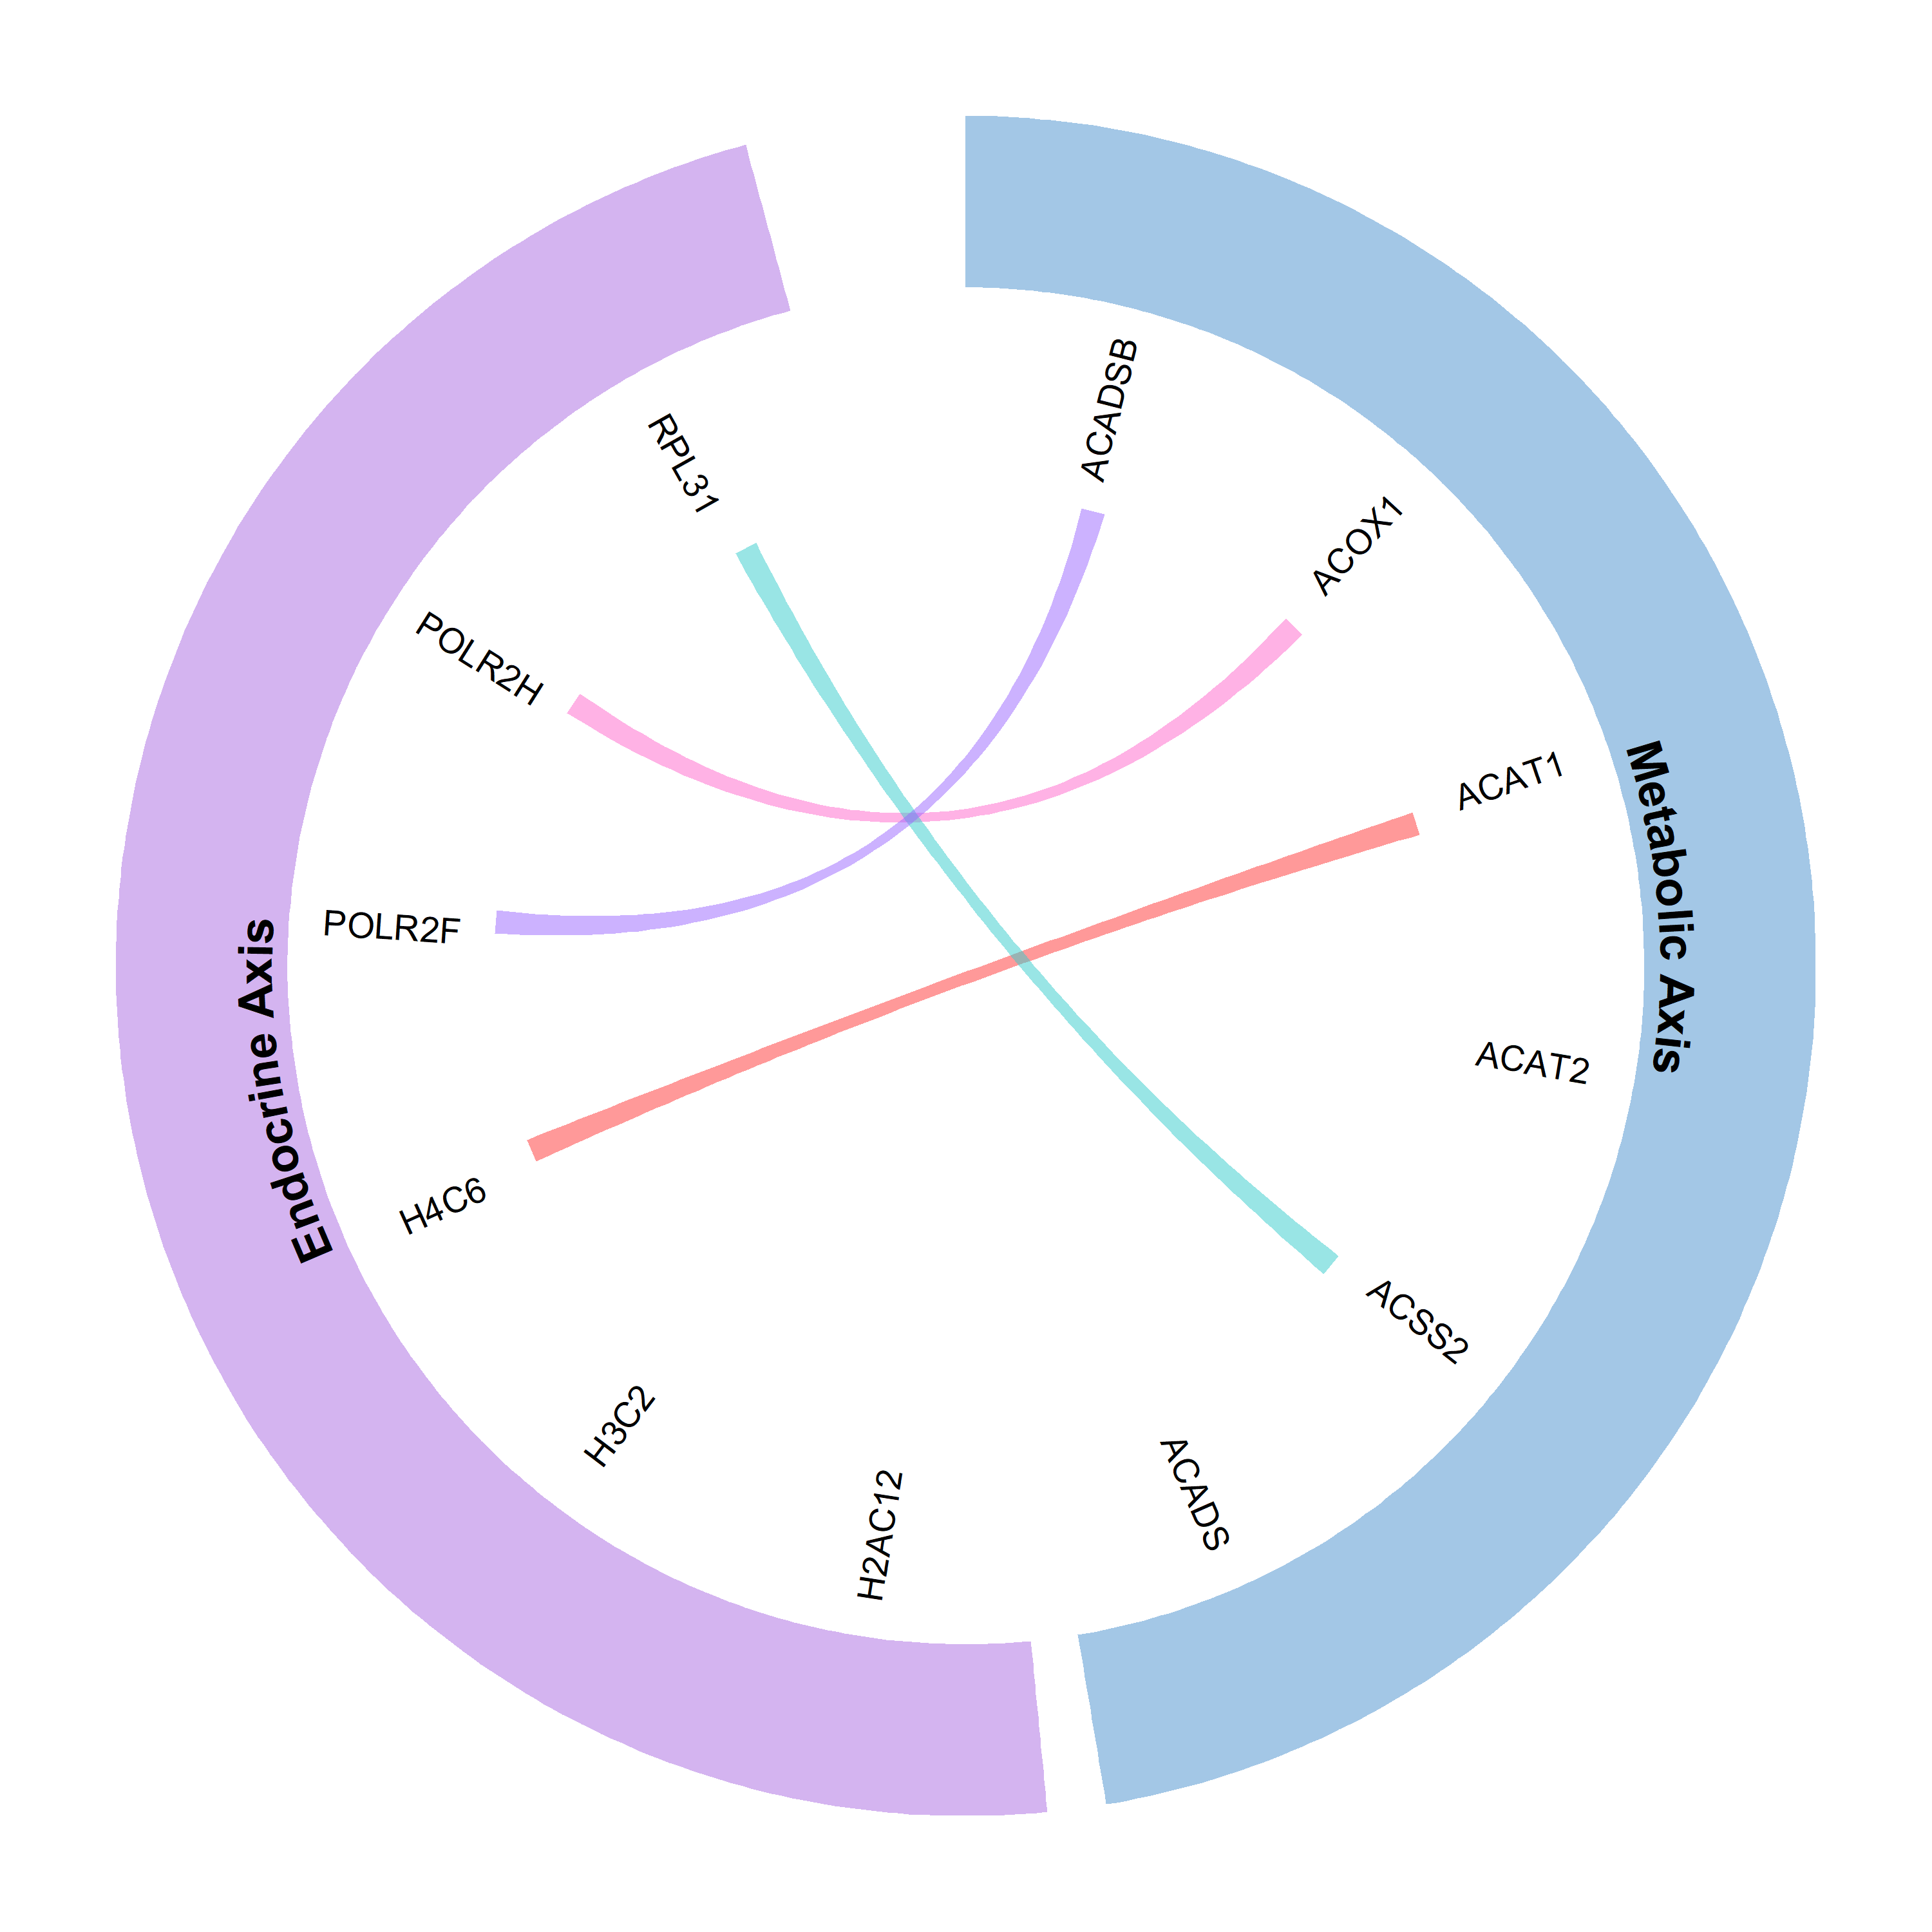
Graphical Summary
The graph shows the Metabolic (left side) and Endocrine/Transcriptional (right side) Aspects of PCOS. The left half of the graph shows the Metabolic Axis (Adipose tissue), including genes that are involved in fatty-acid oxidation and mitochondrial energy-circuit functions (ACADSB, ACOX1, ACAT1/2, ACSS2, ACADS). The right half of the graph shows the Endocrine/Transcriptional Axis (Ovarian tissue), including chromatin, transcriptional regulators/opregulators, and ribosomal components (H2AC12, H3C2, H4C6, POLR2F, POLR2H, and RPL31).
In summary, this picture provides evidence of the idea that PCOS is a systems-level disorder that results from interactions between metabolic stress and endocrine/transcription dysregulation.
Pink Line→ PCOS has a Connection to Cortisol Signaling
Red Line → PCOS has a Connection to Inflammatory Processes
Teal Line → PCOS has a Connection to MAPK Signaling;
Purple Line → PCOS has a Connection to Cytokine Signaling.
Integrated Circos model summarizing the molecular axes driving PCOS.

Slide 24
LIMITATIONS
It is limited by several factors.
Small sample size in multiple microarray datasets reduces the statistical power.
WGCNA module detection failed due to the low sample number, which limits resolution of the co-expression network.
Incomplete or absent metadata restricted valid DEG comparisons, such as the absence of PCOS/control labels in GSE137684 and a control-only dataset in GSE114419.
Dataset heterogeneity (different platforms, tissues, technologies) complicates cross-dataset integration.

Slide 25
FUTUTRE DIRECTIONS
The use of qPCR, WB and/or IHC techniques to experimentally validate important genes and pathways in PCOS using an animal model.
Conducting larger population-based studies along with Single Cell RNA Sequencing to generate better estimates of mechanism(s) for specific cell types in PCOS.
Integrating transcriptomics, proteomics, and metabolomics to create a comprehensive multi-omics evaluation of PCOS.
Developing/Testing interventions against dysregulated metabolic pathways, altered glucocorticoid-mediated processes, and disrupted cytokine-based interactions.
Creating predictive models based on machine learning to analyze potential prognostic markers and classify PCOS into distinct subtypes.
One Sentence Vision: Future studies will focus on validating molecular markers of PCOS and using those markers to develop diagnostic and therapeutic strategies.

Slide 26
Thank You!
Questions?
Contact: vanisha0209@gmail.com

