Slide 1
Time Series Forecasting Project
Analysis of Passenger Traffic at Paris-Orly Airport

Slide 2
Introduction
• Objective: Forecasting monthly passenger traffic at Paris-Orly Airport.
• Dataset: Monthly traffic data from January 2000 to December 2024.
• Key elements:
- Identification of trends, seasonality, and outliers.
- Use of the Box-Jenkins methodology for modeling.

Slide 3
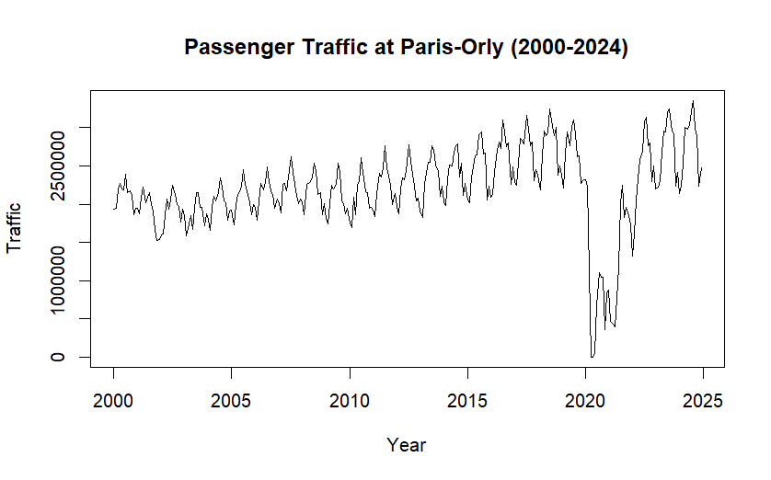

Slide 4
Description of the Time Series
• Data covers 25 years of monthly observations.
• Observed trends:
- General upward trend.
- Strong seasonal patterns.
- Impact of COVID-19: Significant dip in 2020-2021.

Slide 5
Stationarity Analysis
• Initial observations:
- Series is non-stationary (trend, seasonality).
• Transformations applied:
- Log transformation to stabilize variance.
- First-order differencing to remove trend.
- Seasonal differencing (order 12) for stationarity.
• Result: Stationarity series achieved if we exclude the covid period.

Slide 6
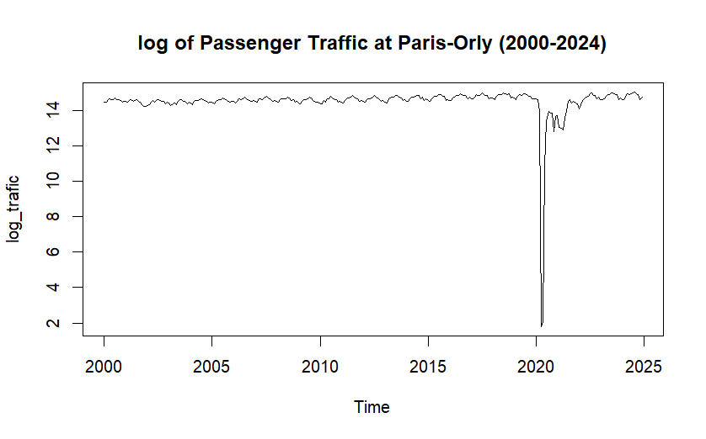
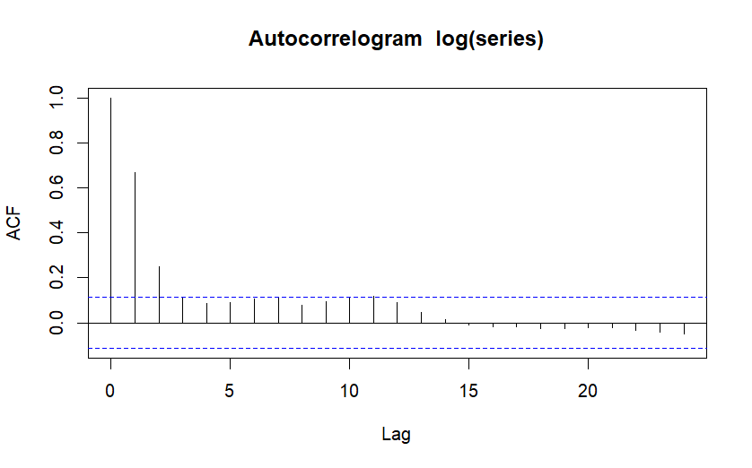
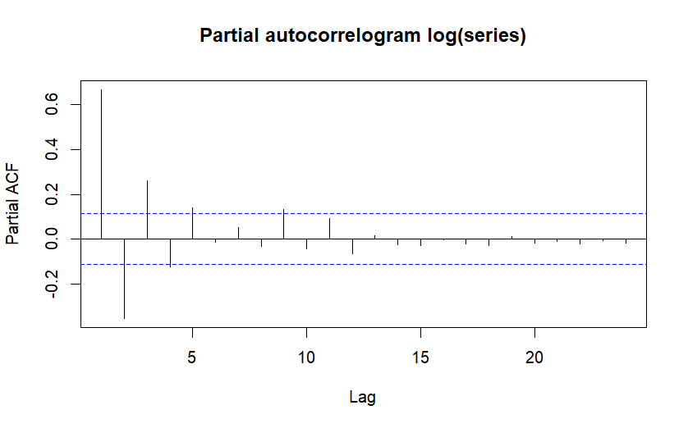

Slide 7
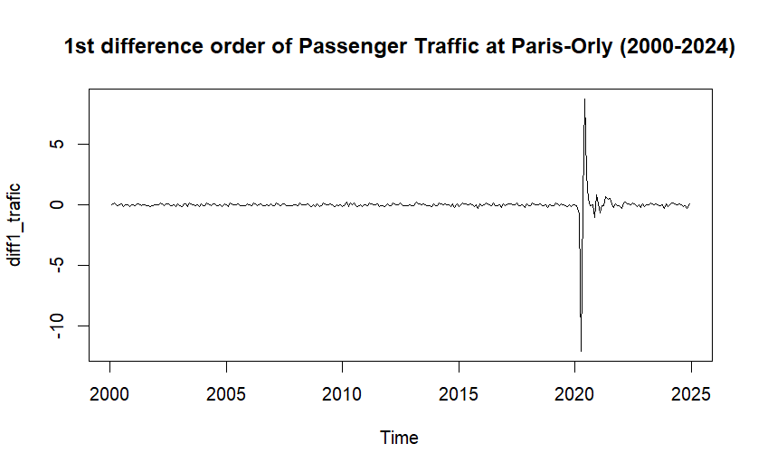
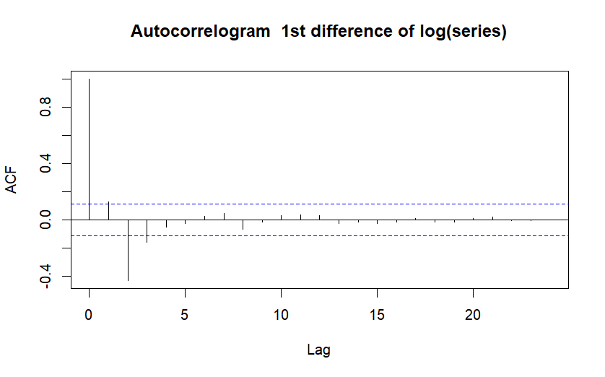
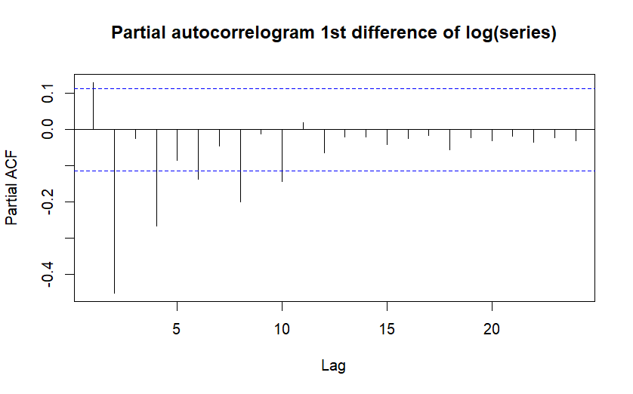

Slide 8
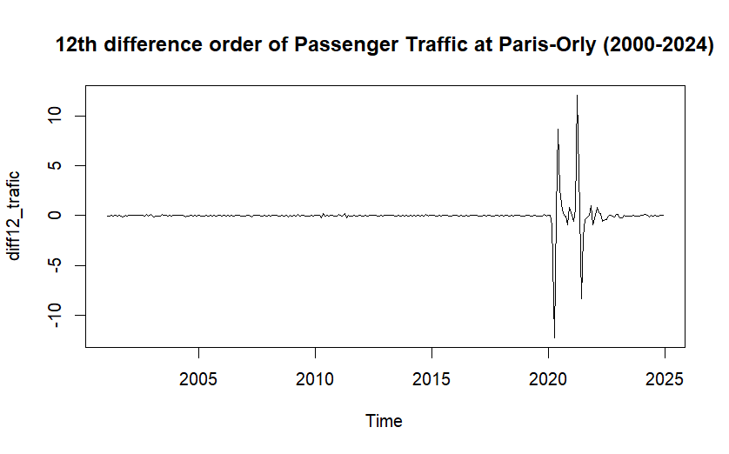
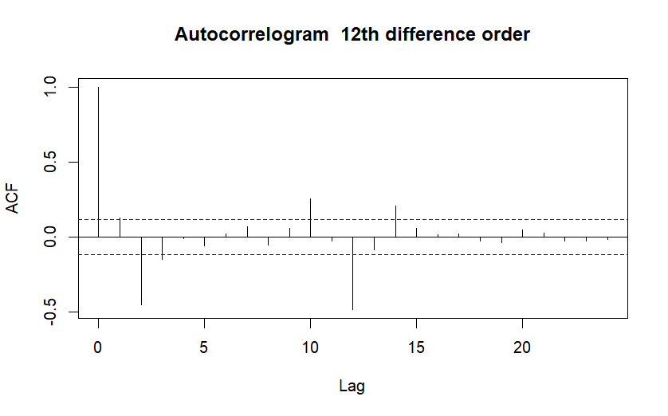
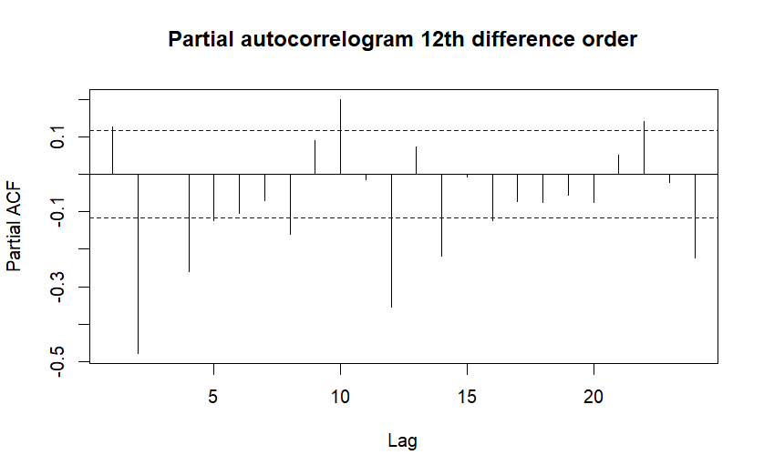

Slide 9
Box-Jenkins Methodology
• Model identification using ACF and PACF
- ARIMA(1,0,1)(1,1,1) at the beginning
- ARIMA(1,0,1)(2,1,1) selected as best model.
• Steps:
1. Estimating initial parameters with ACF and PACF of diff12_trafic
2. Validate coefficients for significance
3. Diagnose residuals (autocorrelation, normality).
• Adjustments made for COVID-19 period (dummy variables).
5 models have been made in total (changing parameters in the model, removing coefficients, changing dummies)

Slide 10
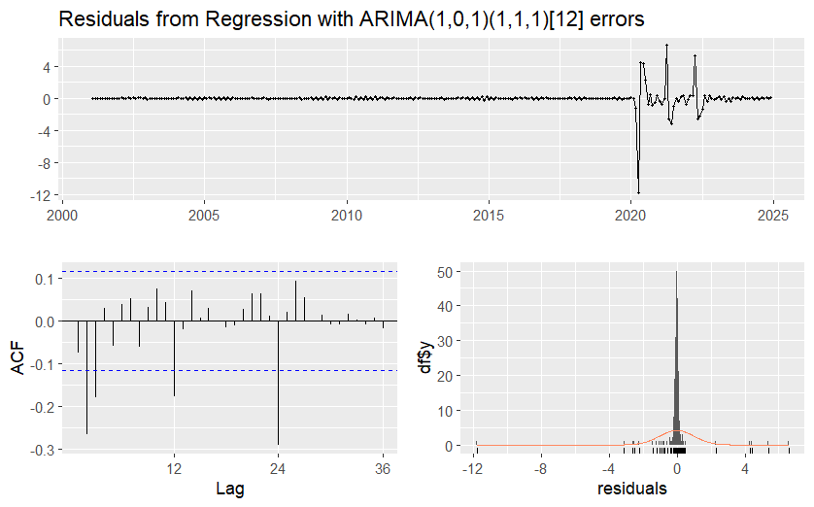
ARIMA (1,0,1)(1,1,1) with unique covid dummy

Slide 11
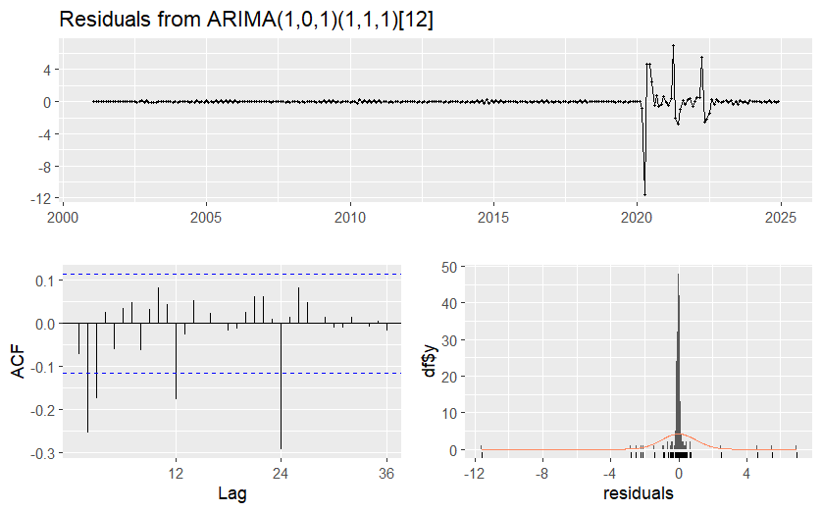
ARIMA (1,0,1)(1,1,1) without covid dummy

Slide 12
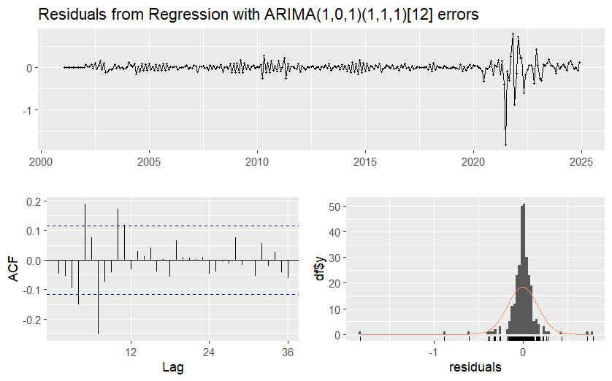
ARIMA (1,0,1)(1,1,1) with a new monthly covid dummy

Slide 13
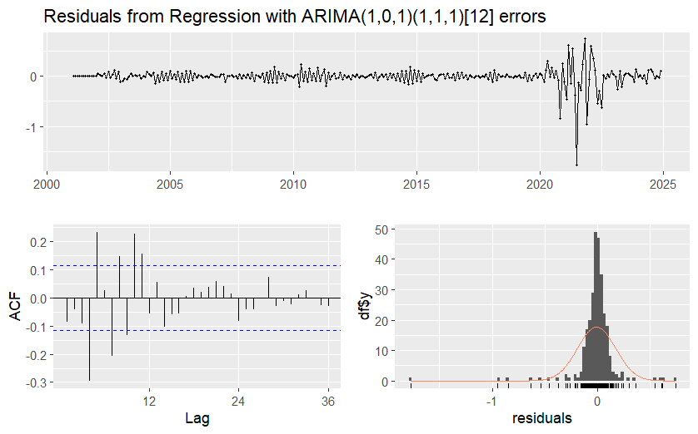
ARIMA (1,0,1)(1,1,1) with the new monthly covid dummy and only significant
Covid months

Slide 14
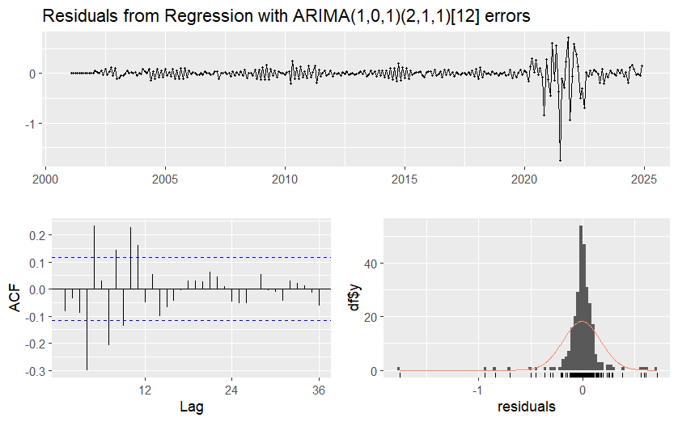
ARIMA (1,0,1)(2,1,1) with the new monthly covid dummy and only significant
Covid months + parameter P = 2 now

Slide 15
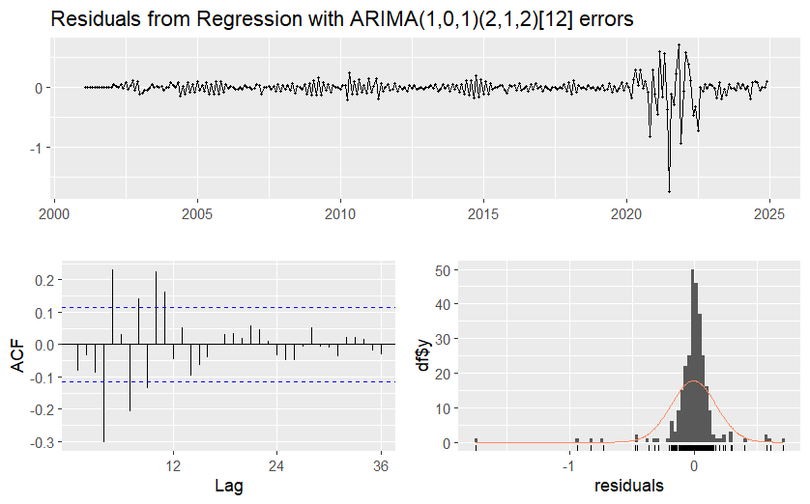
ARIMA (1,0,1)(2,1,2) with the new monthly covid dummy and only significant
Covid months + parameter Q = 2 now

Slide 16
Model Validation
• In-sample validation:
- RMSE: 0.1839, MAE: 0.0886.
• Out-of-sample validation:
- RMSE: 0.1917, MAE: 0.1312.
• Observations:
- Captures overall trends.
- Struggles with local variations.

Slide 17
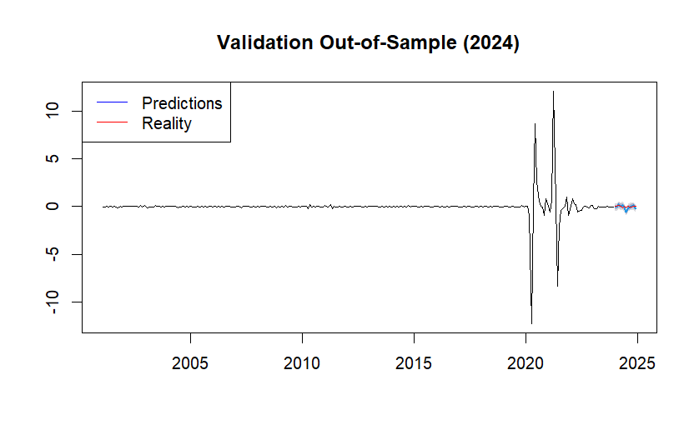

Slide 18
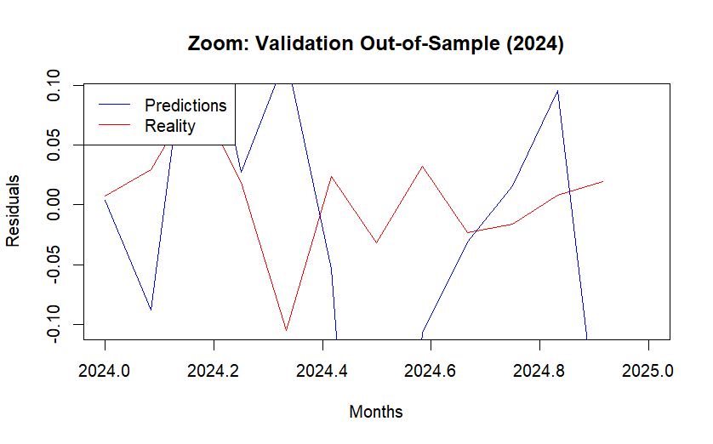

Slide 19
Forecast for the Next 3 Months
• Predicted passenger traffic for January-March 2025.
• Forecast aligns with historical trends.
• Stability in short-term projections.
• Challenges:
- Residual autocorrelation.
- Non-normality of residuals.

Slide 20
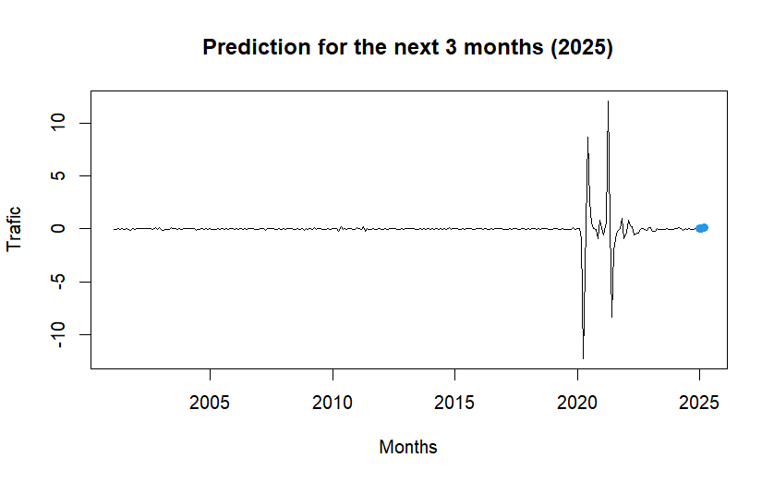

Slide 21
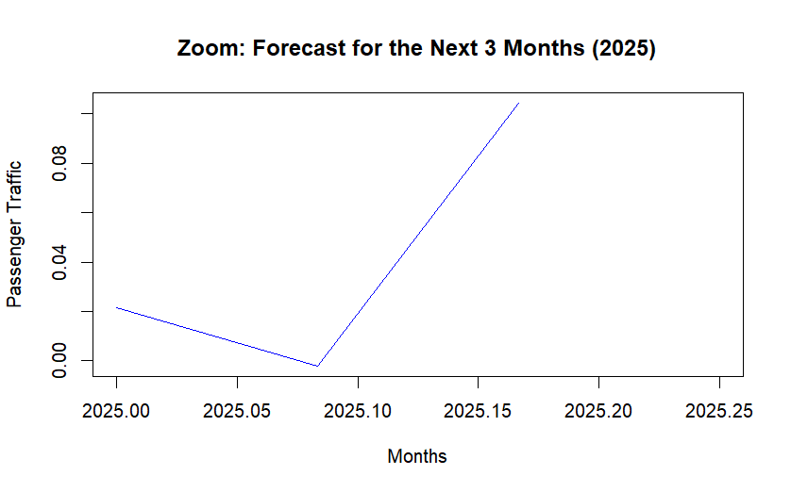

Slide 22
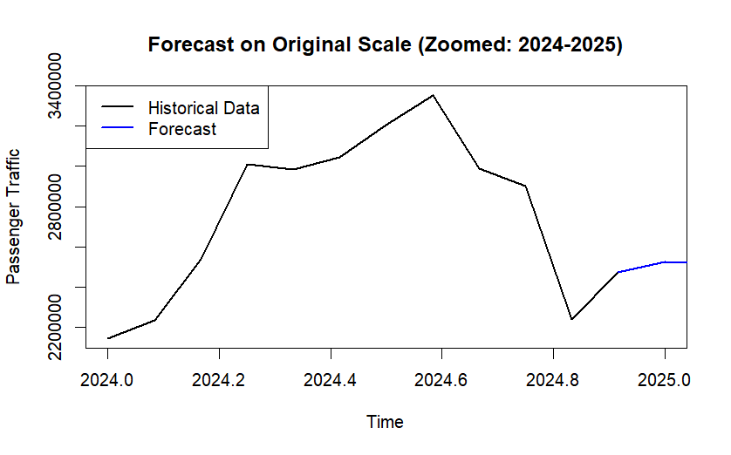

Slide 23
Conclusion
• Achievements:
- Developed a SARIMA model for forecasting.
- Addressed challenges with transformations and dummy variables.
• Limitations:
- Residual autocorrelation remains.
- Forecast accuracy could be improved.
•Future work:
- Explore alternative models to capture the COVID period
- Refine residual handling.

