Slide 1
Concepts of SQL
Data Base Lab-2

Slide 2
Topics
Basic Structure
Set Operations
Aggregate Functions
Null Values

Slide 3
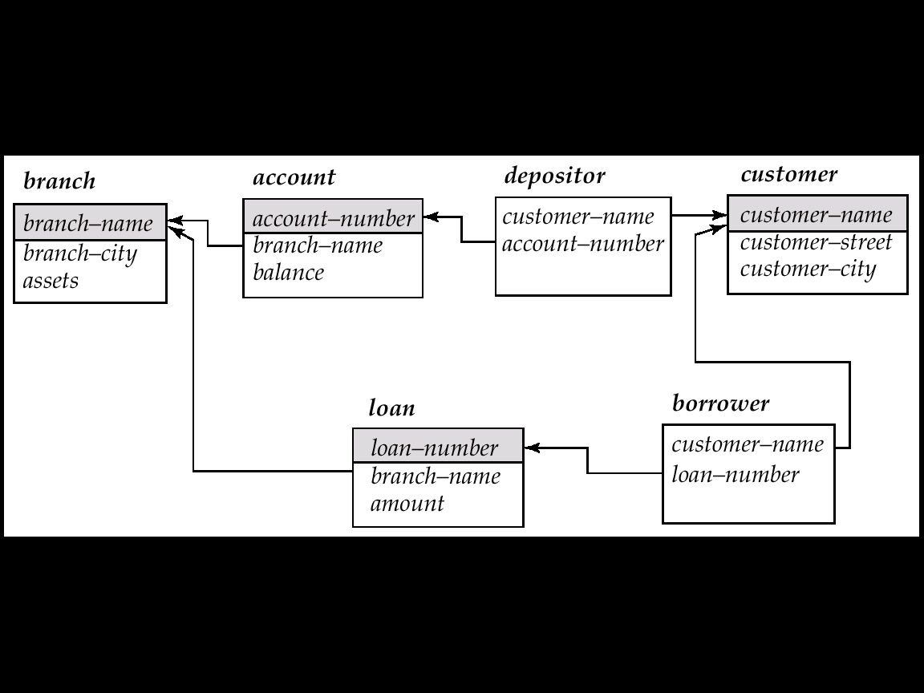
Schema Used in Examples

Slide 4
Basic Structure
A typical SQL query has the form: select A₁, A₂, ..., A_{n} from r₁, r₂, ..., r_{m} where P
A_{i}s represent attributes
r_{i}s represent relations
P is a predicate( condition)
The result of an SQL query is a relation.

Slide 5
The select Clause(1/3)
The select clause list the attributes desired in the result of a query
E.g. find the names of all branches in the loan relation select branch_name from loan
SQL does not permit the ‘-’ character in names,
NOTE: SQL names are case insensitive, i.e. you can use capital or small letters.

Slide 6
The select Clause (2/3)
SQL allows duplicates in relations as well as in query results.
To force the elimination of duplicates, insert the keyword distinct after select.
Find the names of all branches in the loan relations, and remove duplicates
select distinct branch-name from loan
The keyword all specifies that duplicates not be removed.
select all branch-name from loan

Slide 7
The select Clause (3/3)
An asterisk in the select clause denotes “all attributes”
select * from loan
The select clause can contain arithmetic expressions involving the operation, +, –, ∗, and /, and operating on constants or attributes of tuples.
The query:
select loan-number, branch-name, amount ∗ 100 from loan
would return a relation which is the same as the loan relations, except that the attribute amount is multiplied by 100.

Slide 8
The where Clause(1/2)
The where clause specifies conditions that the result must satisfy.
To find all loan number for loans made at the Perryridge branch with loan amounts greater than $1200. select loan-number from loan where branch-name = ‘Perryridge’ and amount > 1200
Comparison results can be combined using the logical connectives and, or, and not.
Comparisons can be applied to results of arithmetic expressions

Slide 9
The where Clause (2/2)
SQL includes a between comparison operator
E.g. Find the loan number of those loans with loan amounts between $90,000 and $100,000 (that is, ≥$90,000 and ≤$100,000)
select loan-number from loan where amount between 90000 and 100000
Notes:
7

Slide 10
The from Clause
The from clause lists the relations involved in the query
Find the Cartesian product borrower x loan select ∗ from borrower, loan
Find the name, loan number and loan amount of all customers having a loan at the Perryridge branch.
select customer-name, borrower.loan-number, amount from borrower, loan where borrower.loan-number = loan.loan-number and branch-name = ‘Perryridge

Slide 11
The Rename Operation
The SQL allows renaming relations and attributes using the as clause: old-name as new-name
Find the name, loan number and loan amount of all customers; rename the column name loan-number as loan-id.
select customer-name, borrower.loan-number as loan-id, amount from borrower, loan where borrower.loan-number = loan.loan-number

Slide 12
Tuple Variables
Tuple variables are defined in the from clause via the use of the as clause.
Find the customer names and their loan numbers for all customers having a loan at some branch.
select customer-name, T.loan-number, S.amount from borrower as T, loan as S where T.loan-number = S.loan-number
Find the names of all branches that have greater assets than some branch located in Brooklyn
select distinct T.branch-name from branch as T, branch as S where T.assets > S.assets and S.branch-city = ‘Brooklyn’

Slide 13
String Operations
SQL includes a string-matching operator for comparisons on character strings. Patterns are described using two special characters:
percent (%). The % character matches any substring.
underscore (_). The _ character matches any character.
Find the names of all customers whose street includes the substring “Main”.
select customer-name from customer where customer-street like ‘%Main%’
Match the name “Main%”
like ‘Main\%’ escape ‘\’
SQL supports a variety of string operations such as
concatenation (using “||”)
converting from upper to lower case (and vice versa)
finding string length, extracting substrings, etc.

Slide 14
Ordering the Display of Tuples
List in alphabetic order the names of all customers having a loan in Perryridge branch
select distinct customer-name from borrower, loan where borrower loan-number = loan.loan-number and branch-name = ‘Perryridge’ order by customer-name
We may specify desc for descending order or asc for ascending order, for each attribute; ascending order is the default.
E.g. order by customer-name desc

Slide 15
Set Operations
The set operations union, intersect, and except operate on relations and correspond to the relational algebra operations ∪, ∩, −.
Each of the above operations automatically eliminates duplicates; to retain all duplicates use the corresponding multiset versions union all, intersect all and except all.
Suppose a tuple occurs m times in r and n times in s, then, it occurs:
m + n times in r union all s
min(m,n) times in r intersect all s
max(0, m – n) times in r except all s

Slide 16
Set Operations
Find all customers who have a loan, an account, or both:
(select customer-name from depositor) union (select customer-name from borrower)
Find all customers who have both a loan and an account
(select customer-name from depositor) intersect (select customer-name from borrower)
Find all customers who have an account but no loan
(select customer-name from depositor) except (select customer-name from borrower)

Slide 17
Aggregate Functions(1/2)
These functions operate on the multiset of values of a column of a relation, and return a value
avg: average value min: minimum value max: maximum value sum: sum of values count: number of values

Slide 18
Aggregate Functions(2/2)
Find the average account balance at the Perryridge branch
select avg (balance) from account where branch-name = ‘Perryridge
Find the number of tuples in the customer relation.
select count (*) from customer
Find the number of depositors in the bank
select count (distinct customer-name) from depositor

Slide 19
Aggregate Functions – Group By
Find the number of depositors for each branch.
select branch-name, count (distinct customer-name) from depositor, account where depositor.account-number = account.account-number group by branch-name
Attributes in select clause outside of aggregate functions must appear in group by list

Slide 20
Aggregate Functions – Having Clause
Find the names of all branches where the average account balance is more than $1,200
select branch-name, avg (balance) from account group by branch-name having avg (balance) > 1200
Note: predicates in the having clause are applied after the formation of groups whereas predicates in the where clause are applied before forming groups

Slide 21
Null Values
It is possible for tuples to have a null value, denoted by null, for some of their attributes
null signifies an unknown value or that a value does not exist.
The predicate is null can be used to check for null values.
E.g. Find all loan number which appear in the loan relation with null values for amount.
select loan-number from loan where amount is null
The result of any arithmetic expression involving null is null
E.g. 5 + null returns null
However, aggregate functions simply ignore nulls
more on this shortly

Slide 22
Null Values and Three Valued Logic
Any comparison with null returns unknown
E.g. 5 < null or null <> null or null = null
Three-valued logic using the truth value unknown:
OR: (unknown or true) = true, (unknown or false) = unknown (unknown or unknown) = unknown
AND: (true and unknown) = unknown, (false and unknown) = false, (unknown and unknown) = unknown
NOT: (not unknown) = unknown
“P is unknown” evaluates to true if predicate P evaluates to unknown
Result of where clause predicate is treated as false if it evaluates to unknown

Slide 23
Null Values and Aggregates
Total all loan amounts
select sum (amount) from loan
Above statement ignores null amounts
result is null if there is no non-null amount
All aggregate operations except count(*) ignore tuples with null values on the aggregated attributes.

Slide 24
Thank You!

