Slide 1
Chapter 15
Review Techniques
Slide Set to accompany
Software Engineering: A Practitioner’s Approach, 7/e
by Roger S. Pressman
Slides copyright © 1996, 2001, 2005, 2009 by Roger S. Pressman
For non-profit educational use only
May be reproduced ONLY for student use at the university level when used in conjunction with Software Engineering: A Practitioner's Approach, 7/e. Any other reproduction or use is prohibited without the express written permission of the author.
All copyright information MUST appear if these slides are posted on a website for student use.
These slides are designed to accompany Software Engineering: A Practitioner’s Approach, 7/e (McGraw-Hill 2009). Slides copyright 2009 by Roger Pressman.

Slide 2
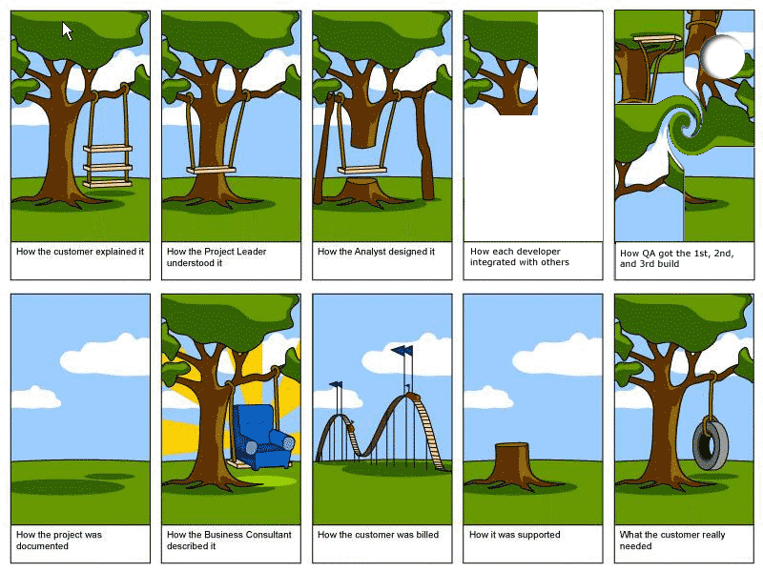
Chinese Whisper
These slides are designed to accompany Software Engineering: A Practitioner’s Approach, 7/e (McGraw-Hill 2009). Slides copyright 2009 by Roger Pressman.

Slide 3
What Are Reviews?
a meeting conducted by technical people for technical people
a technical assessment of a work product created during the software engineering process
a software quality assurance mechanism
a training ground
These slides are designed to accompany Software Engineering: A Practitioner’s Approach, 7/e (McGraw-Hill 2009). Slides copyright 2009 by Roger Pressman.

Slide 4
What Reviews Are Not
A project summary or progress assessment
A meeting intended solely to impart information
A mechanism for political or personal reprisal!
These slides are designed to accompany Software Engineering: A Practitioner’s Approach, 7/e (McGraw-Hill 2009). Slides copyright 2009 by Roger Pressman.

Slide 5
What Do We Look For?
Errors and defects
  Error—a quality problem found before the software is released to end users
  Defect—a quality problem found only after the software has been released to end-users
We make this distinction because errors and defects have very different economic, business, psychological, and human impact
However, the temporal distinction made between errors and defects in this book is not mainstream thinking
These slides are designed to accompany Software Engineering: A Practitioner’s Approach, 7/e (McGraw-Hill 2009). Slides copyright 2009 by Roger Pressman.

Slide 6
Defect Amplification
A defect amplification model [IBM81] can be used to illustrate the generation and detection of errors during the design and code generation actions of a software process.
Defects
Detection
Errors from
Previous step
Errors passed through
Percent
Efficiency
Errors passed
To next step
Amplified errors 1:x
Newly generated errors
Development step
These slides are designed to accompany Software Engineering: A Practitioner’s Approach, 7/e (McGraw-Hill 2009). Slides copyright 2009 by Roger Pressman.

Slide 7
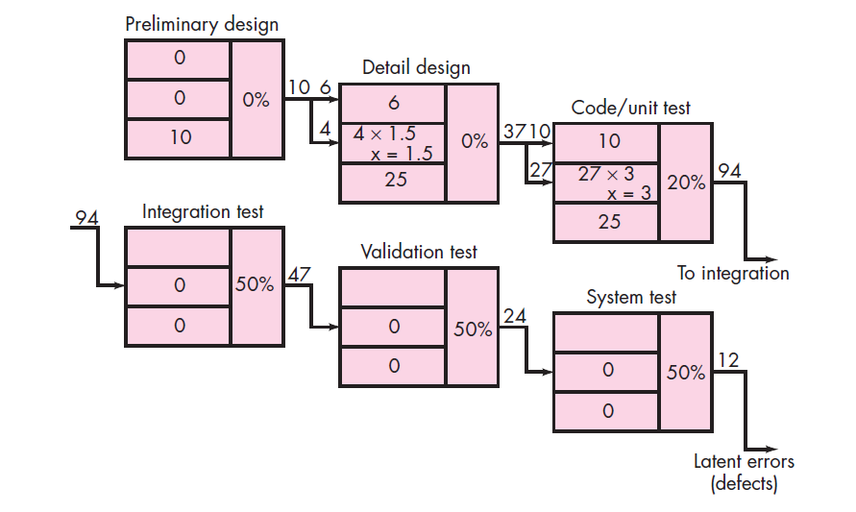
Defect Amplification-no review
These slides are designed to accompany Software Engineering: A Practitioner’s Approach, 7/e (McGraw-Hill 2009). Slides copyright 2009 by Roger Pressman.

Slide 8
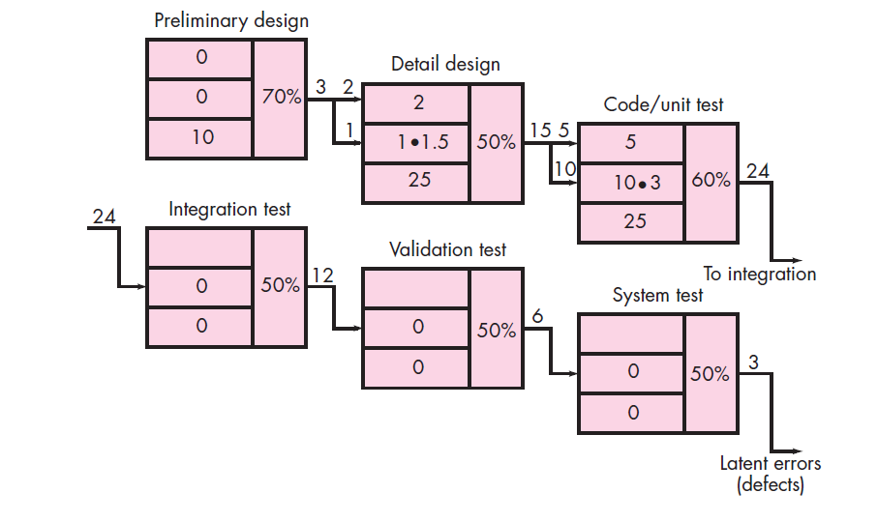
Defect Amplification-review conducted
These slides are designed to accompany Software Engineering: A Practitioner’s Approach, 7/e (McGraw-Hill 2009). Slides copyright 2009 by Roger Pressman.

Slide 9
Defect Amplification
In the example provided in SEPA, Section 15.2,
  a software process that does NOT include reviews,
    yields 94 errors at the beginning of testing and
    Releases 12 latent defects to the field
  a software process that does include reviews,
    yields 24 errors at the beginning of testing and
    releases 3 latent defects to the field
  A cost analysis indicates that the process with NO reviews costs approximately 3 times more than the process with reviews, taking the cost of correcting the latent defects into account
These slides are designed to accompany Software Engineering: A Practitioner’s Approach, 7/e (McGraw-Hill 2009). Slides copyright 2009 by Roger Pressman.

Slide 10
Metrics
The total review effort and the total number of errors discovered are defined as:
    E_{review} = E_{p} + E_{a} + E_{r}
    Err_{tot} = Err_{minor} + Err_{major}
Defect density represents the errors found per unit of work product reviewed.
    Defect density = Err_{tot} / WPS
where …
These slides are designed to accompany Software Engineering: A Practitioner’s Approach, 7/e (McGraw-Hill 2009). Slides copyright 2009 by Roger Pressman.

Slide 11
Metrics
Preparation effort, E_{p}—the effort (in person-hours) required to review a work product prior to the actual review meeting
Assessment effort, E_{a}— the effort (in person-hours) that is expending during the actual review
Rework effort, E_{r}— the effort (in person-hours) that is dedicated to the correction of those errors uncovered during the review
Work product size, WPS—a measure of the size of the work product that has been reviewed (e.g., the number of UML models, or the number of document pages, or the number of lines of code)
Minor errors found, Err_{minor}—the number of errors found that can be categorized as minor (requiring less than some pre-specified effort to correct)
Major errors found, Err_{major}— the number of errors found that can be categorized as major (requiring more than some pre-specified effort to correct)
These slides are designed to accompany Software Engineering: A Practitioner’s Approach, 7/e (McGraw-Hill 2009). Slides copyright 2009 by Roger Pressman.

Slide 12
An Example—I
If past history indicates that
  the average defect density for a requirements model is 0.6 errors per page, and a new requirement model is 32 pages long,
  a rough estimate suggests that your software team will find about 19 or 20 errors during the review of the document.
  If you find only 6 errors, you’ve done an extremely good job in developing the requirements model or your review approach was not thorough enough.
These slides are designed to accompany Software Engineering: A Practitioner’s Approach, 7/e (McGraw-Hill 2009). Slides copyright 2009 by Roger Pressman.

Slide 13
An Example—II
The effort required to correct a minor model error (immediately after the review) was found to require 4 person-hours.
The effort required for a major requirement error was found to be 18 person-hours.
Examining the review data collected, you find that minor errors occur about 6 times more frequently than major errors. Therefore, you can estimate that the average effort to find and correct a requirements error during review is about 6 person-hours.
Requirements related errors uncovered during testing require an average of 45 person-hours to find and correct. Using the averages noted, we get:
Effort saved per error = E_{testing} – E_{reviews}
45 – 6 = 30 person-hours/error
Since 22 errors were found during the review of the requirements model, a saving of about 660 person-hours of testing effort would be achieved. And that’s just for requirements-related errors.
These slides are designed to accompany Software Engineering: A Practitioner’s Approach, 7/e (McGraw-Hill 2009). Slides copyright 2009 by Roger Pressman.

Slide 14
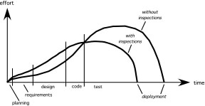
Overall
Effort expended with and without reviews
with reviews
These slides are designed to accompany Software Engineering: A Practitioner’s Approach, 7/e (McGraw-Hill 2009). Slides copyright 2009 by Roger Pressman.

Slide 15
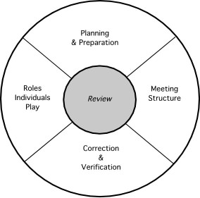
Reference Model
These slides are designed to accompany Software Engineering: A Practitioner’s Approach, 7/e (McGraw-Hill 2009). Slides copyright 2009 by Roger Pressman.

Slide 16
Informal Reviews
Informal reviews include:
  a simple desk check of a software engineering work product with a colleague
  a casual meeting (involving more than 2 people) for the purpose of reviewing a work product, or
  the review-oriented aspects of pair programming
pair programming encourages continuous review as a work product (design or code) is created.
  The benefit is immediate discovery of errors and better work product quality as a consequence.
These slides are designed to accompany Software Engineering: A Practitioner’s Approach, 7/e (McGraw-Hill 2009). Slides copyright 2009 by Roger Pressman.

Slide 17
Formal Technical Reviews
The objectives of an FTR are:
  to uncover errors in function, logic, or implementation for any representation of the software
  to verify that the software under review meets its requirements
  to ensure that the software has been represented according to predefined standards
  to achieve software that is developed in a uniform manner
  to make projects more manageable
The FTR is actually a class of reviews that includes walkthroughs and inspections.
These slides are designed to accompany Software Engineering: A Practitioner’s Approach, 7/e (McGraw-Hill 2009). Slides copyright 2009 by Roger Pressman.

Slide 18
The Review Meeting
Between three and five people (typically) should be involved in the review.
Advance preparation should occur but should require no more than two hours of work for each person.
The duration of the review meeting should be less than two hours.
Focus is on a work product (e.g., a portion of a requirements model, a detailed component design, source code for a component)
These slides are designed to accompany Software Engineering: A Practitioner’s Approach, 7/e (McGraw-Hill 2009). Slides copyright 2009 by Roger Pressman.

Slide 19
The Players
review
leader
standards bearer (SQA)
producer
maintenance
oracle
recorder
reviewer
user rep
These slides are designed to accompany Software Engineering: A Practitioner’s Approach, 7/e (McGraw-Hill 2009). Slides copyright 2009 by Roger Pressman.

Slide 20
The Players
Producer—the individual who has developed the work product
  informs the project leader that the work product is complete and that a review is required
Review leader—evaluates the product for readiness, generates copies of product materials, and distributes them to two or three reviewers for advance preparation.
Reviewer(s)—expected to spend between one and two hours reviewing the product, making notes, and otherwise becoming familiar with the work.
Recorder—reviewer who records (in writing) all important issues raised during the review.
These slides are designed to accompany Software Engineering: A Practitioner’s Approach, 7/e (McGraw-Hill 2009). Slides copyright 2009 by Roger Pressman.

Slide 21
Conducting the Review
Review the product, not the producer.
Set an agenda and maintain it.
Limit debate and rebuttal.
Enunciate problem areas, but don't attempt to solve every problem noted.
Take written notes.
Limit the number of participants and insist upon advance preparation.
Develop a checklist for each product that is likely to be reviewed.
Allocate resources and schedule time for FTRs.
Conduct meaningful training for all reviewers.
Review your early reviews.
These slides are designed to accompany Software Engineering: A Practitioner’s Approach, 7/e (McGraw-Hill 2009). Slides copyright 2009 by Roger Pressman.

Slide 22
Review Options Matrix
*
IPR
WT
IN
RRR
trained leader
agenda established
reviewers prepare in advance
producer presents product
“reader” presents product
recorder takes notes
checklists used to find errors
errors categorized as found
issues list created
team must sign-off on result
IPR—informal peer review WT—Walkthrough
IN—Inspection RRR—round robin review
yes
yes
yes
no
yes
yes
yes
yes
yes
yes
yes
yes
yes
no
no
yes
no
no
yes
maybe
no
maybe
maybe
maybe
no
maybe
no
no
no
no
yes
yes
yes
yes
no
yes
no
no
yes
yes
*
These slides are designed to accompany Software Engineering: A Practitioner’s Approach, 7/e (McGraw-Hill 2009). Slides copyright 2009 by Roger Pressman.

Slide 23
Sample-Driven Reviews (SDRs)
SDRs attempt to quantify those work products that are primary targets for full FTRs.
To accomplish this …
Inspect a fraction a_{i} of each software work product, i. Record the number of faults, f_{i} found within a_{i}.
Develop a gross estimate of the number of faults within work product i by multiplying f_{i} by 1/a_{i}.
Sort the work products in descending order according to the gross estimate of the number of faults in each.
Focus available review resources on those work products that have the highest estimated number of faults.
These slides are designed to accompany Software Engineering: A Practitioner’s Approach, 7/e (McGraw-Hill 2009). Slides copyright 2009 by Roger Pressman.

Slide 24
Metrics Derived from Reviews
inspection time per page of documentation
inspection time per KLOC or FP
inspection effort per KLOC or FP
errors uncovered per reviewer hour
errors uncovered per preparation hour
errors uncovered per SE task (e.g., design)
number of minor errors (e.g., typos)
number of major errors
(e.g., nonconformance to req.)
number of errors found during preparation
These slides are designed to accompany Software Engineering: A Practitioner’s Approach, 7/e (McGraw-Hill 2009). Slides copyright 2009 by Roger Pressman.

