Slide 1
Chapter 16
Software Quality Assurance
Slide Set to accompany
Software Engineering: A Practitioner’s Approach, 7/e
by Roger S. Pressman
Slides copyright © 1996, 2001, 2005, 2009 by Roger S. Pressman
For non-profit educational use only
May be reproduced ONLY for student use at the university level when used in conjunction with Software Engineering: A Practitioner's Approach, 7/e. Any other reproduction or use is prohibited without the express written permission of the author.
All copyright information MUST appear if these slides are posted on a website for student use.
These slides are designed to accompany Software Engineering: A Practitioner’s Approach, 7/e (McGraw-Hill 2009). Slides copyright 2009 by Roger Pressman.

Slide 2
Comment on Quality
Phil Crosby once said:
  The problem of quality management is not what people don't know about it. The problem is what they think they do know . . .
  Everybody is for it. (Under certain conditions, of course.)
  Everyone feels they understand it. (Even though they wouldn't want to explain it.)
  Everyone thinks execution is only a matter of following natural inclinations. (After all, we do get along somehow.)
  And, of course, most people feel that problems in these areas are caused by other people. (If only they would take the time to do things right.)
These slides are designed to accompany Software Engineering: A Practitioner’s Approach, 7/e (McGraw-Hill 2009). Slides copyright 2009 by Roger Pressman.

Slide 3
Elements of SQA
Standards
Reviews and Audits
Testing
Error/defect collection and analysis
Change management
Education
Vendor management
Security management
Safety
Risk management
These slides are designed to accompany Software Engineering: A Practitioner’s Approach, 7/e (McGraw-Hill 2009). Slides copyright 2009 by Roger Pressman.

Slide 4
Role of the SQA Group-I
Prepares an SQA plan for a project.
  The plan identifies
    evaluations to be performed
    audits and reviews to be performed
    standards that are applicable to the project
    procedures for error reporting and tracking
    documents to be produced by the SQA group
    amount of feedback provided to the software project team
Participates in the development of the project’s software process description.
  The SQA group reviews the process description for compliance with organizational policy, internal software standards, externally imposed standards (e.g., ISO-9001), and other parts of the software project plan.
These slides are designed to accompany Software Engineering: A Practitioner’s Approach, 7/e (McGraw-Hill 2009). Slides copyright 2009 by Roger Pressman.

Slide 5
Role of the SQA Group-II
Reviews software engineering activities to verify compliance with the defined software process.
  identifies, documents, and tracks deviations from the process and verifies that corrections have been made.
Audits designated software work products to verify compliance with those defined as part of the software process.
  reviews selected work products; identifies, documents, and tracks deviations; verifies that corrections have been made
  periodically reports the results of its work to the project manager.
Ensures that deviations in software work and work products are documented and handled according to a documented procedure.
Records any noncompliance and reports to senior management.
  Noncompliance items are tracked until they are resolved.
These slides are designed to accompany Software Engineering: A Practitioner’s Approach, 7/e (McGraw-Hill 2009). Slides copyright 2009 by Roger Pressman.

Slide 6
SQA Goals (see Figure 16.1)
Requirements quality. The correctness, completeness, and consistency of the requirements model will have a strong influence on the quality of all work products that follow.
Design quality. Every element of the design model should be assessed by the software team to ensure that it exhibits high quality and that the design itself conforms to requirements.
Code quality. Source code and related work products (e.g., other descriptive information) must conform to local coding standards and exhibit characteristics that will facilitate maintainability.
Quality control effectiveness. A software team should apply limited resources in a way that has the highest likelihood of achieving a high quality result.
These slides are designed to accompany Software Engineering: A Practitioner’s Approach, 7/e (McGraw-Hill 2009). Slides copyright 2009 by Roger Pressman.

Slide 7
Statistical SQA
Product
& Process
Collect information on all defects
Find the causes of the defects
Move to provide fixes for the process
measurement
... an understanding of how
to improve quality ...
These slides are designed to accompany Software Engineering: A Practitioner’s Approach, 7/e (McGraw-Hill 2009). Slides copyright 2009 by Roger Pressman.

Slide 8
Statistical SQA
Information about software errors and defects is collected and categorized.
An attempt is made to trace each error and defect to its underlying cause (e.g., non-conformance to specifications, design error, violation of standards, poor communication with the customer).
Using the Pareto principle (80 percent of the defects can be traced to 20 percent of all possible causes), isolate the 20 percent (the vital few).
Once the vital few causes have been identified, move to correct the problems that have caused the errors and defects.
These slides are designed to accompany Software Engineering: A Practitioner’s Approach, 7/e (McGraw-Hill 2009). Slides copyright 2009 by Roger Pressman.

Slide 9
A Generic Example
Although hundreds of different problems are uncovered, all can be tracked to one (or more) of the following causes:
Incomplete or erroneous specifications (IES)
Misinterpretation of customer communication (MCC)
Intentional deviation from specifications (IDS)
Violation of programming standards (VPS)
Error in data representation (EDR)
Inconsistent component interface (ICI)
These slides are designed to accompany Software Engineering: A Practitioner’s Approach, 7/e (McGraw-Hill 2009). Slides copyright 2009 by Roger Pressman.

Slide 10
Conti…
Error in design logic (EDL)
Incomplete or erroneous testing (IET)
Inaccurate or incomplete documentation (IID)
Error in programming language translation of design (PLT)
Ambiguous or inconsistent human/computer interface (HCI)
Miscellaneous (MIS)
These slides are designed to accompany Software Engineering: A Practitioner’s Approach, 7/e (McGraw-Hill 2009). Slides copyright 2009 by Roger Pressman.

Slide 11
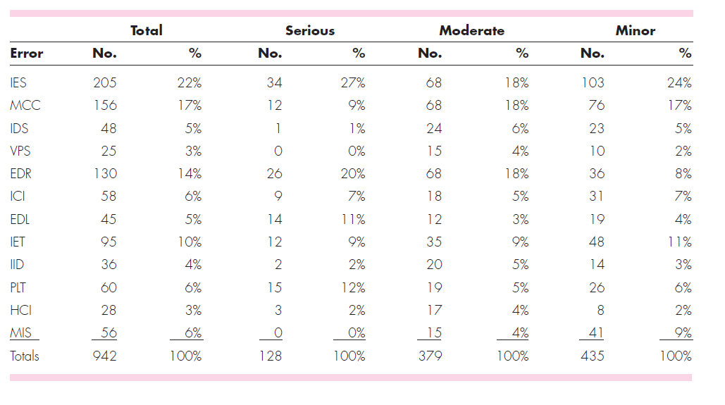
Data collection for statistical SQA
These slides are designed to accompany Software Engineering: A Practitioner’s Approach, 7/e (McGraw-Hill 2009). Slides copyright 2009 by Roger Pressman.

Slide 12
Conti..
The application of the statistical SQA and the Pareto principle can be summarized in a single sentence:
Spend your time focusing on things that really matter, but first be sure that you understand what really matters!
These slides are designed to accompany Software Engineering: A Practitioner’s Approach, 7/e (McGraw-Hill 2009). Slides copyright 2009 by Roger Pressman.

Slide 13
Six-Sigma for Software Engineering
The term “six sigma” is derived from six standard deviations—3.4 instances (defects) per million occurrences—implying an extremely high quality standard.
The Six Sigma methodology defines three core steps:
  Define customer requirements and deliverables and project goals via well-defined methods of customer communication
  Measure the existing process and its output to determine current quality performance (collect defect metrics)
  Analyze defect metrics and determine the vital few causes.
If an existing software process is in place, but improvement is required, Six Sigma suggests two additional steps:
  Improve the process by eliminating the root causes of defects.
  Control the process to ensure that future work does not reintroduce the causes of defects.
These slides are designed to accompany Software Engineering: A Practitioner’s Approach, 7/e (McGraw-Hill 2009). Slides copyright 2009 by Roger Pressman.

Slide 14
Conti…
If an organization is developing a software process (rather than improving an existing process), the core steps are augmented as follows:
Design the process to (1) avoid the root causes of defects and (2) to meet customer requirements.
Verify that the process model will, in fact, avoid defects and meet customer requirements.
These slides are designed to accompany Software Engineering: A Practitioner’s Approach, 7/e (McGraw-Hill 2009). Slides copyright 2009 by Roger Pressman.

Slide 15
Software Reliability
A simple measure of reliability is mean-time-between-failure (MTBF), where
MTBF = MTTF + MTTR
The acronyms MTTF and MTTR are mean-time-to-failure and mean-time-to-repair, respectively.
Software availability is the probability that a program is operating according to requirements at a given point in time and is defined as
Availability = [MTTF/(MTTF + MTTR)] x 100%
These slides are designed to accompany Software Engineering: A Practitioner’s Approach, 7/e (McGraw-Hill 2009). Slides copyright 2009 by Roger Pressman.

Slide 16
Software Safety
Software safety is a software quality assurance activity that focuses on the identification and assessment of potential hazards that may affect software negatively and cause an entire system to fail.
If hazards can be identified early in the software process, software design features can be specified that will either eliminate or control potential hazards.
These slides are designed to accompany Software Engineering: A Practitioner’s Approach, 7/e (McGraw-Hill 2009). Slides copyright 2009 by Roger Pressman.

Slide 17
ISO 9001:2000 Standard
ISO 9001:2000 is the quality assurance standard that applies to software engineering.
The standard contains 20 requirements that must be present for an effective quality assurance system.
The requirements delineated by ISO 9001:2000 address topics such as
  management responsibility, quality system, contract review, design control, document and data control, product identification and traceability, process control, inspection and testing, corrective and preventive action, control of quality records, internal quality audits, training, servicing, and statistical techniques.
These slides are designed to accompany Software Engineering: A Practitioner’s Approach, 7/e (McGraw-Hill 2009). Slides copyright 2009 by Roger Pressman.

