Slide 1
Chapter 23
Product Metrics
Slide Set to accompany
Software Engineering: A Practitioner’s Approach, 7/e
by Roger S. Pressman
Slides copyright © 1996, 2001, 2005, 2009 by Roger S. Pressman
For non-profit educational use only
May be reproduced ONLY for student use at the university level when used in conjunction with Software Engineering: A Practitioner's Approach, 7/e. Any other reproduction or use is prohibited without the express written permission of the author.
All copyright information MUST appear if these slides are posted on a website for student use.
These slides are designed to accompany Software Engineering: A Practitioner’s Approach, 7/e (McGraw-Hill 2009). Slides copyright 2009 by Roger Pressman.

Slide 2
McCall’s Triangle of Quality
M
a
i
n
t
a
i
n
a
b
i
l
i
t
y
M
a
i
n
t
a
i
n
a
b
i
l
i
t
y
P
o
r
t
a
b
i
l
i
t
y
P
o
r
t
a
b
i
l
i
t
y
F
l
e
x
i
b
i
l
i
t
y
F
l
e
x
i
b
i
l
i
t
y
R
e
u
s
a
b
i
l
i
t
y
R
e
u
s
a
b
i
l
i
t
y
T
e
s
t
a
b
i
l
i
t
y
T
e
s
t
a
b
i
l
i
t
y
I
n
t
e
r
o
p
e
r
a
b
i
l
i
t
y
I
n
t
e
r
o
p
e
r
a
b
i
l
i
t
y
P
R
O
D
U
C
T
R
E
V
I
S
I
O
N
P
R
O
D
U
C
T
R
E
V
I
S
I
O
N
P
R
O
D
U
C
T
T
R
A
N
S
I
T
I
O
N
P
R
O
D
U
C
T
T
R
A
N
S
I
T
I
O
N
P
R
O
D
U
C
T
O
P
E
R
A
T
I
O
N
P
R
O
D
U
C
T
O
P
E
R
A
T
I
O
N
C
o
r
r
e
c
t
n
e
s
s
C
o
r
r
e
c
t
n
e
s
s
U
s
a
b
i
l
i
t
y
U
s
a
b
i
l
i
t
y
E
f
f
i
c
i
e
n
c
y
E
f
f
i
c
i
e
n
c
y
I
n
t
e
g
r
i
t
y
R
e
l
i
a
b
i
l
i
t
y
I
n
t
e
g
r
i
t
y
R
e
l
i
a
b
i
l
i
t
y
These slides are designed to accompany Software Engineering: A Practitioner’s Approach, 7/e (McGraw-Hill 2009). Slides copyright 2009 by Roger Pressman.

Slide 3
A Comment
McCall’s quality factors were proposed in the early 1970s. They are as valid today as they were in that time. It’s likely that software built to conform to these factors will exhibit high quality well into the 21st century, even if there are dramatic changes in technology.
These slides are designed to accompany Software Engineering: A Practitioner’s Approach, 7/e (McGraw-Hill 2009). Slides copyright 2009 by Roger Pressman.

Slide 4
Measures, Metrics and Indicators
A measure provides a quantitative indication of the extent, amount, dimension, capacity, or size of some attribute of a product or process
The IEEE glossary defines a metric as “a quantitative measure of the degree to which a system, component, or process possesses a given attribute.”
An indicator is a metric or combination of metrics that provide insight into the software process, a software project, or the product itself
These slides are designed to accompany Software Engineering: A Practitioner’s Approach, 7/e (McGraw-Hill 2009). Slides copyright 2009 by Roger Pressman.

Slide 5
Measurement Principles
The objectives of measurement should be established before data collection begins;
Each technical metric should be defined in an unambiguous manner;
Metrics should be derived based on a theory that is valid for the domain of application (e.g., metrics for design should draw upon basic design concepts and principles and attempt to provide an indication of the presence of an attribute that is deemed desirable);
Metrics should be tailored to best accommodate specific products and processes [Bas84]
These slides are designed to accompany Software Engineering: A Practitioner’s Approach, 7/e (McGraw-Hill 2009). Slides copyright 2009 by Roger Pressman.

Slide 6
Measurement Process
Formulation. The derivation of software measures and metrics appropriate for the representation of the software that is being considered.
Collection. The mechanism used to accumulate data required to derive the formulated metrics.
Analysis. The computation of metrics and the application of mathematical tools.
Interpretation. The evaluation of metrics results in an effort to gain insight into the quality of the representation.
Feedback. Recommendations derived from the interpretation of product metrics transmitted to the software team.
These slides are designed to accompany Software Engineering: A Practitioner’s Approach, 7/e (McGraw-Hill 2009). Slides copyright 2009 by Roger Pressman.

Slide 7
Goal-Oriented Software Measurement
The Goal/Question/Metric Paradigm
  (1) establish an explicit measurement goal that is specific to the process activity or product characteristic that is to be assessed
  (2) define a set of questions that must be answered in order to achieve the goal, and
  (3) identify well-formulated metrics that help to answer these questions.
Goal definition template
  Analyze {the name of activity or attribute to be measured}
  for the purpose of {the overall objective of the analysis}
  with respect to {the aspect of the activity or attribute that is considered}
  from the viewpoint of {the people who have an interest in the measurement}
  in the context of {the environment in which the measurement takes place}.
These slides are designed to accompany Software Engineering: A Practitioner’s Approach, 7/e (McGraw-Hill 2009). Slides copyright 2009 by Roger Pressman.

Slide 8
Example..
Analyze the SafeHome software architecture
for the purpose of evaluating architectural components
with respect to the ability to make SafeHome more extensible
from the viewpoint of the software engineers performing the work
in the context of product enhancement over the next three years.
These slides are designed to accompany Software Engineering: A Practitioner’s Approach, 7/e (McGraw-Hill 2009). Slides copyright 2009 by Roger Pressman.

Slide 9
Metrics Attributes
Simple and computable. It should be relatively easy to learn how to derive the metric, and its computation should not demand inordinate effort or time
Empirically and intuitively persuasive. The metric should satisfy the engineer’s intuitive notions about the product attribute under consideration
Consistent and objective. The metric should always yield results that are unambiguous.
Consistent in its use of units and dimensions. The mathematical computation of the metric should use measures that do not lead to bizarre combinations of unit.
Programming language independent. Metrics should be based on the analysis model, the design model, or the structure of the program itself.
Effective mechanism for quality feedback. That is, the metric should provide a software engineer with information that can lead to a higher quality end product
These slides are designed to accompany Software Engineering: A Practitioner’s Approach, 7/e (McGraw-Hill 2009). Slides copyright 2009 by Roger Pressman.

Slide 10
Collection and Analysis Principles
Whenever possible, data collection and analysis should be automated;
Valid statistical techniques should be applied to establish relationship between internal product attributes and external quality characteristics
Interpretative guidelines and recommendations should be established for each metric
These slides are designed to accompany Software Engineering: A Practitioner’s Approach, 7/e (McGraw-Hill 2009). Slides copyright 2009 by Roger Pressman.

Slide 11
Metrics for the Requirements Model
Function-based metrics: use the function point as a normalizing factor or as a measure of the “size” of the specification
Specification metrics: used as an indication of quality by measuring number of requirements by type
These slides are designed to accompany Software Engineering: A Practitioner’s Approach, 7/e (McGraw-Hill 2009). Slides copyright 2009 by Roger Pressman.

Slide 12

Function-Based Metrics
The function point metric (FP), first proposed by Albrecht [ALB79], can be used effectively as a means for measuring the functionality delivered by a system.
Function points are derived using an empirical relationship based on countable (direct) measures of software's information domain and assessments of software complexity
Information domain values are defined in the following manner:
  number of external inputs (EIs)
  number of external outputs (EOs)
  number of external inquiries (EQs)
  number of internal logical files (ILFs)
  Number of external interface files (EIFs)
These slides are designed to accompany Software Engineering: A Practitioner’s Approach, 7/e (McGraw-Hill 2009). Slides copyright 2009 by Roger Pressman.

Slide 13
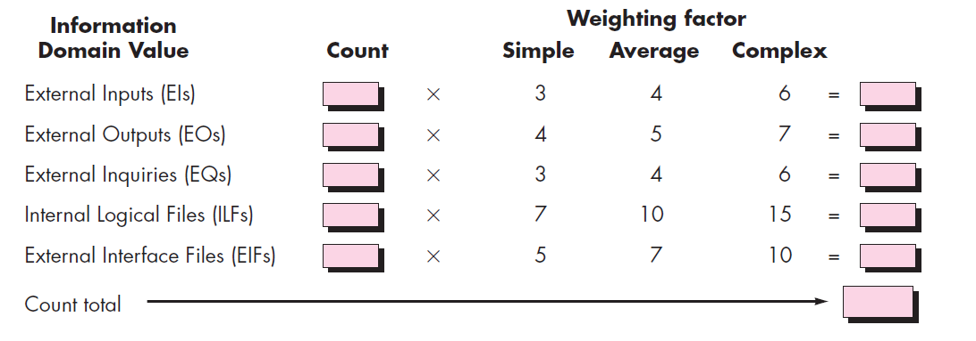
Function Points
These slides are designed to accompany Software Engineering: A Practitioner’s Approach, 7/e (McGraw-Hill 2009). Slides copyright 2009 by Roger Pressman.

Slide 14
Conti…
The Fi (i 1 to 14) are value adjustment factors (VAF) based on responses to the following questions [Lon02]:
1. Does the system require reliable backup and recovery?
2. Are specialized data communications required to transfer information to or
from the application?
3. Are there distributed processing functions?
4. Is performance critical?
5. Will the system run in an existing, heavily utilized operational environment?
6. Does the system require online data entry?
7. Does the online data entry require the input transaction to be built over multiple screens or operations?
These slides are designed to accompany Software Engineering: A Practitioner’s Approach, 7/e (McGraw-Hill 2009). Slides copyright 2009 by Roger Pressman.

Slide 15
Conti…
8. Are the ILFs updated online?
9. Are the inputs, outputs, files, or inquiries complex?
10. Is the internal processing complex?
11. Is the code designed to be reusable?
12. Are conversion and installation included in the design?
13. Is the system designed for multiple installations in different organizations?
14. Is the application designed to facilitate change and ease of use by the user?
Each of these questions is answered using a scale that ranges from 0 (not important or applicable) to 5 (absolutely essential).
The constant values in Equation (23.1) and the weighting factors that are applied to information domain counts are determined empirically.
These slides are designed to accompany Software Engineering: A Practitioner’s Approach, 7/e (McGraw-Hill 2009). Slides copyright 2009 by Roger Pressman.

Slide 16
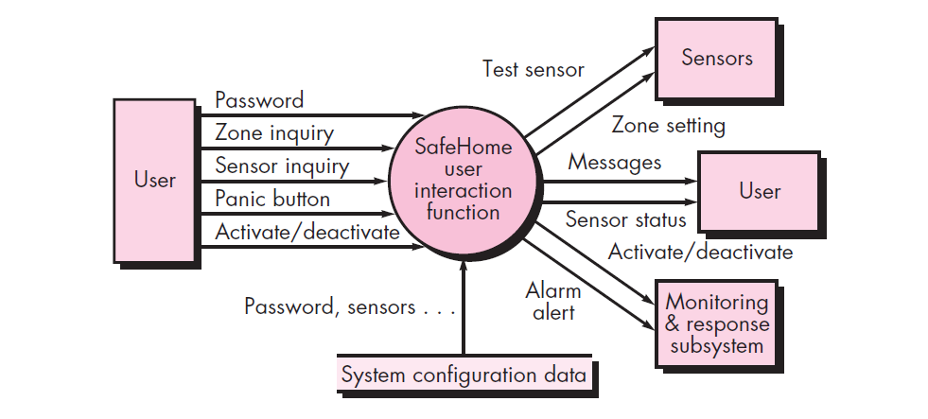
FP Example
A data flow model for SafeHome Software
These slides are designed to accompany Software Engineering: A Practitioner’s Approach, 7/e (McGraw-Hill 2009). Slides copyright 2009 by Roger Pressman.

Slide 17
Metrics for Specification Quality
A list of characteristics that can be used to assess the quality of the requirements model and the corresponding requirements specification: specificity (lack of ambiguity), completeness, correctness, understandability, verifiability, internal and external consistency, achievability, concision, traceability, modifiability, precision, and reusability.
Although many of these characteristics appear to be qualitative in nature, each can be represented using one or more metrics.
These slides are designed to accompany Software Engineering: A Practitioner’s Approach, 7/e (McGraw-Hill 2009). Slides copyright 2009 by Roger Pressman.

Slide 18
Conti…
For example, we assume that there are n_{r} requirements in a specification, such that
n_{r} = n_{f} + n_{nf}
where n_{f} is the number of functional requirements and n_{nf} is the number of nonfunctional (e.g., performance) requirements.
These slides are designed to accompany Software Engineering: A Practitioner’s Approach, 7/e (McGraw-Hill 2009). Slides copyright 2009 by Roger Pressman.

Slide 19
Conti…
To determine the specificity (lack of ambiguity) of requirements, Davis et al. suggest a metric that is based on the consistency of the reviewers’ interpretation of each requirement:
Q₁=n_{ui} / n_{r}
where n_{ui} is the number of requirements for which all reviewers had identical interpretations. The closer the value of Q to 1, the lower is the ambiguity of the specification.
These slides are designed to accompany Software Engineering: A Practitioner’s Approach, 7/e (McGraw-Hill 2009). Slides copyright 2009 by Roger Pressman.

Slide 20
Conti…
The completeness of functional requirements can be determined by computing the ratio
Q₂ = n_{u} / (n_{i} *n_{s} )
where nu is the number of unique functional requirements, n_{i} is the number of inputs (stimuli) defined or implied by the specification, and ns is the number of states specified.
These slides are designed to accompany Software Engineering: A Practitioner’s Approach, 7/e (McGraw-Hill 2009). Slides copyright 2009 by Roger Pressman.

Slide 21
Conti…
The Q2 ratio measures the percentage of necessary functions that havebeen specified for a system. However, it does not address nonfunctional requirements.To incorporate these into an overall metric for completeness, you must considerthe degree to which requirements have been validated:
Q₃ = n_{c} / (n_{c} + n_{nv})
where n_{c} is the number of requirements that have been validated as correct and n_{nv} is the number of requirements that have not yet been validated.
These slides are designed to accompany Software Engineering: A Practitioner’s Approach, 7/e (McGraw-Hill 2009). Slides copyright 2009 by Roger Pressman.

Slide 22
Architectural Design Metrics
Architectural design metrics
  Structural complexity = g(fan-out)
  Data complexity = f(input & output variables, fan-out)
  System complexity = h(structural & data complexity)
HK metric: architectural complexity as a function of fan-in and fan-out
Morphology metrics: a function of the number of modules and the number of interfaces between modules
These slides are designed to accompany Software Engineering: A Practitioner’s Approach, 7/e (McGraw-Hill 2009). Slides copyright 2009 by Roger Pressman.

Slide 23
Metrics for OO Design-I
Whitmire [Whi97] describes nine distinct and measurable characteristics of an OO design:
  Size
    Size is defined in terms of four views: population(static), volume(dynamic), length(depth of inheritance tree), and functionality(value delivered to the customer)
  Complexity
    How classes of an OO design are interrelated to one another
  Coupling
    The physical connections between elements of the OO design (e.g., the number of collaborations between classes or the number of messages passed between objects)
  Sufficiency
    “the degree to which an abstraction possesses the features required of it, or the degree to which a design component possesses features in its abstraction, from the point of view of the current application.”
  Completeness
    An indirect implication about the degree to which the abstraction or design component can be reused
These slides are designed to accompany Software Engineering: A Practitioner’s Approach, 7/e (McGraw-Hill 2009). Slides copyright 2009 by Roger Pressman.

Slide 24
Metrics for OO Design-II
  Cohesion
    The degree to which all operations working together to achieve a single, well-defined purpose
  Primitiveness
    Applied to both operations and classes, the degree to which an operation is atomicatomic—that is, the operation cannot be constructed out of a sequence of other operations contained within a class.
  Similarity
    The degree to which two or more classes are similar in terms of their structure, function, behavior, or purpose
  Volatility
    Measures the likelihood that a change will occur
These slides are designed to accompany Software Engineering: A Practitioner’s Approach, 7/e (McGraw-Hill 2009). Slides copyright 2009 by Roger Pressman.

Slide 25

Class-Oriented Metrics
Proposed by Chidamber and Kemerer [Chi94]:
weighted methods per class
Assume that n methods of complexity c₁, c₂, . . . , c_{n} are defined for a class C. The specific complexity metric that is chosen(e.g., cyclomatic complexity) should be normalized so that nominal complexity for a method takes on a value of 1.0.
These slides are designed to accompany Software Engineering: A Practitioner’s Approach, 7/e (McGraw-Hill 2009). Slides copyright 2009 by Roger Pressman.

Slide 26
More metrics
depth of the inheritance tree
number of children
coupling between object classes
response for a class
lack of cohesion in methods
These slides are designed to accompany Software Engineering: A Practitioner’s Approach, 7/e (McGraw-Hill 2009). Slides copyright 2009 by Roger Pressman.

Slide 27
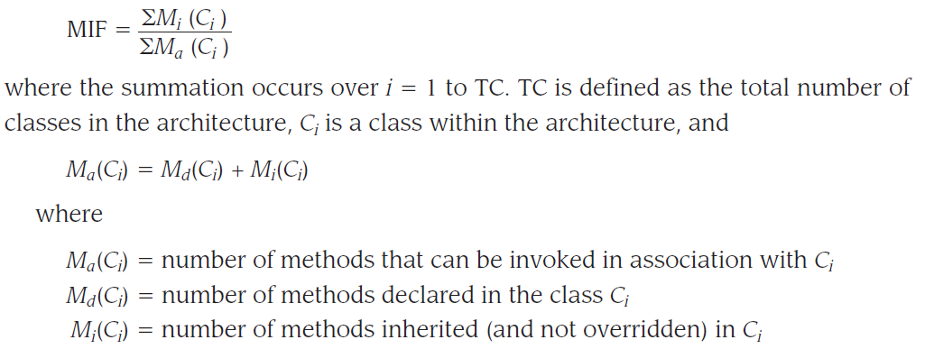
Class-Oriented Metrics
The MOOD Metrics Suite [Har98b]:
Method inheritance factor
The degree to which the class architecture of an OO system makes use of inheritance for both methods (operations) and attributes is defined as
These slides are designed to accompany Software Engineering: A Practitioner’s Approach, 7/e (McGraw-Hill 2009). Slides copyright 2009 by Roger Pressman.

Slide 28
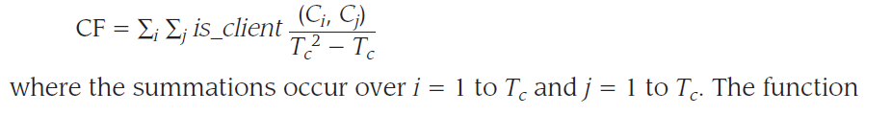
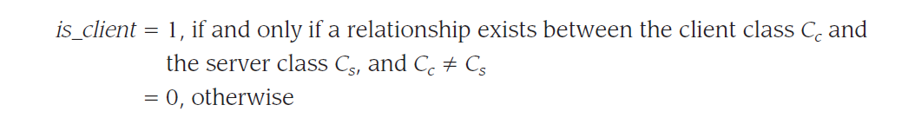
More metrics
Coupling factor
Coupling is an indication of the connections between elements of the OO design. The MOOD metrics suite defines coupling in the following way:
These slides are designed to accompany Software Engineering: A Practitioner’s Approach, 7/e (McGraw-Hill 2009). Slides copyright 2009 by Roger Pressman.

Slide 29
More metrics
Polymorphism factor
These slides are designed to accompany Software Engineering: A Practitioner’s Approach, 7/e (McGraw-Hill 2009). Slides copyright 2009 by Roger Pressman.

Slide 30
Operation-Oriented Metrics
Proposed by Lorenz and Kidd [Lor94]:
Size- size of class
Inheritance-reuse through inheritance
Internals-cohesion
Externals-coupling,reuse
These slides are designed to accompany Software Engineering: A Practitioner’s Approach, 7/e (McGraw-Hill 2009). Slides copyright 2009 by Roger Pressman.

Slide 31
Component-Level Design Metrics
Cohesion metrics: a function of data objects and the locus of their definition
Coupling metrics: a function of input and output parameters, global variables, and modules called
Complexity metrics: hundreds have been proposed (e.g., cyclomatic complexity)
These slides are designed to accompany Software Engineering: A Practitioner’s Approach, 7/e (McGraw-Hill 2009). Slides copyright 2009 by Roger Pressman.

Slide 32
Interface Design Metrics
Layout appropriateness: a function of layout entities, the geographic position and the “cost” of making transitions among entities
These slides are designed to accompany Software Engineering: A Practitioner’s Approach, 7/e (McGraw-Hill 2009). Slides copyright 2009 by Roger Pressman.

Slide 33
Design Metrics for WebApps
Does the user interface promote usability?
Are the aesthetics of the WebApp appropriate for the application domain and pleasing to the user?
Is the content designed in a manner that imparts the most information with the least effort?
Is navigation efficient and straightforward?
Has the WebApp architecture been designed to accommodate the special goals and objectives of WebApp users, the structure of content and functionality, and the flow of navigation required to use the system effectively?
Are components designed in a manner that reduces procedural complexity and enhances the correctness, reliability and performance?
These slides are designed to accompany Software Engineering: A Practitioner’s Approach, 7/e (McGraw-Hill 2009). Slides copyright 2009 by Roger Pressman.

Slide 34
Code Metrics
Halstead’s Software Science: a comprehensive collection of metrics all predicated on the number (count and occurrence) of operators and operands within a component or program
  It should be noted that Halstead’s “laws” have generated substantial controversy, and many believe that the underlying theory has flaws. However, experimental verification for selected programming languages has been performed (e.g. [FEL89]).
These slides are designed to accompany Software Engineering: A Practitioner’s Approach, 7/e (McGraw-Hill 2009). Slides copyright 2009 by Roger Pressman.

Slide 35
Metrics for Testing
Testing effort can also be estimated using metrics derived from Halstead measures
Binder [Bin94] suggests a broad array of design metrics that have a direct influence on the “testability” of an OO system.
  Lack of cohesion in methods (LCOM).
  Percent public and protected (PAP).
  Public access to data members (PAD).
  Number of root classes (NOR).
  Fan-in (FIN).
  Number of children (NOC) and depth of the inheritance tree (DIT).
These slides are designed to accompany Software Engineering: A Practitioner’s Approach, 7/e (McGraw-Hill 2009). Slides copyright 2009 by Roger Pressman.

Slide 36
Maintenance Metrics
IEEE Std. 982.1-1988 [IEE94] suggests a software maturity index (SMI) that provides an indication of the stability of a software product (based on changes that occur for each release of the product). The following information is determined:
    M_{T} = the number of modules in the current release
    F_{c} = the number of modules in the current release that have been changed
    F_{a} = the number of modules in the current release that have been added
    F_{d} = the number of modules from the preceding release that were deleted in the current release
The software maturity index is computed in the following manner:
    SMI = [M_{T} - (F_{a} + F_{c} + F_{d})]/M_{T}
As SMI approaches 1.0, the product begins to stabilize.
These slides are designed to accompany Software Engineering: A Practitioner’s Approach, 7/e (McGraw-Hill 2009). Slides copyright 2009 by Roger Pressman.

