Slide 1
Chapter 26
Estimation for Software Projects
Slide Set to accompany
Software Engineering: A Practitioner’s Approach, 7/e
by Roger S. Pressman
Slides copyright © 1996, 2001, 2005, 2009 by Roger S. Pressman
For non-profit educational use only
May be reproduced ONLY for student use at the university level when used in conjunction with Software Engineering: A Practitioner's Approach, 7/e. Any other reproduction or use is prohibited without the express written permission of the author.
All copyright information MUST appear if these slides are posted on a website for student use.
These slides are designed to accompany Software Engineering: A Practitioner’s Approach, 7/e (McGraw-Hill 2009). Slides copyright 2009 by Roger Pressman.

Slide 2
Software Project Planning
The overall goal of project planning is to establish a pragmatic strategy for controlling, tracking, and monitoring a complex technical project.
Why?
So the end result gets done on time, with quality!
These slides are designed to accompany Software Engineering: A Practitioner’s Approach, 7/e (McGraw-Hill 2009). Slides copyright 2009 by Roger Pressman.

Slide 3
Project Planning Task Set-I
Establish project scope
Determine feasibility
Analyze risks.
Define required resources
  Determine require human resources
  Define reusable software resources
  Identify environmental resources
These slides are designed to accompany Software Engineering: A Practitioner’s Approach, 7/e (McGraw-Hill 2009). Slides copyright 2009 by Roger Pressman.

Slide 4
Project Planning Task Set-II
Estimate cost and effort
  Decompose the problem
  Develop two or more estimates using size, function points, process tasks or use-cases
  Reconcile the estimates
Develop a project schedule
  Scheduling is considered in detail in Chapter 27.
    Establish a meaningful task set
    Define a task network
    Use scheduling tools to develop a timeline chart
    Define schedule tracking mechanisms
These slides are designed to accompany Software Engineering: A Practitioner’s Approach, 7/e (McGraw-Hill 2009). Slides copyright 2009 by Roger Pressman.

Slide 5
Estimation
Estimation of resources, cost, and schedule for a software engineering effort requires
  experience
  access to good historical information (metrics)
  the courage to commit to quantitative predictions when qualitative information is all that exists
Estimation carries inherent risk and this risk leads to uncertainty
These slides are designed to accompany Software Engineering: A Practitioner’s Approach, 7/e (McGraw-Hill 2009). Slides copyright 2009 by Roger Pressman.

Slide 6
Write it Down!
Project Scope
Estimates
Risks
Schedule
Control strategy
Software
Project
Plan
These slides are designed to accompany Software Engineering: A Practitioner’s Approach, 7/e (McGraw-Hill 2009). Slides copyright 2009 by Roger Pressman.

Slide 7
To Understand Scope ...
Understand the customers needs
understand the business context
understand the project boundaries
understand the customer’s motivation
understand the likely paths for change
understand that ...
Even when you understand,
nothing is guaranteed!
These slides are designed to accompany Software Engineering: A Practitioner’s Approach, 7/e (McGraw-Hill 2009). Slides copyright 2009 by Roger Pressman.

Slide 8
What is Scope?
Software scope describes
  the functions and features that are to be delivered to end-users
  the data that are input and output
  the “content” that is presented to users as a consequence of using the software
  the performance, constraints, interfaces, and reliability that bound the system.
Scope is defined using one of two techniques:
    A narrative description of software scope is developed after communication with all stakeholders.
    A set of use-cases is developed by end-users.
These slides are designed to accompany Software Engineering: A Practitioner’s Approach, 7/e (McGraw-Hill 2009). Slides copyright 2009 by Roger Pressman.

Slide 9
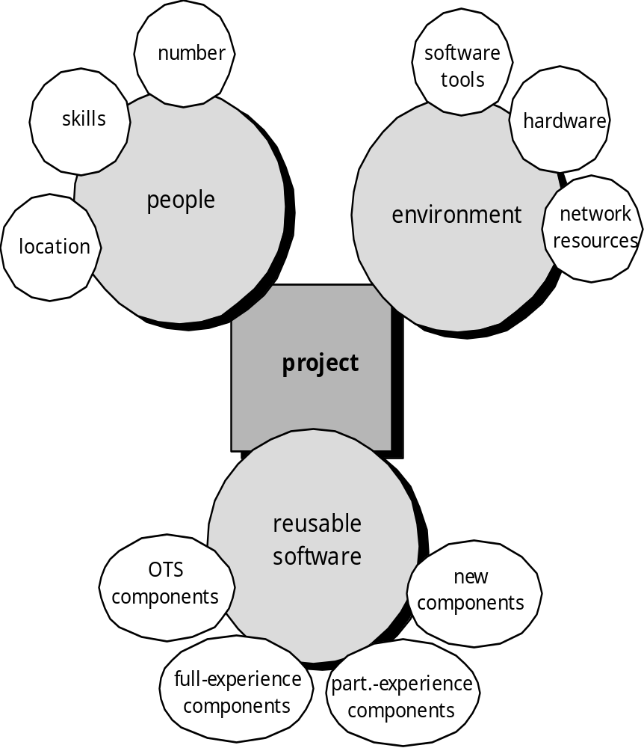
Resources
These slides are designed to accompany Software Engineering: A Practitioner’s Approach, 7/e (McGraw-Hill 2009). Slides copyright 2009 by Roger Pressman.

Slide 10

Project Estimation
Project scope must be understood
Elaboration (decomposition) is necessary
Historical metrics are very helpful
At least two different techniques should be used
Uncertainty is inherent in the process
These slides are designed to accompany Software Engineering: A Practitioner’s Approach, 7/e (McGraw-Hill 2009). Slides copyright 2009 by Roger Pressman.

Slide 11

Estimation Techniques
Past (similar) project experience
Conventional estimation techniques
  task breakdown and effort estimates
  size (e.g., LOC, FP) estimates
Empirical models
Automated tools
These slides are designed to accompany Software Engineering: A Practitioner’s Approach, 7/e (McGraw-Hill 2009). Slides copyright 2009 by Roger Pressman.

Slide 12
Estimation Accuracy
Predicated on …
  the degree to which the planner has properly estimated the size of the product to be built
  the ability to translate the size estimate into human effort, calendar time, and dollars (a function of the availability of reliable software metrics from past projects)
  the degree to which the project plan reflects the abilities of the software team
  the stability of product requirements and the environment that supports the software engineering effort.
These slides are designed to accompany Software Engineering: A Practitioner’s Approach, 7/e (McGraw-Hill 2009). Slides copyright 2009 by Roger Pressman.

Slide 13
Software sizing
Putnam and Myers [Put92] suggest four different approaches to the sizing problem:
“Fuzzy logic” sizing. To apply this approach, the planner must identify the type of application, establish its magnitude on a qualitative scale, and then refine the magnitude within the original range.
Function point sizing. The planner develops estimates of the information domain characteristics
Standard component sizing. The project planner estimates the number of occurrences of each standard component and then uses historical project data to estimate the delivered size per standard component.
Change sizing. The planner estimates the number and type (e.g., reuse, adding code, changing code, deleting code) of modifications that must be accomplished.
These slides are designed to accompany Software Engineering: A Practitioner’s Approach, 7/e (McGraw-Hill 2009). Slides copyright 2009 by Roger Pressman.

Slide 14

Conventional Methods:
LOC/FP Approach
compute LOC/FP using estimates of information domain values
use historical data to build estimates for the project
A three-point or expected value can then be computed. The expected value for the estimation variable (size) S can be computed as a weighted average of the optimistic (s_{opt}), most likely (s_{m}), and pessimistic (s_{pess}) estimates. For example,
These slides are designed to accompany Software Engineering: A Practitioner’s Approach, 7/e (McGraw-Hill 2009). Slides copyright 2009 by Roger Pressman.

Slide 15
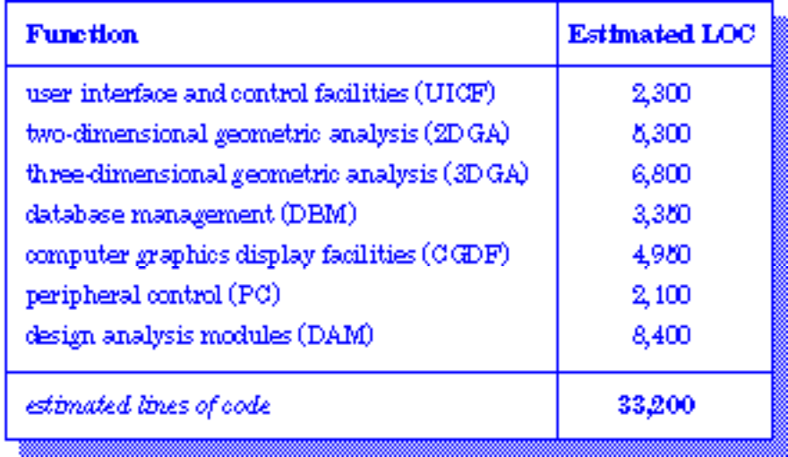
Example: LOC Approach
Average productivity for systems of this type = 620 LOC/pm.
Burdened labor rate =$8000 per month, the cost per line of code is approximately $13.
Based on the LOC estimate and the historical productivity data, the total estimated project cost is $431,000 and the estimated effort is 54 person-months.
These slides are designed to accompany Software Engineering: A Practitioner’s Approach, 7/e (McGraw-Hill 2009). Slides copyright 2009 by Roger Pressman.

Slide 16
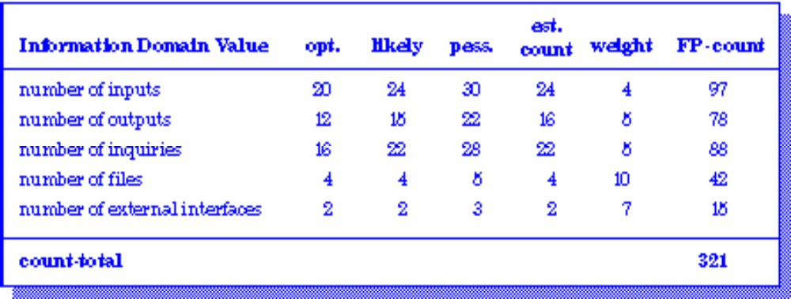
Example: FP Approach
The estimated number of FP is derived:
FP_{estimated} = count-total 3 [0.65 + 0.01 3 S (F_{i})]
FP_{estimated} = 375
organizational average productivity = 6.5 FP/pm.
burdened labor rate = $8000 per month, approximately $1230/FP.
Based on the FP estimate and the historical productivity data, total estimated project cost is $461,000 and estimated effort is 58 person-months.
These slides are designed to accompany Software Engineering: A Practitioner’s Approach, 7/e (McGraw-Hill 2009). Slides copyright 2009 by Roger Pressman.

Slide 17
Process-Based Estimation
Obtained from “process framework”
framework activities
application
functions
Effort required to accomplish
each framework activity for each application function
These slides are designed to accompany Software Engineering: A Practitioner’s Approach, 7/e (McGraw-Hill 2009). Slides copyright 2009 by Roger Pressman.

Slide 18
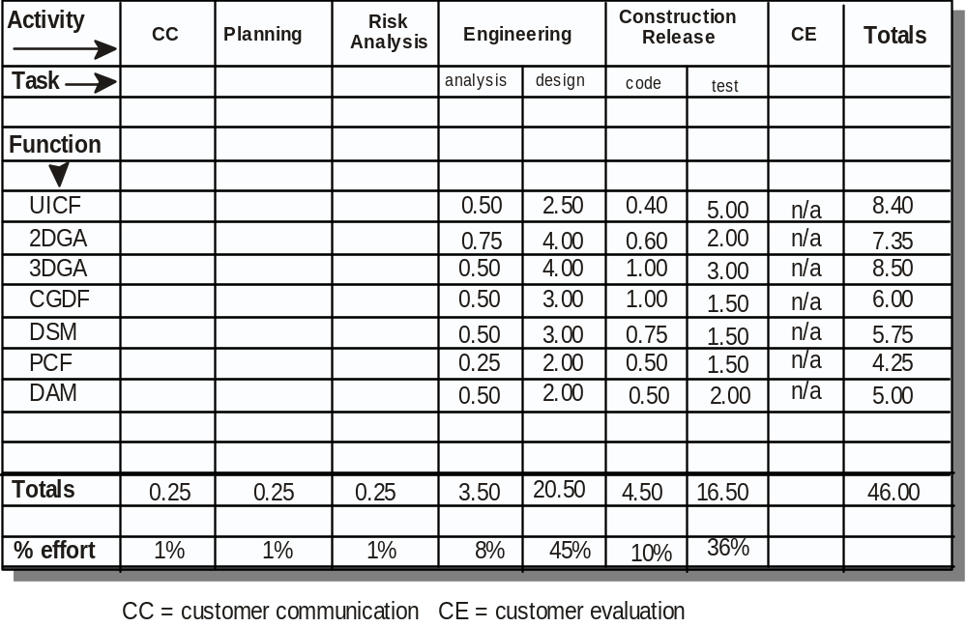
Process-Based Estimation Example
Based on an average burdened labor rate of $8,000 per month, the total estimated project cost is $368,000 and the estimated effort is 46 person-months.
These slides are designed to accompany Software Engineering: A Practitioner’s Approach, 7/e (McGraw-Hill 2009). Slides copyright 2009 by Roger Pressman.

Slide 19

Tool-Based Estimation
project characteristics
calibration factors
LOC/FP data
These slides are designed to accompany Software Engineering: A Practitioner’s Approach, 7/e (McGraw-Hill 2009). Slides copyright 2009 by Roger Pressman.

Slide 20
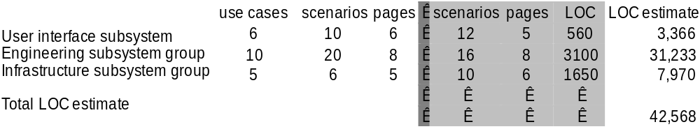
Estimation with Use-Cases
Using 620 LOC/pm as the average productivity for systems of this type and a burdened labor rate of $8000 per month, the cost per line of code is approximately $13. Based on the use-case estimate and the historical productivity data, the total estimated project cost is $552,000 and the estimated effort is 68 person-months.
These slides are designed to accompany Software Engineering: A Practitioner’s Approach, 7/e (McGraw-Hill 2009). Slides copyright 2009 by Roger Pressman.

Slide 21
Empirical Estimation Models
General form:
exponent
effort = tuning coefficient * size
usually derived
empirically
as person-months
derived
of effort required
usually LOC but
may also be
either a constant or
function point
a number derived based
on complexity of project
These slides are designed to accompany Software Engineering: A Practitioner’s Approach, 7/e (McGraw-Hill 2009). Slides copyright 2009 by Roger Pressman.

Slide 22
COCOMO-II
COCOMO II is actually a hierarchy of estimation models that address the following areas:
    Application composition model. Used during the early stages of software engineering, when prototyping of user interfaces, consideration of software and system interaction, assessment of performance, and evaluation of technology maturity are paramount.
    Early design stage model. Used once requirements have been stabilized and basic software architecture has been established.
    Post-architecture-stage model. Used during the construction of the software.
These slides are designed to accompany Software Engineering: A Practitioner’s Approach, 7/e (McGraw-Hill 2009). Slides copyright 2009 by Roger Pressman.

Slide 23
The Software Equation
A dynamic multivariable model
E = [LOC x B^{0.333}/P]³ x (1/t⁴)
where
E = effort in person-months or person-years
t = project duration in months or years
B = “special skills factor”
P = “productivity parameter”
These slides are designed to accompany Software Engineering: A Practitioner’s Approach, 7/e (McGraw-Hill 2009). Slides copyright 2009 by Roger Pressman.

Slide 24
Estimation for OO Projects-I
Develop estimates using effort decomposition, FP analysis, and any other method that is applicable for conventional applications.
Using object-oriented requirements modeling (Chapter 6), develop use-cases and determine a count.
From the analysis model, determine the number of key classes (called analysis classes in Chapter 6).
Categorize the type of interface for the application and develop a multiplier for support classes:
  Interface type Multiplier
  No GUI 2.0
  Text-based user interface 2.25
  GUI 2.5
  Complex GUI 3.0
These slides are designed to accompany Software Engineering: A Practitioner’s Approach, 7/e (McGraw-Hill 2009). Slides copyright 2009 by Roger Pressman.

Slide 25
Estimation for OO Projects-II
Multiply the number of key classes (step 3) by the multiplier to obtain an estimate for the number of support classes.
Multiply the total number of classes (key + support) by the average number of work-units per class. Lorenz and Kidd suggest 15 to 20 person-days per class.
Cross check the class-based estimate by multiplying the average number of work-units per use-case
These slides are designed to accompany Software Engineering: A Practitioner’s Approach, 7/e (McGraw-Hill 2009). Slides copyright 2009 by Roger Pressman.

Slide 26
Estimation for Agile Projects
Each user scenario (a mini-use-case) is considered separately for estimation purposes.
The scenario is decomposed into the set of software engineering tasks that will be required to develop it.
Each task is estimated separately. Note: estimation can be based on historical data, an empirical model, or “experience.”
  Alternatively, the ‘volume’ of the scenario can be estimated in LOC, FP or some other volume-oriented measure (e.g., use-case count).
Estimates for each task are summed to create an estimate for the scenario.
  Alternatively, the volume estimate for the scenario is translated into effort using historical data.
The effort estimates for all scenarios that are to be implemented for a given software increment are summed to develop the effort estimate for the increment.
These slides are designed to accompany Software Engineering: A Practitioner’s Approach, 7/e (McGraw-Hill 2009). Slides copyright 2009 by Roger Pressman.

Slide 27
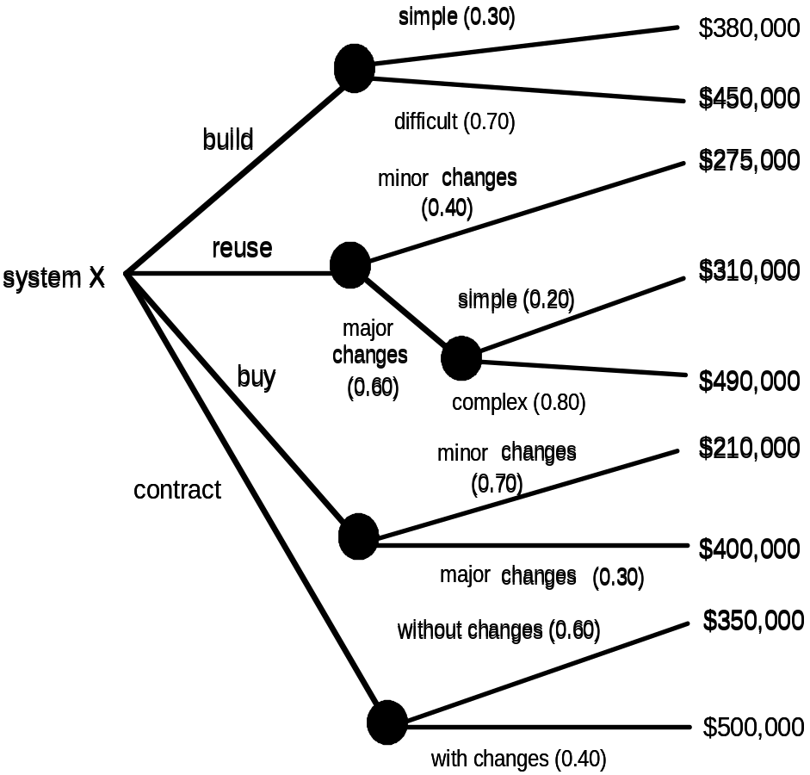
The Make-Buy Decision
These slides are designed to accompany Software Engineering: A Practitioner’s Approach, 7/e (McGraw-Hill 2009). Slides copyright 2009 by Roger Pressman.

Slide 28
Computing Expected Cost
expected cost =
(path probability) x (estimated path cost)
i
i
For example, the expected cost to build is:
expected cost = 0.30 ($380K) + 0.70 ($450K)
build
= $429 K
similarly,
expected cost = $382K
reuse
expected cost = $267K
buy
expected cost = $410K
contr
These slides are designed to accompany Software Engineering: A Practitioner’s Approach, 7/e (McGraw-Hill 2009). Slides copyright 2009 by Roger Pressman.

