Slide 1
Chapter 28
Risk Analysis
Slide Set to accompany
Software Engineering: A Practitioner’s Approach, 7/e
by Roger S. Pressman
Slides copyright © 1996, 2001, 2005, 2009 by Roger S. Pressman
For non-profit educational use only
May be reproduced ONLY for student use at the university level when used in conjunction with Software Engineering: A Practitioner's Approach, 7/e. Any other reproduction or use is prohibited without the express written permission of the author.
All copyright information MUST appear if these slides are posted on a website for student use.
These slides are designed to accompany Software Engineering: A Practitioner’s Approach, 7/e (McGraw-Hill 2009). Slides copyright 2009 by Roger Pressman.

Slide 2
Project Risks
What can go wrong?
What is the likelihood?
What will the damage be?
What can we do about it?
These slides are designed to accompany Software Engineering: A Practitioner’s Approach, 7/e (McGraw-Hill 2009). Slides copyright 2009 by Roger Pressman.

Slide 3
Reactive Risk Management
project team reacts to risks when they occur
mitigation—plan for additional resources in anticipation of fire fighting
fix on failure—resource are found and applied when the risk strikes
crisis management—failure does not respond to applied resources and project is in jeopardy
These slides are designed to accompany Software Engineering: A Practitioner’s Approach, 7/e (McGraw-Hill 2009). Slides copyright 2009 by Roger Pressman.

Slide 4
Proactive Risk Management
formal risk analysis is performed
organization corrects the root causes of risk
  TQM concepts and statistical SQA
  examining risk sources that lie beyond the bounds of the software
  developing the skill to manage change
These slides are designed to accompany Software Engineering: A Practitioner’s Approach, 7/e (McGraw-Hill 2009). Slides copyright 2009 by Roger Pressman.

Slide 5
Seven Principles
Maintain a global perspective—view software risks within the context of system and the business problem
Take a forward-looking view—think about the risks that may arise in the future; establish contingency plans
Encourage open communication—if someone states a potential risk, don’t discount it.
Integrate—a consideration of risk must be integrated into the software process
Emphasize a continuous process—the team must be vigilant throughout the software process, modifying identified risks as more information is known and adding new ones as better insight is achieved.
Develop a shared product vision—if all stakeholders share the same vision of the software, it likely that better risk identification and assessment will occur.
Encourage teamwork—the talents, skills and knowledge of all stakeholder should be pooled
These slides are designed to accompany Software Engineering: A Practitioner’s Approach, 7/e (McGraw-Hill 2009). Slides copyright 2009 by Roger Pressman.

Slide 6
Risk Management Paradigm
control
track
RISK
identify
plan
analyze
These slides are designed to accompany Software Engineering: A Practitioner’s Approach, 7/e (McGraw-Hill 2009). Slides copyright 2009 by Roger Pressman.

Slide 7
Risk Identification
Product size—risks associated with the overall size of the software to be built or modified.
Business impact—risks associated with constraints imposed by management or the marketplace.
Customer characteristics—risks associated with the sophistication of the customer and the developer's ability to communicate with the customer in a timely manner.
Process definition—risks associated with the degree to which the software process has been defined and is followed by the development organization.
Development environment—risks associated with the availability and quality of the tools to be used to build the product.
Technology to be built—risks associated with the complexity of the system to be built and the "newness" of the technology that is packaged by the system.
Staff size and experience—risks associated with the overall technical and project experience of the software engineers who will do the work.
These slides are designed to accompany Software Engineering: A Practitioner’s Approach, 7/e (McGraw-Hill 2009). Slides copyright 2009 by Roger Pressman.

Slide 8
Assessing Project Risk-I
Have top software and customer managers formally committed to support the project?
Are end-users enthusiastically committed to the project and the system/product to be built?
Are requirements fully understood by the software engineering team and their customers?
Have customers been involved fully in the definition of requirements?
Do end-users have realistic expectations?
These slides are designed to accompany Software Engineering: A Practitioner’s Approach, 7/e (McGraw-Hill 2009). Slides copyright 2009 by Roger Pressman.

Slide 9
Assessing Project Risk-II
Is project scope stable?
Does the software engineering team have the right mix of skills?
Are project requirements stable?
Does the project team have experience with the technology to be implemented?
Is the number of people on the project team adequate to do the job?
Do all customer/user constituencies agree on the importance of the project and on the requirements for the system/product to be built?
These slides are designed to accompany Software Engineering: A Practitioner’s Approach, 7/e (McGraw-Hill 2009). Slides copyright 2009 by Roger Pressman.

Slide 10
Risk Components
performance risk—the degree of uncertainty that the product will meet its requirements and be fit for its intended use.
cost risk—the degree of uncertainty that the project budget will be maintained.
support risk—the degree of uncertainty that the resultant software will be easy to correct, adapt, and enhance.
schedule risk—the degree of uncertainty that the project schedule will be maintained and that the product will be delivered on time.
These slides are designed to accompany Software Engineering: A Practitioner’s Approach, 7/e (McGraw-Hill 2009). Slides copyright 2009 by Roger Pressman.

Slide 11
Risk Projection
Risk projection, also called risk estimation, attempts to rate each risk in two ways
  the likelihood or probability that the risk is real
  the consequences of the problems associated with the risk, should it occur.
The are four risk projection steps:
  establish a scale that reflects the perceived likelihood of a risk
  delineate the consequences of the risk
  estimate the impact of the risk on the project and the product,
  note the overall accuracy of the risk projection so that there will be no misunderstandings.
These slides are designed to accompany Software Engineering: A Practitioner’s Approach, 7/e (McGraw-Hill 2009). Slides copyright 2009 by Roger Pressman.

Slide 12
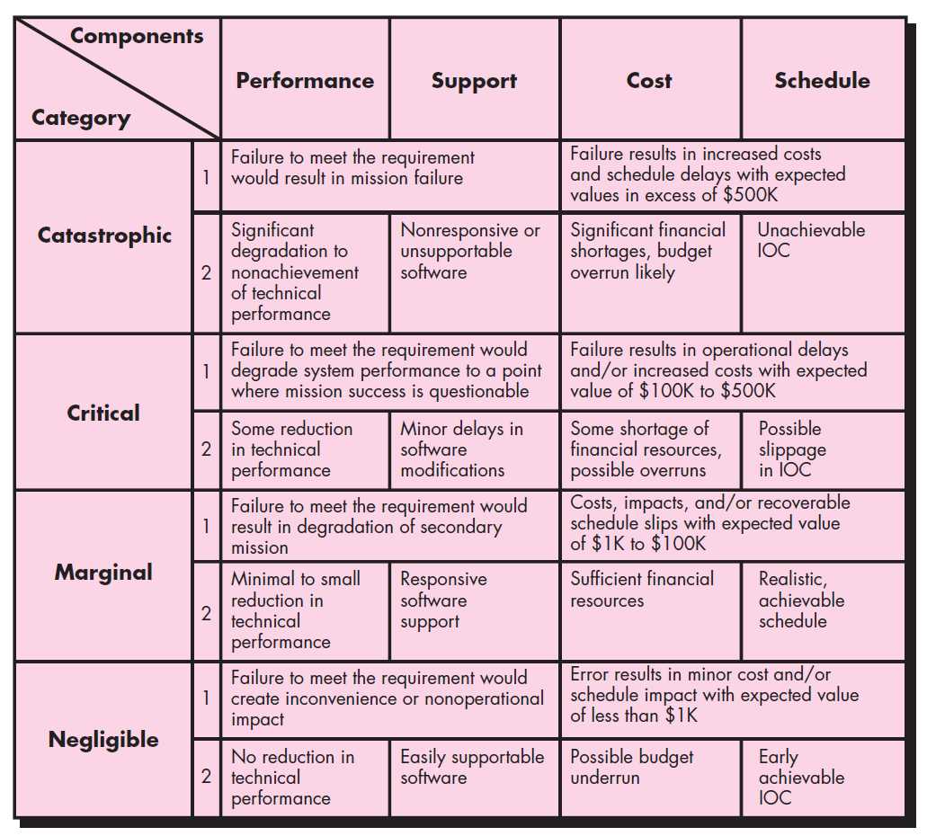
These slides are designed to accompany Software Engineering: A Practitioner’s Approach, 7/e (McGraw-Hill 2009). Slides copyright 2009 by Roger Pressman.

Slide 13
Building a Risk Table
Risk
Probability
Impact
RMMM
Risk
Mitigation
Monitoring
&
Management
These slides are designed to accompany Software Engineering: A Practitioner’s Approach, 7/e (McGraw-Hill 2009). Slides copyright 2009 by Roger Pressman.

Slide 14
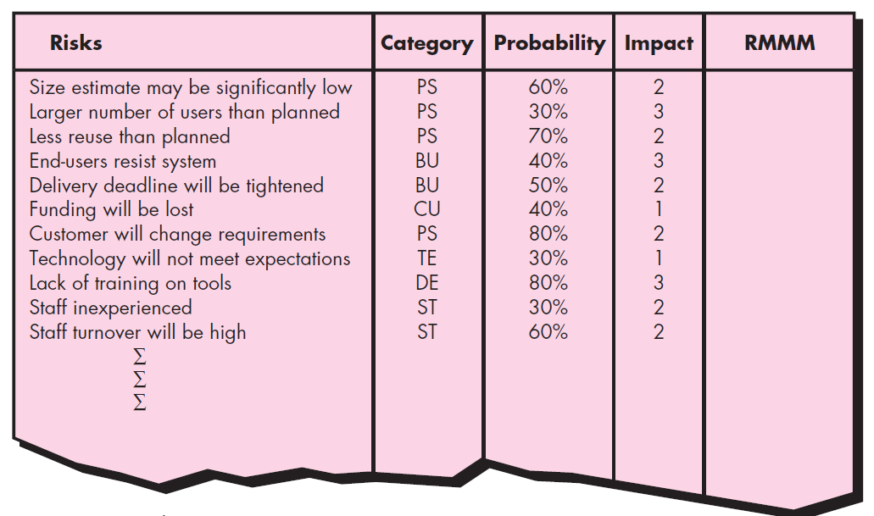

These slides are designed to accompany Software Engineering: A Practitioner’s Approach, 7/e (McGraw-Hill 2009). Slides copyright 2009 by Roger Pressman.

Slide 15
Building the Risk Table
Estimate the probability of occurrence
Estimate the impact on the project on a scale of 1 to 4, where
Impact values:
    1—catastrophic
    2—critical
    3—marginal
    4—negligible
sort the table by probability and impact
Study the resultant sorted table and define a cutoff line.
These slides are designed to accompany Software Engineering: A Practitioner’s Approach, 7/e (McGraw-Hill 2009). Slides copyright 2009 by Roger Pressman.

Slide 16
Risk Exposure (Impact)
The overall risk exposure, RE, is determined using the following relationship [Hal98]:
RE = P x C
where
P is the probability of occurrence for a risk, and
C is the cost to the project should the risk occur.
These slides are designed to accompany Software Engineering: A Practitioner’s Approach, 7/e (McGraw-Hill 2009). Slides copyright 2009 by Roger Pressman.

Slide 17
Risk Exposure Example
Risk identification. Only 70 percent of the software components scheduled for reuse will, in fact, be integrated into the application. The remaining functionality will have to be custom developed.
Risk probability. 80% (likely).
Risk impact. 60 reusable software components were planned. If only 70 percent can be used, 18 components would have to be developed from scratch (in addition to other custom software that has been scheduled for development). Since the average component is 100 LOC and local data indicate that the software engineering cost for each LOC is $14.00, the overall cost (impact) to develop the components would be 18 x 100 x 14 = $25,200.
Risk exposure. RE = 0.80 x 25,200 ~ $20,200.
These slides are designed to accompany Software Engineering: A Practitioner’s Approach, 7/e (McGraw-Hill 2009). Slides copyright 2009 by Roger Pressman.

Slide 18
Risk Mitigation, Monitoring, and Management
mitigation—how can we avoid the risk?
monitoring—what factors can we track that will enable us to determine if the risk is becoming more or less likely?
management—what contingency plans do we have if the risk becomes a reality?
These slides are designed to accompany Software Engineering: A Practitioner’s Approach, 7/e (McGraw-Hill 2009). Slides copyright 2009 by Roger Pressman.

Slide 19
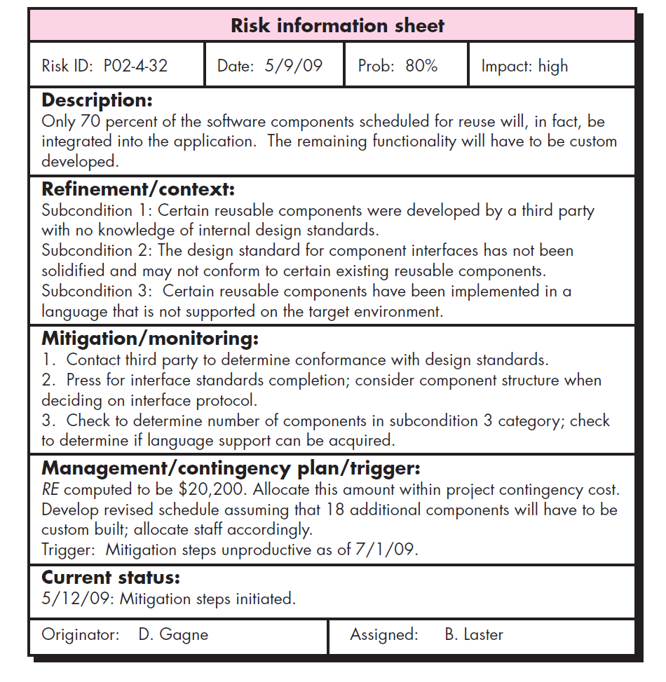
These slides are designed to accompany Software Engineering: A Practitioner’s Approach, 7/e (McGraw-Hill 2009). Slides copyright 2009 by Roger Pressman.

Slide 20
Risk Due to Product Size
Attributes that affect risk:
• estimated size of the product in LOC or FP?
• estimated size of product in number of programs,
files, transactions?
• percentage deviation in size of product from
average for previous products?
• size of database created or used by the product?
• number of users of the product?
• number of projected changes to the requirements
for the product? before delivery? after delivery?
• amount of reused software?
These slides are designed to accompany Software Engineering: A Practitioner’s Approach, 7/e (McGraw-Hill 2009). Slides copyright 2009 by Roger Pressman.

Slide 21
Risk Due to Business Impact
Attributes that affect risk:
• affect of this product on company revenue?
• visibility of this product by senior management?
• reasonableness of delivery deadline?
• number of customers who will use this product
• interoperability constraints
• sophistication of end users?
• amount and quality of product documentation that
must be produced and delivered to the customer?
• governmental constraints
• costs associated with late delivery?
• costs associated with a defective product?
These slides are designed to accompany Software Engineering: A Practitioner’s Approach, 7/e (McGraw-Hill 2009). Slides copyright 2009 by Roger Pressman.

Slide 22
Risks Due to the Customer
Questions that must be answered:
• Have you worked with the customer in the past?
• Does the customer have a solid idea of requirements?
• Has the customer agreed to spend time with you?
• Is the customer willing to participate in reviews?
• Is the customer technically sophisticated?
• Is the customer willing to let your people do their
job—that is, will the customer resist looking over your
shoulder during technically detailed work?
• Does the customer understand the software
engineering process?
These slides are designed to accompany Software Engineering: A Practitioner’s Approach, 7/e (McGraw-Hill 2009). Slides copyright 2009 by Roger Pressman.

Slide 23
Risks Due to Process Maturity
Questions that must be answered:
• Have you established a common process framework?
• Is it followed by project teams?
• Do you have management support for
software engineering
• Do you have a proactive approach to SQA?
• Do you conduct formal technical reviews?
• Are CASE tools used for analysis, design and
testing?
• Are the tools integrated with one another?
• Have document formats been established?
These slides are designed to accompany Software Engineering: A Practitioner’s Approach, 7/e (McGraw-Hill 2009). Slides copyright 2009 by Roger Pressman.

Slide 24
Technology Risks
Questions that must be answered:
• Is the technology new to your organization?
• Are new algorithms, I/O technology required?
• Is new or unproven hardware involved?
• Does the application interface with new software?
• Is a specialized user interface required?
• Is the application radically different?
• Are you using new software engineering methods?
• Are you using unconventional software development
methods, such as formal methods, AI-based approaches,
artificial neural networks?
• Are there significant performance constraints?
• Is there doubt the functionality requested is "do-able?"
These slides are designed to accompany Software Engineering: A Practitioner’s Approach, 7/e (McGraw-Hill 2009). Slides copyright 2009 by Roger Pressman.

Slide 25
Staff/People Risks
Questions that must be answered:
• Are the best people available?
• Does staff have the right skills?
• Are enough people available?
• Are staff committed for entire duration?
• Will some people work part time?
• Do staff have the right expectations?
• Have staff received necessary training?
• Will turnover among staff be low?
These slides are designed to accompany Software Engineering: A Practitioner’s Approach, 7/e (McGraw-Hill 2009). Slides copyright 2009 by Roger Pressman.

Slide 26
Recording Risk Information
Project: Embedded software for XYZ system
Risk type: schedule risk
Priority (1 low ... 5 critical): 4
Risk factor: Project completion will depend on tests which require
hardware component under development. Hardware component
delivery may be delayed
Probability: 60 %
Impact: Project completion will be delayed for each day that
hardware is unavailable for use in software testing
Monitoring approach:
Scheduled milestone reviews with hardware group
Contingency plan:
Modification of testing strategy to accommodate delay using
software simulation
Estimated resources: 6 additional person months beginning in July
These slides are designed to accompany Software Engineering: A Practitioner’s Approach, 7/e (McGraw-Hill 2009). Slides copyright 2009 by Roger Pressman.

