Slide 1
Web Technology (16ITC19) UNIT - I

Slide 2
Introduction: Web Fundamentals,
Origins
What the Internet is
Internet Protocol Address
Domain names
The World Wide Web
Web Browsers
Web Servers
Uniform Resource Locator
Multipurpose Internet Mail Extensions
The Hypertext Transfer Protocol
Security
The Web Programmer’s Toolbox

Slide 3
Origins
U.S. Department of Defense(DoD) interested in developing a new large-scale computer network in the 1960’s, which led to ARPAnet(Advanced Research Projects Agency net).
ARPAnet was simple text- based communications through e-mail.
Later in 1970’s and 1980’s BITNET(Because It’s Time Network) and CSNET(Computer Science Network) were developed for servicing the institutions of the Universities.
In 1986 NSFnet(National Science Foundation) was created and replaced ARPAnet for non-military uses.
By 1992, a wide variety of organizations had established nodes on this network and had connected more than 1 million computers around the world.
In 1995 a small part of NSFnet returned to being a research network and the rest became as Internet.

Slide 4
What The Internet Is?
The internet is a huge collection of computers connected in a communication network.
Transmission Control Protocol/Internet Protocol (TCP/IP), became the standard for computer network connections in 1982. It can be used directly to allow a program on one computer to communicate with a program on another computer via the Internet.
Rather than connecting every computer on the Internet directly to every other computer on the Internet, normally the individual computers in an organization are connected to each other in a local network. (LAN)
One node on this local network is physically connected to the Internet. So, the Internet is actually a network of networks,rather than a network of computers.
LAN → MAN → WAN

Slide 5
Internet-Based Services
Some of the basic services available to Internet users are −
Email − A fast, easy, and inexpensive way to communicate with other Internet users around the world.
Telnet − Allows a user to log into a remote computer as though it were a local system.
FTP − Allows a user to transfer virtually every kind of file that can be stored on a computer from one Internet-connected computer to another.
UseNet news − A distributed bulletin board that offers a combination news and discussion service on thousands of topics.
World Wide Web (WWW) − A hypertext interface to Internet information resources.

Slide 6
Internet Protocol Address
Internet nodes are identified by numeric addresses.
The Internet Protocol (IP) address of a machine connected to the Internet is a unique 32-bit number.
IP addresses usually are written (and thought of) as four 8-bit numbers, separated by periods.
The four parts are separately used by Internet-routing computers to decide where a message must go next to get to its destination.
Class | Address Range | Supports
Class A | 1.0.0.1 to 126.255.255.254 | Supports 16 million hosts on each of 127 networks.
Class B | 128.1.0.1 to 191.255.255.254 | Supports 65,000 hosts on each of 16,000 networks.
Class C | 192.0.1.1 to 223.255.254.254 | Supports 254 hosts on each of 2 million networks.
Class D | 224.0.0.0 to 239.255.255.255 | Reserved for multicast groups.
Class E | 240.0.0.0 to 254.255.255.254 | Reserved for future use, or Research and Development Purposes.

Slide 7
Domain Names
Because people have difficulty dealing with and remembering numbers, machines on the Internet also have textual names.
Ex: movies.comedy.marxbros.com
movies local name domain
Fully Qualified Domain Name
The host name along with the domain names are together called a fully qualified domain name.
These domain names are converted into IP addresses by Domain Name System(DNS)
host

Slide 8
DNS
Because IP addresses are the addresses used internally by the Internet, the fully qualified domain name of the destination for a message, which is what is given by a browser user, must be converted to an IP address before the message can be transmitted over the Internet to the destination.
These conversions are done by software systems called name servers, which implement the Domain Name System (DNS).
Name servers serve a collection of machines on the Internet and are operated by organizations that are responsible for the part of the Internet to which those machines are connected.
All document requests from browsers are routed to the nearest name server.
If the name server can convert the fully qualified domain name to an IP address, it does so. If it cannot, the name server sends the fully qualified domain name to another name server for conversion. Like IP addresses, fully qualified domain names must be unique.
Figure 1.1 shows how fully qualified domain names requested by a browser are translated into IPs before they are routed to the appropriate Web server.

Slide 9
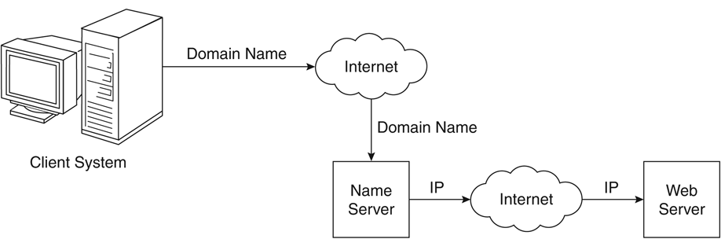
Figure 1.1 Domain name conversion
Source: Figure extracted from : Sebesta Text Book

Slide 10
The World Wide Web
In 1989, a small group of people led by Tim Berners-Lee at CERN (Conseil Européen pour la Recherche Nucléaire, or European Organization for Particle Physics),proposed a new protocol for the Internet, as well as a system of document access to use it.
The intent of this new system, which the group named the World WideWeb, was to allow scientists around the world to use the Internet to exchange documents describing their work.
Documents are sometimes just text, usually with embedded links to other documents, but they often also include images, sound recordings, or other kinds of media. When a document contains nontextual information, it is called hypermedia.

Slide 11
Web or Internet?
It is important to understand that the Internet and the Web are not the same thing.
The Internet is a collection of computers and other devices connected by equipment that allows them to communicate with each other.
The Web is a collection of software and protocols that has been installed on most, if not all, of the computers on the Internet.
Some of these computers run Web servers, which provide documents, but most run Web clients, or browsers, which request documents from servers and display them to users.
The Internet was quite useful before the Web was developed, and it is still useful without it. However, most users of the Internet now use it through the Web.

Slide 12
Web Browser and Web Server
A browser is a client on the Web because it initiates the communication with a server, which waits for a request from the client.
Web servers are programs that provide documents to requesting browsers.
Servers are slave programs: They act only when requests are made to them by browsers running on other computers on the Internet.
The most commonly used Web servers are Apache, which has been implemented for a variety of computer platforms, and Microsoft’s Internet Information Server(IIS), which runs under Windows operating systems.

Slide 13
Web Server Operation
Web browsers initiate network communications with servers by sending them URLs
A URL can specify one of two different things:
i)the address of a data file stored on the server that is to be sent to the client, or
ii) a program stored on the server that the client wants executed, with the output of the program returned to the client.
All the communications between a Web client and a Web server use the standard Web protocol, Hypertext Transfer Protocol (HTTP).
The primary task of a Web server is to monitor a communications port on its host machine, accept HTTP commands through that port, and perform the operations specified by the commands.
All HTTP commands include a URL, which includes the specification of a host server machine. When the URL is received, it is translated into either a file name (in which case the file is returned to the requesting client) or a program name (in which case the program is run and its output is sent to the requesting client).

Slide 14
Uniform Resource Locators
Uniform (or universal) resource locators (URLs) are used to identify documents (resources) on the Internet. There are many different kinds of resources, identified by different forms of URLs.
All URLs have the same general format:
scheme:object-address
The scheme is often a communications protocol. Common schemes include http, ftp, gopher, telnet, file, mailto, and news.
Different schemes use object addresses that have different forms. Our interest here is in the HTTP protocol, which supports the Web.
This protocol is used to request and send eXtensible Hypertext Markup Language (XHTML) documents. In the case of HTTP, the form of the object address of a URL is as follows:
//fully-qualified-domain-name/path-to-document
When file is the protocol, the fully qualified domain name is omitted, making the form of such URLs as follows:
file://path-to-document

Slide 15
Multipurpose Internet Mail Extensions(MIME)
A browser needs some way of determining the format of a document it receives from a Web server. Without knowing the form of the document, the browser would be unable to render it, because different document formats require different rendering tools.
The forms of these documents are specified with Multipurpose Internet Mail Extensions (MIME).
MIME was developed to specify the format of different kinds of documents to be sent via Internet mail.
These documents could contain various kinds of text, video data, or sound data.
Because the Web has needs similar to those of Internet mail, MIME was adopted as the way to specify document types transmitted over the Web.
A Web server attaches a MIME format specification to the beginning of the document that it is about to provide to a browser. When the browser receives the document from a Web server, it uses the included MIME format specification to determine what to do with the document.
If the content is text, for example, the MIME code tells the browser that it is text and also indicates the particular kind of text it is. If the content is sound, the MIME code tells the browser that it is sound and then gives the particular representation of sound so that the browser can choose a program to which it has access to produce the transmitted sound.
MIME specifications have the following form:
type/subtype

Slide 16
The HyperText Transfer Protocol(http)
All Web communications transactions use the same protocol: the Hypertext Transfer Protocol (HTTP) formally defined as RFC 2616
HTTP consists of two phases:
the request and the response.
Each HTTP communication (request or response) between a browser and a Web server consists of two parts:
a header and a body.
The header contains information about the communication; the body contains the data of the communication if there is any.

Slide 17
The Request Phase
The general form of an HTTP request is as follows:
1. HTTP method Domain part of the URL HTTP version
2. Header fields
3. Blank line
4. Message body
The following is an example of the first line of an HTTP request:
GET /storefront.html HTTP/1.1
Only a few request methods are defined by HTTP, and even a smaller number of these are typically used.
The below Table lists the most commonly used methods.

Slide 18
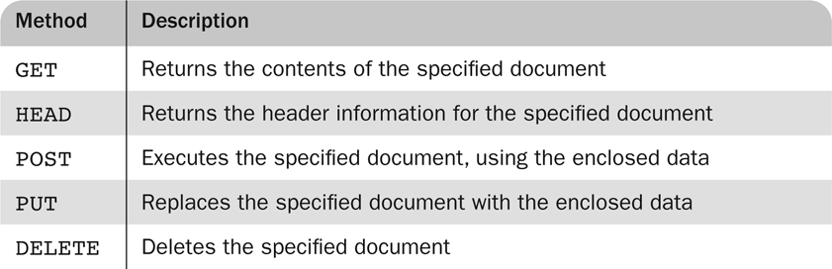
HTTP Request Methods
HTTP
The format of a header field is the field name followed by a colon and the value of the field. There are four categories of header fields:
1. General: For general information, such as the date
2. Request: Included in request headers
3. Response: For response headers
4. Entity: Used in both request and response headers

Slide 19
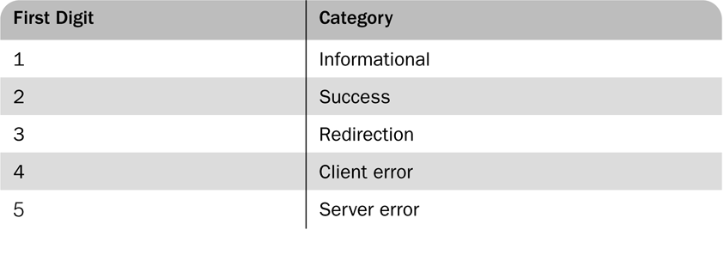
The Response Phase
The general form of an HTTP response is as follows:
1. Status line
2. Response header fields
3. Blank line
4. Response body
The status line includes the HTTP version used, a three-digit status code for the response, and a short textual explanation of the status code. For example, most responses begin with the following:
HTTP/1.1 200 OK
The status codes begin with 1, 2, 3, 4, or 5. The general meanings of the five categories specified by these first digits are shown in Table
First Digits of HTTP Status Codes

Slide 20
The Web Programmer’s Toolbox
HTML - a markup language
To describe the general form and layout of documents
HTML is not a programming language - it cannot be used describe computations.
An HTML document is a mix of content and controls
Controls are tags and their attributes
Tags often delimit content and specify something about how the content should be arranged in the document For example, <p>Write a paragraph here </p> is an element.
Attributes provide additional information about the content of a tag For example, <img src = "redhead.jpg"/> <font color ="Red" />
Plug ins
Integrated into tools like word processors, effectively converting them to WYSIWYG(What You See Is What You Get) HTML editors
Filters
Convert documents in other formats to HTML
Advantages of both filters and plug-ins:
Existing documents produced with other tools can be converted to HTML documents
Use a tool you already know to produce HTML
Disadvantages of both filters and plug-ins:
HTML output of both is not perfect - must be fine tuned
HTML may be non-standard
You have two versions of the document, which are difficult to synchronize

Slide 21
ToolBox contd..
XML
A meta-markup language (a language for defining markup language)
Used to create a new markup language for a particular purpose or area
Because the tags are designed for a specific area, they can be meaningful
JavaScript
A client-side HTML-embedded scripting language
Provides a way to access elements of HTML documents and dynamically change them
Flash
A system for building and displaying text, graphics, sound, interactivity, and animation (movies)
Two parts:
Authoring environment
Player
Supports both motion and shape animation
PHP
A server-side scripting language
Great for form processing and database access through the Web
Ajax
Asynchronous JavaScript + XML
No new technologies or languages
Much faster for Web applications that have extensive user/server interactions
Uses asynchronous requests to the server
Requests and receives small parts of documents, resulting in much faster responses
Java Web Software
Servlets – server-side Java classes
JavaServer Pages (JSP) – a Java-based approach to server-side scripting
JavaServer Faces – adds an event-driven interface model on JSP

Slide 22
ToolBox contd..
ASP.NET
Does what JSP and JSF do, but in the .NET environment
Allows.NET languages to be used as server-side scripting language
Ruby
A pure object-oriented interpreted scripting language
Every data value is an object, and all operations are via method calls
Most operators can be redefined by the user
Both classes and objects are dynamic
Rails
A development framework for Web-based applications
Particularly useful for Web applications that access databases
Written in Ruby and uses Ruby as its primary user language

Slide 23
Python
Python is a popular programming language. It was created in 1991 by Guido van Rossum.
It is used for:
web development (server-side),
software development,
mathematics,
system scripting.
What can Python do?
Python can be used on a server to create web applications.
Python can be used alongside software to create workflows.
Python can connect to database systems. It can also read and modify files.
Python can be used to handle big data and perform complex mathematics.
Python can be used for rapid prototyping, or for production-ready software development.
Why Python?
Python works on different platforms (Windows, Mac, Linux, Raspberry Pi, etc).
Python has a simple syntax similar to the English language.
Python has syntax that allows developers to write programs with fewer lines than some other programming languages.
Python runs on an interpreter system, meaning that code can be executed as soon as it is written. This means that prototyping can be very quick.
Python can be treated in a procedural way, an object-orientated way or a functional way.

