Slide 1
Definition of a web service
A Web service is seen as an application accessible to other applications over the Web .
This is a very open definition, under which just about anything that has a URL is a Web service.
A more precise definition is provided by the UDDI consortium, which characterizes Web services as "self-contained, modular business applications that have open, Internet-oriented, standards-based interfaces".
This definition is more detailed, placing the emphasis on the need for being compliant with Internet standards.

Slide 2
World Wide Web consortium (W3C), and specifically the group involved in the Web Service Activity: "a software application identified by a URI, whose interfaces and bindings are capable of being defined, described, and discovered as XML artifacts.
A Web service supports direct intimations with other software agents using XML-based messages exchanged via Internet-based protocols“.
The definition stresses that Web services should be capable of being "defined, described, and discovered," thereby clarifying the meaning of "accessible" and making more concrete the notion of "Internet-oriented, standards-based interfaces."

Slide 3
Web services are components that can be integrated into more complex distributed applications.
in the online technical dictionary Webopedia, a Web service is defined as "a standardized way of integrating Web-based applications using the XML, SOAP, WSDL, and UDDI open standards over an Internet protocol backbone. XML is used to tag the data, SOAP is used to transfer the data, WSDL is used for describing the services available, and UDDI is used for listing what services are available" .

Slide 4
Web Services Architecture
The Web Services architecture is based upon the interactions between three roles: service provider, service registry and service requestor.
The interactions involve the publish, find and
bind operations.
Together, these roles and operations act upon the Web Services artifacts

Slide 5
In a typical scenario, a service provider hosts
a network-accessible software module (an implementation of a Web service).
The service provider defines a service description for the Web service and publishes it to a service requestor or service registry.
The service requestor uses a find operation to retrieve the service description locally or from the service registry and uses the service description to bind with the service provider and invoke or interact with the Web service implementation.

Slide 6
Service provider and service requestor roles are logical constructs and a service can exhibit characteristics of both.
Figure 1 illustrates these operations, the components providing them and their interactions

Slide 7
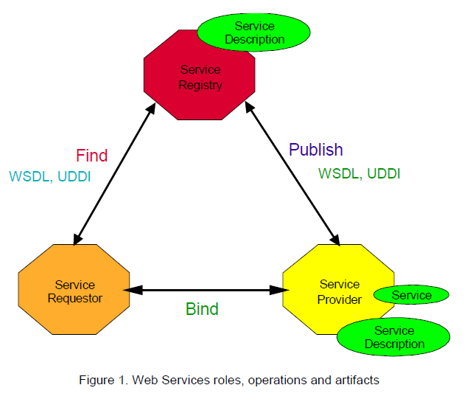

Slide 8
Roles in a Web Services Architecture
Service provider. From a business perspective, this is the owner of the service.
From an architectural perspective, this is the platform that hosts access to the service.
Service requestor. From a business perspective, this is the business that requires certain functions to be satisfied.
From an architectural perspective, this is the application that is looking for and invoking or initiating an interaction with a service.
The service requestor role can be played by a browser driven by a person or a program without a user interface, for example another Web service.

Slide 9
Service registry. This is a searchable registry of service descriptions where service providers publish their service descriptions.
Service requestors find services and obtain binding information (in the service descriptions) for services during development for static binding or during execution for dynamic binding.
For statically bound service requestors, the service registry is an optional role in the architecture, because a service
provider can send the description directly to service requestors.
Likewise, service requestors can obtain a service description from other sources besides a service registry, such as a local file, FTP site, Web site, Advertisement and Discovery of Services (ADS) or Discovery of Web Services (DISCO).

Slide 10
Operations in a Web Service Architecture
For an application to take advantage of Web Services, three behaviors must take place:
publication of service descriptions, lookup or finding of service descriptions, and binding orinvoking of services based on the service description.
These behaviors can occur singly or iteratively. In detail, these operations are:

Slide 11
Publish. To be accessible, a service description needs to be published so that the service requestor can find it. Where it is published can vary depending upon the requirements of the application.
Find. In the find operation, the service requestor retrieves a service description directly or queries the service registry for the type of service required (see “Service Discovery”for more details).
The find operation can be involved in two different lifecycle phases for
the service requestor: at design time to retrieve the service’s interface description for program development, and at runtime to retrieve the service’s binding and location description for invocation

Slide 12
Bind. Eventually, a service needs to be invoked.
In the bind operation the service requestor invokes or initiates an interaction with the service at runtime using the binding details in the service description to locate, contact and invoke the service.

Slide 13
Web Services Architecture
There are two different aspects to be considered when analyzing Web services architectures. The first aspect is related to the fact that Web services are a way to expose internal operations so that they can be invoked through the Web.
Such an implementation requires the system to be able to receive requests through the Web and to pass them to the underlying IT system. In doing this, the problems are analogous to those encountered in conventional middleware.
We will refer to such an infrastructure as internal middleware for Web services. Correspondingly, we will use the term internal architecture to refer to the organization and structure of the internal middleware.

Slide 14
The other facet of Web services architectures is represented by the middleware infrastructure whose purpose is to integrate different Web services.
Web Services will refer to such an infrastructure as external middleware for Web services .
Correspondingly, we will use the term external architecture to refer to the organization and structure of the external middleware.
The external architecture has three main components:

Slide 15
Centralized brokers. These are analogous to the centralized components in conventional middleware that route messages and provide properties to the interactions (such as logging, transactional guarantees, name and directory services, and reliability). However, as we will see, in practice the name and directory server is often the only centralized component present in Web services architectures.
• Protocol infrastructure. This refers to the set of components that coordinate the interactions among Web services and, in particular, implement the peer-to-peer protocols (such as the horizontal protocols and the meta protocols discussed in the previous section) whose aim is to provide middleware properties in those B2B settings where a centralized middleware platform cannot be put in place due to trust and privacy issues.
• Service composition infrastructure. This refers to the set of tools that support the definition and execution of composite services

Slide 16
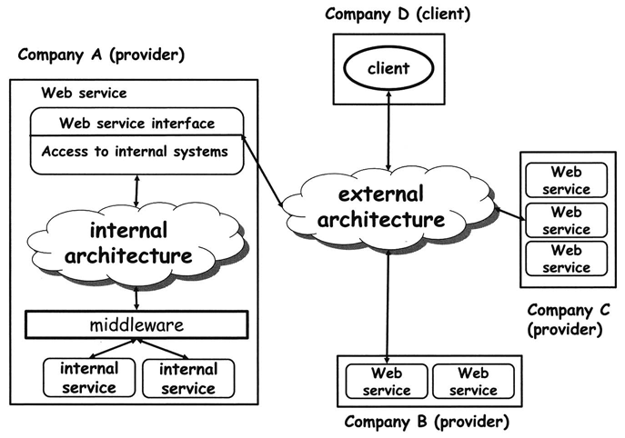

Slide 17
There are Web services technologies and products that take care solely of the internal architecture of a Web service.
There are also technologies and products that address only the external architecture of a Web service. Standardization efforts, however, mainly revolve around the external architecture.
In practice both the internal and the external architecture must work together so that a Web service can make its functionality accessible to client.

Slide 18
In EAI, conventional middleware is used to build multi-tier architectures. In these architectures, individual programs or applications are hidden behind service abstractions that are combined into higher order programs or applications by using the functionality provided by the underlying middleware.
The resulting higher order programs can in turn be hidden behind new service abstractions and can be used as building blocks for new services.

Slide 19
Web services or, better, the technologies supporting Web services, play the same role as conventional middleware, but on a different scale. The basis for composition is service abstractions very similar in nature to those used in conventional middleware, so that implementing a Web service essentially requires an extra tier on top of the others to enable access using standard Web services protocols

Slide 20
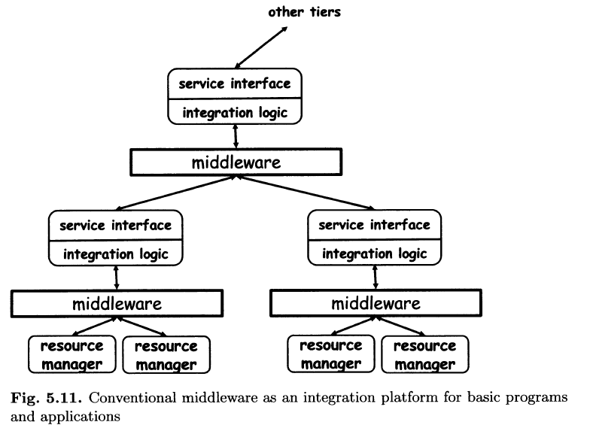

Slide 21
The implementation does not occur at the Web services layer, but within conventional middleware.
As observed earlier, Web services are just wrappers. They invoke internal
services that implement whatever application logic is needed, and then collect
the results.
Today, much of the internal middleware for Web services revolves around packing and unpacking messages exchanged between Web services and converting them into the format supported by the underlying middleware.

Slide 22
Processing a SOAP Message
The division between header and body already provides some indication of how SOAP expects messages to be processed by the different nodes along the message path.
These nodes will, in most cases, constitute the different tiers of the Web services middleware.
In the SOAP model, nodes processing a message can play one or more roles.
Each block in a SOAP header may include the definition of the role for which it is intended.
The SOAP specification defines three roles, informally called none, next, and ultimateReceiver:

Slide 23
If a block is assigned to a none role, it means that such a block should not be processed by any node receiving the message (although the block might be read if it contains information important for processing other blocks).
If a block is assigned to the ultimateReceiver role, that block is solely intended for the recipient of the message, not for any intermediate node.
If a block is assigned to the next role, every node receiving the message can process that block. This is because every node receiving a message is the "next" one in the chain of nodes processing the message. The ultimateReceiver is also included in the set of next nodes.

Slide 24
The body of the message does not have a role associated to it. Its role defaults to ultimateReceiver.
Processing a block may encompass very different operations, and each node involved in the processing could do something different.
For example, processing can involve removing blocks from the header, performing some action(such as logging the message), extending the header with additional information,removing the header and introducing a new one, and more.

Slide 25
A block may contain a must Understand flag, indicating that a node playing the role indicated by the block must process the block.
If the flag is set and, for some reason, the node cannot process the block as needed, any further processing of that message stops and a fault is generated. The message is not forwarded to any other node.
If the must Understand flag is not set or is absent, a node is free to decide whether to process or ignore the block (assuming it has the corresponding role).

Slide 26
Structure and Contents of a SOAP Message
SOAP exchanges information using messages. These messages are used as an envelope where the application encloses whatever information needs to be sent.
Each envelope contains two parts: a header and a body (Figure 6.4) given below.
The header is optional, that is, it may or may not be present in a SOAP message.
The body is mandatory, i.e., all SOAP messages must have a body.

Slide 27
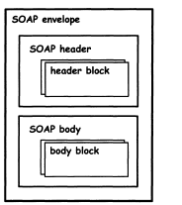
Both header and body can have multiple sub-parts in the form of header blocks or body blocks.

Slide 28
SOAP assumes that every message has a sender, an ultimate receiver, and an arbitrary number of intermediaries (called nodes) that process the message and route it to the receiver.
The core of the information the sender wants to transmit to the receiver should be in the body of the message.
Any additional information necessary for intermediate processing or added value services (like transactional interaction, security, etc.) goes into the header

Slide 29
The header contains information that can be processed by intermediate nodes. The payload or body is the actual message being conveyed.
This is the reason why the header is optional. If there are no intermediaries in a SOAP transmission, the header might not be necessary at all.
If there are intermediaries, they will work with the information in the headers as the need dictates (processing the header, adding new headers, keeping track of the message, etc.)

Slide 30
SOAP does not require any further structure within the content placed in header or body blocks. Nevertheless, there are a few common ways in which the header and body are constructed, and these are likely to become accepted forms.
Typically, there are two aspects that influence how the header and body of a SOAP message are constructed: interaction style and encoding rules.

Slide 31
Broadly speaking, SOAP can be used in two interaction styles: document-style and RPC-style.
In document-style interaction, the two interacting applications agree upon the structure of documents exchanged between them.
SOAP messages are used to transport these documents from one application to the other.

Slide 32
In RPC-style interaction, one SOAP message encapsulates the request while another message encapsulates the response, just as in document-style interaction.
However, the difference is in the way these messages are constructed.
The body of the request message contains the actual call. This includes the name of the procedure being invoked and the input parameters.
The body of the response message contains the result and output parameters.

Slide 33
If there are additional properties associated with the RPC call, they are expressed in the header.
Thus, if the RPC is going to be transactional, the header would include the necessary transactional context for the receiving site to process the request transactionally.
Figure given below (document-style interaction) involves the client sending a PurchaseOrder document and the supplier responding with an Acknowledgement document.

Slide 34
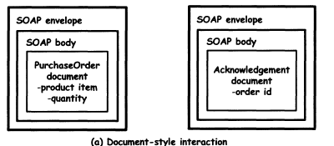

Slide 35
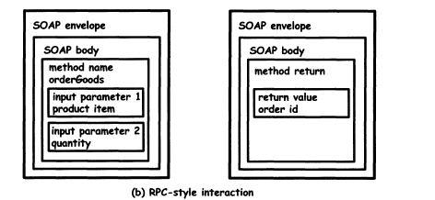

Slide 36
In the above diagram ,The RPC-style interaction involves the client making a orderGoods method call using a SOAP message and the supplier responding with a order id as the return value in another SOAP message

Slide 37
The structure of a SOAP message is also influenced by encoding rules,which define how a particular entity or data structure is represented in XML.
For example, a product item can be represented in several ways, some of which are shown in Figure 6.6.
In order for the client and server to interoperate, it is essential that they agree on how the contents of a SOAP message are encoded.
SOAP 1.2 defines a particular form of encoding called SOAP encoding.
This defines how data structures including basic types such as integers and strings as well as complex types such as arrays and structures can be serialized into XML.

Slide 38

Fig. 6.6. Different encodings result in different XML structures in a SOAP message

Slide 39
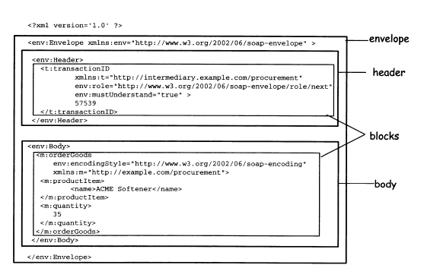
An example of a SOAP message with a header block that is intended for processing by an intermediary

Slide 40
Structure of WSDL
To address the above-mentioned problems, WSDL specifications are often characterized by an abstmct part, conceptually analogous to conventional IDL,and a concrete part, that defines protocol binding and other information (Figure 6.10).
The abstract part is made of port type definitions, which are analogous to interfaces in traditional middleware IDLs. Each port type is a logical
collection of related operations.

Slide 41
Each operation defines a simple exchange of messages. As described in the previous section.
A message is a unit of communication with a Web service, representing the data exchanged in a single logical transmission.
As in the case of other Web services standards, these constructs are all defined in XML.

Slide 42
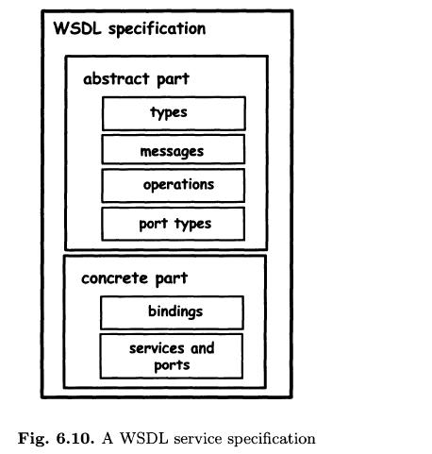

Slide 43
As with any IDL, WSDL needs a type system so that the data being exchanged can be correctly interpreted at both ends of the communication.
By default, WSDL uses the same type system as XML Schemas, although the WSDL document can specify a different type system if necessary.

Slide 44
XML Schemas have built-in basic data types and allow users to define more complex data types such as structures.
So, the first step in defining a WSDL interface is to identify and define all the data structures that will be exchanged as parts of messages between applications.
The second step is to define messages that build on such data structures.
In WSDL, each message is a typed document divided into parts.
Each part is characterized by a name and by a type, referring to a type typically defined in XML schema.

Slide 45
The third step in defining a WSDL interface is to define operations, also called transmission primitives or interactions.
There are four basic operations:
one-way, request-response, solicit-response, and notification.

Slide 46
One-way and notification operations involve a single message. In one-way interaction, the client invokes a service by sending a message.
In notifications, it is the service that sends the message.
Request-response and solicit-response involve the exchange of two messages. The former is initiated from outside the service (the service is invoked and a response follows).
The latter is started by the service itself (the service makes a request and expects a response in return).

Slide 47
Synchronous interactions are defined using request-response or solicit-response operations.
while asynchronous interactions are defined using one-way and notification operations.
The final step in defining an abstract WSDL interface is to group operations into port types.
WSDL 1.2 allows a port type to be extended from other port types.
In such cases, the port type contains all of the operations from the port types it extends, along with any other operations it defines.

Slide 48
The concrete part of a WSDL interface is defined using the following three constructs
InterfaceBindings. The binding specifies the message encoding and protocol bindings for all operations and messages defined in a given port type.
For instance, it could specify that an operation is an RPC-style operation or a document-style operation.
Given that the communications protocol is SOAP, the main available transport binding options are HTTP and SMTP.

Slide 49
An InterfaceBinding also specifies the encoding rules that should be used in serializing the parts of a message into XML
There are usually two possible encodings-literal and SOAP. Literal encoding takes the WSDL types defined in XML Schemas and "literally" uses those definitions to represent the XML content of messages.
In other words, the abstract WSDL types also become concrete types.
SOAP encoding, on the other hand, takes the XML Schema definitions as abstract entities, and translates them into XML using SOAP encoding rules defined as part of SOAP 1.2.
Typically, literal encoding is used for document-style interactions whereas SOAP encoding is used for RPC-style interactions.

Slide 50
Ports. Also known as Endpoints, ports combine the InterfaceBinding information with a network address (specified by a URI) at which the implementation of the port type can be accessed.
Again, this is not needed in conventional middleware due to the presence of a centralized infrastructure that manages addresses in a transparent manner.

Slide 51
Services. Services are logical grouping of ports. Note that, at least in principle, this also means that a specific WSDL service could be available at different Web addresses.
In practice, however, it is likely that a WSDL service will group related ports, typically available at the same address.

Slide 52
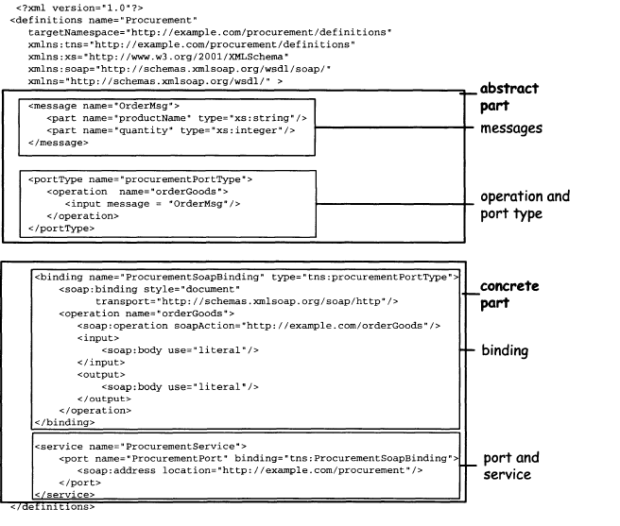
A WSDL service specification

Slide 53
UDDI: Universal Description Discovery and
Integration(goals)
The primary goal of UDDI is the specification of a framework for describing and discovering Web services. The core of UDDI revolves around the notion of business registry, which is essentially a sophisticated naming and directory service.
In particular, UDDI defines data structures and APIs for publishing service descriptions in the registry and for querying the registry to look for
published descriptions.

Slide 54
The UDDI registry specifications have two main goals with respect to service discovery:
first, to support developers in finding information about services,so that they know how to write clients that interact with those services.
Second, to enable dynamic binding, by allowing clients to query the registry and obtain references to services of interest.
This dual nature is clearly reflected in UDDI, which leaves room for both structured and unstructured information.

Slide 55
UDDI also addresses the notion of Universal Business Registry (UBR).
In fact, the initial goal of the consortium was supporting worldwide directories where everybody could publish service descriptions (essentially for free) and where everybody could query these directories to find services of interest.

Slide 56
Information in a UDDI Registry
A simple way of categorizing the information contained in a UDDI registry is in terms of what each type of information is used for.
This categorization is best understood by means of an analogy with the telephone directory
White pages. They are listings of organizations, of contact information(e.g., telephone or e-mail address), and of the services these organizations provide.
Using the registry as a white pages catalogue, UDDI clients can find Web services provided by a given business.

Slide 57
Yellow pages. They are classifications of both companies and Web services according to taxonomies that can be either standardized or user defined.
Through yellow pages, it is possible to search for services based on the category they belong to, according to a given classification scheme.
Green pages. This information describes how a given Web service can be invoked. It is provided by means of pointers to service description documents, typically stored outside the registry (e.g., at the service provider's site) .

Slide 58
UDDI Registry API
UDDI registries have three main types of users to whom they expose their API:service providers that publish services, requesters that look for services, and other registries that need to exchange information.
These clients can access the registry through six sets of APIs:

Slide 59
The UDDI Inquiry API :
Includes operations to find registry entries that satisfy search criteria and to get overview information about those entities (find_business, find_service, find_binding, find_tMode, and operations that provide details about a specific entity(get_businessDetail,get_serviceDetail,get_bindingDetail, get _ tModeLDetail).
This API is meant to be used by UDDI browser tools that help developers find information and by clients at run-time, for dynamic binding.

Slide 60
The UDDI Publishers API:
Is directed to service providers.
It enables them to add, modify, and delete entries in the registry.
Examples of operations it supports are save_business, save_service, save_binding
and save_tModel for creating or modifying entries, and delete_business delete_service, delete_binding, and delete_tModel for removing entries.Upon publication, the registry also assigns unique keys to the newly added entries.

Slide 61
The UDDI Security API
Allows UDDI users to get and discard authentication tokens to be used in further communication with the registry(get_auth Token, discard_auth Token).

Slide 62
The UDDI Custody and Ownership Transfer API
Enable registries to transfer the "custody" of information among themselves and to transfer ownership of these structures from One publisher to another.
Messages exchanged in this API include get_ transfer Token, transfer_entities, and transfer_
custody.

Slide 63
The UDDI Subscription API
Enables the monitoring of changes in a registry by subscribing to track new, modified, and deleted entries.
The Subscription API includes the following operations: delete_subscription,get_subscriptionResults, get_subscriptions, and save_subscriptions

Slide 64
The UDDI Replication API
supports replication of information between
registries, so that different registries can be kept synchronized.

Slide 65
UDDI registries maintain different access points (URIs) for requesters,publishers, and other registries.
For example, Figure 6.15 depicts two UDDI registries (UDDI registry A and UDDI registry B).
Each of these registries exposes an Inquiry API and a Publishers API for service requestors and providers to use, and Subscription, Replication, and Custody Transfer APIs for communicating with other UDDI registries.

Slide 66
One reason for access point separation is that inquiries do not require authentication (they use standard HTTP)
while other invocations require users to authenticate themselves with the registry (the interaction takes place through HTTPS).

Slide 67
