Slide 1
Unit 4: The Unified Software Development Process

Slide 2
A Requirements Statement for the Unified Process
According to Booch, et. al., software development needs a process that:
  Provides guidance to the order of a teams activities
  Directs the tasks of individual developers and the team as a whole
  Specifies what artifacts should be developed
  Offers criteria for monitoring and measuring a project’s products and activities

Slide 3
The Unified Process: A Snapshot
The unified process is made of components connected via well defined interfaces
  Based on the Unified Modeling Language (UML)
  Use Case Driven, Architecture-centric, Iterative and Incremental

Slide 4
Use Cases
A Use Case can be defined as a piece of functionality that gives a user a result of value
  Sum of all use cases form the use case model
Use cases capture functional requirements - replace the traditional functional specification

Slide 5
Architectures
Booch, et. al. describe an architecture as the different views of the system being built
Embodies the most significant static and dynamic aspects of the system
  Influenced by platform, operating systems, DBMS, etc.
  View of the whole design with the important characteristics mode more visible by leaving the details aside

Slide 6

Life of the Unified Process
Inception
The seed idea for the development is brought to the point of being sufficiently well founded to warrant entering into the elaboration phase
Elaboration
The architecture
is defined
Construction
The software is brought from an executable architectural baseline
to the point where it is ready to be transitioned to the user community
Transition
The software is turned over to the user community
...
...
Iteration
n-1
Iteration n
...
...
Iteration 1
Iteration 2
...
Cycles
Birth
Death

Slide 7
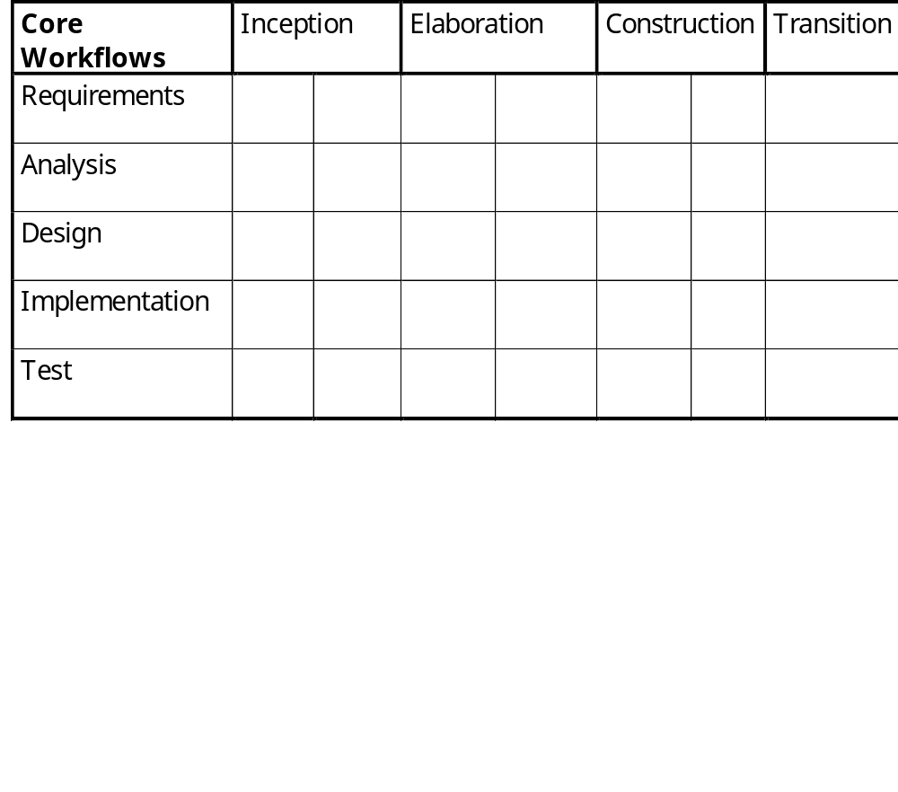
Core Work Flows

Slide 8
Unified Process Models
Use Case Model
Models Use Cases
and their relationships to users
specified by
verified by
Analysis Model
Refines the use cases and makes an initial allocation of behavior to set of objects
Test Model
Describes the test cases that verify the use cases
realized by
distributed by
Design Model
Defines the static structure of the system as subsystems, classes and interfaces and defines the use cases as collaborations of subsystems, classes and interfaces
Deployment Model
Defines the physical nodes of computers and the mapping of the components to those nodes
implemented by
Implementation Model
Includes components (representing source code) and the mapping of classes to components

Slide 9
The Four Ps in Software Development - People, Project, Product and Process
People - The architects, developers, testers and the supporting management, users, customers, and stakeholders - Actual Humans!
Project - The organizational element through which software is managed.
Product - Artifacts that are created during the life of the project, e.g., models, source code.
Process - A definition of the complete set of activities needed to transform users’ requirements into a product. A process is a template for creating projects.
  Tools - Software that is used to automate the activities defined in the process.

Slide 10
Resources and Workers
People are resources
Worker is a position that a person is assigned and they accept
  Worker types is a role that an individual may play in software development, e.g. use case specifier
  Workers are responsible for a set of activities
  A worker may be realized by a set of individuals working together
  A resource may be many workers during the development of the software

Slide 11
Software Systems and Artifacts
A software system is composed of all the artifacts that it takes to represent it to the machines, workers and stakeholders
An artifact is a general term for any kind of information created, produced, changed or used by workers in developing the system
  Artifacts include UML diagrams and their associated text, user-interface sketches and prototypes
  Management artifacts include business case for the system, allocation of resources to workers and specification of development environment

Slide 12
Process and Projects
Process is a definition of a set of activities, not their execution
  A process instance is a project
A process is composed of workflows where a workflow is a set of activities
To create a work flow
  Identify the workers
  Identify the artifacts
  Identify the relationships between workers and artifacts
Activity diagrams and swim-lanes (p.25) show how work flows from worker to worker

Slide 13
Process Merits
The process can be modified to accommodate organizational factors, domain factors, life cycle factors and technical factors
Everyone on the development team understands their responsibilities
Developers can better understand what other developers are doing
Supervisors and managers who may be code illiterate can understand what the developers are doing
Developers, supervisors and managers can transfer between projects and divisions without having to learn a new process
Training can be standardized within a company and obtained from colleges and short courses.
The course of software development is repeatable.

Slide 14
Tools Are Essential for Development
Requirements Management - Store, browse, review, track and navigate the requirements for a software project.
Visual Modeling - Used to automate the use of UML (or other modeling languages!) and assemble an application visually. Integrate with programming environments and ensure that the model and implementation are consistent.
Programming tools - Used to provide a range of tools to include editors, compilers, debuggers, error detectors and performance analyzers.
Quality Assurance - Used to test applications and components, i.e., to execute test cases and regression test.

Slide 15
A View Into Use Cases ( 1 of 4)
(From UML Language User Guide)*
A Use Case describes as set of sequences, in which each sequence represents the interaction of the things outside the system (its actors) with the system itself (its key abstractions). These behaviors are in effect system level functions used to visualize, specify, construct and document the intended behavior of the system during requirements capture and analysis. A use case represents a functional requirement of the system as a whole.
*Booch, Jacobson, Rumbaugh, Addison-Wesley 1999

Slide 16
A View Into Use Cases (2 of 4)
Use cases involve the interaction of actors and the system. Actors can be human or automated systems.
Use cases can have variants, particularly specialization, composition and behavioral extension.
Use cases can be applied to the system as a whole or subsystems.
    Applied to subsystems they are useful for regression testing
    Applied to system as a whole they are useful for integration and system testing

Slide 17
A View Into Use Cases (3 of 4)
Each use case must have a unique name
  Typically represented as an oval with the name inside
An actor represents a coherent set of roles that users play when interacting with the user
  Connected to use cases only by association
  Can be specialized
  Typically represented as a labeled stick figure
Behavior of a use case is described by a flow of events in textual format
  Include how and when use case starts and ends
  When use case interacts with actors
  What objects are exchanged
  Exceptions

Slide 18
A View Into Use Cases (4 of 4)
Scenarios are to Use Cases as instances are to classes
  Represents one possible flow through all of the variations described by the use case
To model the behavior of an element (i.e., system or subsystem)
  Identify the actors that interact with the element.
  Organize the actors by identifying general and more specialized roles
  For each actor, consider the primary ways in which the actor interacts with the element
  Consider also the exceptional ways in which each actor interacts with the element
  Organize these behaviors as use cases, applying include and extend relationships to factor common behavior and extend exceptional behavior.

Slide 19
A Use Case Example (1 of 3)
generalization
association
Validate User
Employee
Salesman
use case
actors

Slide 20
A Use Case Example (2 of 3)
(Adapted from UML Language User Guide)*
Flow of Events
  Main flow of events: The use case starts when the system prompts the salesman for a password. The salesman can now enter a password via the keypad. The salesman commits the entry by pressing the Enter button. The system then checks the password to see if it is valid. If the password is valid, the system acknowledges the entry, thus ending the use case.
  Exceptional flow of events: The salesman can cancel a transaction at any time by pressing the cancel button, thus restarting the use case. No changes are made to the salesman’s account.
  Exception flow of events: The salesman can clear a password anytime before committing it and reenter a new password.
*Booch, Jacobson, Rumbaugh, Addison-Wesley 1999

Slide 21
A Use Case Example (3 of 3)
(From UML Language User Guide)*
Place Order
Extension points
set priority
<<extend>>
(set priority)
Place Rush
Order
<<include>>
Validate User
Check
Password
Track
Order
<<include>>
generalization
Retinal Scan
*Booch, Jacobson, Rumbaugh, Addison-Wesley 1999

Slide 22
Why Use Cases?
Use cases provide a systematic and intuitive means of capturing functional requirements
Use cases drive the development process since most activities such as analysis, design and test are performed starting from use cases.
Ties functionality to users (actors)
  Focuses the analysis and reduces specification of superfluous functionality
Use cases are simple to read
  Facilitates reaching an agreement with customers and users

Slide 23
The Need for Software Architectures
Software architectures are needed to:
  Understand often large technologically complex systems which combine distributed computing, COTS and reusable components which result in complex behavior
  Organize development to result in reduced communications between geographically distributed entities
  Foster use of reusable components
  Design the system for evolution

Slide 24
Software Architectures
Software architectures encompass the significant decisions about:
  The organization of a software system
  The structural elements and their interfaces that will comprise the system, together with their behavior as specified in the collaborations among those elements
  The composition of the structural and behavioral elements into progressively larger subsystems
  The architectural style that guides the organization: the elements and their interfaces, their collaborations and their composition

Slide 25
Architectural Concepts
Architectures are specified in an architectural description
An architecture is developed iteratively during the elaboration phase through requirements, analysis, design, implementation and test
The architecture description is a view into the models of the system

Slide 26
The Architecture Description
The architecture is represented by views into the various models
  Contains five sections, one for the use case model, the analysis model (often not maintained), the design model, the deployment model and the implementation model
  No view into the test model as it has no role in describing the architecture and used to verify the architecture baseline only

Slide 27
Architectural Views
The architectural view of the use-case model presents the most important actors and use-cases
The architectural view of the design model presents the most important subsystems, interfaces and a few very important classes
The architectural view of the deployment model defines the architecture in terms of connected nodes, hardware units that the software components can execute on
The architectural view of the implementation model is a straightforward mapping from the design and deployment model - each design service subsystem results in one component that is installed on a node

Slide 28
Architectural Influences
System Software
Use Cases
Middleware
Legacy Systems
Architecture
Standards and policies
Experience
Previous Architectures
Architectural patterns
Nonfunctional Requirements
Distribution needs
Constraints and enablers

Slide 29
What Is Not Architecture
Most classes, with operations, interfaces and attributes that are private to subsystems
Subsystems that are variants of other subsystems
Most Use Case realizations
Information needed to validate or verify the architecture

Slide 30
Architectural Patterns
A pattern is a solution to a commonly occurring design problem
  A general collaboration that can be specialized as defined by a template
Architectural patterns focus on larger grained structure and interactions of subsystems and systems (e.g., broker, client server, peer-to-peer)
Layered architecture has individual subsystems at various layers (a set of subsystems that share the same degree of generality and volatility)

Slide 31
Requirements Capture and Workflow

Slide 32
Requirements Capture Defined
Requirements capture can be defined as the process of finding out what needs to be built
  Achieved by describing the system requirements well enough so that an agreement can be reached between the customer and the system developers
Aka Jacobson et. al. “it is absurd to believe that the human mind can come up with a consistent and relevant list of thousands of requirements of the form “The system shall…””
The users often do not understand what the system ought to do until the system is completed
  Jacobson suggests that believing that users know what the requirements are can be incorrect

Slide 33
Requirements Capture Overview
List Candidate Requirements
  Over the life of the system
  Metadata includes status, estimated cost to implement, priority, associated risk
Understand System Context
  Domain modeling describes the important concepts as domain objects and links the objects to another
  Business modeling describes existing and perceived processes and which processes are to be supported by the system
Capture Functional Requirements
  use-case based - each use-case represents one way of using the system
  Also specify what the user interface looks like

Slide 34
Requirements Capture Overview
Capture Nonfunctional Requirements
  Generally refers to constrains, “ilities” such as maintainability, reliability, extensibility
  Connected as tagged values to the use-cases
  Some nonfunctional requirements cannot be tagged to a particular use-case and should be maintained on a list of supplementary requirements
Traditional requirements specification is replaced by a the use-case model and a list of supplementary requirements

Slide 35
Requirements Capture Artifacts
Work To Be Done
Resulting Artifact
List Candidate Requirements
Feature List
Understand System Context
Business or Domain Model
Capture Functional Requirements
Use-case Model
Defines
Traditional
Requirements
Specification
Capture Nonfunctional Requirements
Supplementary requirements
or individual use-cases for
use-casespecific requirements

Slide 36
Distribution of Requirements by Phase
~10%
~80%
~10%

Slide 37
Domain Models
Domain Models consist of business objects, real-world objects, events that will or have transpired, e.g. ….
Order
item
Date of submission
delivery address
Description
picture
cost
1..*
1..*
payable
buyer
Invoice
Account
account
date of submission
last date of payment
1
balance
owner
seller
1

Slide 38
Domain Models
Modest domains usually require between 10 and 50 classes
The purpose is not to model system internals but to contribute to an understanding of the system’s requirements as the originate from context

Slide 39
Business Models
Goal is to understand the system by understanding the business processes
  Can model the the system encompassing the software system that is being developed
Describes the business processes of a company in terms of business use-cases and business actors
Described in terms of use-case diagrams
Business-object is an interior model of the business
Business-entity represents something which workers access, inpsect, manipulate, produce or use in a business case
A work unit is a set of buiness entities that forms a recognizable whole to the end use

Slide 40
Business Models
Business models are developed by first preparing a business use-case model that identifies the actors to the business and the business use-cases that the actors use.
Secondly, a business object model is developed which consists of workers, business entities and work units that realize the business use-cases.
Business models differ from domain models in three primary ways
  Domain classed are pulled out of the knowledge base of a few domain experts while business entities are derived by starting from the customers of the business, identifying the business use-cases and the finding the entities

Slide 41
Business Models
Business models differ from domain models in three primary ways (cont.)
  Domain classes have attributes but few if any operations. Business modeling identifies the workers that will participate by using the entities and through the operations that the entities will provide
  Workers found in business modeling are used as a starting point to derive a first set of actors and use-cases for the information system to be built.
To derive use-cases from business models
  Identify the system actors for every worker and business actor (customer)

Slide 42
Business Models
To derive use-cases from business models (cont.)
  Identify all the business use-case realizations in which each worker participates
  Find use-cases for the system actors of the information system
  Identify a tentative set of use-cases by creating a use-case for each corresponding actor for each role of each worker and business actor

Slide 43
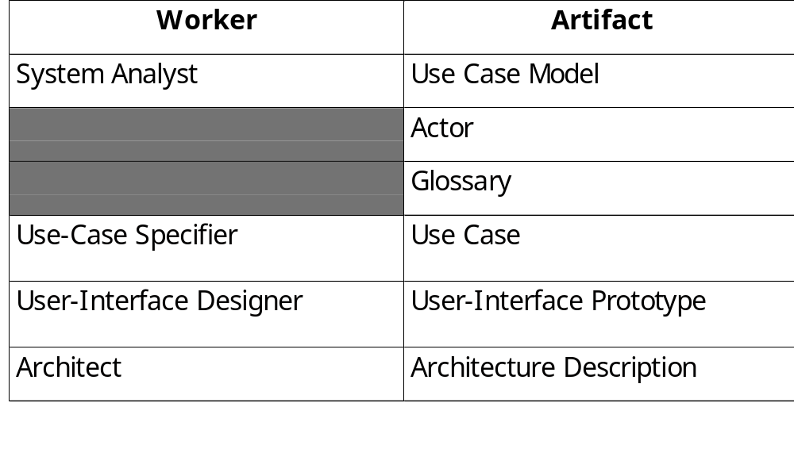
Requirements Artifacts

Slide 44
Requirements Artifacts
Use-case model provides the functional model of the system containing actors, use-cases and their relationships
  Actors are all parties (human and automated) that collaborate with the system - plays one role for each use-case that it collaborates with
  Use-cases specify a sequence of actions, including alternatives to the sequence, that the system can perform
  Use-cases have operations and attributes - thus a use-case description can include state chart diagrams, collaborations and sequence diagrams
  Use-case attributes represent the values that a use-case instance uses and manipulates
  Use-case instances do not interact with other use-case instances - reason is that use-case models should be simple and intuitive
  The flow of events and special requirements are captured in special textual descriptions

Slide 45
Requirements Artifacts
Architecture description contains a view of the use-case model depicting the architecturally significant use cases
Glossary defines important and common terms used by analysts when they describe the system - tends to be focused on the system to be built as opposed to the context
The user-interface prototype helps understand and specify the interactions between the human actors and the system

Slide 46
Four Workers Involved In Use-Case Modeling
System Analyst is responsible for all requirements modeled as use-cases, use-case specific non-functional requirements, finding the actors and ensuring consistency as well as structuring the use-case model
  Not responsible for individual use-cases
  One system analyst for each system
Use-Case Specifiers take the responsibility for the detailed descriptions of one or more of the use-cases, working closely with intended users of the system
User-Interface Designers create user interfaces specified by use-cases
Architects prioritize the use-cases to describe architectural view of the use-case model

Slide 47
Requirements Capture Workflow Overview
Find Actors and Use Cases
Structure the Use-Case Model
System Analyst
Architect
Prioritize Use Cases
Use-Case Specifier
Detail a Use Case
User-Interface Designer
Prototype User-Interface

Slide 48
Find Actors and Use Cass
Purpose
  To delimit the system from its environment
  Outline who and what actors will interact with the system and what functionality is expected from the system
  Capture and define a glossary of common terms that are essential for creating detailed descriptions of the systems functionality
Business or Domain Model
System Analyst
Use-Case Model Outlined
Supplementary
Requirements
Find Actors and Use-Cases
Feature List
Glossary

Slide 49
More On Finding Actors and Use-Cases
If a business model exists, a one to one mapping between actors and workers and business actors
It should be possible to find at least one user per candidate actor
There should be a minimum of overlap between the roles that instances of the different actors play in relation to the system
As a starting point, a use-case is suggested for every role of each worker or each actor in supporting the work to create, change, track, remove or study business objects
  Some initial use-cases may become parts of other use-cases
Each successfully performed use case should provide some value to the actor such that the actor achieves some goal. As discussed, use-cases should be tied to a particular actor.
Segments of the use-case model can be organized into use-case packages

Slide 50
More On Finding Actors and Use-Cases
A use-case model is reviewed to ensure that all necessary functional requirements have been captured as use-cases, the sequence of actions is correct, complete and understandable for each use-case and use-cases that have minimal value have been identified
  Use cases are prioritized
  Flow of events within a use case can be described as state transitions
Transition description (e.g., pay invoice)
State
State
(e.g. paid)
State
Start
Stop
Transitions

Slide 51
What to Include in Use-Cases
Define the start state
How and when the use-case starts
Required order of actions performed
How and when the use-case ends
Possible end states of the use-case
Paths of execution that are allowed and not allowed
Alternative path descriptions that have been extracted
System interactions with the actors and what they exchange
Usage of objects, values and resources in the system
Use-case instances that access other use-case instances attributes are forbidden
Non-functional requirements are tagged
Protocols for interactions with other systems
A use-case description is finished when it is deemd understandable, correct, complete and consistent with other descriptions

Slide 52
Creating Logical User-Interface Design
For each actor, user interface issues can be driven by the following:
  Determine which user interface elements are needed to enable the use-cases and their relationships
  How should they look and be manipulated and how do they differ from each other
  Which of the domain classes, business entities or work units are suitable as user-interface elements for the use-case?
  What user-interface elements doe the actor work with?
  What actions can the actor invoke and what decision can he make?
  What guidance and info does the actor need before invoking the actions in the use case
  What info does the actor need to supply to the system?
  What info does the actor need to supply to the system
  What are the average values for all input/output parameters?
  Consider essential use-case modeling a la Constantine.

Slide 53
Structuring the Use Case Model
Extract general and shared use-case descriptions of functionality that can be used by more specific use-case descriptions
  Generalization between use-cases is a kind of inheritance - use-cases can perform all behavior described in the generalizing use-case
  Complete use-cases are concrete
  Abstract use-cases can be instantiated and reused
Extract additional or optional use-case descriptions of functionality that can extend more specific use-case descriptions
  An extend relationship models additions to a use case’s sequence of actions
  Extend relationships model the condition(s) for extension and the extension point, I.e., the position in the use-case where the extension can be made
Can view the include relationships as a reversed extend relationship that provides explicit and unconditioned extensions to a use-case

Slide 54
Requirements Workflow Summary
Requirements capture can be viewed as:
  A business model or a domain model to set the context of the system
  A use-case model that captures the functional and non-functional requirements that are specific to individual use-cases
  A set of user interface sketches and prototypes for each actor representing the design of the user interfaces
  A supplementary requirements specification for the requirements that are generic and not specific for a particular use-case

