Slide 1
A multilayer network dataset of interaction and influence spreading in a virtual world
Virtual worlds and online games create interesting environments having the ability to monitor content
diffusion with mechanics close to the real systems. Users, represented by avatars in synchronic
environments, perform actions similar to real world face-to-face communication, with direct contact
between content sender and recipient. The level of interaction and the content sharing is influenced by
factors similar to those occurring in the real world, such as visual characteristics, social ties, activity within
groups and emotions. Virtual worlds can be treated as laboratories for analysis and observing social and
economic phenomena. Virtual worlds have been used for studying the dynamics of infectious diseases,
virtual goods transmission, visual factors affecting the spread of information.

Slide 2
Domain description (motivation)
Presented data contains the record of five spreading campaigns that occurred in a virtual world platform. Users distributed avatars between each other during the campaigns. The processes varied in time and range and were either incentivized or not incentivized. Campaign data is accompanied by events. The data can be used to build a multilayer network to place the campaigns in a wider context. The study is the first publicly available dataset containing a complete real multilayer social network together, along with five complete spreading processes in it.
Campaign Id - Content type (Incentives, Quality, Mechanics, Duration)
C1 - Occasional avatar related to the special Halloween event (No, Premium, Low resistance, ~11 days)
C2 - Occasional avatar related to the special Halloween event (Yes, Premium , Low resistance, ~11 days)
C3 - Winter avatar adjusted to winter theme and seasonal room (No, Basic, High resistance, ~209 days)
C4 - Thematic avatar for special anniversary event (No, Premium, High resistance, ~204 days)
C5 - User designed avatar with emotional appeal in a form of Guy Fawkes mask (No, Premium, High resistance, ~154 days)

Slide 3
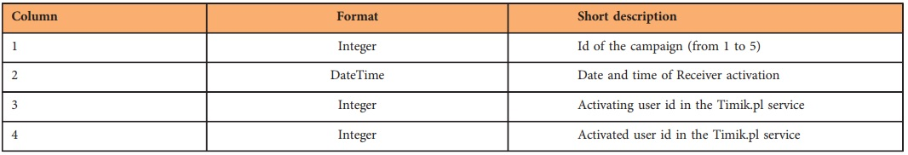
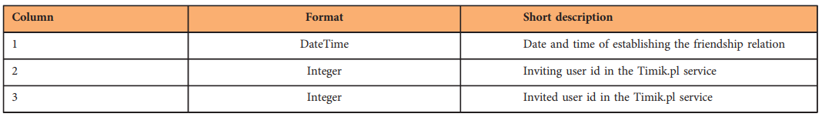
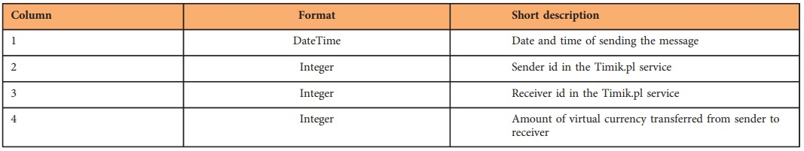
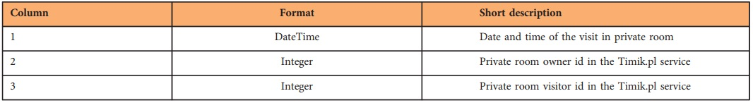
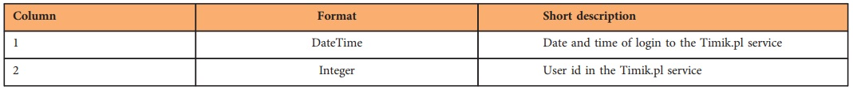
Data description
1. Campaigns:
2. Friends
3. Transactions
4. Visits
5. Logins

Slide 4
Results
Campaign 1: (duration ~10 days)
Campaign 2: (duration ~10 days)
#Day | #Users | #Spreading content
1 | 807 | 825
2 | 286 | 218
3 | 164 | 108
4 | 87 | 52
5 | 68 | 42
6 | 115 | 79
7 | 77 | 48
8 | 35 | 19
9 | 31 | 17
10 | 60 | 36
#Day | #Users | #Spreading content
1 | 1948 | 1977
2 | 247 | 181
3 | 111 | 70
4 | 55 | 32
5 | 82 | 54
6 | 102 | 70
7 | 66 | 44
8 | 68 | 49
9 | 31 | 19
10 | 60 | 38
Campaigns 1 and 2 were activated at same day 2010.10.31. Main difference between these two campaigns was that first was without users motivations (incentives like prizes). We can see that number of spreding content and number of activated users in campaigns are different at first day of campaigns and that users were more motivated for Campaign 2.

Slide 5
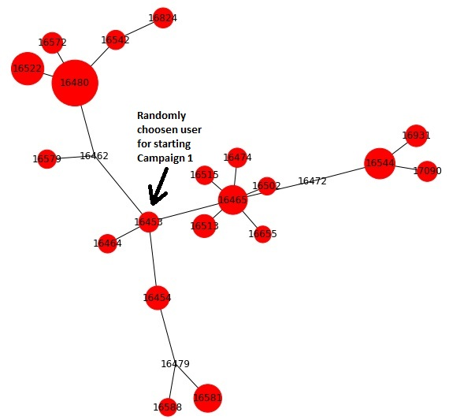
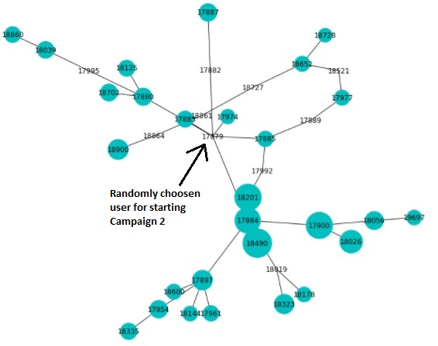
Graphs of users who were most active in Campaign 1 and 2

Slide 6
Campaign 3: (from 2011.12.11 to 2012.07.07)
Campaign 4: (from 2011.12.24 to 2012.07.15)
#20days | #Users | #Spreading content
1 | 265 | 264
2 | 16 | 9
3 | 11 | 6
4 | 4 | 2
5 | 12 | 8
6 | 2 | 1
7 | 5 | 3
8 | 0 | 0
9 | 0 | 0
10 | 3 | 2
#20days | #Users | #Spreading content
1 | 372 | 371
2 | 22 | 16
3 | 10 | 6
4 | 22 | 16
5 | 17 | 12
6 | 11 | 8
7 | 4 | 3
8 | 0 | 0
9 | 3 | 2
10 | 2 | 1
Campaigns 3 and 4 were activated with 13 days difference. In Campaign 3 quality of spreding content was on low level (avatar had 'Basic' look) but in Campaign 4 quality of content was higher (avatar had 'Premium' look). We can see that number of spreding content and number of activated users in campaigns are different at first 20 days and after and that users were more motivated for Campaign 4.

Slide 7
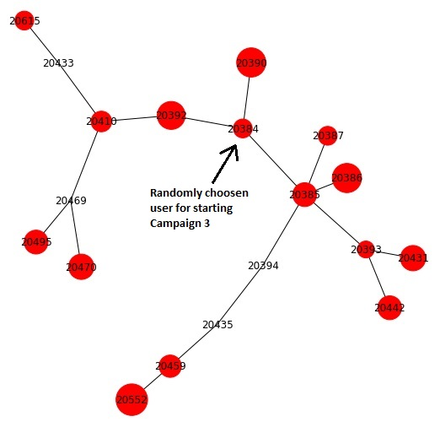
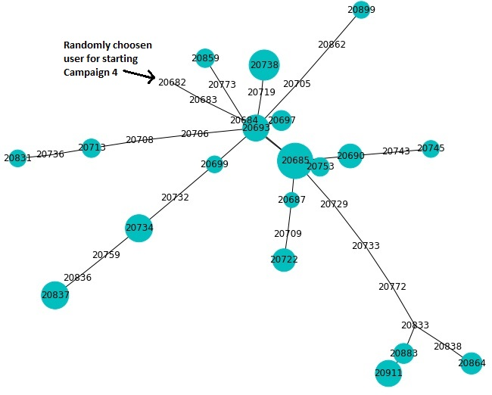
Graphs of users who were most active in Campaign 3 and 4

Slide 8
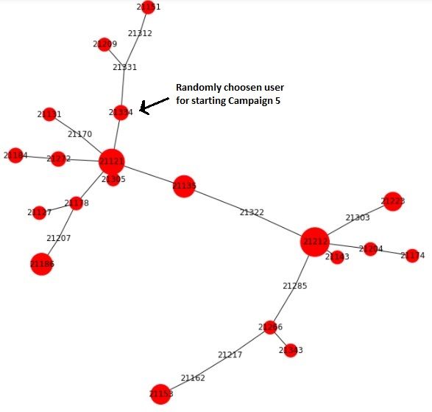
Campaign 5: (from 2012.01.30 to 2012.07.02)
Graph of users who were most active in Campaign 5
#20days | #Users | #Spreading content
1 | 246 | 246
2 | 4 | 2
3 | 9 | 6
4 | 16 | 13
5 | 4 | 2
6 | 0 | 0
7 | 0 | 0

Slide 9
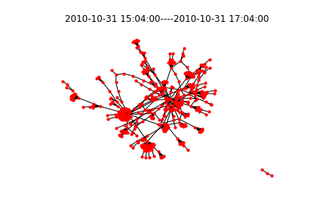
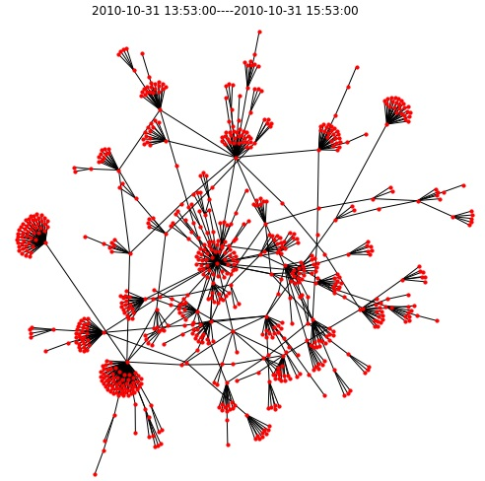
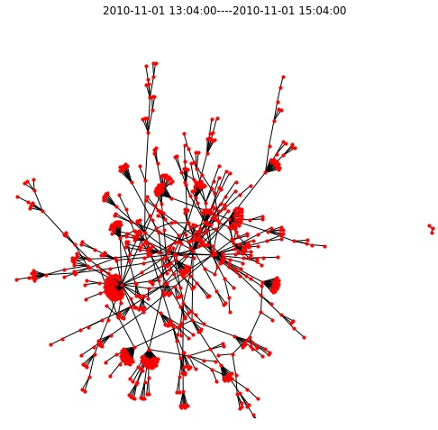
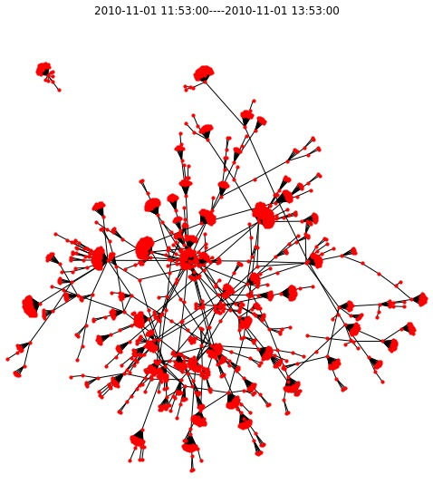
Spreading process in Campaigns 1 and 2 (first 24h)
1426 users were activated in Campaign 1
2505 users were activated in Campaign 2
Number of nodes in graph: 476
Diameter: 13
Radius: 7
Time: 15:04 - 17:04 (2010-10-31)
Number of nodes in graph: 761
Diameter: 13
Radius: 7
Time: 13:53 - 15:53 (2010-10-31)
Number of nodes in graph: 1928
Diameter: 18
Radius: 9
Time: 11:53 - 13:53 (2010-11-01)
Number of nodes in graph: 807
Diameter: 16
Radius: 8
Time: 13:04 - 15:04 (2010-11-01)

Slide 10
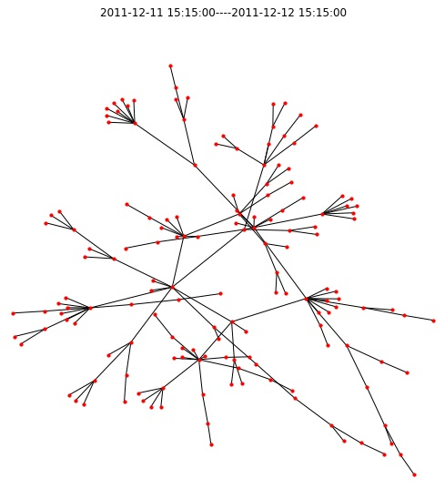
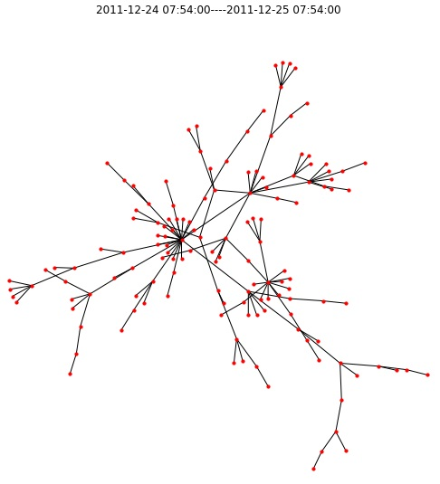
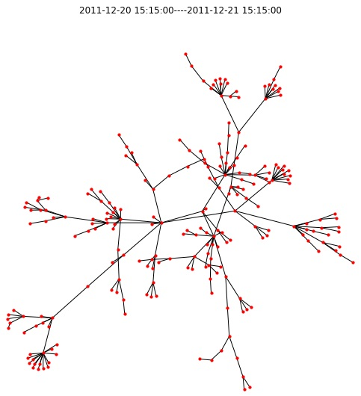
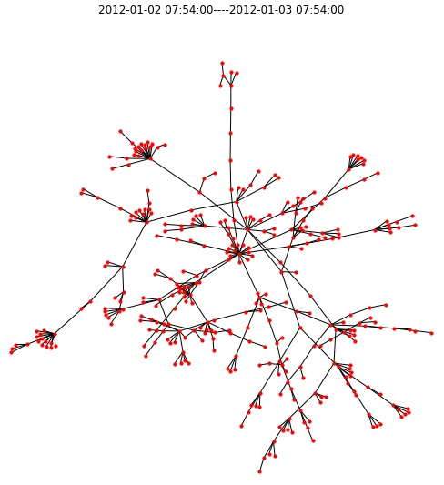
Spreading process in Campaigns 3 and 4 (first 10 days)
298 users were activated in Campaign 3
437 users were activated in Campaign 4
Number of nodes in graph: 156
Diameter: 13
Radius: 7
Time: 2011-12-11 to 2011-12-12
Number of nodes in graph: 140
Diameter: 14
Radius: 7
Time: 2011-12-24 to 2011-12-25
Number of nodes in graph: 227
Diameter: 14
Radius: 7
Time: 2011-12-20 to 2011-12-21
Number of nodes in graph: 352
Diameter: 20
Radius: 10
Time: 2012-01-02 to 2012-01-03

Slide 11
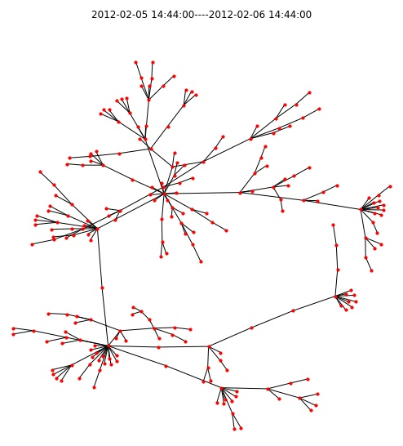
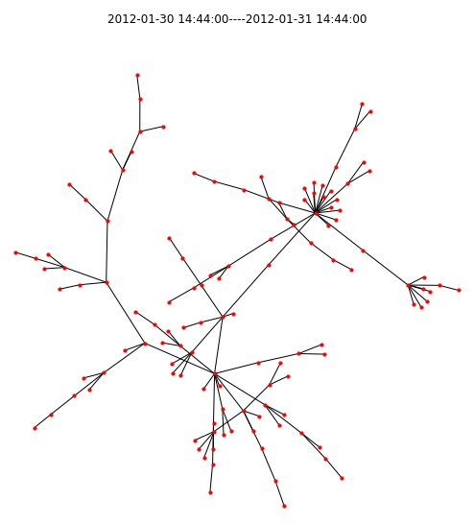
Spreading process in Campaigns 5 (first week)
270 users were activated in Campaign 5
Number of nodes in graph: 124
Diameter: 15
Radius: 8
Time: 2012-01-30 to 2012-01-31
Number of nodes in graph: 234
Diameter: 18
Radius: 9
Time: 2012-02-05 to 2012-02-06

Slide 12
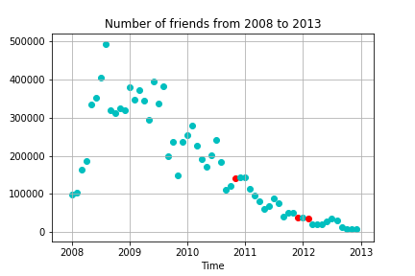
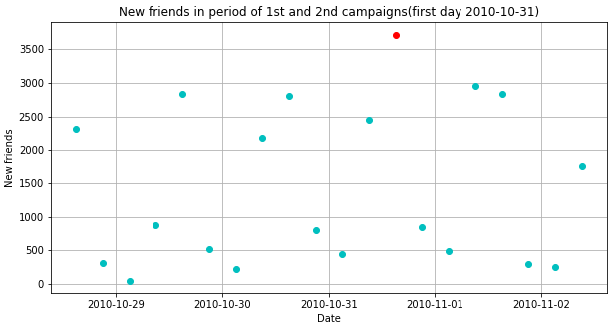
Friends:
Number of friends increased when 1st and 2nd campaign started
Number of new friends calculated monthly from 2008 to 2013

Slide 13
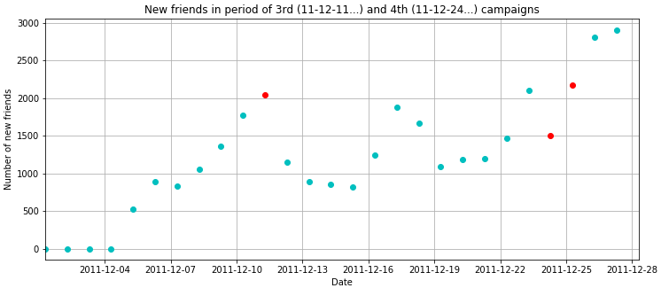
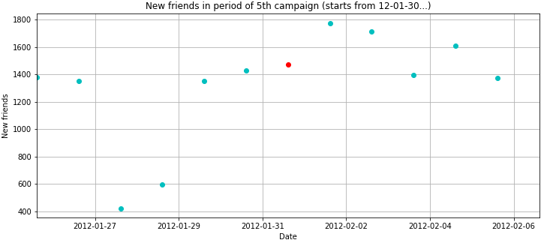

Slide 14
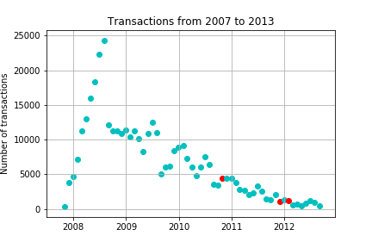
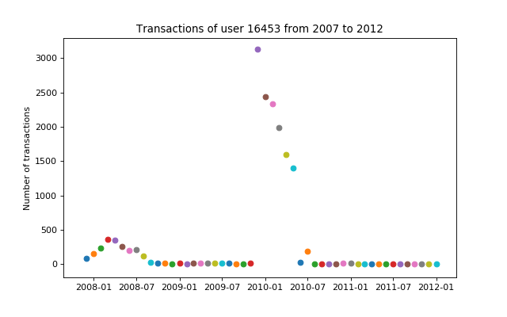
Transactions:
Number of transactions calculated monthly from 2007 to 2013
16453 is user with most transactions and graph shows his montly number of transactions from 2008 to 2012

Slide 15
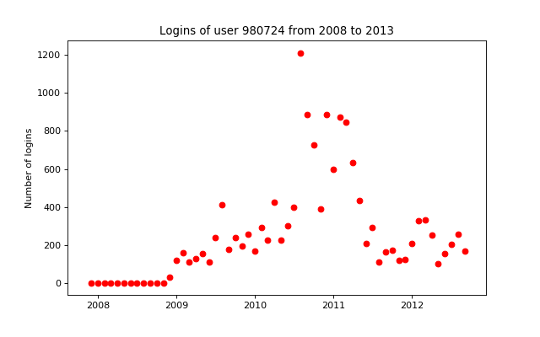
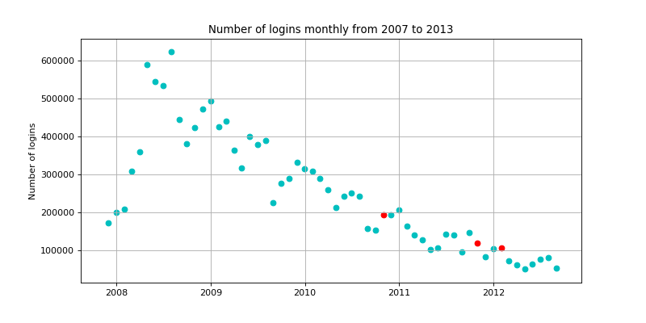
Logins:
Number of logins calculated monthly from 2007 to 2013
980724 is user with most logins and graph shows his montly number of logins from 2008 to 2013

Slide 16
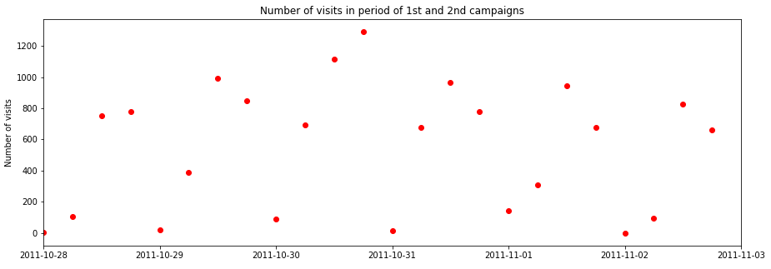
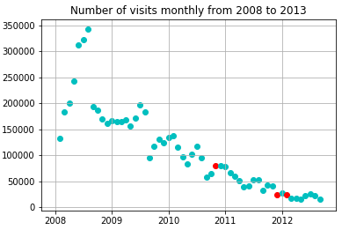
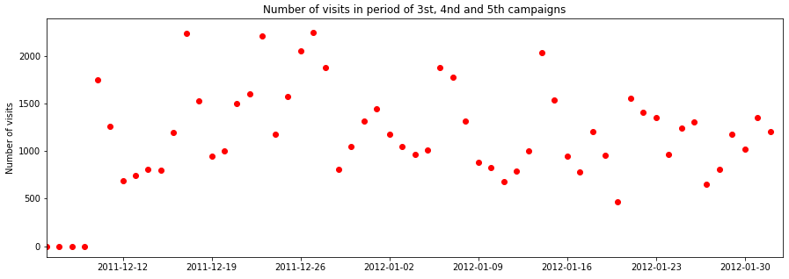
Visits:

Slide 17
Correlation for all data:
Correlation all data | Friends | Logins | Transactions | Visits
Friends | 1 | 0.943283 | 0.899211 | 0.869627
Logins | 0.943283 | 1 | 0.951744 | 0.949435
Transactions | 0.899211 | 0.951744 | 1 | 0.980925
Visits | 0.869627 | 0.949435 | 0.980925 | 1
Correlation table for user 236410:
Correlation 236410 | Friends | Logins | Transactions | Visits
Friends | 1 | 0.435607 | 0.218425 | 0.318880
Logins | 0.435607 | 1 | 0.263189 | 0.755894
Transactions | 0.218425 | 0.263189 | 1 | 0.348659
Visits | 0.318880 | 0.755894 | 0.348659 | 1

Slide 18
Pagerank for first 100 users with most friends:
(16769, 0.007317350498679531), (154274, 0.00552212024934792), (236410, 0.004595281651778911),
(474661, 0.004423023481695385), (175050, 0.004093386317272385), (1632839, 0.0038327201029005704),
(476074, 0.003752986826111178), (325009, 0.003750590651602733), (100248, 0.0037376374621602916),
(193674, 0.003668315231064162), (980724, 0.0036298228760374123), (481265, 0.0035768411816614),
(787633, 0.003500950969209045), (749841, 0.0034184592298210983), (155957, 0.0034003413586529596),
(781623, 0.0033857548411924533), (163080, 0.0033749859692298167), (374805, 0.003369451848749646),
(1221508, 0.003350670365636845), (695178, 0.003310067483458956), (164051, 0.003229968635222647),
(714705, 0.003158968871763153), (50661, 0.0031333990102260906),....

Slide 19
List of Python packages and functions:
Campaign(1,2,3,4,5):
os (chdir)
numpy, matplotlib,pyplot (figure,savefig)
pandas (DataFrame, read_csv, as_matrix, to_datetime, Series, strftime, date_range)
networkx (from_pandas_dataframe, degree, spring_layout, draw_networkx_nodes, draw_networkx_edges, diameter, radius, subgraph, connected_component_subgraphs,out_degree, in_degree, shortest_path, order, size, compose)
random (choice)
matplotlib (figure,savefig)
Friends:
matplotlib,pyplot (scatter)
networkx (pagerank)
Logins:
pandas (DataFrame, groupby.count, rename, sort_values)
Correlation:
pandas (DataFrame.corr)

Slide 20
Conclusions and ideas for future work
Motivation of the users for the campaign can arise due to the desire for reward, prestige or spontaneous copying of other users.
Games of this type allow the monitoring of user groups and their behavior in various social situations. By representing the virtual world, users discover their behavior through the various campaigns they place on them.
A detailed analysis of the campaign can determine the behavior of the mass, the individual and reveal the connection of users.
Motivation to spread content to other users in viral campaigns can be based on spontaneous need of sharing content; this takes place in many online viral actions. Push and pull mechanisms are the main drivers of viral campaigns.
Marketers use incentives to motivate users to share content for the purposes of increasing the dynamics of information spreading processes. In order to observe effect of incentives in one of five campaigns, incentives were used and users spreading content took parts in the contests with prizes given to the most active spreaders.
Campaigns increased social relations and were making the system more interesting. It was a game where users shared knowledge about new products with friends, and established their position by possessing unique products or information. This led to the creation of a certain level of interest, emotions and demand for a product, which was not available for everyone.

