Slide 1

COVID- 19 , INDIA ANALYSIS DATA SCIENCE PROJECT
By : vanmit kaur Kataria
Roll number : 2018csc1022
Link :
https://github.com/Vanmit30/DsProject

Slide 2
TOPICS TO BE DISCUSSED:
INTRODUCTION
DATASETS
DATA VISUALIZATION
RESEARCH PROBLEM

Slide 3
INTRODUCTION:
THE AIM OF THIS PROJECT IS TO UNDERSTAND COVID-19 INDIA BETTER, BY IMPLEMENTING/ VIEWING DATA GRAPHICALLY.
THE COVID – 19 PANDEMIC IS AN ONGOING GLOBAL PANDEMIC CAUSED BY SEVERE ACUTE RESPIRATORY SYNDROME CORONAVIRUS.
THE VIRUS HAS SPREAD WIDELY, AND THE NUMBER OF CASES IS RISING DAILY AS THE GOVERNMENT WORK TO SLOW ITS SPREAD.
THE COVID – 19 PANDEMIC IS ONE OF THE DEADLIEST PANDEMIC IN HISTORY.

Slide 4
DATASETS:
SOURCE FOR THE DATASET : KAGGLE
WE EXTRACTED “INDIVIDUAL.CSV” ,“STATE_LEVEL_LATEST.CSV” FROM THE GIVEN SITE AND COMPUTED “AGEDISTRIBUTION.CSV” FROM THE FIRST FILE
WE ARE GOING TO USE THESE FILES FOR ANALYSIS
ALL THE DATA HAS BEEN CLEANED BY REMOVING UNECESSARY VALUES AND COLUMNS.
THE GIVEN DATASETS PROVIDES US WITH THE DAILY INFORMATION ON THE NUMBER OF AFFECTED CASES, DEATHS AND RECOVERY, STATE WISE CONFIRMED, RECOVERED, ACTIVE AND DEATH CASES.

Slide 5
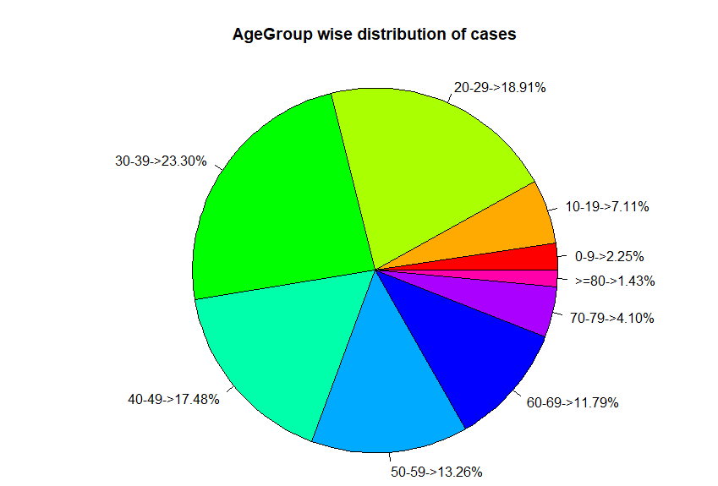
AGE GROUP ANALYSIS
HERE THE IMAGE CLEARLY SHOWS THAT’S THE AGE GROUP OF <50 IS THE MOST AFFECTED. APPROX 17% OF THE PEOPLE ABOVE >60 ARE AFFECTED.
ONE OF THE MAIN REASONS COULD BE THAT, BECAUSE YOUNG PEOPLE TRAVEL AND MEET OTHERS AND INORDER TO PROTECT THE ELDERLY WE USUALLY ASK THEM NOT TO STEP OUT OF THE HOUSE.
SO THE YOUNG GENERATION IS UNDER THE THREAT OF COMMUNITY TRANSMISSION MORE THAN OTHERS.

Slide 6
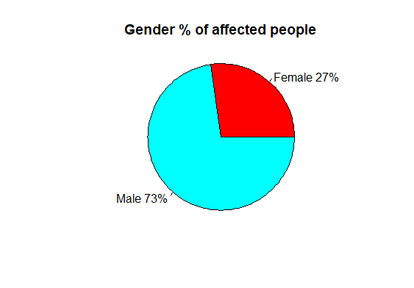
PERCENTAGE DISTRIBUTION GENDER WISE
THIS TELLS THAT THE FEMALES WERE LESS AFFECTED BY THE VIRUS THAN THE MALES.
STUDIES SHOW THAT WOMEN PRODUCE BETTER ANTIBODIES THAN MEN HENCE LESS AFFECTED BY THE VIRUS. MEN ALSO TEND TO ENGAGE THEMSELVES IN SMOKING AND ALCOHOL THUS RENDERING THEIR IMMUNE SYSTEM WEAK.

Slide 7
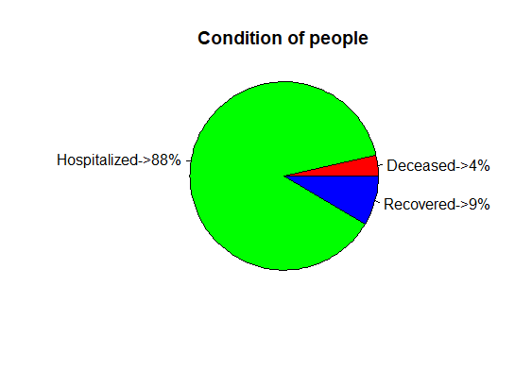
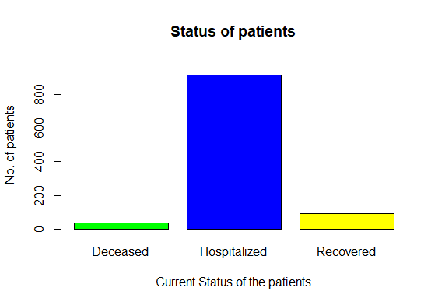
CURRENT STATUS OF PATIENTS:
MOST OF THEM ARE STILL HELD IN QUARANTINE
NUMBER OF PATIENTS DECEASED = 4%
NUMBER OF PATIENTS RECOVERED = 9%
NUMBER OF PATIENTS HOSPITALIZED = 89%

Slide 8
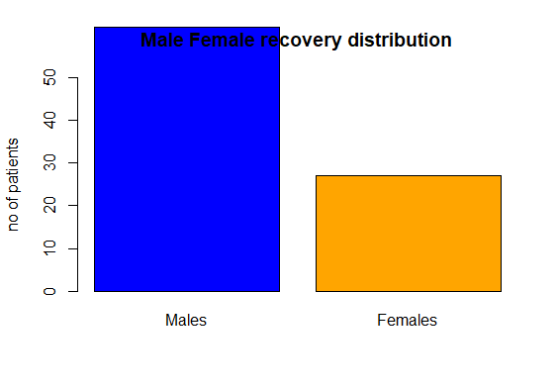
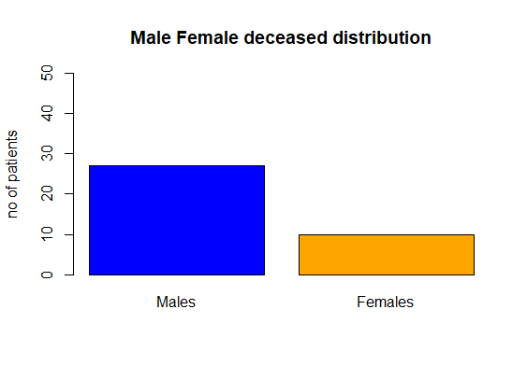
GENDER WISE PATIENT STATUS:

Slide 9
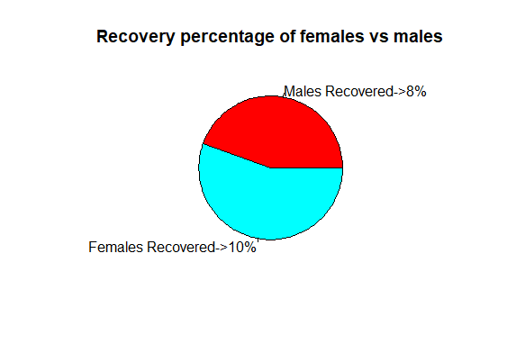
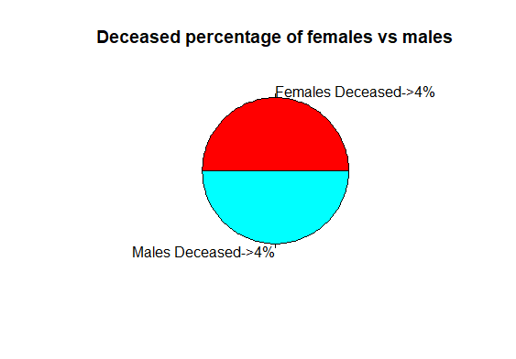
GENDER WISE PATIENT STATUS
4% OF THE TOTAL FEMALES AFFECTED WERE DECEASED AND 4% OF THE MALES AFFECTED WERE DECEASED.
10% OF THE FEMALES AFFECTED WERE RECOVERED AS ALREADY MENTIONED DUE TO THEIR HIGHER IMMUNITY. WHEREAS ONLY 8% OF THE MALES RECOVERED.

Slide 10
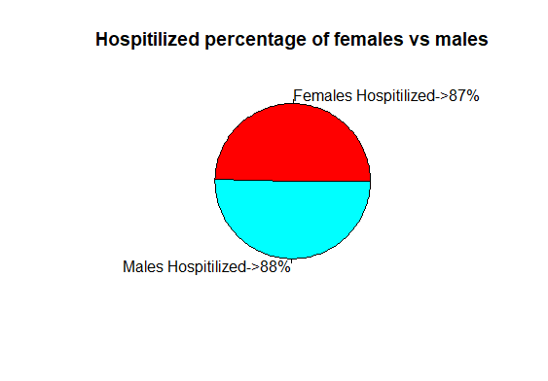
GENDER WISE PATIENT STATUS:
QUARANTINE STATUS :
QUARANTINE IS A STATE, PERIOD, OR PLACE OF ISOLATION IN WHICH PEOPLE THAT HAVE ARRIVED FROM ELSEWHERE OR HAVE BEEN EXPOSED TO INFECTIOUS OR CONTAGIOUS DISEASE ARE PLACED.
88% OF THE TOTAL MEN AFFECTED AND 87% OF THE TOTAL FEMALES AFFECTED ARE STILL KEPT IN QUARANTINE TO SLOW DOWN THE COMMUNITY TRANSMISSION.

Slide 11
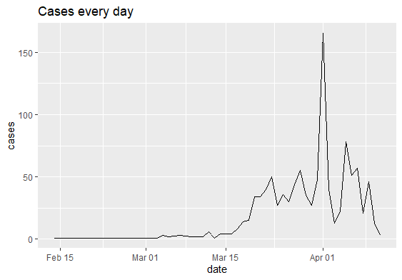
DAILY REPORT:
A GRAPH SHOWING THE TOTAL NUMBER OF CASES CONFIRMED IN A DAY.
THE MAXIMUM NUMBER OF CASES IN A SINGLE DAY WERE RECORDED ON 1ST APRIL. APRROX 163 CASES.

Slide 12
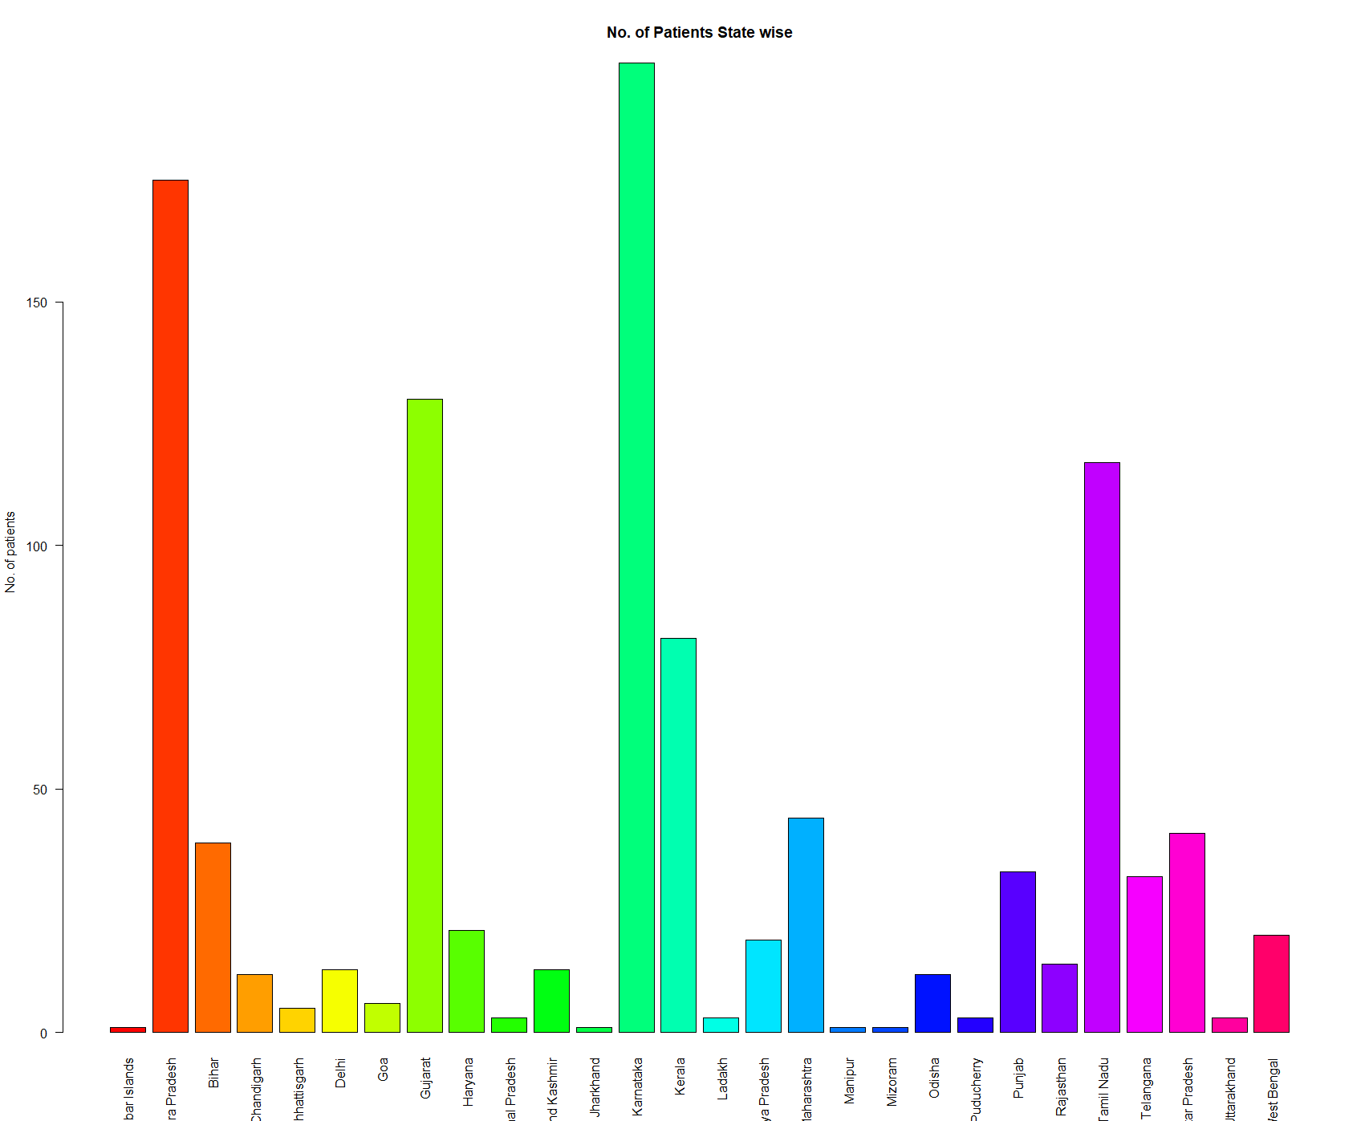
STATE WISE CASE DISTRIBUTION
KARNATAKA HAS MAXIMUM NUMBER OF CASES FOLLOWED BY ANDHRA PRADESH AND TAMIL NADU.

Slide 13
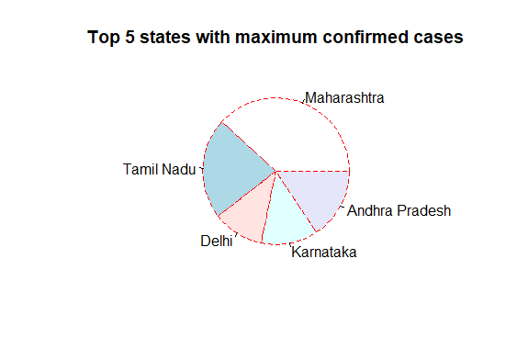
TOP 5 STATES WITH MAXIMUM CASES
OVER A PERIOD OF TIME THE CASES IN MAHARASHTHA BECAME THE MAXIMUM DUE TO LACK OF PRECAUTIONS.
NEXT THE CASES IN DELHI HAS ALSO INCREASED WITH RAPIDITY DUE TO POLLUTION AND OTHER CONTRIBUTING FACTORS.

Slide 14
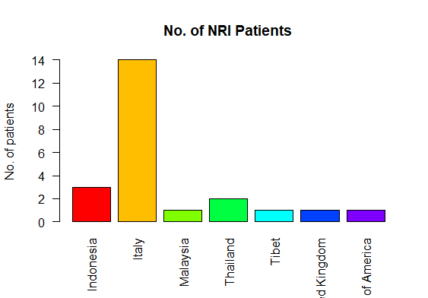
REPORT OF NRI PATIENTS
THESE PEOPLE MIGHT HAVE CARRIED VIRUS WHILE TRAVELLING TO INDIA OR ANY OTHER COUNTRY.
THESE PEOPLE WERE PRESENT IN INDIA WHEN TESTED POSITIVE. DUE TO HIGH NRI PATIENTS THE GOVERNMENT LATER STOPPED ALL MODES OF TRANSPORTATION.

Slide 15
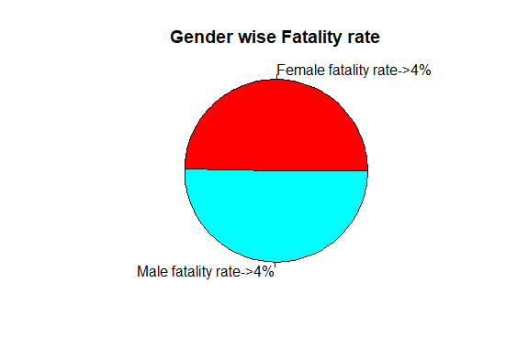
FATALITY RATE OF MALES AND FEMALES
THE FATALITY RATE OF BOTH MALE AND FEMALE IS 4%.
THE OVERALL FATALITY RATE IS ALSO 4%.
THE FATALITY RATE IS PROPORTION OF DEATHS FROM A CERTAIN DISEASE COMPARED TO THE TOTAL NUMBER OF PEOPLE DIAGNOSED WITH THE DISEASE FOR A CERTAIN PERIOD.

Slide 16
RESEARCH PROBLEM:
IN CONCLUSION, THE CORONAVIRUS DISEASE CONTINUES TO SPREAD ACROSS THE WORLD FOLLOWING A TRAJECTORY THAT IS DIFFICULT TO PREDICT. THE ONLY WAY WE CAN PROTECT OURSELVES AS WELL AS OTHERS ARE IF WE TAKE PROPER PRECAUTIONS LIKE WEARING A MASK, SOCIAL DISTANCING, WE MUST AVOID GOING OUT FOR NO REASON.
FINDINGS CONSISTENTLY INDICATE THAT QUARANTINE IS IMPORTANT IN REDUCING INCIDENCE AND MORTALITY DURING COVID – 19 PANDEMIC.
IN ORDER TO MAINTAIN THE BEST POSSIBLE BALANCE OF MEASURES, DECISION MAKERS MUST CONSTANTLY MONITOR THE OUTBREAK SITUATION AND IMPACT OF THE MEASURES IMPLEMENTED.
EARLY IMPLEMENTATION OF QUARANTINE AND COMBINING QUARANTINE WITH OTHER PUBLIC HEALTH MEASURES IS IMPORTANT TO ENSURE EFFECTIVENESS.

Slide 17


