Slide 1

Computer Shop
Lypengleang SEANG
Group3:
Vannet THAI
Chhinchhun EAB

Slide 2
Content
Overview
Purpose
Sitemap
Features
Reference
Coding Tools

Slide 3
Overview
We are offering an E-Commerce website that can get you a step closer to this goal and today we want to share with you why it’s important for businesses to have an E-Commerce website in place to better serve their customers.

Slide 4
Purpose
This website will provide users the best experiences by tracking the products that are valued in such systems; these presumably include best quality of product, accurate place to the map, fast response time, flexibility, and, above all, saving times.

Slide 5
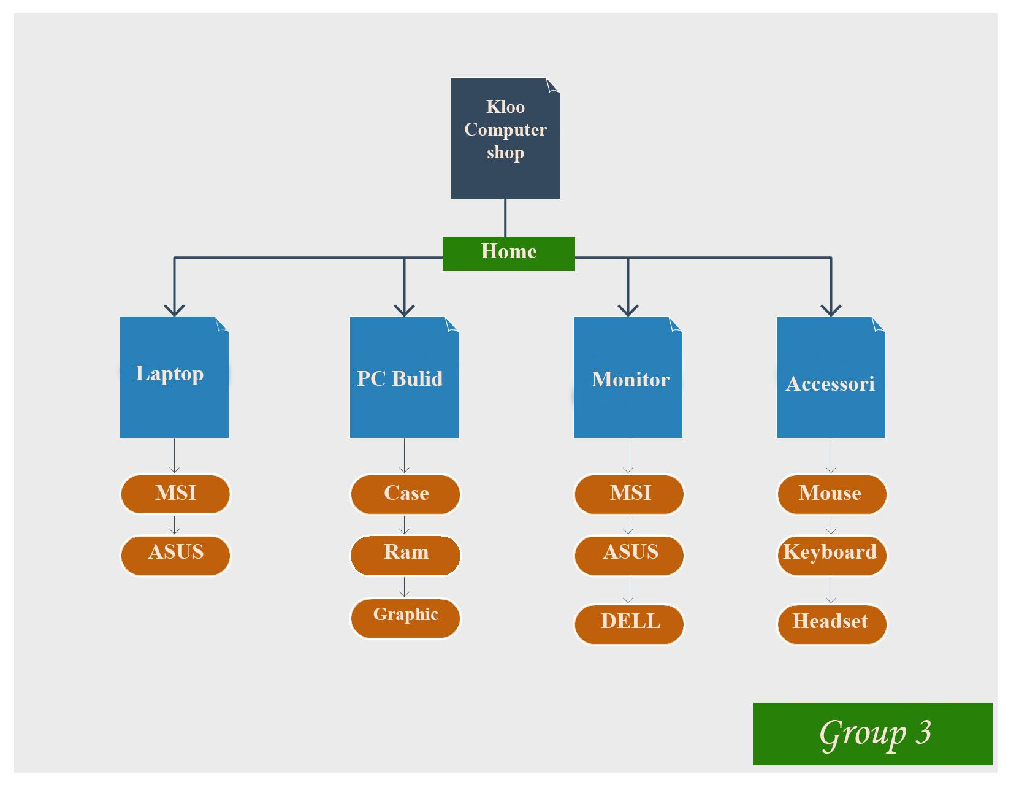
Sitemap

Slide 6
Features

Slide 7

Home

Slide 8
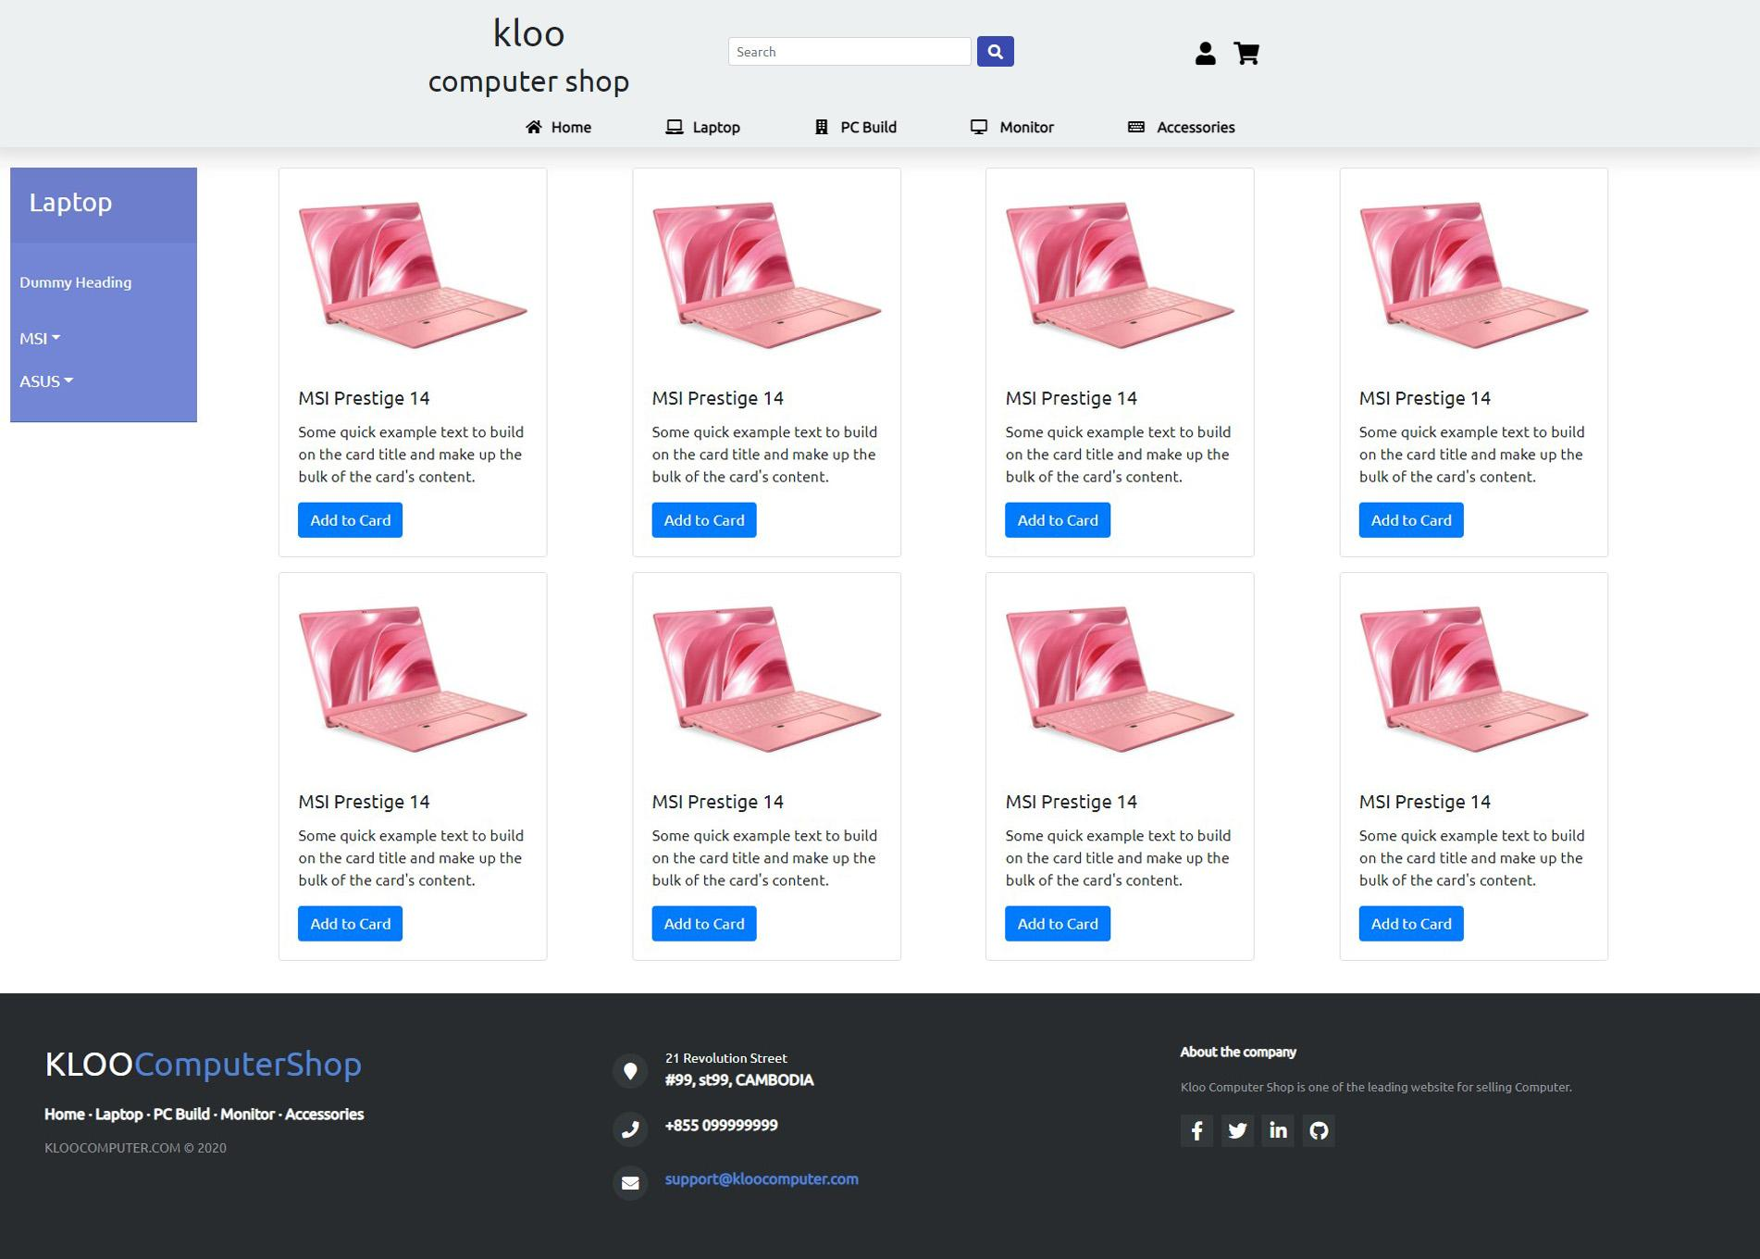
laptop
(Product catalog)

Slide 9
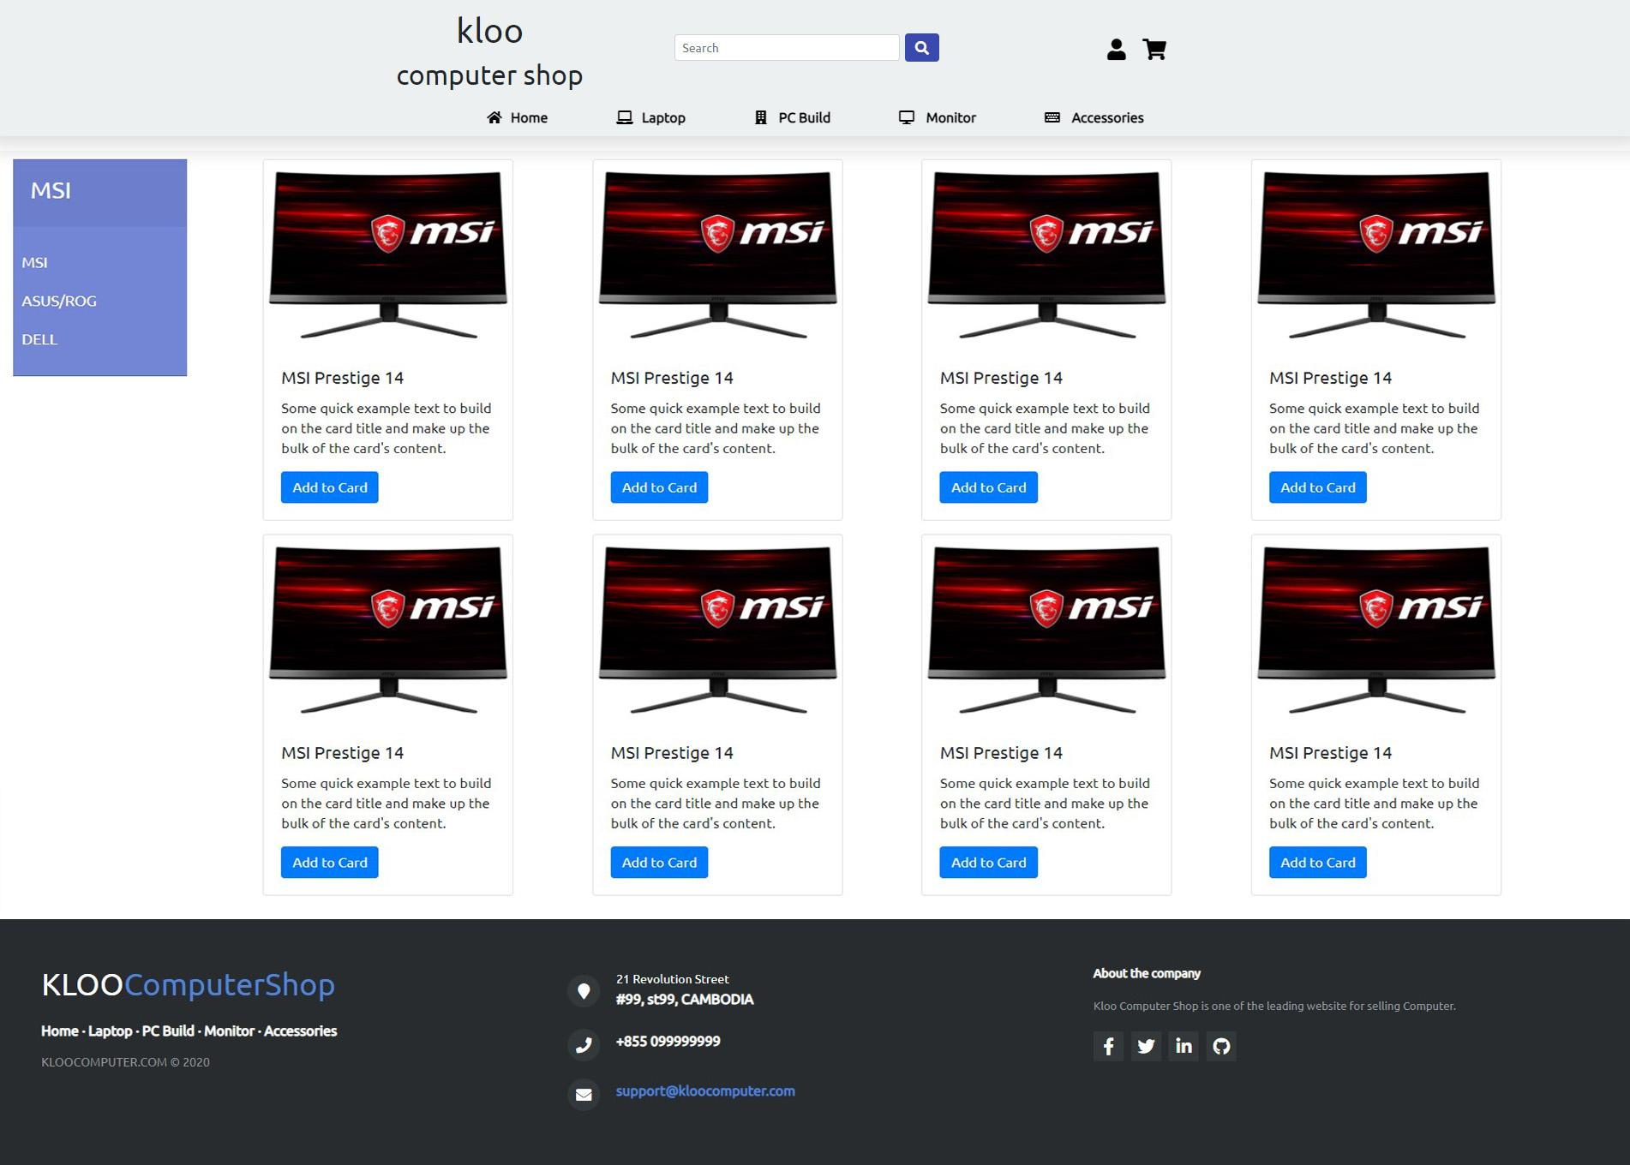
Monitor
(Product catalog)

Slide 10
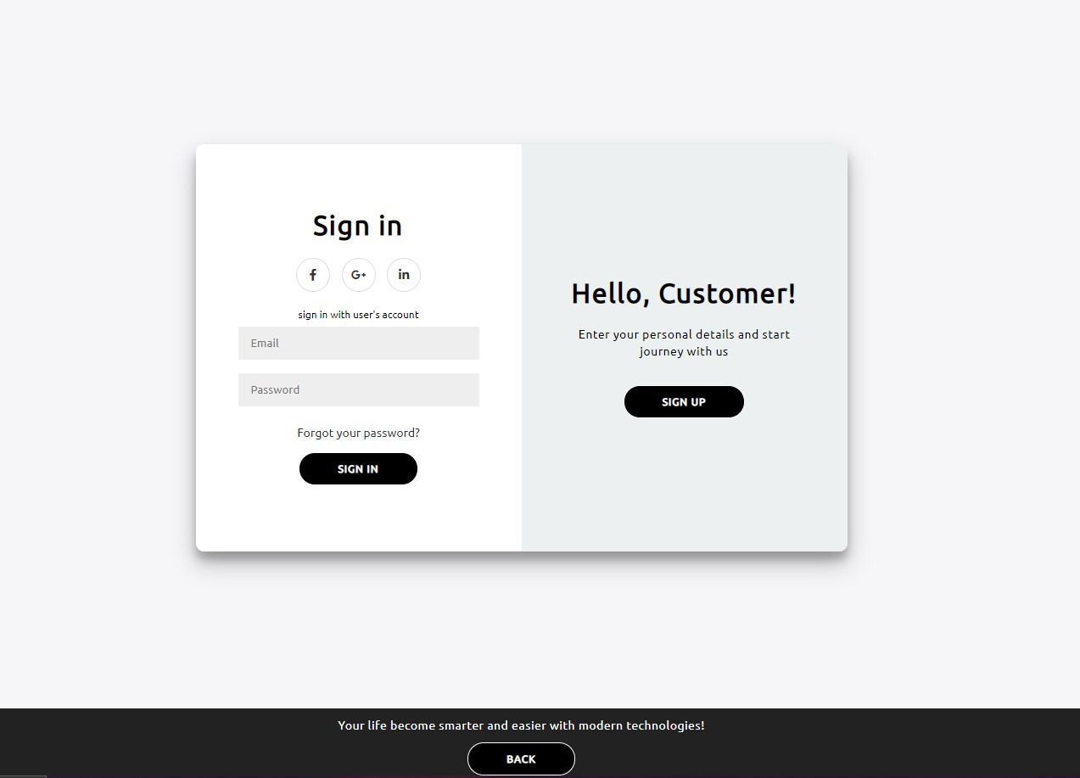
Login Page
(Product catalog)

Slide 11
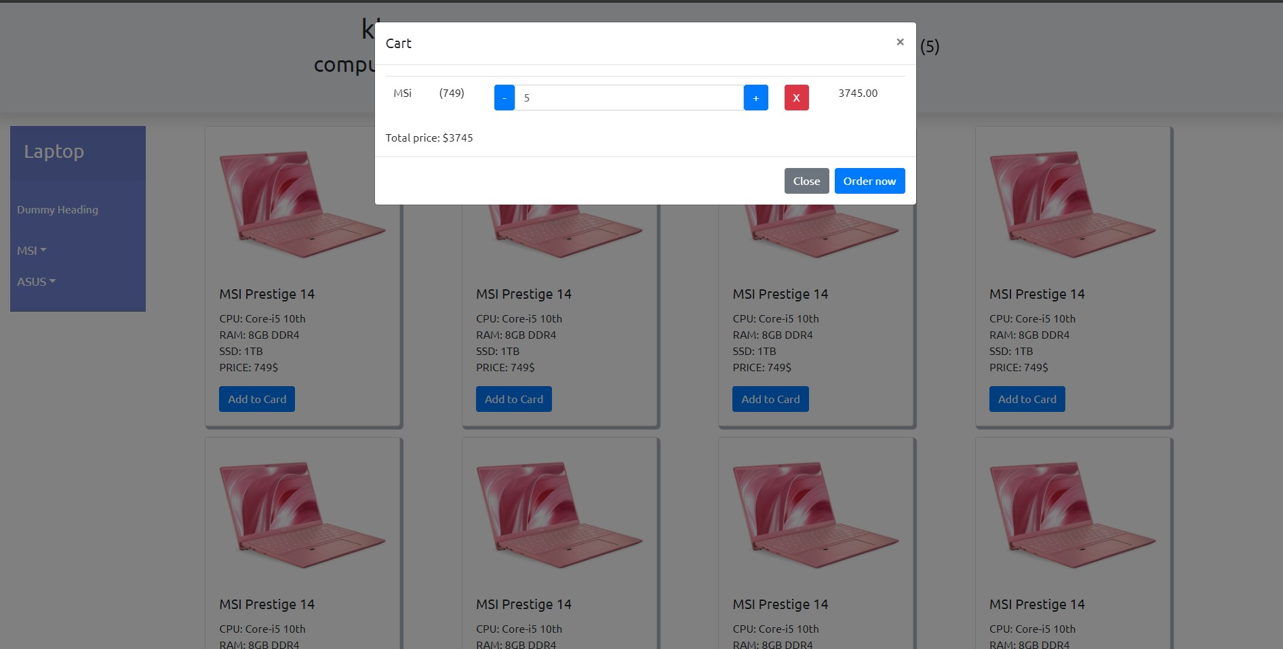
Shopping Cart
(Product catalog)

Slide 12



References:

Slide 13




References:

Slide 14


Coding Tools:

Slide 15
THE END
THANK YOU
FOR
ATTENDING

