Slide 1


Electricity Generation Forecast in Canada 2000-2007
Vannia Hnatiuk
Data Science Program

Slide 2
Characterize the electricity generation in a timespan
How many Megawatt-hours can be generated from 2000 to 2007 from previous decades?
This was inspired to make a prediction for the next 5 years. However, the dataset on current values was drastically reduced after performing EDA.

Slide 3
Business Case
How much will cost to produce electricity?
How much expensive will be to consume/produce electricity?
Notes:
Industry and Businesses must know how much capital to allocate for energy consumption for their production. Equally important, they can determine the cost of their products or services.

Slide 4



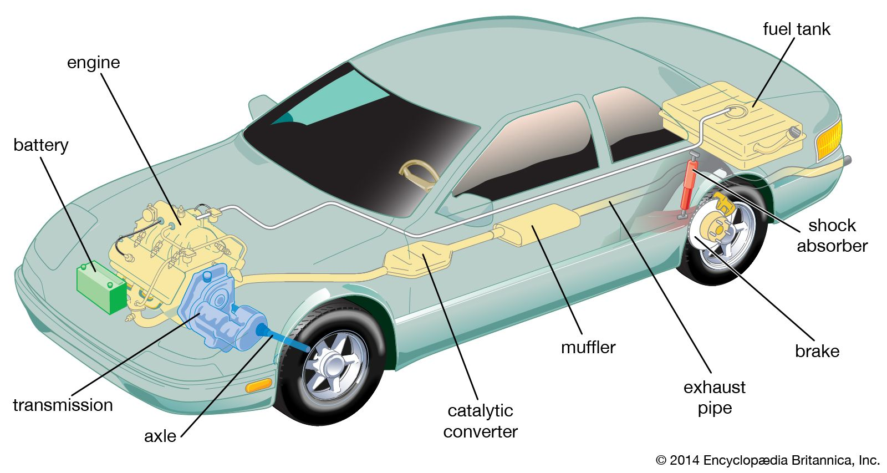
What is a Megawatt – Hour?
1 Mwh = 1000 Kwh
10 automobile engines
330 homes
Notes:
A megawatt hour (Mwh) is equal to 1,000 Kilowatt hours (Kwh). It is equal to 1,000 kilowatts of electricity used continuously for one hour.
One megawatt is equivalent to the energy produced by 10 automobile engines.
It is about equivalent to the amount of electricity used by about 330 homes during one hour.

Slide 5
Data Description
REF_DATE | Power
1985-11-01 | 40,023,030
1970-01-01 | 18,869,000
2003-10-01 | 42,966,467
1959-05-01 | 8,739,000
1965-10-01 | 12,568,000
1979-04-01 | 28,312,703
1971-10-01 | 18,241,000
1997-07-01 | 43,816,610
1984-10-01 | 35,291,380
1960-03-01 | 10,071,000
The target observation will be Power Electricity scaled in Mega Watt-Hour.
It is calculated using the following equation:
P = IV
Where:
P=Power in Watts
I=current in Ampers
V=Voltage in Volts
Notes:
Because a time series analysis will be conducted is The timestamp is the independent variable and Value will be the target variable. Where Value is actually Electric Power. Electric Power is the rate at which electrical energy is produced
Electric Power can be calculated through the formula.
And scaled on million of megawatts hour.

Slide 6

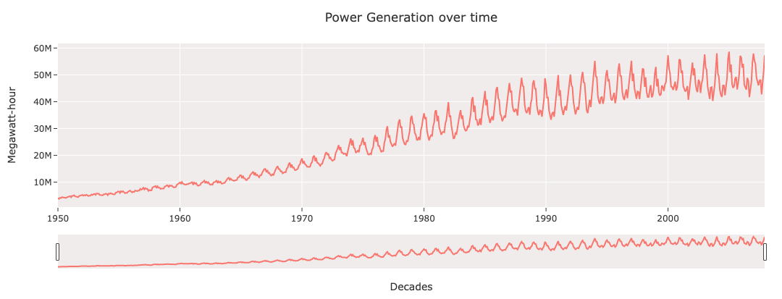

Original Data
Upward Trend
Higher Crest in Winter
Lower peak in summer
Year Seasonality
Fluctuating Variance
Notes:
The Electricity generation is defined by an Upstream Trend, when year by year: more electricity is being generated according to the population growth. The seasonality exhibits peaks in winter months (from November to January). This is because in winther months: days are shorter and cooler. For this reason the production tries to fulfill this demand for ilumination, heating and heat pumps.
Next, the generation slows down and becomes steady towards March. After, it declines into warmer months when ilumination and heating is less required. On the other hand, a slight peak happens in July and August when temperature rises and more electricity is required for air conditioning. As a result, cooling appliances consume immense loads of power.
Additionally,the distance between peaks and valleys fluctuates year by year showing an increasing variance.
Maximum values ranges in 50 millions of megawatts and minimum values on 40 millions of megawatts.

Slide 7
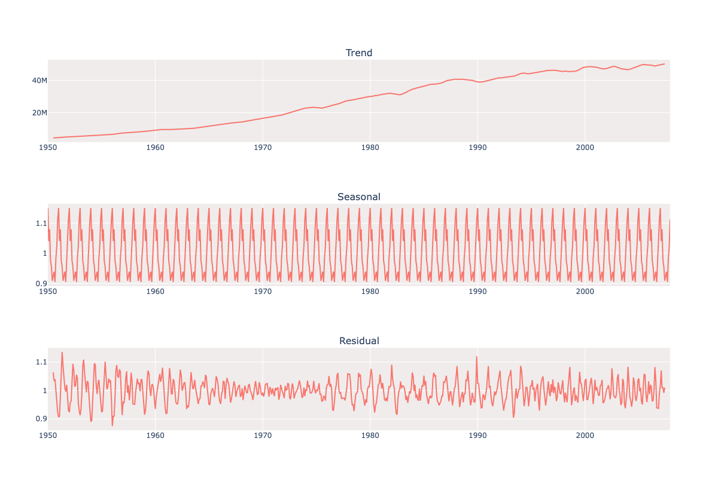
Trend Decomposition
Power generation growth
Seasonality is cyclical and same pattern
Residuals shows Heteroscedascity
Notes:
The seasonal plot shows constant seasonality and repeated pattern and scaled in 0.9 to 1.1 .

Slide 8
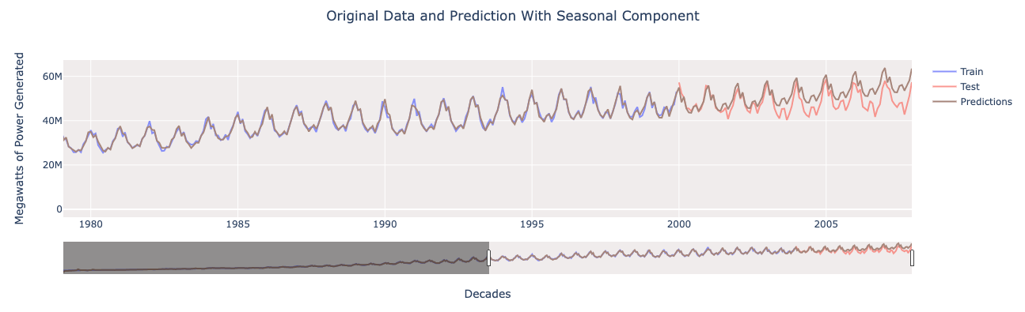
ARIMA Grid Search
Keep Waveform
Upward
MAPE Train 2.62%
MAPE Test 8.13%
Notes:
Automated method to determine the parameters p,q,d and seasonal order. Best criterion of lowest AIC. AIC (Akaike information criterion) metric. Where the lowest value determines the best model. This metric helps to avoid overfitting because it penalize models with lots of parameter and high d, D’s. this optimal model could capture the pattern of the training data and only 11 months in the test dataset, then it started to float over the test trend. Still, it could preserved the original waveform like the original data and the last prediction pointed 6.17 M of megawatts </span> higher than the last observation in the test dataset.

Slide 9
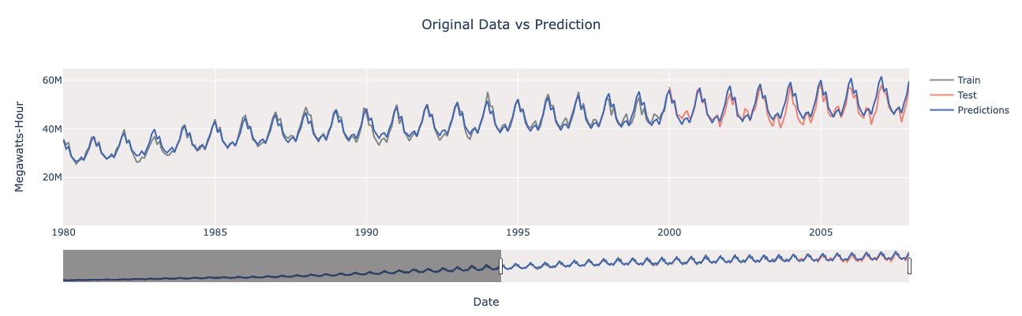
Facebook Prophet
Multiplicative seasonality
Canadian Holidays input
User Friendly → Data Scientist Friendly
MAPE Training 4.15%
MAPE Test 4.18 %
Notes:
The knight on the white horse: Facebook Prophet, it could make a robust prediction for periods ahead of 11 months. Equally important, Prophet is an advanced time series forecast model because the processing time is fast, it is accurate and it doesn't require data preprocessing as other models. For instance, it is flexible for parameter customization such the holidays and trend changepoints for domain experts. Above all, Prophet is easy to run, any data beginner can run it with little subject knowledge.

Slide 10

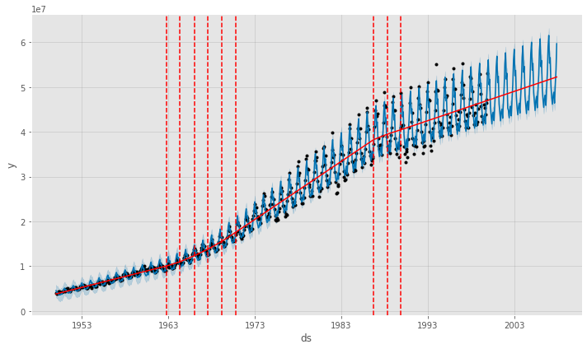
Change points
Notes:
Explain Method of adjustment

Slide 11
Model Comparison
Model | Configuration | train MAE | test MAE | train MAPE | test MAPE
ARIMA seasonal difference | SARIMAX(15,1,8) | 500,859.94 | 1,781,417.75 | 230.40% | 309.42%
ARIMA on original data | SARIMAX(12,1,6) | 579,057.65 | 3,912,764.13 | 3.11% | 8.43%
ARIMA with seasonal component | SARIMAX(3,1,1)(2,1,2)[12] | 574,951.67 | 1,170,546.95 | 2.62% | 8.13%
ARIMA with logarithmic transformation | SARIMAX(1,1,0) | 1,529,292.73 | 9,446,018.91 | 5.69% | 20.40%
Facebook Prophet | seasonality_mode ='multiplicative', CAN holidays | 784,938.33 | 1,998,462.67 | 4.16% | 4.18%

Slide 12
Raw Cost of Electricity
Price per kwh:
Min $0.99
Max $1.06
Transmission and Distribution costs Not included
Notes:
. In 2007, an average of $ 52 billions of Canadian dollars were sold from the Electric companies(depending on each province) to the industry and commercial sector.

Slide 13
References
Datasets:
Power Dataset
Electric power selling price index(non-residential)
Electricity
Gorse, Christopher Johnston, David Pritchard, Martin. (2012). Dictionary of Construction, Surveying and Civil Engineering - electric power. (pp. 132). Oxford University Press. Retrieved from: https://app.knovel.com/hotlink/pdf/id:kt00C1GZJ1/dictionary-construction/electric-power

Slide 14

Gracias
Thank You

