Slide 1
junksort.AI
Juliette Lavoie, Isabella Nikolaidis, Julie Tseng AI for Social Good Summer Lab | McGill Innovation

Slide 2
Overview
Motivation
Problem Definition and Scope
Design Process
Final Product Demo
Further Areas of Work

Slide 3
Introduction

Slide 4
Investigation Goals
Main Questions
Is the thought behavior of an individual similar to the travelling path idea?
How do we characterize this behavior from measurable quantities?
Do individual differences in thought behavior relate to hippocampal volumes?
To determine meaningful variables that characterize the thought behavior of an individual
To investigate the existence of a correlation between the variables and hippocampal volume
Notes:
Similarly to how you would see me return to Leggett time after time, are there variables we can identify to characterize whether an individual is returning to the same thought? And do individual differences in natural thought behavior relate to hippocampal volumes?
These questions guided the investigation goals. Of course, a difficult problem since there is no ground truth, but interesting nonetheless!

Slide 5
Background
Human Connectome Project
Collection of a large amount of MRI and behavioral data with valuable pre-processing (ex. Group ICA)
More on next slide
Other MATLAB Toolboxes
Built-in functions such as:
Smoothing average filter
Finding abrupt changes in standard deviation
Merging tables based on subject keys
… and more!
t-SNE dimensionality reduction algorithm
Major component of the multi-node analysis
Visualizing high dimensional data
Resources Used
Notes:
For this project, I used rfMRI data from the Human Connectome Project, which is a collection of a large amount of MRI, behavioral data with pre-processing. More in a second.
Also used built-in functions from toolboxes such as the Signal Processing toolbox, for data smoothing and analysis.
Finally, a major component of the multi-node analysis phase of this investigation is a dimensionality reduction algorithm.

Slide 6
Background
HCP820-MegaTrawl Release
rfMRI data for 820 individuals
Resting-state functional magnetic resonance imaging
Data collection relies on BOLD contrast concept (Seiji):
“Blood-oxygen-level dependent contrast imaging”
Observes brain activity over time
Use magnetic characteristic of oxygenated and deoxygenated blood
Data available in 15, 25, 50, 100, 200, 300 nodes
Node = group of regions of the brain
Pre-processed with group ICA (independent components analysis)
Look at single node case and multi-node case
Human Connectome Project
Notes:
I used the resting state fMRI data from the MegaTrawl release, where the data was pre-processed into network matrices which are easy to work with.
There were 820 subjects in the sample, each with an hour’s worth of fMRI data.
fMRIs are a method of looking at brain activity over time. They rely on the BOLD concept, where BOLD stands for Blood oxygen level dependent contrast imaging.
Essentially, when neurons fire, there is a sharp intake of oxygen to give it the energy it needs. Furthermore, there are differences in the magnetism of oxygenated and deoxygenated blood.
By taking a control condition, the fMRI looks at these changes in magnetism and infers brain activity from that.
The network matrices have 4800 timepoints sampled at 750ms – that’s an hour’s worth of data. Furthermore, the data for each individual is available in different numbers of nodes, or a group of regions of the brain. This data is provided for 15, 25, 50, 100, 200, 300 nodes – so at each time point, there are X values that collectively describe the state of the brain. We used the 15 node one in this analysis.
Back to my previous analogy about the travelling path – that was an easy one because we can very easily visualize the dimensions. However, we can’t visualize 15 dimensions! So where to begin? Firstly, by looking at a single node or dimension, and then looking at the multi-node case.

Slide 7
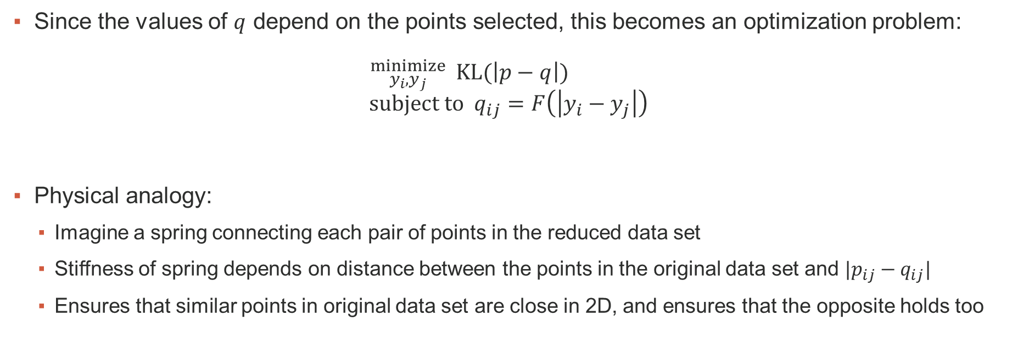
t-SNE Algorithm: Broad Strokes
Since the values of $q$ depend on the points selected, this becomes an optimization problem:
$${}_{y_{i}, y_{j} }^{minimize}{ KL(\left|p−q\right|)} \\ subject to q_{ij}=F\left(\left|y_{i}−y_{j}\right|\right)$$
Physical analogy:
Imagine a spring connecting each pair of points in the reduced data set
Stiffness of spring depends on distance between the points in the original data set and $|p_{ij}−q_{ij}|$
Ensures that similar points in original data set are close in 2D, and ensures that the opposite holds too
1 L.J.P. van der Maaten and G.E. Hinton. Visualizing High-Dimensional Data Using t-SNE. Journal of Machine Learning Research 9(Nov):2579-2605, 2008
Notes:
This optimization problem means we’re choosing the coordinates to overall minimize the difference between the probability matrices.
Explain the physical analogy!

Slide 8
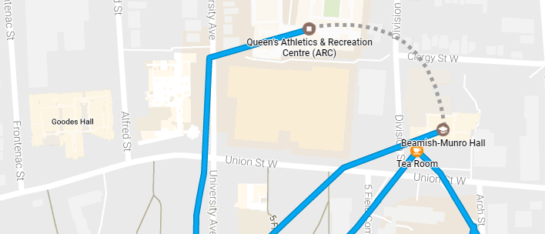


Duration and Number of Transitions
Layer 0:
820 subjects
Layer 1:
Varying the threshold value from 5 to 50 and in intervals of 5
Layer 2:
Maximum duration
Average duration
Number of transitions
Layer 3:
Hippocampal volumes
Notes:
So to recap.
For each of our 820 subjects, we have their fMRI data. For each of these subjects, we smoothed their node signal and reduced the data from 15 dimensions to 2.
We applied the duration analysis I just described on thresholds varying from 5 to 50 in intervals of 5.
THEN, we arrived at three potential variables:
Maximum duration (out of all their ‘thoughts’, what was the longest one?)
Average duration (are some more prone to having longer average thoughts?)
Number of transitions (how many times did they jump from one thought to another?) NOTE: We treated “same locations” as separation transitions and did not consider overall time spent in a certain state. Hard to classify.
With these variables in mind, we want to now investigate whether there exists a correlation to hippocampus volumes.

Slide 9
Further Areas of Work
Better image recognition and category sorting
Better user interface
Integrate with university app or city app
Multi-Node Analysis

