Slide 1
Automate Robotic Cart with BLE (D008)
Martijn Lemmens & Joeri Rethy & Stijn Acke

Slide 2
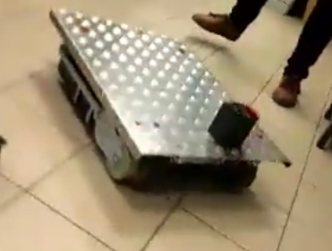
Index
SOFTWARE
HARDWARE
PROBLEEMSTELLING
RESULTAAT

Slide 3
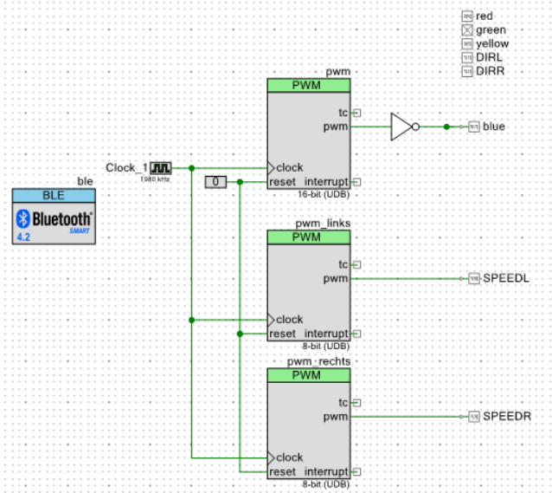
SOFTWARE
BLE
PWM
TIMER

Slide 4
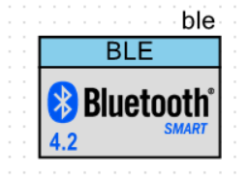
SOFTWARE - BLE
Client
Server
Database
Connectie

Slide 5
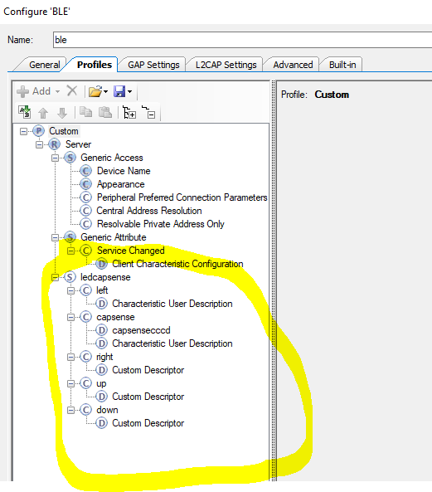
SOFTWARE - BLE
Configuratie
Service
Karakteristiek

Slide 6
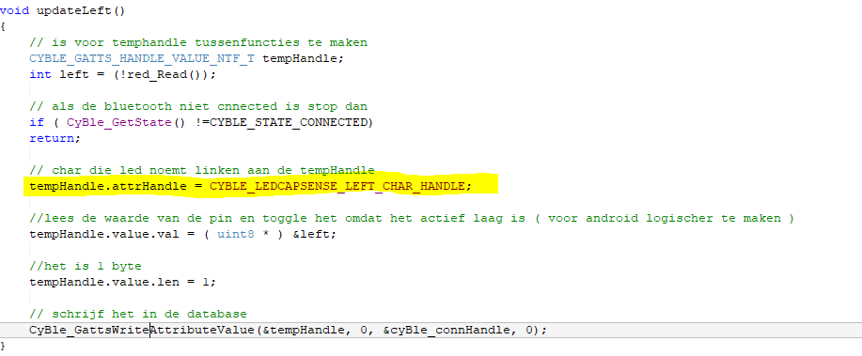
SOFTWARE - BLE
Ingelezen waarde in de database plaatsen

Slide 7
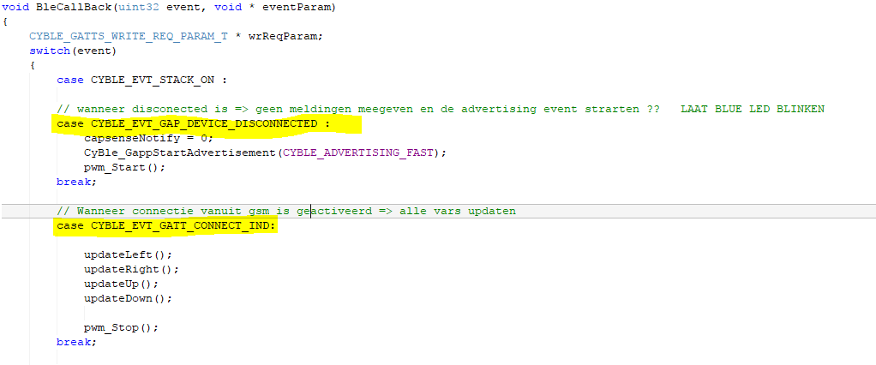
SOFTWARE - BLE
Connectie mogelijkheden d.m.v. een case structuur

Slide 8
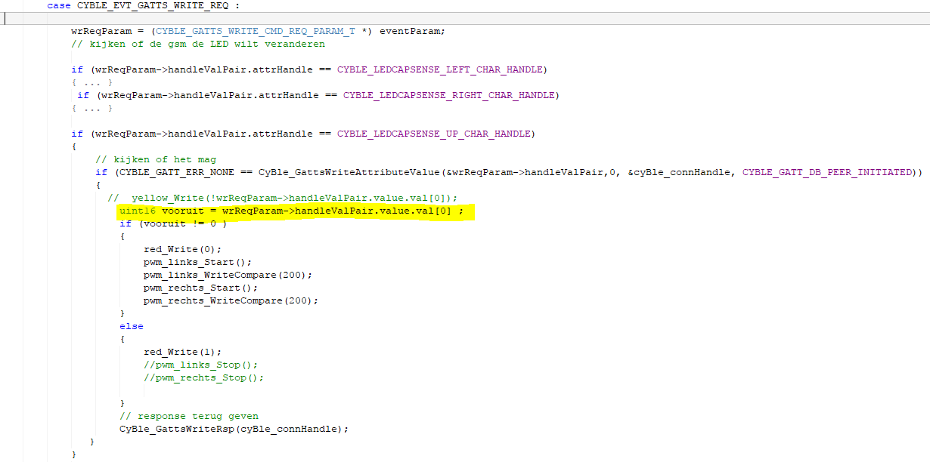
SOFTWARE - BLE
Aansturing

Slide 9
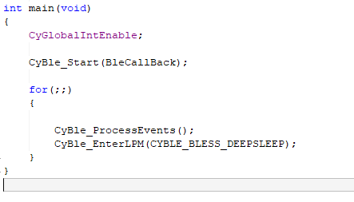
SOFTWARE - BLE
Activeren

Slide 10
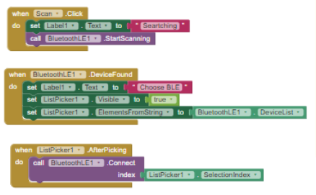
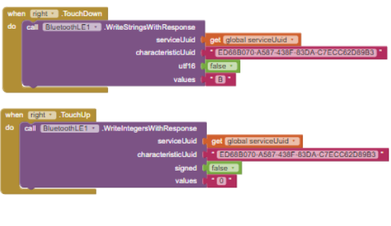

SOFTWARE - BLE AP-INVENTOR

Slide 11
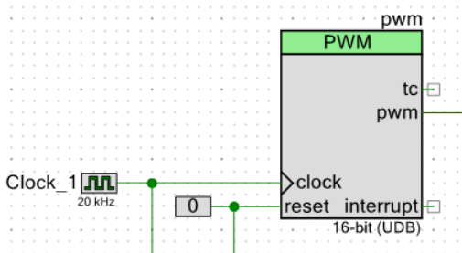
SOFTWARE - PWM
Klok 20kHz
Datasheet
Periode
100
Compare
50

Slide 12
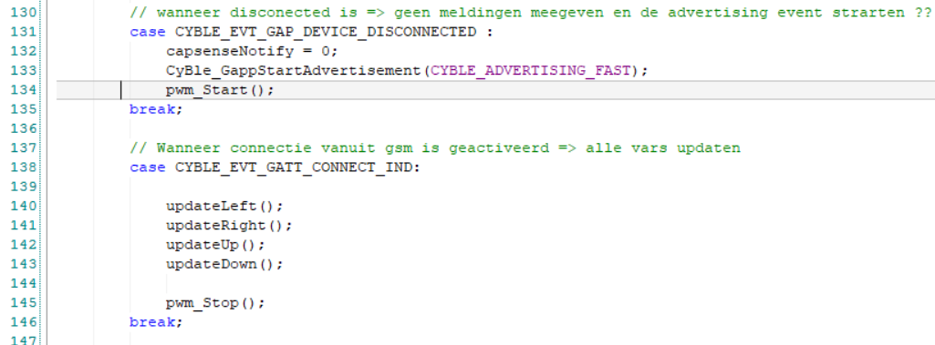
SOFTWARE - PWM
Aanzetten en uitzetten

Slide 13
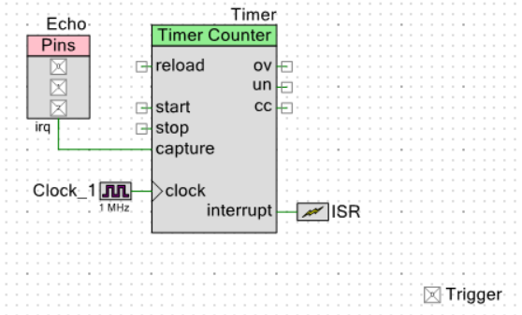
SOFTWARE - TIMER
Ultrasoon
Vier pins

Slide 14
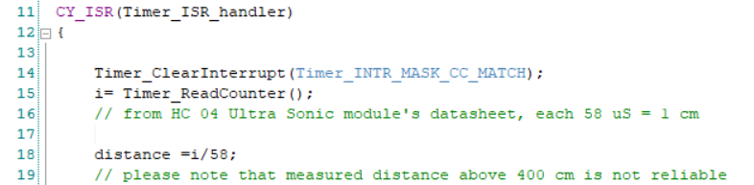
SOFTWARE - TIMER
Timer handler
Functie beschrijving
Berekening

Slide 15
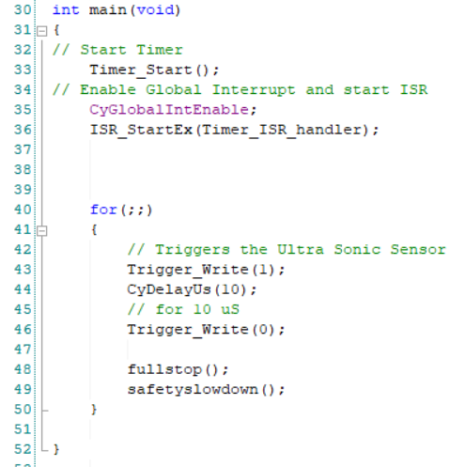
SOFTWARE - TIMER
Triggers
Activeren

Slide 16
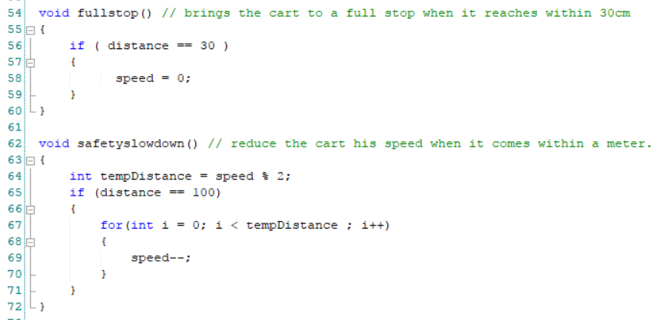
SOFTWARE - TIMER
Functies

Slide 17
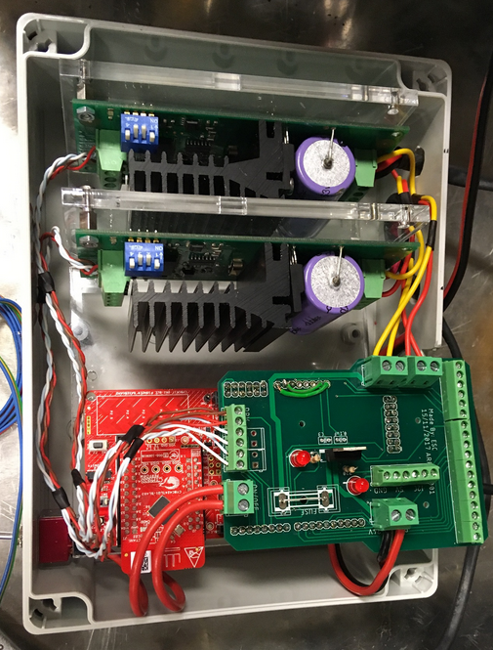
HARDWARE
Motorsturing
5V-0V
BLE
Sturing
Nieuw
24V motor
Rotary encoder

Slide 18
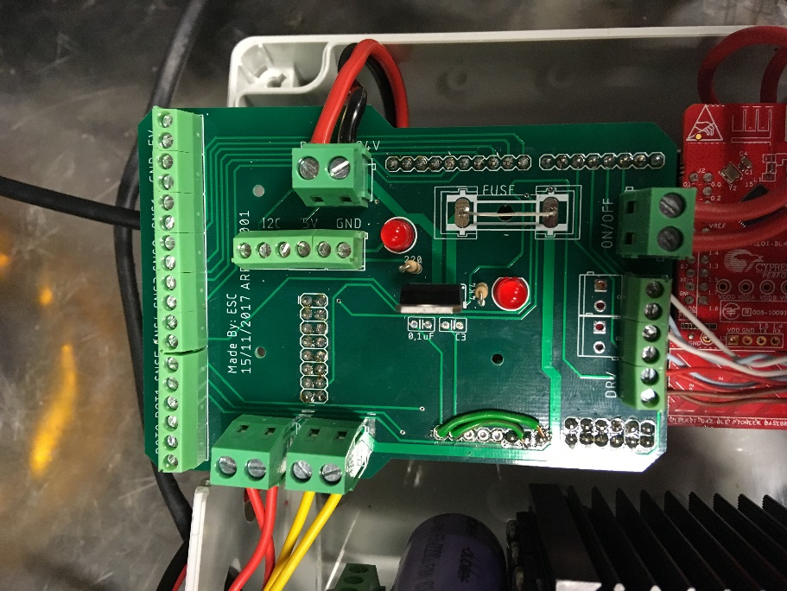
HARDWARE
Nieuw design

Slide 19
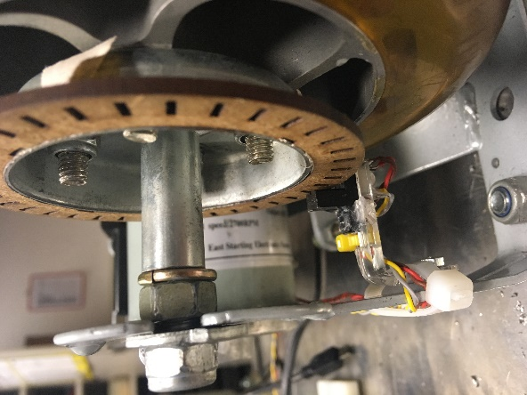
HARDWARE
Infrarood rotary encoder

Slide 20
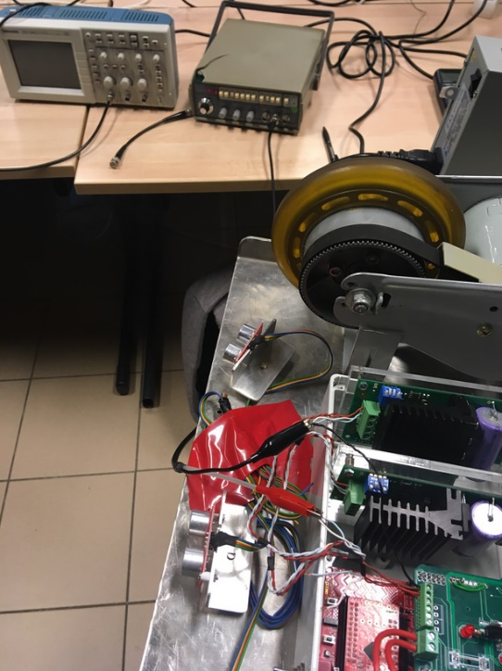
PROBLEEMSTELLING
Slecht functioneren aandrijving
Test fase (CODE of HARDWARE)
Oscilloscoop
Functie generator
PWM

Slide 21
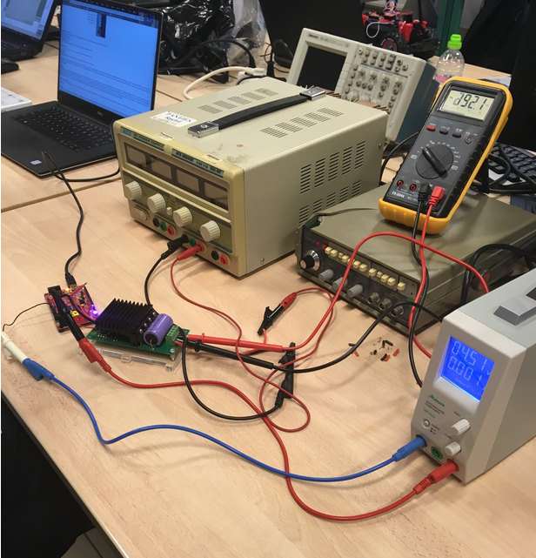
CONCLUSIE
Educatief project
Defecte motoraansturing
Helaas unfinished

Slide 22
FIN
Zijn er nog vragen ?

