Slide 1
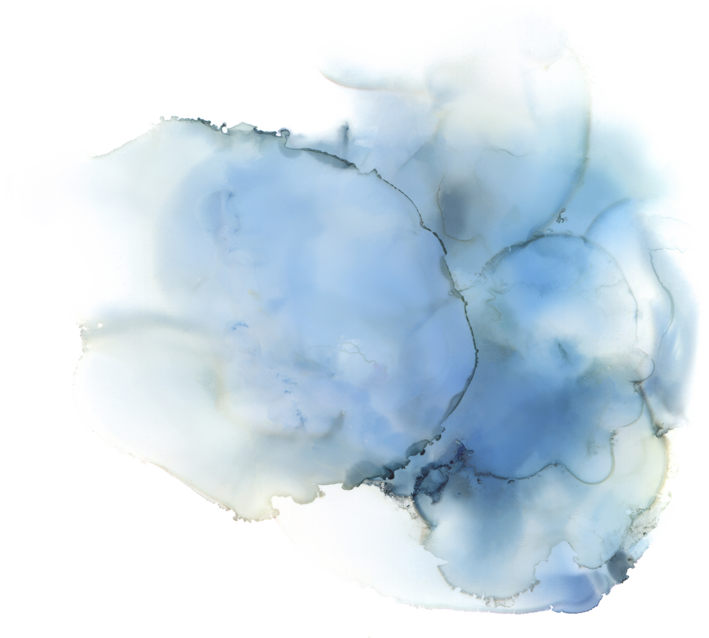

ALGORITHMS AND AI
PROJECT
Under the Guidance of Dr Animesh Chaturvedi

Slide 2

GROUP MEMBERS
D SHANMUKHA 22BDS019
RAJDEEP MANIK 22BDS048
G LEELADITYA 22BDS024
VANSH LAL TOLANI 22BDS061

Slide 3
PROJECT TITLE
Integrating Graph Analytics with AI Algorithms for
Enhanced Breast Cancer Classification and
Interpretability

Slide 4

BRIEFF OVERVIEW
Primary goal: Enhance breast cancer classification by integrating traditional AI algorithms with advanced graph analytics and deep learning.
Focus: Improve interpretability and accuracy by combining original data features with graph-based metrics.
Technology: Use Apache Spark for scalable graph processing.
Techniques: Apply Graph Neural Networks (GNN) to explore relationships within the dataset.
Explainability: Integrate explainable AI methods like SHAP and LIME to provide insights into feature importance.
Objective: Support more transparent and reliable classification outcomes.

Slide 5
DATASET DESCRIPTION
The Breast Cancer Wisconsin
(Diagnostic) Dataset
Source of the dataset: Kaggle [https://www.kaggle.com/datasets/uciml/breast-cancer-wisconsin-data]
Key Features and Labels:
This dataset includes 30 numerical features extracted from images of cell nuclei.
Categories of Features: Each characteristic (e.g., radius, texture, perimeter) is represented by three types of values:
Mean: Average value of the characteristic.
Standard Error: Variation or uncertainty of the characteristic.
Worst Value: The largest value of the characteristic within the dataset sample.

Slide 6
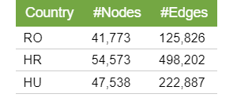
DATASET DESCRIPTION
Feature Types: Here are some key features, each computed as mean, standard error, and worst value
Radius: Mean distance from center to perimeter points.
Texture: Standard deviation of gray-scale values.
Perimeter and Area.
Smoothness: Variation in radius lengths.
Target Label:
Malignant (cancerous): Often coded as 1.
Benign (non-cancerous): Often coded as 0.

Slide 7
Preprocessing Data
Handling Missing Values: Check for missing values; if found, fill with mean/median or remove rows.
Encoding Labels: Convert labels to numeric form (1 for Malignant, 0 for Benign) for compatibility.
Feature Scaling: Apply standardization or normalization, essential for algorithms sensitive to feature scales.
Train-Test Split: Split the data into training and testing sets (e.g., 70-30 or 80-20) to validate model performance on unseen data.

Slide 8
AI ALGORITHMS FOR CLASSIFICATION

Slide 9
1.Random Forest (RF):
An ensemble method that builds multiple decision trees and combines their outputs for prediction. It is robust to overfitting and handles large datasets well.
2.Decision Tree (DT):
A tree-based model that splits the data based on feature values to make predictions. It's easy to interpret but can overfit, especially with deep trees.
3.Support Vector Machine (SVM):
SVM aims to find the hyperplane that best separates the two classes (benign and malignant). It works well with high-dimensional datasets and is effective for binary classification problems.
4.K-Nearest Neighbors (KNN):
A simple, instance-based learning algorithm that classifies data based on the majority label of its k-nearest neighbors. It’s a non-parametric method and works well when the decision boundary is irregular.

Slide 10
Rationale for Choosing These Algorithms
Random Forest and Decision Trees are chosen for their simplicity and interpretability. They provide insights into the importance of features and allow for easy visualization.
SVM is selected for its effectiveness in high-dimensional spaces and its ability to create complex decision boundaries.
KNN is chosen for its simplicity and performance in cases where the decision boundaries are not linear, providing a good contrast to the other methods.

Slide 11
Performance Metrics Used
Accuracy: Measures the overall correctness of the model’s predictions.
Precision: Focuses on how many of the positive predictions (malignant tumors) are actually correct.
Recall: Measures how many of the actual positives (malignant tumors) the model is able to correctly identify.
F1-Score: A balanced measure between precision and recall, particularly useful in cases with imbalanced class distributions.

Slide 12
Converting Dataset to Graph Dataset
We converted the Original Dataset to a Graph Based Dataset
Here nodes are the patients id
Connections (edges) between nodes could be based on similarities in attributes like diagnosis, mean radius, mean texture,
It has 508 nodes and 1857 edges

Slide 13
Introduction to Apache Spark for Large-Scale Graph Processing:
Apache Spark is a powerful open-source distributed computing system that provides an easy-to-use interface for processing large datasets.
It is highly scalable, allowing it to run on a cluster of machines and process data in parallel, making it suitable for handling big data.

Slide 14
Graph Metrics and Their Purpose
In this project, several key graph metrics are used to analyze the relationships between data points and provide insights into the structure of the dataset. The following metrics are implemented:
Page Rank
Connected Components
Triangle Counting

Slide 15
Page Rank
In the context of breast cancer data, PageRank can be used to assess the relative importance of each tumor sample (node) in relation to others.
If certain benign or malignant tumors are connected to many similar tumors, they may be deemed more important in terms of classification.
PageRank could help uncover key tumors that have strong relationships with others, which may indicate shared features or behaviors.

Slide 16
Connected Components
In breast cancer classification, connected components can identify groups of similar samples (tumors) based on their features.
This helps uncover patterns in the data where samples share common characteristics, such as benign tumors being more likely to cluster together and malignant tumors forming distinct, possibly more dispersed, clusters.

Slide 17
Triangle Counting
In breast cancer data, triangle counting can highlight more complex relationships between tumor samples and their features.
If three samples are all interconnected, it suggests that these samples share a set of similar characteristics that make them more closely related.

Slide 18
Merging Graph-Based Metrics with Original Data

Slide 19
Process of Integrating Graph Metrics
After applying the graph-based metrics (PageRank, Connected Components, Triangle Counting) on the graph constructed from the breast cancer dataset, these metrics are computed and added as new features to the original dataset.
The merging process involves:
Generating Graph Features: For each tumor sample, the corresponding PageRank, connected component label, and triangle count are calculated.
Merging with Original Data: These graph-based features are then merged with the original dataset, which contains the tumor characteristics (e.g., mean radius, area, texture). The result is a richer feature set that includes both traditional features and graph-based insights.

Slide 20
Purpose of Enhancing Dataset with Graph Metrics
Enriching Feature Set: By merging graph-based metrics with traditional features, we are enhancing the dataset to include relationships and structural patterns that may not be captured by the raw features alone. These new features can reveal hidden patterns in the data that might help the model make more accurate predictions.
Improved Classification Performance: Graph-based metrics like PageRank and Connected Components can improve the model's ability to distinguish between benign and malignant tumors by incorporating interrelationships between samples. These added features can help the classifier identify more complex patterns and make better predictions.
Model Robustness

Slide 21
Deep Learning and Graph Neural Networks (GNN)

Slide 22
Explanation of Artificial Neural Networks (ANN) and Deep Neural Networks (DNN)
Artificial Neural Networks (ANNs) and Deep Neural Networks (DNNs) are a class of machine learning models inspired by the structure of the human brain. ANNs consist of layers of interconnected neurons, where each neuron processes information and passes it to the next layer.
DNNs are ANNs with multiple hidden layers that allow for the learning of complex patterns in large datasets. These models are particularly effective when handling high-dimensional data, such as images, speech, and text.

Slide 23
Explanation of Artificial Neural Networks (ANN) and Deep Neural Networks (DNN)
In the context of breast cancer classification, DNNs can be used to learn non-linear patterns in tumor data by processing the raw features (e.g., mean radius, texture) and making predictions about tumor malignancy.

Slide 24
Introduction to Graph Neural Networks (GNN):
Graph Neural Networks (GNNs) are a type of deep learning model designed to work directly with graph data.
GNNs have emerged as a powerful tool for analyzing data that is naturally represented as graphs, such as social networks, biological networks, and molecular structures.
A GNN operates by iteratively updating the representations (embeddings) of nodes based on their neighbors in the graph.

Slide 25
Use of Graph Neural Networks (GNN):
In this project, GNNs could be used to process the augmented dataset, where both traditional tumor features and graph-based features (like PageRank or connected component labels) are input into the model.
By learning from the graph structure, GNNs can capture more complex dependencies between tumors and their features, improving classification accuracy for breast cancer.

Slide 26
Graph-Augmented Data for GNNs
The enriched dataset, which includes both traditional and graph-based features, can be fed into a GNN for training.
This allows the model to learn not just from the individual tumor characteristics but also from the relationships between tumors, potentially uncovering more sophisticated patterns that might be missed by traditional classifiers.

Slide 27
Explanation of ANN and DNN Architectures Used

Slide 28
Artificial Neural Networks (ANNs)
Architecture Overview:
ANNs consist of multiple layers of nodes (neurons) connected to each other. Each neuron in a layer is connected to the neurons in the previous and next layers, passing information forward through weighted connections.
The key components of an ANN are:
Input Layer: Takes the raw features from the dataset, such as tumor characteristics (e.g., radius, texture, area).
Hidden Layers: Each hidden layer consists of neurons that transform the input data via activation functions (e.g., ReLU, sigmoid) to capture non-linear relationships.
Output Layer: Produces the final predictions (e.g., benign or malignant classification). A softmax activation function is typically used in classification tasks to output probabilities.

Slide 29
ANN Use in Classification:
ANNs are capable of learning from data by adjusting the weights of connections through backpropagation.
For breast cancer classification, an ANN model can learn complex non-linear patterns between tumor features and malignancy.
The model adjusts weights to minimize the error between predicted and actual labels during training.

Slide 30
Deep Neural Networks (DNNs)
Architecture Overview:
DNNs are a type of ANN with multiple hidden layers, allowing the model to learn increasingly abstract representations of the input data.
This deep structure enables DNNs to model very complex relationships and is well-suited for high-dimensional data.

Slide 31
A typical DNN architecture for breast cancer classification includes:
Multiple Hidden Layers: Each hidden layer captures higher-level features of the data, such as combinations of tumor characteristics that might be indicative of malignancy.
Activation Functions: Non-linear functions like ReLU or tanh are applied after each hidden layer to allow the network to capture non-linear relationships in the data.
Output Layer: The output layer typically uses a softmax activation function (for multi-class classification) or a sigmoid function (for binary classification like benign vs. malignant).

Slide 32
Model Interpretability with SHAP/LIME

Slide 33
SHAP (Shapley Additive explanations):
Overview:
SHAP is a method to explain the output of machine learning models by assigning each feature a contribution value to the final prediction. It is based on cooperative game theory, where each feature is considered as a "player" contributing to the model's decision.
Application in Model Interpretability:
In the context of breast cancer classification, SHAP can help explain the role of each feature (e.g., tumor size, texture) in predicting whether a tumor is malignant or benign. For example, it can show that mean radius or texture had the most significant positive contribution to predicting malignancy, while smoothness might have had a lesser impact.

Slide 34
LIME (Local Interpretable Model-agnostic Explanations):
Overview:
LIME works by approximating the behavior of complex models locally with interpretable models (e.g., linear regression or decision trees). It generates local explanations by perturbing the input data and observing how the model’s output changes.
Application in Model Interpretability:
LIME can be used to understand the behavior of deep learning models (like DNNs or GNNs), which are often seen as "black boxes." By approximating the decision boundary locally, LIME provides insights into which features were most influential for specific predictions, helping clinicians or researchers understand why the model predicted a certain outcome.

Slide 35
Interpretability Results:
SHAP and LIME can be used to visualize feature importance and understand the decisions made by the model. For example:
SHAP plots can show that high PageRank values or triangle counts had significant positive contributions to identifying malignant tumors, whereas texture features may have contributed more to benign classifications.
LIME might provide local explanations for individual predictions, showing that for a particular tumor, the combination of mean radius and area was the most influential.

Slide 36
Results

Slide 37
Results after applying AI Algorithms
Algorithms | Accuracy | Precision | Recall | F1-Score
Random Forest | 0.96 | 0.97(0) | 0.97 | 0.97
 |  | 0.96(1) | 0.96 | 0..96
Decision Tree | 0.91 | 0.94(0) | 0.91 | 0.92
 |  | 0.88(1) | 0.91 | 0.90
SVM | 0.98 | 0.97(0) | 1.00 | 0.99
 |  | 1.00(1) | 0.96 | 0.98
KNN | 0.94 | 0.92(0) | 1.00 | 0.96
 |  | 1.00(1) | 0.87 | 0.93

Slide 38
Apache Spark PySprak Results
The Highest Pagerank Results is node 556
The Connected component is 0 as all belong to the same community
The triangle counting is 161028 for most of the patients

Slide 39
SHAP/LIME Results
Sum of importance of all columns=0.7
All the columns importance probababilty ranges between -0.4 and 0.4

Slide 40
Results after applying DeepLearning Models
Algorithm | Accuracy | Precision | Recall | F1-score
ANN | 0.97 | 0.98(0) | 0.97 | 0.98
 |  | 0.95(1) | 0.97 | 0.96
GNN | 0.89 | 0.88(0) | 0.95 | 0.92
 |  | 0.91(1) | 0.79 | 0.85
DNN | 0.96 | 0.96(0) | 0.96 | 0.96
 |  | 0.96 | 0.96 | 0.96

Slide 41
Conclusion
By seeing the results we conclude that,
The addition of graph data i.e Connected Components,PageRank,Triangle Counting values to the original Breast cancer dataset using GNN(89%) is decreasing the accuracy of the overall machine learning model.
This maybe due to slight overfitting of the data in the machine learning model .
Hence it was not necessary to add graph details to the original dataset.
And comparing the results of ANN and DNN with the normal ML models like Random Forest,KNN,SVM,Decision Tree we found that the normal ML models are working well especially,the SVM model with 98% accuracy.It is due to our small dataset of only 569 rows into 33 columns as ANN,DNN work better on bigger and complex datasets

Slide 42

Github Link:https://github.com/Vansh-1007/Algorithms_and_AI_Project

