Slide 1


CLOUD COMPUTING
PROJECT
Under the Guidance of Dr Animesh Chaturvedi

Slide 2

GROUP MEMBERS
D SHANMUKHA 22BDS019
RAJDEEP MANIK 22BDS048
G LEELADITYA 22BDS024
VANSH LAL TOLANI 22BDS061

Slide 3
PROJECT TITLE
LLM-Based Mental Health Chatbot with Mobile App Integration

Slide 4
PROJECT TIMELINE
1
2
3
4
5
6
OVERVIEW
RESEARCH & LITERATURE REVIEW
DESIGN & ARCHITECTURE
IMPLEMENTATION
RESULTS & TESTING
CONCLUSION & FUTURE WORK

Slide 5
OVERVIEW

Slide 6

BRIEFF OVERVIEW
Project Objective: Develop an AI-powered mental health chatbot for accessible emotional support.
Technologies Used:
Frontend: Flutter for a cross-platform mobile application.
Backend: FastAPI/Flask for API development.
AI Model: GPT-based LLM for intelligent response generation.
Key Features:
Real-time conversational support.
AI-powered suggestions and coping strategies.

Slide 7
PROBLEM STATEMENT
Mental health issues are increasing, but access to professional help remains limited.
Many individuals feel uncomfortable discussing their emotions openly.
Existing mental health resources lack real-time, AI-driven support.
The need for a scalable, accessible, and supportive mental health chatbot.

Slide 8
SOLUTION
Development of an AI-powered mental health chatbot using LLMs (GPT-based models).
Flutter-based mobile application for an interactive and user-friendly experience.
FastAPI/Flask backend to handle user queries and connect with the AI model.
Cloud deployment for scalability and real-time support.
Ensures 24/7 availability, privacy, and accessibility for mental health assistance.
Uses natural language understanding to interpret user concerns
Provides emotionally intelligent responses using LLMs like GPT-3.5
Incorporates predefined mental health modules, such as breathing exercises, grounding techniques, and affirmations

Slide 9
Research & Literature Review

Slide 10
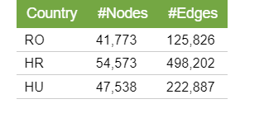
DATASET DESCRIPTION
Source:
The dataset, taken from Kaggle, is specifically designed for mental health chatbots. It includes frequently asked questions (FAQs) and corresponding responses, structured to help AI models generate reliable and empathetic replies to mental health-related queries
Key Attributes:
Question: User queries related to mental health concerns.
Answer: Predefined responses addressing concerns like stress, depression, anxiety, and therapy guidance.
Category: Topics such as coping strategies, self-care, professional help, and emotional well-being.

Slide 11
DATASET DESCRIPTION
Usage in LLM
The dataset helps in fine-tuning the chatbot to provide accurate and relevant responses.
It enables the chatbot to offer context-aware replies by learning from real-world mental health FAQs.
The processed data is integrated with a GPT-based model to generate natural, conversational responses.

Slide 12
Design & Architecture

Slide 13
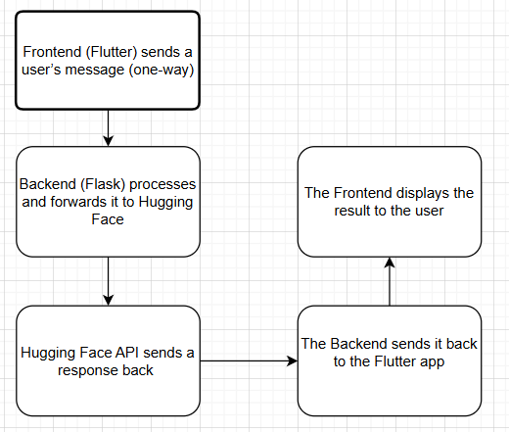
SYSTEM ARCHITECTURE

Slide 14
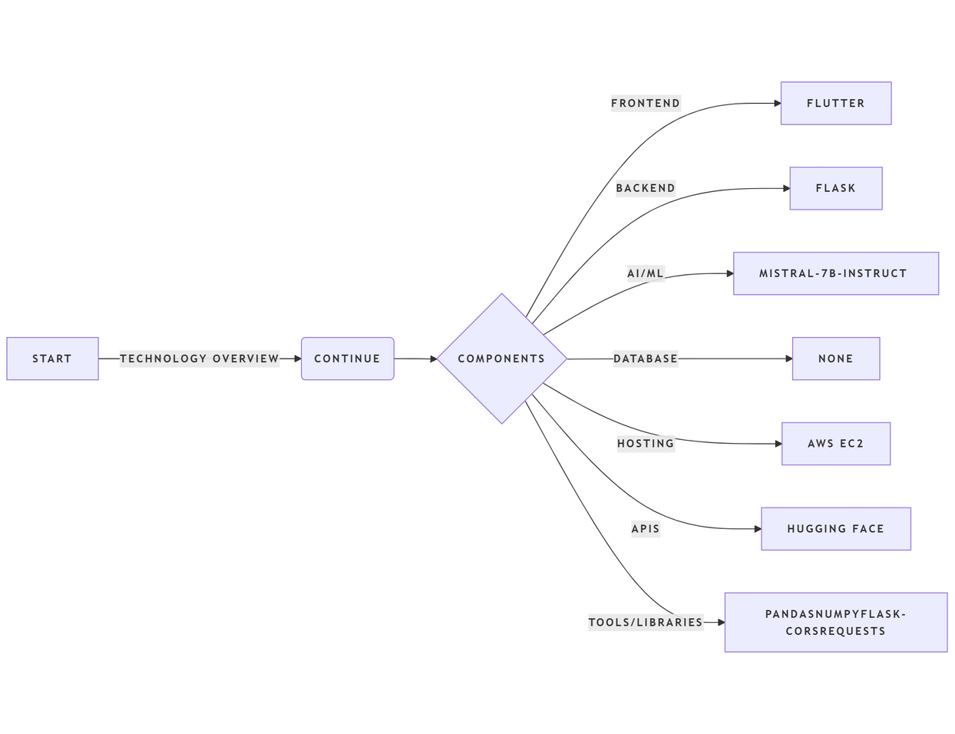
TECHNOLOGY STACK

Slide 15
Implementation

Slide 16
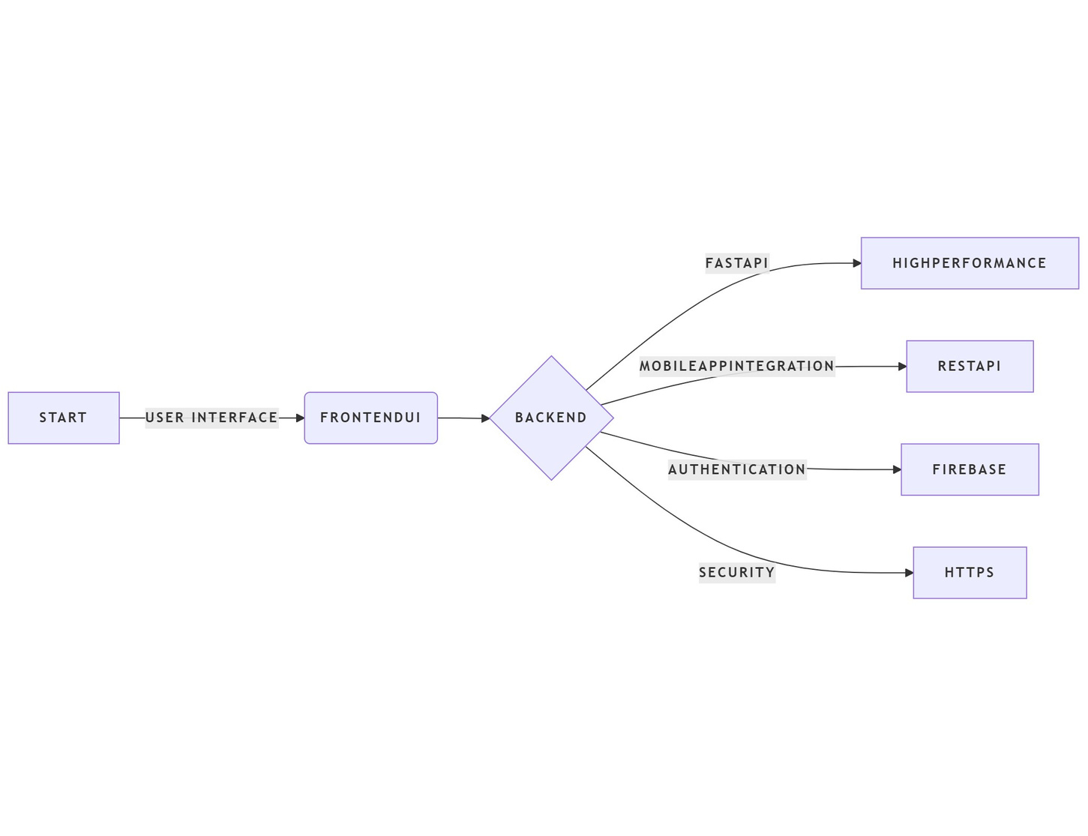
Implementation details

Slide 17
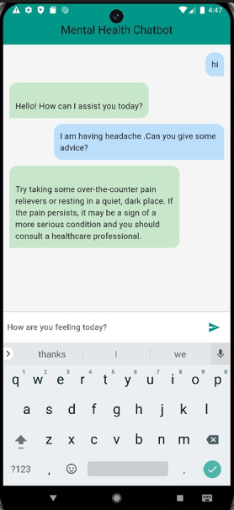
App interface

Slide 18
CONCLUSION

Slide 19
CONCLUSION
Successfully built and tested a mental health chatbot powered by GPT.
Empathetic responses validated by user testing and emotional relevance..
Proved that LLMs can be a valuable part of mental health tools.
This project showcases the potential of combining Large Language Models, mobile interfaces, and scalable backend infrastructure for mental health assistance. The chatbot successfully generates context-aware, empathetic replies and delivers them via a user-friendly mobile app.

Slide 20

Github Link:https://github.com/Vansh-1007/Cloud-Computing-Project

