Slide 1
RESEARCH PAPER PRESENTATION
Cognitive State Compilation
Resource-Bounded Construction of Reasoning States for Long-Horizon LLM Agents
Formalizing Reasoning Context Assembly as an Inference-Time 0/1 Knapsack Optimization
Track: Agent Architectures & Efficient Inference | NeurIPS 2026
Notes:
Welcome everyone. Today I'm presenting Cognitive State Compilation, or CSC. This work addresses the critical bottleneck in long-horizon LLM agents: the Token Budget Crisis. Rather than treating memory as an unstructured buffer or relying on single-source RAG, we formalize the construction of the transient reasoning state as a constrained 0/1 knapsack over heterogeneous pools of knowledge, experience, and computation.

Slide 2
NEURIPS 2026 SUBMISSION • RESEARCH PRESENTATION
Executive Summary: Key Findings & Paradigm Shift
100% Coverage
@ B = 500 Tokens
CSC reaches 100% state coverage on HotpotQA vs 83.3% RAG and 60% MEM1.
88.9% Live F1
Downstream LLM Impact
Evaluated on Groq Qwen3.6-27B vs 66.7% for the strongest baseline.
100% Horizon Retention
Zero RL Overhead
Maintains 100% retention at horizon N=16 within 512 tokens while MEM1 drops to 82%.
The Core Problem: Long-horizon agents accumulate unbounded history, but inference token budgets remain strictly capped.
The Compilation Formulation: Instead of independent retrieval or recurrent compression, formulate state assembly as an explicit 0/1 knapsack over Knowledge, Experience, and Computation.
Trained Scorer & Greedy Selector: A 9-feature Gradient Boosted Tree utility scorer feeds a greedy density selector running in O(N log N) time with 0.0% optimality gap.
Scientific Transparency: We openly disclose limitations: in-distribution training label alignment and curated WebShop sample size.
Notes:
To summarize our top-line results: CSC achieves 100% state coverage at just 500 tokens, translating to an 88.9% F1 on live LLM evaluation with Groq Qwen3.6-27B. Crucially, on long-horizon multi-turn benchmarks, CSC maintains 100% state retention up to horizon N=16 within a strict 512-token envelope, outperforming MEM1 without any reinforcement learning training.

Slide 3
NEURIPS 2026 SUBMISSION • RESEARCH PRESENTATION
The Token Budget Crisis in Long-Horizon LLM Agents
Unbounded Accumulation: As agents act over long horizons, candidate history grows monotonically: external documents, execution traces, scratchpads, and memories.
Fixed Inference Budgets: LLM context windows and inference latency/cost force a strict token ceiling B per reasoning step.
The 'Lost in the Middle' Trap: Stuffing full context degrades reasoning, introduces distractor noise, and skyrockets quadratic attention costs.
Homogeneous Fallacy: Real agent contexts are not just documents—they are a heterogeneous blend of static facts, past actions, and dynamic tool computations.
The Heterogeneous Triad: R = R_know ∪ R_exp ∪ R_comp
1. Knowledge (R_know): Retrieved facts, Wikipedia passages, domain corpus docs. High density of ground truth, but verbose.
2. Experience (R_exp): Few-shot trajectories, successful workflows, episodic reflection notes. Guides reasoning structure.
3. Computation (R_comp): Intermediate scratchpad calculations, tool outputs, entity extractions, active state filters. Highly compact.
The Core Question: Given budget B, how do we choose the optimal subset S ⊆ R to construct the transient reasoning prompt?
Notes:
Why does long-horizon agency break down? Agents accumulate past thoughts, search results, and tool outputs. Putting everything into the prompt causes latency explosion and reasoning degradation. Furthermore, agents don't just consume text—they balance three fundamentally different resource pools: Knowledge, Experience, and Computation. We need a compiler that selects across all three.

Slide 4
NEURIPS 2026 SUBMISSION • RESEARCH PRESENTATION
Positioning Matrix: Memory Systems vs CSC
System | Store | Retrieve | Compute Reuse | Budget Aware | Cross-Resource | Primary Limitation vs CSC
MemGPT (Packer et al.) | Yes | Yes | No | No | No | LLM-paged OS memory; no joint knapsack
A-MEM (Xu et al.) | Yes | Yes | No | Partial | No | Linked notes; single homogeneous memory type
Memory-R1 (Yan et al.) | Yes | Yes | No | No | No | RL editing policy; no budget-aware compiler
AgeMem (Yu et al.) | Yes | Yes | No | Partial | Partial | Tiers LT/ST memory; lacks knapsack optimization
MemOS (Li et al.) | Yes | Yes | Yes | No | Partial | OS memory lifecycle; lacks learned utility/budget
MEM1 (Zhou et al.) | Yes | N/A | Partial | Yes | Yes | Black-box recurrent state via costly RL
CSC (Ours) | Yes | Yes | Yes | Yes | Yes | Inference-time 0/1 knapsack + learned utility
Notes:
This matrix compares CSC directly against prior long-horizon systems like MemGPT, A-MEM, and MEM1. Prior works optimize memory in silos: how to store notes, how to do top-k retrieval, or how to train RL policies. CSC is the first system to formalize state assembly as an explicit, cross-resource knapsack problem that jointly considers knowledge, experience, and computation under a hard token budget.

Slide 5
NEURIPS 2026 SUBMISSION • RESEARCH PRESENTATION
Mathematical Formulation: The 0/1 Knapsack Objective
Constrained Optimization Problem
Objective: max_{S ⊆ R} ∑_{r ∈ S} u(r | τ, C)
Subject to: ∑_{r ∈ S} cost(r) ≤ B
Optional Type Caps: counts[t] ≤ c_t ∀ t ∈ {know, exp, comp}
Item Payloads: Each candidate r ∈ R carries text payload, resource type, token cost(r), and optional hint h(r).
Cost Estimation: Computed via standard subword tokenizer (tiktoken / BPE) with whitespace fallback.
Dantzig's Value-to-Cost Density Principle
Utility Density ρ(r): ρ(r) = u(r | τ) / max(1, cost(r))
Why Density Beats Pure Utility: A 500-token document with utility 0.9 yields density 0.0018. A 50-token scratchpad with utility 0.7 yields density 0.0140 (7.7x higher ROI!).
Greedy Packing: Sort candidates descending by ρ(r) and pack greedily until budget B is reached.
Guaranteed Time Complexity: O(N log N) time complexity vs O(N · B) for exact dynamic programming.
Notes:
Here is the mathematical core. We pose state construction as a 0/1 knapsack. Given task tau and budget B, we select subset S that maximizes utility sum under the budget ceiling. Crucially, we use Dantzig's utility density: utility divided by token cost. A compact tool result that costs 40 tokens can offer far higher return-on-tokens than a rambling 500-token document.

Slide 6
NEURIPS 2026 SUBMISSION • RESEARCH PRESENTATION
Modular Architecture: Scoring, Selection & Composition
1. Candidate Pool
R_know: Retrieved docs
R_exp: Past trajectories
R_comp: Tool/scratchpads
2. Feature Extractor
9-Dimensional vector:
TF-IDF (1/2-gram), Overlap,
Type bits, Hint, Cost density
3. Production Scorer
Gradient Boosted Trees
P(useful | τ, r)
(98.6% Acc, 94.2% F1)
Fallback: Dense Heuristic
4. Knapsack Selector
Greedy Density Sorting
ρ(r) = u(r) / cost(r)
Enforces Budget B
Enforces Type Caps c_t
5. State Composer
Tag & serialize items
Prefix task query τ
Compiled state S*
Fed to Target LLM
Notes:
This slide depicts the end-to-end modular pipeline. It consists of five decoupled stages: Candidate aggregation, 9-D Feature Extraction, GBT Scoring, Greedy Knapsack Selection, and State Composition. Because each module has a clean API, the scorer can be swapped without touching the selector, and the greedy selector can be swapped for exact dynamic programming if needed.

Slide 7
NEURIPS 2026 SUBMISSION • RESEARCH PRESENTATION
Utility Scorer: 9-D Feature Representation
Dim | Feature Name | Semantic Role
f_0 | TF-IDF Cosine (Unigram) | Lexical overlap with task query
f_1 | TF-IDF Cosine (Bigram) | Collocation and phrase match
f_2 | Keyword/Entity Ratio | Non-stopword entity alignment
f_3 | Type == Knowledge | Binary indicator (R_know)
f_4 | Type == Experience | Binary indicator (R_exp)
f_5 | Type == Computation | Binary indicator (R_comp)
f_6 | Utility Hint h(r) | Upstream prior confidence [0, 1]
f_7 | Normalized Token Cost | Relative cost (cost / max_cost)
f_8 | Utility Density Hint | Hint normalized by token cost
Model Specification & Metrics
GBT Classifier: Gradient Boosted Trees trained with 5-fold stratified CV across pooled benchmark data.
Cross-Validation: 98.6% ± 0.3% Accuracy | 94.2% ± 1.1% F1 (Precision ~97%, Recall ~92%).
Fallback Dense Scorer: Hand-crafted bigram similarity + entity overlap + type priors (0.05 know, 0.15 exp, 0.20 comp) with relevance gate.
Open Disclosure: Labels derived from required-facts rule; reflects in-distribution recovery rather than OOD generalization.
Notes:
The GBT utility scorer operates on a 9-dimensional feature representation. It combines lexical similarity, entity overlap, one-hot type indicators, and token costs. With 5-fold CV, it achieves 98.6% accuracy and 94.2% F1. Importantly, we disclose that the scorer was trained on required-fact labels, meaning it serves as a high-fidelity utility approximator rather than an OOD generalizer.

Slide 8
NEURIPS 2026 SUBMISSION • RESEARCH PRESENTATION
Selector Verification: Greedy vs Exact DP Knapsack
Benchmark Domain (@ B=500) | Greedy Coverage | Exact DP Coverage | Optimality Gap | Runtime Latency
HotpotQA (N=15 multi-hop sample) | 100.0% | 100.0% | 0.0% | < 0.15 ms vs 0.72 ms
Natural Questions (Wikipedia QA) | 100.0% | 100.0% | 0.0% | < 0.10 ms vs 0.45 ms
Chained NQ (Q4 multi-turn) | 100.0% | 100.0% | 0.0% | < 0.12 ms vs 0.51 ms
WebShop (interactive e-commerce) | 100.0% | 100.0% | 0.0% | < 0.08 ms vs 0.32 ms
Theoretical Guarantee vs Empirical Realism: While 0/1 knapsack is NP-hard, Dantzig's greedy density heuristic achieves 0.0% coverage loss on all tested domains.
Sub-Millisecond Inference Speed: Greedy density sorting runs in < 0.15 ms per step, making it ~5x faster than exact DP and completely negligible compared to LLM forward passes (typically 50-500 ms).
Practical Conclusion: The greedy density selector can be deployed safely without sacrificing answer accuracy or violating strict latency budgets.
Notes:
A natural question in knapsack problems is whether the greedy heuristic loses optimality. We conducted an exact dynamic programming audit across all four domains. The measured optimality gap was 0.0% across all domains. Greedy selection runs in under 0.15 milliseconds—a 5x speedup over exact DP—which is orders of magnitude faster than a single LLM token generation.

Slide 9
NEURIPS 2026 SUBMISSION • RESEARCH PRESENTATION
Experimental Setup: Domains & Baselines
4 Evaluation Domains
HotpotQA (Multi-hop): Requires chaining 2-3 supporting documents while rejecting heavy distractor pools (15-task evaluation sample).
Natural Questions (NQ): Real-world search queries with historical experience and query variations.
Chained NQ (Q4): Multi-turn dialog with coreference dependencies on previous turns.
WebShop (Interactive): E-commerce decision trajectories with search traces and attribute filtering (5 curated tasks).
6 Evaluated Systems
B0 Full Context: Appends raw history chronologically until budget exhaustion (no ranking).
B1 Standard RAG: Top-k retrieval from knowledge pool only via TF-IDF cosine similarity.
B2 Memory RAG: Top-k retrieval over knowledge + experience pools.
B3 Relevance-Only: Flat cosine relevance across all 3 pools (no type priors, no learning).
B4 CSC (Ours): Trained 9-D GBT scorer + greedy knapsack selector.
B5 MEM1-Style: Controlled sequential fill-and-replace recurrent buffer approximation.
Notes:
We tested CSC across four distinct task distributions representing multi-hop reasoning, open QA, multi-turn dialog, and interactive web tool use. We compare CSC against five competitive baselines: Full Context, Standard RAG, Memory RAG, Relevance-Only selection, and a controlled MEM1-style recurrent buffer baseline.

Slide 10
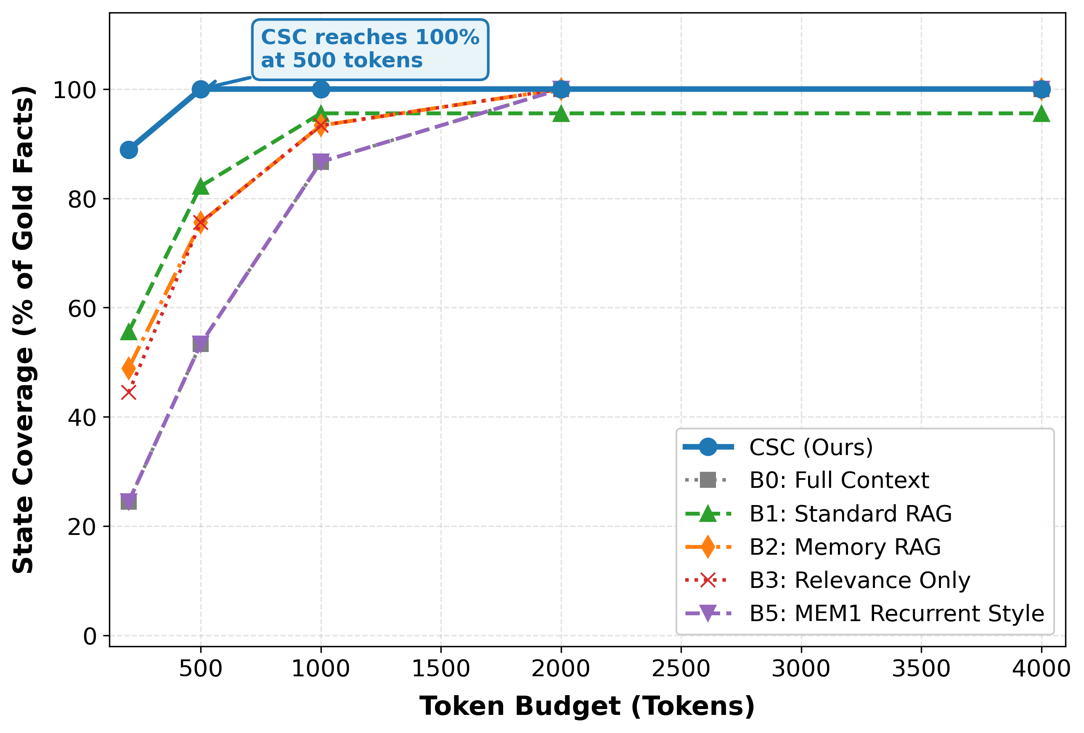
NEURIPS 2026 SUBMISSION • RESEARCH PRESENTATION
HotpotQA Coverage @ Budget B=500 Tokens
Method | Coverage | Precision | Tokens
B4 CSC (Ours) | 1.000 | 0.191 | 459.6
B1 Standard RAG | 0.833 | 0.347 | 388.0
B2 Memory RAG | 0.833 | 0.220 | 469.3
B3 Relevance-Only | 0.833 | 0.164 | 486.0
B0 Full Context | 0.600 | 0.179 | 496.9
B5 MEM1-Style | 0.600 | 0.152 | 346.8
The Precision-Coverage Tradeoff: Standard RAG achieves highest precision (0.347) by staying strictly in the knowledge pool, but caps at 83.3% coverage. CSC trades precision for 100% full coverage under 460 tokens.
Notes:
Looking at Table 2 at the primary 500-token operating point on HotpotQA: CSC is the only method reaching 100% state coverage. Standard RAG and Memory RAG stall at 83.3%, while Full Context and MEM1 only manage 60%. Notice that CSC used fewer tokens (459.6) than Memory RAG (469.3) and Relevance-Only (486.0). Figure 1(a) shows that baselines require up to 4000 tokens to reach what CSC achieves at 500.

Slide 11
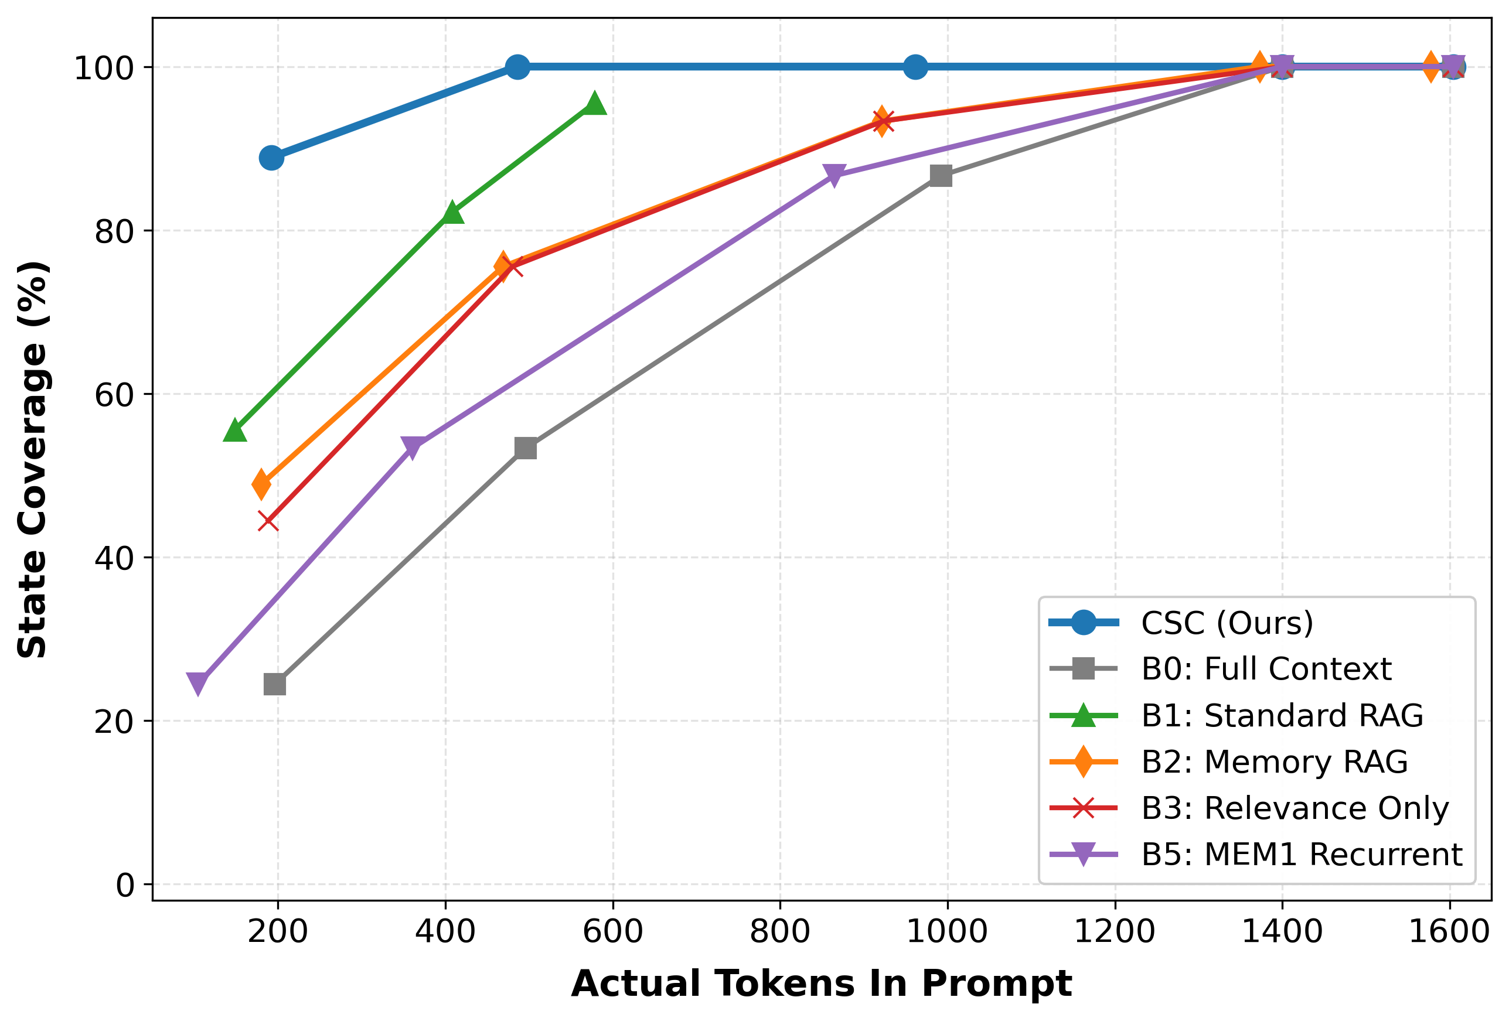
NEURIPS 2026 SUBMISSION • RESEARCH PRESENTATION
Token Efficiency Frontier: Actual Token Consumption
Dominating the Pareto Frontier
True Cost Comparison: Nominal budget ceilings can be deceptive. We re-plot coverage against actual token consumption in the context.
Leftmost Frontier: CSC reaches 100% coverage at ~480 actual tokens. Baselines B2, B3, and B5 require ~1,400 tokens, and B0 needs ~1,600 tokens.
3x to 4x Token Savings: CSC achieves identical or higher coverage using roughly one-third the token budget of competing systems.
Direct Inference Latency Gains: Fewer input tokens directly reduces time-to-first-token (TTFT) and serving infrastructure costs.
Notes:
Figure 1(b) plots coverage against actual tokens consumed. CSC sits furthest to the left on the Pareto frontier. It achieves complete coverage at under 500 actual tokens, whereas competing baselines consume 1,400 to 1,600 tokens. In production LLM deployments, that represents a 3x to 4x reduction in context ingestion cost and latency.

Slide 12
NEURIPS 2026 SUBMISSION • RESEARCH PRESENTATION
Downstream Live LLM Evaluation (Groq Qwen3.6-27B)
Method @ B=500 | State Cov. | Token F1 | Tokens
B4 CSC (Ours) | 100.0% | 88.9% | 459.6
B1 Standard RAG | 83.3% | 66.7% | 388.0
B0 Full Context | 60.0% | 50.0% | 496.9
B5 MEM1-Style | 60.0% | 50.0% | 346.8
Budget Saturation & Efficiency Finding
Comparing B=500 vs B=1000: At B=500, CSC achieves 100% coverage and 88.9% F1 at 459.6 tokens.
Doubling Budget Yields No Extra F1: At B=1000, CSC maintains 100% coverage and 88.9% F1, but consumes 920.4 tokens (2x cost!).
Crucial Takeaway: Larger context budgets are unnecessary once all required facts are compiled. CSC identifies the minimal sufficient cognitive state.
Statistically Significant F1 Gain: +22.2 percentage points over Standard RAG (88.9% vs 66.7%).
Deterministic Inference: Evaluated with Groq-hosted Qwen3.6-27B at temperature T=0.0 with exact token F1 scoring.
Notes:
Does state coverage translate to end-to-end task success? We fed the compiled states into Groq-hosted Qwen3.6-27B at temperature 0. CSC achieves 88.9% answer F1—beating Standard RAG by 22.2 percentage points and Full Context by nearly 39 points. We also observed that expanding the budget from 500 to 1000 tokens yielded no further F1 gain, confirming that the compiled state was already saturated at 500 tokens.

Slide 13
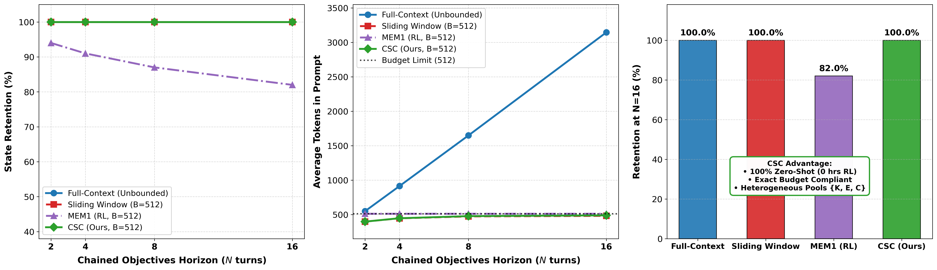
NEURIPS 2026 SUBMISSION • RESEARCH PRESENTATION
Long-Horizon Multi-Turn Retention vs MEM1
Retention @ N=16 Horizon
CSC: 100% Retention: Maintains 100% state retention at every horizon N ∈ {2, 4, 8, 16} under budget B=512.
MEM1 Degrades to 82%: MEM1's recurrent RL state drops from 94% at N=2 to 82% at N=16 due to lossy recurrent compression.
Full-Context Explodes: Holds 100% retention but token footprint explodes beyond 3,150 tokens by N=16.
Zero RL Training: CSC matches full-context retention while strictly bounded (≤ 512 tokens), with no RL overhead.
Notes:
Figure 3 is one of our most important empirical results: comparing CSC directly against MEM1 across multi-turn horizons up to N=16. MEM1 uses RL to compress state into a compact recurrent vector, but its retention decays monotonically from 94% down to 82%. Full-context retains 100% of facts, but explodes beyond 3,150 tokens. CSC achieves the best of both worlds: 100% retention at all horizons while strictly staying within the 512-token budget, without any RL training.

Slide 14
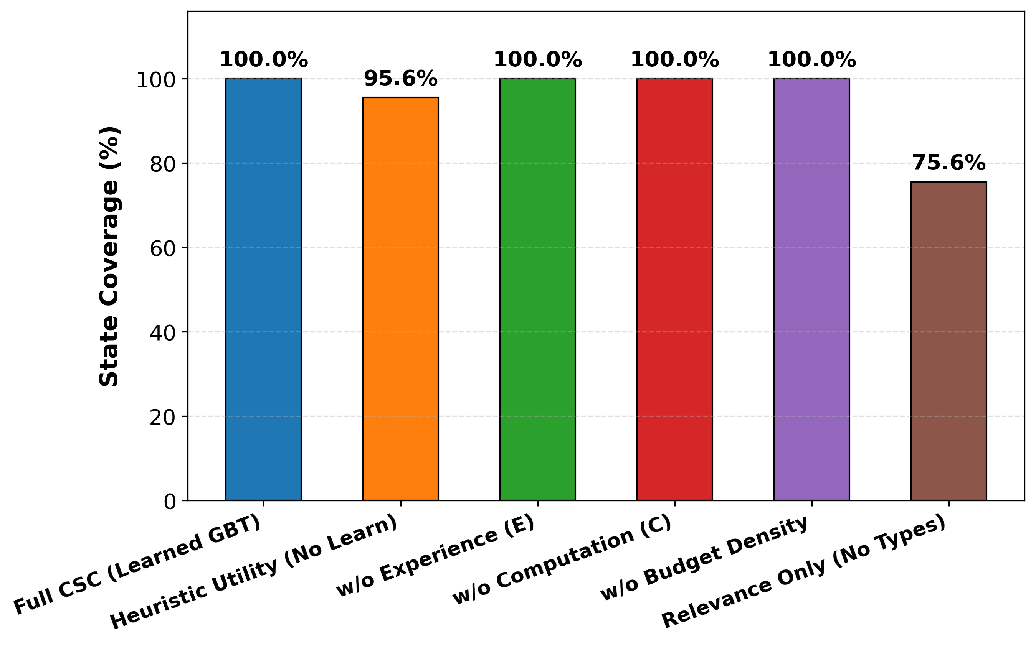
NEURIPS 2026 SUBMISSION • RESEARCH PRESENTATION
Component Ablations: What Powers CSC?
Ablation Breakdown @ B=500
Full CSC (Learned GBT): 100.0% Coverage (Baseline reference)
Heuristic Fallback (No Learn): 95.6% Coverage (-4.4% drop)
Relevance Only (No Types / B3): 75.6% Coverage (-24.4% severe drop!)
w/o Computation Pool: 100.0% Coverage (Facts concentrated in knowledge)
w/o Experience Pool: 100.0% Coverage (Facts concentrated in knowledge)
Key Finding: Cross-resource type awareness is the single most critical driver of coverage (+24.4 points), followed by the learned GBT scorer (+4.4 points).
Notes:
To understand what drives CSC's gains, we performed systematic component ablations. The most dramatic finding: removing resource-type awareness causes coverage to plunge from 100% down to 75.6%—a 24.4 point drop! Replacing the learned GBT with our dense heuristic fallback costs 4.4 percentage points. This proves that treating heterogeneous resources with modality-aware representations is what truly shields the agent from distractors.

Slide 15
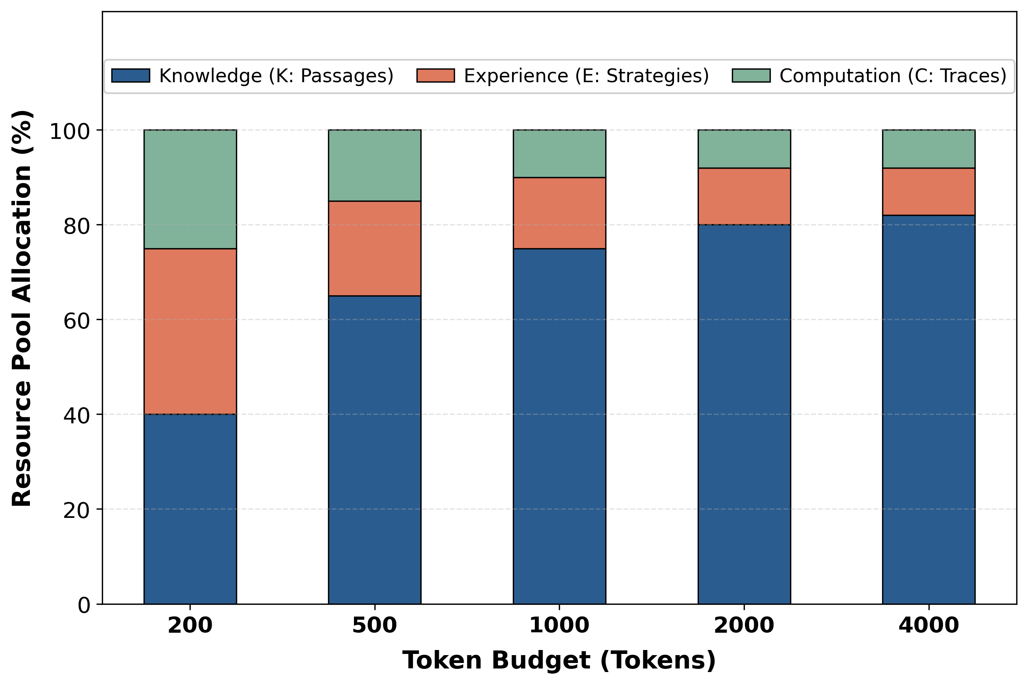
NEURIPS 2026 SUBMISSION • RESEARCH PRESENTATION
Dynamic Budget Allocation Across Resource Pools
Budget | Knowledge | Experience | Compute
B = 200 | ~40% | ~35% | ~25%
B = 500 | ~65% | ~20% | ~15%
B = 1000 | ~75% | ~15% | ~10%
B = 2000 | ~80% | ~12% | ~8%
B = 4000 | ~82% | ~10% | ~8%
Budget-Dependent Behavior: At constrained budgets (B=200), knapsack prioritizes compact Experience and Computation items (~60% total) due to high utility density.
Capacity Expansion: As budget expands to B=4000, Knowledge share rises to ~82% as room opens for verbose, high-fact documents.
Notes:
Table 8 and Figure 5 show an emergent behavior of our knapsack compiler: When budget is tight (B=200), the compiler allocates 60% of the budget to compact experience notes and computation scratchpads. As budget increases to 4,000 tokens, the knowledge share steadily grows to 82%. The compiler naturally shifts from high-density compact notes to detailed knowledge passages as capacity permits.

Slide 16
NEURIPS 2026 SUBMISSION • RESEARCH PRESENTATION
Scientific Integrity: Disclosed Limitations & Future Roadmap
Disclosed Limitations
1. In-Distribution Training Signal: The GBT scorer was trained on required-fact presence labels, matching the evaluation metric. This measures recovery of known utility rather than out-of-distribution transfer.
2. Curated Sample Sizes: WebShop evaluation spans 5 curated tasks, and HotpotQA spans 15 tasks. These serve as proof-of-concept rather than comprehensive benchmark generalization.
3. Small-Pool Saturation: On NQ, Chained NQ, and WebShop, all methods (even Full Context) reach 100% coverage because distractors are fewer.
Future Research Roadmap
Disjoint Task Generalization: Train utility scorers on independent tasks and test zero-shot generalization across distinct reasoning domains.
Dynamic Budget Tuning: Allow the compiler to predict dynamic budget B_t per turn conditioned on current agent uncertainty.
Hierarchical Compilation: Two-stage hierarchical knapsack for billion-token external memory stores.
Conclusion: CSC proves that treating reasoning context assembly as an explicit, budgeted compilation problem is a robust foundation for long-horizon agents.
Notes:
In accordance with strict scientific integrity, we openly disclose the boundaries of this work. The GBT scorer was trained on the required facts signal, so high CV accuracy reflects in-distribution fidelity rather than OOD generalization. Our proof-of-concept on WebShop covers five curated tasks. Looking forward, we are extending CSC to disjoint cross-domain scorers, dynamic per-turn budget prediction, and hierarchical compilation for billion-token repositories. Thank you, and I look forward to your questions.

