Slide 1


Shri Sai Shikshan Sanstha’s
NAGPUR INSTITUTE OF TECHNOLOGY, NAGPUR
Survey No.13/2, Mahurzari, Near Fetri, Katol Road, Nagpur-441501
Department of Computer Science and Engineering
Project Progress Seminar – 2, on
SmartLearn
Presented By : - Tejal Kawale
Shreya Kohad
Shravani Dudhbade
Vaishnavi Ughade
Tejal Tijare
https://nit.edu.in/computer-science-engineering/

Slide 2
Shri Sai Shikshan Sanstha’s
NAGPUR INSTITUTE OF TECHNOLOGY, NAGPUR
Survey No.13/2, Mahurzari, Near Fetri, Katol Road, Nagpur-441501
INDEX
Problem Definition and Aim & Objectives
Brief Recap of Work(Seminar - 1)
Current progress
System Design and Screenshots
Testing and Result
Challenges faced and Solutions implemented
Remaining Work
Budget Utilization and Resource requirements
Conclusion and Future scope
https://nit.edu.in/computer-science-engineering/

Slide 3
Shri Sai Shikshan Sanstha’s
NAGPUR INSTITUTE OF TECHNOLOGY, NAGPUR
Survey No.13/2, Mahurzari, Near Fetri, Katol Road, Nagpur-441501
Problem Definition
                Traditional studying is boring and reduces focus.
                Students struggle to retain information effectively.
                Aim
                Create an interactive platform to make learning engaging and improve retention.
                Objective
                Develop an interactive web dashboard with animations and visual effects.
                Provide customizable features like background music to enhance study experience
https://nit.edu.in/computer-science-engineering/

Slide 4
Shri Sai Shikshan Sanstha’s
NAGPUR INSTITUTE OF TECHNOLOGY, NAGPUR
Survey No.13/2, Mahurzari, Near Fetri, Katol Road, Nagpur-441501
Brief Recap of Work (Seminar - 1)
Designed the entire UI using HTML for structure and layout clarity.
Styled with Tailwind CSS, ensuring a modern, responsive, and visually appealing design.
Implemented JavaScript for interactivity — handling user input, API calls, and dynamic content updates.
Added animated themes and color transitions that change based on the selected story or learning mode.
https://nit.edu.in/computer-science-engineering/

Slide 5
Shri Sai Shikshan Sanstha’s
NAGPUR INSTITUTE OF TECHNOLOGY, NAGPUR
Survey No.13/2, Mahurzari, Near Fetri, Katol Road, Nagpur-441501
Current Progress
Backend developed with Django, managing API requests and routing between frontend and AI engine.
Created and configured Django server to handle API requests and serve AI-generated responses efficiently.
Integrated Google Gemini API to generate smart, context-aware responses for user queries.
https://nit.edu.in/computer-science-engineering/

Slide 6
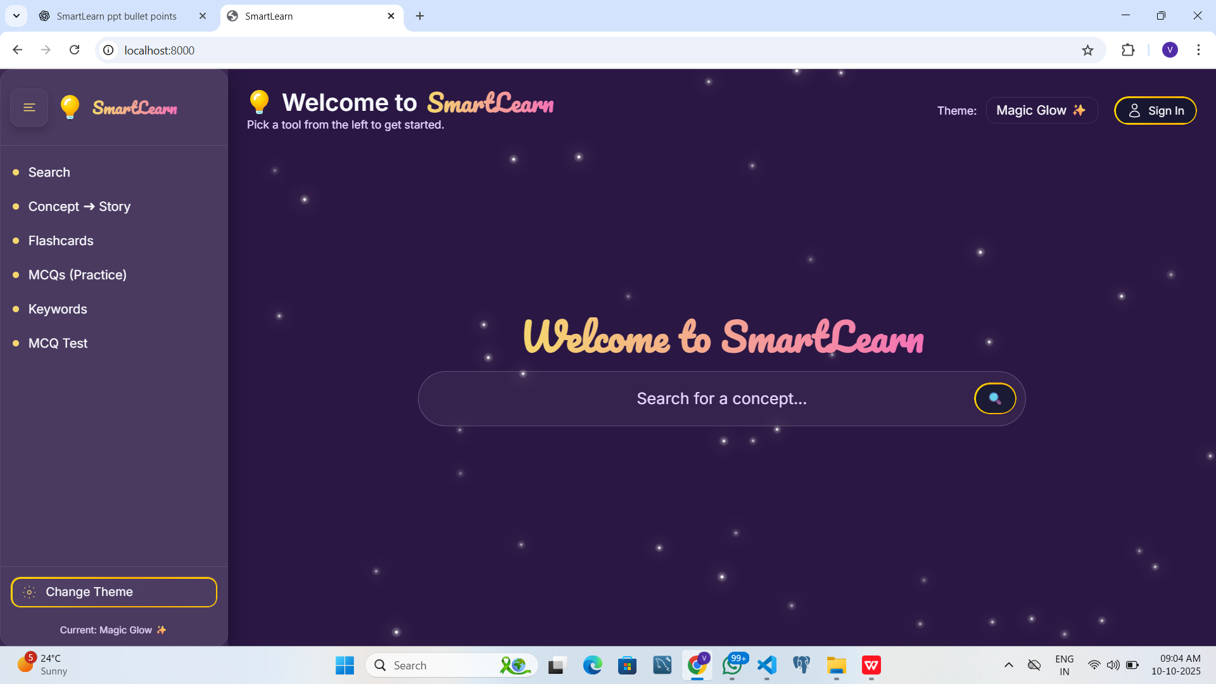
Shri Sai Shikshan Sanstha’s
NAGPUR INSTITUTE OF TECHNOLOGY, NAGPUR
Survey No.13/2, Mahurzari, Near Fetri, Katol Road, Nagpur-441501
System Design and Screenshots
https://nit.edu.in/computer-science-engineering/

Slide 7
Shri Sai Shikshan Sanstha’s
NAGPUR INSTITUTE OF TECHNOLOGY, NAGPUR
Survey No.13/2, Mahurzari, Near Fetri, Katol Road, Nagpur-441501
Testing and Result
Successfully tested the Django server and verified smooth communication between frontend and backend.
API responses from Gemini integrated and displayed instantly on the webpage without reload or delay.
Search and response system works efficiently — users can enter queries and get accurate AI-generated outputs.
https://nit.edu.in/computer-science-engineering/

Slide 8
Shri Sai Shikshan Sanstha’s
NAGPUR INSTITUTE OF TECHNOLOGY, NAGPUR
Survey No.13/2, Mahurzari, Near Fetri, Katol Road, Nagpur-441501
Challenges faced and Solutions implemented
AI responses were not displaying inside the result div
Search bar and result section overlapping due to CSS positioning issues
Gemini API not responding due to environment variable setup issues.
Fixed DOM selection and updated JavaScript to correctly target and insert the response dynamically.
Adjusted Tailwind CSS layout with proper spacing (margin, padding, flex, z-index) for clear separation.
Used .env file and or secure key access and proper API authentication.
https://nit.edu.in/computer-science-engineering/

Slide 9
Shri Sai Shikshan Sanstha’s
NAGPUR INSTITUTE OF TECHNOLOGY, NAGPUR
Survey No.13/2, Mahurzari, Near Fetri, Katol Road, Nagpur-441501
Remaining Work
Implement AI learning modes – extend the response system to generate Stories, Flashcards, and MCQs dynamically.
Design separate UI sections for each mode (story view, flashcard view, quiz view) with unique themes and animations
MCQ Mode: Generates quiz-style questions for self-assessment.
Flashcard Mode: Displays key terms and definitions for quick revision.
https://nit.edu.in/computer-science-engineering/

Slide 10
Shri Sai Shikshan Sanstha’s
NAGPUR INSTITUTE OF TECHNOLOGY, NAGPUR
Survey No.13/2, Mahurzari, Near Fetri, Katol Road, Nagpur-441501
Budget Utilization and Resource requirements
AI API (Google Gemini) – cost depends on usage volume; essential for AI-generated responses, stories, flashcards, and MCQs.
Development Tools & Libraries – mostly free/open-source (VS Code, PyCharm Community Edition, Tailwind CSS, Django, JavaScript).
https://nit.edu.in/computer-science-engineering/

Slide 11
Shri Sai Shikshan Sanstha’s
NAGPUR INSTITUTE OF TECHNOLOGY, NAGPUR
Survey No.13/2, Mahurzari, Near Fetri, Katol Road, Nagpur-441501
Conclusion and Future Scope
SmartLearn provides an interactive AI-powered learning platform with dynamic themes and responsive UI.
Successfully integrated Django backend, Google Gemini API, and frontend (HTML, Tailwind CSS, JS).
Current system supports real-time AI responses, smooth user experience, and multiple story-based themes.
Expand Learning Modes: Implement Stories, Flashcards, and MCQs for versatile learning.
User Profiles & Progress Tracking: Allow login, save history, and track learning progress.
https://nit.edu.in/computer-science-engineering/

Slide 12

THANK YOU

