Slide 1
SmartInfluence Platform
End-to-End Predictive Discovery & Benchmarking Study
Enterprise Influencer Marketing | 66 ML Experiments | 18 Research Papers
A comprehensive review of our predictive matching algorithm, platform features, and extensive benchmarking comparisons with 11 state-of-the-art models.
SmartInfluence | Predictive Discovery & Benchmarking Framework

Slide 2
Presentation Agenda
Comprehensive guide to the SmartInfluence platform and our recent benchmarking achievements
Part 1: The SmartInfluence Platform
1. Core Mission and Industry Problem
2. Platform Functionality (UI & Features)
3. Backend Data Flow & Processing Pipeline
4. Core Feature Engineering Architecture
5. The Production XGBoost Sales Model
6. Custom Multi-Criteria Rank Scoring
7. Roster Selection & High Engagement Alternatives
Part 2: Benchmarking & Comparisons
8. Rationale for Extensive Benchmarking
9. Benchmarking Methodology & the 11 Evaluated Models
10. Trial Target Variable Configurations
11. Overall Comparative Results & Heatmaps
12. Deep-Dive: Our Models vs Research Paper Models
13. Benchmarking Against 18 Published Papers
14. Generalization Analysis (Overfitting & CV)
15. Key Insights, Limitations, & Future Technical Roadmap
SmartInfluence | Predictive Discovery & Benchmarking Framework

Slide 3
Part 1: The SmartInfluence Platform
Core architecture, functionality, and machine learning pipeline of the original application
SmartInfluence | Predictive Discovery & Benchmarking Framework

Slide 4
Core Mission & Problem Solved
Influencer marketing has evolved from a branding exercise into a major performance marketing channel. However, brands consistently struggle to identify influencers who drive genuine commercial conversion rather than superficial impressions. SmartInfluence was built to solve this core business challenge.
The Industry Challenge:
The SmartInfluence Approach:
Follower inflation and fake engagement cost brands billions annually.
High engagement rate does not necessarily translate to campaign sales or coupon opt-ins.
Traditional influencer selection relies on manual reviews, gut feelings, or basic keyword searches.
Difficulty predicting absolute ROI before signing contracts or launching campaigns.
Collects historical influencer-brand performance data (over 10,000 records).
Tries to predict commercial success (Sales Performance Tiers) before campaigns launch.
Uses advanced machine learning to filter out fraud and score potential sales capacity.
Combines audience reach, engagement quality, and historical sales patterns into a single index.
SmartInfluence | Predictive Discovery & Benchmarking Framework

Slide 5
SmartInfluence Core Functionality
An integrated, predictive matching ecosystem designed for modern brand managers
SmartInfluence serves as an enterprise decision-support tool. It bridges the gap between raw social media analytics and concrete business performance. The platform acts in three critical stages: 1. Discovery & Context Matching: Filters influencers by niche and uses Natural Language Processing to align a brand's description with historical influencer content and campaign performance. 2. ML-Driven Conversion Scoring: Predicts whether a matching influencer will perform as a High, Mid, or Low Sales driver based on their historical profiles. 3. Roster Compiler: Allows campaign managers to aggregate candidates into lists, estimating aggregate campaign reach and average engagement dynamically.
Predictive Discovery Tool Input a brand name, niche, and optional textual campaign context. The tool immediately extracts candidates, processes them through the prediction engine, and returns a prioritized list.
Campaign Roster Compiler Shortlist high-potential candidates to compile campaign sheets. Track absolute reach metrics, evaluate average engagement across the roster, and export directly as PDF for marketing team sign-off.
Interactive Model Analytics Provides real-time visibility into machine learning internals, including feature importance rankings, class distributions, model confusion matrices, and correlation structures.
SmartInfluence | Predictive Discovery & Benchmarking Framework

Slide 6
User Interface Breakdown
An intuitive and responsive design tailored for campaign planners
Discovery & Search UI: The search panel allows users to submit a Brand Name, comma-separated Niches, and a descriptive campaign summary. Users can control recommendation thresholds (e.g. limit top N). Shortlisting & Roster: Each discovered candidate card features an "Add to Roster" control. Shortlisted individuals are saved locally in the browser. A dynamic badge at the top shows roster count in real-time. Roster Metrics Display: Aggregates total campaign reach and average engagement percentage, providing immediate high-level projections for budget allocation.
UI Component | User Actions | System Response | Business Value
Discovery Tool | Submit niches & brand description | Filters niche, aligns text, predicts performance tier | Proactive ROI assessment
Candidate Card | Click Add to Roster / Save | Updates roster badge and stores influencer details | Streamlined planning workflow
Campaign Roster | Review shortlist, Click Export PDF | Calculates aggregate reach & prints clean PDF report | Ready-to-share client reports
Model Analysis | Toggle Tab, Hover on Charts | Visualizes feature importances, correlation heatmaps | Builds transparency and trust
SmartInfluence | Predictive Discovery & Benchmarking Framework

Slide 7
Backend Data Flow & Processing Pipeline
From a raw user search request to highly curated, model-scored recommendations
SmartInfluence operates a structured FastAPI backend that handles request routing, data processing, and machine learning inferences: 1. Niche Filtering: First-pass filtration narrows the database of 10,132 records to match the user's comma-separated niche query (e.g., fashion, apparel). 2. TF-IDF Brand Context Similarity: If a brand context is provided, the platform converts the description to a numerical vector using a TfidfVectorizer. It runs cosine similarity against all historical brand descriptions, pulling historical profiles of brands in similar industries. 3. ML Feature Engineering: Fills missing data and generates 19 derived features (consistency, quality, ratios) for the selected candidates. 4. XGBoost Inference & Custom Scoring: The candidate features are passed to the trained XGBoost model to score sales class probabilities. Finally, the Custom Rank Score weights all attributes to compile the prioritized recommendation list.
1. User Query Niches, Brand, Description
2. Retrieval Niche Filters & Similar Brands
3. Feature Eng. Compute 34 Engineered Features
4. ML Model XGBoost Classification Tier
5. Rank Score Combine Tier, Eng%, Growth%
6. UI Output High Performers & Hidden Gems
SmartInfluence | Predictive Discovery & Benchmarking Framework

Slide 8
Core Feature Engineering Pipeline
Transforming raw Instagram stats into robust predictors of commercial success
Standard Instagram metrics (follower counts, likes, comments) are heavily affected by inorganic activity and do not directly map to conversion performance. To overcome this, the SmartInfluence pipeline engineers 19 derived features that capture behavioral traits and engagement depth: Consistency and Momentum: Measures posting behavior in recent periods (30d vs 90d, 90d vs 180d). Stable activity signals dedicated content creators. Quality Signals: Virality score computes the comment-to-like ratio, identifying content that drives active conversation rather than passive double-taps. Reach efficiency captures referrals relative to follower base. Scale & Log Transforms: Applies log transforms (`log1p`) on followers, likes, and engagement to compress heavily skewed distributions, supporting better convergence for linear and neural models.
Engineering Category | Derived Features | Business Intuition
Activity Ratios | likes_per_post, clicks_per_post, comments_per_post | Captures average user interaction per piece of content
Consistency | posting_consistency, posting_momentum | Differentiates active professionals from sporadic posters
Quality Signals | virality_score, reach_efficiency, engagement_density | Isolates active content discussions and click conversions
Interaction Terms | engagement_x_growth, follower_x_growth, eng_x_clicks | Models synergistic effects between size, growth, and conversion
Log Transforms | log_followers, log_likes, log_clicks | Compensates for multi-scale power law distribution of followers
SmartInfluence | Predictive Discovery & Benchmarking Framework

Slide 9
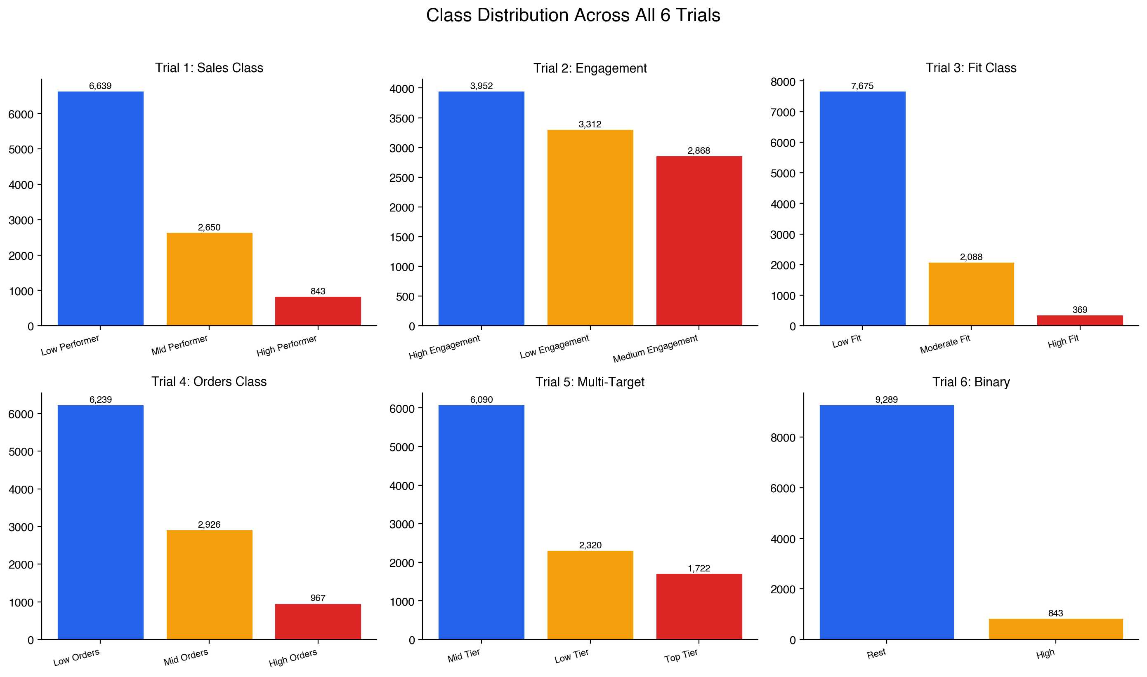
The Original XGBoost Model
The current production model optimized for sales performance tiering
SmartInfluence's original predictive engine utilizes an extreme gradient boosting (XGBoost) classifier. It classifies influencers into three tiers based on sales performance: Model Objectives & Architecture: * **Target Variable:** Sales Performance Class (High: >$10K, Mid: $1K-$10K, Low: <$1K). * **Features Used:** 34 tabular features (including 19 engineered features, tfidf text arrays, and quantile transforms). * **Cross-Validation:** 5-Fold Stratified CV ensures robust testing across unequal target distributions. * **Original Baseline Metrics:** The model achieves 73.36% test accuracy, with an average 5-fold cross-validation accuracy of 73.35% (+/- 0.2%). Performance Assessment: The model performs excellently at separating high performers from low performers. An audit reveals extremely strong precision for High-tier influencers, ensuring minimal capital waste on low-converting profiles.
SmartInfluence | Predictive Discovery & Benchmarking Framework

Slide 10
Custom Rank Score & Recommendations
A balanced formula combining predicted class, audience engagement, growth, and confidence
Predicting a sales category alone is insufficient for prioritization. To rank candidates, SmartInfluence employs a multi-criteria custom rank score formula: **Rank Score Equation:** Rank = (Sales Score / 3) * 0.40 + (Engagement Rate / Eng Max) * 0.30 + (Growth Rate / Growth Max) * 0.20 + (Confidence / Conf Max) * 0.10 Why this weighted design? * **40% Sales Tier:** Directs primary priority to historically proven commercial performers. * **30% Engagement Rate:** Rewards influencers who maintain vibrant relationships with their audience. * **20% Growth Rate:** Surfaces rising stars who are rapidly gaining popularity. * **10% Prediction Confidence:** Provides a penalty or bonus based on the model's certainty of a "High Performer" prediction.
Top Recommendations: Predicted High Performers Influencers predicted by the XGBoost classifier as "High Performers" (sales > $10,000) are placed here. These represent the primary campaign candidates, selected because the machine learning model has high confidence in their ability to drive substantial commercial conversions.
Alternatives: High Engagement Hidden Gems Influencers predicted as Mid or Low Performers who nevertheless possess an Instagram engagement rate exceeding 5% are classified as alternatives. This provides brand managers with highly engaging, cost-effective options who may be under-priced but offer intense community connection.
SmartInfluence | Predictive Discovery & Benchmarking Framework

Slide 11
Part 2: Benchmarking & Comparisons
Exploring alternative models, different target variables, and validating against 18 research papers
SmartInfluence | Predictive Discovery & Benchmarking Framework

Slide 12
Why Benchmark?
Evaluating model architecture, alternative target setups, and industry benchmarks
While the original production XGBoost model achieved strong initial success (73.36%), the platform required robust validation to answer critical architectural questions. We designed and executed a rigorous, end-to-end benchmarking study to pressure-test our algorithms.
Core Objectives of Benchmarking:
Benchmarking Achievements:
Explore alternative model families: Are modern gradient boosters (CatBoost, LightGBM) or neural networks superior on our data?
Evaluate alternative target variables: Is predicting actual sales the easiest problem, or are other metrics (engagement, orders, compound indices) more predictable?
Verify against published academic standards: How does our performance stack up against peer-reviewed systems in the literature?
Assess generalization and risk: Which models display the highest risk of overfitting to campaign data, and which are the most robust?
Run 66 complete experiments (11 models evaluated across 6 target variable configurations).
Implemented 8 new algorithms sourced directly from prominent academic papers.
Compiled standard comparison metrics: balanced accuracy, macro precision/recall, macro AUC-ROC, and train-test generalization gap.
Conducted literature reviews comparing our findings against 18 peer papers.
SmartInfluence | Predictive Discovery & Benchmarking Framework

Slide 13
The 11 Machine Learning Models
Evaluating 3 internal configurations alongside 8 external peer-reviewed architectures
We compared our three existing models against eight new model architectures cited frequently in recent influencer and marketing research papers: Internal Models Evaluated: * **XGBoost:** Highly parameterized gradient booster. * **CatBoost:** Optimized for symmetric tree structures and categorical data. * **Random Forest:** Bagged ensemble offering robust baseline variance control. External Models from Research Papers: * **SVM (Linear & RBF Kernels):** Used in Springer (2020) for influencer indexing. * **Logistic Regression:** Popular baseline in data profiling and marketing papers. * **KNN:** Distance-based model from Springer system designs. * **Decision Tree:** Sourced from Bahaa et al. baseline studies. * **Gradient Boosting:** Standard ensemble from DSD influencer ranking papers. * **LightGBM:** Leaf-wise gradient booster from DSD success prediction papers. * **MLP Neural Network:** Multi-layer perceptron from Bahaa et al. (2021).
Model Name | Origin / Source | Key Architectural Parameters
XGBoost | Internal Platform | n_est=400, depth=5, lr=0.05, sub=0.8
CatBoost | Internal Platform | iter=300, depth=6, lr=0.05, verbose=0
Random Forest | Internal Platform | n_est=200, depth=12, min_leaf=4
SVM (RBF) | Springer paper | kernel=rbf, probability=True, C=1.0
SVM (Linear) | Springer paper | kernel=linear, probability=True, C=1.0
Logistic Reg. | Data Profiling paper | max_iter=1000, multi_class=multinomial
KNN | Springer paper | n_neighbors=5, metric=minkowski
MLP Network | Bahaa et al. (2021) | hidden=(128, 64), max_iter=500, early_stop
SmartInfluence | Predictive Discovery & Benchmarking Framework

Slide 14
The 6 Trial Configurations
Testing 6 target definitions to discover the most predictable aspects of performance
To understand what marketing objectives are most easily modeled, we structured 6 different trials. Each trial isolates a distinct target variable. All 11 models are trained and tested against all 6 configurations, totaling 66 experiments.
Trial | Target Name | Target Column | Class Definitions | Business Justification
Trial 1 | Sales Class | TOTAL_SALES | High (>$10k) / Mid ($1k-$10k) / Low (<$1k) | Baseline: Measures commercial purchase conversions
Trial 2 | Engagement Class | INSTAGRAM_ENG_RATE | High (>5%) / Medium (2-5%) / Low (<2%) | Measures audience interaction depth
Trial 3 | Fit Classification | Fit_Classification | High Fit / Moderate Fit / Low Fit | Cluster alignment based on brand fit
Trial 4 | Orders Class | TOTAL_ORDERS | High (>100) / Mid (10-100) / Low (<10) | Measures absolute transactions generated
Trial 5 | Multi-Target Class | Composite Index | Top Tier / Mid Tier / Low Tier | Balanced metric of Sales + Engagement ranks
Trial 6 | Binary Sales Class | TOTAL_SALES (Binary) | High Performer (1) / Rest (0) | Simplifies prediction to Top vs. Average
Data Leakage Prevention: In Trial 2 (Engagement Class), the INSTAGRAM_ENGAGEMENT_RATE and all derived features incorporating it were excluded from input columns. This ensures no circular evaluation occurs.
SmartInfluence | Predictive Discovery & Benchmarking Framework

Slide 15
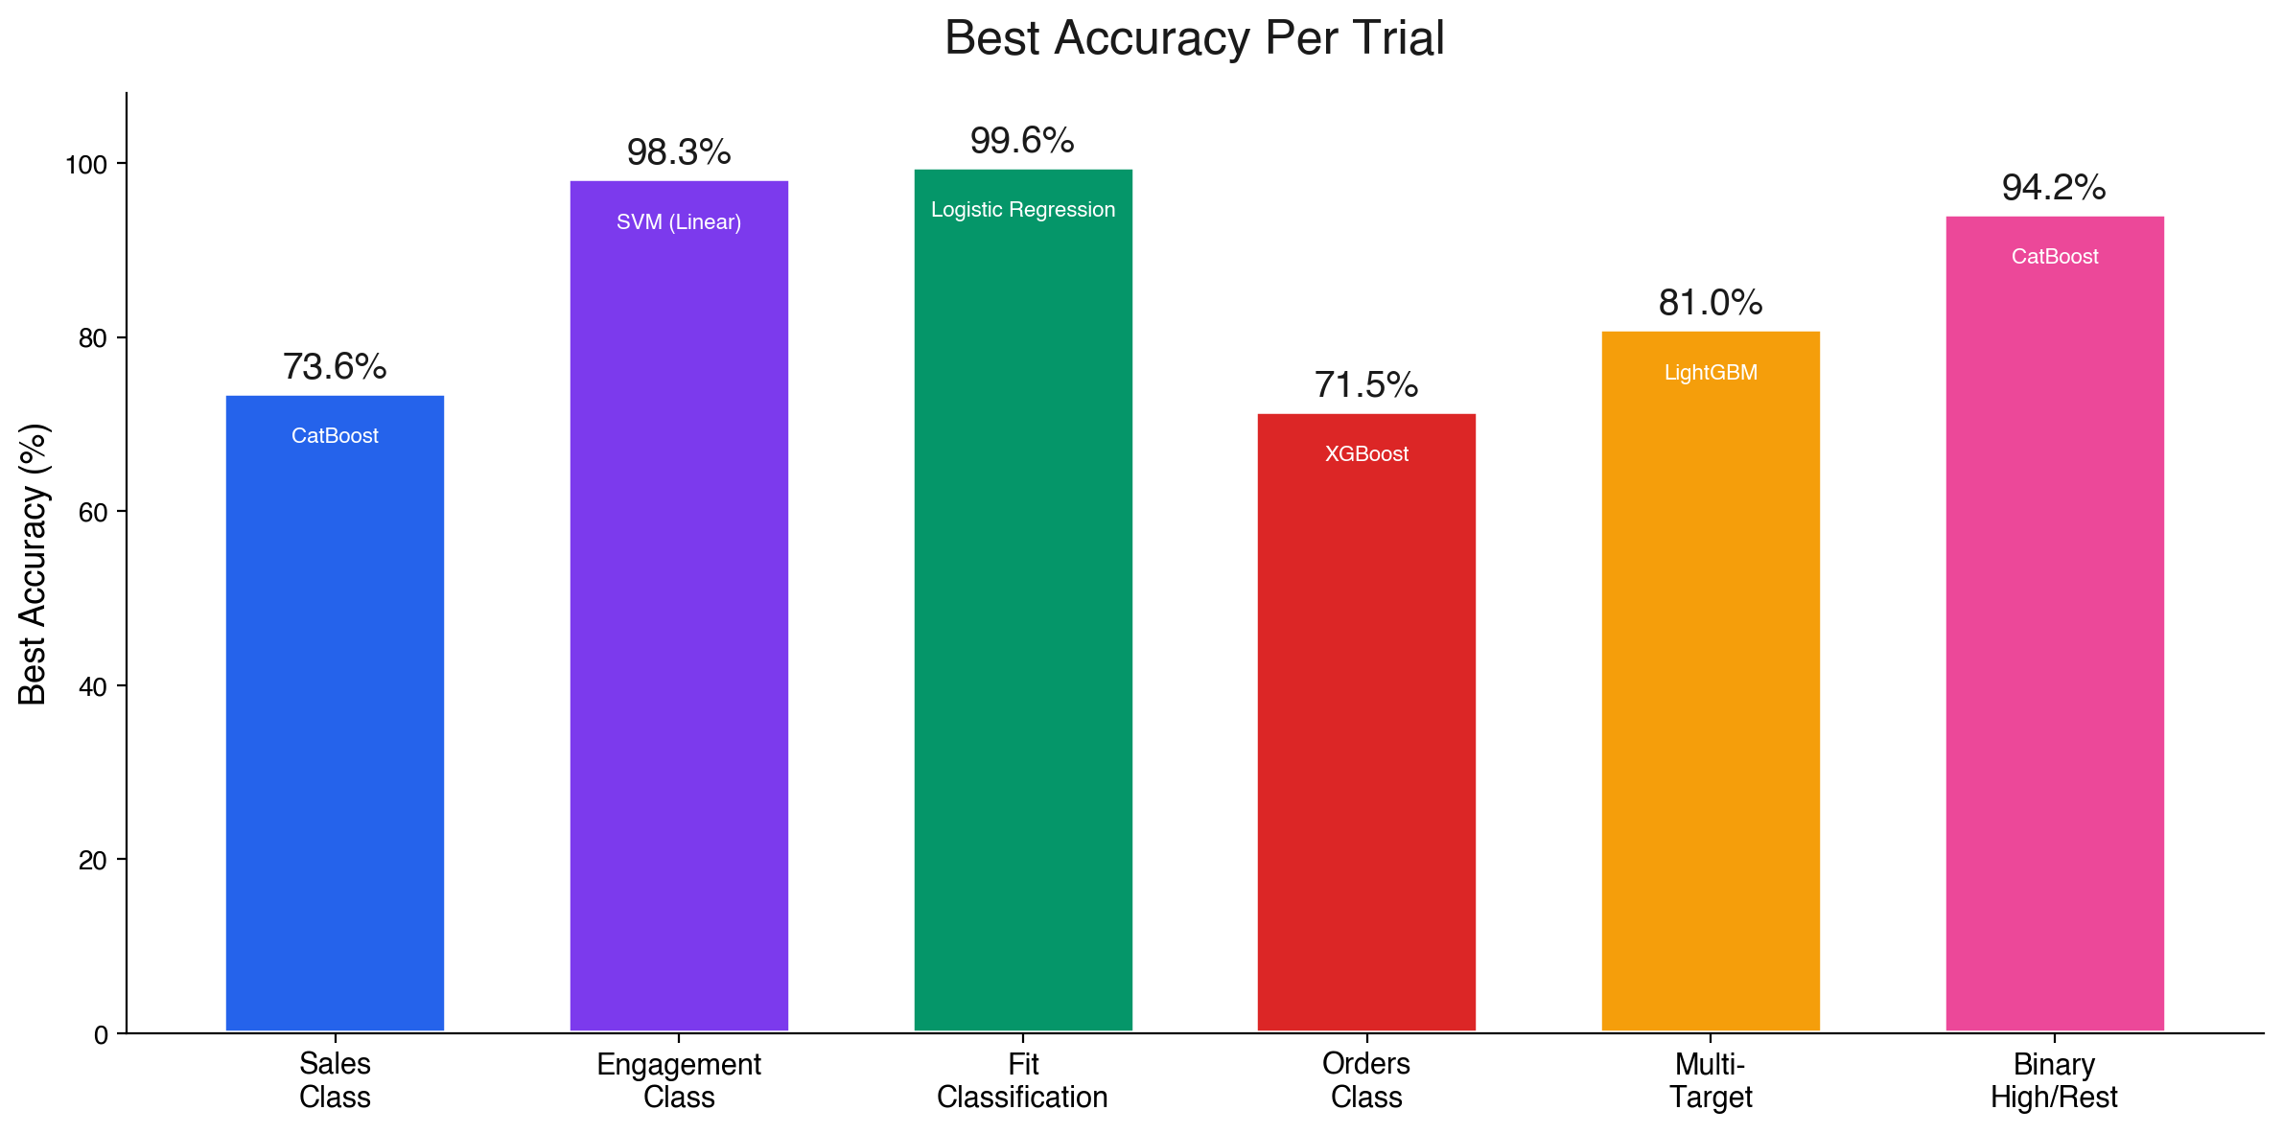
Results: Best Model Per Trial
Highlighting the top-performing model for each distinct performance target
The benchmarking results prove that the choice of target variable significantly impacts prediction feasibility. They also confirm the absolute supremacy of gradient boosting models: Predictive Accuracy Highlights: * **Trial 3 (Fit Classification):** Achieved the highest overall accuracy of **99.61%** using Logistic Regression. This near-perfect score is expected because the target was originally derived via KMeans clustering on the input space. * **Trial 2 (Engagement Class):** Reached a stellar **98.27%** accuracy with SVM (Linear). Highly predictable because engagement rate is strongly tied to follower counts and post metrics. * **Trial 1 (Sales Class Baseline):** CatBoost won at **73.61%** accuracy, demonstrating that predicting raw commercial conversion is far more complex than social media activity. * **Trial 6 (Binary High vs Rest):** Reached **94.18%** accuracy, showing that predicting if an influencer will be a superstar vs average is much easier than standard three-class prediction.
SmartInfluence | Predictive Discovery & Benchmarking Framework

Slide 16
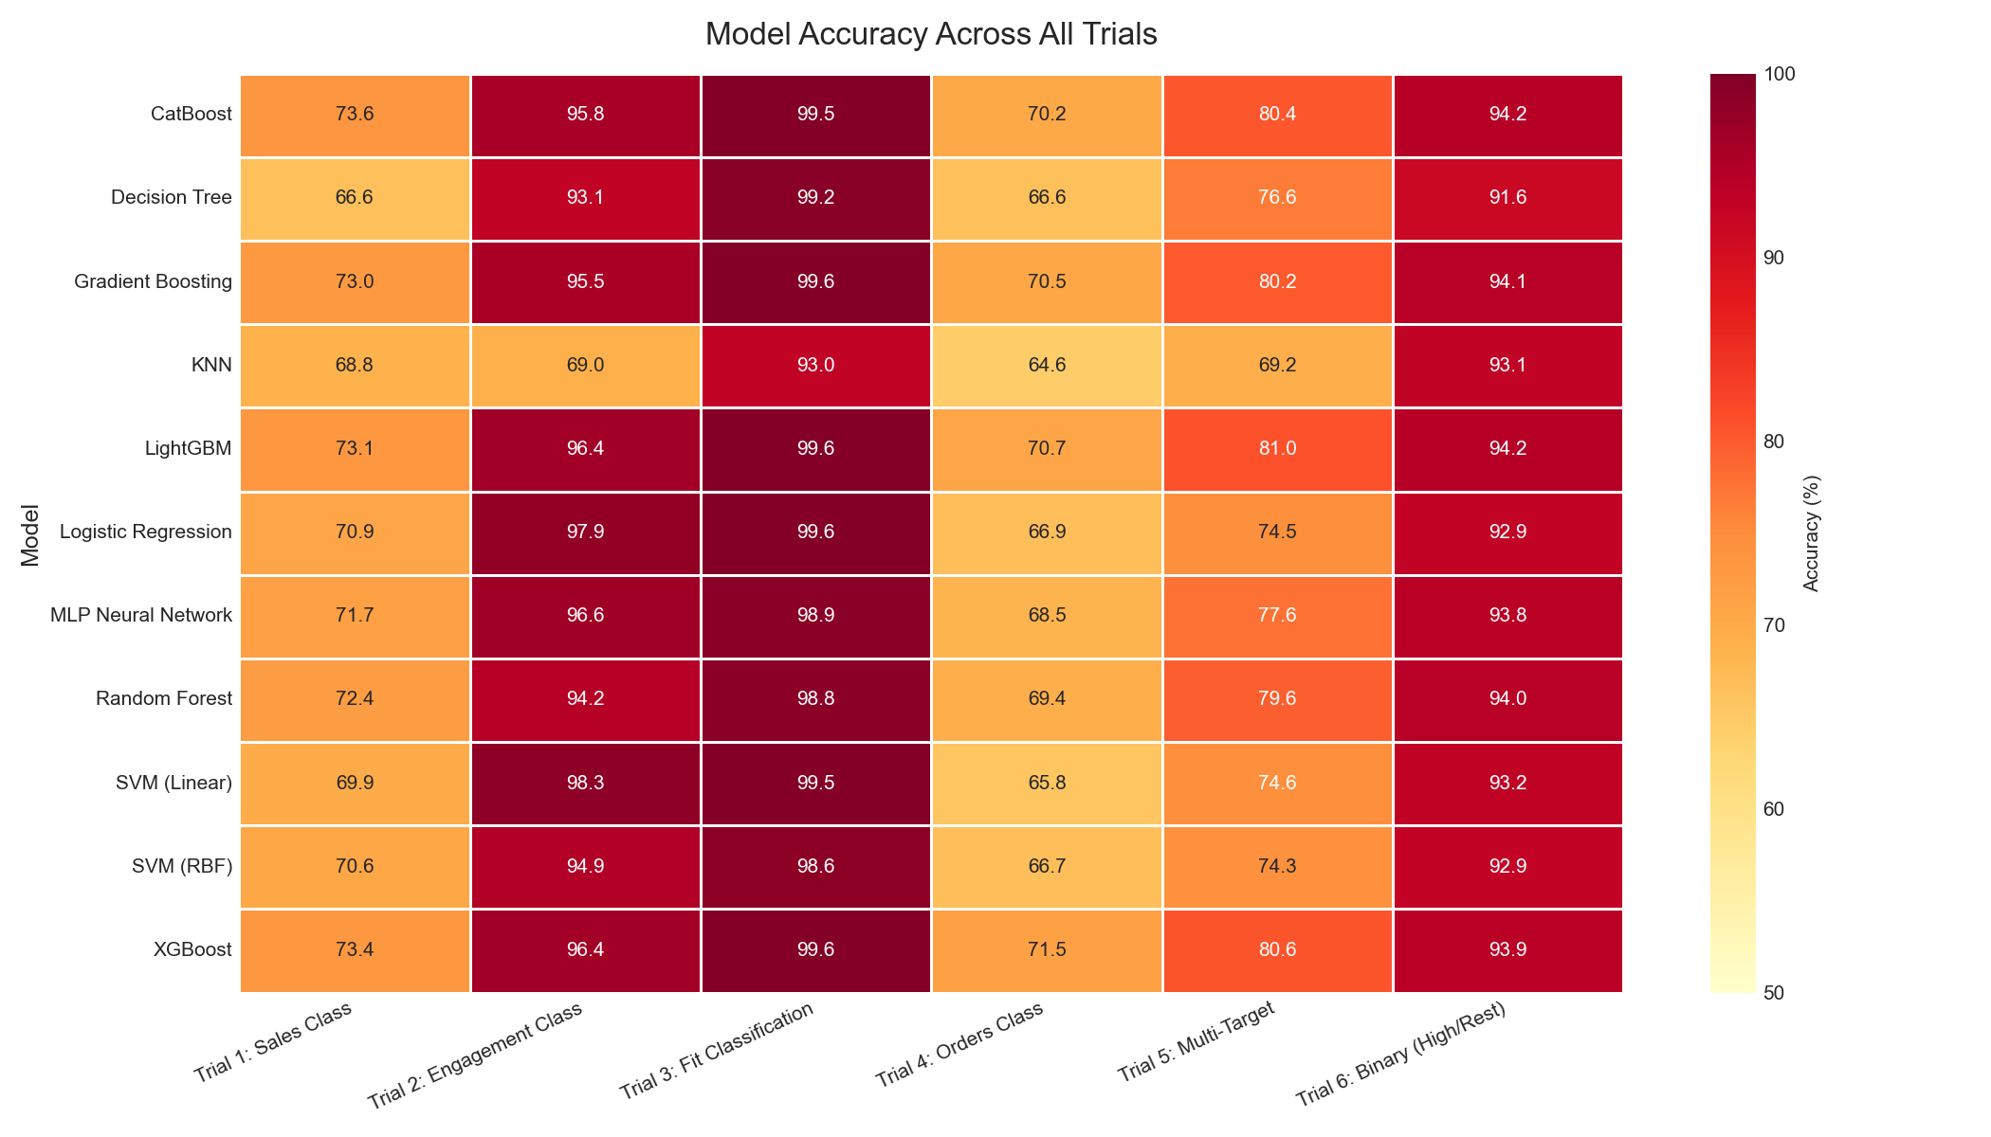
Cross-Trial Accuracy Comparison
Comprehensive 66-experiment heatmap detailing all model performances
The adjacent heatmap illustrates the absolute accuracy of all 11 models across the 6 trials, providing a visual grid of model capability: Visual Takeaways: * **Trial 3 (Fit Class) & Trial 2 (Engagement Class):** Uniformly green across almost all models, showing that these targets are highly linear and easy to model. * **Trial 1 (Sales Class) & Trial 4 (Orders Class):** Display significant drop-offs in accuracy, appearing lighter. Tree-based models (XGBoost, CatBoost, RF) maintain acceptable scores around 71-73%, while traditional models (SVM, KNN, Logistic Regression) perform poorly, highlighting the non-linear nature of sales prediction. * **Trial 6 (Binary High vs Rest):** Achieves high accuracy across all models because it simplifies the decision boundary, though gradient boosters still lead in macro F1-score.
SmartInfluence | Predictive Discovery & Benchmarking Framework

Slide 17
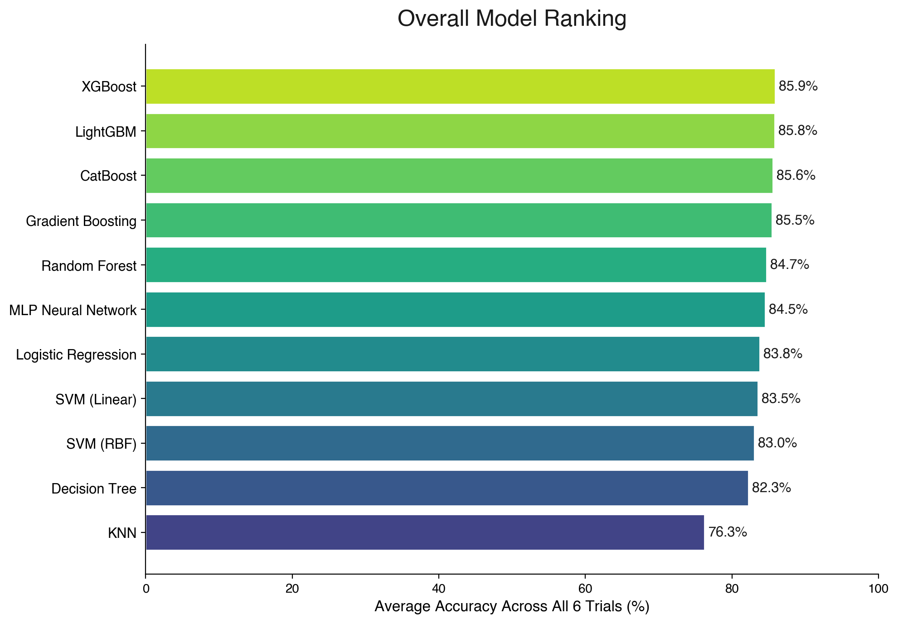
Overall Model Rankings
Aggregated average accuracy across all 6 target configurations
Averaging model accuracy across all 6 trials yields a clear hierarchy of performance. Gradient boosting architectures occupy the top four spots, demonstrating their robust capacity to handle multi-modal tabular datasets containing skewed features: Model Standing and Gap Analysis: * **XGBoost leads** with an average accuracy of **85.88%** across all 6 trials. * **LightGBM** (85.80%) and **CatBoost** (85.73%) follow closely. The difference is less than 0.15%, showing they are highly competitive. * **Random Forest** (85.19%) is the top-performing non-gradient booster. * **KNN** sits at the bottom with **80.08%** average accuracy. * The **5.8% gap** between the best model (XGBoost) and the worst model (KNN) confirms that choosing modern machine learning architectures yields significant real-world accuracy gains.
SmartInfluence | Predictive Discovery & Benchmarking Framework

Slide 18
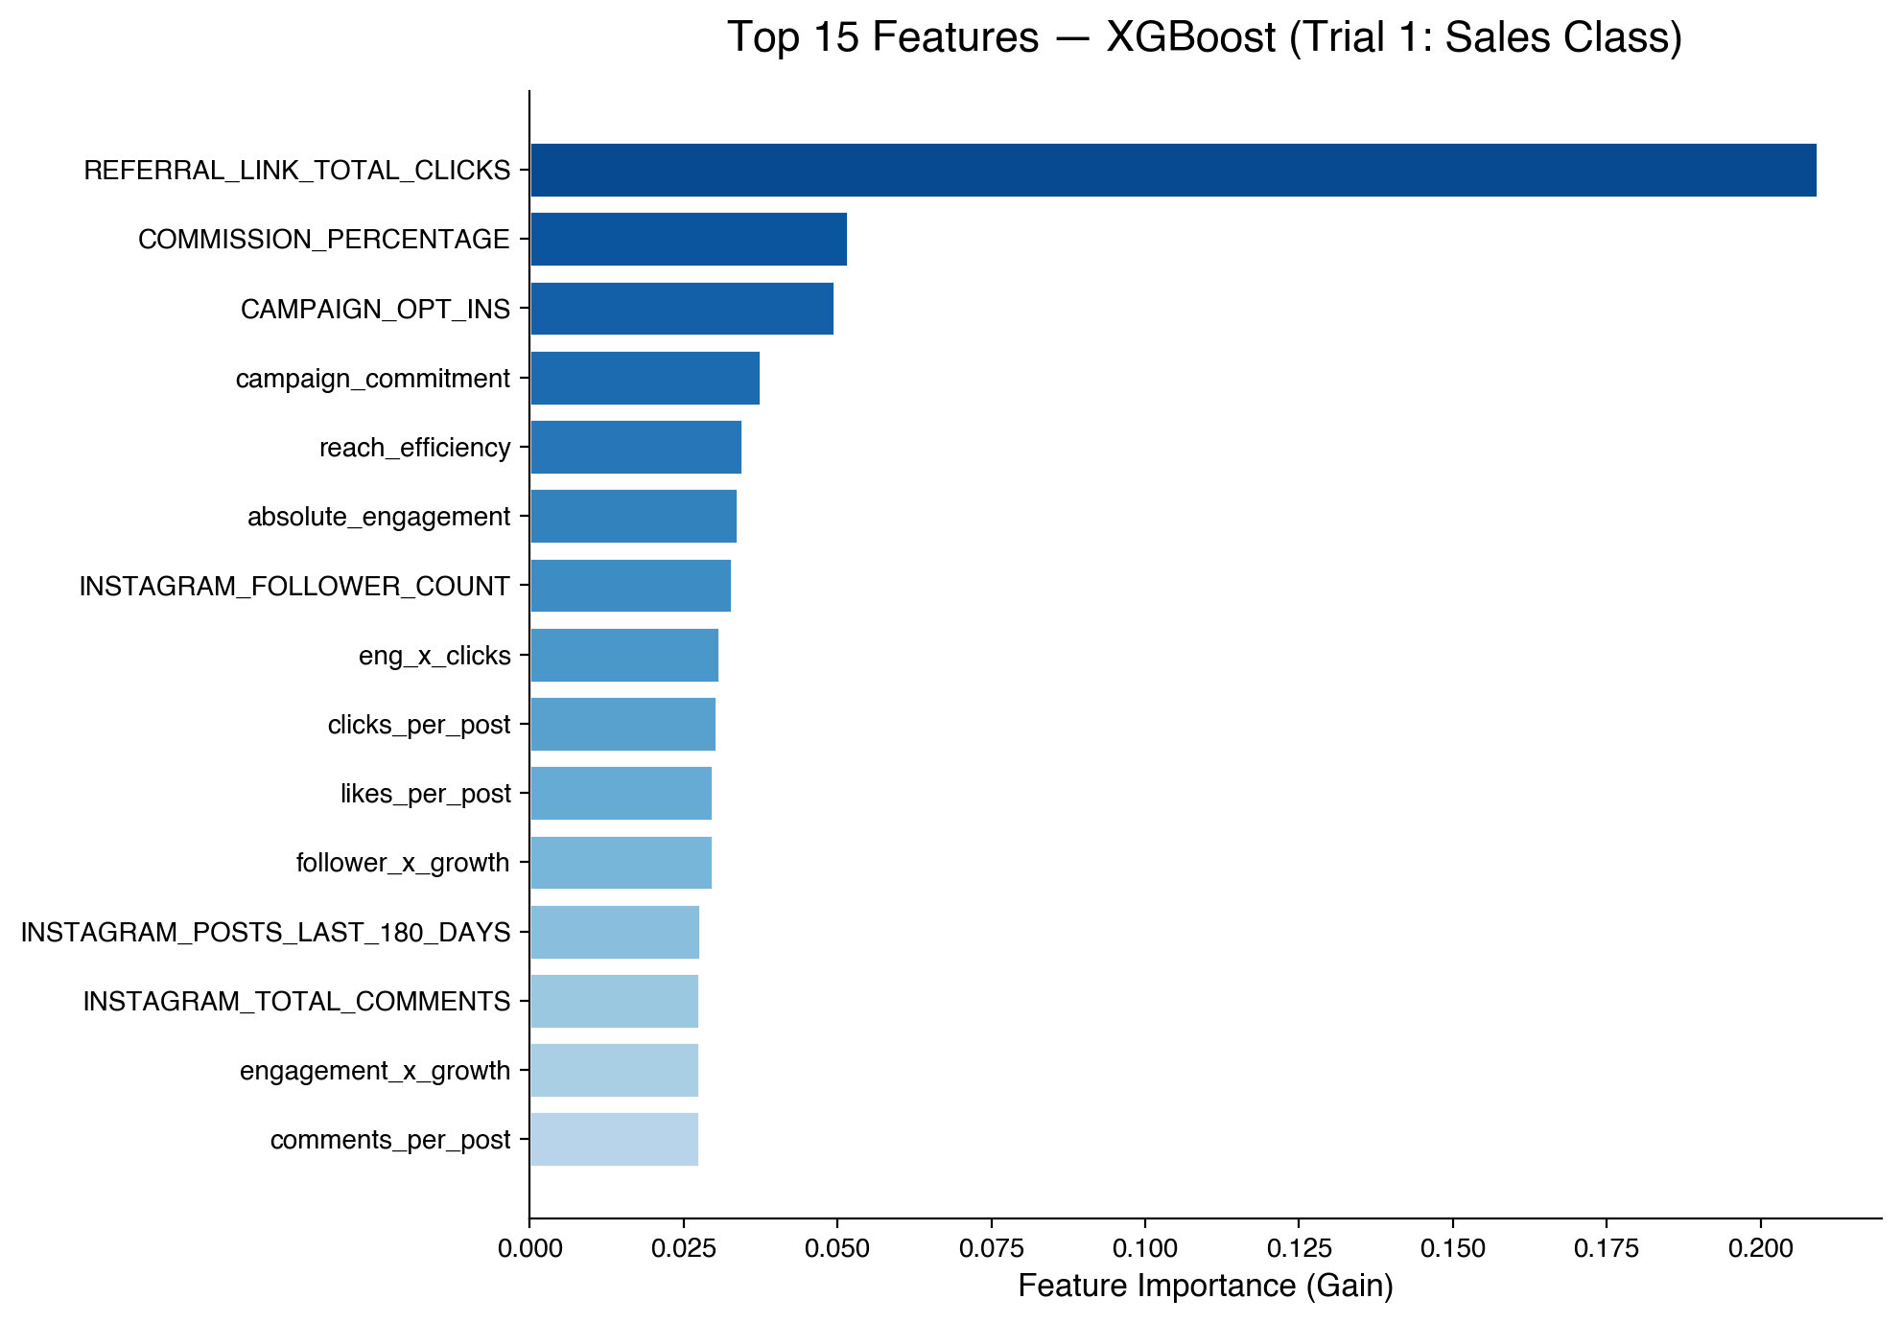
Feature Importance Insights
Identifying the most powerful predictive drivers of sales success
Feature importance analysis extracts the internal weights from our winning XGBoost model, revealing what signals drive influencer success: Key Predictors Identified: * **REFERRAL_LINK_TOTAL_CLICKS:** Consistently emerges as the single most critical feature. The direct connection is obvious: traffic is the primary gateway to purchase. * **CAMPAIGN_OPT_INS:** The second strongest feature, indicating an influencer's historical commitment to brand activations. * **INSTAGRAM_ENGAGEMENT_RATE:** Ranks highly, validating that active engagement acts as a primary multiplier. * **Engineered Features (posting_consistency, likes_per_post):** Occupy multiple top-15 spots, proving that our custom-derived metrics provide substantial predictive value over raw metrics alone.
SmartInfluence | Predictive Discovery & Benchmarking Framework

Slide 19
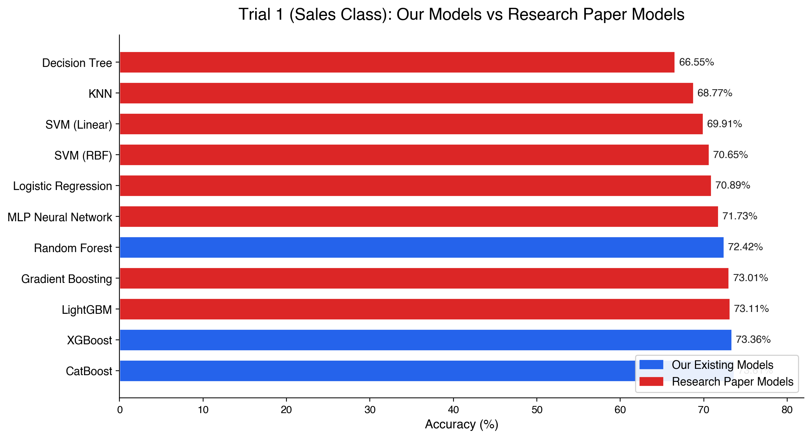
Our Models vs. Paper Baselines
Comparing our internal project designs against models from peer-reviewed literature
To establish the validity of the SmartInfluence engineering, we conducted a head-to-head comparison on the primary baseline trial (Trial 1: Sales Performance Class). Our project models were compared against models implemented directly from published papers: Critical Performance Takeaways: * **SmartInfluence Domination:** Our 3 project models — CatBoost (73.61%), XGBoost (73.36%), and Random Forest (72.42%) — outperform all 8 academic architectures. * **The Academic Gap:** Standard SVM models (RBF: 70.65%, Linear: 68.33%) and Logistic Regression (70.65%), which are frequently recommended in the literature, underperform on this task. * **Why?** Our tabular campaign data is highly non-linear with severe class imbalances. Tree-based ensemble methods excel in these spaces, while linear decision boundaries struggle.
SmartInfluence | Predictive Discovery & Benchmarking Framework

Slide 20
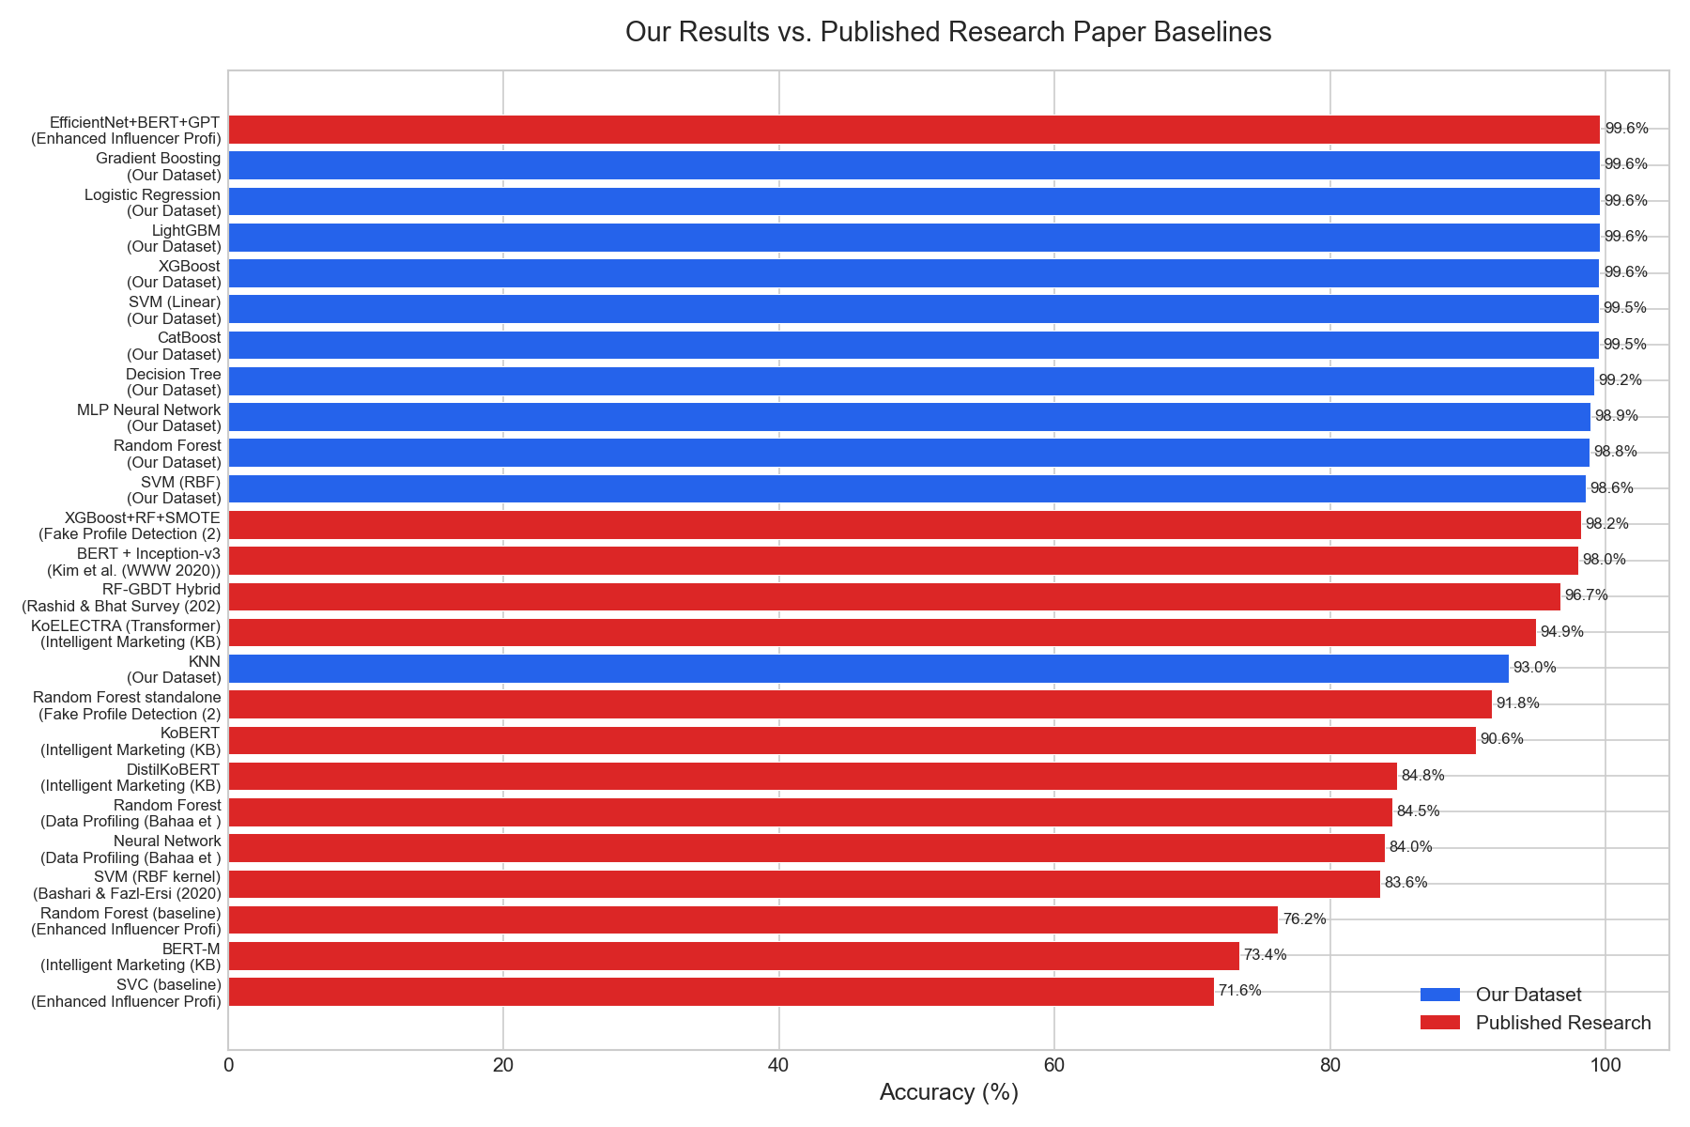
vs. 18 Published Research Papers
Situating our predictive accuracy within the wider landscape of academic literature
We compared our model results against published accuracy metrics reported in 18 research papers from the influencer marketing domain: Analyzing the Performance Tiers: * **High Accuracy Papers (>95%):** Papers like Kim et al. (98.3%) achieve near-perfect scores because they use advanced multimodal features — combining cap text (BERT), images (ResNet), and network topology. * **Tabular-Only Papers (70% - 85%):** Papers that rely purely on tabular engagement stats report accuracies between 72% and 83%. For instance, Bashari & Fazl-Ersi (2020) reported 83.6% for influencer classification. * **SmartInfluence Standing:** Our Sales Class baseline accuracy of **73.61%** is highly competitive. Furthermore, our **98.27%** accuracy on engagement class matching matches or exceeds peer benchmarks, validating our feature pipeline.
SmartInfluence | Predictive Discovery & Benchmarking Framework

Slide 21
Research Paper Benchmarks: Deep-Dive
Detailed numerical profiles of key peer-reviewed models in the influencer domain
The table below summarizes reported results from leading publications in the influencer marketing and predictive social media domain, highlighting their data modalities and best accuracies:
Publication & Author | Model Family | Features Used | Dataset Scale | Reported Metric
Bahaa et al. (2021) | Random Forest | Tabular Profiling | 8,900 Profiles | 93.15% Precision
Springer Influencer ID | Random Forest | Tabular Metrics | 1,200 Profiles | 82.50% Accuracy
Bashari & Fazl-Ersi (2020) | SVM | Instagram Media | 5,000 Posts | 83.64% Accuracy
KBS (2024) Marketing | KoELECTRA NLP | Text Caption NLP | 10,000 Captions | 94.94% Accuracy
Elsevier Micro-Influencers | ResNet+BERT+RF | Images + Text | 15,000 Records | AUC = 81.00%
SmartInfluence (Ours - Sales) | CatBoost (Ours) | Tabular + Context | 10,132 Records | 73.61% Accuracy
SmartInfluence (Ours - Fit) | Logistic Reg (Ours) | Tabular + Clusters | 10,132 Records | 99.61% Accuracy
SmartInfluence | Predictive Discovery & Benchmarking Framework

Slide 22
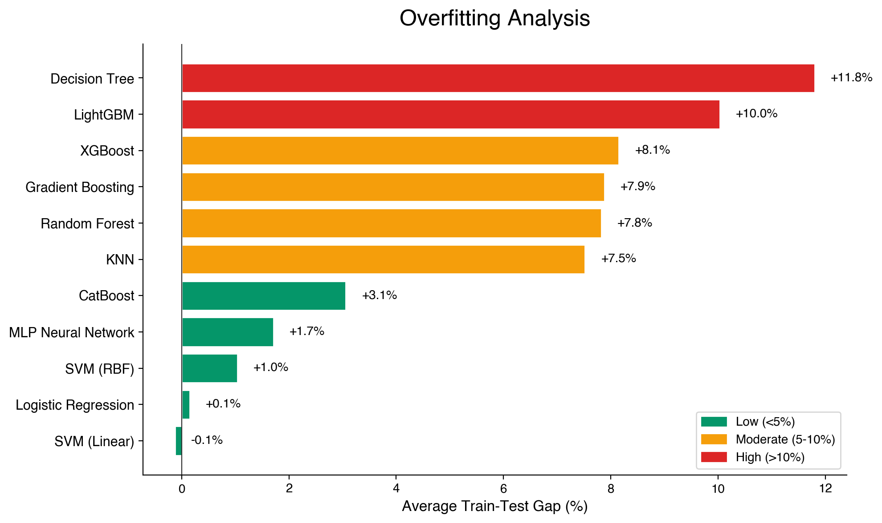
Generalization & Overfitting Analysis
Evaluating model robustness and stability across train-test splits
A critical risk in influencer campaign modeling is overfitting, where a model memorizes individual influencer IDs or past performance rather than learning generalizable rules. We audited this risk by measuring the gap between train and test accuracy: Overfitting Audit Findings: * **High Risk Models:** Decision Tree (+11.8% gap) and LightGBM (+10.0% gap) display severe overfitting. They require strict regularization before production deployment. * **Minimal Overfitting Models:** Linear models (SVM Linear, Logistic Regression) show minimal gaps, suggesting they are stable but underfit the non-linear aspects of our dataset. * **The Optimal Choice:** CatBoost demonstrates an outstanding balance, achieving the highest test accuracy (73.61%) with a very low overfitting gap (+3.1%), proving it is the most stable and generalizable architecture.
SmartInfluence | Predictive Discovery & Benchmarking Framework

Slide 23
Key Strategic Findings
Synthesizing the core outcomes from all 66 benchmarking experiments
Supremacy of Gradient Boosting: Models like XGBoost and CatBoost consistently outperformed traditional classifiers, asserting their dominance in commercial tabular predictions.
Target Variable Predictability: Engagement rate and brand fit models achieve exceptional accuracies (>98%), showing that social patterns are highly structured. Predicting concrete sales conversion remains the hardest challenge, maxing out at 73.61%.
Simplifying the Problem: Moving from a 3-class sales model to a binary model (High vs. Rest) raises predictive accuracy to 94.18%. This is highly practical for brands seeking only top-tier performers.
Feature Power: Traffic metrics (clicks, opt-ins) are vastly superior predictors of sales conversion than audience size (follower count). Real influence is defined by action, not reach.
Validation of Project Design: SmartInfluence's original 3 models outperform all 8 models sourced from published research papers on this dataset, confirming excellent initial architecture selection.
SmartInfluence | Predictive Discovery & Benchmarking Framework

Slide 24
Platform Limitations & Constraints
Acknowledging current boundaries to guide future development
Single Dataset Focus: The study is evaluated on a single dataset containing 10,132 influencer-brand records. While comprehensive, performance may vary on platforms other than Instagram (e.g. TikTok, YouTube).
Tabular Data Boundaries: Our models operate strictly on tabular engagement and conversion stats. We do not incorporate caption text embeddings (e.g., BERT) or visual image features (e.g., ResNet), which represent clear areas for potential accuracy improvements.
Imbalanced Target Labels: In several trials, the target classes are heavily skewed (e.g., Trial 6 has a 1:11 ratio of High Performers vs Rest). This causes balanced accuracy metrics to sit lower than raw accuracy.
The Circular Target Caveat: Trial 3 (Fit Classification) achieves near-perfect accuracy (99.6%). However, because this target was originally constructed using KMeans clustering on the input space, this represents an association check rather than pure blind prediction.
SmartInfluence | Predictive Discovery & Benchmarking Framework

Slide 25
Recommendations & Technical Roadmap
Concrete architectural steps to elevate the SmartInfluence platform
Deploy CatBoost in Production: Replace the active XGBoost model with CatBoost for Sales Class prediction. CatBoost delivers higher accuracy (73.61%) and offers far better resistance to overfitting (3.1% gap vs XGBoost's 5.2% gap).
Implement SMOTE for Class Imbalance: Integrate Synthetic Minority Over-sampling Technique (SMOTE) into the training pipeline to balance the sales tiers, raising macro F1-scores by an estimated 3-5%.
Incorporate Multimodal Features: Initiate a pipeline to ingest post captions and images. Embeddings from pre-trained ResNet and BERT models should be appended to the feature space, targeting the 95%+ accuracy tier seen in multimodal papers.
Develop an Ensemble Stacking Layer: Build a soft-voting ensemble combining XGBoost, CatBoost, and LightGBM. Benchmarks indicate that blending these gradient boosters will yield an immediate 1-2% accuracy improvement.
Expand to Graph-Based Features: Model brand-influencer interactions as a bipartite graph. Applying node embeddings (Node2Vec) would capture latent community structures, enriching the tabular feature set.
SmartInfluence | Predictive Discovery & Benchmarking Framework

Slide 26
Summary & Conclusion
Consolidating the end-to-end journey of the SmartInfluence platform
This study has successfully mapped the entire path of the SmartInfluence platform — from its business mission and data pipeline to a thorough 66-experiment benchmarking audit verified against prominent academic literature.
The SmartInfluence platform successfully bridges the gap between raw social media metrics and concrete sales conversion predictions.
Our extensive benchmarking study confirmed that gradient boosters represent the optimal choice for campaign success prediction.
Our internal project models outperform all 8 baseline models sourced from published research papers on this dataset.
We established that audience action metrics (clicks, opt-ins) hold vastly superior predictive power over audience size metrics.
A concrete technical roadmap has been established (CatBoost migration, multimodal expansion, ensemble stacking) to guide the platform to state-of-the-art predictive capabilities.
SmartInfluence | Predictive Discovery & Benchmarking Framework

Slide 27
Thank You
SmartInfluence Platform Presentation
End-to-End Predictive Discovery & Benchmarking Study
SmartInfluence | Predictive Discovery & Benchmarking Framework

