Slide 1
UNIT –II Greedy Method

Slide 2
What is Greedy Method?
A Greedy Algorithm is an approach that makes the best possible choice at each step in order to reach an optimal solution. It always selects the locally best option without worrying about future consequences. The main idea is that choosing the best decision at every stage will lead to the best overall result.
A Greedy Algorithm makes the best possible choice at each step to reach the final solution.
Greedy means choosing the best option immediately without thinking too much about the future.
EXAMPLE
Buying maximum chocolates with limited money.

Slide 3
Key Characteristics of Greedy Method
Greedy algorithms make decisions step-by-step.
do not reconsider previous choices, and aim for fast and efficient solutions.
They are easy to understand and implement
which makes them popular for solving optimization problems.

Slide 4
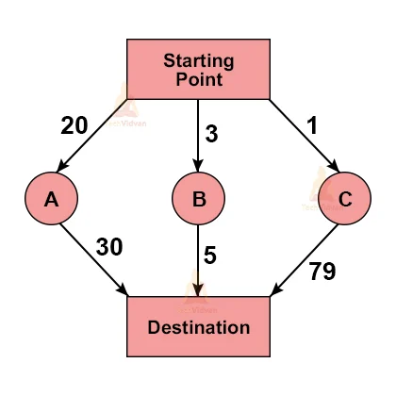
Visual Understanding
Start → Choose Best → Add → Repeat → Stop

Slide 5
Applications of Greedy Algorithm
shortest path algorithms
data compression techniques
network design problems.
Advantages
simple logic
easy implementation
fast execution
reduced computational complexity

Slide 6
Problem solving using- fractional knapsack problem,
3 Ways to solve
Select Max Profit
Select Min Weight
Select Profit/Weight Ratio

Slide 7
Algorithm fractional knapsack
Algorithm FractionalKnapsack(p[], w[], n, W) 1. For i = 1 to n ratio[i] = p[i] / w[i] 2. Sort items in descending order of ratio 3. profit = 0 4. For i = 1 to n If w[i] <= W then profit = profit + p[i] W = W - w[i] Else profit = profit + ratio[i] * W break 5. Return profit

Slide 8
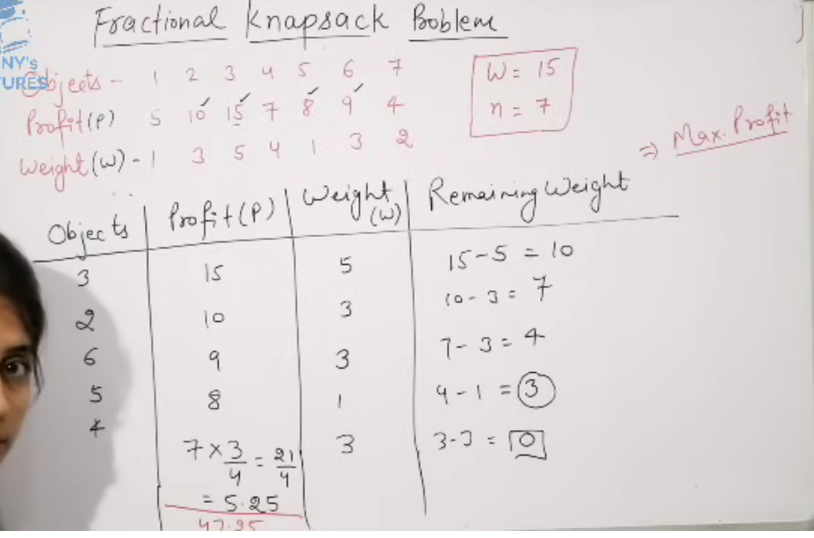

Slide 9
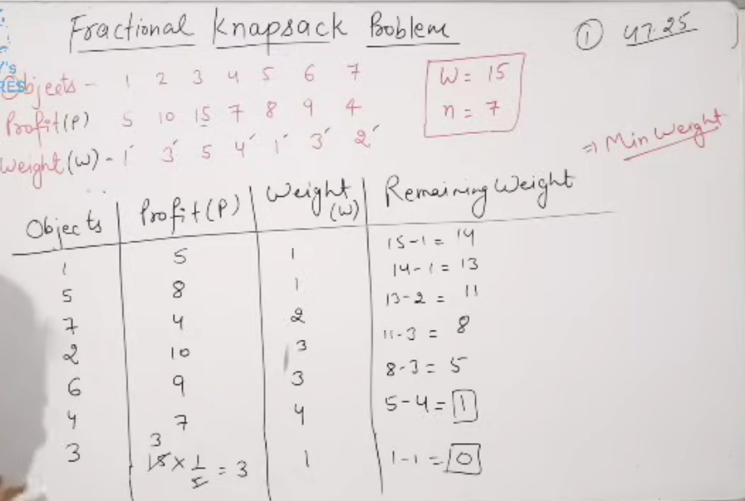

Slide 10
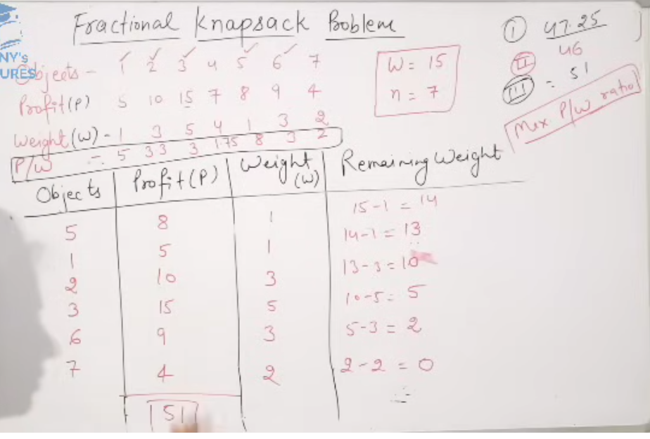

Slide 11
fractional knapsack problem,
Item
Weight (kg)
Profit (₹)
MAX CAPACITY = 60 KG
N=5
I1 | I2 | I3 | I4 | I5
10 | 20 | 30 | 40 | 15
100 | 180 | 120 | 240 | 150
Total Profit=280+100+150+90=620​

Slide 12
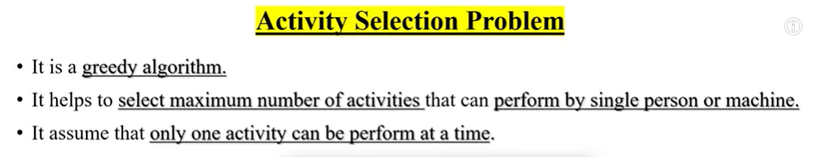
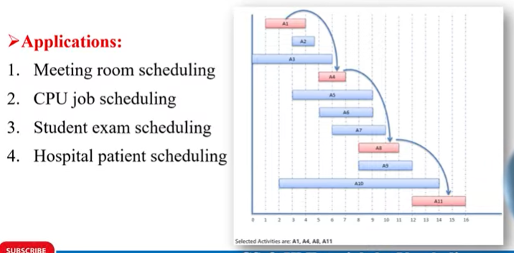

Slide 13
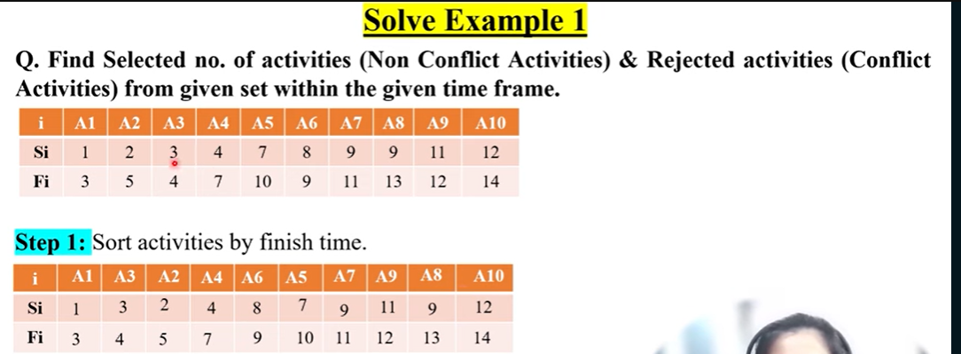
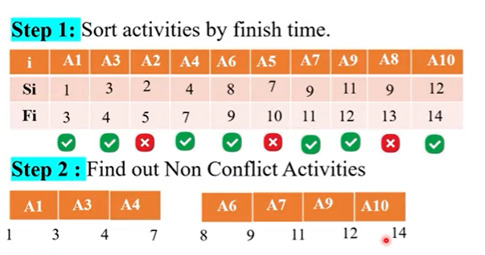
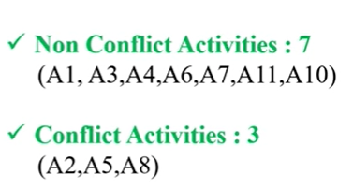
Si – Start Activity
Fi- Finish Activity

Slide 14
Activity Selection Problem – Example
Activity | Start Time | Finish Time
A1 | 1 | 3
A2 | 2 | 5
A3 | 4 | 6
A4 | 6 | 7
A5 | 5 | 8
A6 | 8 | 9
Selected Activities: A1, A3, A4, A6

Slide 15
Job Sequencing with Deadline
Job Sequencing with Deadline is a greedy algorithm problem where we arrange jobs in such a way that:
Each job takes exactly 1 unit time.
Each job has:
Deadline (d) – last time before which job must be completed.
Profit (p) – money earned after completing the job.
Only one job can be done at a time

Slide 16
Steps for Job Sequencing with Deadline
Sort all jobs in decreasing order of profit.
Create time slots from 1 to maximum deadline.
For each job:
Try to schedule it in the latest free slot before its deadline.
If slot is available → assign job.
If slot not available → skip job.

Slide 17
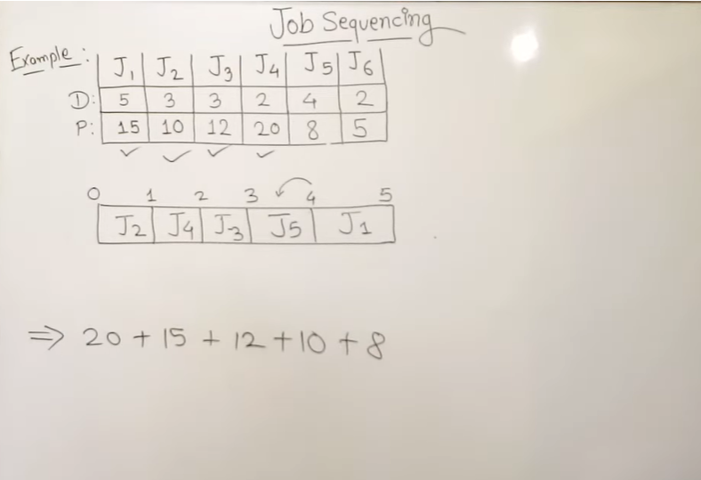
Job Sequencing with Deadline Example

Slide 18
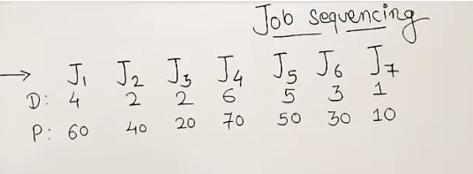
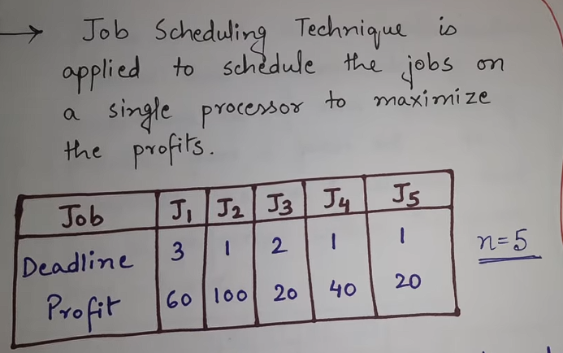
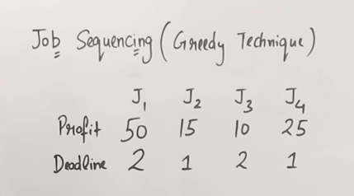
Example

Slide 19
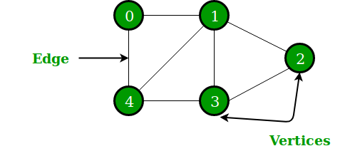
What is a Graph?
A graph is a non-linear data structure
It consists of:
Vertices (Nodes)
Edges (Connections)
Real Life Examples:
Social Networks
Google Maps
Computer Networks
Example

Slide 20
Types of Graphs
Undirected Graph
Directed Graph
Weighted Graph
Unweighted Graph
Cyclic & Acyclic Graph

Slide 21
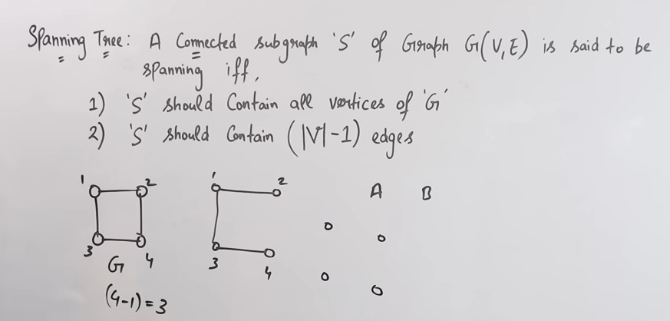
Minimum Spanning Tree (MST)
Prim’s Algorithm
Dijkstra’s Algorithm

Slide 22
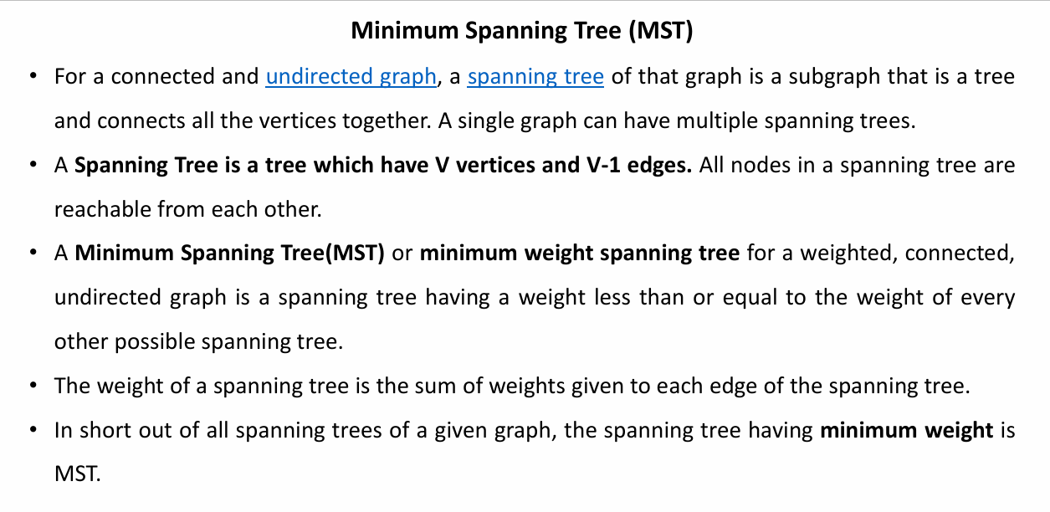

Slide 23
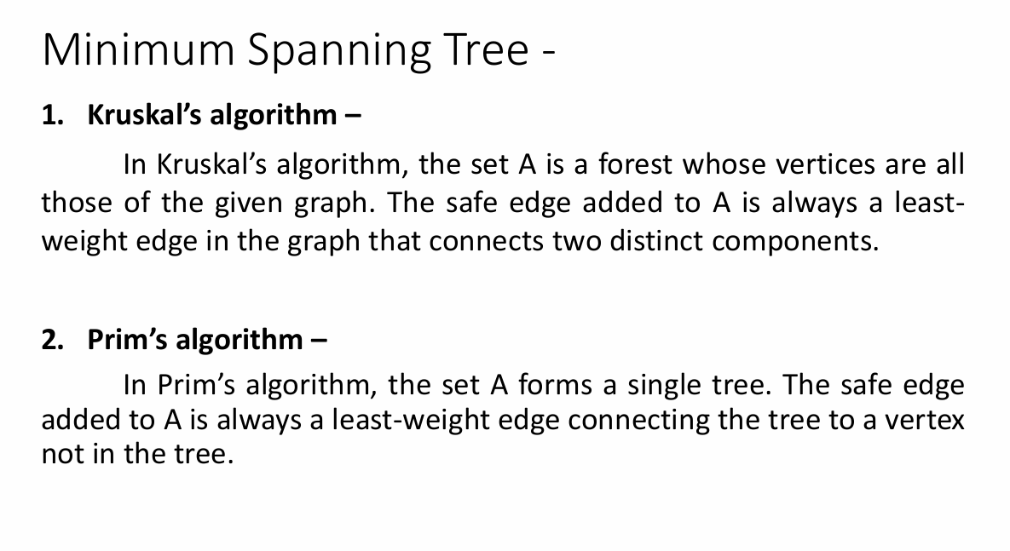

Slide 24
Kruskal’s algorithm
Sort all the edges in non-decreasing order of their weight.
Pick the smallest edge. Check if it forms a cycle with the spanning tree formed so far. If the cycle is not formed, include this edge. Else, discard it.
Repeat step#2 until there are (V-1) edges in the spanning tree.

Slide 25
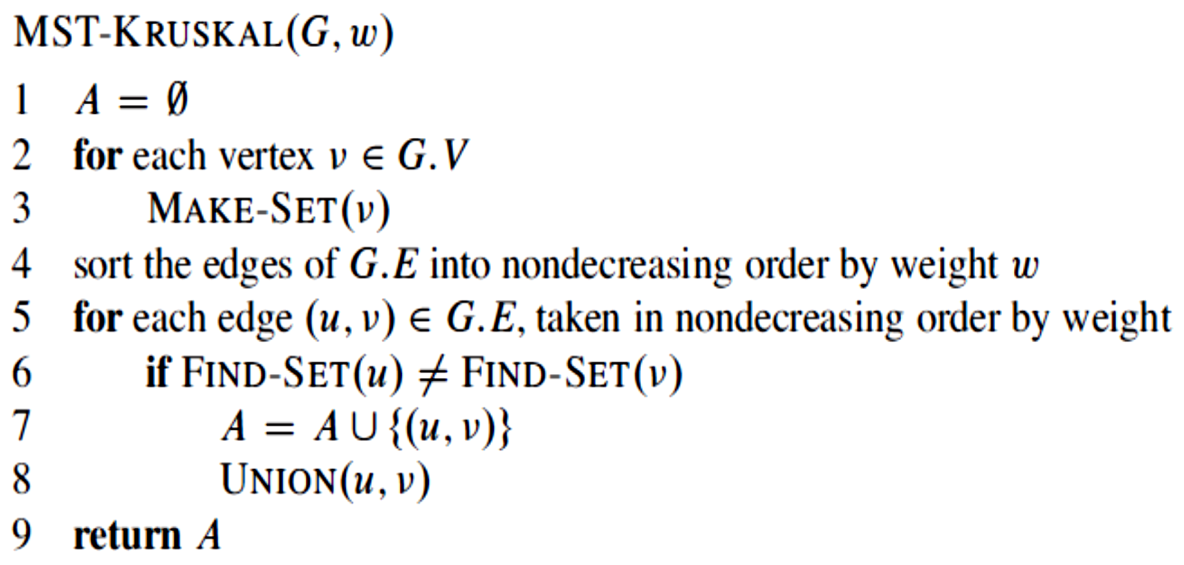
Kruskal’s algorithm

Slide 26
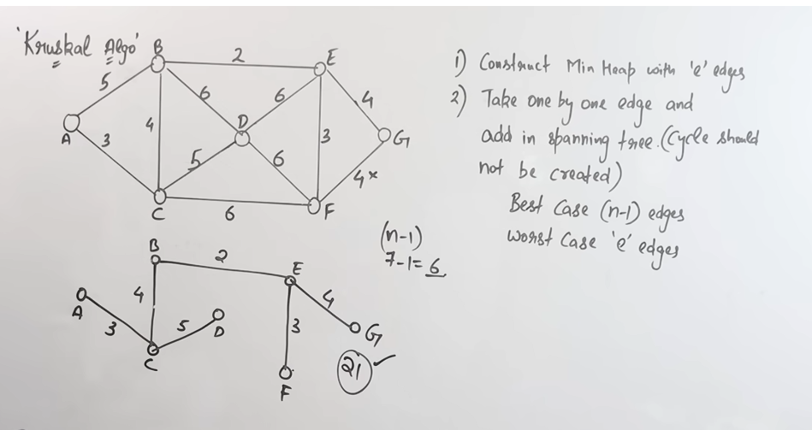
Kruskal’s algorithm Example

Slide 32
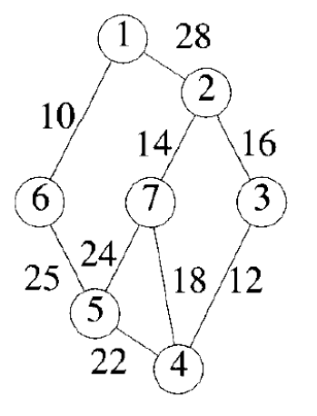
Homework

Slide 34
Prims Algorithm
Like Kruskal’s algorithm, Prim’s algorithm is a special case of the generic minimum- spanning-tree method.
Prim’s algorithm operates much like Dijkstra’s algorithm for finding shortest paths in a graph.
It has the property that the edges in the set A always form a single tree.
The tree starts from an arbitrary root vertex r and grows until the tree spans all the vertices in V . Each step adds to the tree A a light edge that connects A to an isolated vertex—one on which no edge of A is incident. This rule adds only edges that are safe for A; therefore, when the algorithm terminates, the edges in A form a minimum spanning tree.
This strategy qualifies as greedy since at each step it adds to the tree an edge that contributes the minimum amount possible to the tree’s weight.

Slide 36
Prims Algorithm
Step 1: Determine an arbitrary vertex as the starting vertex of the MST. Step 2: Follow steps 3 to 5 till there are vertices that are not included in the MST (known as fringe vertex). Step 3: Find edges connecting any tree vertex with the fringe vertices. Step 4: Find the minimum among these edges. Step 5: Add the chosen edge to the MST if it does not form any cycle. Step 6: Return the MST and exit

Slide 37
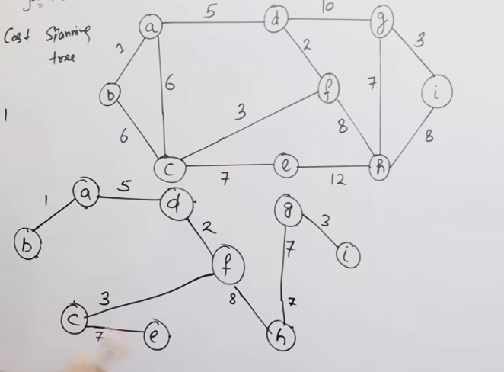
Prim’s Algorithm

Slide 43
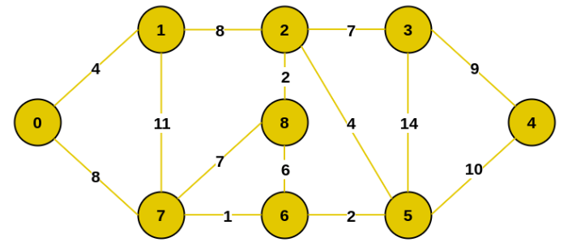
Homework

Slide 44
Coin Change Problem using Greedy Algorithm
When it comes to finding the minimum number of coins to make change for a given amount, the Greedy Algorithm is particularly useful.
This problem is often referred to as the “Minimum Coin Change Problem.” The goal is to determine the fewest number of coins needed to represent a given sum of money.
How Greedy Algorithm works for Minimum Coin Change?
The Greedy Algorithm works by selecting the largest denomination of coin that is less than or equal to the remaining amount, and repeats this process until the amount becomes zero. The idea is to always choose the coin with the highest value at each step, ensuring that the total number of coins used is minimized.

Slide 45
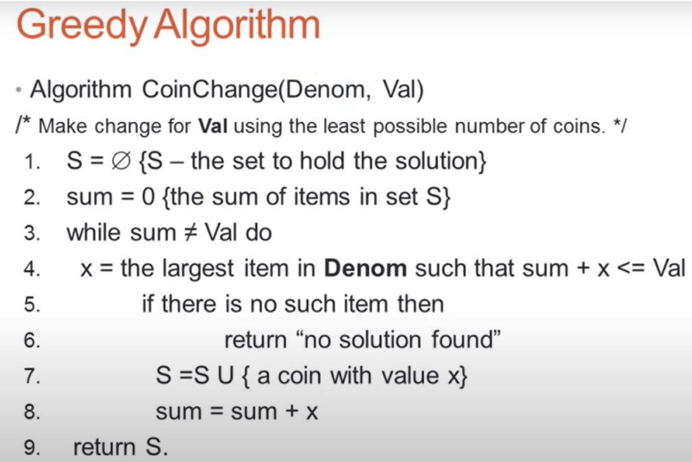

Slide 46
Coin Change Problem using Greedy Algorithm
Follow the steps below to implement the idea:
Sort the array of coins in decreasing order.
Initialize answer vector as empty.
Find the largest denomination that is smaller than remaining amount
while it is smaller than the remaining amount:
Add found denomination to answer.
Subtract value of found denomination from amount.
If amount becomes 0, then print answer.

Slide 47
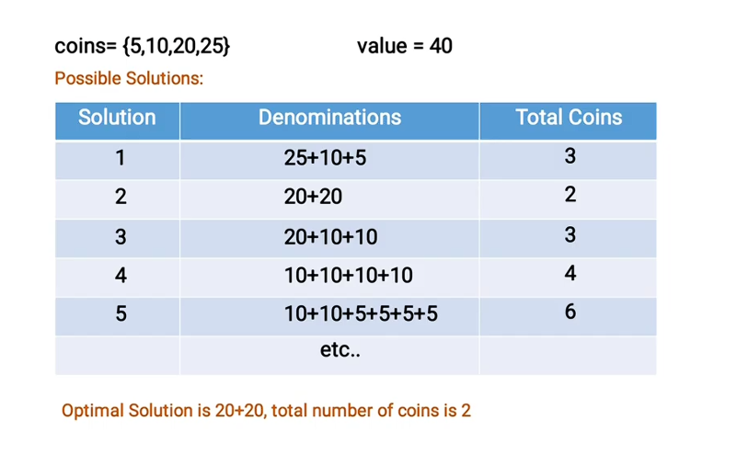

Slide 48
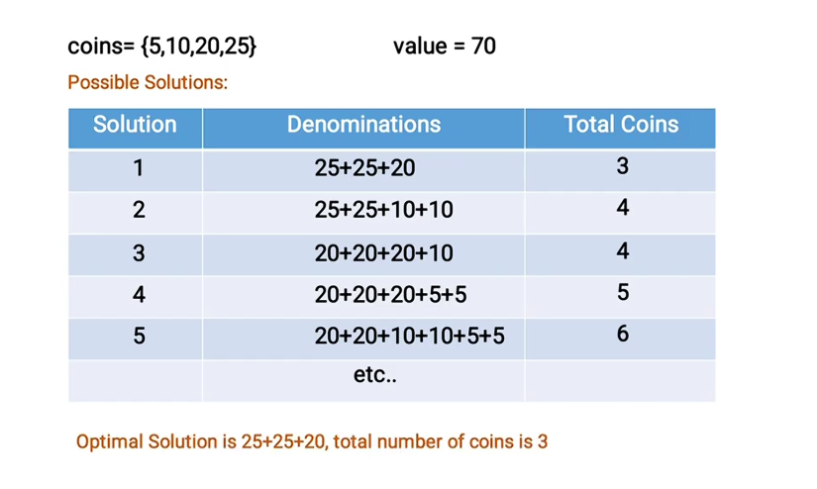

Slide 49
Example: coin[] = {25,20,10,5} value = 50
Take coin[0] twice. (25+25 = 50).
Total coins = 2 (25+25)
Example: coin[] = {25,20,10,5} value = 70
Take coin[0] twice. (25+25 = 50).
If we take coin[0] one more time, the end result will exceed the given value. So, change the next coin.
Take coin[1] once. (50 + 20 = 70).
Total coins needed = 3 (25+25+20)

Slide 50
Minimum coin change problem : solving by greedy method
Let’s apply this algorithm to make change for $63 using coin denominations
[25, 10, 5, 1].
Sort Denominations: [25, 10, 5, 1]
Initialize Variables:
remaining_amount = $63
coin_count = 0
Greedy Coin Selection:
Iteration 1: Select 25, subtract from $63 (remaining_amount = $38), and increment coin_count (coin_count = 1).
Iteration 2: Select 25, subtract from $38 (remaining_amount = $13), and increment coin_count (coin_count = 2).
Iteration 3: Select 10, subtract from $13 (remaining_amount = $3), and increment coin_count (coin_count = 3).
Iteration 4: Select 1, subtract from $3 (remaining_amount = $2), and increment coin_count (coin_count = 4).
Iteration 5: Select 1, subtract from $2 (remaining_amount = $1), and increment coin_count (coin_count = 5).
Iteration 6: Select 1, subtract from $1 (remaining_amount = $0), and increment coin_count (coin_count = 6).
Result: The minimum number of coins needed is 6.

Slide 51
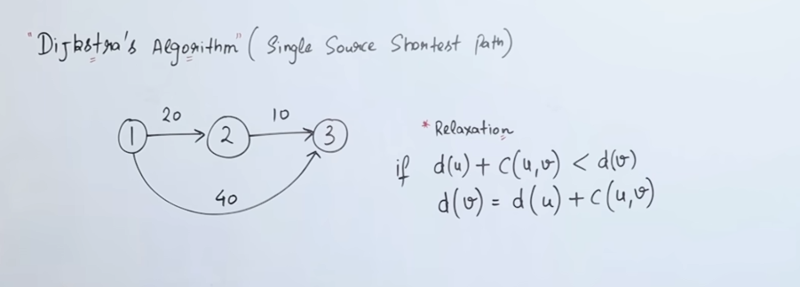
Single-source shortest path (Dijkstra’s)

Slide 52
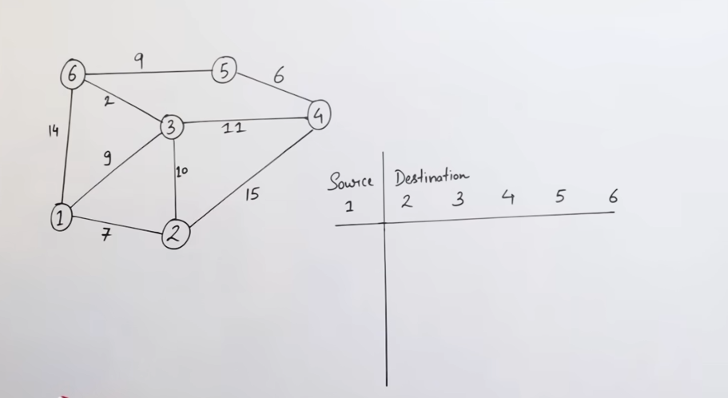

Slide 53
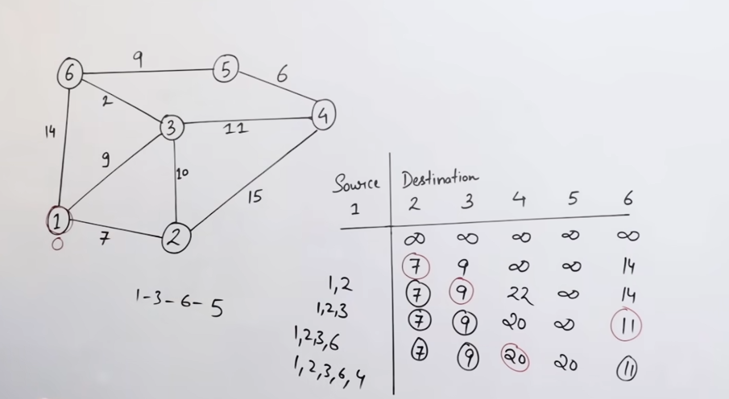

Slide 54
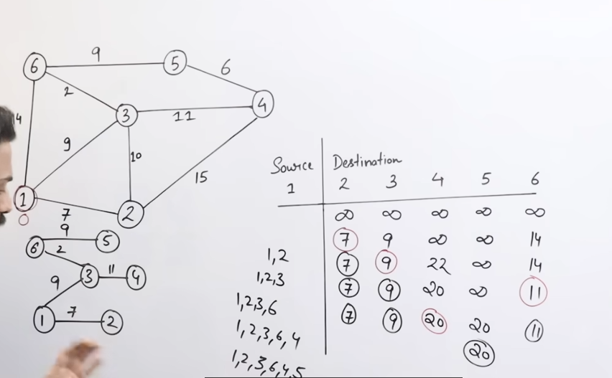

Slide 55
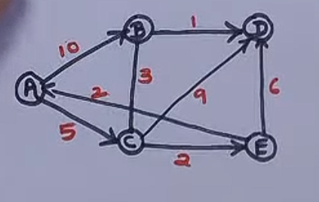
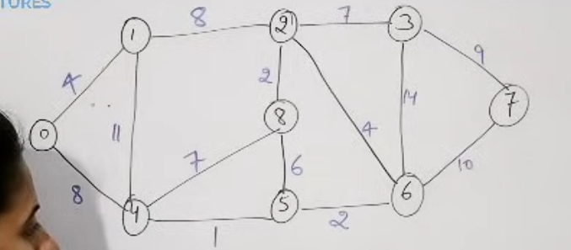
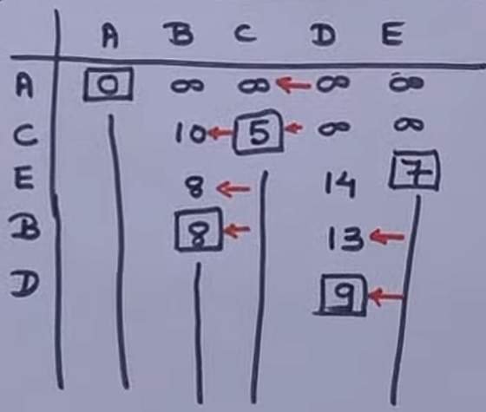
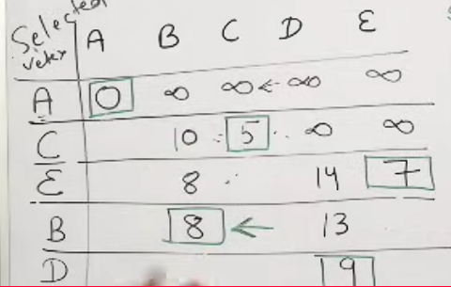

Slide 56
