Slide 1
UNIT –III Dynamic Programming

Slide 2
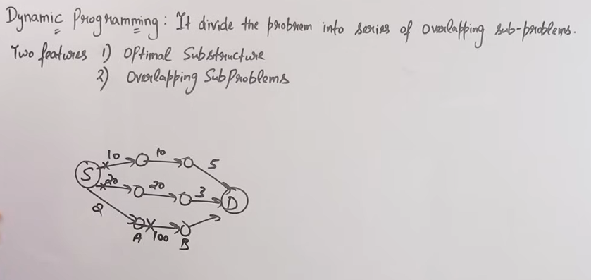
Dynamic programming

Slide 3
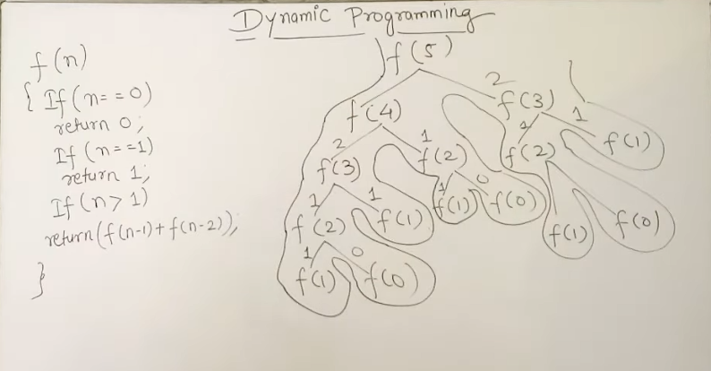

Slide 4
Dynamic programming
Typically used for Optimization Problem.
Dynamic programming, like the divide-and-conquer method, solves problems by combining the solutions to subproblems.
A dynamic-programming algorithm solves each subproblem just once and then saves its answer in a table.

Slide 5
Dynamic Programming

Slide 7
Steps in Dynamic Programming

Slide 8
Elements of Dynamic Programming
Optimal Substructure
Overlapping Subproblems
Memoization
Reconstruction of Optimal Solution

Slide 9
Elements of Dynamic Programming

Slide 12
Where Dynamic Programming is Used
• Shortest path problems
• Fibonacci series
• Knapsack problem
• Matrix chain multiplication
• Resource optimization problems

Slide 13
Principle of Optimality
Proposed by Richard Bellman.
It states that an optimal solution contains optimal solutions of subproblems.
If we solve smaller problems optimally, we can build the optimal solution for the larger problem.
This property allows dynamic programming to work efficiently.

Slide 14
Example: Fibonacci Series
Fibonacci Formula:
F(n) = F(n-1) + F(n-2)
Example:
F(5) = F(4) + F(3)
F(4) = F(3) + F(2)
Subproblems like F(3) appear many times.
Dynamic Programming stores the result and reuses it.

Slide 15
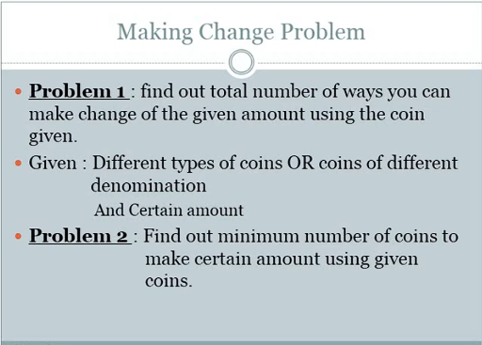

Slide 16
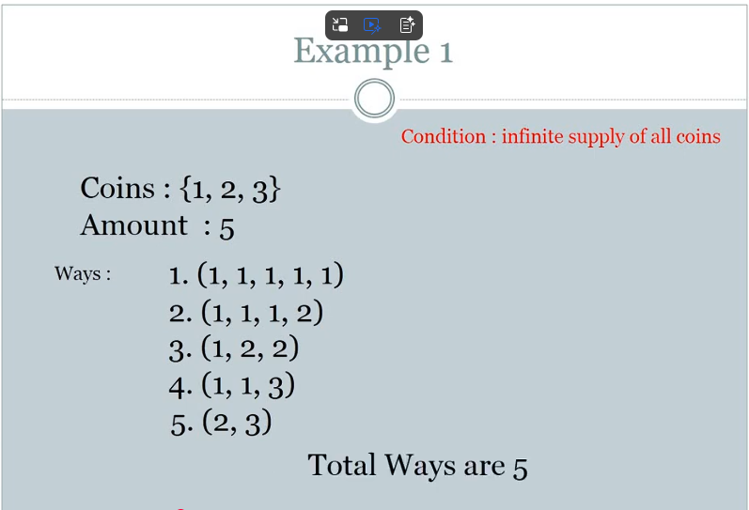

Slide 17
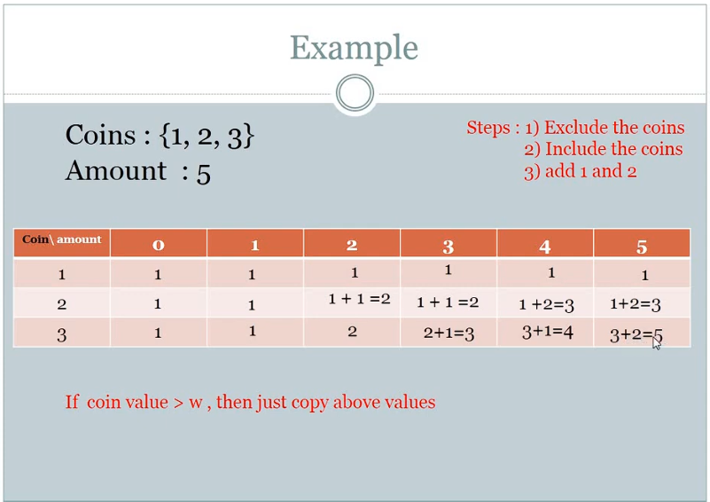

Slide 18
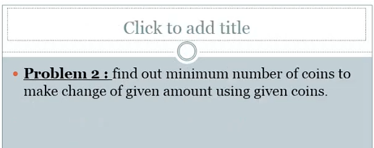
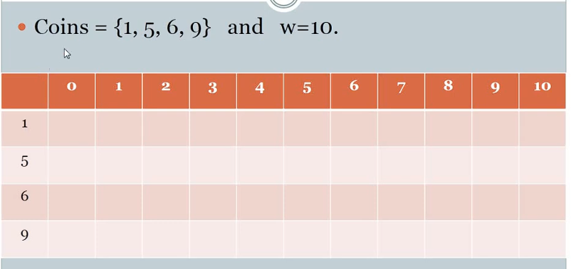

Slide 19
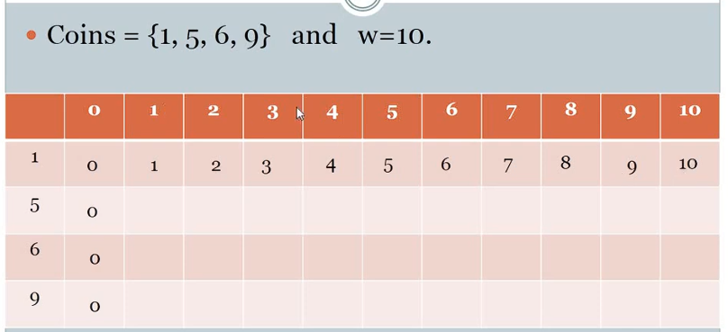
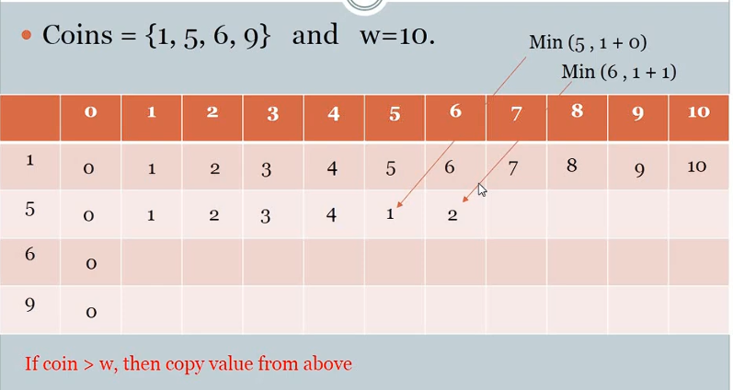

Slide 20
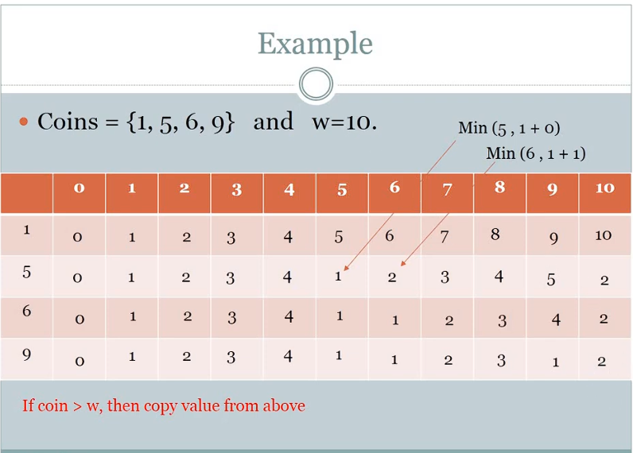

Slide 21
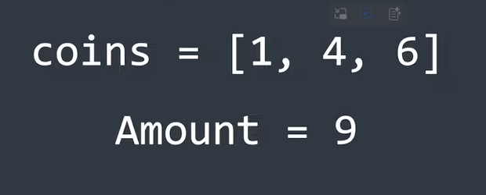
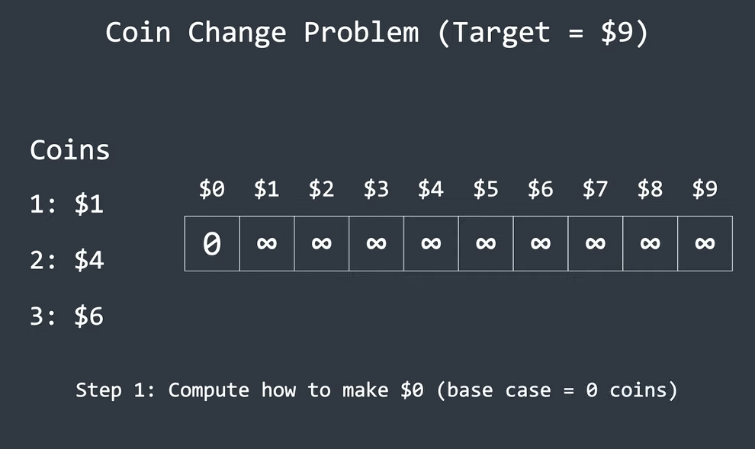
coin change problem dynamic programming

Slide 22
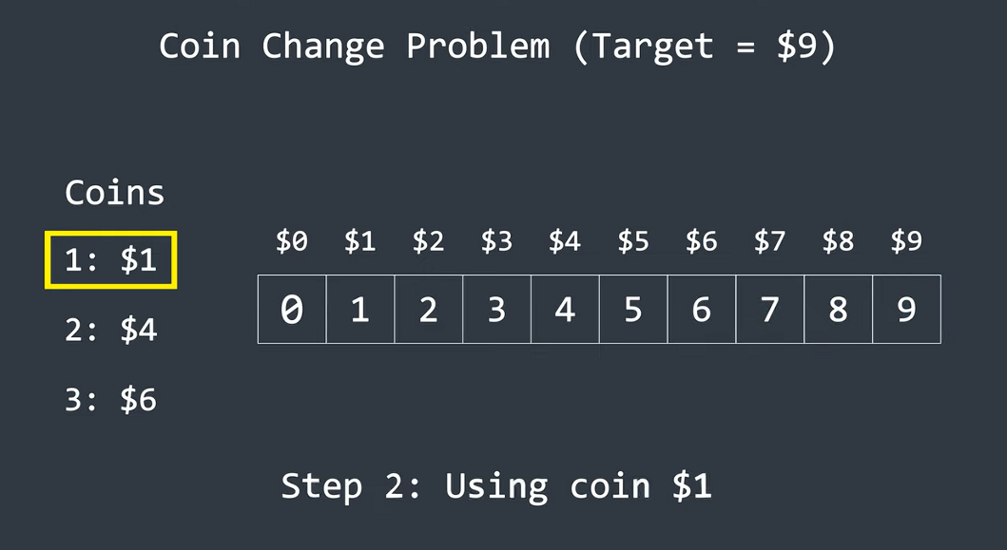

Slide 23
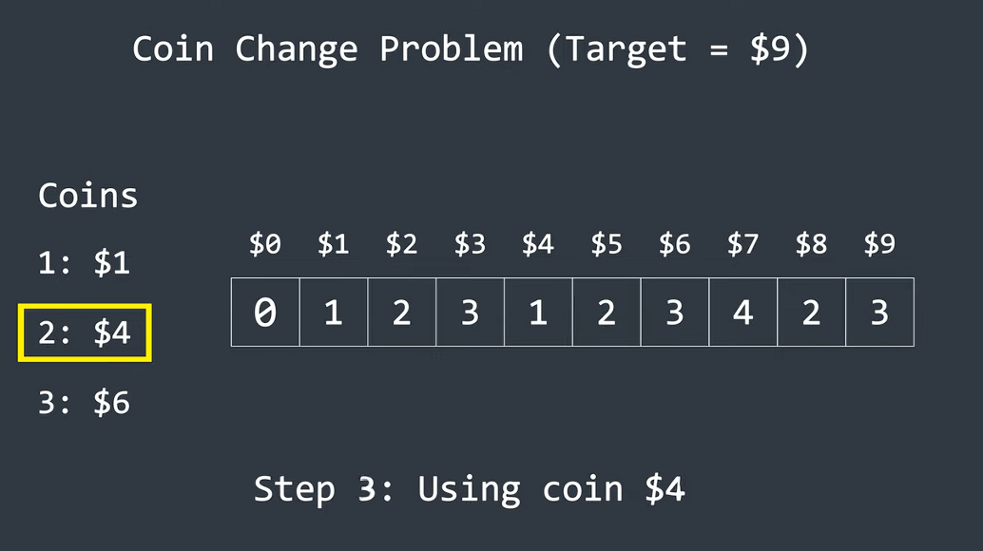

Slide 24
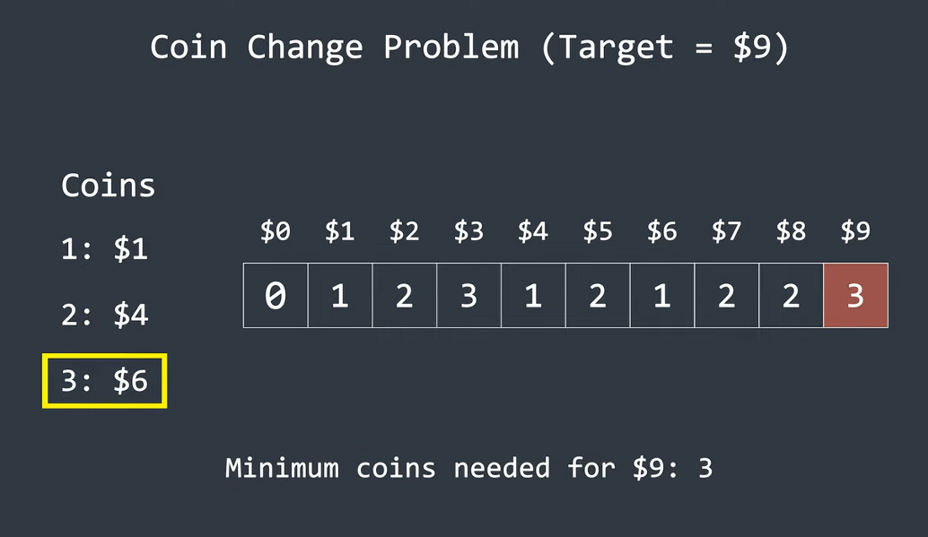

Slide 25
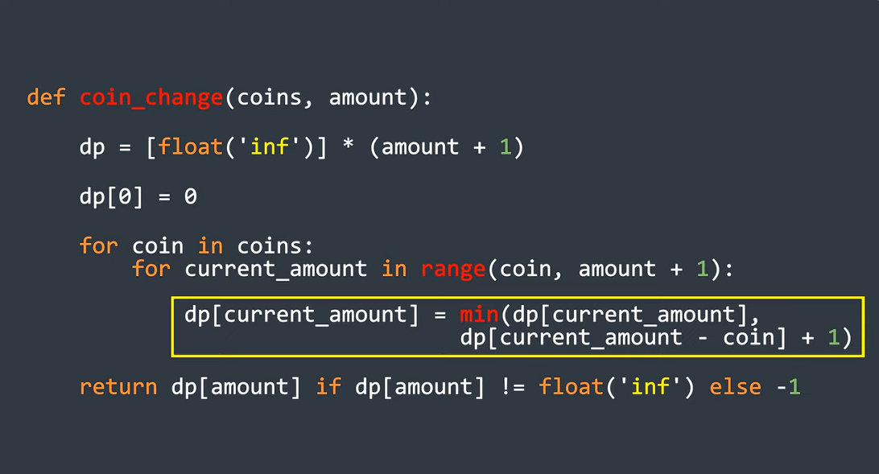

Slide 26
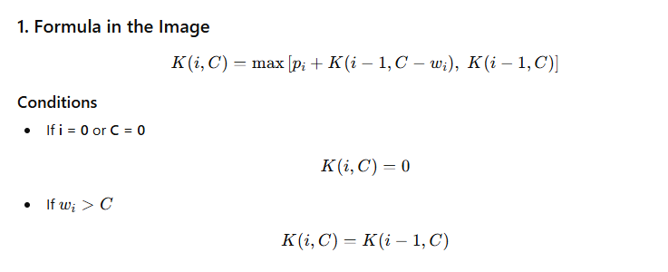
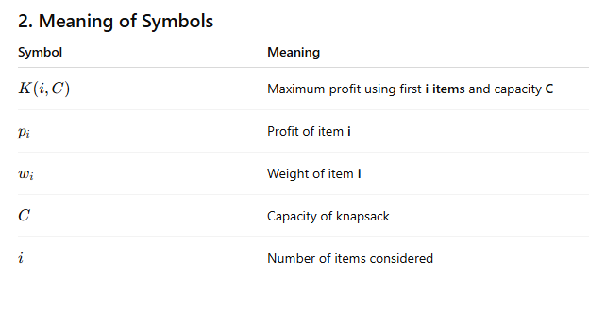
0/1 Knapsack Problem using Dynamic Programming.

Slide 27
Capacity C=6
DP Table
Item | Profit (p) | Weight (w)
1 | 10 | 1
2 | 12 | 2
3 | 28 | 4
i \ C | 0 | 1 | 2 | 3 | 4 | 5 | 6
0 | 0 | 0 | 0 | 0 | 0 | 0 | 0
1 | 0 | 10 | 10 | 10 | 10 | 10 | 10
2 | 0 | 10 | 12 | 22 | 22 | 22 | 22
3 | 0 | 10 | 12 | 22 | 28 | 38 | 40

Slide 28
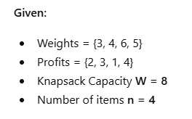
i \ W | 0 | 1 | 2 | 3 | 4 | 5 | 6 | 7 | 8
0 | 0 | 0 | 0 | 0 | 0 | 0 | 0 | 0 | 0
1 | 0 | 0 | 0 | 2 | 2 | 2 | 2 | 2 | 2
2 | 0 | 0 | 0 | 2 | 3 | 3 | 3 | 5 | 5
3 | 0 | 0 | 0 | 2 | 3 | 3 | 3 | 5 | 5
4 | 0 | 0 | 0 | 2 | 3 | 4 | 4 | 5 | 6

Slide 29
Matrix Chain Multiplication using Dynamic Programming
The task is to find the most efficient way to multiply these matrices together such that the total number of element multiplications is minimum.
Note that in the matrix-chain multiplication problem, we are not actually multiplying matrices. Our goal is only to determine an order for multiplying matrices that has the lowest cost.

Slide 30
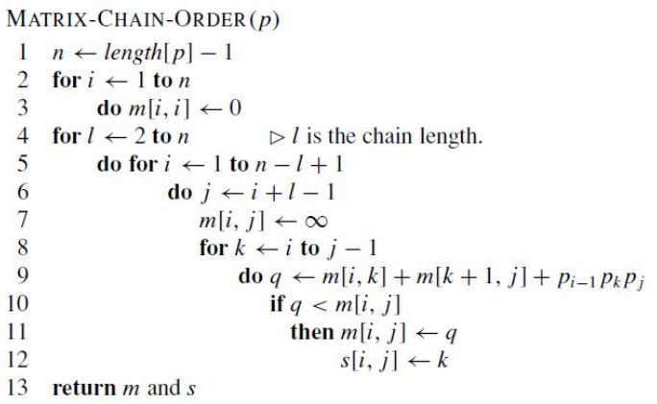
Matrix Chain Multiplication using Dynamic Programming
Total Complexity
is: O (n³)

Slide 31
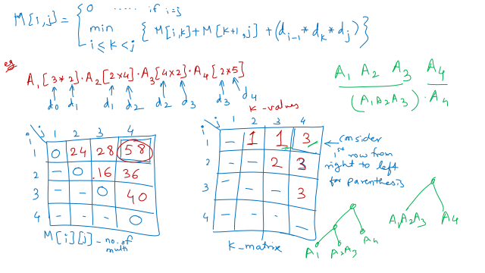
4.3 Matrix Chain Multiplication - Dynamic Programming - YouTube

Slide 32
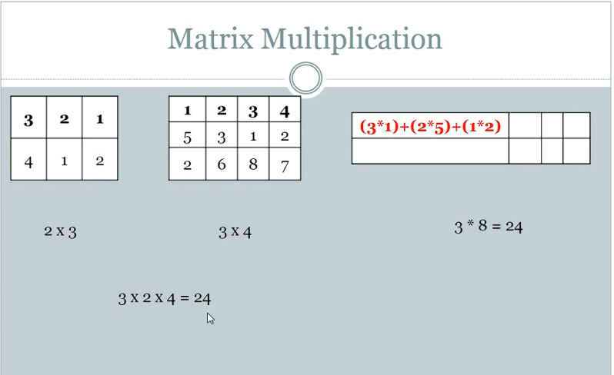
Matrix Chain Multiplication IN DP

Slide 33
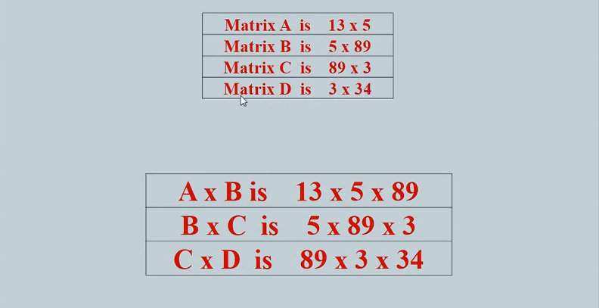

Slide 34
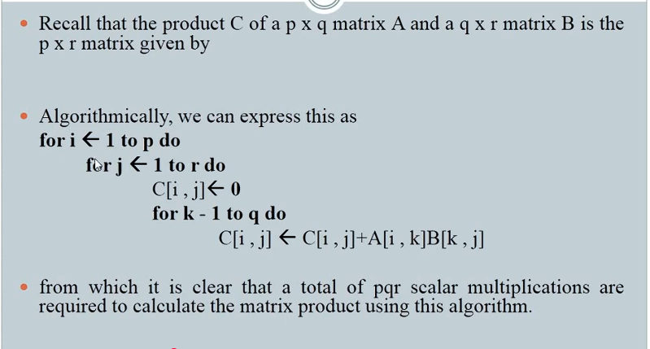

Slide 35
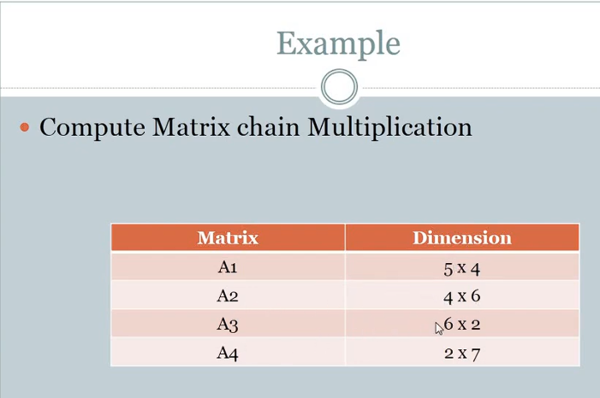
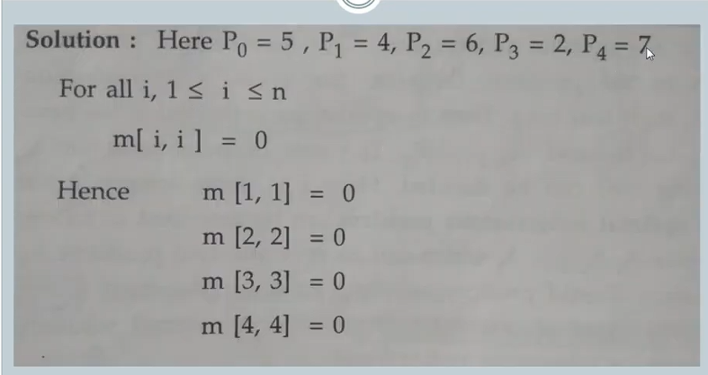

Slide 36
All Pairs Shortest Path Algorithm/ Floyd Warshall Algorithm
The all pair shortest path algorithm is also known as Floyd-Warshall algorithm is used to find all pair shortest path problem from a given weighted graph.
It uses Dynamic programming formulation on a directed graph G (V, E).
As a result of this algorithm, it will generate a matrix, which will represent the minimum distance from any node to all other nodes in the graph.
At first the output matrix is same as given cost matrix of the graph.
After that the output matrix will be updated with all vertices k as the intermediate vertex.
The time complexity of this algorithm is O(V3), here V is the number of vertices in the graph.
We assume that there are no negative weight cycles.

Slide 37
All Pairs Shortest Path Algorithm Floyd Warshall Algorithm
Floyd Warshal (cost or weight)
Input − The cost matrix of given Graph.
Output − Matrix for shortest path between any vertex to any vertex.

Slide 38
Analysis of Floyd Warshall Algorithm
The running time of the Floyd-Warshall algorithm is easy to analyze.
The main loop is executed n times and
The inner loop considers each of O(n2) pairs of vertices, performing a constant-time computation for each pair.
If we use a data structure, such as the adjacency matrix structure, that supports methods are Adjacent and insert Directed Edge in O(1) time,
Total running time is O(n3).

Slide 39
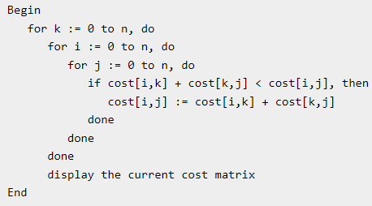
All Pairs Shortest Path Algorithm Floyd Warshall Algorithm for Practical
floydWarshal (cost)
Input − The cost matrix of given Graph.
Output − Matrix to for shortest path between any vertex to any vertex.

Slide 40
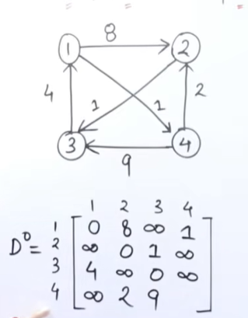
All Pairs Shortest Path Algorithm Floyd Warshall Algorithm

Slide 41
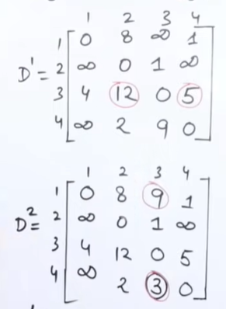

Slide 42
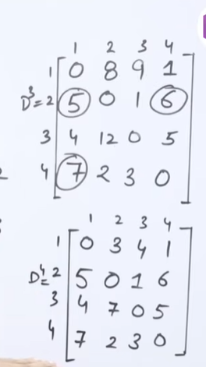

Slide 43

 | 1 | 2 | 3 | 4
1 | 0 | 3 | ∞ | 7
2 | 8 | 0 | 2 | ∞
3 | 5 | ∞ | 0 | 1
4 | 2 | ∞ | ∞ | 0
8
1
2
3
7
2
2
5
4
3
1
 | 1 | 2 | 3 | 4
1 | 0 | 3 | ∞ | 7
2 | 8 | 0 | 2 | ∞
3 | 5 | ∞ | 0 | 1
4 | 2 | ∞ | ∞ | 0
A0

Slide 44
 | 1 | 2 | 3 | 4
1 | 0 | 3 | ∞ | 7
2 | 8 | 0 | 2 | ∞
3 | 5 | ∞ | 0 | 1
4 | 2 | ∞ | ∞ | 0
A0 =
A1 =
 | 1 | 2 | 3 | 4
1 | 0 | 3 | ∞ | 7
2 | 8 | 0
3 | 5 |  | 0
4 | 2 |  |  | 0

Slide 45
A0 =
A1[2.3] A0[2,1] + A0[1,3]
2 8 + ∞ = ∞
A1 =
 | 1 | 2 | 3 | 4
1 | 0 | 3 | ∞ | 7
2 | 8 | 0 | 2 | ∞
3 | 5 | ∞ | 0 | 1
4 | 2 | ∞ | ∞ | 0
 | 1 | 2 | 3 | 4
1 | 0 | 3 | ∞ | 7
2 | 8 | 0 | 2
3 | 5 |  | 0
4 | 2 |  |  | 0

Slide 46
A0 =
A1[2,3] A0[2,1] + A0[1,3]
2 8 + ∞ = ∞
A1[2,4] A0[2,1] + A0[1,4]
∞ 8 + 7 = 15
A1 =
 | 1 | 2 | 3 | 4
1 | 0 | 3 | ∞ | 7
2 | 8 | 0 | 2 | ∞
3 | 5 | ∞ | 0 | 1
4 | 2 | ∞ | ∞ | 0
 | 1 | 2 | 3 | 4
1 | 0 | 3 | ∞ | 7
2 | 8 | 0 | 2 | 15
3 | 5 |  | 0
4 | 2 |  |  | 0

Slide 47
A0 =
A1[2,3] A0[2,1] + A0[1,3]
2 8 + ∞ = ∞
A1[2,4] A0[2,1] + A0[1,4]
∞ 8 + 7 = 15
A1 = A1[3,2] A0[3,1] + A0[1,2]
∞ 5 + 3 = 8
 | 1 | 2 | 3 | 4
1 | 0 | 3 | ∞ | 7
2 | 8 | 0 | 2 | ∞
3 | 5 | ∞ | 0 | 1
4 | 2 | ∞ | ∞ | 0
 | 1 | 2 | 3 | 4
1 | 0 | 3 | ∞ | 7
2 | 8 | 0 | 2 | 15
3 | 5 | 8 | 0
4 | 2 |  |  | 0

Slide 48
A0 =
A1[2,3] A0[2,1] + A0[1,3]
2 8 + ∞ = ∞
A1[2,4] A0[2,1] + A0[1,4]
∞ 8 + 7 = 15
A1 = A1[3,2] A0[3,1] + A0[1,2]
∞ 5 + 3 = 8
A1[3,4] A0[3,1] + A0[1,4]
1 5 + 7 = 12
 | 1 | 2 | 3 | 4
1 | 0 | 3 | ∞ | 7
2 | 8 | 0 | 2 | ∞
3 | 5 | ∞ | 0 | 1
4 | 2 | ∞ | ∞ | 0
 | 1 | 2 | 3 | 4
1 | 0 | 3 | ∞ | 7
2 | 8 | 0 | 2 | 15
3 | 5 | 8 | 0 | 1
4 | 2 |  |  | 0

Slide 49
A0 =
A1[2,3] A0[2,1] + A0[1,3]
2 8 + ∞ = ∞
A1[2,4] A0[2,1] + A0[1,4]
∞ 8 + 7 = 15
A1 = A1[3,2] A0[3,1] + A0[1,2]
∞ 5 + 3 = 8
A1[3,4] A0[3,1] + A0[1,4]
1 5 + 7 = 12
A1[4,2] A0[4,1] + A0[1,2]
∞ 2 + 3 = 5
 | 1 | 2 | 3 | 4
1 | 0 | 3 | ∞ | 7
2 | 8 | 0 | 2 | ∞
3 | 5 | ∞ | 0 | 1
4 | 2 | ∞ | ∞ | 0
 | 1 | 2 | 3 | 4
1 | 0 | 3 | ∞ | 7
2 | 8 | 0 | 2 | 15
3 | 5 | 8 | 0 | 1
4 | 2 | 5 |  | 0

Slide 50
A0 =
A1[2,3] A0[2,1] + A0[1,3]
2 8 + ∞ = ∞
A1[2,4] A0[2,1] + A0[1,4]
∞ 8 + 7 = 15
A1 = A1[3,2] A0[3,1] + A0[1,2]
∞ 5 + 3 = 8
A1[3,4] A0[3,1] + A0[1,4]
1 5 + 7 = 12
A1[4,2] A0[4,1] + A0[1,2]
∞ 2 + 3 = 5
A1[4,3] A0[4,1] + A0[1,3]
∞ 2 + ∞ = ∞
 | 1 | 2 | 3 | 4
1 | 0 | 3 | ∞ | 7
2 | 8 | 0 | 2 | ∞
3 | 5 | ∞ | 0 | 1
4 | 2 | ∞ | ∞ | 0
 | 1 | 2 | 3 | 4
1 | 0 | 3 | ∞ | 7
2 | 8 | 0 | 2 | 15
3 | 5 | 8 | 0 | 1
4 | 2 | 5 | ∞ | 0

Slide 51
 | 1 | 2 | 3 | 4
1 | 0 | 3 | ∞ | 7
2 | 8 | 0 | 2 | 15
3 | 5 | 8 | 0 | 1
4 | 2 | 5 | ∞ | 0
A1 =
A2 =
 | 1 | 2 | 3 | 4
1 | 0 | 3
2 | 8 | 0 | 2 | 15
3 |  | 8 | 0
4 |  | 5 |  | 0

Slide 52
 | 1 | 2 | 3 | 4
1 | 0 | 3 | ∞ | 7
2 | 8 | 0 | 2 | 15
3 | 5 | 8 | 0 | 1
4 | 2 | 5 | ∞ | 0
A1 =
A2[1,3] A1[1,2] + A1[2,3]
∞ 3 + 2 = 5
A2 =
 | 1 | 2 | 3 | 4
1 | 0 | 3 | 5
2 | 8 | 0 | 2 | 15
3 |  | 8 | 0
4 |  | 5 |  | 0

Slide 53
 | 1 | 2 | 3 | 4
1 | 0 | 3 | ∞ | 7
2 | 8 | 0 | 2 | 15
3 | 5 | 8 | 0 | 1
4 | 2 | 5 | ∞ | 0
A1 =
A2[1,3] A1[1,2] + A1[2,3]
∞ 3 + 2 = 5
A2[1,4] A1[1,2] + A1[2,4]
7 3 + 15 = 18
A2 =
 | 1 | 2 | 3 | 4
1 | 0 | 3 | 5 | 7
2 | 8 | 0 | 2 | 15
3 |  | 8 | 0
4 |  | 5 |  | 0

Slide 54
 | 1 | 2 | 3 | 4
1 | 0 | 3 | ∞ | 7
2 | 8 | 0 | 2 | 15
3 | 5 | 8 | 0 | 1
4 | 2 | 5 | ∞ | 0
A1 =
A2[1,3] A1[1,2] + A1[2,3]
∞ 3 + 2 = 5
A2[1,4] A1[1,2] + A1[2,4]
7 3 + 15 = 18
A2 = A2[3,1] A1[3,2] + A1[2,1]
5 8 + 8 = 16
 | 1 | 2 | 3 | 4
1 | 0 | 3 | 5 | 7
2 | 8 | 0 | 2 | 15
3 | 5 | 8 | 0
4 |  | 5 |  | 0

Slide 55
 | 1 | 2 | 3 | 4
1 | 0 | 3 | ∞ | 7
2 | 8 | 0 | 2 | 15
3 | 5 | 8 | 0 | 1
4 | 2 | 5 | ∞ | 0
A1 =
A2[1,3] A1[1,2] + A1[2,3]
∞ 3 + 2 = 5
A2[1,4] A1[1,2] + A1[2,4]
7 3 + 15 = 18
A2 = A2[3,1] A1[3,2] + A1[2,1]
5 8 + 8 = 16
A2[3,4] A1[3,2] + A1[2,4]
1 8 + 15 = 23
 | 1 | 2 | 3 | 4
1 | 0 | 3 | 5 | 7
2 | 8 | 0 | 2 | 15
3 | 5 | 8 | 0 | 1
4 |  | 5 |  | 0

Slide 56
 | 1 | 2 | 3 | 4
1 | 0 | 3 | ∞ | 7
2 | 8 | 0 | 2 | 15
3 | 5 | 8 | 0 | 1
4 | 2 | 5 | ∞ | 0
A1 =
A2[1,3] A1[1,2] + A1[2,3]
∞ 3 + 2 = 5
A2[1,4] A1[1,2] + A1[2,4]
7 3 + 15 = 18
A2 = A2[3,1] A1[3,2] + A1[2,1]
5 8 + 8 = 16
A2[3,4] A1[3,2] + A1[2,4]
1 8 + 15 = 23
A2[4,1] A1[4,2] + A1[2,1]
2 5 + 8 = 13
A2[4,3] A1[4,2] + A1[2,3]
∞ 5 + 2 = 7
 | 1 | 2 | 3 | 4
1 | 0 | 3 | 5 | 7
2 | 8 | 0 | 2 | 15
3 | 5 | 8 | 0 | 1
4 | 2 | 5 | 7 | 0

Slide 57
A3 =
A4 =
 | 1 | 2 | 3 | 4
1 | 0 | 3 | 5 | 6
2 | 7 | 0 | 2 | 3
3 | 5 | 8 | 0 | 1
4 | 2 | 5 | 7 | 0
 | 1 | 2 | 3 | 4
1 | 0 | 3 | 5 | 6
2 | 5 | 0 | 2 | 3
3 | 3 | 6 | 0 | 1
4 | 2 | 5 | 7 | 0

Slide 58
 | 1 | 2 | 3 | 4
1 | 0 | 3 | ∞ | 7
2 | 8 | 0 | 2 | 15
3 | 5 | 8 | 0 | 1
4 | 2 | 5 | ∞ | 0
 | 1 | 2 | 3 | 4
1 | 0 | 3 | 5 | 6
2 | 7 | 0 | 2 | 3
3 | 5 | 8 | 0 | 1
4 | 2 | 5 | 7 | 0
A1 = A3 =
A2 = A4 =
 | 1 | 2 | 3 | 4
1 | 0 | 3 | 5 | 7
2 | 8 | 0 | 2 | 15
3 | 5 | 8 | 0 | 1
4 | 2 | 5 | 7 | 0
 | 1 | 2 | 3 | 4
1 | 0 | 3 | 5 | 6
2 | 5 | 0 | 2 | 3
3 | 3 | 6 | 0 | 1
4 | 2 | 5 | 7 | 0

Slide 59
Single source shortest path Bellman Ford Algorithm

Slide 60
Bellman ford is a single source shortest path algorithm based on the bottom-up approach of dynamic programming. It starts from a single vertex and calculates the shortest path from the starting vertex to all the nodes in a weighted graph.
The main idea behind the working of the bellman ford algorithm is, it begins with a single source and estimates the distance to each node. Initially, the distance is unknown and estimated as infinity, later on the algorithm relaxes those path by finding out few shorter paths. That’s why it is said that the algorithm is based on the “Principle of relaxation”.
To ensure that the obtained result is optimized or not, repeat the steps for all the vertices. If you find any new shorter path for any vertex, this means previous result was not optimized.
Given a weighted graph with V vertices and E edges, and a source vertex src, find the shortest path from the source vertex to all vertices in the given graph. If a vertex cannot be reached from source vertex, mark its distance as infinity.
Note: a graph should not contains negative weight cycle.

Slide 61
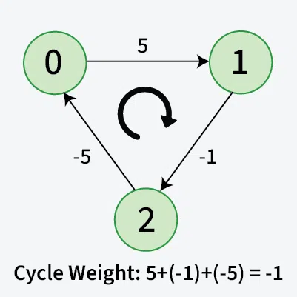
Some concepts related to Bellman Ford Algorithm
Negative weight cycle:
A negative weight cycle is a cycle in a graph, whose sum of edge weights is negative.
If you traverse the cycle, the total weight accumulated would be less than zero.
In the presence of negative weight cycle in the graph, the shortest path doesn’t exist because with each traversal of the cycle shortest path keeps decreasing.
Fig: Negative Weight Cycle

Slide 62
Limitation/Disadvantage of Dijkshtra’s Shortest Path Algorithm (Greedy approach)
It is only used for positive weights
If negative weight in the path then shortest path may be incorrect.
Since, we need to find the single source shortest path, we might initially think of using Dijkstra’s algorithm. However, Dijkstra is not suitable when the graph consists of negative edges. The reason is, it doesn’t revisit those nodes which have already been marked as visited. If a shorter path exists through a longer route with negative edges, Dijkstra’s algorithm will fail to handle it.

Slide 63
Bellman-Ford Algorithm – O(V*E) Time and O(V) Space
Bellman-Ford is a single source shortest path algorithm. It effectively works in the cases of negative edges and is able to detect negative cycles as well. It works on the principle of relaxation of the edges.
Principle of Relaxation of Edges
Relaxation means updating the shortest distance to a node if a shorter path is found through another node. For an edge (u, v) with weight w:
If going through u gives a shorter path to v from the source node (i.e., distance[v] > distance[u] + w), we update the distance[v] as distance[u] + w.
In the bellman-ford algorithm, this process is repeated (V – 1) times for all the edges.

Slide 65
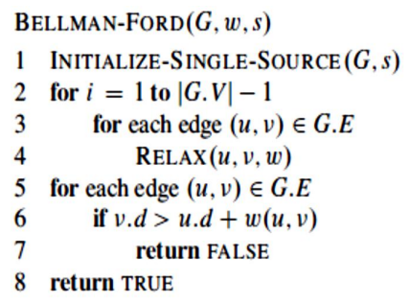
The Bellman-Ford algorithm runs in time O ( VE ) since the initialization in line 1 takes θ ( V ) time, each of the | V | - 1 passes over the edges in lines 2–4 takes time θ ( E ), and the for loop of lines 5–7 takes O ( E ) time.

Slide 66
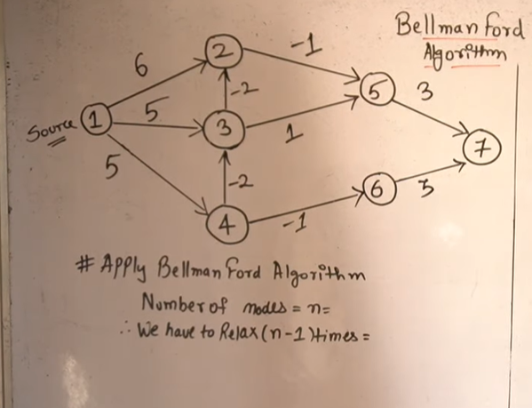
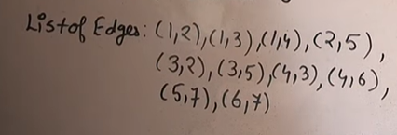

Slide 67
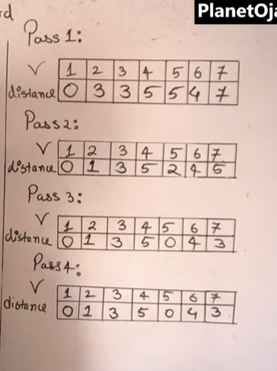

Slide 68
Edges – 1-2, 1-3, 1-4, 2-5, 3-2, 3-5, 4-3, 4-6, 5-7, 6-7 ∞ -1 ∞
2
5
6 -2 1 3
5 ∞ ∞
5 -2 3
∞ -1 ∞
1
3
7
4
6

Slide 69
Edges – 1-2, 1-3, 1-4, 2-5, 3-2, 3-5, 4-3, 4-6, 5-7, 6-7 ∞ 6 -1 ∞
2
5
6 -2 1 3
5 ∞ ∞
5 -2 3
∞ -1 ∞
1
3
7
4
6

Slide 70
Edges – 1-2, 1-3, 1-4, 2-5, 3-2, 3-5, 4-3, 4-6, 5-7, 6-7 ∞ 6 -1 ∞
2
5
6 -2 1 3
5 ∞ 5 ∞
5 -2 3
∞ -1 ∞
1
3
7
4
6

Slide 71
Edges – 1-2, 1-3, 1-4, 2-5, 3-2, 3-5, 4-3, 4-6, 5-7, 6-7 ∞ 6 -1 ∞
2
5
6 -2 1 3
5 ∞ 5 ∞
5 -2 3
∞ 5 -1 ∞
1
3
7
4
6

Slide 72
Edges – 1-2, 1-3, 1-4, 2-5, 3-2, 3-5, 4-3, 4-6, 5-7, 6-7 ∞ 6 -1 ∞ 5
2
5
6 -2 1 3
5 ∞ 5 ∞
5 -2 3
∞ 5 -1 ∞
1
3
7
4
6

Slide 73
Edges – 1-2, 1-3, 1-4, 2-5, 3-2, 3-5, 4-3, 4-6, 5-7, 6-7 3 ∞ 6 -1 ∞ 5
2
5
6 -2 1 3
5 ∞ 5 ∞
5 -2 3
∞ 5 -1 ∞
1
3
7
4
6

Slide 74
Edges – 1-2, 1-3, 1-4, 2-5, 3-2, 3-5, 4-3, 4-6, 5-7, 6-7 3 ∞ 6 -1 ∞ 5
2
5
6 -2 1 3
5 ∞ 5 ∞
5 -2 3
∞ 5 -1 ∞
1
3
7
4
6

Slide 75
Edges – 1-2, 1-3, 1-4, 2-5, 3-2, 3-5, 4-3, 4-6, 5-7, 6-7 3 ∞ 6 -1 ∞ 5
2
5
6 -2 1 3
5 ∞ 5 3 ∞
5 -2 3
∞ 5 -1 ∞
1
3
7
4
6

Slide 76
Edges – 1-2, 1-3, 1-4, 2-5, 3-2, 3-5, 4-3, 4-6, 5-7, 6-7 3 ∞ 6 -1 ∞ 5
2
5
6 -2 1 3
5 ∞ 5 3 ∞
5 -2 3
∞ 5 -1 ∞ 4
1
3
7
4
6

Slide 77
Edges – 1-2, 1-3, 1-4, 2-5, 3-2, 3-5, 4-3, 4-6, 5-7, 6-7 3 ∞ 6 -1 ∞ 5
2
5
6 -2 1 3
5 ∞ 5 3 ∞ 8
5 -2 3
∞ 5 -1 ∞ 4
1
3
7
4
6

Slide 78
Edges – 1-2, 1-3, 1-4, 2-5, 3-2, 3-5, 4-3, 4-6, 5-7, 6-7 3 ∞ 6 -1 ∞ 5
2
5
6 -2 1 3
5 ∞ 5 3 ∞ 8 7
5 -2 3
∞ 5 -1 ∞ 4
1
3
7
4
6

Slide 79
Edges – 1-2, 1-3, 1-4, 2-5, 3-2, 3-5, 4-3, 4-6, 5-7, 6-7 3 ∞ 6 -1 ∞ 5
2
5
6 -2 1 3
5 ∞ 5 3 ∞ 8 7
5 -2 3
∞ 5 -1 ∞ 4
2nd iteration
1
3
7
4
6

Slide 80
Edges – 1-2, 1-3, 1-4, 2-5, 3-2, 3-5, 4-3, 4-6, 5-7, 6-7 3 ∞ 6 -1 ∞ 5
2
5
6 -2 1 3
5 ∞ 5 3 ∞ 8 7
5 -2 3
∞ 5 -1 ∞ 4
2nd iteration
1
3
7
4
6

Slide 81
Edges – 1-2, 1-3, 1-4, 2-5, 3-2, 3-5, 4-3, 4-6, 5-7, 6-7 3 ∞ 6 -1 ∞ 5
2
5
6 -2 1 3
5 ∞ 5 3 ∞ 8 7
5 -2 3
∞ 5 -1 ∞ 4
2nd iteration
1
3
7
4
6

Slide 82
Edges – 1-2, 1-3, 1-4, 2-5, 3-2, 3-5, 4-3, 4-6, 5-7, 6-7 3 ∞ 6 -1 ∞ 5 2
2
5
6 -2 1 3
5 ∞ 5 3 ∞ 8 7
5 -2 3
∞ 5 -1 ∞ 4
2nd iteration
1
3
7
4
6

Slide 83
Edges – 1-2, 1-3, 1-4, 2-5, 3-2, 3-5, 4-3, 4-6, 5-7, 6-7 3 1 ∞ 6 -1 ∞ 5 2
2
5
6 -2 1 3
5 ∞ 5 3 ∞ 8 7
5 -2 3
∞ 5 -1 ∞ 4
2nd iteration
1
3
7
4
6

Slide 84
Edges – 1-2, 1-3, 1-4, 2-5, 3-2, 3-5, 4-3, 4-6, 5-7, 6-7 3 1 ∞ 6 -1 ∞ 5 2
2
5
6 -2 1 3
5 ∞ 5 3 ∞ 8 7
5 -2 3
∞ 5 -1 ∞ 4
2nd iteration
1
3
7
4
6

Slide 85
Edges – 1-2, 1-3, 1-4, 2-5, 3-2, 3-5, 4-3, 4-6, 5-7, 6-7 3 1 ∞ 6 -1 ∞ 5 2
2
5
6 -2 1 3
5 ∞ 5 3 ∞ 8 7
5 -2 3
∞ 5 -1 ∞ 4
2nd iteration
1
3
7
4
6

Slide 86
Edges – 1-2, 1-3, 1-4, 2-5, 3-2, 3-5, 4-3, 4-6, 5-7, 6-7 3 1 ∞ 6 -1 ∞ 5 2
2
5
6 -2 1 3
5 ∞ 5 3 ∞ 8 7
5 -2 3
∞ 5 -1 ∞ 4
2nd iteration
1
3
7
4
6

Slide 87
Edges – 1-2, 1-3, 1-4, 2-5, 3-2, 3-5, 4-3, 4-6, 5-7, 6-7 3 1 ∞ 6 -1 ∞ 5 2
2
5
6 -2 1 3
5 ∞ 5 3 ∞ 8 7 5
5 -2 3
∞ 5 -1 ∞ 4
2nd iteration
1
3
7
4
6

Slide 88
Edges – 1-2, 1-3, 1-4, 2-5, 3-2, 3-5, 4-3, 4-6, 5-7, 6-7 3 1 ∞ 6 -1 ∞ 5 2
2
5
6 -2 1 3
5 ∞ 5 3 ∞ 8 7 5
5 -2 3
∞ 5 -1 ∞ 4
2nd iteration
1
3
7
4
6

Slide 89
Edges – 1-2, 1-3, 1-4, 2-5, 3-2, 3-5, 4-3, 4-6, 5-7, 6-7 3 1 ∞ 6 -1 ∞ 5 2
2
5
6 -2 1 3
5 ∞ 5 3 ∞ 8 7 5
5 -2 3
∞ 5 -1 ∞ 4
3rd iteration
1
3
7
4
6

Slide 90
Edges – 1-2, 1-3, 1-4, 2-5, 3-2, 3-5, 4-3, 4-6, 5-7, 6-7 3 1 ∞ 6 -1 ∞ 5 2
2
5
6 -2 1 3
5 ∞ 5 3 ∞ 8 7 5
5 -2 3
∞ 5 -1 ∞ 4
3rd iteration
1
3
7
4
6

Slide 91
Edges – 1-2, 1-3, 1-4, 2-5, 3-2, 3-5, 4-3, 4-6, 5-7, 6-7 3 1 ∞ 6 -1 ∞ 5 2 0
2
5
6 -2 1 3
5 ∞ 5 3 ∞ 8 7 5
5 -2 3
∞ 5 -1 ∞ 4
3rd iteration
1
3
7
4
6

Slide 92
Edges – 1-2, 1-3, 1-4, 2-5, 3-2, 3-5, 4-3, 4-6, 5-7, 6-7 3 1 ∞ 6 -1 ∞ 5 2 0
2
5
6 -2 1 3
5 ∞ 5 3 ∞ 8 7 5
5 -2 3
∞ 5 -1 ∞ 4
3rd iteration
1
3
7
4
6

Slide 93
Edges – 1-2, 1-3, 1-4, 2-5, 3-2, 3-5, 4-3, 4-6, 5-7, 6-7 3 1 ∞ 6 -1 ∞ 5 2 0
2
5
6 -2 1 3
5 ∞ 5 3 ∞ 8 7 5
3
5 -2 3
∞ 5 -1 ∞ 4
3rd iteration
1
3
7
4
6

Slide 94
Edges – 1-2, 1-3, 1-4, 2-5, 3-2, 3-5, 4-3, 4-6, 5-7, 6-7 3 1 ∞ 6 -1 ∞ 5 2 0
2
5
6 -2 1 3
5 ∞ 5 3 ∞ 8 7 5
3
5 -2 3
∞ 5 -1 ∞ 4
3rd iteration
1
3
7
4
6

Slide 95
Edges – 1-2, 1-3, 1-4, 2-5, 3-2, 3-5, 4-3, 4-6, 5-7, 6-7 3 1 ∞ 6 -1 ∞ 5 2 0
2
5
6 -2 1 3
5 ∞ 5 3 ∞ 8 7 5
3
5 -2 3
∞ 5 -1 ∞ 4
4th iteration No Change
1
3
7
4
6

Slide 96
Edges – 1-2, 1-3, 1-4, 2-5, 3-2, 3-5, 4-3, 4-6, 5-7, 6-7 3 1 ∞ 6 -1 ∞ 5 2 0
2
5
6 -2 1 3
5 ∞ 5 3 ∞ 8 7 5
3
5 -2 3
∞ 5 -1 ∞ 4
5th , 6th iteration No Change
1
3
7
4
6

Slide 97
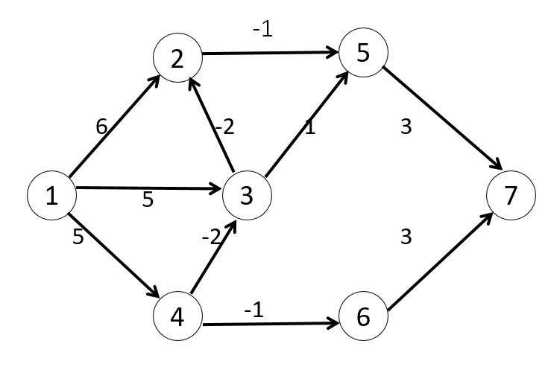
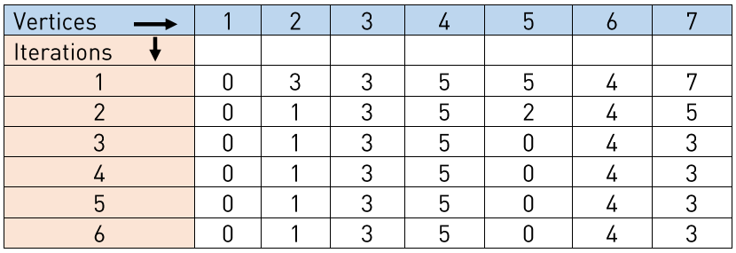

Slide 99
Travelling salesman problem
Given a 2d matrix cost[][] of size n where cost[i][j] denotes the cost of moving from city i to city j.
The task is to complete a tour from city 1 (based index) to all other cities such that we visit each city exactly once and then at the end come back to city 1 at minimum cost.
Analysis
There are at the most 2^{n}.n sub-problems and each one takes linear time to solve. Therefore, the total running time is O(2^{n}.n²).

Slide 100
Let us consider a graph G = (V,E), where V is a set of cities and E is a set of weighted edges. An edge e(u, v) represents that vertices u and v are connected. Distance between vertex u and v is d(u, v), which should be non-negative.
Suppose we have started at city 1 and after visiting some cities now we are in city j. Hence, this is a partial tour. We certainly need to know j, since this will determine which cities are most convenient to visit next. We also need to know all the cities visited so far, so that we don't repeat any of them. Hence, this is an appropriate sub-problem.
For a subset of cities S ϵϵ {1,2,3,...,n} that includes 1, and j ϵϵ S, let C(S, j) be the length of the shortest path visiting each node in S exactly once, starting at 1 and ending at j.
When |S|> 1 , we define C(S,1)= ∝ since the path cannot start and end at 1.
Now, let express C(S, j) in terms of smaller sub-problems. We need to start at 1 and end at j. We should select the next city in such a way that

Slide 101
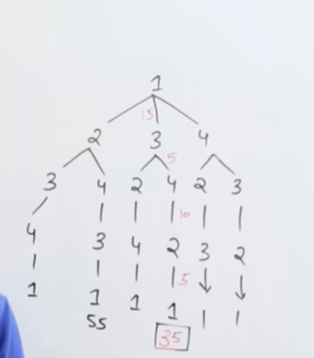
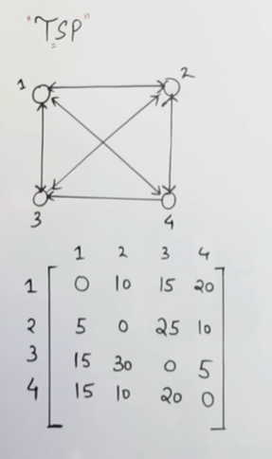
https://www.youtube.com/watch?v=Q4zHb-Swzro
Travelling Salesperson Problem

Slide 102
Longest Common Subsequence
Given two strings, s1 and s2, the task is to find the length of the Longest Common Subsequence. If there is no common subsequence, return 0. A subsequence is a string generated from the original string by deleting 0 or more characters, without changing the relative order of the remaining characters.
For example, subsequences of “ABC” are “”, “A”, “B”, “C”, “AB”, “AC”, “BC” and “ABC”. In general, a string of length n has 2^{n} subsequences.
Examples:
Input: s1 = “ABC”, s2 = “ACD” Output: 2 Explanation: The longest subsequence which is present in both strings is “AC”.
Input: s1 = “AGGTAB”, s2 = “GXTXAYB” Output: 4 Explanation: The longest common subsequence is “GTAB”.
Input: s1 = “ABC”, s2 = “CBA” Output: 1 Explanation: There are three longest common subsequences of length 1, “A”, “B” and “C”.

Slide 103
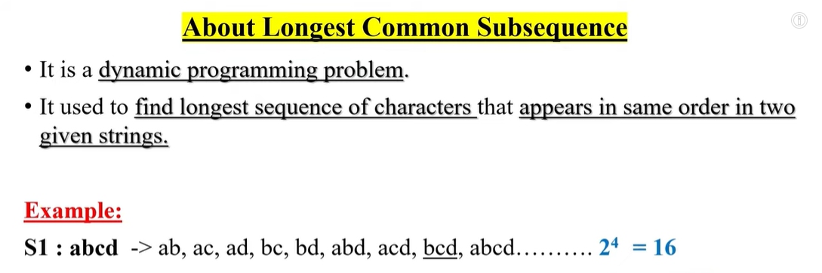

Slide 104
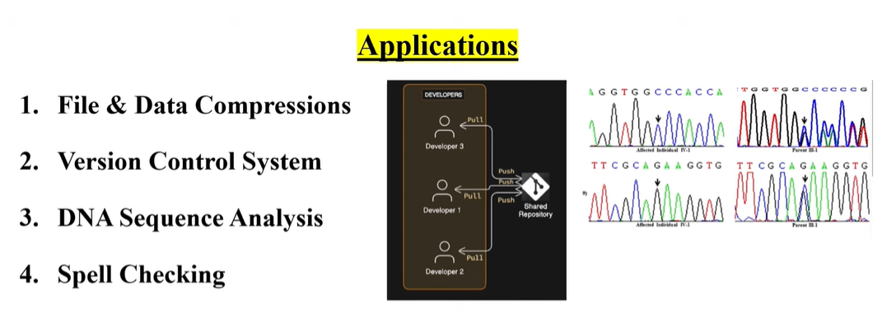

Slide 105
