Slide 1
Unit 4 Backtracking and Branch & Bound

Slide 2
Backtracking – Introduction
Backtracking is an algorithmic technique for solving problems recursively.
It tries to build a solution step by step.
If a step leads to an invalid solution, the algorithm goes back (backtracks) and tries another option.

Slide 3
Key Idea of Backtracking
1. Build solution step by step
2. Check if the current step is valid
3. If not valid, go back and try another possibility
4. Continue until all solutions are found

Slide 4
Applications of Backtracking
N-Queen Problem
Sudoku Solver
Hamiltonian Cycle
Subset Generation
Permutation Problems

Slide 5
N-Queen Problem – Definition
Place N queens on an N×N chessboard so that:
• No two queens attack each other
Conditions:
• No same row
• No same column
• No same diagonal

Slide 6
Example: 4-Queen Problem
Board Size: 4 × 4
We must place 4 queens so that none attack each other.
Backtracking tries different column positions in each row.

Slide 7
4-Queen One Valid Solution
Q . . .
. . Q .
. . . .
. Q . .
Another common valid arrangement also exists.

Slide 8
Steps of Backtracking in N-Queen
1. Place queen in first row
2. Move to next row and try safe column
3. If conflict occurs, try next column
4. If no column works, backtrack to previous row

Slide 9
Advantages
Efficient pruning of invalid solutions
Systematic search for solutions
Used in many combinatorial problems

Slide 10
Algorithm to solve the n queen problem:
Start with an empty chessboard of size n x n.
Place the first queen in the top-left corner of the board (i.e., row 1, column 1).
Move to the next row and try to place a queen in each column until a valid position is found or all columns have been tried.
If a valid position is found, move to the next row and repeat step 3.
If all columns have been tried in the current row without finding a valid position, backtrack to the previous row and move the queen to the next column in that row. Repeat step 3.
If all rows have been tried without finding a solution, backtrack to the previous row and move the queen to the next column in that row. Repeat step 3.
If a solution is found, print the positions of the queens on the board and exit the program.

Slide 11
Q
Q

Slide 12
Q
X
Q
X | X

Slide 13
Q
X | X | Q
Q
X | X | Q

Slide 14
We stuck!!! Backtrack
Q
X | X | Q
X | X | X | X

Slide 15
Q
X | X | Q | Q
Failed to get Solution @ Q
hence backtrack and go for next option Q

Slide 16
Q
X | X | X | Q
X | Q
Successfully placed queen in 3rd row go for next row

Slide 17
Q
X | X | X | Q
X | Q
X | X | X | X
Cant place queen in 4th row backtrack

Slide 18
Q
X | X | X | Q
X | Q | X | X
As we have backtrack to 3rd row go for next option in 3rd row but we can’t hence again Backtrack to previous row

Slide 19
Q
X | X | X | Q
As we have backtrack to 2nd row go for next option in 2rd row but we can’t hence again Backtrack to previous row

Slide 20
Q
As we have backtrack to 1st row go for next option in 1st row

Slide 21
 | Q
As we have backtrack to 1st row go for next option in 1st row

Slide 22
 | Q
X | X | X | Q
Try to place queen in 2nd row
Successfully placed hence go for next row

Slide 23
 | Q
X | X | X | Q
Q
Try to place queen in 3rd row
Successfully placed hence go for next row

Slide 24
 | Q
X | X | X | Q
Q
X | X | Q
4th queen is placed in 4th row
Successfully

Slide 25
Q
Q
X
Q
X | X
Q
X | X | Q
Q
X | X | Q
X | X | X | X
Q
X | X | X | Q
X | Q
Q
X | X | X | Q
X | Q | X | X
 | Q
Backtrack !!!
 | Q
X | X | X | Q
 | Q
X | X | X | Q
Q
 | Q
X | X | X | Q
Q
X | X | Q
 |  | Q
Q
 |  |  | Q
 | Q

Slide 26
And we get two solutions as follow
a solution is (2, 4, 1, 3)
a solution is (3, 1, 4, 2)
 | Q
 |  |  | Q
Q
 |  | Q
 |  | Q
Q
 |  |  | Q
 | Q

Slide 27
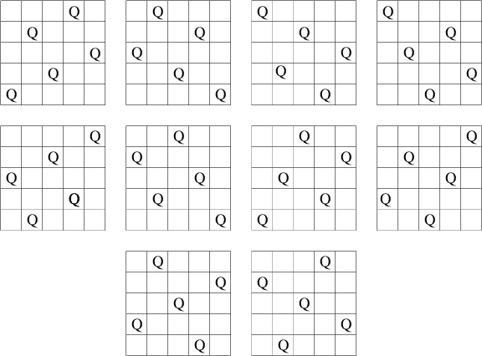
Homework:
Give the solution to 5-Queen problem: 10 solutions are available
Also draw the state space tree.

Slide 28
8 queens problems
The 8-Queens problem consist of placing four queens on a 8x8 chessboard such that no two queen’s attacks each other.
Explicit Constraints : 8 queens on 8X8 chessboard
Implicit Constraints :
No two queens on same row
No two queens on same column
No two queens on same diagonal

Slide 29
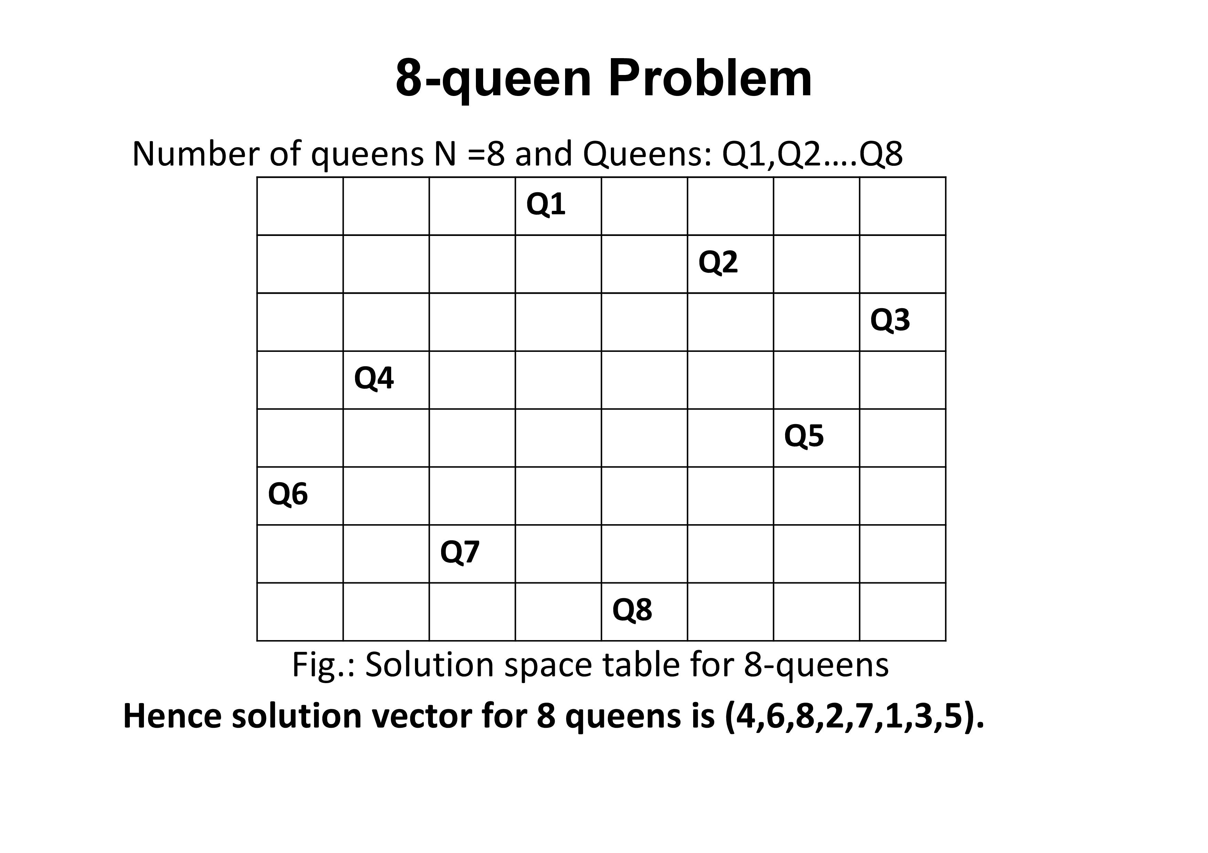

Slide 30
 | 1 | 2 | 3 | 4 | 5 | 6 | 7 | 8
1
2
3
4 |  | Q4
5
6
7
8

Slide 31
Col
 | 1 | 2 | 3 | 4 | 5 | 6 | 7 | 8
1
2
3
4 |  | Q4
5
6
7
8
Row

Slide 32
1st Diagonal Coordinates - {3,1} {4,2} {5,3} {6,4} {7,5} {8,6}
Col
 | 1 | 2 | 3 | 4 | 5 | 6 | 7 | 8
1
2
3
4 |  | Q4
5
6
7
8
Row

Slide 33
2nd Diagonal Coordinates - {1,5} {2,4} {3,3} {4,2} {5,1}
Col
 | 1 | 2 | 3 | 4 | 5 | 6 | 7 | 8
1
2
3
4 |  | Q4
5
6
7
8
Row

Slide 34
1st Diagonal Coordinates - {3,1} {4,2} {5,3} {6,4} {7,5} {8,6}
General Formula : row – column = 2
Col
 | 1 | 2 | 3 | 4 | 5 | 6 | 7 | 8
1
2
3
4 |  | Q4
5
6
7
8
Row

Slide 35
2nd Diagonal Coordinates - {1,5} {2,4} {3,3} {4,2} {5,1}
General Formula : row + column = same
Col
 | 1 | 2 | 3 | 4 | 5 | 6 | 7 | 8
1
2
3
4 |  | Q4
5
6
7
8
Row

Slide 36
Sum of Subset
Suppose we are given n distinct positive numbers (usually called weights) and we desire to find all combinations of these numbers whose sum is M. This is called the sum of subsets problem.

Slide 37
Example
https://www.youtube.com/watch?v=kyLxTdsT8ws
N=4, w= {11, 13, 24, 7}
M= 31
Desired sets – {11, 13, 7} = 31
- {24, 7 } = 31
{1, 2, 3, 4} and w= 7
Solution Vector – {1, 2, 4} and {3, 4}
along with this {1, 4, 2} can also be solution
to avoid this repetition we have to set implicit
constraint for this

Slide 38
Example
N=6
W={5, 10, 12, 13, 15, 18}
M= 30
X1 | X2 | X3 | X4 | X5 | X6 | Total
5 | 10 | 12 | 13 | 15 | 18 | 73

Slide 39
Current wt | level | total
0 | 1 | 73
X1 | X2 | X3 | X4 | X5 | X6 | Total
5 | 10 | 12 | 13 | 15 | 18 | 73

Slide 40
Current wt | level | total
0 | 1 | 73
X1 | X2 | X3 | X4 | X5 | X6 | Total
5 | 10 | 12 | 13 | 15 | 18 | 73

Slide 41
Current wt | level | Rem
0 | 1 | 73
X1 | X2 | X3 | X4 | X5 | X6 | Total
5 | 10 | 12 | 13 | 15 | 18 | 73
X1=1
X1=0
5 | 2 | 68
0 | 2 | 68

Slide 42
Current wt | level | total
0 | 1 | 73
X1 | X2 | X3 | X4 | X5 | X6 | Total
5 | 10 | 12 | 13 | 15 | 18 | 73
X1=1
X1=0
5 | 2 | 68
0 | 2 | 68
0+5=5
73-5=68
0+0=0
73-5=68

Slide 43
Current wt | level | total
0 | 1 | 73
X1 | X2 | X3 | X4 | X5 | X6 | Total
5 | 10 | 12 | 13 | 15 | 18 | 73
X1=1
X1=0
5 | 2 | 68
0 | 2 | 68

Slide 44
Current wt | level | total
0 | 1 | 73
X1 | X2 | X3 | X4 | X5 | X6 | Total
5 | 10 | 12 | 13 | 15 | 18 | 73
X1=1
5 | 2 | 68

Slide 45
Current wt | level | total
0 | 1 | 73
X1 | X2 | X3 | X4 | X5 | X6 | Total
5 | 10 | 12 | 13 | 15 | 18 | 73
X1=1
5 + 10=15
5 | 2 | 68
68-10=58
X2=1
15 | 3 | 58

Slide 46
Current wt | level | total
0 | 1 | 73
X1 | X2 | X3 | X4 | X5 | X6 | Total
5 | 10 | 12 | 13 | 15 | 18 | 73
X1=1
5 | 2 | 68
X2=1
15 | 3 | 58

Slide 47
Current wt | level | total
0 | 1 | 73
X1 | X2 | X3 | X4 | X5 | X6 | Total
5 | 10 | 12 | 13 | 15 | 18 | 73
X1=1
5 | 2 | 68
X2=1
15 | 3 | 58
X3=1
27 | 3 | 46

Slide 48
Current wt | level | total
0 | 1 | 73
X1 | X2 | X3 | X4 | X5 | X6 | Total
5 | 10 | 12 | 13 | 15 | 18 | 73
X1=1
5 | 2 | 68
X2=1
15 | 3 | 58
X3=1
27 | 4 | 46
X4=1
40

Slide 49
Current wt | level | total
0 | 1 | 73
X1 | X2 | X3 | X4 | X5 | X6 | Total
5 | 10 | 12 | 13 | 15 | 18 | 73
X1=1
5 | 2 | 68
X2=1
15 | 3 | 58
X3=1
27 | 4 | 46
X4=1
40

Slide 50
Current wt | level | total
0 | 1 | 73
X1 | X2 | X3 | X4 | X5 | X6 | Total
5 | 10 | 12 | 13 | 15 | 18 | 73
X1=1
5 | 2 | 68
X2=1
15 | 3 | 58
X3=1
27 | 4 | 46
X4=1
X4=0
40
27 | 5 | 33

Slide 51
Current wt | level | total
0 | 1 | 73
X1 | X2 | X3 | X4 | X5 | X6 | Total
5 | 10 | 12 | 13 | 15 | 18 | 73
X1=1
5 | 2 | 68
X2=1
15 | 3 | 58
X3=1
27 | 4 | 46
X4=0
27 | 5 | 33
X5=1
42

Slide 52
Current wt | level | total
0 | 1 | 73
X1 | X2 | X3 | X4 | X5 | X6 | Total
5 | 10 | 12 | 13 | 15 | 18 | 73
X1=1
5 | 2 | 68
X2=1
15 | 3 | 58
X3=1
27 | 4 | 46
X4=0
27 | 5 | 33
X5=1
42

Slide 53
Current wt | level | total
0 | 1 | 73
X1 | X2 | X3 | X4 | X5 | X6 | Total
5 | 10 | 12 | 13 | 15 | 18 | 73
X1=1
5 | 2 | 68
X2=1
15 | 3 | 58
X3=1
27 | 4 | 46
X4=0
27 | 5 | 33
X5=1
X5=0
42
27 | 6 | 18

Slide 54
Current wt | level | total
0 | 1 | 73
X1 | X2 | X3 | X4 | X5 | X6 | Total
5 | 10 | 12 | 13 | 15 | 18 | 73
X1=1
5 | 2 | 68
X2=1
15 | 3 | 58
X3=1
27 | 4 | 46
X4=0
27 | 5 | 33
X5=0
27 | 6 | 18
X6=1
46

Slide 55
Current wt | level | total
0 | 1 | 73
X1 | X2 | X3 | X4 | X5 | X6 | Total
5 | 10 | 12 | 13 | 15 | 18 | 73
X1=1
5 | 2 | 68
X2=1
15 | 3 | 58
X3=1
27 | 4 | 46
X4=0
27 | 5 | 33
X5=0
27 | 6 | 18
X6=0
27 | 7 | 0

Slide 56
Current wt | level | total
0 | 1 | 73
X1 | X2 | X3 | X4 | X5 | X6 | Total
5 | 10 | 12 | 13 | 15 | 18 | 73
X1=1
5 | 2 | 68
X2=1
15 | 3 | 58
X3=1
X3=0
27 | 4 | 46
15 | 4 | 46
X4=0
27 | 5 | 33
X5=0
27 | 6 | 18

Slide 57
Current wt | level | total
0 | 1 | 73
X1 | X2 | X3 | X4 | X5 | X6 | Total
5 | 10 | 12 | 13 | 15 | 18 | 73
X1=1
5 | 2 | 68
X2=1
15 | 3 | 58
X3=1
X3=0
27 | 4 | 46
15 | 4 | 46
X4=0
X4=1
27 | 5 | 33
28 | 5 | 33
X5=0
27 | 6 | 18

Slide 58
Current wt | level | total
0 | 1 | 73
X1 | X2 | X3 | X4 | X5 | X6 | Total
5 | 10 | 12 | 13 | 15 | 18 | 73
X1=1
5 | 2 | 68
X2=1
15 | 3 | 58
X3=1
X3=0
27 | 4 | 46
15 | 4 | 46
X4=0
X4=1
27 | 5 | 33
28 | 5 | 33
X5=0
X5=1
27 | 6 | 18
43

Slide 59
Current wt | level | total
0 | 1 | 73
X1 | X2 | X3 | X4 | X5 | X6 | Total
5 | 10 | 12 | 13 | 15 | 18 | 73
X1=1
5 | 2 | 68
X2=1
15 | 3 | 58
X3=1
X3=0
27 | 4 | 46
15 | 4 | 46
X4=0
X4=1
27 | 5 | 33
28 | 5 | 33
X5=0
X5=1
X5=0
27 | 6 | 18
43
28 | 6 | 18

Slide 60
Current wt | level | total
0 | 1 | 73
X1 | X2 | X3 | X4 | X5 | X6 | Total
5 | 10 | 12 | 13 | 15 | 18 | 73
X1=1
5 | 2 | 68
X2=1
15 | 3 | 58
X3=1
X3=0
27 | 4 | 46
15 | 4 | 46
X4=0
X4=1
27 | 5 | 33
28 | 5 | 33
X5=0
X5=1
X5=0
27 | 6 | 18
43
28 | 6 | 18
X6=1
46

Slide 61
Current wt | level | total
0 | 1 | 73
X1 | X2 | X3 | X4 | X5 | X6 | Total
5 | 10 | 12 | 13 | 15 | 18 | 73
X1=1
5 | 2 | 68
X2=1
15 | 3 | 58
X3=1
X3=0
27 | 4 | 46
15 | 4 | 46
X4=0
X4=1
X4=0
27 | 5 | 33
28 | 5 | 33
15 | 5 | 33
X5=0
X5=0
27 | 6 | 18
28 | 6 | 18

Slide 62
Current wt | level | total
0 | 1 | 73
X1 | X2 | X3 | X4 | X5 | X6 | Total
5 | 10 | 12 | 13 | 15 | 18 | 73
X1=1
5 | 2 | 68
X2=1
15 | 3 | 58
X3=1
X3=0
27 | 4 | 46
15 | 4 | 46
X4=0
X4=1
X4=0
27 | 5 | 33
28 | 5 | 33
15 | 5 | 33
X5=0
X5=0
X5=1
27 | 6 | 18
28 | 6 | 18
30 | 6 | 3
Sol → {X1,X2,X3,X4,X5}{ 1, 1, 0, 0, 1}

Slide 63
{1,0,1,1}
{1,1,0,0,1}
{0,0,1,0,0,1}

Slide 64
N= 4
W= { 1, 3, 4, 5 }
M= 8

Slide 65
Graph Colouring Problem
Graph coloring refers to the problem of coloring vertices of a graph in such a way that no two adjacent vertices have the same color. This is also called the vertex coloring problem. If coloring is done using at most m colors, it is called m-coloring.
m-colourability problem: In the M-Coloring problem, our task is to find if it is possible to assign nodes of a given graph with m different colors, such that no two adjacent vertices of the graph are of the same colors.
m-colourability decision problem
chromatic number: The chromatic number of a graph G, denoted as χ(G), is the minimum number of colors required to color the vertices of a graph G in such a way that no two adjacent vertices share the same color. Formally, it is the smallest positive integer k for which there exists a proper vertex coloring with k colors.
Graph should be Planner graph: edges should not intersect each other

Slide 69
State space tree for graph colouring problem of 4 node graph

Slide 70
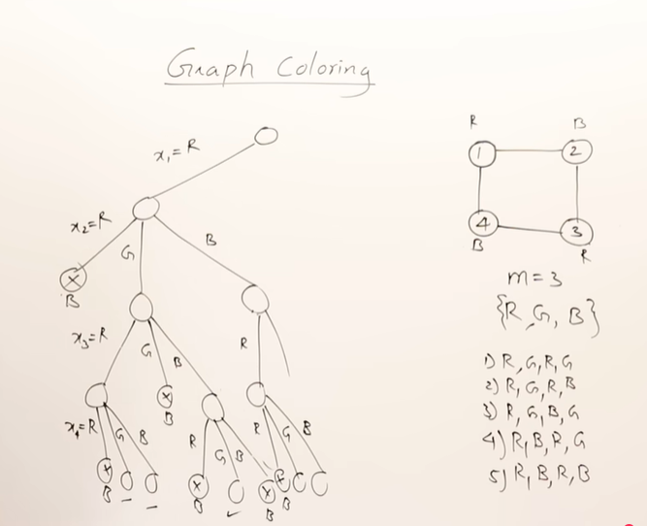

Slide 71
Example of graph coloring only for your understanding:
(in exam you have to write algorithm and draw state space tree only.)
Do not use different color pens in exam
A
B
F
C
E
D

Slide 72
R
A
B
F
C
E
D

Slide 73
R
G
A
B
F
C
E
D

Slide 74
R
G
R
A
B
F
C
E
D

Slide 75
R
G
R
G
A
B
F
C
E
D

Slide 76
R
G
R B
G
A
B
F
C
E
D

Slide 77
R
G
R B
G
Fourth colour required for node ‘F’
hence Backtrack!!! to previous step i.e node ‘D’
A
B
F
C
E
D

Slide 78
R
G
R
G
For node ‘G’ green is already used, cant use Red
Hence go for new color
A
B
F
C
E
D

Slide 79
R
G
R
B
A
B
F
C
E
D

Slide 80
R
G
R G
B
A
B
F
C
E
D

Slide 81
R
G B
R G
B
A
B
F
C
E
D

Slide 82
Branch and Bound
It uses BFS (breadth first search)
The B&B strategy is very similar to backtracking in that a state space tree is used to solve a problem.
Does not limit us to any particular way of traversing the tree.
Branch and Bound is the generalization of both graph search strategies, BFS and DFS.
A BFS (queue) like state space search is called as FIFO (First in first out)
A BFS (stack) like state space search is called as LIFO (last in first out)
It is used only for optimization problem
B&B is rather general optimization technique that applies where the greedy method & dynamic programming fail.

Slide 83
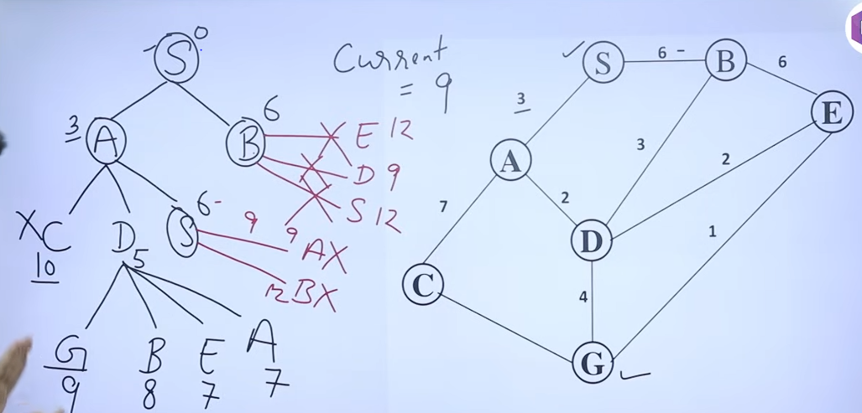
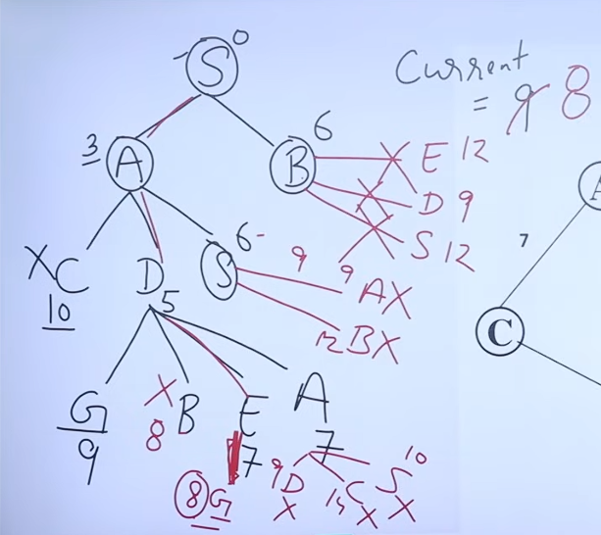

Slide 84
There are 3 types of search strategies:
1. FIFO (First In First Out)
2. LIFO (Last In First Out)
3. LC (Least Cost) Search

Slide 85
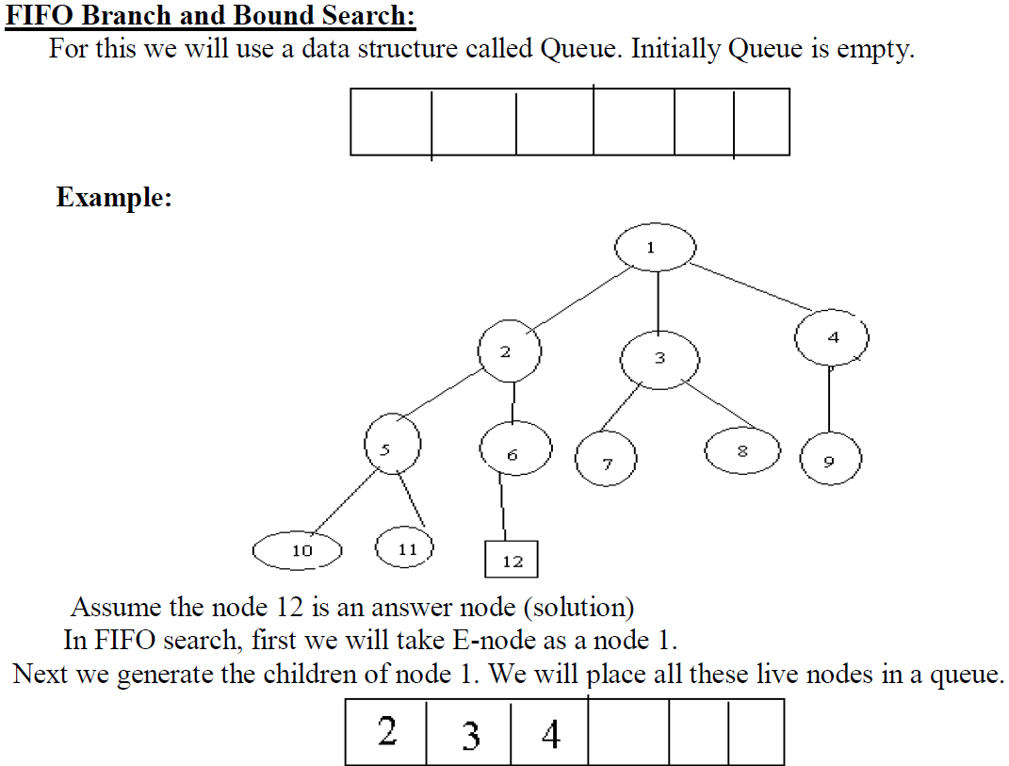

Slide 86
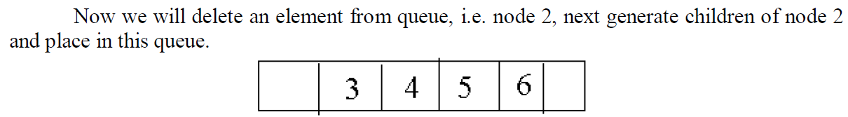
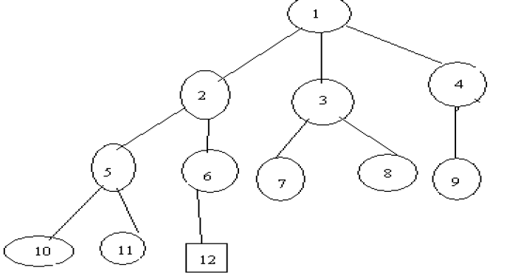
FIFO Branch and Bound
Data Structure: Queue.
Behavior: Explores the tree level-by-level.
Pros: Guarantees finding the shortest path first if cost is based on depth.
Cons: Uses more memory and can be slow in large trees.

Slide 87
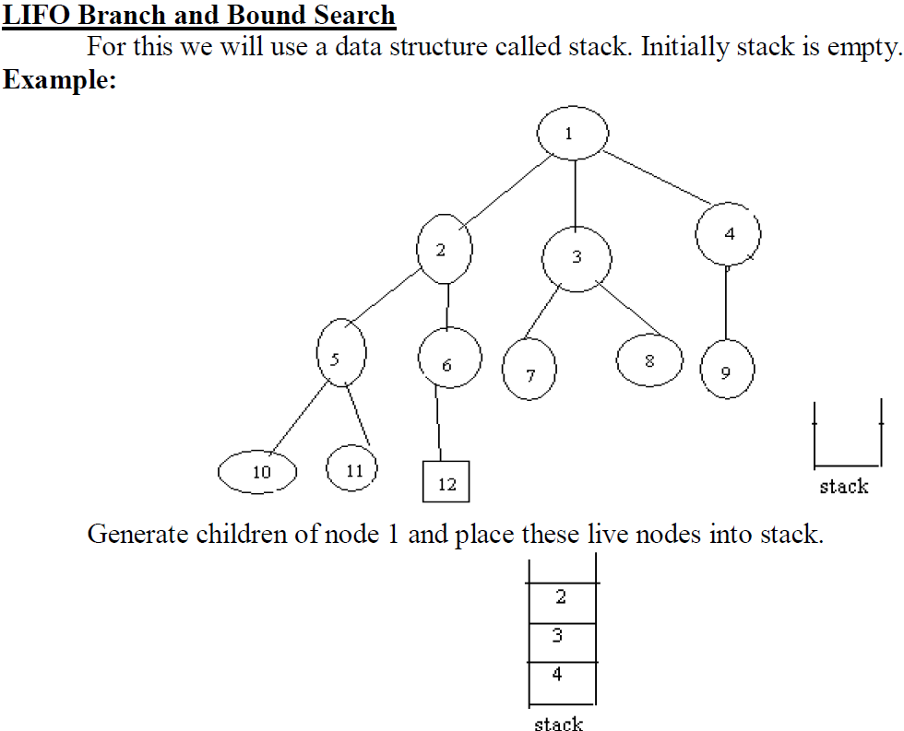

Slide 88
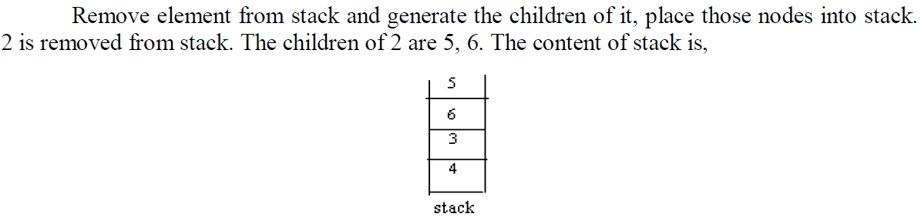
LIFO Branch and Bound
Data Structure: Stack.
Behavior: Dives deep into the tree before backtracking.
Pros: Fast at finding a solution; uses less memory.
Cons: May not find optimal solution early; more backtracking required.

Slide 89
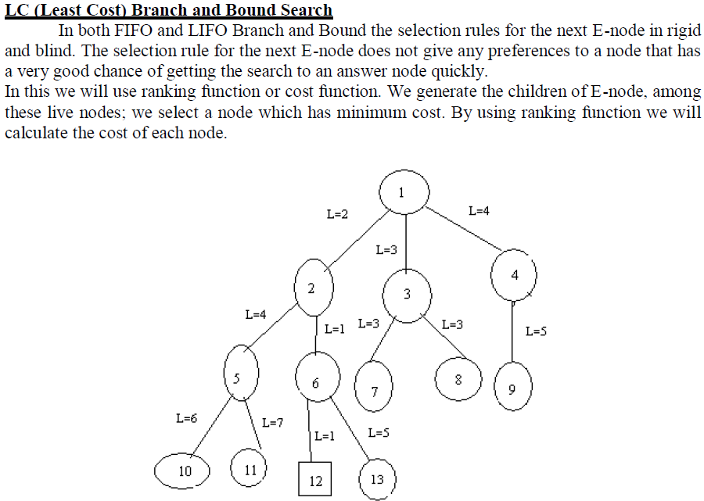

Slide 90
Least Cost (LC) Branch and Bound
Data Structure: Priority Queue.
Behavior: Selects the next node with the lowest cost estimate (bound).
Pros: Efficient in finding the optimal solution faster by pruning unpromising paths.
Cons: More complex to implement; requires good cost estimation (bounding function).

Slide 91
Feature | FIFO Branch and Bound | LIFO Branch and Bound | Least Cost Branch and Bound
Queue Type | Queue (FIFO) | Stack (LIFO) | Priority Queue (based on cost estimate)
Node Selection Strategy | First node added is explored first | Last node added is explored first | Node with least estimated cost (bound) is explored first
Search Order | Breadth-First Search (BFS) | Depth-First Search (DFS) | Best-First Search
Space Complexity | High | Low | Moderate to High (depends on queue size)
Time Efficiency | May explore many irrelevant nodes | Can reach solutions quickly but may not be optimal early | Often finds optimal solutions faster
Suitability | Good when solution is shallow in tree | Good for deeper solutions with tighter constraints | Best for optimization problems needing early pruning
Example Use Cases | Simple decision trees, constraint satisfaction | Puzzles, backtracking-based problems | TSP, Knapsack, Job scheduling

