Slide 1
String Matching Algorithms
Unit-V 03 Hrs.
String Matching Algorithms:
The naive string-matching algorithm,
The Rabin Karp algorithm,
String matching with finite automata,
The Knuth Morris Pratt algorithm

Slide 2
String-Matching Problem
Elements of T and P are characters from a finite alphabet ∑
E.g., ∑ = {0, 1} or ∑ = {a, b, …, z}
Usually T and P are called strings of characters
The text is in an array T [1..n] of length n
The pattern is in an array P [1..m] of length m

Slide 3
We say that pattern P occurs with shift s in text T if:
T.length - P.length
0 ≤ s ≤ n-m and
T [(s+1)..(s+m)] = P [1..m]
If P occurs with shift s in T, then s is a valid shift,
otherwise s is an invalid shift
String-matching problem: finding all valid shifts for a given T and P

Slide 4
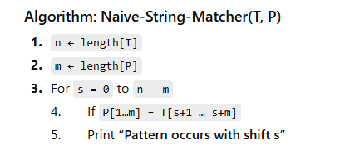

Slide 5
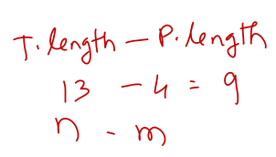
The Naive String Matching Algorithm
0
1
2
3
4
5
6
7
8
9
10
11
12
text T
a | b | c | a | b | a | a | b | c | a | b | a | c
pattern P
a | b | a | a
0
1
2
3

Slide 6
The Naive String Matching Algorithm
0
1
2
3
4
5
6
7
8
9
10
11
12
text T
a | b | c | a | b | a | a | b | c | a | b | a | c
s = 0
pattern P
a | b | a | a
0
1
2
3
shift s = 0 is a invalid shift

Slide 7
The Naive String Matching Algorithm
0
1
2
3
4
5
6
7
8
9
10
11
12
text T
a | b | c | a | b | a | a | b | c | a | b | a | c
s = 1
pattern P
a | b | a | a
0
1
2
3
shift s = 1 is a invalid shift

Slide 8
The Naive String Matching Algorithm
0
1
2
3
4
5
6
7
8
9
10
11
12
text T
a | b | c | a | b | a | a | b | c | a | b | a | c
s = 2
pattern P
a | b | a | a
0
1
2
3
shift s = 2 is a invalid shift

Slide 9
The Naive String Matching Algorithm
0
1
2
3
4
5
6
7
8
9
10
11
12
text T
a | b | c | a | b | a | a | b | c | a | b | a | c
s = 3
pattern P
a | b | a | a
0
1
2
3
shift s = 3 is a valid shift
(n=13, m=4 and 0 ≤ s ≤ n-m holds)

Slide 10
0
1
2
3
4
5
6
7
8
9
10
11
12
text T
a | b | c | a | b | a | a | b | c | a | b | a | a
shift s = 9 is a valid shift
(n=13, m=4 and 0 ≤ s ≤ n-m holds)
s = 9
a
b
a
a
0
1
2
3

Slide 11
pattern P
a
b
a
a
0
1
2
3
4
5
6
7
8
9
10
11
12
text T
a | b | c | a | b | a | a | b | c | a | b | a | a
s = 3
a | b | a | a
0
1
2
3
s = 9
a
b
a
a
0
1
2
3

Slide 12
Naïve String-Matching Algorithm
The naive algorithm finds all valid shifts using a loop that checks the condition P[1..m] = T [(s+1)..(s+m)] for each of the n - m + 1 possible values of s.
Input: Text strings T [1..n] and P[1..m]
Result: All valid shifts displayed
NAÏVE-STRING-MATCHER (T, P)
n ← length[T]
m ← length[P]
for s ← 0 to (n-m)
if P[1….m] = T [ (s+1)….(s+m) ]
print “pattern occurs with shift” s

Slide 13
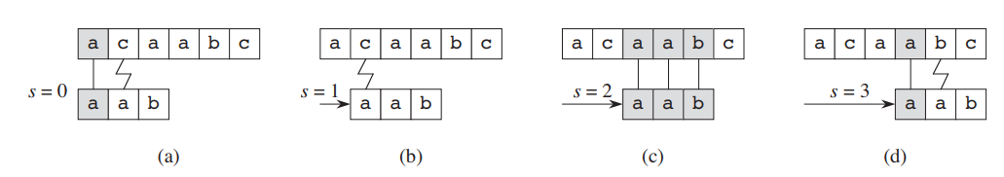

Slide 14
Analysis: Worst-case Example
0
1
2
3
pattern P
a
a
a
a
0
1
2
3
4
5
6
7
8
9
10
11
12
text T
a | a | a | a | a | a | a | a | a | a | a | a | a
a
a
a
a
a
a
a
a

Slide 15
Analysis: Worst-case Example
1
2
3
4
pattern P
a
a
a
b
1
2
3
4
5
6
7
8
9
10
11
12
13
text T
a | a | a | a | a | a | a | a | a | a | a | a | a
a
a
a
b
a
a
a
b

Slide 16
Worst-case Analysis
There are m comparisons for each shift in the worst case
There are n-m+1 shifts
So, the worst-case running time is Θ((n-m+1)m)
In the example on previous slide, we have (13-4+1) 4 comparisons in total
Naïve method is inefficient because information from a shift is not used again

Slide 17
Analysis: Best-case Example
1
2
3
4
pattern P
c
a
a
b
1
2
3
4
5
6
7
8
9
10
11
12
13
text T
a | a | a | b | a | b | a | a | b | a | b | a | a
c
a
a
b
c
a
a
b

Slide 18
Best-case Analysis
There is m=1 comparison for each shift in the worst case
There are n-m+1 shifts
So, the best-case running time is Θ((n-m+1)1)

Slide 19
Rabin-Karp Approach
Idea: Before spending a lot of time comparing characters for a match, do some pre-processing to eliminate locations that could not possibly match
If we could quickly eliminate most of the positions, then we can run the naïve algorithm on what's left
Eliminate enough to hopefully get O(n) runtime overall

Slide 20
The Rabin-Karp string matching algorithm calculates a hash value for the pattern, as well as for each M-character subsequences of text to be compared.
If the hash values are unequal, the algorithm will determine the hash value for next M-character sequence.
If the hash values are equal, the algorithm will analyze the pattern and the M-character sequence.
In this way, there is only one comparison per text subsequence, and character matching is only required when the hash values match.
Spurious Hit: When the hash value of the pattern matches with the hash value of a window of the text but the window is not the actual pattern then it is called a spurious hit.

Slide 21
Rabin-Karp Approach
We can view a string of k characters (digits) as a length-k decimal number
E.g., the string “31425” corresponds to the decimal number 31,425
Given a pattern P [1..m], let p denote the corresponding decimal value
Given a text T [1..n], let t_{s} denote the decimal value of the length-m substring T [(s+1)..(s+m)] for s=0, 1,…, (n-m)

Slide 22
Rabin-Karp Approach
t_{s} = p iff T [(s+1)..(s+m)] = P [1..m]
s is a valid shift iff t_{s} = p
p can be computed in O(m) time
p = P[m] + 10 (P[m-1] + 10 (P[m-2]+…))
t₀ can similarly be computed in O(m) time
Other t₁, t₂,…, t_{n-m} can be computed in O(n-m) time since t_{s+1} can be computed from t_{s} in constant time

Slide 23
The Rabin-Karp algorithm

Slide 24
The Rabin Karp Algorithm

Slide 25
The Rabin-Karp algorithm

Slide 26

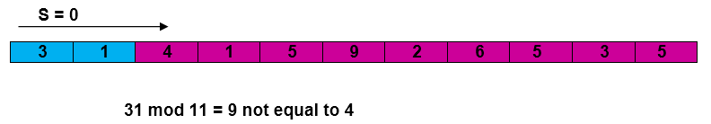
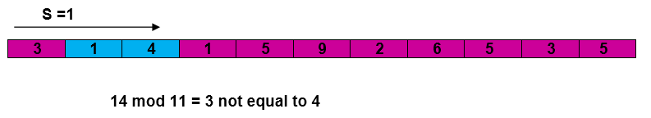
Working modulo q = 11, how many spurious hits does the Rabin-Karp matcher encounter in the text T = 3141592653589793 when looking for the pattern P =26 ?
Solution: P mod q = 26 mod 11 = 4
Now find the exact match of P mod q i.e. 4

Slide 27
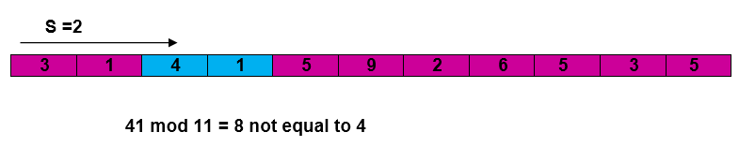
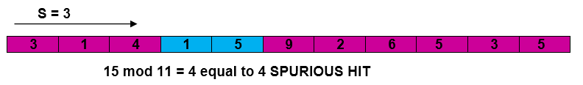
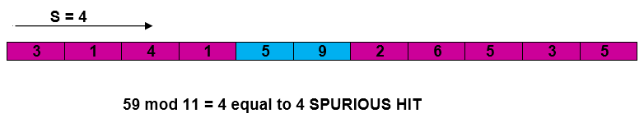

Slide 28
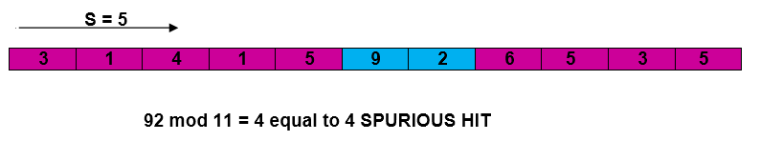
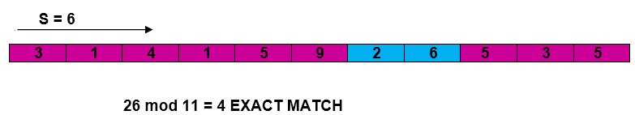
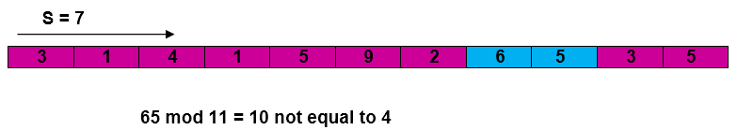

Slide 29
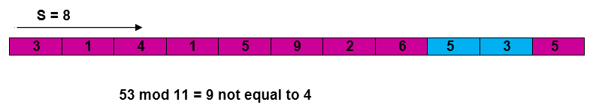
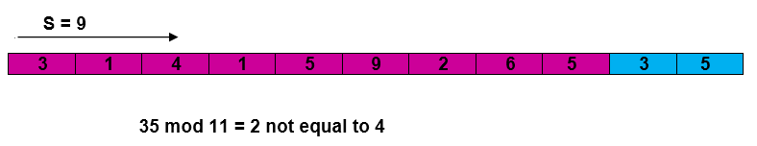
Pattern occurs with shift 6.

Slide 30
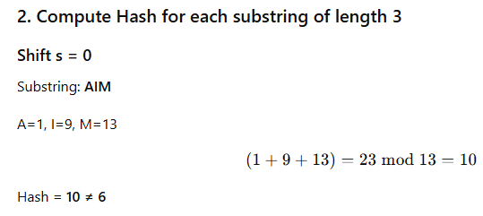
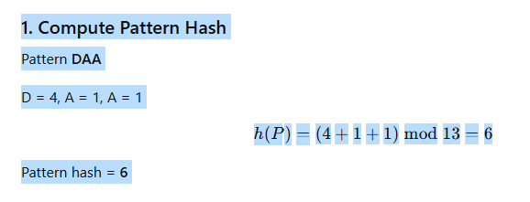
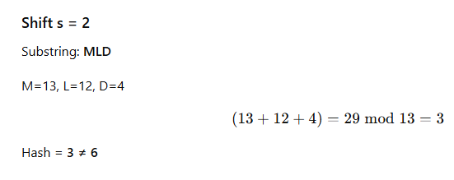
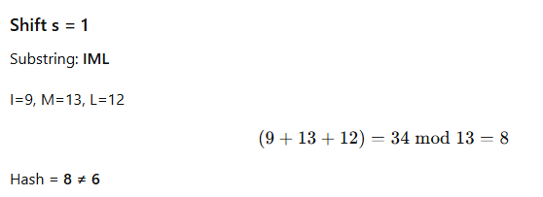
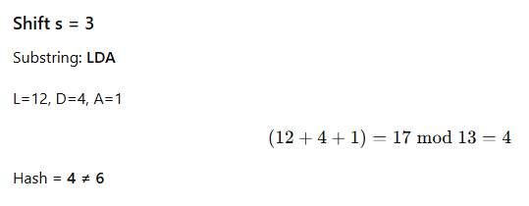
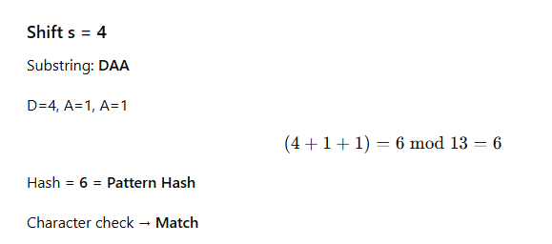
Apply the Rabin–Karp string matching algorithm using modulo arithmetic (mod 13) to find all occurrences of the pattern in the given text.
Text: AIMLDAA
Pattern: DAA

Slide 31
Time Complexity:
The average and best-case running time of the Rabin-Karp algorithm is O(n+m), but its worst-case time is O(nm).
The worst case of the Rabin-Karp algorithm occurs when all characters of pattern and text are the same as the hash values of all the substrings of T[ ] match with the hash value of P[ ].
Auxiliary Space: O(1)
Limitations of Rabin-Karp Algorithm
Spurious Hit: When the hash value of the pattern matches with the hash value of a window of the text but the window is not the actual pattern then it is called a spurious hit. Spurious hit increases the time complexity of the algorithm. In order to minimize spurious hit, we use good hash function. It greatly reduces the spurious hit.
https://www.youtube.com/watch?v=qQ8vS2btsxI&t=802s

Slide 32
T= 315265
P= 26
T = "pabctxjabcjfsabcd”
P = "abc“
Txt = "DAACABCDBA”
Ptrn = "CAB"

Slide 33
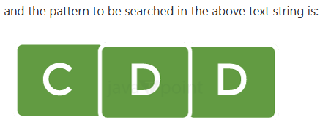

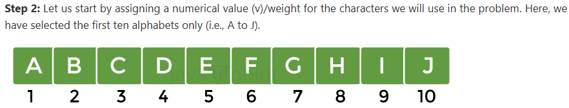
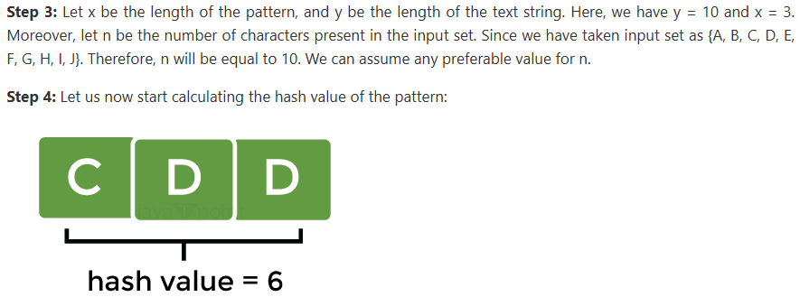
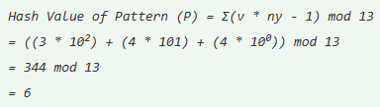

Slide 35

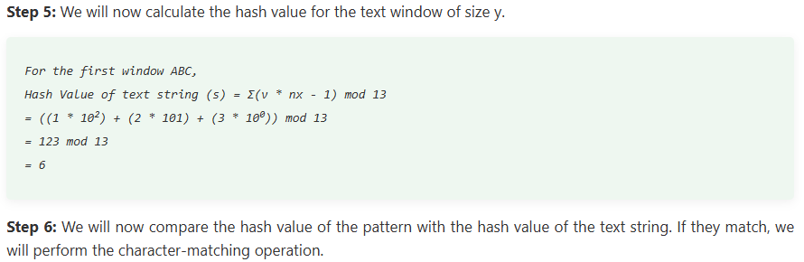

Slide 36
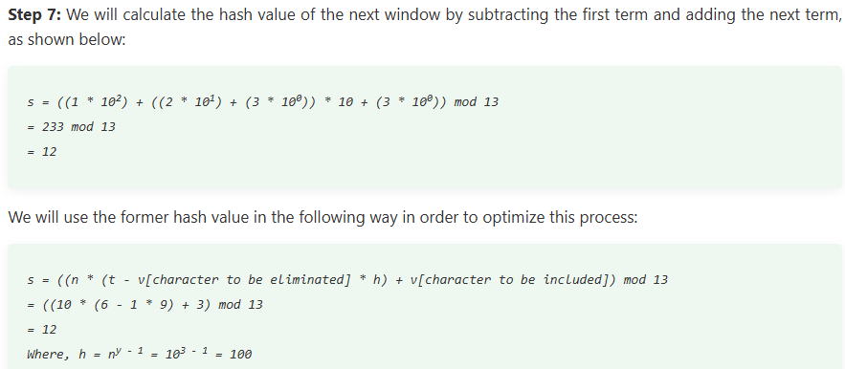

Slide 37
3. The KMP Algorithm
The Knuth-Morris-Pratt (KMP) algorithm looks for the pattern in the text in a left-to-right order.
But it shifts the pattern more intelligently than the brute force algorithm.
KMP runs in optimal time: O(m+n)
very fast
The algorithm never needs to move backwards in the input text, T
this makes the algorithm good for processing very large files that are read in from external devices or through a network stream
https://www.youtube.com/watch?v=V5-7GzOfADQ&t=14s

Slide 40
T = a b c a b a b b
P = a b a b b

Slide 41
Apply the Knuth–Morris–Pratt (KMP) string matching algorithm to find all occurrences of the pattern: BAN in the Text: BANANABANANA. Construct the LPS array and show the step-by-step matching process.

Slide 42
P = a b a b b

Slide 43
P = a b a b b

Slide 44
T = a b c a b a b b
P = a b a b b

Slide 45
T = a b c a b a b b
P = a b a b b

Slide 46
T = a b c a b a b b
P = a b a b b

Slide 47
T = a b c a b a b b
P = a b a b b

Slide 54
a | b | a | b | c | a | b | c | a | b | a | b | d

Slide 55
a | b | a | b | c | a | b | c | a | b | a | b | a | b | d
a b a b d

Slide 56
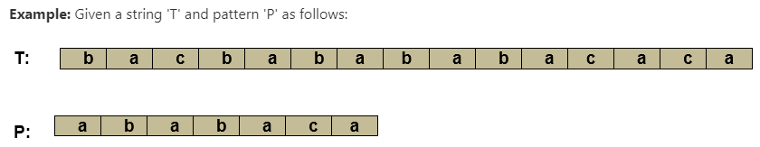
n = size of T = 15
m = size of P = 7

Slide 58
String Matching using Finite Automata

Slide 59
The finite automaton starts in state q₀ and reads the characters of its input string one at a time. If the automaton is in state q and reads input character a, it moves from state q to state δ (q, a). Whenever its current state q is a member of A, the machine M has accepted the string read so far. An input that is not allowed is rejected.

Slide 60
The following procedure computes the transition function δ from given pattern P [1....m]

Slide 63
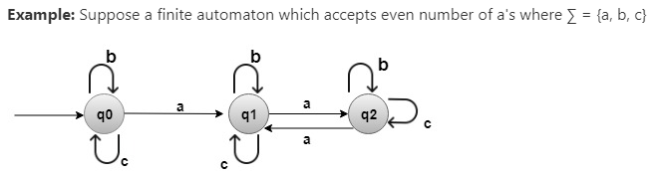
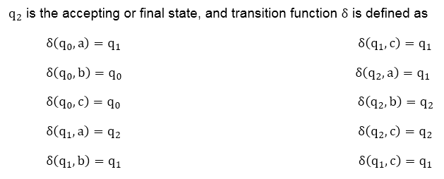
Solution:
q₀ is the initial state.

Slide 64
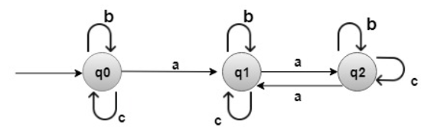
Suppose w is a string such as,

Slide 65
Solution:
q₀ is the initial state.

Slide 66
Suppose w is a string such as,

Slide 67
