Slide 1
Design and Analysis of Algorithms
SY AIML
2025-26
SEM - II

Slide 2
Unit-I 05 Hrs.
Introduction: Analysis of control statements and loops, solving recurrence relations using tree, substitution, master method, analysis of quick sort and merge sort Problem Solving using divide and conquer algorithm- Max-Min problem, Strassen’s Matrix Multiplication
Unit-II 06 Hrs.
Greedy Method: Introduction, Problem solving using- fractional knapsack problem, activity se
lection problem, job sequencing with deadline, Graph: Minimum Spanning trees(Kruskal’s algorithm (Use find and union concept, Prim’s algorithm), Single source shortest path (Dijkstra’s algorithm), coin change problem.

Slide 3
Unit-III 08 Hrs.
Dynamic Programming: Introduction, principle of optimality, Components of dynamic programming, characteristics of dynamic programming, Fibonacci problem, Coin Changing problem, 0/1 knapsack (table method), All pairs shortest paths (Floyd Warshall Algorithm), Single source shortest path (Bellman-Ford Algorithm), Matrix Chain Multiplication, Travelling salesperson problem, Longest Common Subsequence (LCS), Analysis of all Algorithms.
Unit-IV Backtracking and Branch-and-Bound: 04 Hrs.
Basics of backtracking, N–queen problem, Sum of subsets, Graph coloring, Analysis of all Algorithms. Branch-and-Bound: Introduction, Types of BB and its properties, Fifteen Puzzle problem
Unit-V 03 Hrs.
String Matching Algorithms: The naive string-matching algorithm, The Rabin Karp algorithm, String matching with finite automata, The Knuth Morris Pratt algorithm

Slide 4
Text Books:
S. Sridhar, “Design and Analysis of Algorithms”, 1st Edition, Oxford Education, 2018.
Goodrich M T, “Design and Analysis of Algorithms”, Wiley, New Delhi, 2021.
Ellis Horowitz, Sartaj Sahni, S. Rajsekaran, “Fundamentals of computer algorithms”, University Press.

Slide 5
Reference Books:
Thomas H. Cormen, Charles E. Leiserson, Ronald L. Rivest, “Introduction to Algorithms”, 4th Edition, The MIT Press, 2022.
Sanjoy Dasgupta, Christos Papadimitriou, Umesh Vazirani, “Algorithms”, Tata McGraw-Hill Edition.
S. K. Basu, “Design Methods and Analysis of Algorithm”, PHI.
John Kleinberg, Eva Tardos, “Algorithm Design”, Pearson.
Michael T. Goodrich, Roberto Tamassia, “Algorithm Design”, Wiley Publication.

Slide 6
Evaluation Scheme:
Theory :
Continuous Assessment (A):
Subject teacher will declare Teacher Assessment criteria at the start of semester.
Continuous Assessment (B):
1. Two term tests of 15 marks each will be conducted during the semester.
2. Average of the marks scored in both the tests will be considered for final grading.
End Semester Examination (C):
1. Question paper based on the entire syllabus, summing up to 60 marks.
2. Total duration allotted for writing the paper is 2 hrs

Slide 7
Evaluation Scheme: Laboratory
Continuous Assessment (TA):
Laboratory work will be based on RCP23ACPC402 with minimum 08 experiments to be incorporated.
The distribution of marks for term work shall be as follows:
Performance in Experiments: 05 Marks
Journal Submission: 05 Marks
Viva-voce: 05 Marks
Subject Specific Lab Assignment/Case Study: 10 Marks
End Semester Examination (ESE):
Oral & Practical examination will be based on the entire syllabus including, the practical's performed during laboratory sessions.

Slide 8
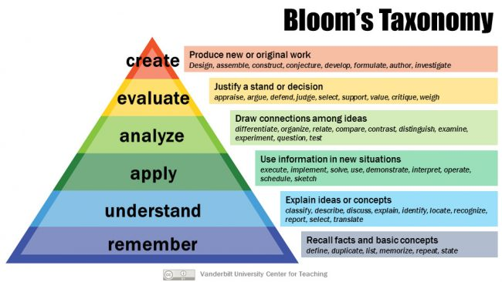

Slide 9


Slide 10
Unit-I Introduction 05 Hrs.
Introduction to Asymptotic Analysis
Analysis of control statements and loops
solving recurrence relations using tree method
solving recurrence relations using substitution method
solving recurrence relations using master method
analysis of quick sort
analysis of merge sort
Problem Solving using divide and conquer algorithm - Max-Min problem
Strassen’s Matrix Multiplication.

Slide 11
Algorithm
An algorithm is a clear step-by-step method used to solve a problem, especially in mathematics or computing.
The word algorithm comes from the name of a Persian mathematician Al-Khwarizmi.
Algorithms can be of different types, such as:
Recursive (a function calls itself)
Serial (steps done one after another)
Parallel or Distributed (multiple steps done at the same time)
We can write an algorithm in many forms:
Normal (English) language
Programming language
Pseudocode (code-like steps)
Flowchart diagrams

Slide 12
Concept of Algorithm
problem
algorithm
“computer”
input
output
Algorithmic solution

Slide 13
Definitions of Algorithm
A mathematical relation between an observed quantity and a variable used in a step-by-step mathematical process to calculate a quantity.
Algorithm is any well defined computational procedure that takes some value or set of values as input and produces some value or set of values as output.
A procedure for solving a mathematical problem in a finite number of steps that frequently involves repetition of an operation; broadly : a step-by-step procedure for solving a problem or accomplishing some end (Webster’s Dictionary).

Slide 14
Algorithmic Problem Solving
Steps in solving a problem using algorithms:
Understand the computer’s ability Know what the computer can do and its limits (memory, speed, etc.).
2. Choose exact or approximate solution Decide whether you need a perfectly accurate answer or a close enough answer.
3. Select proper data structure Choose how to store data (array, list, stack, queue, tree, etc.).
4. Design the algorithm Plan the step-by-step procedure to solve the problem.
5. Analyze the algorithm Check how fast it works and how much memory it uses.
6. Coding (Implementation) Convert the algorithm into a program using a programming language.
Understand the problem
Design an algorithm and proper data structures
Analyze the algorithm
Code the algorithm

Slide 15
Basic Issues Related to Algorithms
How to design algorithms
How to create step-by-step methods to solve a problem.
How to express algorithms
How to write or show the algorithm so others can understand it.
Proving correctness
Showing that the algorithm always gives the correct answer.
Efficiency
How fast and memory-saving the algorithm is.
Theoretical analysis
Experimental analysis
Optimality / Best Solution
Finding the best possible solution among all algorithms.

Slide 16
Analysis of Algorithms
How good is the algorithm?
Correctness
Time efficiency
Space efficiency

Slide 17
What is an algorithm? (Properties)
Unambiguous: Every step must be clearly defined.
Input: Can have zero or more inputs.
Output: Must produce at least one output.
Finiteness: Should terminate after a finite number of steps.
Effectiveness: Each step must be basic enough to be carried out.
Independence: Should be independent of any programming language
Notes:
The formalization of the notion of an algorithm led to great breakthroughs in the
foundations of mathematics in the 1930s.

Slide 18
Algorithm Designing Methods / Design Techniques
Incremental Approach
Divide and Conquer
Dynamic Programming
Greedy Approach
Backtracking
Linear Programming
Branch and Bound method
Randomized Algorithm

Slide 19
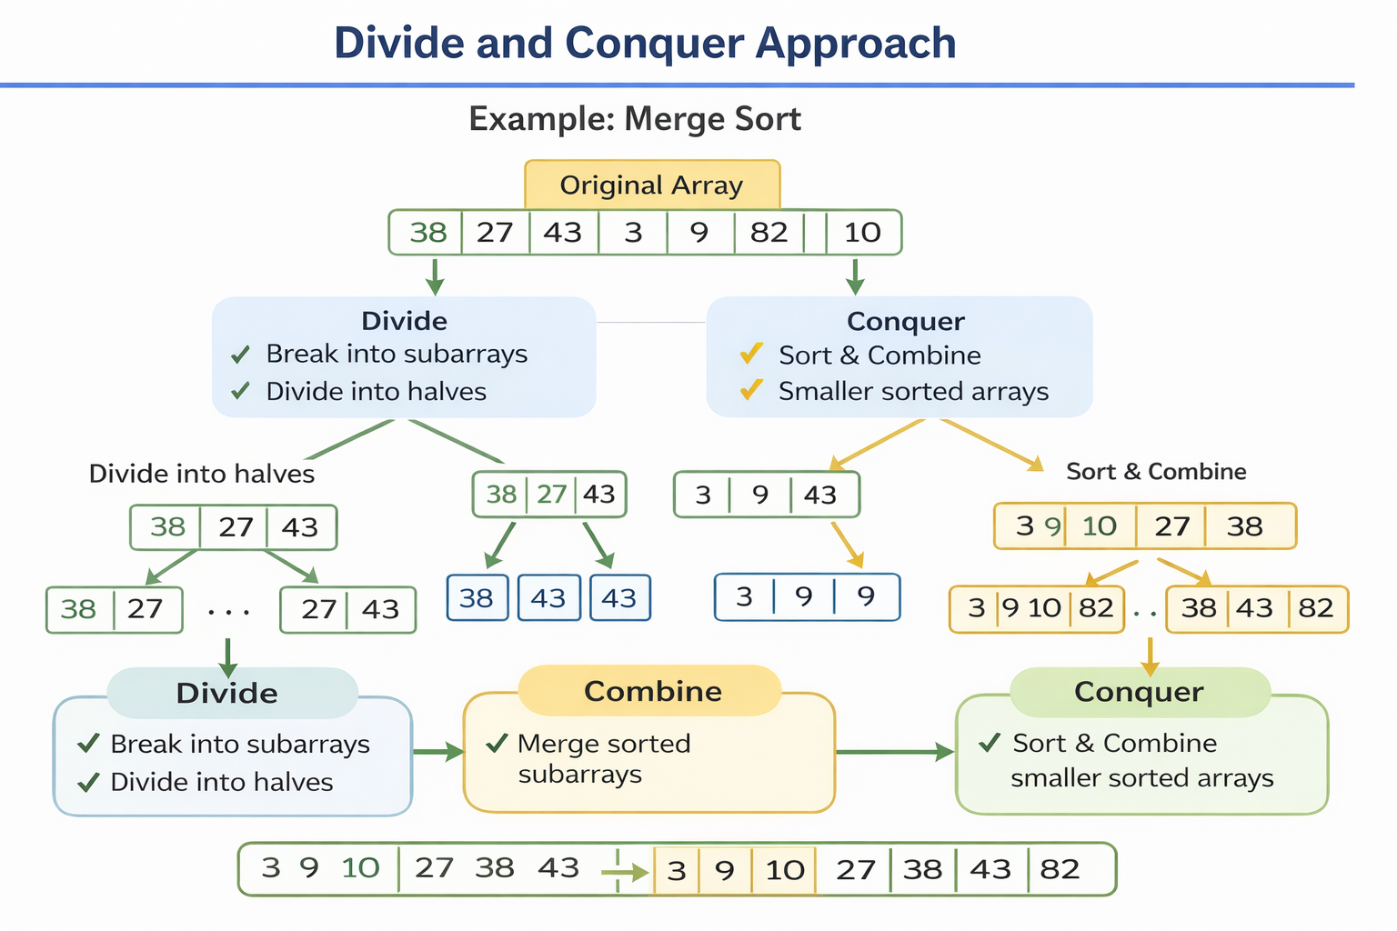
Divide and Conquer Approach:
It is a top-down approach. The algorithms which follow the divide & conquer techniques involve three steps:
Divide the original problem into a set of subproblems.
Solve every subproblem individually, recursively.
Combine the solution of the subproblems (top level) into a solution of the whole original problem.

Slide 20
2. Greedy Technique:
The Greedy algorithm is used to solve problems where we want the best result — either:
Maximum profit
Minimum cost
Minimum time
Shortest distance
These are called optimization problems.
Example— Coin Change Problem
You want to make ₹18 using coins: ₹10, ₹5, ₹2, ₹1
Greedy Approach
Always pick largest coin first.
Take 10 → Remaining = 8
Take 5 → Remaining = 3
Take 2 → Remaining = 1
Take 1 → Remaining = 0
Total coins used = 4 (Good solution)

Slide 21
3. Dynamic Programming:
Dynamic Programming (DP) is a technique used to solve complex problems by:
Solving small sub-problems first Saving their answers Using them again to build the final big answer
So instead of solving the same problem again and again, we remember previous results.
Example — Fibonacci Numbers
We want to find:
F(n)=F(n−1)+F(n−2)………
0, 1, 1, 2, 3, 5, 8, 13, 21 …

Slide 22
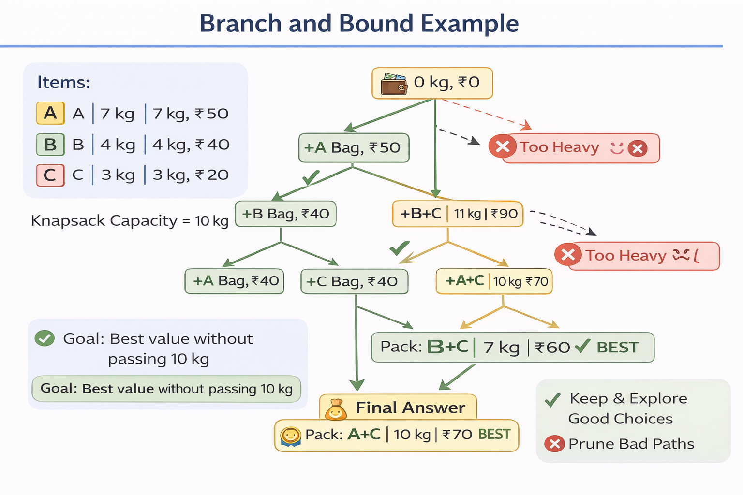
4. Branch and Bound :
Branch and Bound is a method used to find the best possible solution from many choices.
It works like a tree:
Branch → Try different possible choices
Bound → Stop exploring a choice if it is already worse than the best answer
In short: Try all good paths, skip bad paths early

Slide 23
5. Randomized Algorithms:
A Randomized Algorithm is an algorithm that uses random numbers (luck/chance) while solving a problem.
So every time you run it → the steps may be slightly different → but the answer is still correct (or almost correct).
6. Backtracking Algorithm: A backtracking algorithm is a method of solving problems by trying all possible options one by one. If one option does not lead to the correct answer, it goes back (backtracks) to the previous step and tries a different option.

Slide 24
Introduction to Analysis of Algorithm
Some people enjoy studying algorithms because it is fun and challenging.
They like to predict how fast and efficiently a program will work.
Computer science attracts people who like making things faster and better.
Algorithm analysis means checking how much time and memory a program needs.

Slide 25
Algorithm Analysis
Analyzing means predicting resources that algorithms requires , i.e.
Space complexity
How much space is required
Time complexity
How much time does it take to run the algorithm

Slide 26
Space Complexity
Space Complexity means how much memory an algorithm needs to run completely.
Sometimes, a program uses more memory than the system has, which can cause errors like core dumps. The most common reason for this is memory leaks, where memory is not released properly.
Some algorithms work faster and better if all the data is loaded into memory, but this is not always possible. So, we must also consider the memory limits of the system.

Slide 27
Time Complexity
Time complexity is often more important than space complexity.
Memory is increasing, but time is still limited.
Even very fast computers need a long time for complex problems.
Therefore, algorithm running time is a critical issue.

Slide 28

Basic Matrix Multiplication
Suppose we want to multiply two matrices of size N x N: for example A x B = C.
C₁₁ = a₁₁b₁₁ + a₁₂b₂₁
C₁₂ = a₁₁b₁₂ + a₁₂b₂₂
C₂₁ = a₂₁b₁₁ + a₂₂b₂₁
C₂₂ = a₂₁b₁₂ + a₂₂b₂₂
2x2 matrix multiplication can be accomplished in 8 multiplications.
(2^{log}₂⁸ =2³)

Slide 29
Divide and Conquer Matrix Multiply
A × B = R
A₀ | A₁
A₂ | A₃
B₀ | B₁
B₂ | B₃
A₀×B₀+A₁×B₂ | A₀×B₁+A₁×B₃
A₂×B₀+A₃×B₂ | A₂×B₁+A₃×B₃
×
=
Divide matrices into sub-matrices: A₀ , A₁, A₂ etc
Use blocked matrix multiply equations
Recursively multiply sub-matrices

Slide 30
Strassens’s Matrix Multiplication
P₁ = (A₁₁+ A₂₂)(B₁₁+B₂₂) P₂ = (A₂₁ + A₂₂) * B₁₁ P₃ = A₁₁ * (B₁₂ - B₂₂) P₄ = A₂₂ * (B₂₁ - B₁₁) P₅ = (A₁₁ + A₁₂) * B₂₂ P₆ = (A₂₁ - A₁₁) * (B₁₁ + B₁₂) P₇ = (A₁₂ - A₂₂) * (B₂₁ + B₂₂)
C₁₁ = P₁ + P₄ - P₅ + P₇ C₁₂ = P₃ + P₅ C₂₁ = P₂ + P₄ C₂₂ = P₁ + P₃ - P₂ + P₆
No. of multiplications: M(n) = 7
No. of additions: A(n) = 18
2^{log}₂⁷ = 2^{2.807} = Θ(n^{2.807})

Slide 31
Strassen’s matrix multiplication
M₁=(A₀₀+A₁₁)*(B₀₀+B₁₁)
M₂=(A₁₀+A₁₁)*B₀₀
M₃=A₀₀*(B₀₁-B₁₁)
M₄=A₁₁*(B₁₀-B₀₀)
M₅=(A₀₀+A₀₁)*B₁₁
M₆=(A₁₀-A₀₀)*(B₀₀+B₀₁)
M₇=(A₀₁-A₁₁)*(B₁₀+B₁₁)
recurrence relations:
multiplication: M(n) = 7
addition: A(n) = 18

Slide 32
Strassen’s method for matrix multiplication
Strassen’s algorithm
Define seven matrices of size (n/2)x(n/2) :
The four (n/2)x(n/2) matrices can be defined in terms of M1,…,M7:
32
Notes:
[] המהות של השיטה של Srassen: הפחתה במכפלה אחת של מטריצות על חשבון מספר פעולות חיבור וחיסור נוספות.
[] מכפלת המטריצות הקטנות יותר הנובעות מחלוקה המטריצות המקוריות לארבעה רבעים, מחושבת באופן רקורסיבי.
[] בסה"כ בכל שלב יש לנו 7 פעולות מכפלה והרבה פעולות חיבור וחיבור שדורשות זמן בסדר גודל של O(n²).
הערה: השיטה של Strassen כוללת פעולות חיבור, כפל וחיסור של מטריצות. פעולות לוגיות המתאימות לחיבור ולכפל הן
OR וְ-AND, אבל חסרה פעולה לוגית מתאימה עבור חיסור. לכן, כדי להתאים את השיטה לכפל מטריצות בוליאניות, תוצאה
חיובית של מכפלת שורה בעמודה נמיר לערך 1 ותוצאה שהיא 0 נשאיר כמו שהיא. לדוגמא:
[1 0 1] * [1 1 1] = 1*1 + 0*1 + 1*1 = 2 >> 1
32

Slide 33
Strassen’s matrix multiplication
M₁=(A₀₀+A₁₁)*(B₀₀+B₁₁)
M₂=(A₁₀+A₁₁)*B₀₀
M₃=A₀₀*(B₀₁-B₁₁)
M₄=A₁₁*(B₁₀-B₀₀)
M₅=(A₀₀+A₀₁)*B₁₁
M₆=(A₁₀-A₀₀)*(B₀₀+B₀₁)
M₇=(A₀₁-A₁₁)*(B₁₀+B₁₁)
b n=< 2
T(n) =
7T(n/2) + an² n > 2
M(n) ≈ Θ(n^{2.807})
A(n) ≈ Θ(n^{2.807})

Slide 34
Strassens’s Matrix Multiplication
Strassen showed that 2x2 matrix multiplication can be accomplished in 7 multiplication and 18 additions or subtractions. .(2^{log}₂⁷ =2^{2.807})
This reduce can be done by Divide and Conquer Approach.
Time Complexity T(N) = 7T(N/2) + O(N²)

Slide 35
Lower bound: a value that is less than or equal to every element of a set of data.
Upper bound: a value that is greater than or equal to every element of a set of data.
Example: in { 3, 5, 11, 20, 22 }
3 is a lower bound, and
22 is an upper bound.

Slide 36
Measurement of Complexity of an Algorithm
Time Complexity there are three cases to analyse an algorithm:
1. Worst Case Analysis (Mostly used)
we calculate the upper bound on the running time of an algorithm.
causes a maximum number of operations to be executed.
For Linear Search, the worst case happens when the element to be searched (x) is not present in the array. When x is not present, the search() function compares it with all the elements of arr[] one by one. Therefore, the worst-case time complexity of the linear search would be O(n).

Slide 37
2. Best Case Analysis (Very Rarely used)
we calculate the lower bound on the running time of an algorithm.
We must know the case that causes a minimum number of operations to be executed.
In the linear search problem, the best case occurs when x is present at the first location. The number of operations in the best case is constant (not dependent on n). So time complexity in the best case would be Ω(1)
3. Average Case Analysis (Rarely used)
we take all possible inputs and calculate the computing time for all of the inputs.
Sum all the calculated values and divide the sum by the total number of inputs.
We must know (or predict) the distribution of cases.

Slide 38
Asymptotic Notation
mathematical tool
used to describe the running time of an algorithm - how much time an algorithm takes with a given input, n.
three different notations:
big O, big Theta (Θ), and big Omega (Ω).
Big-Oh O
Small-Oh o
Big Omega Ω
Small-Omega ω
Theta Notations Θ

Slide 39
Popular Notations in Complexity Analysis of Algorithms
1. Big-O Notation
We define an algorithm’s worst-case time complexity by using the Big-O notation, which determines the set of functions grows slower than or at the same rate as the expression.
It explains the maximum amount of time an algorithm requires to consider all input values.

Slide 40
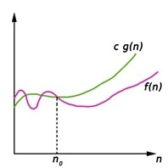
Big-Oh (O) notation (worst case)
gives an upper bound for a function f(n) to within a constant factor. (n is the size of input)
f(n) = O(g(n)), If there are positive constants n0 and c such that, to the right of n0 the f(n) always lies on or below c*g(n)
f(n) <= c*g(n) …… n ≥ n0
O(g(n)) = { f(n) : There exist positive constant c and n0 such that 0 ≤ f(n) ≤ c g(n), for all n ≥ n0, c >0 }
After some n0 value of c*g(n) is always greater than f(n)
f(n) = O(g(n)) … n>=n0, c>0, n0>1
t

Slide 41
Little-o Notation (o)
Little-o notation is used to denote an upper-bound that is not asymptotically tight. It is formally defined as:
o(g(n)) = { f(n) : There exist positive constant c and n0 such that 0 ≤ f(n) ≤ c g(n), for all n ≥ n0, c >0 }
for any positive constant , there exists positive constant such that for all .
The set of functions f(n) are strictly smaller than c*g(n), meaning that little-o notation is a stronger upper bound than big-O notation.
In other words, the little-o notation does not allow the function to have the same growth rate as .

Slide 42
2. Omega Notation (Big Omega) Ω
It defines the best case of an algorithm’s time complexity, the Omega notation defines whether the set of functions will grow faster or at the same rate as the expression.
It explains the minimum amount of time an algorithm requires to consider all input values.

Slide 43
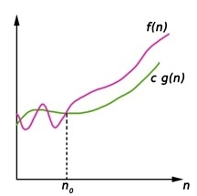
Big-Omega Ω notation gives a lower bound for a function f(n) to within a constant factor.
We write f(n) = Ω(g(n)), If there are positive constants n0 and c such that, to the right of n0 the f(n) always lies on or above c*g(n).
Ω(g(n)) = { f(n) : There exist positive constant c and n0 such that 0 ≤ c g(n) ≤ f(n), for all n ≥ n0}
f(n) >= c g(n) … n>=n0, c>0, n0>1

Slide 44
3. Theta Notation Θ
It defines the average case of an algorithm’s time complexity.
Theta notation defines when the set of functions lies in both O(expression) and Omega(expression), then Theta notation is used.

Slide 45
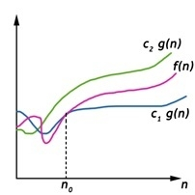
Big-Theta(Θ) notation gives bound for a function f(n) to within a constant factor.
We write f(n) = Θ(g(n)), If there are positive constantsn0 and c1 and c2 such that, to the right of n0 the f(n) always lies between c1*g(n) and c2*g(n) inclusive.
Θ(g(n)) = {f(n) : There exist positive constant c1, c2 and n0 such that 0 ≤ c1 g(n) ≤ f(n) ≤ c2 g(n), for all n ≥ n0}
c1 g(n) ≤ f(n) ≤ c2 g(n)
…n>=n0, c1, c2 >0, n0>=1

Slide 46
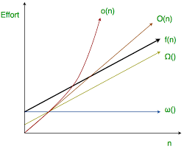

Slide 47
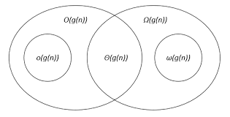

Slide 48
Big-Oh Notation
Small oh -

Slide 49
Omega Notation

Slide 50
Theta Notation

Slide 51
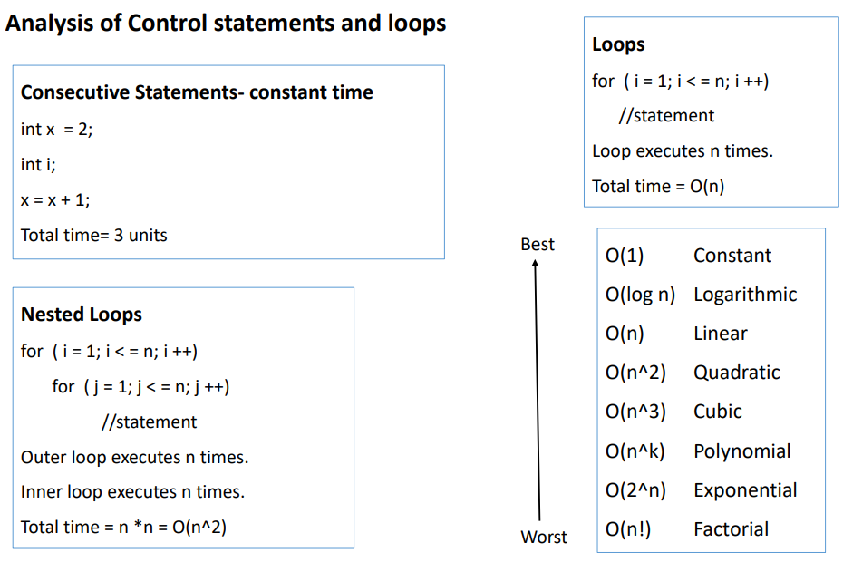

Slide 52
Selection Sort
The selection sort enhances the bubble sort by making only a single swap for each pass through the rundown.
In order to do this, a selection sort searches for the biggest value as it makes a pass and, after finishing the pass, places it in the best possible area.
Similarly, as with a bubble sort, after the first pass, the biggest item is in the right place. After the second pass, the following biggest is set up.
This procedure proceeds and requires n-1 goes to sort n item since the last item must be set up after the (n-1)th pass.
Not in Syllabus 2024-25

Slide 53
How Selection Sort works
In the selection sort, first of all, we set the initial element as a minimum.
Now we will compare the minimum with the second element. If the second element turns out to be smaller than the minimum, we will swap them, followed by assigning to a minimum to the third element.
Else if the second element is greater than the minimum, which is our first element, then we will do nothing and move on to the third element and then compare it with the minimum. We will repeat this process until we reach the last element.
After the completion of each iteration, we will notice that our minimum has reached the start of the unsorted list.
For each iteration, we will start the indexing from the first element of the unsorted list. We will repeat the Steps from 1 to 4 until the list gets sorted or all the elements get correctly positioned.
Not in Syllabus 2024-25

Slide 54
Insertion Sort
Not in Syllabus 2024-25

Slide 55
Not in Syllabus 2024-25
For best case
Condition false, each time
Hence tj = 1
(n-1)

Slide 56
Not in Syllabus 2024-25
For worst case
Condition true for max possible value, hence generate series
(n(n+1)/2)-1

Slide 57
Recursion
A function that calls itself.
Every recursive program should have a termination condition, otherwise program may go into the infinite loop.
Recursion solves bigger problem in terms of smaller problems.
For recursive function, number of parameters never change, code will never change, only parameter values will changes.
Example: Fact(5) = 120
= 5* Fact (4) ………. Reducing problem size
= 5* 5* Fact (3)

Slide 58
Advantages of Recursion
Recursion can reduce time complexity
Adds clarity to code
Reduce time to debug
Disadvantages of Recursion
Uses more memory (stack in fact(5) example)
Recursion can be slow

Slide 59
Recurrences A recurrence is just a way of describing a problem using smaller versions of the same problem. Instead of writing a direct formula, we say: “To solve a big input, first solve smaller inputs — then combine their results.” So the time (or work) needed for size n depends on the time needed for smaller sizes.

Slide 60
Recurrence of Merge Sort: T(n) = 2T(n/2) + n
Recurrence of Binary Search: T(n) = T(n/2) + 1
BINARY-SEARCH (A, low, high, x)
if (low > high)
return FALSE
mid ← ⎣(low + high)/2⎦
if x = A[mid]
return TRUE
if ( x < A[mid] )
BINARY-SEARCH (A, low, mid-1, x)
if ( x > A[mid] )
BINARY-SEARCH (A, mid+1, high, x)

Slide 61
Recurrence equation example:
Void fun (int n) T(n)….. Sum of all steps inside equation
{
if (n > 0 ) 1 …… constant time
{
print (n) 1 …… constant time
fun (n-1) T(n-1)
}
}
T(n) = T(n-1) + 2 = T(n-1) + C

Slide 62
Indirect Recurrence equation example:
fun (---)
{
----
newfun(---)
----
}
newfun (---)
{
----
fun(---)
----
}

Slide 63
Solving Recurrences
Substitution method
Master method / Master’s Theorem
Recursion Tree Method
Iteration method…………….not in syllabus

Slide 64
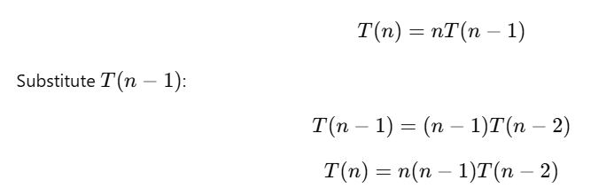


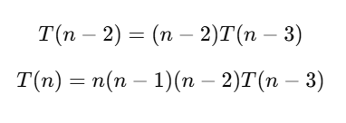
Substitution method
Time Complexity=O(n!)

Slide 65
Master’s method
…….. where, a ≥ 1, b > 1, and f(n) > 0
n is the size of the problem.
a is the number of subproblems in the recursion. (Subproblems can not be in fraction)
n/b is the size of each subproblem. (Here it is assumed that all subproblems are essentially the same size.)
f (n) is the sum of the work done outside the recursive calls, which includes the sum of dividing the problem and the sum of combining the solutions to the subproblems. (f (n) can not be negative.)
It is not possible always bound the function according to the requirement, so we make three cases which will tell us what kind of bound we can apply on the function.

Slide 66
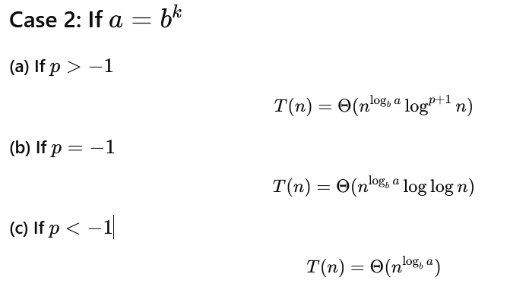
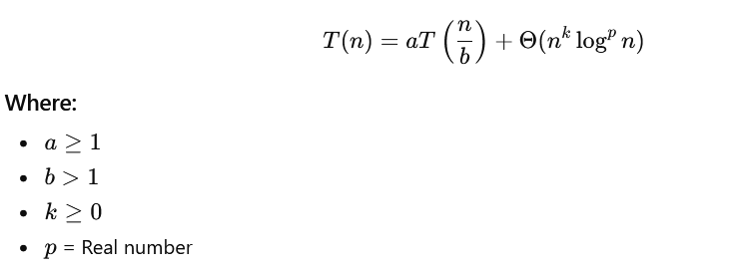
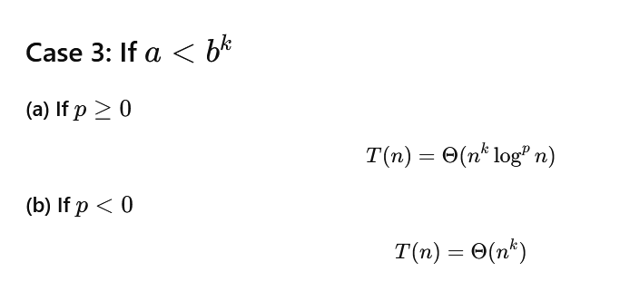
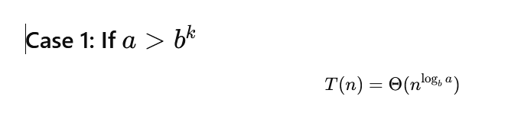
Master Theorem
Recurrence Form

Slide 67
Master’s method
…….. where, a ≥ 1, b > 1, and f(n) > 0
n is the size of the problem.
a is the number of subproblems in the recursion. (Subproblems can not be in fraction)
n/b is the size of each subproblem. (Here it is assumed that all subproblems are essentially the same size.)
f (n) is the sum of the work done outside the recursive calls, which includes the sum of dividing the problem and the sum of combining the solutions to the subproblems. (f (n) can not be negative.)
It is not possible always bound the function according to the requirement, so we make three cases which will tell us what kind of bound we can apply on the function.

Slide 68
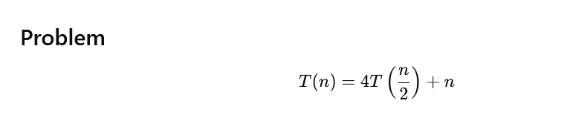
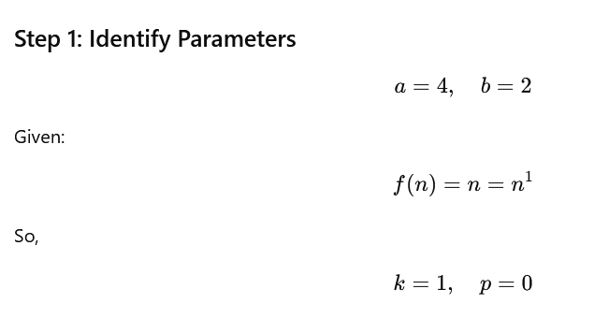
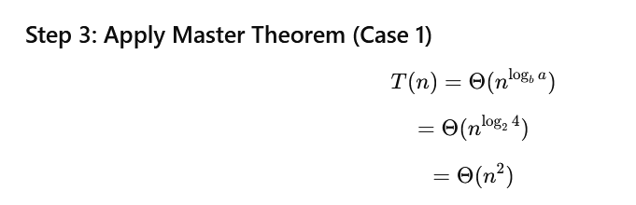
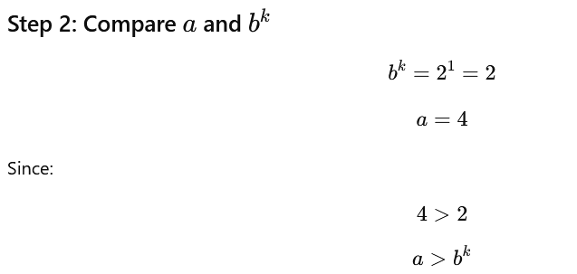
Examples

Slide 69

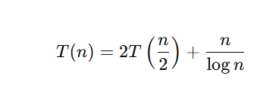

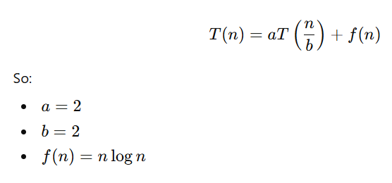


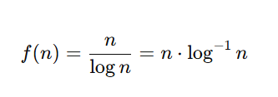
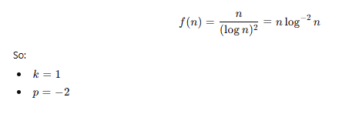

Master Theorem Example Case -II
1.
2.
3.
k=1
p=−1

Slide 70
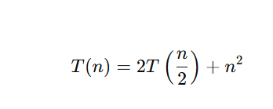




Master Theorem Example Case -III
1
2

Slide 71

Recursion Tree Method
Draw recurrence tree and calculate time taken by each level.
Sum the work done by all the levels.
f(n) : time require to break n into 2 parts, f(n) : always root node of tree
Recursion Tree Method is a pictorial representation of an iteration method which is in the form of a tree where at each level nodes are expanded.
It is useful when the divide & Conquer algorithm is used.
It is sometimes difficult to come up with a good guess. In Recursion tree, each root and child represents the cost of a single subproblem.
We sum the costs within each of the levels of the tree to obtain a set of pre-level costs and then sum all pre-level costs to determine the total cost of all levels of the recursion.
A Recursion Tree is best used to generate a good guess, which can be verified by the Substitution Method.
No. of children

Slide 72
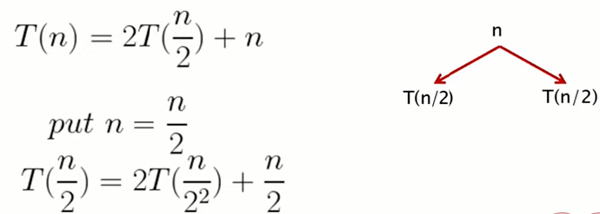
Examples

Slide 73
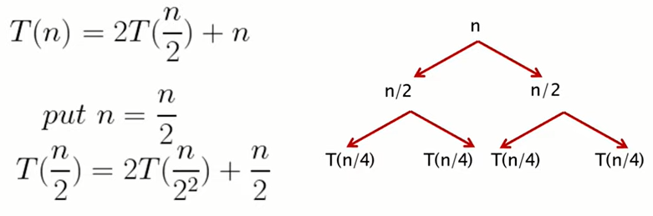
Expand the tree until it reaches the base condition of the recursion T(1).

Slide 74
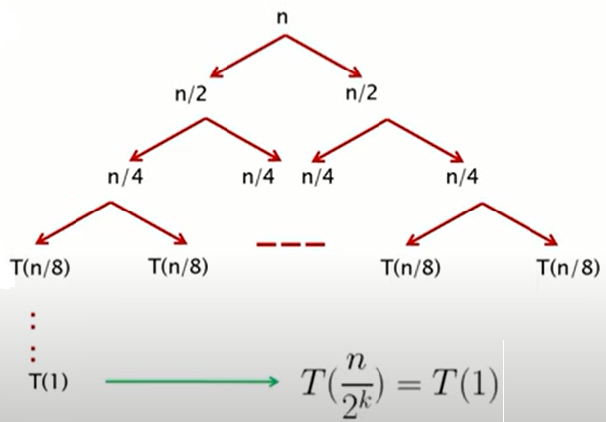

Slide 75
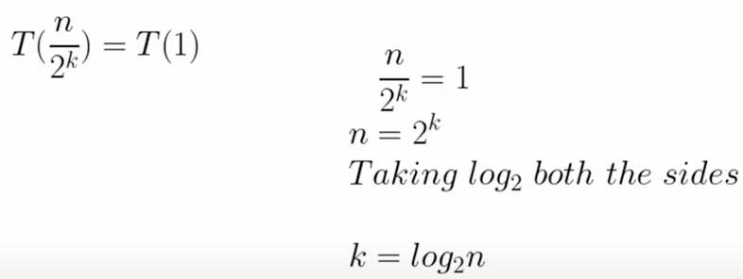

Slide 76
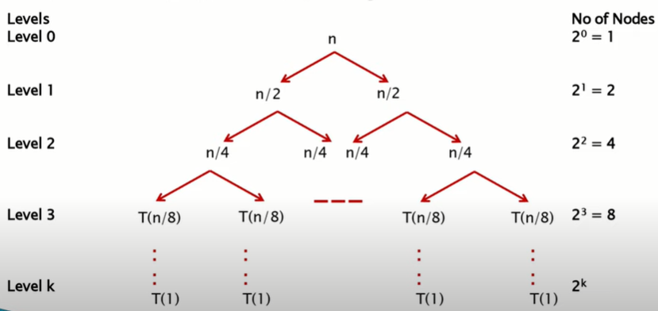

Slide 77
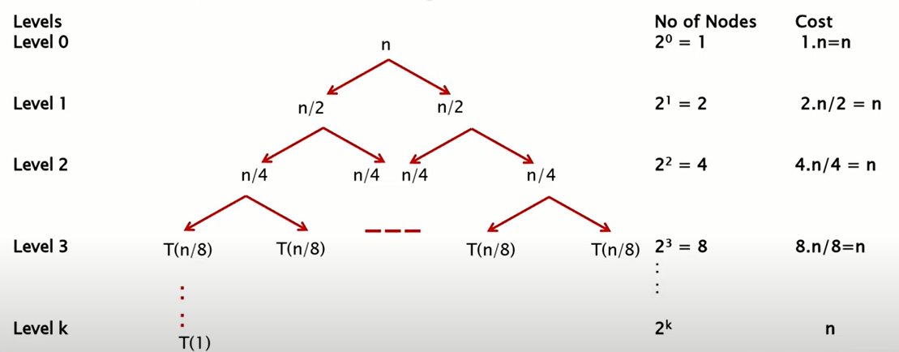



Slide 78
The recursion-tree method
Convert the recurrence into a tree:
Each node represents the cost incurred at various levels of recursion
Sum up the costs of all levels
Used to “guess” a solution for the recurrence

Slide 79
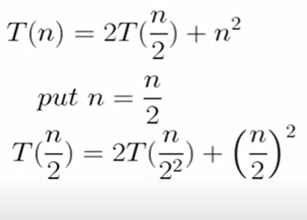
Example :

Slide 80
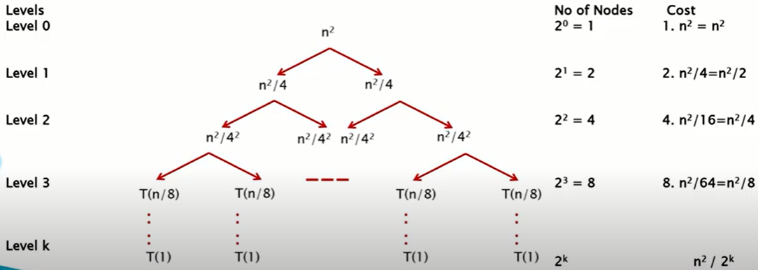

Slide 81
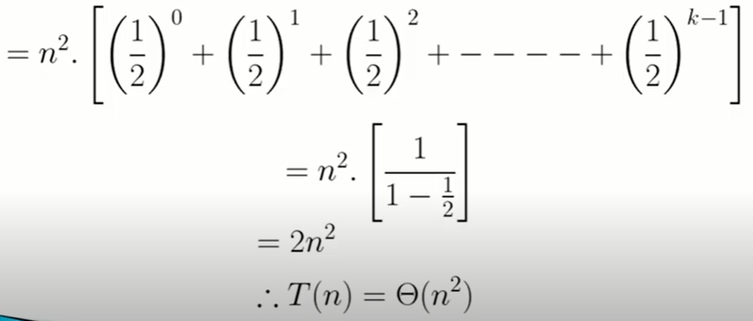

Slide 82
Divide-and-Conquer
Divide and Conquer is a method of algorithm design that has created such efficient algorithms as Merge Sort.
three distinct steps:
Divide: If the input size is too large to deal with in a straightforward manner, divide the data into two or more disjoint subsets.
Recur: Use divide and conquer to solve the sub problems associated with the data subsets.
Conquer: Take the solutions to the sub problems and “merge” these solutions into a solution for the original problem.

Slide 83
Divide-and-conquer Technique
a problem of size n
subproblem 1
of size n/2
subproblem 2
of size n/2
a solution to
subproblem 1
a solution to
subproblem 2
a solution to
the original problem

Slide 84
Divide & Conquer Algorithm
Algo D and C(P)
{
If small (P) then return S(P)
else
{
Divide P into smaller instances P₁,P₂ ….P_{k} , k>=1
Apply D and C to each of these problem
Return combine (D and C(P₁), D and C(P₂)…D and C(P_{k} );
}
}

Slide 85
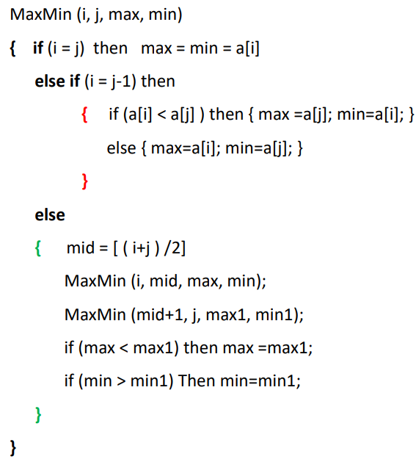
Min-Max Algorithm

Slide 86
Merge-Sort
Algorithm:
Divide: If S has at leas two elements (nothing needs to be done if S has zero or one elements), remove all the elements from S and put them into two sequences, S₁ and S₂, each containing about half of the elements of S. (i.e. S₁ contains the first ⎡n/2⎤ elements and S₂ contains the remaining ⎣n/2⎦ elements.
Recur: Recursive sort sequences S₁ and S₂.
Conquer: Put back the elements into S by merging the sorted sequences S₁ and S₂ into a unique sorted sequence.

Slide 87
Merge-Sort Algorithm
Divide: Divide the n-element sequence to be sorted into two subsequences of n=2 elements each.
Conquer: Sort the two subsequences recursively using merge sort.
Combine: Merge the two sorted subsequences to produce the sorted answer

Slide 88
Merge-Sort
Merge Sort Tree:
Take a binary tree T
Each node of T represents a recursive call of the merge sort algorithm.
We associate with each node v of T a the set of input passed to the invocation v represents.
The external nodes are associated with individual elements of S, upon which no recursion is called.

Slide 89
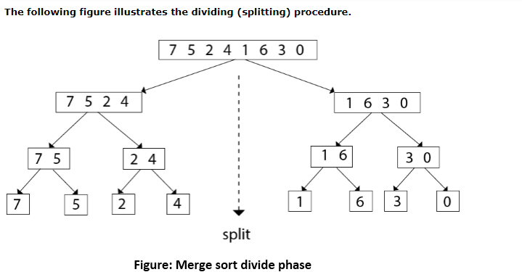
Merge Sort

Slide 90
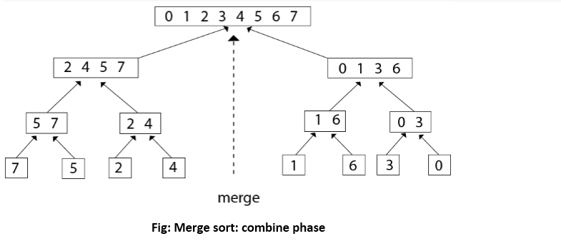
Merge Sort

Slide 91
Merge-Sort

Slide 92
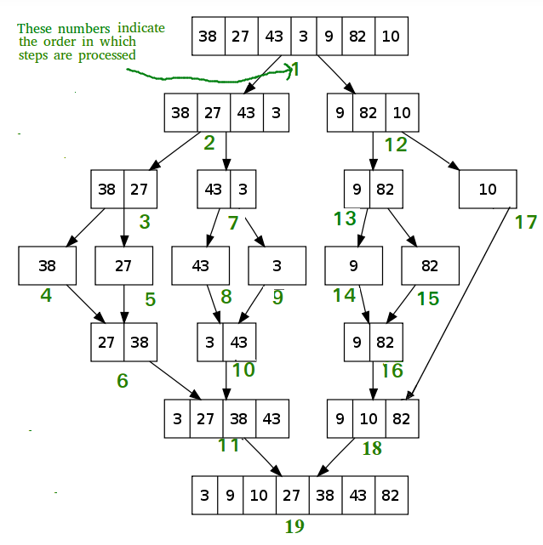
Merge-Sort

Slide 93
Quick-Sort
Another divide-and-conquer sorting algorithm
To understand quick-sort, let’s look at a high-level description of the algorithm
1) Divide : If the sequence S has 2 or more elements, select an element x from S to be your pivot. Any arbitrary element, like the last, will do. Remove all the elements of S and divide them into 3 sequences:
L, holds S’s elements less than x
E, holds S’s elements equal to x
G, holds S’s elements greater than x
2) Recurse: Recursively sort L and G
3) Conquer: Finally, to put elements back into S in order, first inserts the elements of L, then those of E, and those of G.

Slide 94
Idea of Quick Sort
1) Select: pick an element
2) Divide: rearrange elements so that x goes to its final position E
3) Recurse and Conquer: recursively sort

Slide 95
Quick-Sort Tree

Slide 96
In-Place Quick-Sort
Divide step: l scans the sequence from the left, and r from the right.
A swap is performed when l is at an element larger than the pivot and r is at one smaller than the pivot.

Slide 97
In Place Quick Sort (cont’d)
A final swap with the pivot completes the divide step

Slide 98
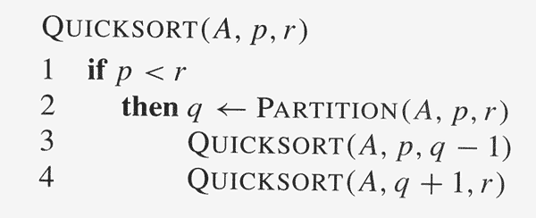
Quick-Sort Algorithm
Partition(A, p, r)
x = A[r] // pivot
i = p - 1
for j = p to r – 1
{
if A[j] ≤ x
{
i = i + 1
exchange A[i] & A[j]
}
}
exchange A[i+1] & A[r]
return i + 1

Slide 99
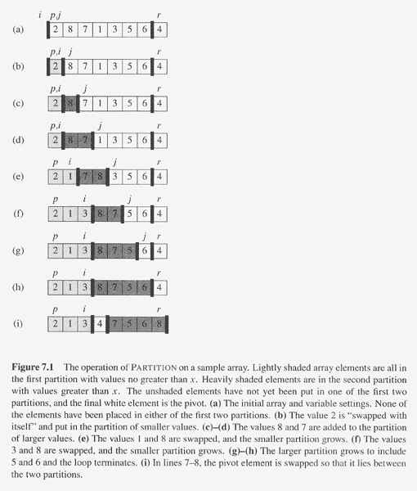
Copyright © The McGraw-Hill Companies, Inc. Permission required for reproduction or display.

Slide 100
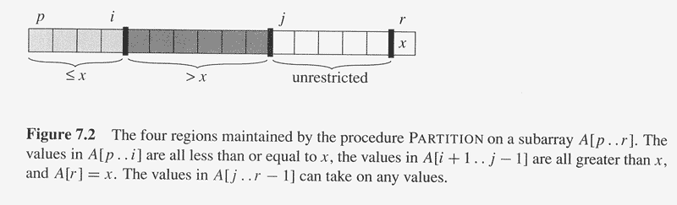
Copyright © The McGraw-Hill Companies, Inc. Permission required for reproduction or display.

Slide 101
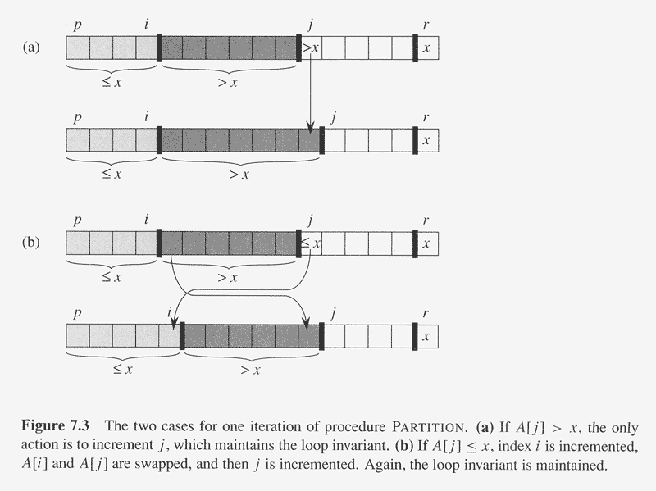
Copyright © The McGraw-Hill Companies, Inc. Permission required for reproduction or display.

Slide 102
Karatsuba Algorithm
Easy Way to Multiply Big Numbers
Karatsuba is a fast multiplication method.
It is used to multiply big numbers.
It is faster than normal multiplication.
Karatsuba algorithm was invented by Anatoly Karatsuba in 1960.

Slide 103
Problem with Normal Method
Example:
1234 × 5678
Normal method needs 4 multiplications when we split numbers.
More digits = More calculations = More time
Karatsuba reduces:
4 multiplications 3 multiplications
It uses Divide and Conquer method.
Step 1: Split numbers into two parts Step 2: Multiply smartly Step 3: Combine the result

Slide 104
Multiply:
1234 × 5678
Split numbers:
1234 → 12 and 34 5678 → 56 and 78
Now calculate:
z₀ = 34 × 78 z₂ = 12 × 56 z₁ = (12+34) × (56+78)
Final formula:
Answer = z₂ × 10² + (z₁ − z₂ − z₀) × 10 + z₀
Final Answer = 7006652 ✅

Slide 105
Advantage
Normal Method → O(n²) Karatsuba → O(n¹·⁵⁸⁵)
Less multiplications
More speed
Better for large numbers
Application
Cryptography
Large number calculations
Computer algorithms

Slide 106
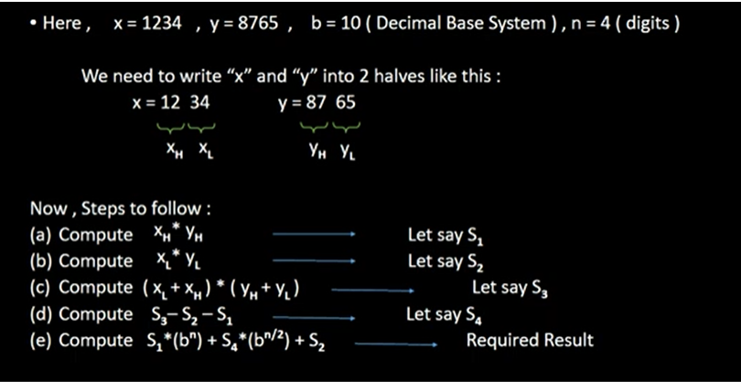

Slide 107
