Slide 1
Admin Screen

Slide 2
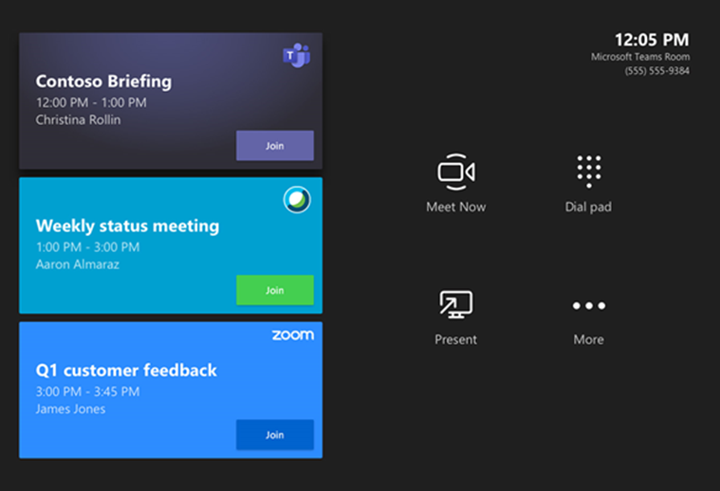
Admin screen – no. of widgets
Team Accounting
Team Tax
Team Payroll
Team Compliance
Team Head/Directors
Team Accounting – “A”
Team Tax – “B”
Team Payroll – “C”
Team Compliance – “D”
Team Head/Directors – “E”

Slide 3
User Roles Hierarchy
Admin
Office Head
Master Dept A
MASTER DEPT B
MASTER DEPT E
MASTER DEPT C
MASTER DEPT D
Head Directors
Operator A
Operator B
Operator C
Operator D
Helper

Slide 4
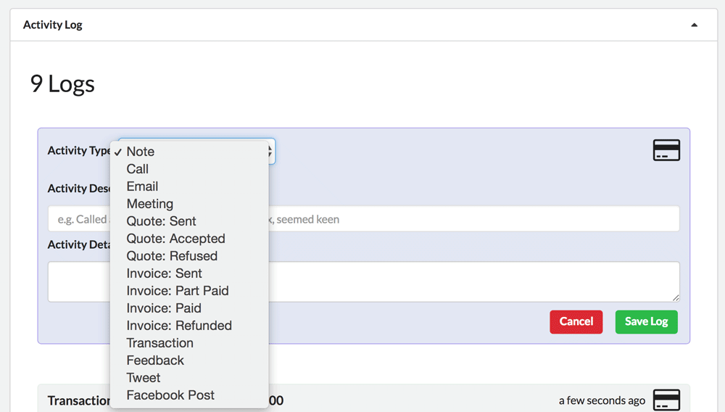
Audit log

Slide 5
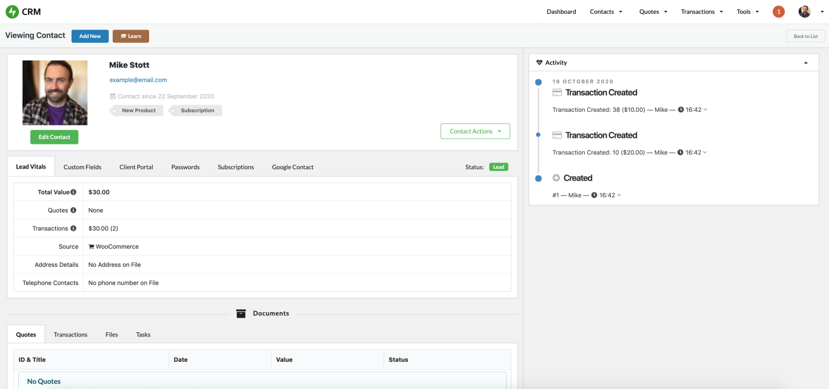
Client account manger screen
We need details
Client Name
SSN
Home address
Contact details
Bank Acc# Creditiional
Credit Card
Email Access
Accounting S/w access
Business Entity
TIN#
EDD#
Permit#

