Slide 1

Real Time Detection of AI Generated Speech and Images
Minor project
Vansh Giri
229303045 CCE C 6th

Slide 2
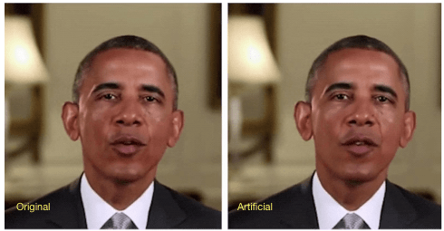

Problem Statement
Generative AI enables creation of highly realistic synthetic speech and images (deepfakes).
Deepfakes pose risks of identity fraud, misinformation, and erosion of digital trust.
Real-time, accurate detection is essential for security, media integrity, and public trust.
Need for models that generalize well, even with limited or imbalanced training data.
This project develops deep learning pipelines for rapid, reliable identification of AI-generated media.

Slide 3
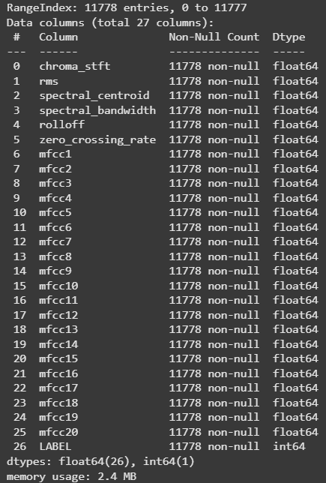

Methodology
1 – CSV Data
Source : Deepfake Audio Detection
CSV file with 11,700 samples × 27 feature
26 numerical features (acoustic parameters)
1 categorical target variable (real/fake)

Slide 4

1 – CSV Data
All using GridSearchCV
RANDOM FOREST
MLP
SVM
GRADIENT BOOSTING
XGBOOST

Slide 5
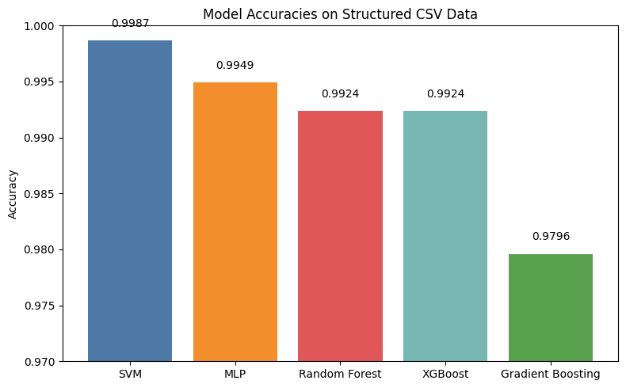
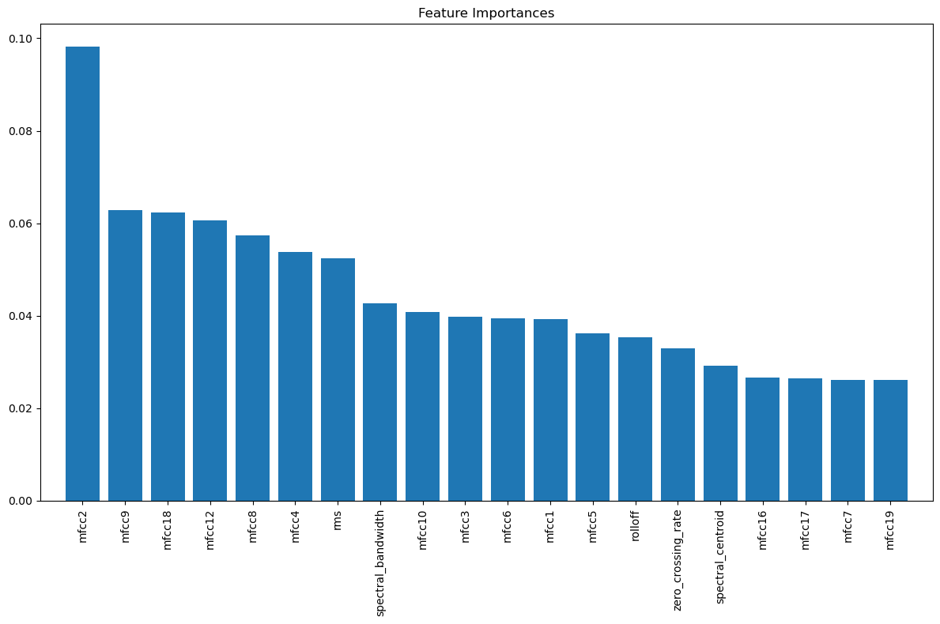
1 – CSV Data

Slide 6

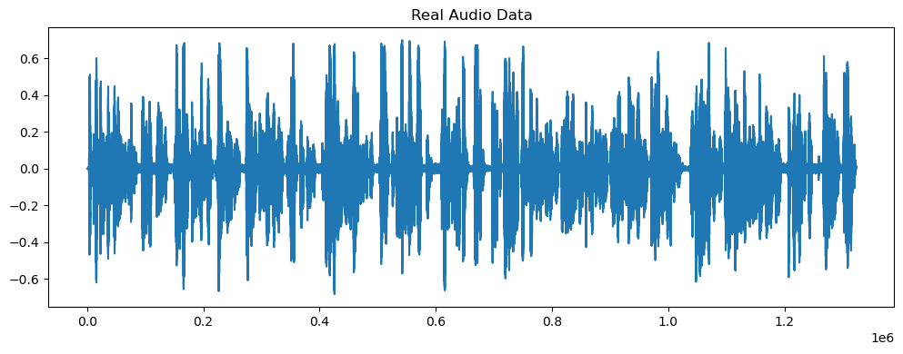
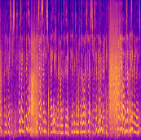
2 - .wav Data
Source : Deepfake Audio Detection
56 fake, 8 real (WAV format)
2 Approaches:
A. Feature Extracted CSV
B. Spectrograms

Slide 7
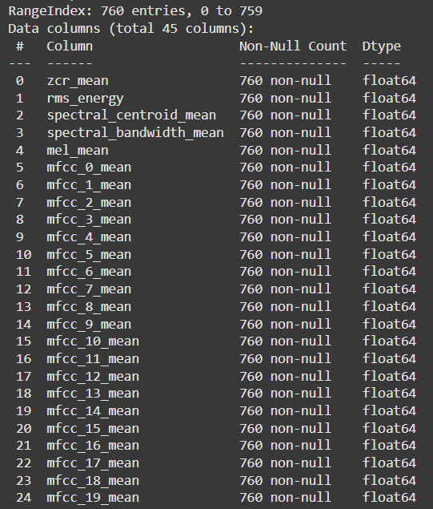
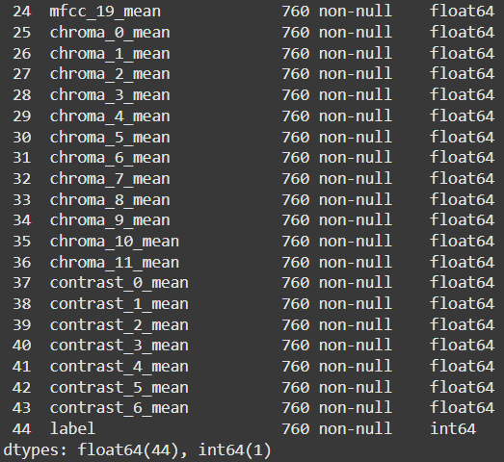
2A – Feature Extracted CSV
Split long files into uniform clips – 10s
Then, extracted features like MFCCs, spectral contrast, etc. Got 2300 fake audio files (each 10s) and 380 real audio files,
After feature extraction combined random 380/2300 fake file data
With 380 real file data to get a 760 x 45 CSV data file.

Slide 8
2A – Feature Extracted CSV
All using GridSearchCV
RANDOM FOREST
MLP
SVM
LOGISTIC REGRESSION
XGBOOST

Slide 9
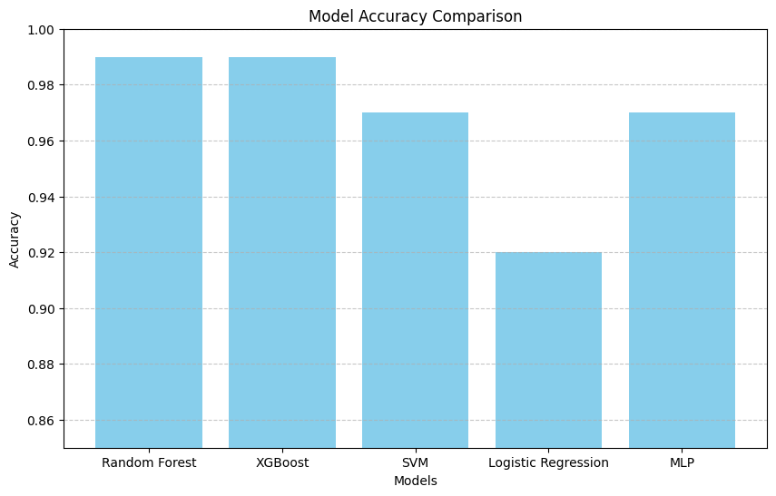
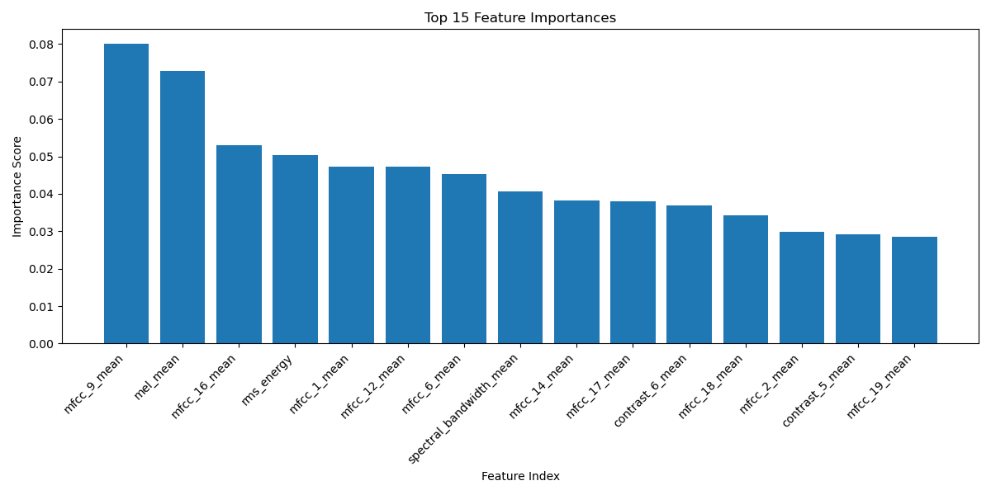
2A – Feature Extracted CSV

Slide 10
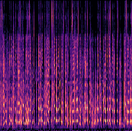
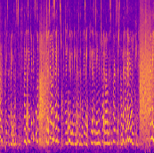
2B - Spectrograms
Augmented original REAL audio files by –
Gaussian noise (SNR=20dB)
Pitch shifting (±4 semitones)
Time stretching (0.8-1.2x speed)
With these new augmented REAL audio files
Generated additional 48 spectrograms to match
Total of 56 with FAKE audio file spectrograms
FAKE
REAL

Slide 11
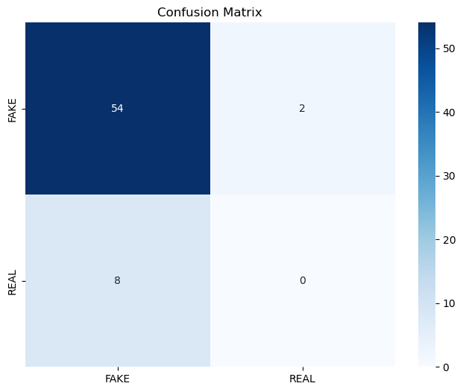
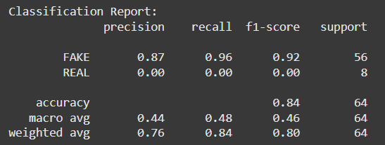
2B - Spectrograms
Trained a simple CNN model and a MobileNetV2 pipeline
Look at the Precision, Recall and F1-score of REAL label Model fails – due to class imbalance NEEDS MORE REAL LABEL FILES

Slide 12
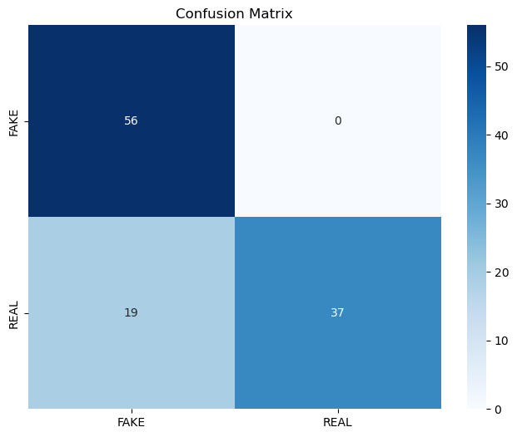
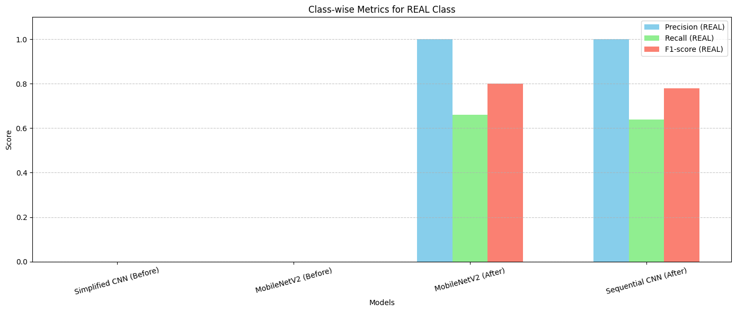
2B – Spectrograms
Model works as classes are balanced
Self trained complex models will also fail after training at high epochs due to less sample size

Slide 13










3 - Image Data
Source : CIFAKE 120,000 images (60k fake / 60k real) 32x32 pixel resolution
REAL
FAKE

Slide 14
3 – Image Data
PREPROCESSING
TRAINING
All images resized to 128×128 pixels for model input consistency.
Random horizontal flip and rotation (±15°) applied for data augmentation.
Images converted to PyTorch tensors and normalized using ImageNet mean and std.
Stratified train-test split ensures balanced evaluation.
ResNet50: 50-layer pretrained model (ImageNet), input 128×128×3, GAP + Dense for 2 classes.
MobileNetV2: Lightweight pretrained model (ImageNet), input 128×128×3, GAP + Dropout + Dense.
SimpleCNN: 5 Conv layers (3→256), MaxPooling, Flatten, FC (256→512→2), ReLU activations.

Slide 15
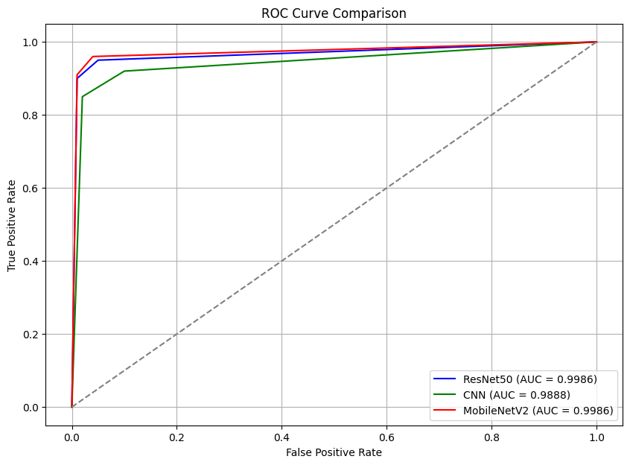
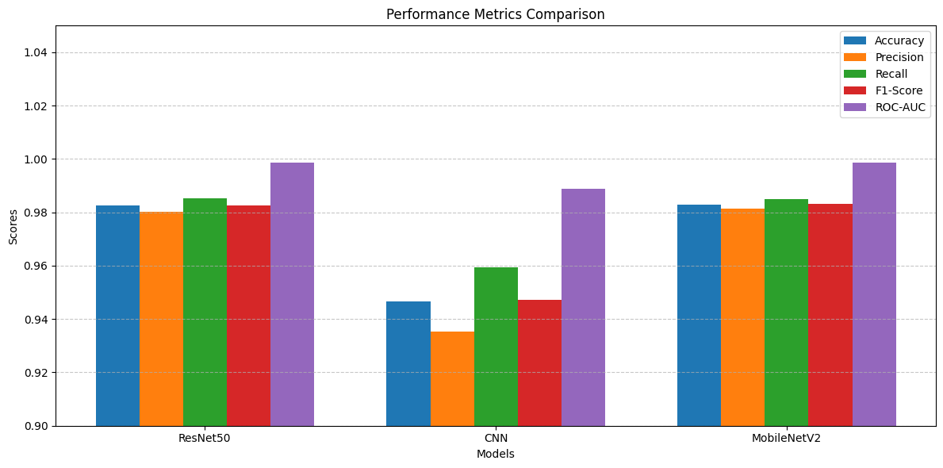
3 – Image Data

Slide 16
Future Work
Extend this research into a formal research paper for academic publication.
Apply the developed audio detection pipelines to personally collected audio data.
Collect real and AI-generated speech from sources like YouTube, Google Translate, ElevenLabs, and Uberduck.
Evaluate performance on diverse, real-world audio samples and new synthetic voices.
Gather and test on new AI-generated image datasets (e.g., ACID, DeepGuardDB, GenImage).
Compare results with current benchmarks and refine models for improved generalization.
Explore advanced augmentation and continual learning to adapt to evolving deepfake generation methods.

Slide 17
THANK YOU

