Slide 1
Beyond the Hairball
Measuring Cross-Community Bridges in Reddit
Longitudinal network analysis · 2018 Q1–Q3 · 170 subreddits
Stable structure? Or a hairball created by the measurement lens?

Slide 2
Can a bridge survive even when its people change?
Community A Community B
● ●
╲ ╱
╲ Broker 1 Broker 2 ╱
╲ Broker 3 ╱
─── BRIDGE ───
↓
NEXT QUARTER
↓
─── BRIDGE ───
╱ New brokers ╲
Structural question
Does the cross-community position persist?
Staffing question
Do the people occupying that position persist?
Structure and occupants are separate quantities.

Slide 3
A longitudinal Reddit dataset at real-world scale
170
3
171.6M
161.7M
subreddits
consecutive quarters
raw comments
retained after cleaning
2018 Q1 55.2M raw → 2018 Q2 57.3M raw → 2018 Q3 59.1M raw
Retention per quarter: 94.3% · 94.2% · 94.1% Overall ≈ 94.2%
Private salted author hashes · frozen cleaning rules · per-quarter coverage reports

Slide 4
From Reddit comments to a community network
Reddit
comments
User × subreddit
bipartite data
Audience overlap
(cosine)
Subreddit
network
Leiden
communities
Participation
coefficient
Bridge
positions
Temporal
comparison
›
›
›
›
›
›
›
Privacy
Salted author hashes; no raw text stored
Reproducibility
Frozen configuration + automated checks
Engineering verification
88 tests passed

Slide 5
The critical modeling choice: what counts as a connection?
USER ×
SUBREDDIT
shared users
↓
cosine audience overlap
SUBREDDIT ×
SUBREDDIT
⚠ Every shared user creates a potential edge.
Goal: identify audience overlap while normalizing for subreddit size.

Slide 6
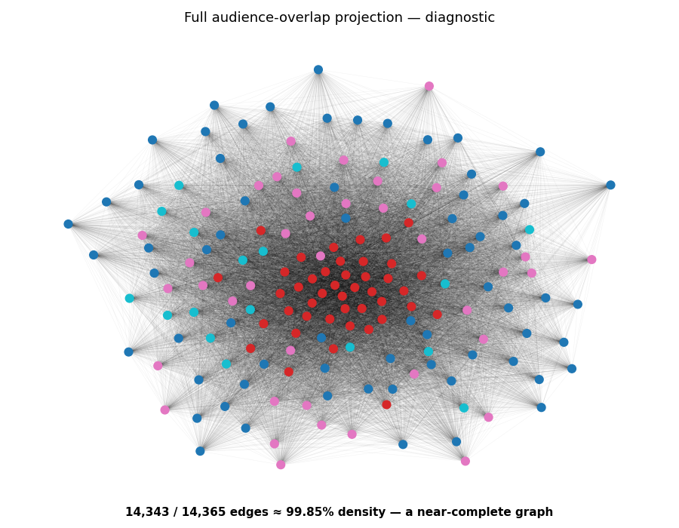
The first representation produced a near-complete network
99.85%
14,343 of 14,365 possible subreddit pairs are connected
Almost every subreddit shares at least some audience with almost every other.

Slide 7
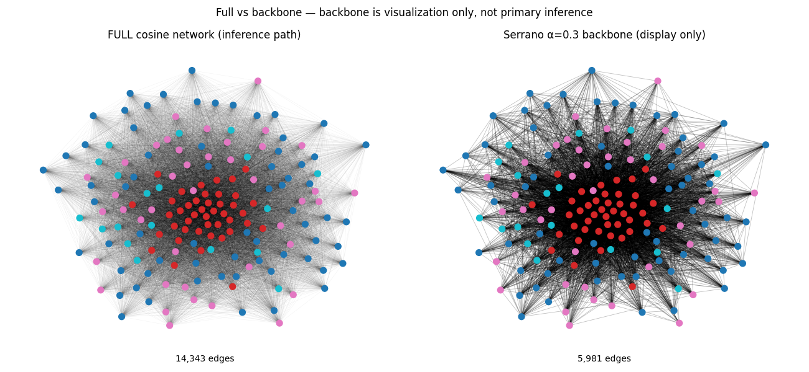
The problem was density, not node count
Backbone is visualization only — not the primary inferential network. A prettier graph ≠ a valid measurement.

Slide 8
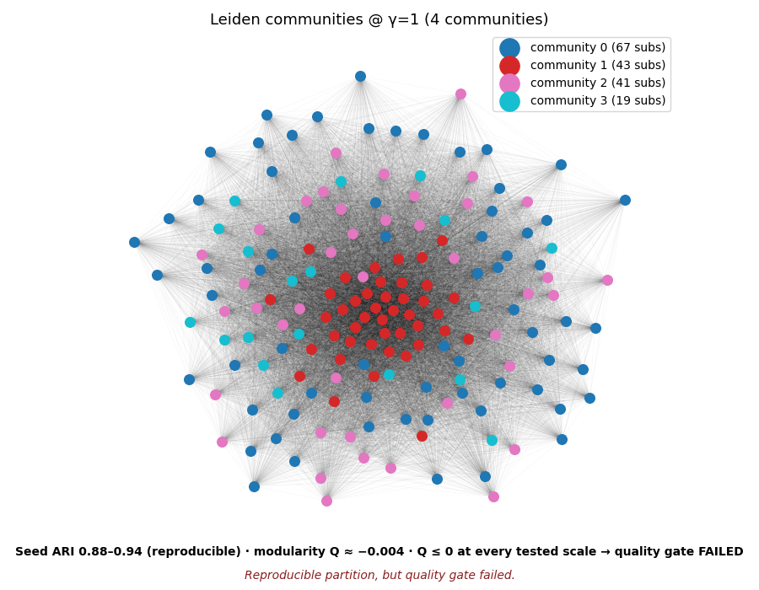
Reproducible — but not structurally convincing
4
communities
0.88–0.94
Q ≤ 0
seed ARI
quality, all scales
Stable across seeds ≠ valid community structure
Resolution profile γ = 0.5 → 1 community · 0.8 → 3 · 1.0 → 4 · 1.2 → 8 · 1.5 → 24 — quality non-positive throughout

Slide 9
The bridge detector then saturated
◉ C1 — C2
◉ C1 — C3
◉ C1 — C4
◉ C2 — C3
◉ C2 — C4
◉ C3 — C4
6 / 6
~4–5.6k
The bridge definition became saturated rather than selective: every pair bridged, thousands of occupants each.
possible pairs bridged
occupants per position
Descriptive only — inference blocked by failure gates

Slide 10
Trackable quarters — but no valid persistence signal
2018 Q1
2018 Q2
2018 Q3
width Jaccard 0.499
correlation 0.9996
mapping 100% / 100%
width Jaccard 0.499
correlation 0.9567
mapping 75% / 95.9%
DESCRIPTIVE ONLY

Slide 11
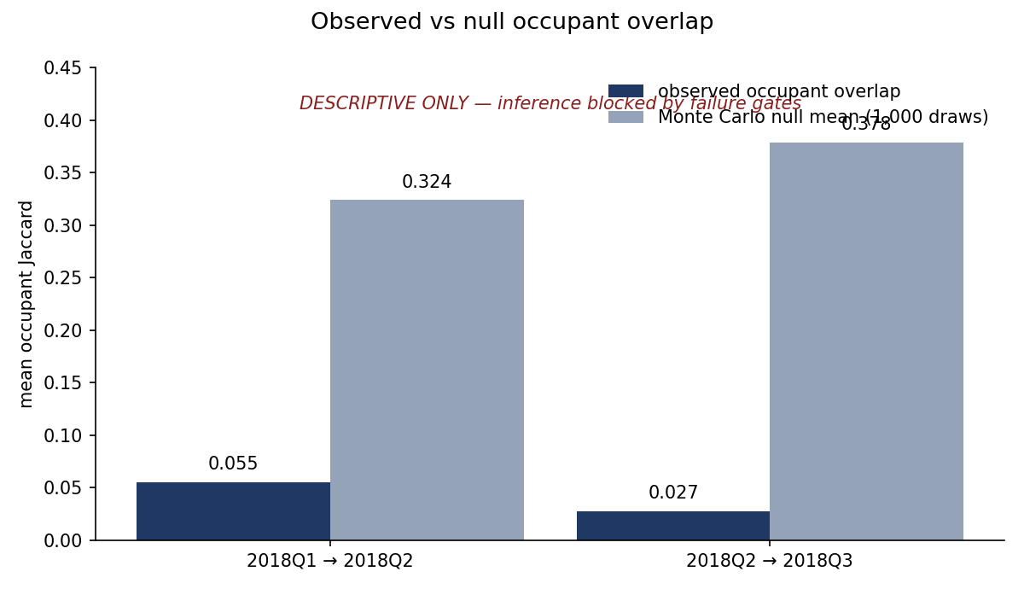
The people changed more than the detected structure
DESCRIPTIVE ONLY — NOT A CONFIRMATORY RESULT. Null = Monte Carlo mean (1,000 draws); observed overlap sits far below it, but positions failed validity gates.

Slide 12
What failed — and what did not
DID NOT FAIL
✓ Real-data extraction
✓ 170/170 frame coverage
✓ Privacy-preserving processing
✓ 3-quarter longitudinal dataset
✓ Reproducible pipeline · 88 tests
✓ Temporal execution
DID FAIL
✗ Primary network representation
✗ Meaningful community separation
✗ Selective bridge identification
✗ Valid longitudinal bridge inference
The pipeline worked. The measurement lens did not.

Slide 13
The negative result became the methodological finding
Research question: persistent bridges?
170 communities × 3 quarters, 171.6M comments
Audience-overlap projection → 99.85% dense
Community structure loses discrimination
Bridge analysis saturates
Inference rejected by prespecified gates
★ NEW QUESTION: separating meaningful co-occurrence from generic overlap?
The data did not refute the hypothesis — they showed this lens could not see it.

Slide 14
From “who overlaps?” to “who overlaps more than expected?”
CURRENT
User × subreddit → cosine → near-complete graph
NEXT
Activity-aware representation → meaningful co-occurrences → sparse network → communities → bridges → turnover
Candidate 1: statistically validated bipartite projection
Candidate 2: direct bipartite community detection
Method selection by construct validity and degree control — not by whichever graph looks prettiest.

Slide 15
What we know now
01 — The data pipeline works at real scale. 170 subreddits, 3 quarters, 171.6M comments, reproducible.
02 — The first network representation is too dense for bridge analysis. 99.85% density caused saturation.
03 — The failure directs the next experiment. Separate degree-driven overlap from structural association.
The next step is not more data. It is a better measurement lens.

Slide 16
Selected methodological references
Serrano, Boguñá & Vespignani (2009). Multiscale backbone. PNAS.
Traag, Waltman & van Eck (2019). From Louvain to Leiden. Sci. Rep.
Guimerà & Amaral (2005). Functional cartography. Nature.
Saracco et al. (2015). Randomizing bipartite networks. Sci. Rep.
Saracco et al. (2017). Entropy-based bipartite projections. NJP.
Larremore, Clauset & Jacobs (2014). Bipartite community inference.
Phipson & Smyth (2010). Permutation P-values should never be zero.

Slide 17
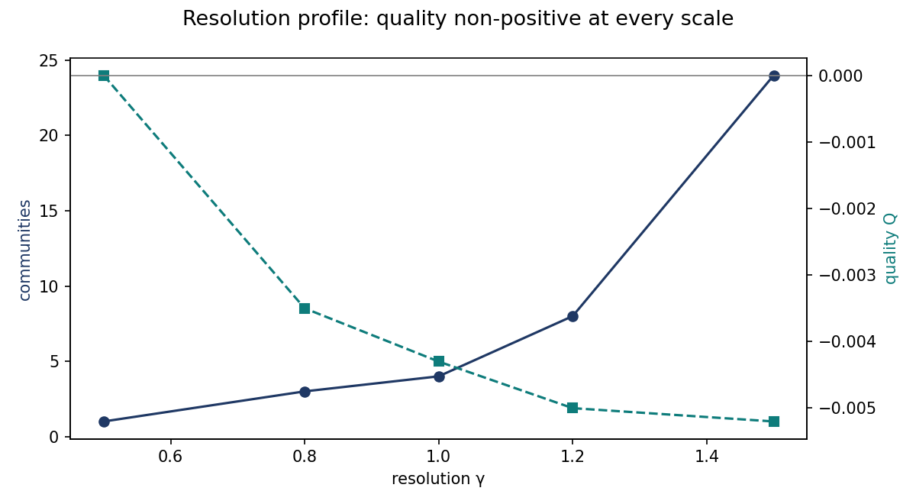
Appendix A — Resolution profile
No tested resolution produced a positive-quality modular solution. RBConfiguration quality at γ=1.

Slide 18
Appendix B — Data & reproducibility
✓ 170/170 frame coverage, all 3 quarters
✓ 88 automated tests passed
✓ Salted author hashes; no raw usernames or text stored
✓ Deterministic null rerun verified identical
✓ Frozen config recorded in every results file
✓ Run manifest: code version, salt fingerprint, gates, outputs

Slide 19
Appendix C — Failure gates
Partition stable? (seed ARI ≥ 0.60, Q > 0)
Mapping valid? (rate ≥ 60%, coverage ≥ 80%)
Enough positions? (≥ 10 shared)
Not saturated? (< 95% of pairs)
Null computable? (SD > 0)
↓
YES → inference NO → descriptive only
These gates prevented unsupported claims: both transitions were correctly demoted.

