Slide 1
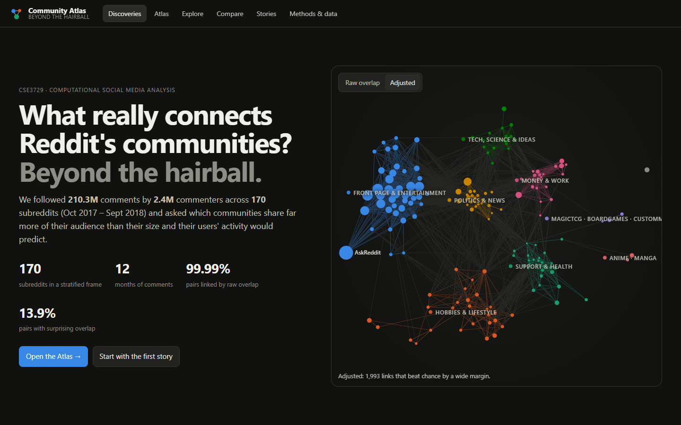
Beyond the Hairball: The Reddit Community Atlas
What really connects Reddit's communities? An interactive map of surprising shared audiences across 170 subreddits, Oct 2017 – Sept 2018
CSE3729 Computational Social Media Analysis · BML Munjal University
Akashita (230779) · Vansh Jaitly (230687)
Notes:
Introduce the question: which Reddit communities share an audience, and which only seem to because they are big. Point at the live map: every circle is a subreddit, every line a surprisingly large shared audience.

Slide 2
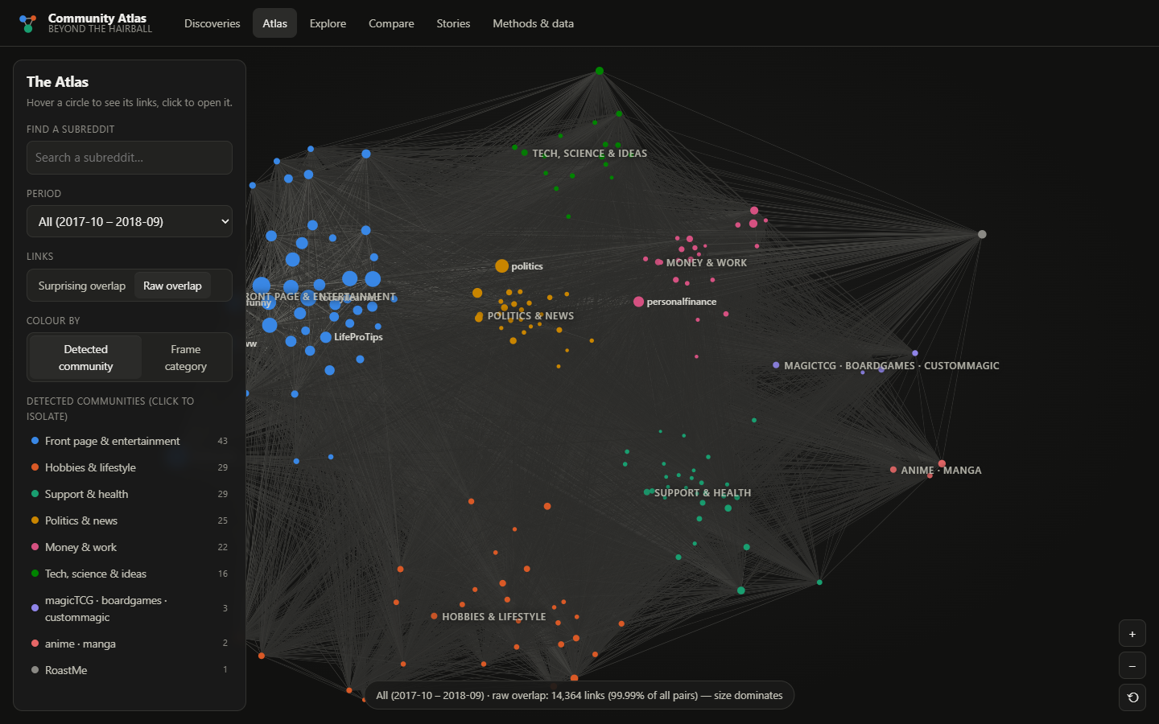
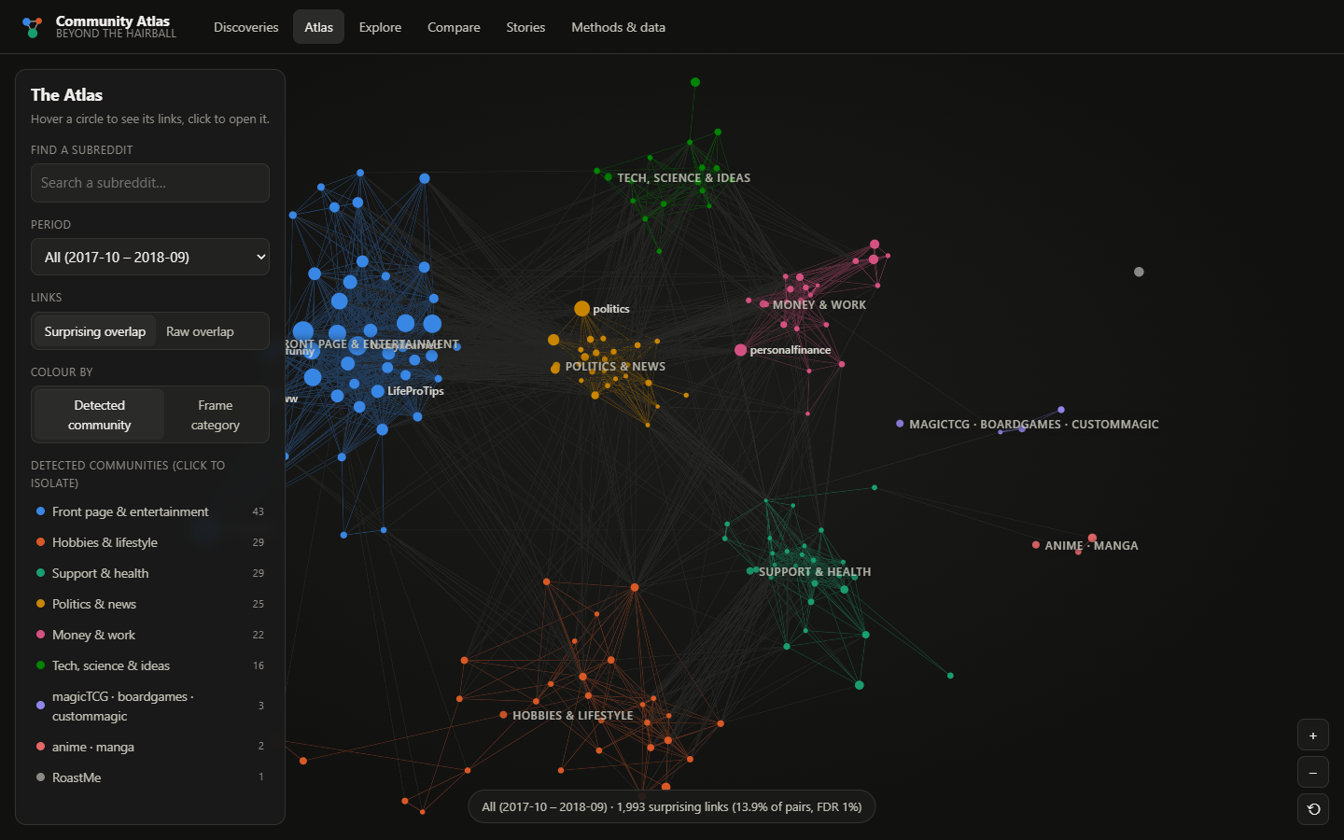
Raw shared audiences connect almost everything
99.99%
13.9%
of subreddit pairs share at least one commenter: the raw network is a hairball
of pairs share far more commenters than size and activity predict
Notes:
Raw overlap links 99.99% of pairs, because one person who comments in many places links all of them. Keeping only pairs that beat the expected overlap leaves 13.9%, and topical communities appear.

Slide 3
A year of Reddit comments, cleaned and pseudonymised
223.2M
210.3M
2.45M
170 × 12
raw comments collected
kept after cleaning (94.2%)
distinct pseudonymised commenters
subreddits × months
Arctic Shift archive
›
Fetch + salted hash
›
Clean (activity, bots)
›
User × subreddit matrix
›
Expected overlap (BiCM)
›
Surprising links (FDR 1%)
›
Communities + roles
›
Atlas app
Frame: 150 topical subreddits (25 in each of 6 categories) + 20 front-page hubs, chosen by a fixed rule before analysis. Scope: the proposal planned 2019–2025; the archive's comments end in Aug 2022, and this bounded study covers 2017 Q4, 2018 Q1, 2018 Q2, 2018 Q3. Privacy: no text stored; usernames hashed at collection; only subreddit-level aggregates published.
Notes:
Data: public comments from the Arctic Shift archive, read remotely with DuckDB. Every fetch checks that all 170 subreddits are present. Cleaning keeps accounts with at least five comments a quarter and removes bot-like accounts.

Slide 4
The question for every pair: more shared commenters than chance?
Expected shared commenters
952 = 952
links validated by our code and the published bicm package (150k-user real sample)
A random Reddit in which every account keeps its number of subreddits and every subreddit keeps its number of commenters, but who comments where is shuffled (Bipartite Configuration Model, Saracco et al. 2015).
83%
of links survive a stricter ≥2-comment threshold
expected(a,b) = Σ users p(u→a) · p(u→b)
affinity(a,b) = shared ÷ expected
83–85%
of links persist from one quarter to the next (Jaccard)
A link is drawn only when the shared count is improbably high: one-sided Poisson test, Benjamini–Hochberg false discovery rate 1% over all 14,365 pairs. Communities: Leiden on log-affinity. Connector role: participation coefficient.
108
automated tests, incl. recomputing every story number from published data
Notes:
Explain observed versus expected in one sentence. The model only keeps how active each person is and how big each community is; anything beyond that is a genuine shared audience. Validation: identical to the reference implementation, robust to a stricter threshold, stable over time.

Slide 5
What popularity hides: hubs vanish from real neighbour lists
49%
r/personalfinance · raw overlap
r/personalfinance · adjusted
r/news
1.09×
r/financialindependence
2.11×
of a topical subreddit's 10 closest neighbours are front-page hubs, by raw overlap
r/LifeProTips HUB
1.36×
r/RealEstate
1.94×
4%
r/AskReddit HUB
0.95×
r/Insurance
1.78×
after adjusting for size and activity
r/pics HUB
0.98×
r/investing
1.59×
r/todayilearned HUB
1.02×
r/Frugal
1.51×
r/AskReddit: 1,526,775 commenters, median affinity 0.80× — big, not close to anyone.
r/funny HUB
0.93×
r/DIY
1.42×
Numbers: affinity (shared ÷ expected) over all 12 months. 1.0× = chance.
Notes:
By raw overlap r/personalfinance looks closest to front-page hubs. Adjusted, its neighbours are r/financialindependence, r/RealEstate, r/Insurance.

Slide 6
9 stable communities emerge from the surprising links
Front page & entertainment
43
Hobbies & lifestyle
29
Support & health
29
Politics & news
25
Money & work
22
Tech, science & ideas
16
magicTCG · boardgames · custommagic
3
anime · manga
2
RoastMe
1
Weighted modularity 0.577 · agreement across 20 seeds ARI 0.995 · each quarter's communities match at ARI 0.887, 0.854, 0.933, 0.903
Notes:
The detected communities largely follow topics, with telling exceptions: r/Economics sits with politics, and media subreddits split between the front page and hobbies.

Slide 7
Unexpected neighbours: for some communities, country beats topic
1,536
commenters shared by r/CanadaPolitics and r/PersonalFinanceCanada
249
expected from size and activity alone
218 cross-category links hold in every quarter and under the stricter threshold. The second strongest is the UK pair. Without text we cannot say why: geography, profession and demographics all fit.
Notes:
A nation's politics forum and its personal-finance forum share an audience seven times larger than chance, in every quarter.

Slide 8
The hidden connectors are mid-sized topical communities, not hubs
0.25
average for the 20 front-page hubs
0.31
average for topical communities
0 = all surprising links stay in one community; towards 1 = spread evenly. Rankings are stable between quarters (ρ 0.87, 0.90, 0.94).
Notes:
Connectors share unusually large audiences with several clusters. That is co-presence, not evidence that information flows through them.

Slide 9
When crowds leave, ties tighten; when they arrive, ties loosen
Crypto: Bitcoin peaked 17 Dec 2017; r/Bitcoin commenters -81% by Sept 2018 while the frame grew 14%. The remaining audiences overlap 3.37× → 9.8×. Marvel: Infinity War (27 Apr 2018) doubled weekly commenters; affinity fell to 3.94× in April. All communities: ρ = -0.452 over 128 swings > 25%. Association, not causation.
Notes:
Arriving crowds mostly comment in only one of the related communities, which dilutes the surprising overlap; a departing crowd leaves a core active in all of them.

Slide 10
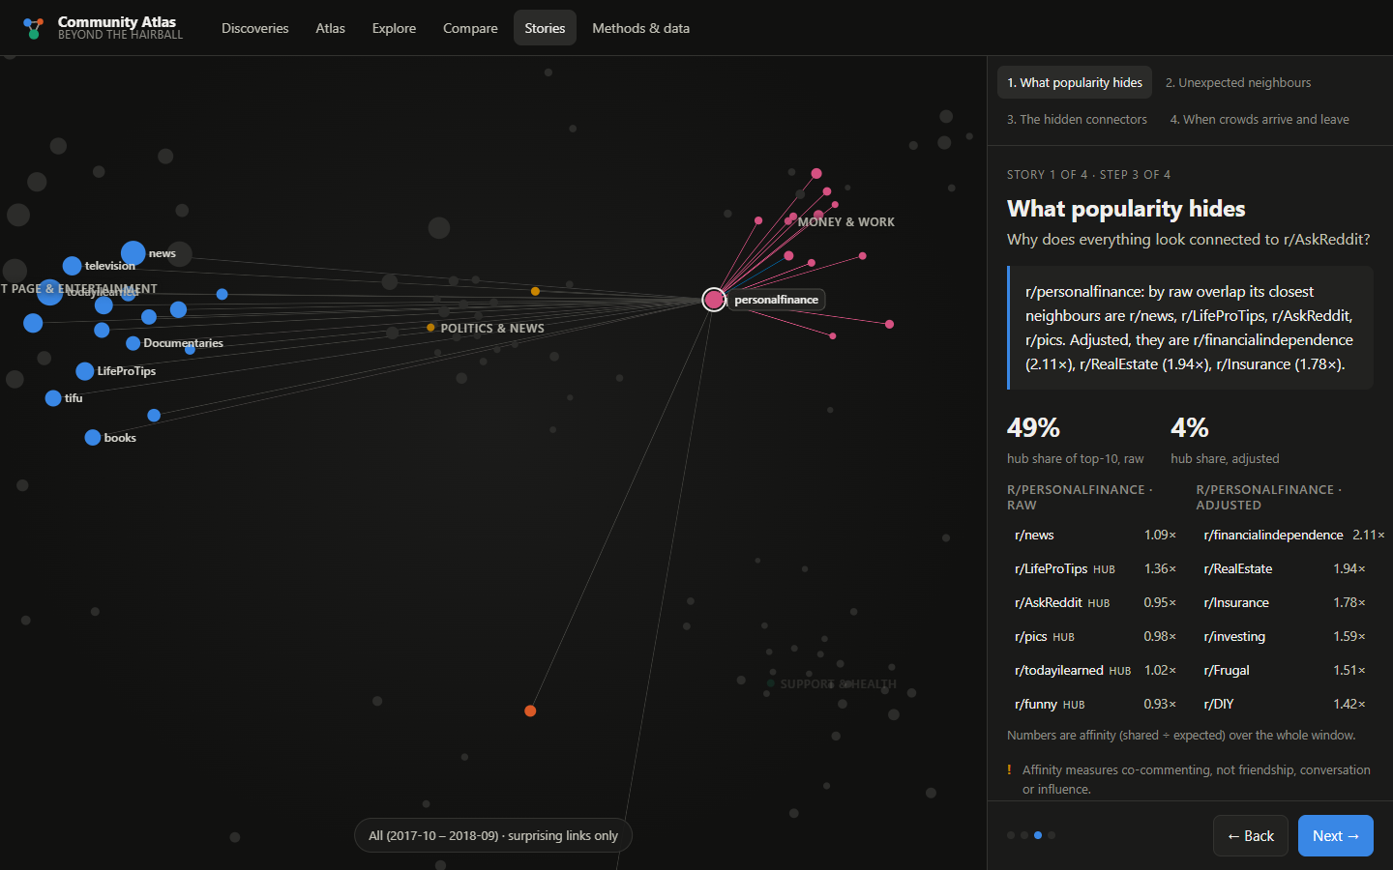
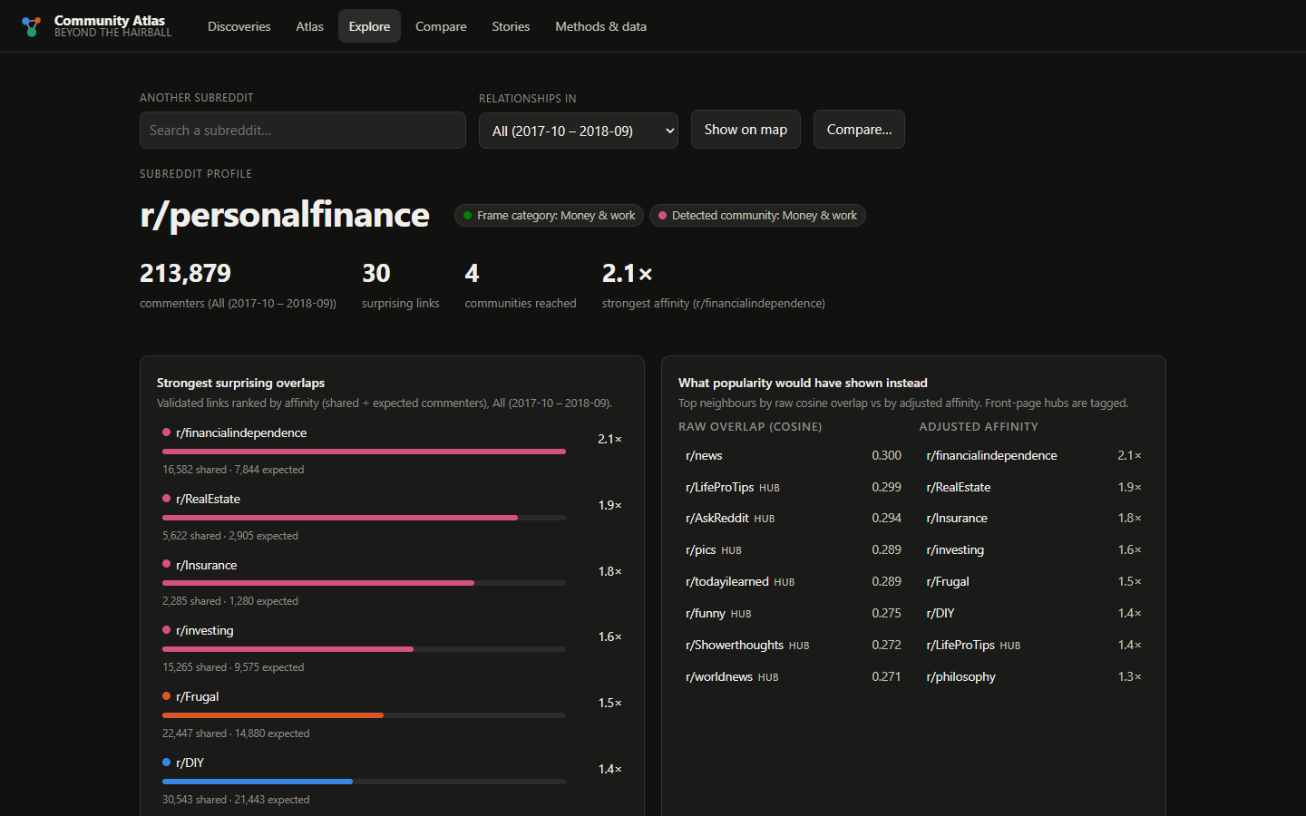
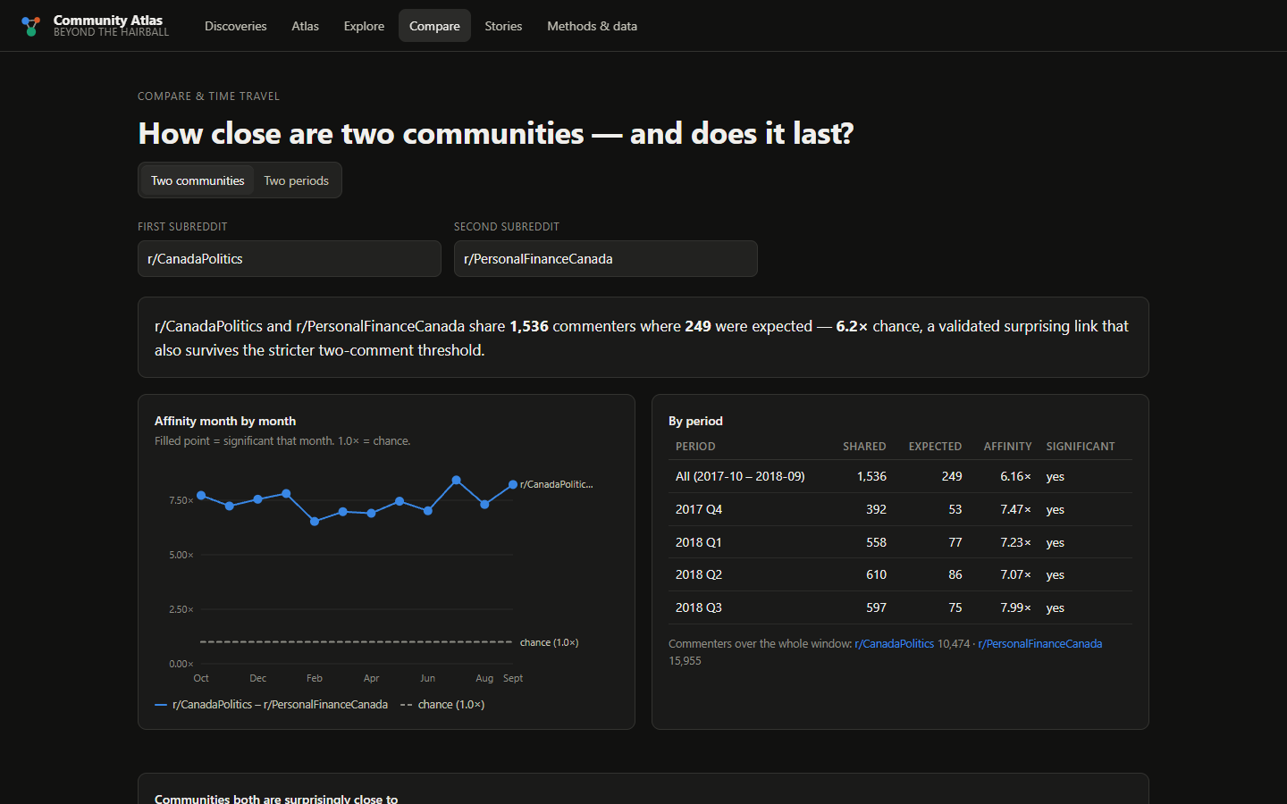
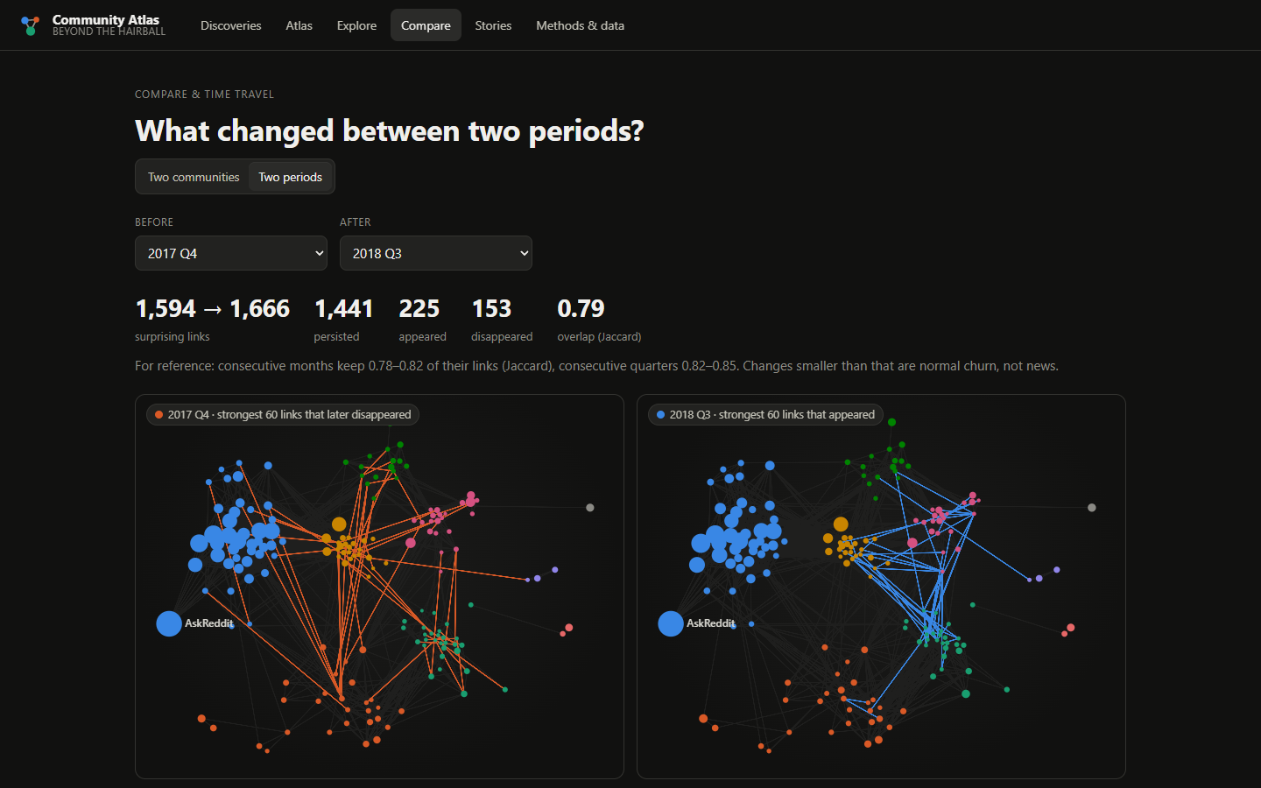
The Atlas lets anyone check every claim
Guided stories drive the map
Profile of any subreddit
Compare two communities over time
Compare two periods: links gained and lost
Notes:
Live demo: open the Atlas, search r/personalfinance, play the crowds story, compare two periods. Every view is a URL; the Streamlit console shows data collection and cleaning.

Slide 11
How the project evolved from the submitted proposal
1
2
3
4
5
Proposal
V1 hairball
Audit
Re-representation
Atlas
Do bridge positions between communities outlast the people occupying them?
Cosine network 99.85% dense; 4 communities → only 6 bridge positions, all saturated
Reported Q -0.0041 was unweighted; the weighted value is 0.1251
Literature on bipartite projections → BiCM validation, checked against the reference code
Bridges become measured connector roles; time becomes the crowd stories
V1 is preserved unchanged at git tag v1-baseline. The occupant-turnover hypothesis is not claimed as proven or disproven: it needs many more bridge positions and a matched null, which is future work.
Notes:
The change of lens follows from evidence, not convenience. The original question survives as the connector role and the temporal stories.

Slide 12
What we can and cannot conclude
We can show
We cannot claim
Which subreddit pairs share more commenters than size and activity explain
Why audiences overlap: no text, so no topics, motives or sentiment
That these links form stable topical communities and connector roles
That events caused the changes: associations only
That audiences changed around dated events, and how affinity moved with them
Anything about Reddit as a whole: a fixed sample of 170 subreddits, 12 months, commenters only, with archive gaps
Notes:
Ethics: public data, salted hashes, aggregate-only publication, sensitive support communities shown only in aggregate.

Slide 13
Size explains most raw overlap. What remains is a readable, stable map
Run it
python atlas/serve.py
python atlas/build_atlas.py
python -m pytest tests/
streamlit run data_curation/dashboard.py
13.9% of pairs, 9 communities, country-level neighbours, mid-sized connectors, and ties that loosen and tighten with crowds.
Report: docs/FINAL_REPORT.pdf

Slide 14
Appendix: the literature behind each design decision
Source | Establishes | Used for
Saracco et al. 2015, 2017 | BiCM null model; Poisson-binomial test with FDR | Edge definition
Neal et al. 2021; Cimini et al. 2022 | Comparing null models; agreement at matched density | BiCM over exact sampling; sensitivity checks
Olson & Neal 2015; Waller & Anderson 2021 | Reddit maps from shared users; beyond-chance similarity | Reddit precedent; observed ÷ expected
Traag et al. 2019; Good et al. 2010 | Leiden; degeneracy of modularity | Leiden + seed/sensitivity reporting
Guimerà & Amaral 2005; Greene et al. 2010 | Participation coefficient; Jaccard matching over time | Connector score; persistence
Shneiderman 1996; Segel & Heer 2010; Archambault et al. 2011 | Overview → details; martini-glass stories; small multiples | App structure and story mode
Gaffney & Matias 2018; Horta Ribeiro et al. 2021 | Missing Pushshift data; text-free event metrics | Lower bounds; crowd-story metrics

