Slide 1

INTERNATIONAL PROJECT • 2026
CASH
COMPASS
Smart financial management for students
Southern Federal University, Russia × Manipal University Jaipur, India
PENNY PILOTS • NINE STUDENTS, TWO COUNTRIES

Slide 2





01 · WHO WE ARE
Kintan
The team in India
Mobile product, interface, economics and user research.
Kintan Jain
Meehika Sharma
Athena Nair
Akshit Saini
Vansh Kapoor
Frontend Lead
Lead UI/UX Designer
Marketing & User Research
Lead Economist
Backend & API Architect
Five at Manipal Jaipur — they own the Android build and the product design.
CASH COMPASS • PENNY PILOTS

Slide 3


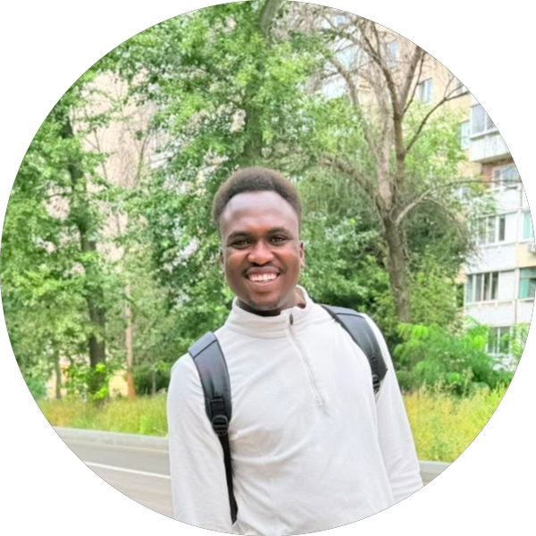

01 · WHO WE ARE
Gleb
The team in Russia
Backend services, data analysis and market research.
Gleb Salnikov
Vladislav Usenko
Ismail Sumamhna
Simphiwe Manaba
Full-stack Developer
Lead Data Analyst
Market Researcher
Lead Graphic Designer
Four at Southern Federal University — one backend serves both platforms.
CASH COMPASS • PENNY PILOTS

Slide 4
02 · THE PROBLEM
Athena
Students don't need a report
Every finance app tells you where your money went.
That is a report, not a decision.
43.3M
STUDENTS IN MARKET
A student standing in a shop with four days left does not need a report.
They need to know whether they can afford this, right now.
18%
TRACK ANY SPENDING
~65%
“Can I afford this now?”
RUN OUT 7–10 DAYS EARLY
CASH COMPASS • PENNY PILOTS
Source: Team Progress & Research Report

Slide 5
03 · THE PRODUCT
Gleb
Six features, one question
Every one of them built to answer “can I afford this now?”
01
Safe-to-Spend limit
02
Reason tags
03
Recurring charges
A daily figure calculated after regular bills and savings goals.
Surfaces impulse, social and discount-driven spending patterns.
Catches repeat payments and subscriptions before they are missed.
04
Savings goals
05
Calendar alerts
06
Insight dashboard
Plan toward future costs and watch progress against a target.
Links exams and festivals to the spending they bring with them.
Organises the financial picture and surfaces useful comparisons.
CASH COMPASS • PENNY PILOTS

Slide 6
04 · HOW IT IS BUILT
Kintan
Front end — the web app
React in the browser, shipping in three languages.
WEB APPLICATION
WHY THREE LANGUAGES
React + TypeScript
Half this team does not speak the other half's first language.
Neither do our users. Translation was not a feature we added at the end — it is a condition of the team that built it.
STYLING
Tailwind CSS
CHARTS
Recharts
LANGUAGES
i18next — 3 languages
HOSTING
Vercel
CASH COMPASS • PENNY PILOTS

Slide 7
04 · HOW IT IS BUILT
Gleb
Back end — one service, both platforms
WEB APP
API LAYER
DATABASE
React
→
→
Python
FastAPI
TiDB
MOBILE APP
Deployed on Railway
Flutter
→
18
4
<100ms
API ENDPOINTS
DATABASE TABLES
CORE ROUTE RESPONSE
The logic exists once, not twice — the website and the phone ask the same service the same questions.
CASH COMPASS • PENNY PILOTS

Slide 8
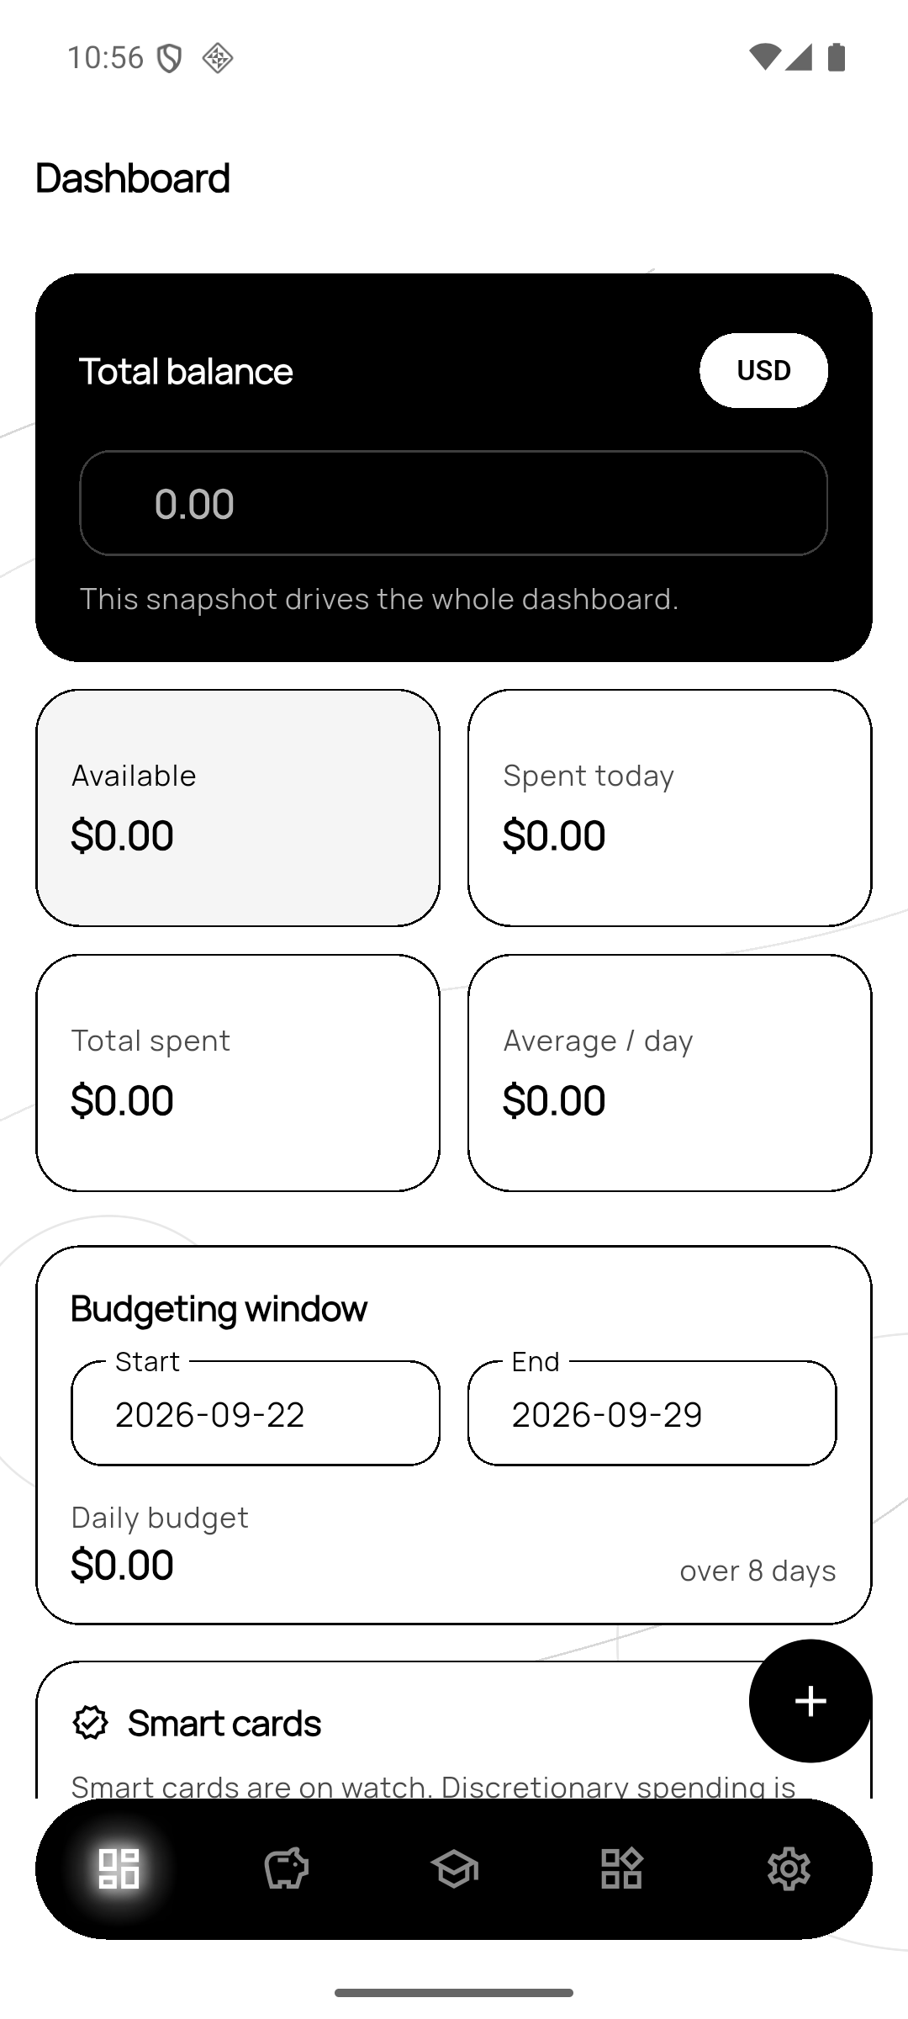
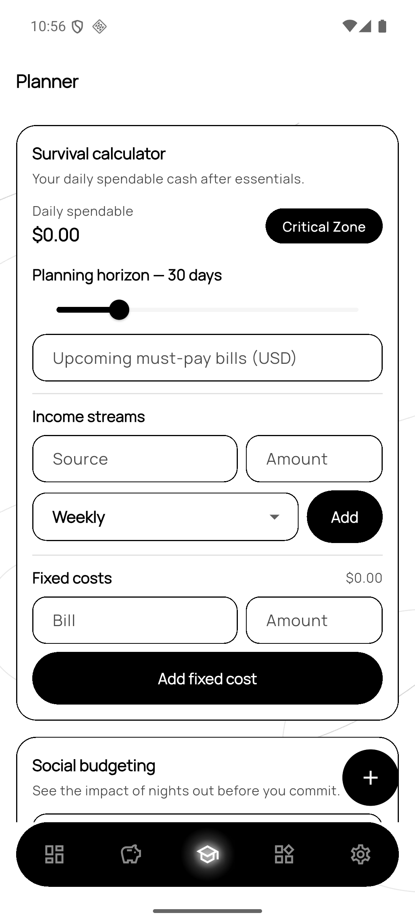
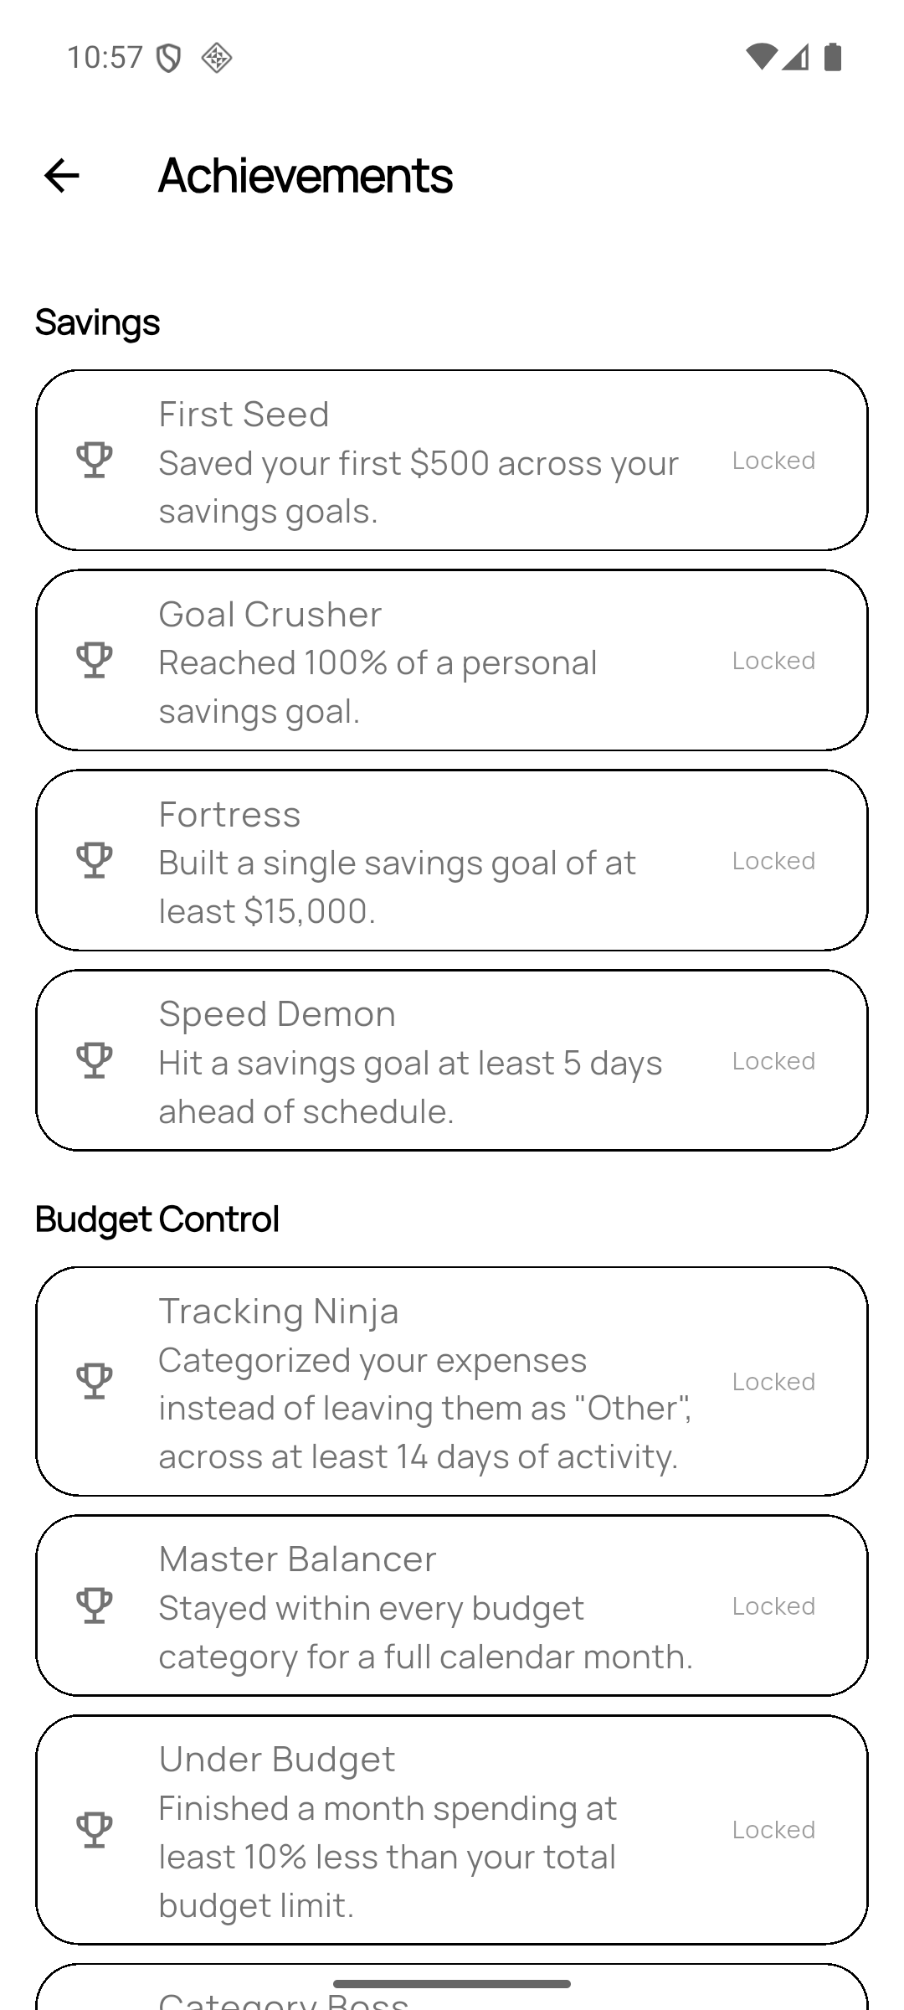
04 · HOW IT IS BUILT
Vansh
Mobile — works with no account, no signal
FLUTTER / DART · ANDROID
No server. No account. No sign-up.
Financial data never leaves the handset, and the app is fully usable offline.
Receipts are read on-device — the photograph is never uploaded anywhere.
Dashboard
Planner
Achievements
23,436
537
1,044
LINES OF DART
TESTS PASSING
TRANSLATED STRINGS
CASH COMPASS • PENNY PILOTS
Source: Cash Compass Technical Report

Slide 9
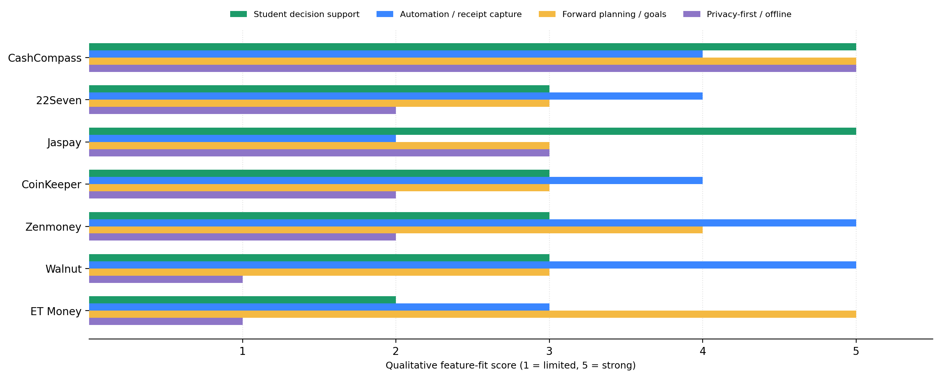
05 · MARKET RESEARCH
Ismail
How we compare
Student-budgeting tools, by documented feature fit.
WHERE WE DIFFER
Student-first decision
Safe-to-Spend answers “can I afford this now”, not “what am I worth”.
Planning, not tracking
Goals, upcoming bills and a daily spendable figure.
Privacy-aware capture
On-device receipt reading; offline-first; user confirms before saving.
CASH COMPASS • PENNY PILOTS
Source: Team Progress & Research Report

Slide 10
06 · ECONOMICS & DATA
Akshit · Vlad
The maths behind the number
THE CORE MODELS
AND ONE VERDICT
Survival calculator
GREEN
Income streams, fixed costs and upcoming bills reduced to one daily figure.
Comfortably inside the daily limit
Social-event budgeting
TIGHT
Tests the cost of a night out before the money is committed.
Close to the limit — plan the rest of the week
Loan-runway visualiser
CRITICAL
How long a lump sum lasts at the current burn rate.
Over the limit — the app says so plainly
Five models in total — and every figure is derived live from the transaction data, never cached.
CASH COMPASS • PENNY PILOTS

Slide 11
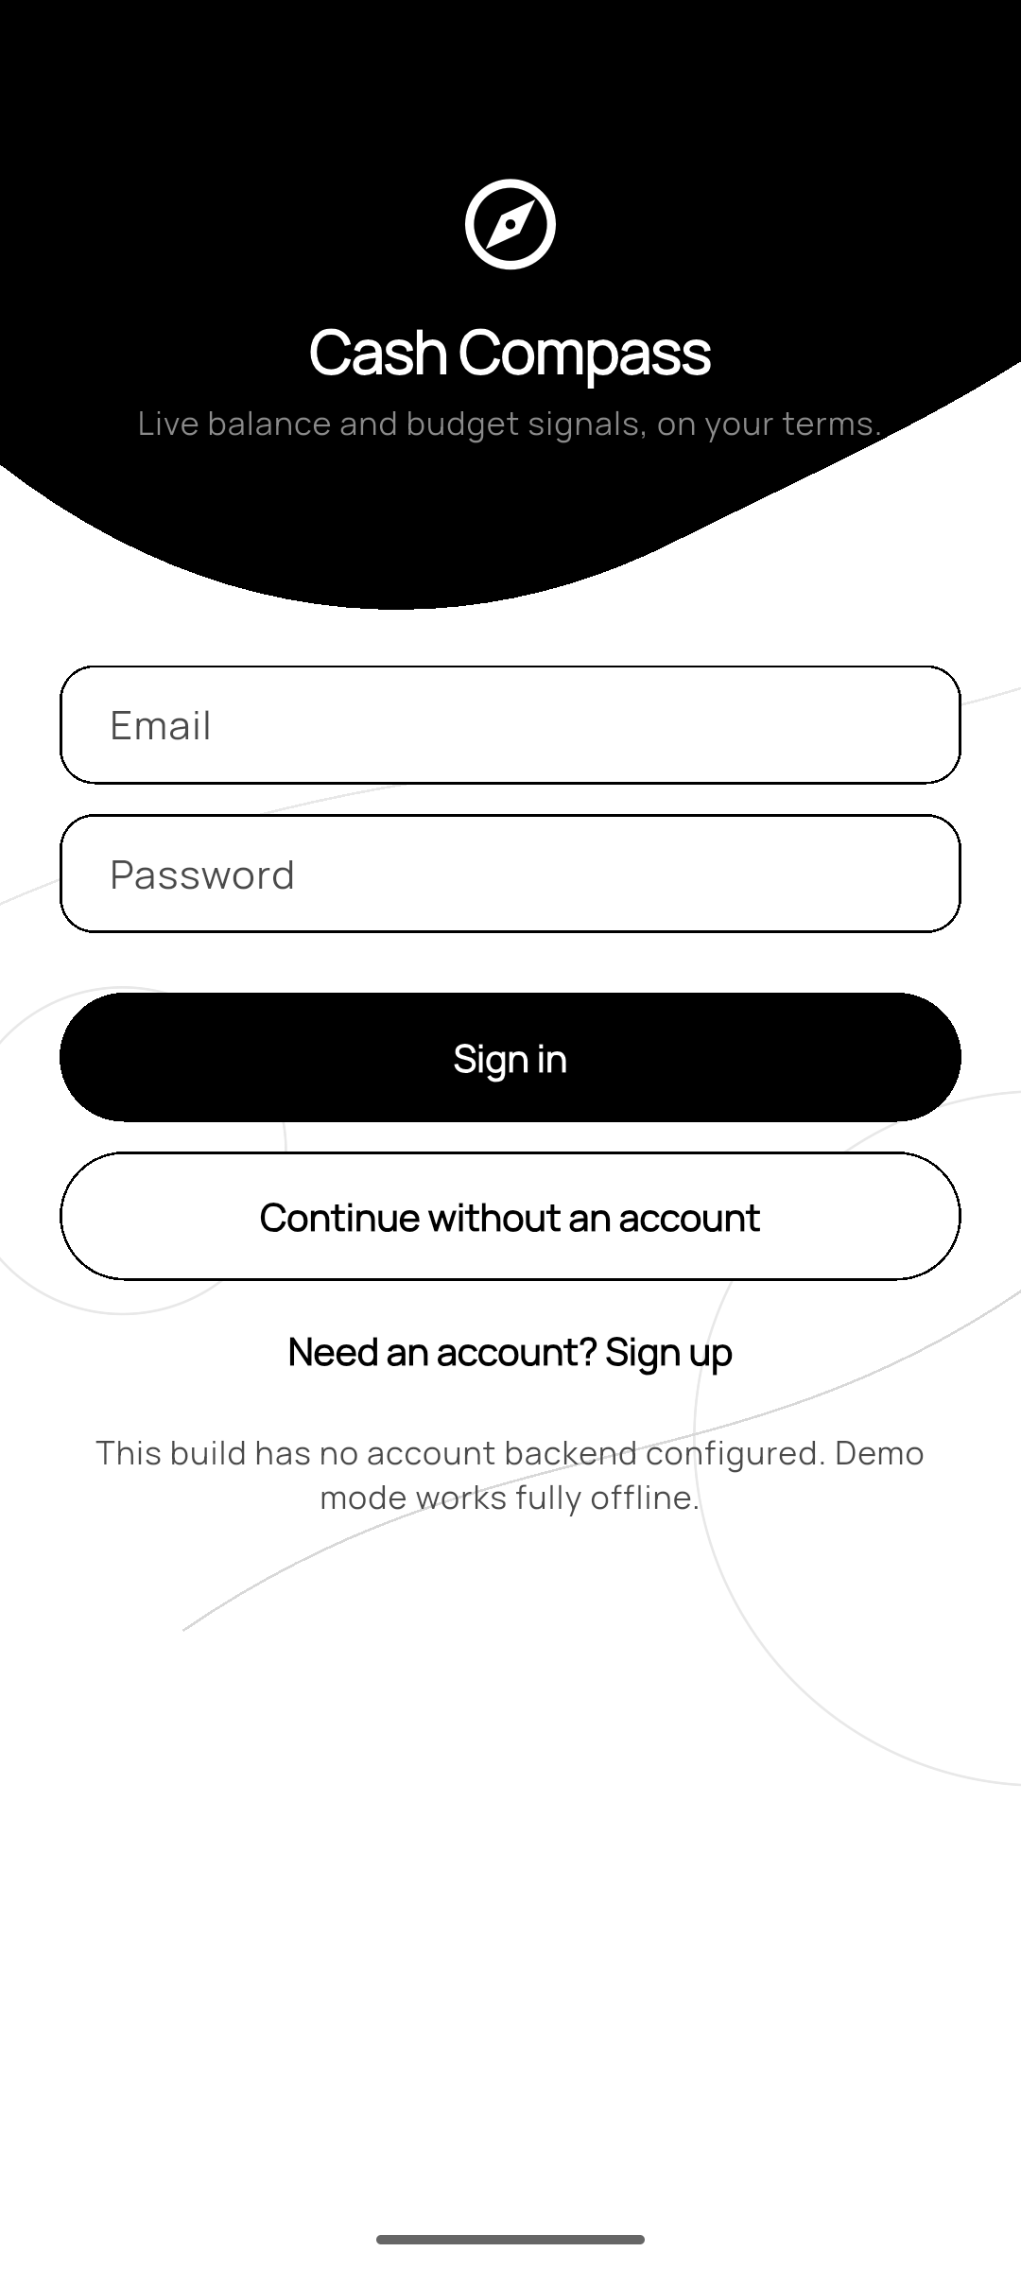
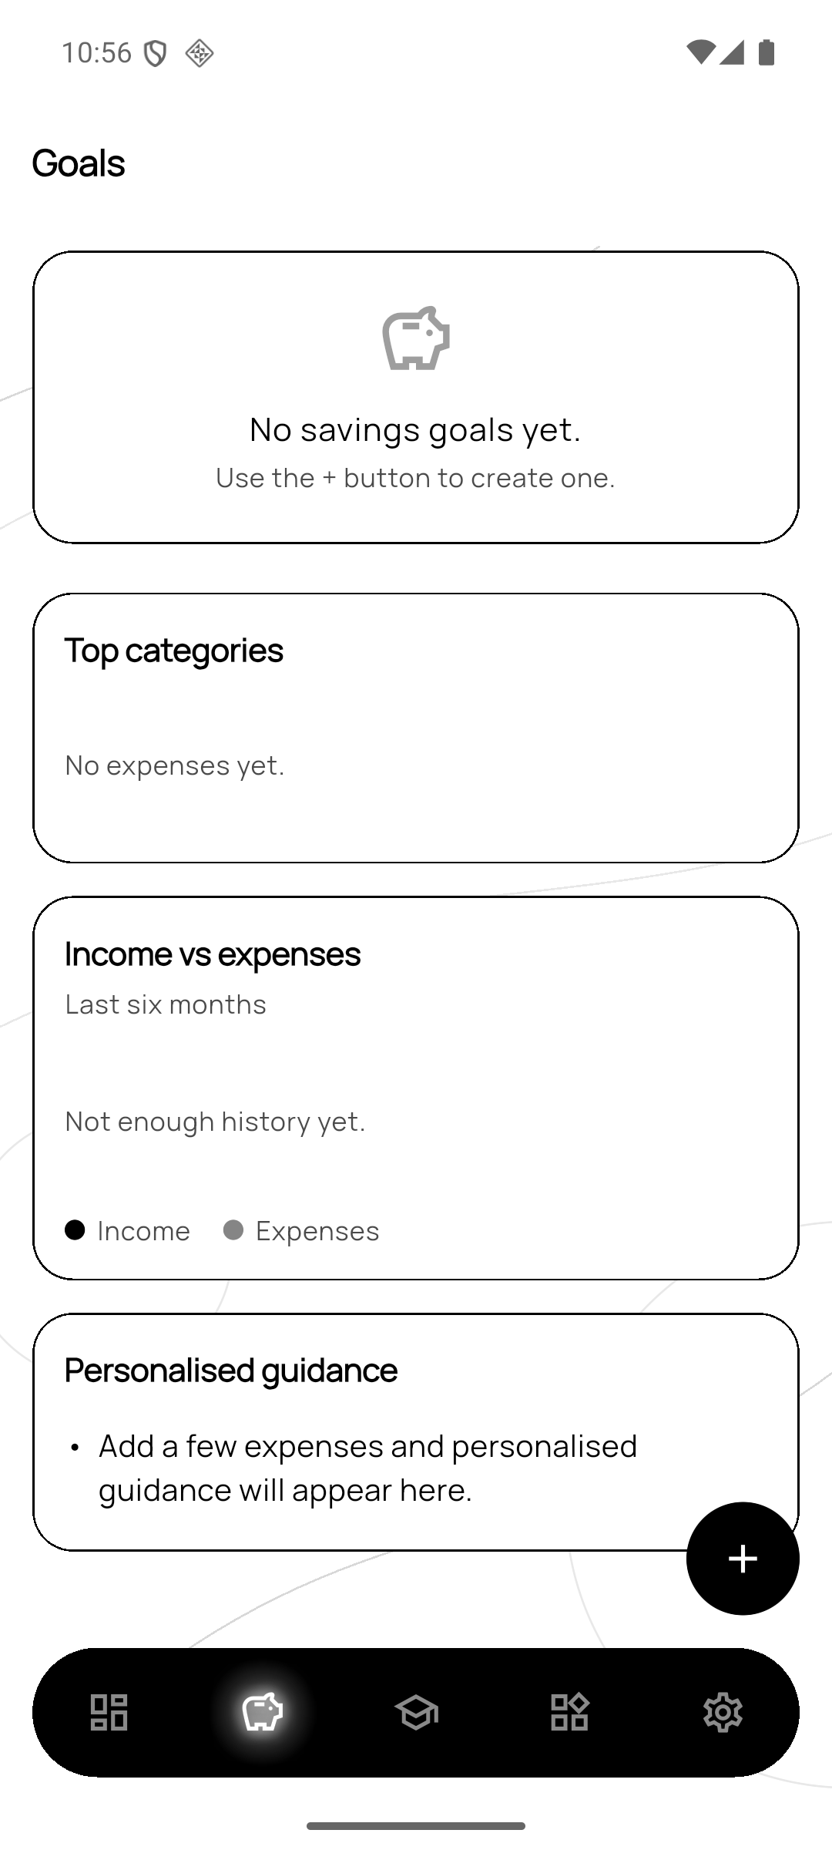
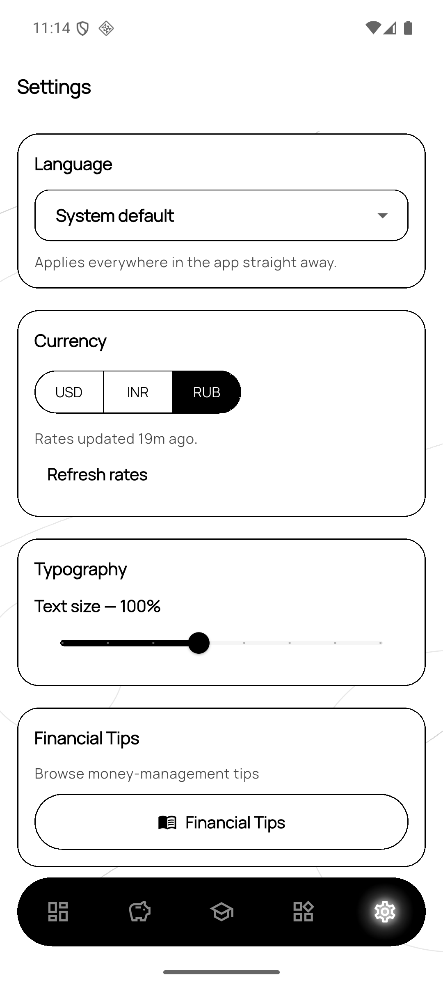
07 · UI/UX & DESIGN
Meehika · Simphiwe
One identity, two platforms
DESIGN SYSTEM
22 high-fidelity screens
Figma, covering every state before a line of UI was written.
Capture → understand → decide
The same three steps on both platforms.
Restraint on mobile
A monochrome system so the numbers carry the page.
Sign in
Goals
Settings
22
16
FIGMA SCREENS
WORKSPACE WIDGETS
CASH COMPASS • PENNY PILOTS

Slide 12
THANK YOU
Two countries. One product.
Built in parallel across Russia and India — and shipping today.
PROJECT REPOSITORY
github.com/Vansh-kap-98/cash-compass
PENNY PILOTS • NINE STUDENTS

