Slide 1

Faculty of Technology, University of Delhi
Department of Electrical Engineering
Load Profile Management &
Forecasting
--An AI-integrated load intelligence dashboard for the Delhi grid
PRESENTED BY
UNDER THE GUIDANCE OF
Vansh Sachan
Animish Gupta
Ayush Rathore
Lavish Rawat
Dr. Ujjal Sur
Supervisor
Dr. Arjun Tyagi
Co-Supervisor

Slide 2
PROBLEM STATEMENT :
Delhi's demand is hotter, peakier and costlier to get wrong
# 256.1 GW
# 8,748 MW
# 67%
# ₹1.11 - ₹9.71
India all-time peak
Delhi all-time peak
of Delhi's daily peak variation
IEX price per unit
25 Apr 2026 · Ministry of Power (PIB)
29 Jun 2026 - Delhi SLDC
explained by heat index · CSE 2025
midday vs night, May 2026 · EAC-PM
Problem :-
Forecast error = penalty
DISCOMs must forecast tomorrow's demand in 96 blocks of 15 minutes. Heat, humidity, rooftop solar and festivals now move that demand faster than older methods can follow. Existing monitoring shows what already happened; it does not tell an engineer what tomorrow's forecast error will cost, which transformer will overload, or how steep the evening ramp will be.
Every MW of deviation is charged under CERC DSM Regulations 2024.
Transformers overheat
Full load on a 40 °C day ages insulation about 10× faster (IEC 60076-7).
Solar makes evenings steep
~24 GWh/day of solar curtailed in May 2026; demand jumps after sunset.
Losses and theft
AT&C losses still 15.04% nationally in FY25 (14th Integrated Rating).
Who is affected : DISCOMs (BRPL, BYPL, TPDDL), SLDC grid operators, and 70+ lakh Delhi consumers.
02 / 15

Slide 3
GAP AND USP :
Others stop at a forecast. We carry it to a consequence.
Typical load-forecasting projects
Our system
Show a graph: "tomorrow = 8,000 MW"
What-if: deviation → ₹ DSM charge (illustrative; CERC 2024 + DERC limits)
One model, one accuracy number
Model ladder, each model must beat the simpler one (persistence still wins at h = 1–2)
Foreign or toy datasets
Real Delhi SLDC 5-min data + Open-Meteo archive weather
No link to tariffs, regulation or equipment
ToD bills, solar ramp, losses and theft now live too -- every engine ships, not just the forecast
No uncertainty band, no explanation
P10–P90 band for every forecast; SHAP on selected days
USP :
By design, one Delhi forecast drives six engines: DSM ₹, IEX cost, ToD bill, transformer ageing, solar ramp, theft ranking. All 12 pages are live now, including IEX, ToD, solar, losses, theft and the data/model card. Forecasting, theft and ToD tools exist separately on GitHub/Kaggle; integrating them on Indian regulation is new.
Load Profile Management & Forecasting · Faculty of Technology, University of Delhi
03 / 15

Slide 4












DASHBOARD :
Twelve pages, all live
LIVE
01
LIVE
02
LIVE
03
LIVE
04
Overview
Load Analytics
Weather Impact
Forecast
Day-ahead peak, peak time, alert (latest test day)
Duration curve, LF, PAR; load curve, heatmap planned
Load vs heat index; what-if slider planned
96 blocks, P10–P90 band, model comparison, SHAP (selected days)
LIVE
05
LIVE
06
LIVE
07
LIVE
08
DSM ₹ Calculator
Transformer Health
IEX Price
ToD Bill Simulator
Illustrative charge for a given deviation
What-if: hot-spot temperature, ageing, life used per hour held
Expensive blocks, purchase cost profile
Flat vs ToD vs optimised bill, shift advice
LIVE
09
LIVE
10
LIVE
11
LIVE
12
Solar & Net Load
Losses & PF
Theft & Segments
Data & Model Card
Duck curve, evening ramp, voltage risk
I²R loss, kVAR needed, phase imbalance
Suspicious meters, consumer load-shape groups
Source, real vs synthetic, accuracy, limits
Load Profile Management & Forecasting · Faculty of Technology, University of Delhi
04 / 15

Slide 5
DATASET & VARIABLES :
Where each number comes from, and what goes in
Feature | Source | Key variables | Tag | How (cleaning, or why synthetic)
Overview | Delhi SLDC 15-min load (Kaggle, Apr 2023 – Jan 2026), cleaned; day-ahead LightGBM forecast (test period) | predicted_mw ×96 blocks, limit_mw → peak_mw, peak_time, peak_block, alert | REAL | Causal Hampel outlier filter, tiered gap-filling, chronological train/val/test split
Load Analytics | Delhi SLDC 15-min load (Kaggle, Apr 2023 – Jan 2026), cleaned | load_mw, ts_ist → load_factor, par, p_avg_mw, p_max_mw, load_duration_curve | REAL | Same cleaning; missing blocks skipped, never counted as zero load
Weather Impact | Delhi SLDC load, cleaned + Open-Meteo weather (lat 28.6139, lon 77.2090) | load_mw, heat_index_c (from temp_c, rh_pct), ts_ist → beta_mw_per_c, r_squared, n_blocks | REAL | Heat index from temp + humidity (Rothfusz); OLS refit on all 96,398 non-missing blocks
Forecast | Delhi SLDC load, cleaned + Open-Meteo weather; LightGBM backtest | ts_target, block, predicted_mw, p10_mw, p90_mw, actual_mw; features tlag_1day, night_temp_c | REAL | Chronological split (test 13 Jul 2025 – 12 Jan 2026); split-conformal P10–P90 band
DSM ₹ Calculator | User what-if input (sliders) | deviation_mw, schedule_limit_mw, normal_rate_per_mwh, excess_multiplier → penalty_rupees | ILLUSTRATIVE | Not data-driven: formula applied to user-supplied values, always tagged illustrative
Transformer Health | User what-if input (sliders) | hotspot_temp_c, hours → ageing_rate_v, life_hours_used | ILLUSTRATIVE | Not data-driven: formula applied to user-supplied values, always tagged illustrative
Feature | Source | Key variables | Tag | How (cleaning, or why synthetic)
IEX Price | Kaggle IEX DAM dataset (2018–2024) | block_of_day_price_inr | REAL | Verified 4/4 against the official IEX site's published price range
ToD Bill Simulator | DERC FY2020-21 tariff order (clause 3(d)) + Delhi SLDC load | tod_rate, peak_hours, offpeak_hours | REAL + ILLUSTRATIVE | Tariff read directly from the DERC PDF; consumer load profile is an illustrative what-if
Solar & Net Load | Open-Meteo radiation + Kaggle solar plant data (validation) | ghi_wm2, capacity_mwp, pr, solar_mw | MODELLED (validated) | Formula on real GHI; validated vs 2 real plants: Plant 1 r²=0.97, Plant 2 r²=0.21
Losses & PF | PFC “Performance of Power Utilities” primary report | brpl_pct, bypl_pct, tpddl_pct, at_c_loss_pct | REAL + ILLUSTRATIVE | AT&C benchmark read directly from PFC's primary PDF; PF/current inputs are user what-ifs
Theft & Segments | SGCC real-world benchmark (China, Zheng et al. 2018) | consumer features, theft_label, K-means segments | FOREIGN-REAL | Real consumer data and theft labels; demo fleet shown elsewhere is synthetic
Data & Model Card | MODEL_RESULTS.md (own backtest) | accuracy, MAPE, coverage, horizon table | REAL (static) | Static summary compiled from this project's own validated results
11 of 12 features run on real or validated open data; only Theft & Segments' demo customer-fleet portion is synthetic -- the SGCC benchmark it is trained on is itself real-world data. All 12 dashboard pages are live.
Load Profile Management & Forecasting · Faculty of Technology, University of Delhi
05 / 15

Slide 6
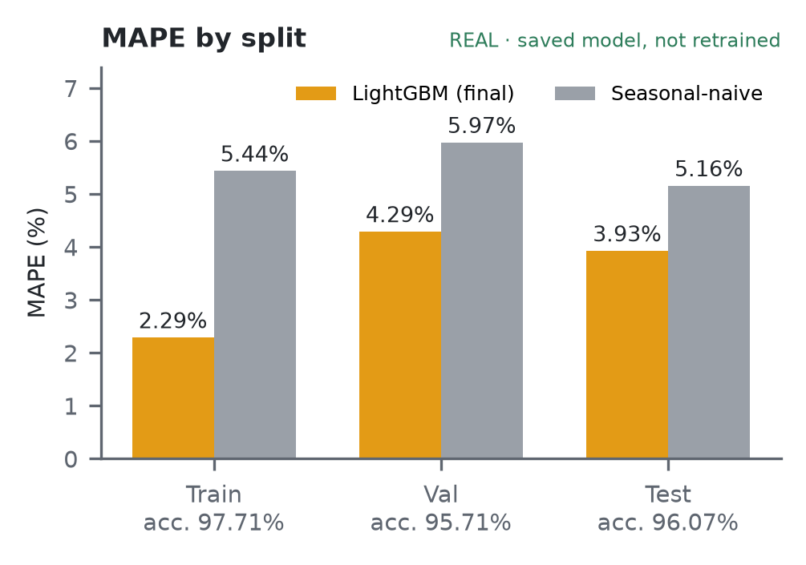
MODEL ACCURACY & FIT CHECK :
Accuracy ≈ 96% on test, no harmful overfitting
Split | MAPE | Accuracy | Naive MAPE | Gain
Train | 2.29% | 97.71% | 5.44% | 58%
Val | 4.29% | 95.71% | 5.97% | 28%
Test | 3.93% | 96.07% | 5.16% | 24%
Test MAPE by horizon | h1–4 | h5–24 | h25–48 | h49–96
LightGBM (naive ≈ 5.16%) | 3.21% | 3.48% | 3.84% | 4.22%
Overfitting: small train–test gap, early stopping at 436/3000, val & test flat → not harmful.
Underfitting: no — beats naive by 24% on test at every horizon.
Two honest caveats
Test set not fully untouched: the target-aligned lags were designed after reading the first model's test-set errors; 3.93% may be slightly optimistic.
Shortest horizons: persistence (next block = last block) beats the model at h = 1 (1.44% vs 3.18%) and h = 2 (2.77% vs 3.20%).
TRAIN ACCURACY
97.71%
MAPE 2.29%
VAL ACCURACY
95.71%
MAPE 4.29%
TEST ACCURACY
96.07%
MAPE 3.93%
Saved model, not retrained. Accuracy = 100 − MAPE. Naive = same block yesterday.
Load Profile Management & Forecasting · Faculty of Technology, University of Delhi
06 / 15

Slide 7
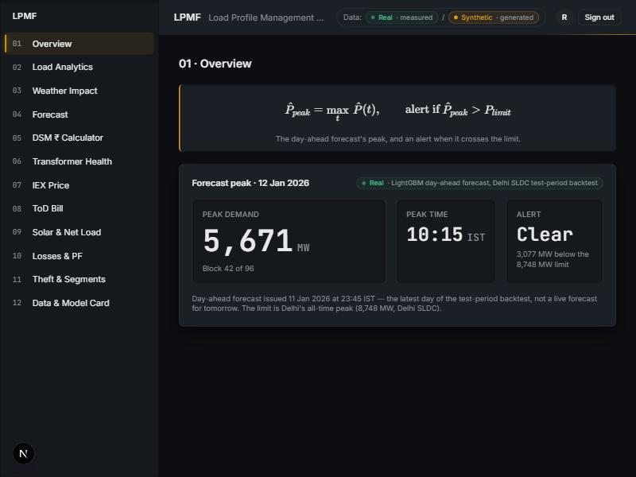
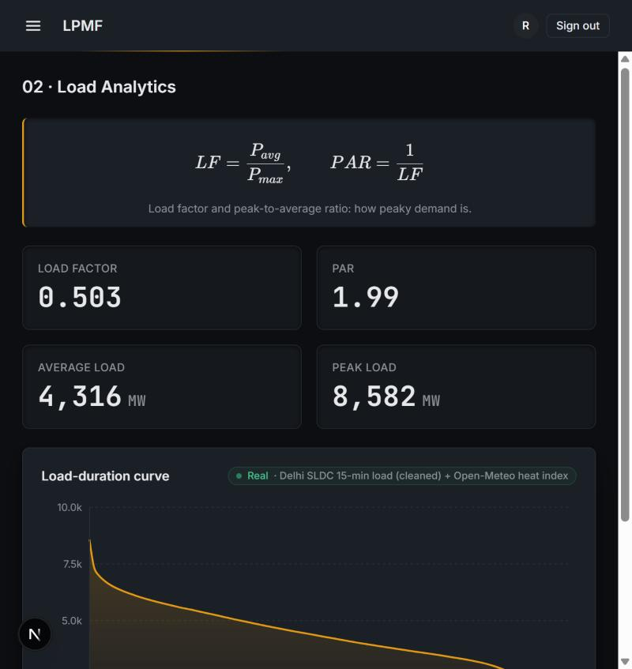
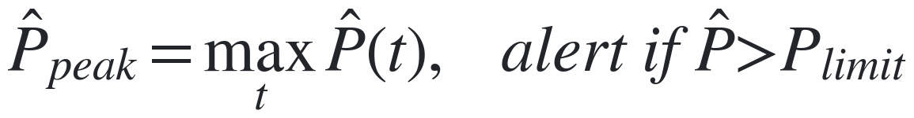
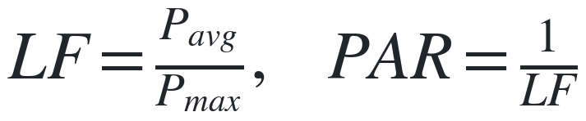
FEATURES 01–02 :
Overview & Load Analytics
01 · Overview
REAL
02 · Load Analytics
REAL
What: Highest of 96 forecast blocks + overload alert if it exceeds the limit.
What: Load factor (avg/peak) and PAR, plus the load-duration curve.
Why: Warns operators before the limit is crossed, not after.
Why: Low LF (high PAR) means idle capacity; PAR is what demand response must cut.
FORMULA
FORMULA
Chart shows: Three tiles: peak MW, time, and alert state (Clear/Alert).
Chart shows: Load-duration curve: % of time (x) vs MW (y), sorted high to low.
Peak 5,671 MW < limit 8,748 MW -> Clear (3,077 MW headroom)
LF 0.503, PAR 1.99 (96,398 blocks, whole period)
Load Profile Management & Forecasting · Faculty of Technology, University of Delhi
07 / 15

Slide 8
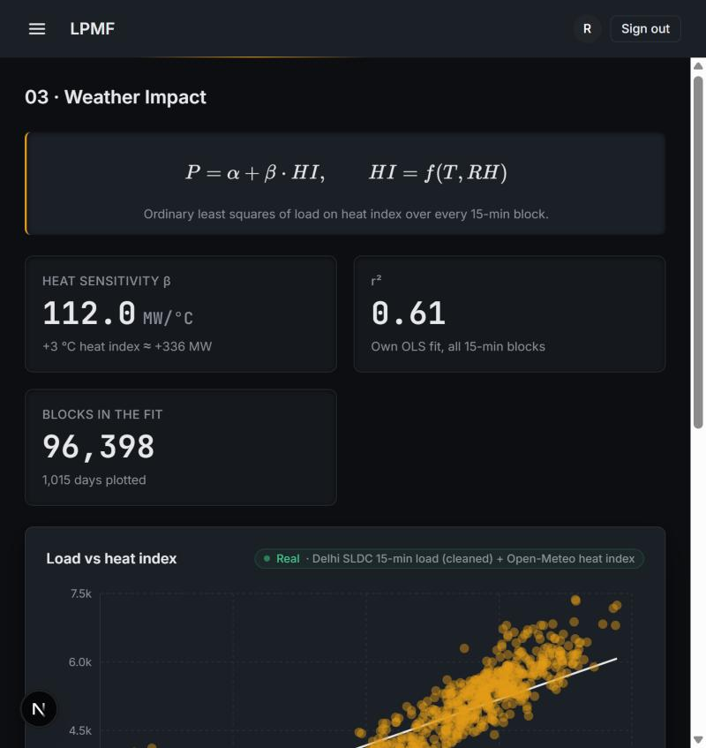
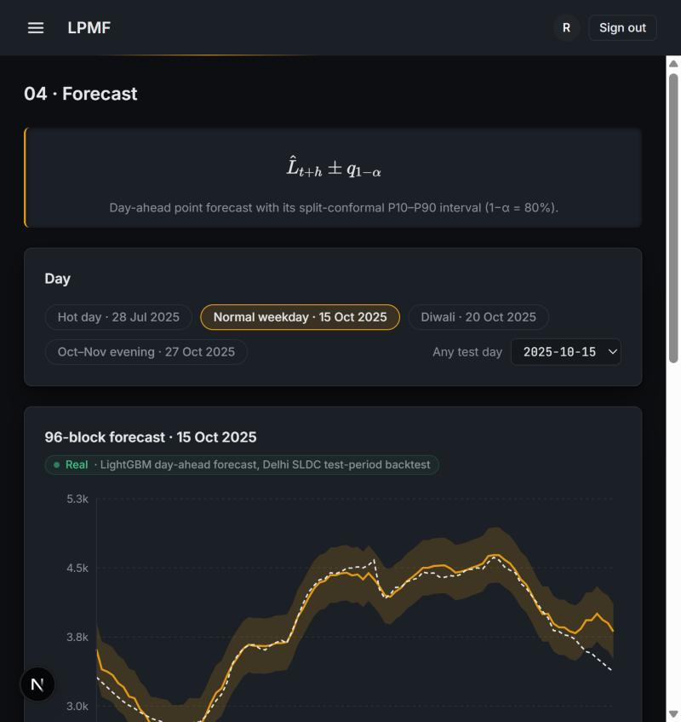
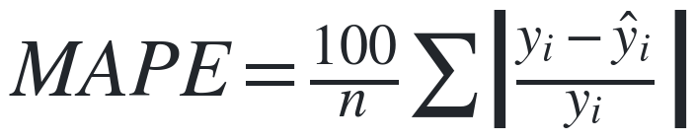
FEATURES 03–04 :
Weather Impact & Forecast
03 · Weather Impact
REAL
04 · Forecast
REAL
What: Extra MW of load per 1 degC rise in heat index, OLS-fitted.
What: Forecast error (MAPE) and how often actual load lands inside the P10-P90 band.
Why: Heat is the main driver of Delhi's swings; beta sizes the margin needed.
Why: One score to compare models, plus a trust-check on the uncertainty band.
FORMULA
FORMULA
Chart shows: Scatter of daily means (heat index vs load) with the OLS fit line.
Chart shows: Forecast vs actual vs P10-P90 band; model-error and SHAP bars below.
beta = 112.0 MW/degC, r^2 = 0.61 (96,398 blocks)
Test MAPE 3.93%, band coverage 84.4% (target 80%)
Load Profile Management & Forecasting · Faculty of Technology, University of Delhi
08 / 15

Slide 9
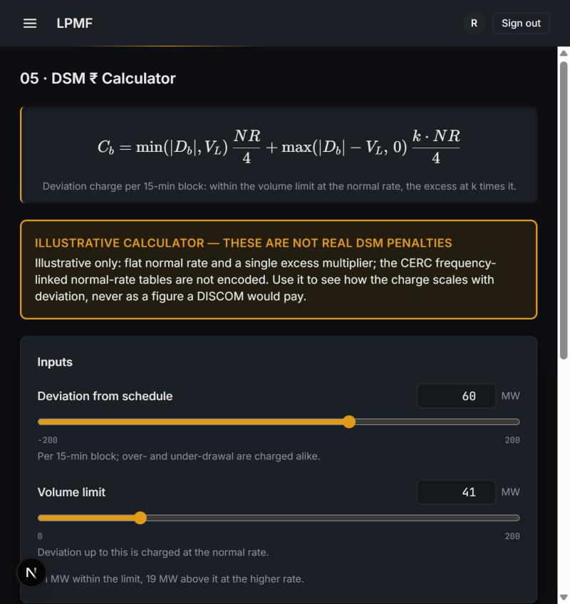
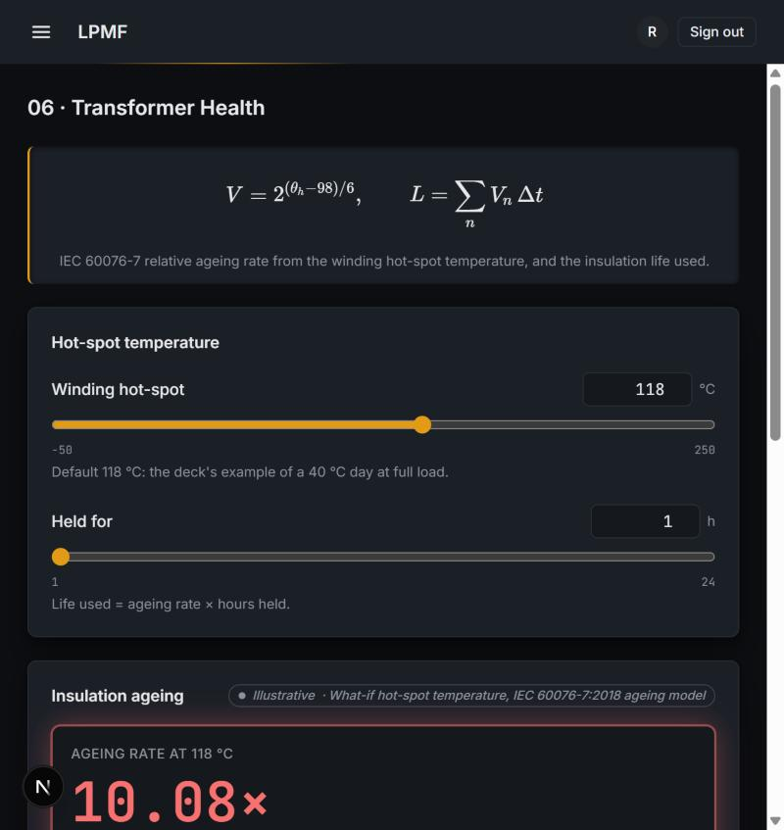
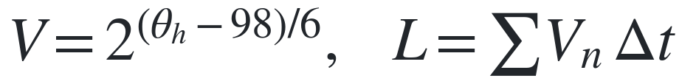
FEATURES 05–06 :
DSM Calculator & Transformer Health
05 · DSM ₹ Calculator
ILLUSTRATIVE
06 · Transformer Health
ILLUSTRATIVE
What: Deviation charge: normal rate up to the volume limit, k times beyond it.
What: Hot-spot temperature -> ageing rate, doubling every 6 degC above 98 degC.
Why: Turns a forecast miss into rupees, not an abstract MW number.
Why: Shows how much insulation life each hour at that temperature consumes.
FORMULA
FORMULA
Chart shows: No chart: two sliders drive three result tiles (charge, per-block, rates).
Chart shows: Ageing rate vs hot-spot temp on a log scale -- a straight line.
60 MW deviation -> Rs 3.475 lakh/hr (illustrative)
118 degC hot-spot -> ageing rate 10.08x normal
Load Profile Management & Forecasting · Faculty of Technology, University of Delhi
09 / 15

Slide 10
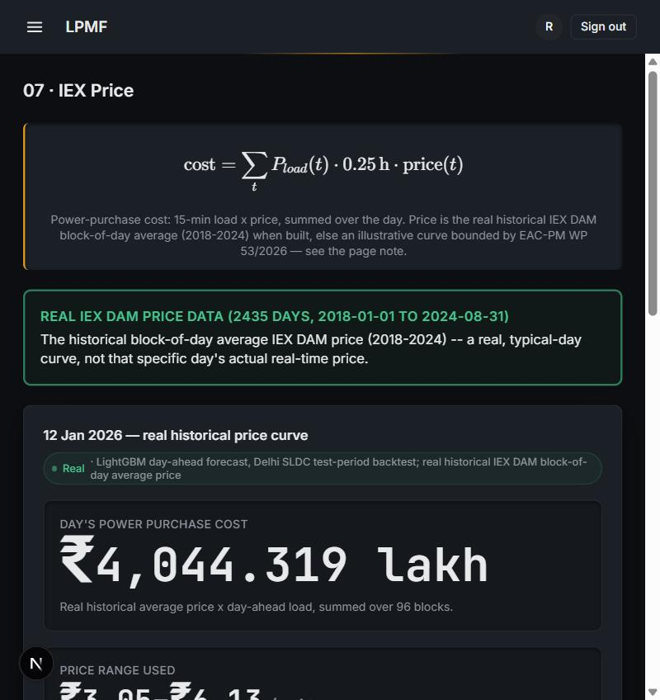
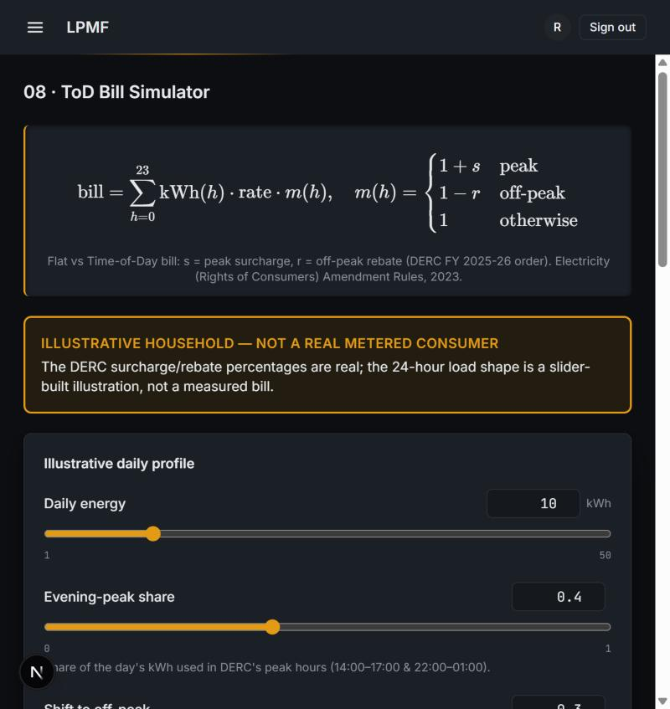
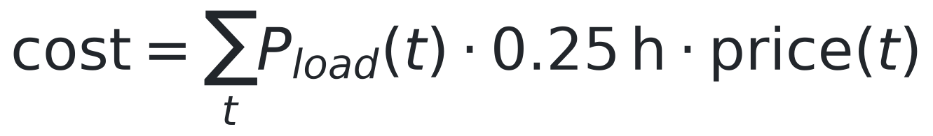
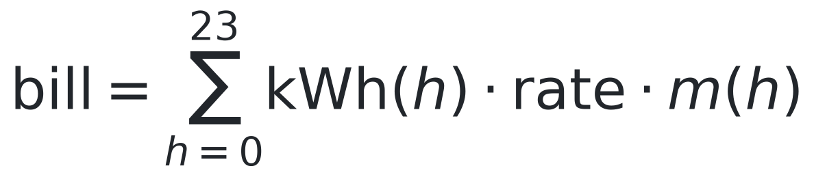
FEATURES 07–08 :
IEX Price & ToD Bill Simulator
07 · IEX Price
REAL
08 · ToD Bill Simulator
REAL
What: Real historical block-of-day average IEX price x day-ahead load.
What: Real DERC Tariff Schedule FY2020-21 rates applied to an illustrative load profile.
Why: Replaces the old illustrative cosine curve with a validated real series.
Why: Corrected from an earlier unverified 30%/25% figure.
FORMULA
FORMULA
Chart shows: Real historical price curve against the day's load; expensive blocks flagged.
Chart shows: Hourly cost under the real DERC ToD multiplier.
Real hourly price range Rs 3.05-6.13/unit (2018-2024 avg)
Peak surcharge 20%, off-peak rebate 20% (clause 3(d))
Load Profile Management & Forecasting · Faculty of Technology, University of Delhi
10 / 15

Slide 11
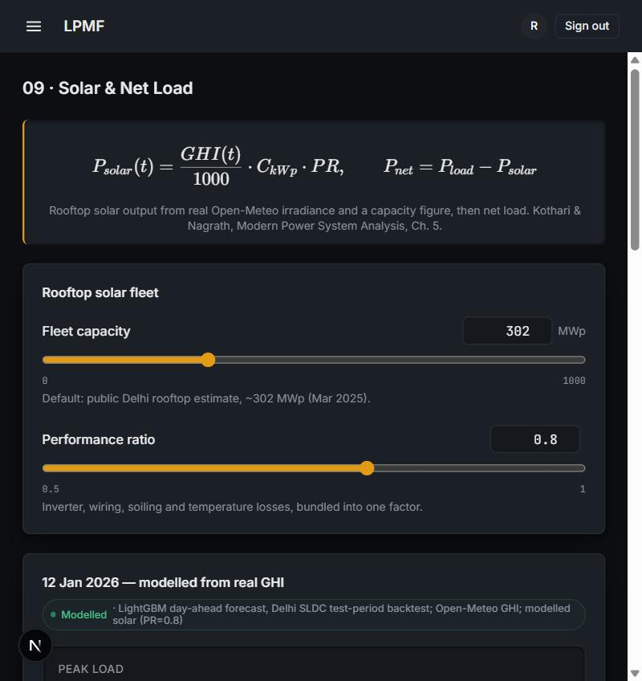
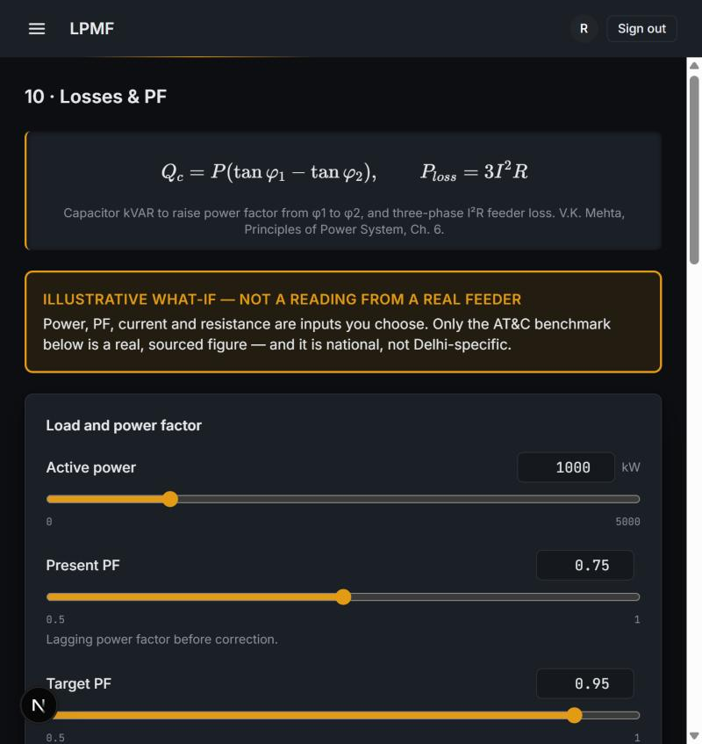
FEATURES 09–10 :
Solar & Net Load, and Losses & PF
09 · Solar & Net Load
MODELLED
10 · Losses & PF
ILLUSTRATIVE
What: PVWatts-style formula on real Open-Meteo GHI, validated against 2 real plants.
What: Illustrative PF/I2R what-ifs, alongside real Delhi-DISCOM AT&C figures.
Why: Plant 2's weak fit was investigated, not hidden -- a real-world sensor limit.
Why: All three DISCOM figures now read directly from PFC's primary PDF.
FORMULA
FORMULA
Chart shows: Load, solar output and net load across the day (duck curve).
Chart shows: National AT&C benchmark alongside real BRPL/BYPL/TPDDL figures.
Plant 1 r^2=0.97; Plant 2 r^2=0.208 (daytime, investigated)
BRPL 6.58%, BYPL 7.84%, TPDDL 5.91% (FY2023-24)
Load Profile Management & Forecasting · Faculty of Technology, University of Delhi
11 / 15

Slide 12
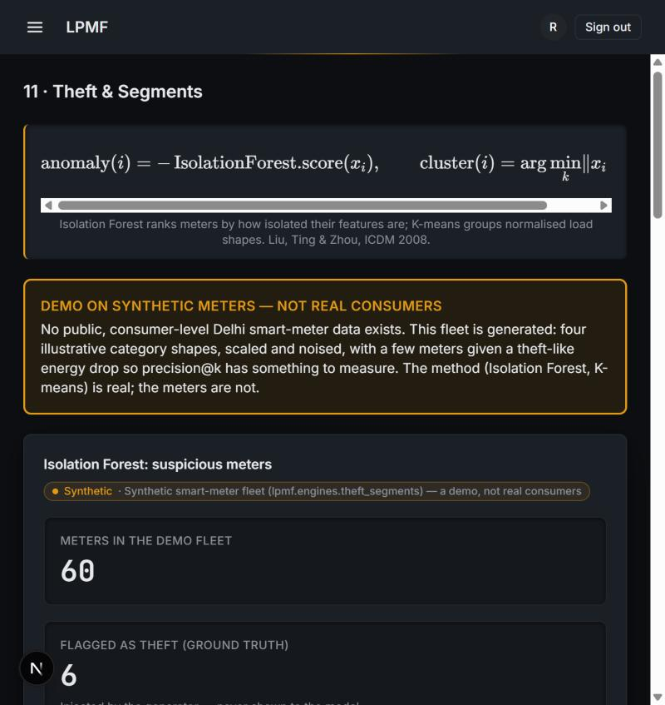
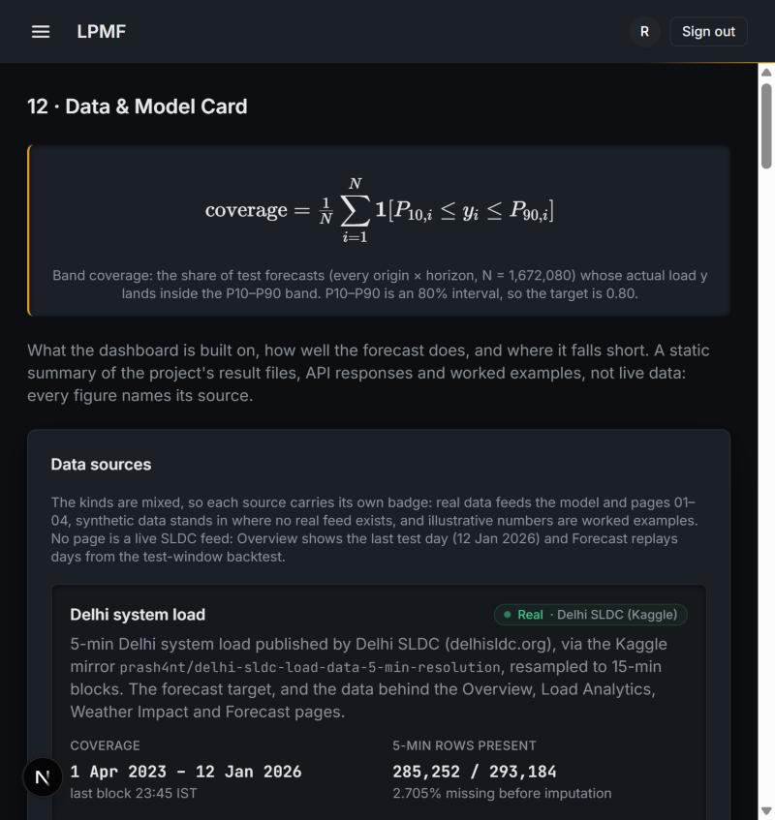
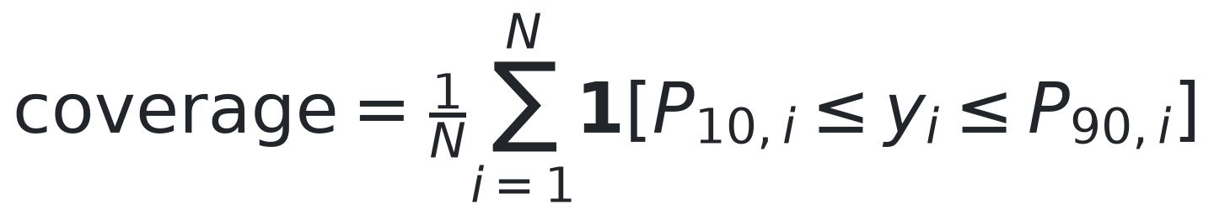
FEATURES 11–12 :
Theft & Segments, and the Data & Model Card
11 · Theft & Segments
FOREIGN
12 · Data & Model Card
REAL
What: Logistic regression -> LightGBM on the real SGCC benchmark (China).
What: Static summary of every page's source, provenance and result.
Why: No Delhi meter data exists; demo fleet stays synthetic, not real consumers.
Why: One place to trace any number back to its source.
FORMULA
FORMULA
Chart shows: Model ladder (logreg -> LightGBM) vs. the paper's stated AUC.
Chart shows: Per-source provenance badges across all 12 pages.
Test AUC-ROC 0.7585 (paper ~0.78, no leakage flag)
All 12 pages documented; band coverage 84.4% vs 80% target
Load Profile Management & Forecasting · Faculty of Technology, University of Delhi
12 / 15

Slide 13
BENCHMARKS :
Every page's benchmark, with its source
Page | Benchmark | Our result | Source
01-04 Forecast | Persistence h=1: 1.44/3.18% | Test MAPE 3.93%, 84.4% coverage | docs/MODEL_RESULTS.md
07 IEX Price | EAC-PM: Rs1.11-9.71/unit | Real history: Rs3.05-6.13/unit (2018-24 avg) | Kaggle mukund604/... (233,760 real rows)
08 ToD Bill | DERC FY20-21 clause 3(d) p.2 | 20%/20%, 14-17h&22-01h/04-10h | tatapower-ddl.com PDF (read directly)
09 Solar & Net Load | Real-plant validation (2 plants) | r2=0.97/0.21 (daytime), MAPE 6.2%/36.2% -- root cause investigated | Kaggle anikannal/solar-power-generation-data
10 Losses & PF | National AT&C 15.37% (FY23) | BRPL 6.58%, BYPL 7.84%, TPDDL 5.91% (FY23-24) | PFC primary PDF, Annexure 1.8, p.76
11 Theft (SGCC) | Paper: ~0.78 AUC-ROC | Test AUC-ROC 0.7585 (no leakage) | Zheng et al., IEEE TII 2018
Solar Plant 2's weak daytime fit (r2=0.208) was actively investigated (timestamp, clipping, sensor placement, day pattern) -- no fixable bug found, numbers unchanged, root cause now evidenced. BYPL AT&C is now confirmed directly from PFC's primary PDF (was unconfirmed). Full table: docs/BENCHMARKS.md.
Load Profile Management & Forecasting · Faculty of Technology, University of Delhi
13 / 15

Slide 14
REFERENCES :
Sources for the external figures and equations
1
Ministry of Power (PIB), all-time peak of 256.1 GW, 25 Apr 2026
11
D.P. Kothari & I.J. Nagrath, Modern Power System Analysis (Ch. 5)
pib.gov.in/PressReleasePage.aspx?PRID=2256313
Textbook (college library)
2
Delhi SLDC, peak demand record 8,748 MW, 29 Jun 2026
12
IEC 60076-7:2018, Loading guide for oil-immersed power transformers
delhisldc.org
webstore.iec.ch
3
CSE, "How Delhi is losing its cool", 2025
13
L.P. Rothfusz, The Heat Index Equation, NWS SR 90-23, 1990
cseindia.org
wpc.ncep.noaa.gov/html/heatindex_equation.shtml
4
S. Sanyal & S. Dev, "The Duck and the Camel", EAC-PM WP 53/2026
14
R.J. Hyndman & G. Athanasopoulos, Forecasting: Principles and Practice, 3rd ed.
eacpm.gov.in
otexts.com/fpp3
5
PFC / MoP, 14th Integrated Rating of DISCOMs (FY25)
15
T. Hong & S. Fan, Probabilistic load forecasting: a tutorial review, IJF 32(3), 2016
pfcindia.com
doi.org/10.1016/j.ijforecast.2015.11.011
6
CERC (Deviation Settlement Mechanism) Regulations, 2024
16
A.F. Ansari et al., Chronos: Learning the Language of Time Series, 2024
cercind.gov.in
arxiv.org/abs/2403.07815
7
DERC, intra-state DSM order, 13 Sep 2024
17
A.N. Angelopoulos & S. Bates, Conformal Prediction (intro), 2021
derc.gov.in
arxiv.org/abs/2107.07511
8
Electricity (Rights of Consumers) Amendment Rules, 2023
18
L. Thurner et al., pandapower, IEEE Trans. Power Systems, 2018
pib.gov.in/PressReleseDetailm.aspx?PRID=1945236
doi.org/10.1109/TPWRS.2018.2829021
9
V.K. Mehta & R. Mehta, Principles of Power System, S. Chand (Ch. 3, 6)
19
F.T. Liu, K.M. Ting & Z.-H. Zhou, Isolation Forest, IEEE ICDM 2008
Textbook (college library)
doi.org/10.1109/ICDM.2008.17
10
T. Gönen, Electric Power Distribution Engineering, 3rd ed., CRC (Ch. 2)
20
Indian Energy Exchange, Day-Ahead & Real-Time market data
Textbook (college library)
iexindia.com
Load Profile Management & Forecasting · Faculty of Technology, University of Delhi
14 / 15

Slide 15
Load Profile Management & Forecasting
Thank you
We welcome your questions and feedback.
TEAM -
GUIDED BY
Vansh Sachan
Ayush Rathore
Dr. Ujjal Sur
Dr. Arjun Tyagi
Animish Gupta
Lavish Rawat

