Slide 1

Faculty of Technology, University of Delhi
Department of Electrical Engineering
Load Profile Management &
Forecasting
--An AI-integrated load intelligence dashboard for the Delhi grid
PRESENTED BY
UNDER THE GUIDANCE OF
Vansh Sachan
Animish Gupta
Ayush Rathore
Lavish Rawat
Dr. Ujjal Sur
Supervisor
Dr. Arjun Tyagi
Co-Supervisor

Slide 2
PROBLEM STATEMENT :
Delhi's demand is hotter, peakier and costlier to get wrong
# 256.1 GW
# 8,748 MW
# 67%
# ₹1.11 - ₹9.71
India all-time peak
Delhi all-time peak
of Delhi's daily peak variation
IEX price per unit
25 Apr 2026 · Ministry of Power (PIB)
29 Jun 2026 - Delhi SLDC
explained by heat index · CSE 2025
midday vs night, May 2026 · EAC-PM
Problem :-
Forecast error = penalty
DISCOMs must forecast tomorrow's demand in 96 blocks of 15 minutes. Heat, humidity, rooftop solar and festivals now move that demand faster than older methods can follow. Existing monitoring shows what already happened; it does not tell an engineer what tomorrow's forecast error will cost, which transformer will overload, or how steep the evening ramp will be.
Every MW of deviation is charged under CERC DSM Regulations 2024.
Transformers overheat
Full load on a 40 °C day ages insulation about 10× faster (IEC 60076-7).
Solar makes evenings steep
~24 GWh/day of solar curtailed in May 2026; demand jumps after sunset.
Losses and theft
AT&C losses still 15.04% nationally in FY25 (14th Integrated Rating).
Who is affected : DISCOMs (BRPL, BYPL, TPDDL), SLDC grid operators, and 70+ lakh Delhi consumers.
02 / 21

Slide 3
GAP AND USP :
Others stop at a forecast. We carry it to a consequence.
Typical load-forecasting projects
Our system
Show a graph: "tomorrow = 8,000 MW"
What-if: deviation → ₹ DSM charge (illustrative; CERC 2024 + DERC limits)
One model, one accuracy number
Model ladder, each model must beat the simpler one (persistence still wins at h = 1–2)
Foreign or toy datasets
Real Delhi SLDC 5-min data + Open-Meteo archive weather
No link to tariffs, regulation or equipment
Transformer-life what-if; ToD bills, solar ramp, losses in future scope
No uncertainty band, no explanation
P10–P90 band for every forecast; SHAP on selected days
USP :
By design, one Delhi forecast drives six engines: DSM ₹, IEX cost, ToD bill, transformer ageing, solar ramp, theft ranking. Built now: six live pages, including the forecast and the DSM and transformer what-if calculators; the rest is future scope. Forecasting, theft and ToD tools exist separately on GitHub/Kaggle; integrating them on Indian regulation is new.
Load Profile Management & Forecasting · Faculty of Technology, University of Delhi
03 / 21

Slide 4












DASHBOARD :
Twelve pages, all live
LIVE
01
LIVE
02
LIVE
03
LIVE
04
Overview
Load Analytics
Weather Impact
Forecast
Day-ahead peak, peak time, alert (latest test day)
Duration curve, LF, PAR; load curve, heatmap planned
Load vs heat index; what-if slider planned
96 blocks, P10–P90 band, model comparison, SHAP (selected days)
LIVE
05
LIVE
06
LIVE
07
LIVE
08
DSM ₹ Calculator
Transformer Health
IEX Price
ToD Bill Simulator
Illustrative charge for a given deviation
What-if: hot-spot temperature, ageing, life used per hour held
Expensive blocks, purchase cost profile
Flat vs ToD vs optimised bill, shift advice
LIVE
09
LIVE
10
LIVE
11
LIVE
12
Solar & Net Load
Losses & PF
Theft & Segments
Data & Model Card
Duck curve, evening ramp, voltage risk
I²R loss, kVAR needed, phase imbalance
Suspicious meters, consumer load-shape groups
Source, real vs synthetic, accuracy, limits
Load Profile Management & Forecasting · Faculty of Technology, University of Delhi
04 / 21

Slide 5
DATASET & VARIABLES :
Where each number comes from, and what goes in
Feature | Source | Key variables | Real / synthetic | How (cleaning, or why synthetic)
Overview | Delhi SLDC 15-min load (Kaggle, Apr 2023 – Jan 2026), cleaned; day-ahead LightGBM forecast (test period) | predicted_mw ×96 blocks, limit_mw → peak_mw, peak_time, peak_block, alert | REAL | Causal Hampel outlier filter, tiered gap-filling, chronological train/val/test split
Load Analytics | Delhi SLDC 15-min load (Kaggle, Apr 2023 – Jan 2026), cleaned | load_mw, ts_ist → load_factor, par, p_avg_mw, p_max_mw, load_duration_curve | REAL | Same cleaning; missing blocks skipped, never counted as zero load
Weather Impact | Delhi SLDC load, cleaned + Open-Meteo weather (lat 28.6139, lon 77.2090) | load_mw, heat_index_c (from temp_c, rh_pct), ts_ist → beta_mw_per_c, r_squared, n_blocks | REAL | Heat index from temp + humidity (Rothfusz); OLS refit on all 96,398 non-missing blocks
Forecast | Delhi SLDC load, cleaned + Open-Meteo weather; LightGBM backtest | ts_target, block, predicted_mw, p10_mw, p90_mw, actual_mw; features tlag_1day, night_temp_c | REAL | Chronological split (test 13 Jul 2025 – 12 Jan 2026); split-conformal P10–P90 band
DSM ₹ Calculator | User what-if input (sliders) | deviation_mw, schedule_limit_mw, normal_rate_per_mwh, excess_multiplier → penalty_rupees | ILLUSTRATIVE | Not data-driven: formula applied to user-supplied values, always tagged illustrative
Transformer Health | User what-if input (sliders) | hotspot_temp_c, hours → ageing_rate_v, life_hours_used | ILLUSTRATIVE | Not data-driven: formula applied to user-supplied values, always tagged illustrative
Future-scope modules only (Theft & Segments, Solar & Net Load): synthetic category profiles (residential, commercial, industrial, agricultural, EV) from a parametric model: base + daily pattern + weekly pattern + heat effect + noise + event bumps, validated against the real aggregate shape (peak timing, load-duration curve, autocorrelation). The six live features above run entirely on real data, except the two illustrative calculators.
Load Profile Management & Forecasting · Faculty of Technology, University of Delhi
05 / 21

Slide 6
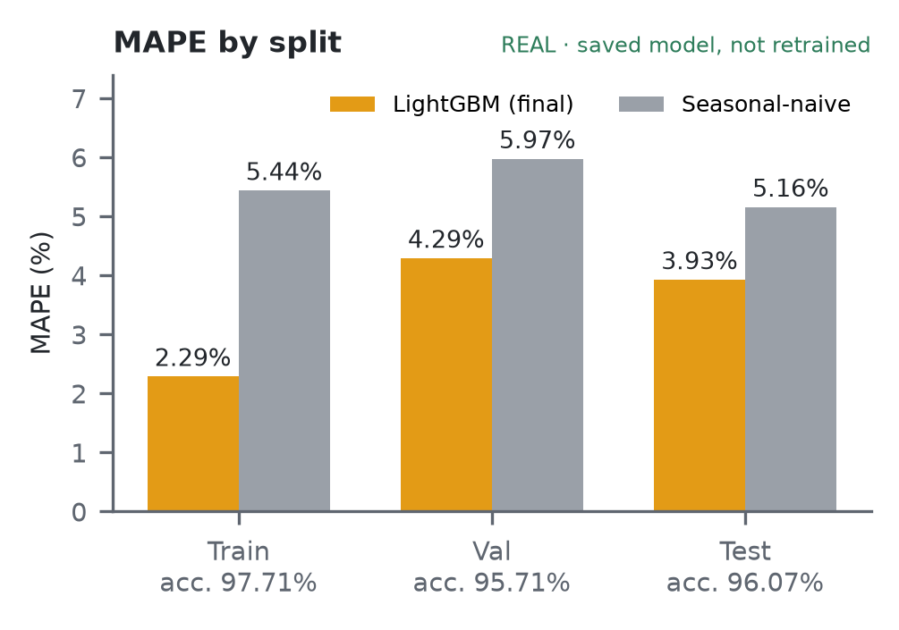
MODEL ACCURACY & FIT CHECK :
Accuracy ≈ 96% on test, no harmful overfitting
Split | MAPE | Accuracy | Naive MAPE | Gain
Train | 2.29% | 97.71% | 5.44% | 58%
Val | 4.29% | 95.71% | 5.97% | 28%
Test | 3.93% | 96.07% | 5.16% | 24%
Test MAPE by horizon | h1–4 | h5–24 | h25–48 | h49–96
LightGBM (naive ≈ 5.16%) | 3.21% | 3.48% | 3.84% | 4.22%
Overfitting: small train–test gap, early stopping at 436/3000, val & test flat → not harmful.
Underfitting: no — beats naive by 24% on test at every horizon.
Two honest caveats
Test set not fully untouched: the target-aligned lags were designed after reading the first model's test-set errors; 3.93% may be slightly optimistic.
Shortest horizons: persistence (next block = last block) beats the model at h = 1 (1.44% vs 3.18%) and h = 2 (2.77% vs 3.20%).
TRAIN ACCURACY
97.71%
MAPE 2.29%
VAL ACCURACY
95.71%
MAPE 4.29%
TEST ACCURACY
96.07%
MAPE 3.93%
Saved model, not retrained. Accuracy = 100 − MAPE. Naive = same block yesterday.
Load Profile Management & Forecasting · Faculty of Technology, University of Delhi
06 / 21

Slide 7
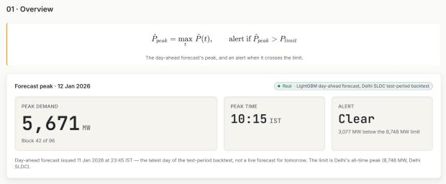
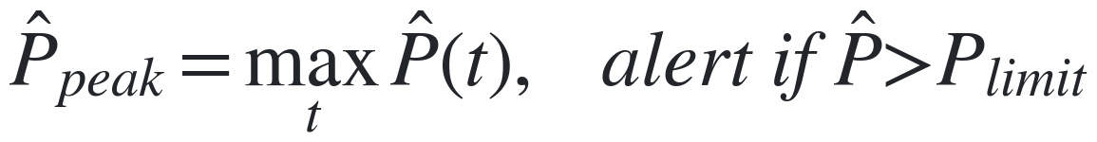
OVERVIEW :
Tomorrow's peak load, and whether it crosses the limit
Overview
REAL
Day-ahead peak demand, when it hits, and an overload alert.
What The highest of the 96 forecast blocks, the 15-min block it falls in, and a flag if it exceeds the limit.
Why Operators are warned before the limit is crossed, not after; the peak sizes purchase and capacity.
localhost:3000/dashboard/overview
FORMULA · PEAK & OVERLOAD ALERT
Ref: V.K. Mehta, Principles of Power System, Ch. 3
WORKED EXAMPLE · this project's numbers
Forecast day 12 Jan 2026: argmax over 96 blocks = block 42
Time = (42 − 1) × 15 min = 615 min → 10:15 IST
Peak = 5,670.83 MW vs limit 8,748 MW (Delhi record): 5,670.83 > 8,748? No → Clear
Headroom = 8,748 − 5,670.83 ≈ 3,077 MW
CHART SHOWS
No curve on this page: three tiles show the peak (MW and block number), its time in IST, and the alert state. Read the Alert tile first: Clear means the peak is under the limit.
Load Profile Management & Forecasting · Faculty of Technology, University of Delhi
07 / 21

Slide 8
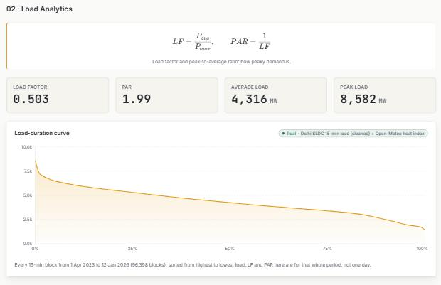
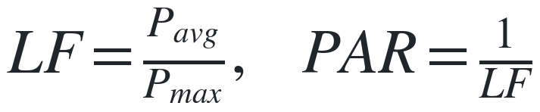
LOAD ANALYTICS :
How peaky is demand? Load factor, PAR and duration curve
Load Analytics
REAL
Load factor, peak-to-average ratio and the load-duration curve.
What Load factor is average load ÷ peak load; PAR is its inverse. The duration curve sorts every block from highest to lowest.
Why A low LF (high PAR) means capacity sits idle most of the time; PAR is what demand response must bring down.
localhost:3000/dashboard/load-analytics
FORMULA · LOAD FACTOR & PAR
Ref: V.K. Mehta, Principles of Power System, Ch. 3
WORKED EXAMPLE · this project's numbers
Illustrative day (530 / 820): LF = 0.646, PAR = 1 / 0.646 = 1.55
Whole period, measured (Apr 2023 – Jan 2026, 96,398 blocks):
LF = 4,316 / 8,582 = 0.503, PAR = 1.99
CHART SHOWS
Load-duration curve: x = % of time, y = MW. Each point is a load level the grid meets or exceeds for that share of time. A sharp spike at the left means rare extreme peaks; a long flat middle is steady base demand.
Load Profile Management & Forecasting · Faculty of Technology, University of Delhi
08 / 21

Slide 9
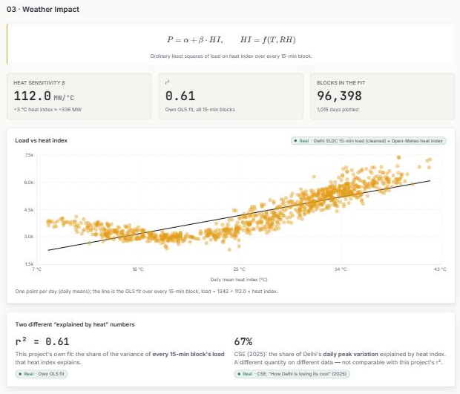
WEATHER IMPACT :
How many extra MW each °C of heat adds
Weather Impact
REAL
localhost:3000/dashboard/weather-impact
Heat sensitivity of Delhi's load, from an ordinary least-squares fit.
What The extra MW of load for each 1 °C rise in heat index (temperature plus humidity), fitted on every 15-min block.
Why Heat is the main driver of Delhi's swings, so β tells engineers how much margin a hot day needs.
FORMULA · HEAT SENSITIVITY (ALL 15-MIN BLOCKS)
Ref: own OLS fit, Delhi SLDC 2023–2026; Rothfusz, NWS SR 90-23
WORKED EXAMPLE · this project's numbers
β = 112.0 MW/°C, intercept 1,342 MW, r² = 0.61 (96,398 blocks)
+3 °C heat index → ΔP ≈ 112.0 × 3 = +336 MW
r² = 0.61 is over all 15-min blocks; CSE's 67% is for daily peaks, a different metric
CHART SHOWS
Scatter of 1,015 daily means: heat index (x) vs load (y). The black line is the OLS fit; its slope is β. Spread around the line is the load that heat does not explain.
Load Profile Management & Forecasting · Faculty of Technology, University of Delhi
09 / 21

Slide 10
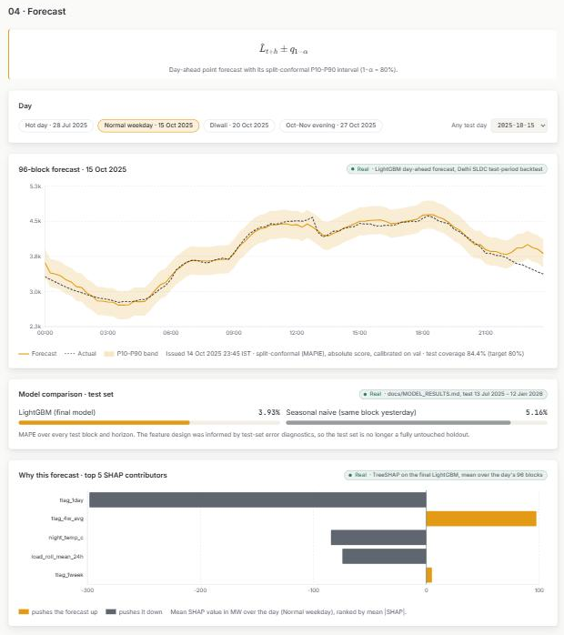
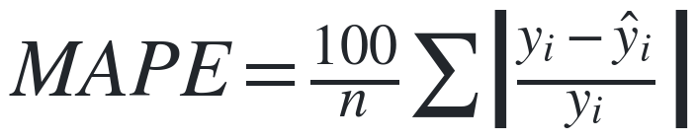
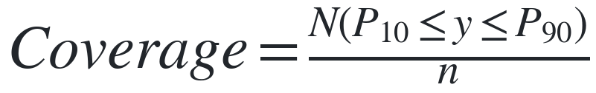
FORECAST :
Day-ahead forecast with an honest error band
Forecast
REAL
localhost:3000/dashboard/forecast
96-block LightGBM forecast with a P10–P90 band and SHAP reasons.
What Average forecast error as a % of actual load (MAPE), and how often actual load lands inside the P10–P90 band.
Why One score to compare models, plus a check that the uncertainty band can be trusted.
FORMULA · FORECAST ACCURACY (MAPE) · BAND COVERAGE
Ref: Hyndman & Athanasopoulos, FPP3 §5.8–5.9; Angelopoulos & Bates 2021
WORKED EXAMPLE · this project's numbers
Test MAPE = 3.93% vs seasonal-naive 5.16% (full test set)
Derived arithmetic, not measured: 4,500 MW × 3.93% ≈ 177 MW
Conformal coverage = 84.4% of actuals inside the band vs 80% target
CHART SHOWS
Amber line = forecast, dashed = actual, shaded = P10–P90 band. Below it: model-error bars (shorter is better) and SHAP bars (amber pushes the forecast up, grey pushes it down).
Load Profile Management & Forecasting · Faculty of Technology, University of Delhi
10 / 21

Slide 11
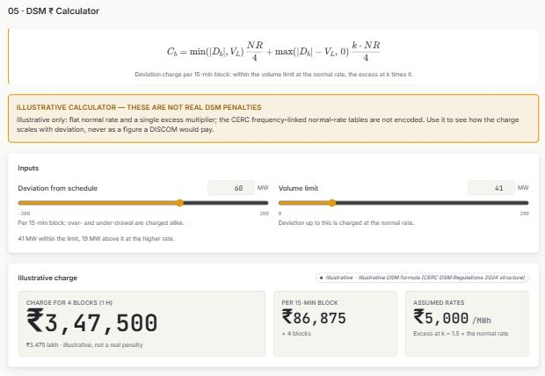
DSM ₹ CALCULATOR :
What a forecast miss would cost, in rupees
DSM ₹ Calculator
ILLUSTRATIVE
Illustrative deviation charge for a what-if deviation from schedule.
localhost:3000/dashboard/dsm-calculator
What Charges deviation up to the volume limit at the normal rate, and the excess at k times that rate.
Why Turns forecast error into money, so a few MW of miss reads as a cost, not an abstract number.
FORMULA · DSM DEVIATION CHARGE
Ref: CERC DSM Regs 2024, Reg. 7; DERC 2024 (tables not encoded)
WORKED EXAMPLE · this project's numbers
D = 60 MW, VL = 41 MW, NR = ₹5,000/MWh, k = 1.5 (assumed)
Per block: 41 × 5,000/4 = ₹51,250, plus 19 × 1.5 × 5,000/4 = ₹35,625 → ₹86,875
× 4 blocks = ₹3,47,500 = ₹3.475 lakh/hr (illustrative, not a real penalty)
CHART SHOWS
No chart: two sliders (deviation, volume limit) drive three tiles: total charge for 1 hour, charge per 15-min block, and the assumed rates.
Load Profile Management & Forecasting · Faculty of Technology, University of Delhi
11 / 21

Slide 12
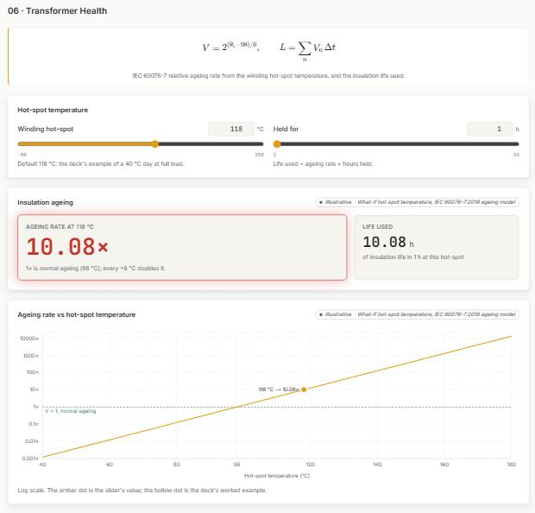
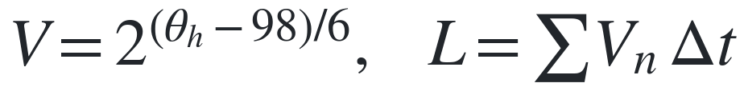
TRANSFORMER HEALTH :
How fast a hot transformer uses up its insulation life
Transformer Health
ILLUSTRATIVE
localhost:3000/dashboard/transformer-health
IEC 60076-7 insulation ageing from winding hot-spot temperature.
What Hot-spot temperature gives a relative ageing rate V (1× at 98 °C, doubling every 6 °C); summing V × time gives life used.
Why Shows how much insulation life each hour at a given temperature consumes.
FORMULA · TRANSFORMER AGEING
Ref: IEC 60076-7:2018, loading guide for oil-immersed transformers
WORKED EXAMPLE · this project's numbers
40 °C ambient, full load: θh = 40 + 55 + 23 = 118 °C
V = 2^((118 − 98)/6) = 2^3.33 = 10.08×
1 hour held at 118 °C uses 10.08 h of insulation life
CHART SHOWS
Ageing rate vs hot-spot temperature on a log scale; it is a straight line because ageing doubles every 6 °C. Dashed line = normal ageing (1× at 98 °C); amber dot = the slider's value (118 °C → 10.08×).
Load Profile Management & Forecasting · Faculty of Technology, University of Delhi
12 / 21

Slide 13
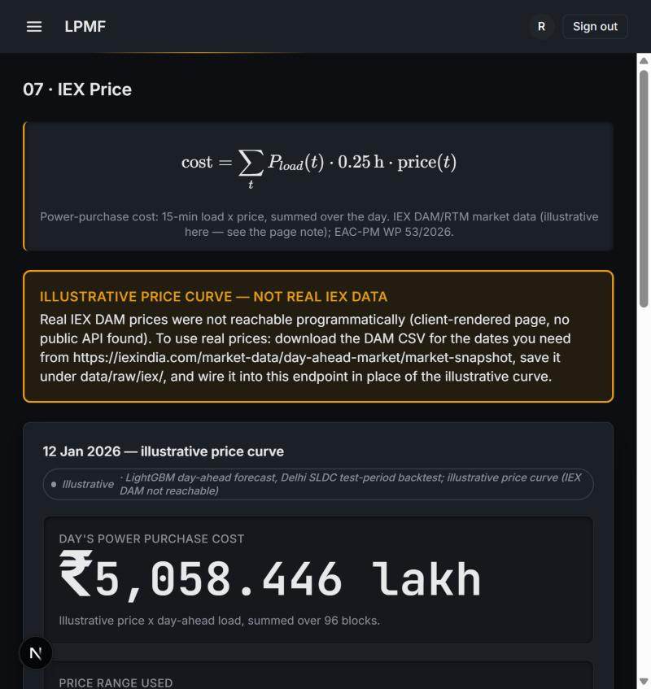
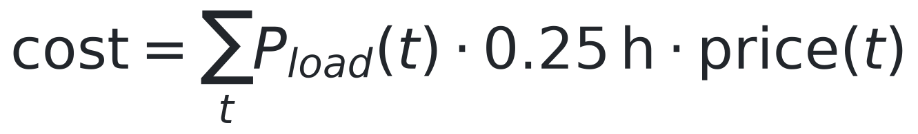
IEX PRICE :
Illustrative power-purchase cost from the day-ahead load curve
Illustrative power-purchase cost
ILLUSTRATIVE
localhost:3000/dashboard/iex-price
Illustrative price curve x real day-ahead load (power-purchase cost)
What Power-purchase cost = sum of 15-min load x price, over the day. The price curve is illustrative (real IEX DAM data not reachable programmatically); EAC-PM WP 53/2026's price range (Rs 1.11-9.71/unit) bounds it.
Why Real-data upgrade identified (Kaggle DAM.xlsx, 2019-2024) but blocked on a missing Kaggle API token at build time.
FORMULA · IEX PRICE
Ref: EAC-PM Working Paper 53/2026; iexindia.com Market Snapshot.
WORKED EXAMPLE · this project's numbers
12 Jan 2026 day-ahead load x illustrative price curve.
Day's power-purchase cost: Rs 5,058 lakh.
28 of 96 blocks in the expensive (top-quartile) band.
CHART SHOWS
Illustrative price curve against the day's load, expensive blocks flagged.
Load Profile Management & Forecasting · Faculty of Technology, University of Delhi
13 / 21

Slide 14
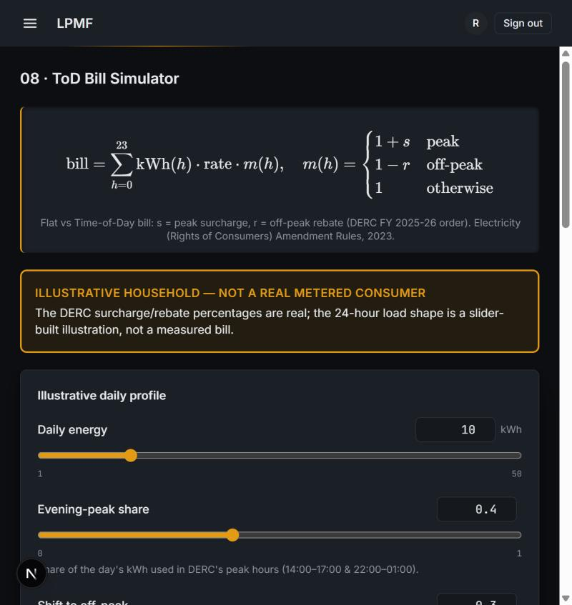
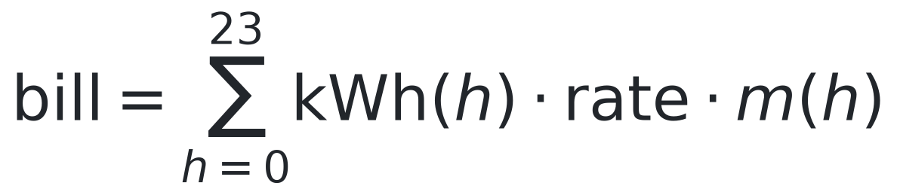
TOD BILL SIMULATOR :
Flat vs Time-of-Day bill, real DERC rates on an illustrative profile
Flat vs Time-of-Day bill
REAL
localhost:3000/dashboard/tod-bill
DERC Tariff Schedule FY 2020-21, clause 3(d) -- read directly, corrected
What Real DERC Tariff Schedule FY 2020-21 (BRPL/BYPL/TPDDL/NDMC), clause 3(d), page 2 -- read directly from the PDF: peak surcharge 20%, off-peak rebate 20%, peak 14:00-17:00 & 22:00-01:00, off-peak 04:00-10:00, May-September only.
Why Corrected from an earlier unverified 30%/25%, 17-22h/22-6h figure.
FORMULA · TOD BILL
Ref: DERC Tariff Schedule FY 2020-21, clause 3(d), p.2 (tatapower-ddl.com).
WORKED EXAMPLE · this project's numbers
10 kWh/day, 40% evening-peak share.
Flat bill vs ToD bill vs after shifting.
30% of peak load moved to off-peak hours.
CHART SHOWS
Hourly cost under the real DERC ToD multiplier.
Load Profile Management & Forecasting · Faculty of Technology, University of Delhi
14 / 21

Slide 15
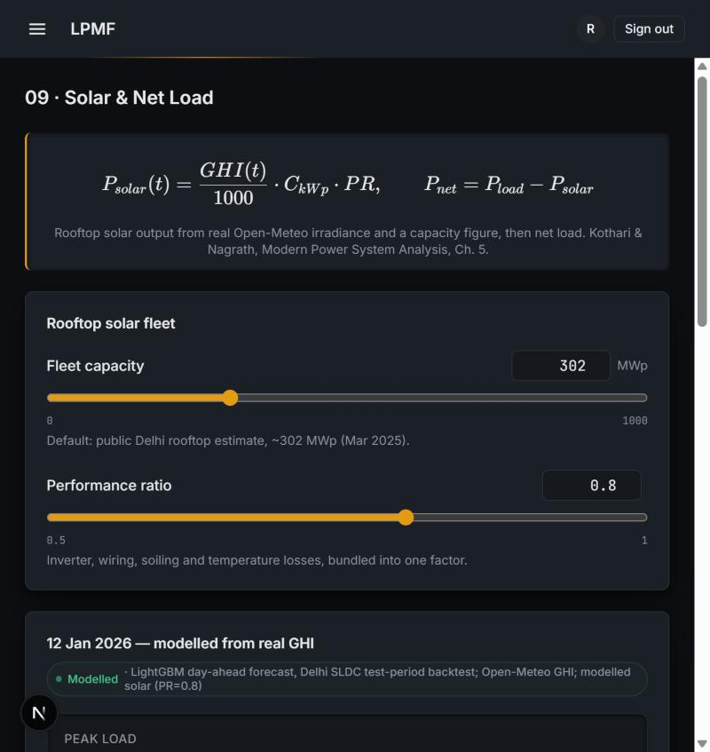
SOLAR & NET LOAD :
Rooftop solar output from real Open-Meteo irradiance
Rooftop solar output
MODELLED
localhost:3000/dashboard/solar-net-load
PVWatts-style formula on real Open-Meteo GHI for Delhi
What PVWatts-style formula on REAL Open-Meteo GHI for Delhi, a FOREIGN capacity benchmark (~302 MWp Delhi rooftop, MNRE/Renewable Watch, Mar 2025).
Why Real-plant r2/MAPE validation (Kaggle India solar dataset) identified but blocked on a missing Kaggle API token at build time.
FORMULA · SOLAR OUTPUT
Ref: MNRE, reported by Renewable Watch (~302 MWp, Mar 2025); Open-Meteo GHI.
WORKED EXAMPLE · this project's numbers
302 MWp fleet, PR=0.8, 12 Jan 2026.
Midday solar peak: 149 MW.
Evening ramp: 364 MW as solar falls, load stays high.
CHART SHOWS
Load, solar output and net load across the day (duck curve).
Load Profile Management & Forecasting · Faculty of Technology, University of Delhi
15 / 21

Slide 16
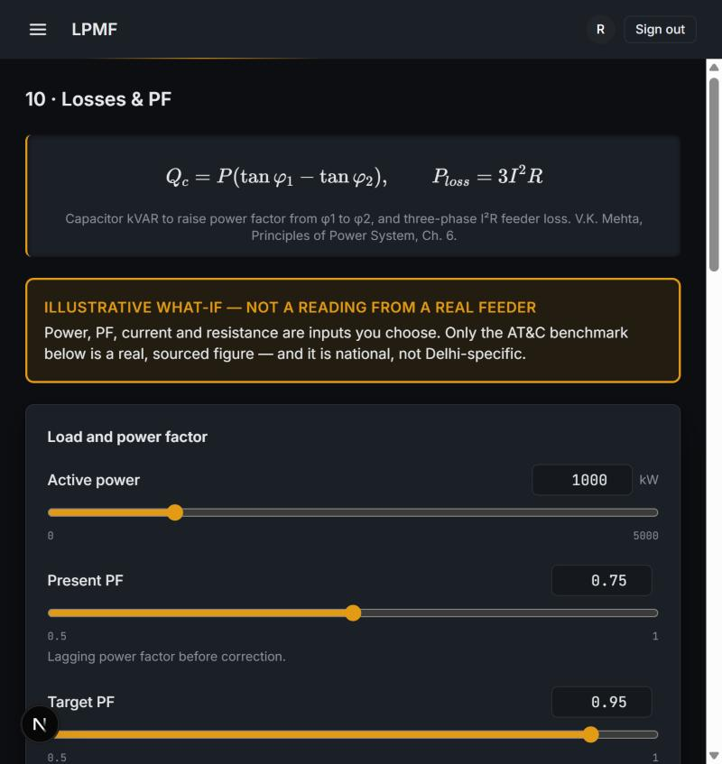
LOSSES & PF :
PF-correction kVAR and I2R loss, with real Delhi-DISCOM AT&C
PF-correction kVAR and I2R loss
ILLUSTRATIVE
localhost:3000/dashboard/losses-pf
Illustrative PF/current what-ifs, now with real Delhi-DISCOM AT&C
What PF/current/resistance are illustrative what-if inputs. Two REAL benchmarks: national AT&C 15.37% (FY2023, Rajya Sabha PQ 266) and Delhi-DISCOM figures -- BRPL 6.58%, TPDDL 5.91% (FY2023-24, PFC).
Why BYPL genuinely unconfirmed in the source read -- reported as unavailable, not guessed.
FORMULA · PF CORRECTION & I2R LOSS
Ref: V.K. Mehta, Principles of Power System, Ch.6; PFC Report on Performance of State Power Utilities 2023-24.
WORKED EXAMPLE · this project's numbers
1000 kW at PF 0.75 -> 0.95.
Capacitor bank needed: 553 kVAR.
300A feeder loss falls 37.7% after correction.
CHART SHOWS
National AT&C benchmark alongside real BRPL/TPDDL figures.
Load Profile Management & Forecasting · Faculty of Technology, University of Delhi
16 / 21

Slide 17
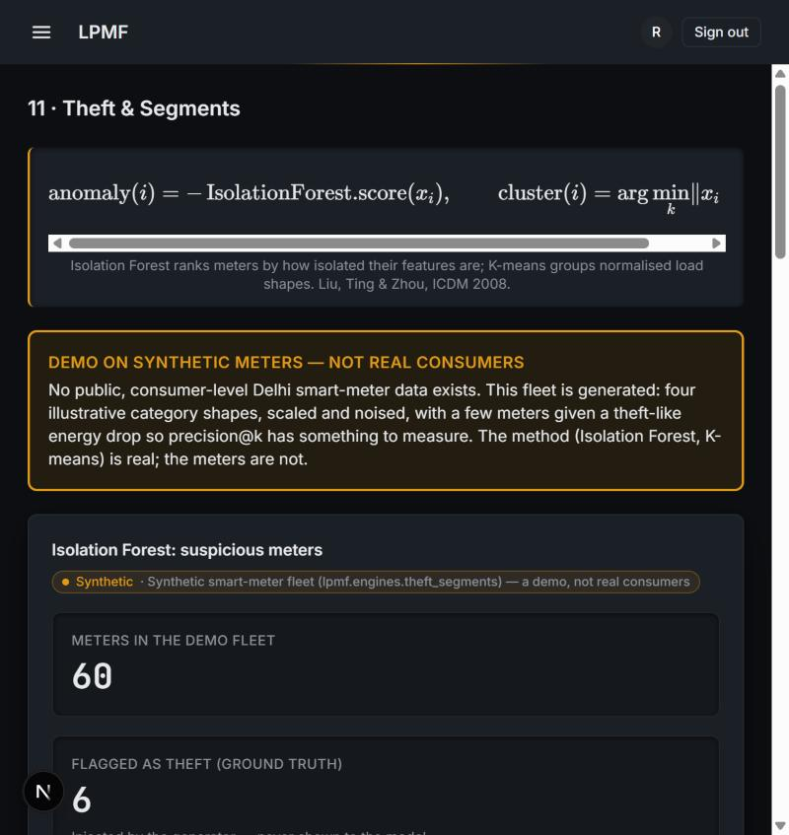
THEFT & SEGMENTS :
Trained on the real SGCC benchmark (China, FOREIGN data)
Trained on the real SGCC benchmark
FOREIGN
localhost:3000/dashboard/theft-segments
SGCC (China, FOREIGN) -- logistic regression -> LightGBM, K-means
What Logistic regression -> LightGBM on the real SGCC dataset (Zheng et al., IEEE TII 2018, China State Grid): 42,372 consumers, 1,034 days, 8.53% theft rate -- verified against the paper.
Why Test AUC 0.7585, below the paper's ~0.78 (no leakage flag). The demo fleet (Isolation Forest) stays SYNTHETIC: no public Delhi meter data exists.
FORMULA · THEFT DETECTION & SEGMENTS
Ref: Zheng, Yang, Chen, Huang & Zhu, 'Wide & Deep CNN for Electricity Theft Detection', IEEE TII 2018.
WORKED EXAMPLE · this project's numbers
Train/Val/Test AUC-ROC: 0.9174 / 0.7511 / 0.7585.
Test scored exactly once, after tuning.
All-normal baseline accuracy: 91.47%.
CHART SHOWS
Model ladder (logreg -> LightGBM) vs. the paper's stated AUC.
Load Profile Management & Forecasting · Faculty of Technology, University of Delhi
17 / 21

Slide 18
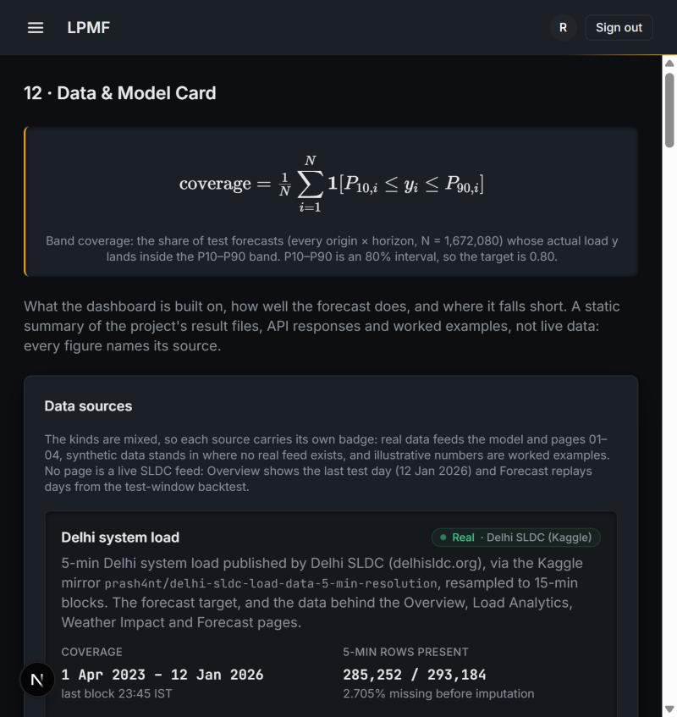
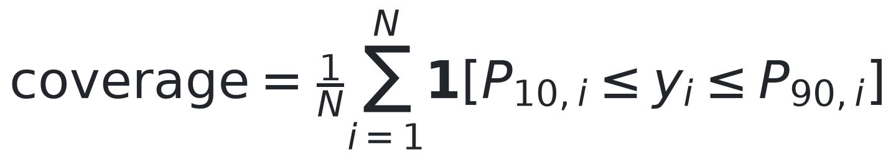
DATA & MODEL CARD :
What the dashboard is built on, and where it falls short
Data & Model Card
REAL
localhost:3000/dashboard/data-model-card
A static summary -- source, provenance, and result for all 12 pages
What A static summary of every page's data source, provenance and result -- not live data. Every figure names its source.
Why See docs/ALL_PAGES_METRICS.md and docs/BENCHMARKS.md for the full detail behind this page.
FORMULA · CONFORMAL BAND COVERAGE
Ref: docs/MODEL_RESULTS.md, docs/ALL_PAGES_METRICS.md, docs/BENCHMARKS.md, docs/DATA_SOURCES_LOG.md.
WORKED EXAMPLE · this project's numbers
Band coverage: 84.4% against an 80% target.
Split-conformal P10-P90.
N=1,672,080 origin x horizon test forecasts.
CHART SHOWS
Per-source provenance badges across all 12 pages.
Load Profile Management & Forecasting · Faculty of Technology, University of Delhi
18 / 21

Slide 19
BENCHMARKS :
Every page's benchmark, with its source
Page | Benchmark | Our result | Source
01-04 Forecast | Persistence h=1: 1.44/3.18% | Test MAPE 3.93%, 84.4% coverage | docs/MODEL_RESULTS.md
07 IEX Price | EAC-PM: Rs1.11-9.71/unit | Illustrative curve in-range | EAC-PM WP 53/2026
08 ToD Bill | DERC FY20-21 clause 3(d) p.2 | 20%/20%, 14-17h&22-01h/04-10h | tatapower-ddl.com PDF (read directly)
09 Solar & Net Load | MNRE: ~302 MWp Delhi rooftop | Midday peak 149 MW, PR=0.8 | MNRE via Renewable Watch, Mar 2025
10 Losses & PF | National AT&C 15.37% (FY23) | BRPL 6.58%, TPDDL 5.91% (FY23-24) | PFC via Power Line, 8 Jul 2025
11 Theft (SGCC) | Paper: ~0.78 AUC-ROC | Test AUC-ROC 0.7585 (no leakage) | Zheng et al., IEEE TII 2018
IEX and Solar real-data upgrades (Kaggle DAM.xlsx; Kaggle India solar plant data) identified but blocked on a missing Kaggle API token at build time -- see docs/DATA_SOURCES_LOG.md. BYPL AT&C genuinely unconfirmed in the one source read directly, reported as unavailable rather than guessed. Full table: docs/BENCHMARKS.md.
Load Profile Management & Forecasting · Faculty of Technology, University of Delhi
19 / 21

Slide 20
REFERENCES :
Sources for the external figures and equations
1
Ministry of Power (PIB), all-time peak of 256.1 GW, 25 Apr 2026
11
D.P. Kothari & I.J. Nagrath, Modern Power System Analysis (Ch. 5)
pib.gov.in/PressReleasePage.aspx?PRID=2256313
Textbook (college library)
2
Delhi SLDC, peak demand record 8,748 MW, 29 Jun 2026
12
IEC 60076-7:2018, Loading guide for oil-immersed power transformers
delhisldc.org
webstore.iec.ch
3
CSE, "How Delhi is losing its cool", 2025
13
L.P. Rothfusz, The Heat Index Equation, NWS SR 90-23, 1990
cseindia.org
wpc.ncep.noaa.gov/html/heatindex_equation.shtml
4
S. Sanyal & S. Dev, "The Duck and the Camel", EAC-PM WP 53/2026
14
R.J. Hyndman & G. Athanasopoulos, Forecasting: Principles and Practice, 3rd ed.
eacpm.gov.in
otexts.com/fpp3
5
PFC / MoP, 14th Integrated Rating of DISCOMs (FY25)
15
T. Hong & S. Fan, Probabilistic load forecasting: a tutorial review, IJF 32(3), 2016
pfcindia.com
doi.org/10.1016/j.ijforecast.2015.11.011
6
CERC (Deviation Settlement Mechanism) Regulations, 2024
16
A.F. Ansari et al., Chronos: Learning the Language of Time Series, 2024
cercind.gov.in
arxiv.org/abs/2403.07815
7
DERC, intra-state DSM order, 13 Sep 2024
17
A.N. Angelopoulos & S. Bates, Conformal Prediction (intro), 2021
derc.gov.in
arxiv.org/abs/2107.07511
8
Electricity (Rights of Consumers) Amendment Rules, 2023
18
L. Thurner et al., pandapower, IEEE Trans. Power Systems, 2018
pib.gov.in/PressReleseDetailm.aspx?PRID=1945236
doi.org/10.1109/TPWRS.2018.2829021
9
V.K. Mehta & R. Mehta, Principles of Power System, S. Chand (Ch. 3, 6)
19
F.T. Liu, K.M. Ting & Z.-H. Zhou, Isolation Forest, IEEE ICDM 2008
Textbook (college library)
doi.org/10.1109/ICDM.2008.17
10
T. Gönen, Electric Power Distribution Engineering, 3rd ed., CRC (Ch. 2)
20
Indian Energy Exchange, Day-Ahead & Real-Time market data
Textbook (college library)
iexindia.com
Load Profile Management & Forecasting · Faculty of Technology, University of Delhi
20 / 21

Slide 21
Load Profile Management & Forecasting
Thank you
We welcome your questions and feedback.
TEAM -
GUIDED BY
Vansh Sachan
Ayush Rathore
Dr. Ujjal Sur
Dr. Arjun Tyagi
Animish Gupta
Lavish Rawat

