Slide 1

Faculty of Technology, University of Delhi
Department of Electrical Engineering
Load Profile Management &
Forecasting
--An AI-integrated load intelligence dashboard for the Delhi grid
PRESENTED BY
UNDER THE GUIDANCE OF
Vansh Sachan
Animish Gupta
Ayush Rathore
Lavish Rawat
Dr. Ujjal Sur
Supervisor
Dr. Arjun Tyagi
Co-Supervisor

Slide 2
PROBLEM STATEMENT :
Delhi's demand is hotter, peakier and costlier to get wrong
# 256.1 GW
# 8,748 MW
# 67%
# ₹1.11 - ₹9.71
India all-time peak
Delhi all-time peak
of Delhi's daily peak variation
IEX price per unit
25 Apr 2026 · Ministry of Power (PIB)
29 Jun 2026 - Delhi SLDC
explained by heat index · CSE 2025
midday vs night, May 2026 · EAC-PM
Problem :-
Forecast error = penalty
DISCOMs must forecast tomorrow's demand in 96 blocks of 15 minutes. Heat, humidity, rooftop solar and festivals now move that demand faster than older methods can follow. Existing monitoring shows what already happened; it does not tell an engineer what tomorrow's forecast error will cost, which transformer will overload, or how steep the evening ramp will be.
Every MW of deviation is charged under CERC DSM Regulations 2024.
Transformers overheat
Full load on a 40 °C day ages insulation about 10× faster (IEC 60076-7).
Solar makes evenings steep
~24 GWh/day of solar curtailed in May 2026; demand jumps after sunset.
Losses and theft
AT&C losses still 15.04% nationally in FY25 (14th Integrated Rating).
Who is affected : DISCOMs (BRPL, BYPL, TPDDL), SLDC grid operators, and 70+ lakh Delhi consumers.
02 / 15

Slide 3
GAP AND USP :
Others stop at a forecast. We carry it to a consequence.
Typical load-forecasting projects
Our system
Show a graph: "tomorrow = 8,000 MW"
What-if: deviation → ₹ DSM charge (illustrative; CERC 2024 + DERC limits)
One model, one accuracy number
Model ladder, each model must beat the simpler one (persistence still wins at h = 1–2)
Foreign or toy datasets
Real Delhi SLDC 5-min data + Open-Meteo archive weather
No link to tariffs, regulation or equipment
Transformer-life what-if; ToD bills, solar ramp, losses in future scope
No uncertainty band, no explanation
P10–P90 band for every forecast; SHAP on selected days
USP :
By design, one Delhi forecast drives six engines: DSM ₹, IEX cost, ToD bill, transformer ageing, solar ramp, theft ranking. Built now: six live pages, including the forecast and the DSM and transformer what-if calculators; the rest is future scope. Forecasting, theft and ToD tools exist separately on GitHub/Kaggle; integrating them on Indian regulation is new.
Load Profile Management & Forecasting · Faculty of Technology, University of Delhi
03 / 15

Slide 4












DASHBOARD :
Twelve pages, all live
LIVE
01
LIVE
02
LIVE
03
LIVE
04
Overview
Load Analytics
Weather Impact
Forecast
Day-ahead peak, peak time, alert (latest test day)
Duration curve, LF, PAR; load curve, heatmap planned
Load vs heat index; what-if slider planned
96 blocks, P10–P90 band, model comparison, SHAP (selected days)
LIVE
05
LIVE
06
LIVE
07
LIVE
08
DSM ₹ Calculator
Transformer Health
IEX Price
ToD Bill Simulator
Illustrative charge for a given deviation
What-if: hot-spot temperature, ageing, life used per hour held
Expensive blocks, purchase cost profile
Flat vs ToD vs optimised bill, shift advice
LIVE
09
LIVE
10
LIVE
11
LIVE
12
Solar & Net Load
Losses & PF
Theft & Segments
Data & Model Card
Duck curve, evening ramp, voltage risk
I²R loss, kVAR needed, phase imbalance
Suspicious meters, consumer load-shape groups
Source, real vs synthetic, accuracy, limits
Load Profile Management & Forecasting · Faculty of Technology, University of Delhi
04 / 15

Slide 5
DATASET & VARIABLES :
Where each number comes from, and what goes in
Feature | Source | Key variables | Real / synthetic | How (cleaning, or why synthetic)
Overview | Delhi SLDC 15-min load (Kaggle, Apr 2023 – Jan 2026), cleaned; day-ahead LightGBM forecast (test period) | predicted_mw ×96 blocks, limit_mw → peak_mw, peak_time, peak_block, alert | REAL | Causal Hampel outlier filter, tiered gap-filling, chronological train/val/test split
Load Analytics | Delhi SLDC 15-min load (Kaggle, Apr 2023 – Jan 2026), cleaned | load_mw, ts_ist → load_factor, par, p_avg_mw, p_max_mw, load_duration_curve | REAL | Same cleaning; missing blocks skipped, never counted as zero load
Weather Impact | Delhi SLDC load, cleaned + Open-Meteo weather (lat 28.6139, lon 77.2090) | load_mw, heat_index_c (from temp_c, rh_pct), ts_ist → beta_mw_per_c, r_squared, n_blocks | REAL | Heat index from temp + humidity (Rothfusz); OLS refit on all 96,398 non-missing blocks
Forecast | Delhi SLDC load, cleaned + Open-Meteo weather; LightGBM backtest | ts_target, block, predicted_mw, p10_mw, p90_mw, actual_mw; features tlag_1day, night_temp_c | REAL | Chronological split (test 13 Jul 2025 – 12 Jan 2026); split-conformal P10–P90 band
DSM ₹ Calculator | User what-if input (sliders) | deviation_mw, schedule_limit_mw, normal_rate_per_mwh, excess_multiplier → penalty_rupees | ILLUSTRATIVE | Not data-driven: formula applied to user-supplied values, always tagged illustrative
Transformer Health | User what-if input (sliders) | hotspot_temp_c, hours → ageing_rate_v, life_hours_used | ILLUSTRATIVE | Not data-driven: formula applied to user-supplied values, always tagged illustrative
Future-scope modules only (Theft & Segments, Solar & Net Load): synthetic category profiles (residential, commercial, industrial, agricultural, EV) from a parametric model: base + daily pattern + weekly pattern + heat effect + noise + event bumps, validated against the real aggregate shape (peak timing, load-duration curve, autocorrelation). The six live features above run entirely on real data, except the two illustrative calculators.
Load Profile Management & Forecasting · Faculty of Technology, University of Delhi
05 / 15

Slide 6
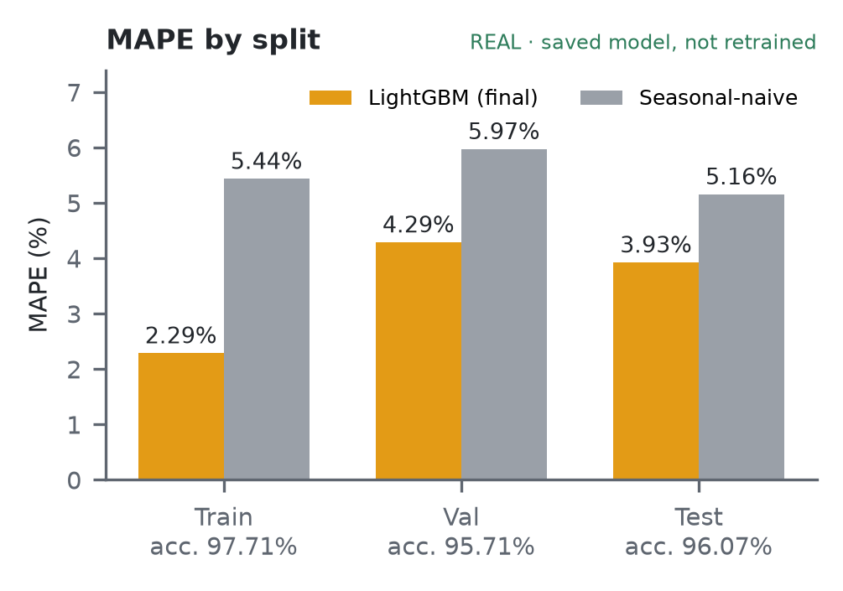
MODEL ACCURACY & FIT CHECK :
Accuracy ≈ 96% on test, no harmful overfitting
Split | MAPE | Accuracy | Naive MAPE | Gain
Train | 2.29% | 97.71% | 5.44% | 58%
Val | 4.29% | 95.71% | 5.97% | 28%
Test | 3.93% | 96.07% | 5.16% | 24%
Test MAPE by horizon | h1–4 | h5–24 | h25–48 | h49–96
LightGBM (naive ≈ 5.16%) | 3.21% | 3.48% | 3.84% | 4.22%
Overfitting: small train–test gap, early stopping at 436/3000, val & test flat → not harmful.
Underfitting: no — beats naive by 24% on test at every horizon.
Two honest caveats
Test set not fully untouched: the target-aligned lags were designed after reading the first model's test-set errors; 3.93% may be slightly optimistic.
Shortest horizons: persistence (next block = last block) beats the model at h = 1 (1.44% vs 3.18%) and h = 2 (2.77% vs 3.20%).
TRAIN ACCURACY
97.71%
MAPE 2.29%
VAL ACCURACY
95.71%
MAPE 4.29%
TEST ACCURACY
96.07%
MAPE 3.93%
Saved model, not retrained. Accuracy = 100 − MAPE. Naive = same block yesterday.
Load Profile Management & Forecasting · Faculty of Technology, University of Delhi
06 / 15

Slide 7
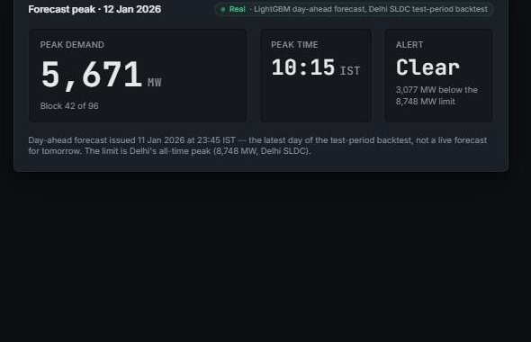
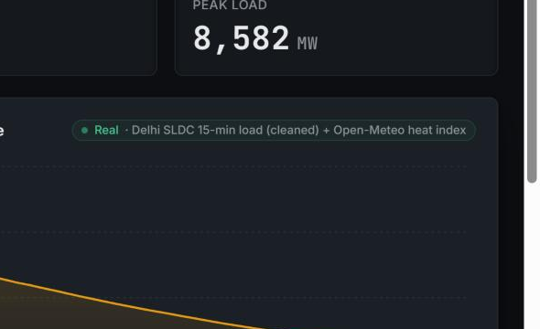
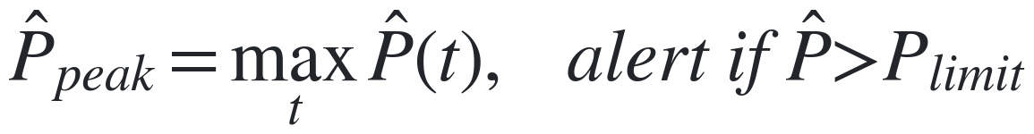
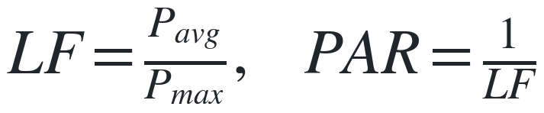
FEATURES 01–02 :
Overview & Load Analytics
01 · Overview
REAL
02 · Load Analytics
REAL
FORMULA
FORMULA
Highest of 96 forecast blocks + an overload alert against Delhi's all-time peak.
Load factor (avg/peak) and PAR, plus the load-duration curve, over the whole period.
Peak 5,671 MW < limit 8,748 MW -> Clear (headroom ~3,077 MW)
LF 0.503, PAR 1.99 (96,398 blocks, Apr 2023-Jan 2026)
Load Profile Management & Forecasting · Faculty of Technology, University of Delhi
07 / 15

Slide 8
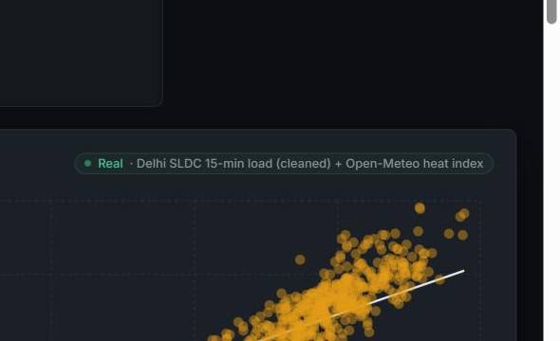
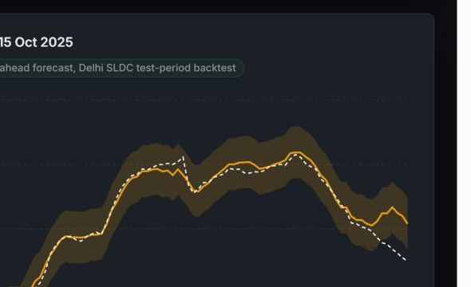
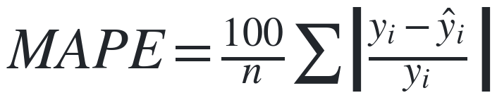
FEATURES 03–04 :
Weather Impact & Forecast
03 · Weather Impact
REAL
04 · Forecast
REAL
FORMULA
FORMULA
OLS fit: extra MW of load per 1 degC rise in heat index (temperature + humidity).
LightGBM multi-horizon forecast with a split-conformal P10-P90 band.
beta = 112.0 MW/degC, r^2 = 0.61 (96,398 blocks)
Test MAPE 3.93%, band coverage 84.4% (target 80%)
Load Profile Management & Forecasting · Faculty of Technology, University of Delhi
08 / 15

Slide 9
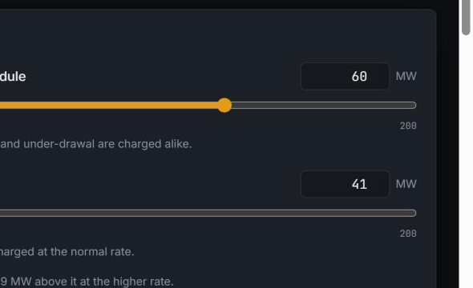
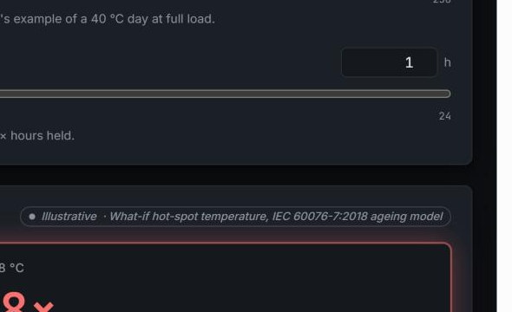
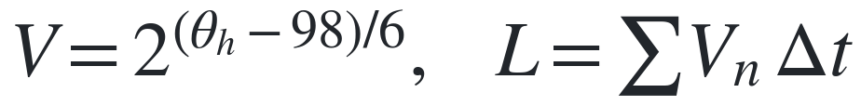
FEATURES 05–06 :
DSM Calculator & Transformer Health
05 · DSM ₹ Calculator
ILLUSTRATIVE
06 · Transformer Health
ILLUSTRATIVE
FORMULA
FORMULA
Deviation charge: normal rate up to the volume limit, k times that rate beyond it.
IEC 60076-7 ageing rate from hot-spot temperature, doubling every 6 degC.
60 MW deviation -> Rs 3.475 lakh/hr (illustrative, not a real penalty)
118 degC hot-spot -> ageing rate 10.08x normal
Load Profile Management & Forecasting · Faculty of Technology, University of Delhi
09 / 15

Slide 10
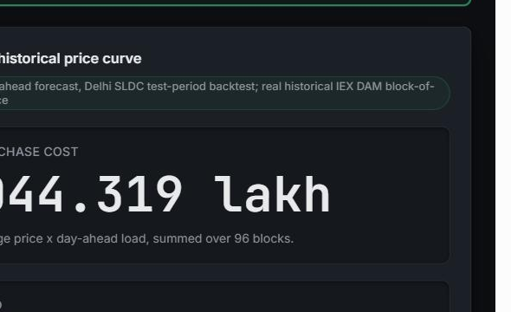
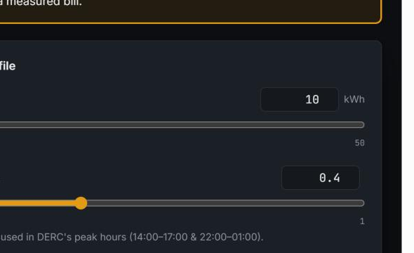
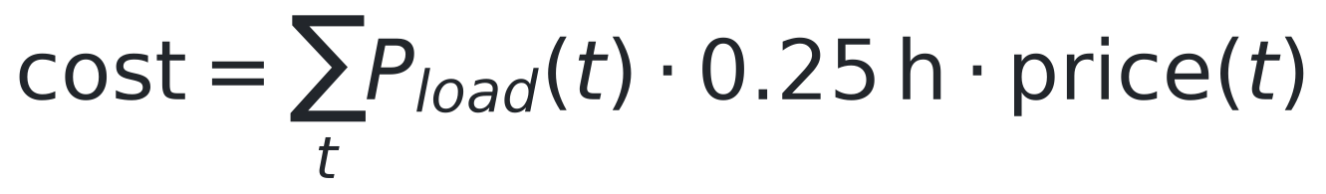
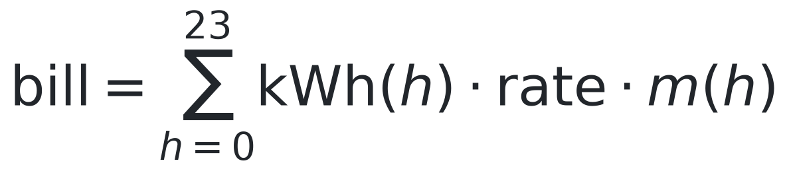
FEATURES 07–08 :
IEX Price & ToD Bill Simulator
07 · IEX Price
REAL
08 · ToD Bill Simulator
REAL
FORMULA
FORMULA
Real IEX DAM block-of-day average price (2018-2024) x real day-ahead load.
Flat vs Time-of-Day bill, real DERC Tariff Schedule FY2020-21, clause 3(d).
Real hourly price range Rs 3.05-6.13/unit (6.7-yr average)
Peak surcharge 20%, off-peak rebate 20% (14-17h & 22-01h / 04-10h)
Load Profile Management & Forecasting · Faculty of Technology, University of Delhi
10 / 15

Slide 11
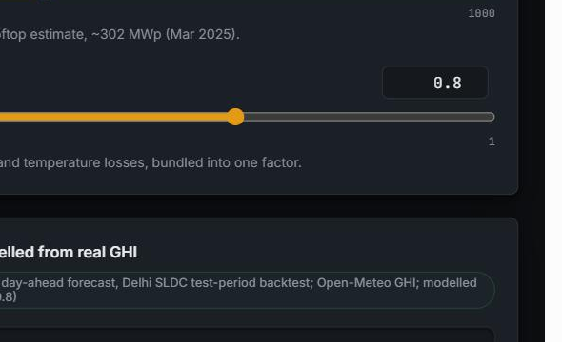
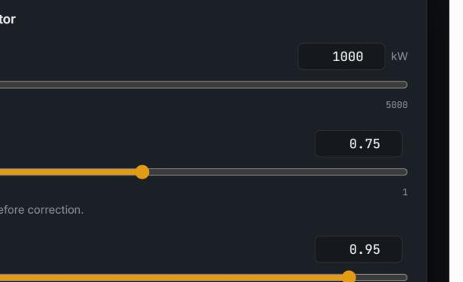
FEATURES 09–10 :
Solar & Net Load, and Losses & PF
09 · Solar & Net Load
MODELLED
10 · Losses & PF
ILLUSTRATIVE
FORMULA
FORMULA
PVWatts-style formula on real Open-Meteo GHI, validated against 2 real Indian plants.
PF-correction kVAR & I2R loss (what-if), alongside real Delhi-DISCOM AT&C.
Plant 1 r^2=0.97 (daytime); Plant 2 r^2=0.208 (daytime, real-world limit)
BRPL 6.58%, BYPL 7.84%, TPDDL 5.91% (FY23-24, PFC primary PDF)
Load Profile Management & Forecasting · Faculty of Technology, University of Delhi
11 / 15

Slide 12
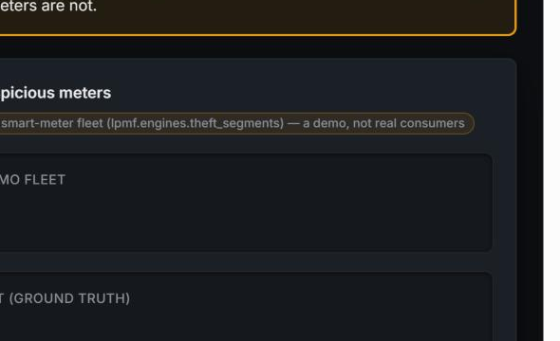
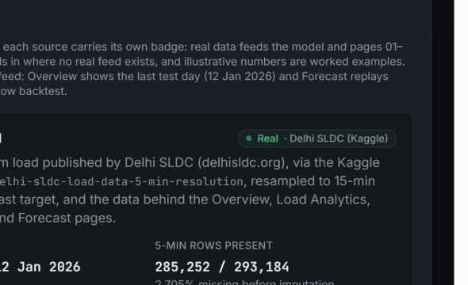
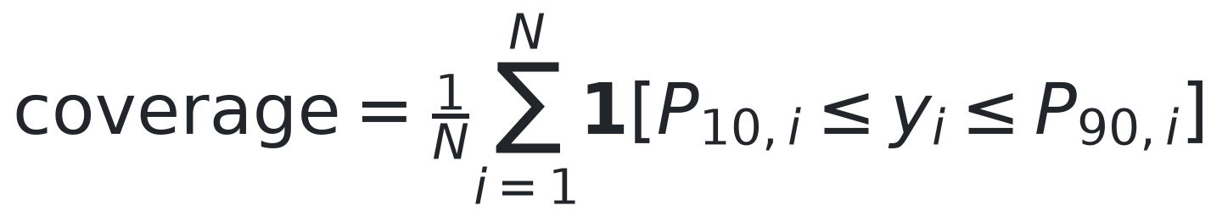
FEATURES 11–12 :
Theft & Segments, and the Data & Model Card
11 · Theft & Segments
FOREIGN
12 · Data & Model Card
REAL
FORMULA
FORMULA
Logistic regression -> LightGBM on the real SGCC benchmark (China State Grid).
Static summary of every page's data source, provenance and result.
Test AUC-ROC 0.7585 (paper ~0.78, no leakage flag)
All 12 pages documented; conformal band coverage 84.4% vs 80% target
Load Profile Management & Forecasting · Faculty of Technology, University of Delhi
12 / 15

Slide 13
BENCHMARKS :
Every page's benchmark, with its source
Page | Benchmark | Our result | Source
01-04 Forecast | Persistence h=1: 1.44/3.18% | Test MAPE 3.93%, 84.4% coverage | docs/MODEL_RESULTS.md
07 IEX Price | EAC-PM: Rs1.11-9.71/unit | Real history: Rs3.05-6.13/unit (2018-24 avg) | Kaggle mukund604/... (233,760 real rows)
08 ToD Bill | DERC FY20-21 clause 3(d) p.2 | 20%/20%, 14-17h&22-01h/04-10h | tatapower-ddl.com PDF (read directly)
09 Solar & Net Load | Real-plant validation (2 plants) | r2=0.99/0.21 (daytime), MAPE 6.3%/36.2% -- root cause investigated, no bug found | Kaggle anikannal/solar-power-generation-data
10 Losses & PF | National AT&C 15.37% (FY23) | BRPL 6.58%, BYPL 7.84%, TPDDL 5.91% (FY23-24) | PFC primary PDF, Annexure 1.8, p.76
11 Theft (SGCC) | Paper: ~0.78 AUC-ROC | Test AUC-ROC 0.7585 (no leakage) | Zheng et al., IEEE TII 2018
Updated 2026-11-11: Solar Plant 2's weak daytime fit (r2=0.208) was actively investigated (timestamp, clipping, sensor placement, day pattern) -- no fixable bug found, numbers unchanged, root cause now evidenced not just hypothesized. BYPL AT&C is now confirmed directly from PFC's primary PDF (was unconfirmed). Full detail: docs/BENCHMARKS.md.
Load Profile Management & Forecasting · Faculty of Technology, University of Delhi
13 / 15

Slide 14
REFERENCES :
Sources for the external figures and equations
1
Ministry of Power (PIB), all-time peak of 256.1 GW, 25 Apr 2026
11
D.P. Kothari & I.J. Nagrath, Modern Power System Analysis (Ch. 5)
pib.gov.in/PressReleasePage.aspx?PRID=2256313
Textbook (college library)
2
Delhi SLDC, peak demand record 8,748 MW, 29 Jun 2026
12
IEC 60076-7:2018, Loading guide for oil-immersed power transformers
delhisldc.org
webstore.iec.ch
3
CSE, "How Delhi is losing its cool", 2025
13
L.P. Rothfusz, The Heat Index Equation, NWS SR 90-23, 1990
cseindia.org
wpc.ncep.noaa.gov/html/heatindex_equation.shtml
4
S. Sanyal & S. Dev, "The Duck and the Camel", EAC-PM WP 53/2026
14
R.J. Hyndman & G. Athanasopoulos, Forecasting: Principles and Practice, 3rd ed.
eacpm.gov.in
otexts.com/fpp3
5
PFC / MoP, 14th Integrated Rating of DISCOMs (FY25)
15
T. Hong & S. Fan, Probabilistic load forecasting: a tutorial review, IJF 32(3), 2016
pfcindia.com
doi.org/10.1016/j.ijforecast.2015.11.011
6
CERC (Deviation Settlement Mechanism) Regulations, 2024
16
A.F. Ansari et al., Chronos: Learning the Language of Time Series, 2024
cercind.gov.in
arxiv.org/abs/2403.07815
7
DERC, intra-state DSM order, 13 Sep 2024
17
A.N. Angelopoulos & S. Bates, Conformal Prediction (intro), 2021
derc.gov.in
arxiv.org/abs/2107.07511
8
Electricity (Rights of Consumers) Amendment Rules, 2023
18
L. Thurner et al., pandapower, IEEE Trans. Power Systems, 2018
pib.gov.in/PressReleseDetailm.aspx?PRID=1945236
doi.org/10.1109/TPWRS.2018.2829021
9
V.K. Mehta & R. Mehta, Principles of Power System, S. Chand (Ch. 3, 6)
19
F.T. Liu, K.M. Ting & Z.-H. Zhou, Isolation Forest, IEEE ICDM 2008
Textbook (college library)
doi.org/10.1109/ICDM.2008.17
10
T. Gönen, Electric Power Distribution Engineering, 3rd ed., CRC (Ch. 2)
20
Indian Energy Exchange, Day-Ahead & Real-Time market data
Textbook (college library)
iexindia.com
Load Profile Management & Forecasting · Faculty of Technology, University of Delhi
14 / 15

Slide 15
Load Profile Management & Forecasting
Thank you
We welcome your questions and feedback.
TEAM -
GUIDED BY
Vansh Sachan
Ayush Rathore
Dr. Ujjal Sur
Dr. Arjun Tyagi
Animish Gupta
Lavish Rawat

