Slide 1

Project Title -Seasonal Agriculture Performance Analysis
Vansh Raj Yadav
GLA University, Mathura
AICTE STU ID :STU6a64da761a57a1784994422

Slide 2

PROBLEM STATEMENT
(Agricultural activities are influenced by seasonal variations in environmental conditions, farming practices, resource availability and market conditions. As a result, agricultural performance may differ from one season to another. However, raw agricultural data does not clearly explain how agricultural performance changes across seasons or what patterns can be observed in different seasonal conditions. The problem is to analyze the given agricultural dataset and investigate seasonal differences in agricultural performance by identifying meaningful patterns, trends, relationships and variations within the available data.

Slide 3
Project Description The project analyzes a 4,000-record agricultural dataset to understand how seasonal conditions and farming factors relate to agricultural performance. The analysis covers yield, profit, water efficiency, crop performance, irrigation methods, state-wise profitability and relationships between environmental variables and yield.

Slide 4

WHO ARE THE END USERS?
Farmers – understand seasonal and crop-level performance.
• Agricultural planners – compare regional and seasonal outcomes.
• Agribusinesses – evaluate profitability and market-oriented performance.
• Irrigation managers – compare irrigation and water-efficiency patterns.
• Researchers & students – use the analysis for agricultural insights and further study.

Slide 5

Technology Used
Python – data analysis and programming
Pandas – data cleaning, grouping and aggregation
NumPy – numerical operations
Matplotlib – charts and visualization
SciPy – statistical testing / ANOVA
Jupyter Notebook / Google Colab – analysis environment
CSV Dataset – source data

Slide 6
RESULTS
Dataset: 4,000 records × 28 columns
• Seasons: Kharif (1,779), Rabi (1,627), Zaid (594)
• 8 crops, 4 irrigation methods and 8 states
• Kharif has the highest average yield (5.64 t/ha) and profit (₹178,915)
• Drip has the highest average yield (6.62 t/ha)
• Rainfed shows the highest water-efficiency value (7.56 t/1000 m³)
• Seasonal profit differences are statistically significant (ANOVA p < 0.001)
• Seasonal yield differences are not statistically significant (ANOVA p = 0.233)

Slide 7
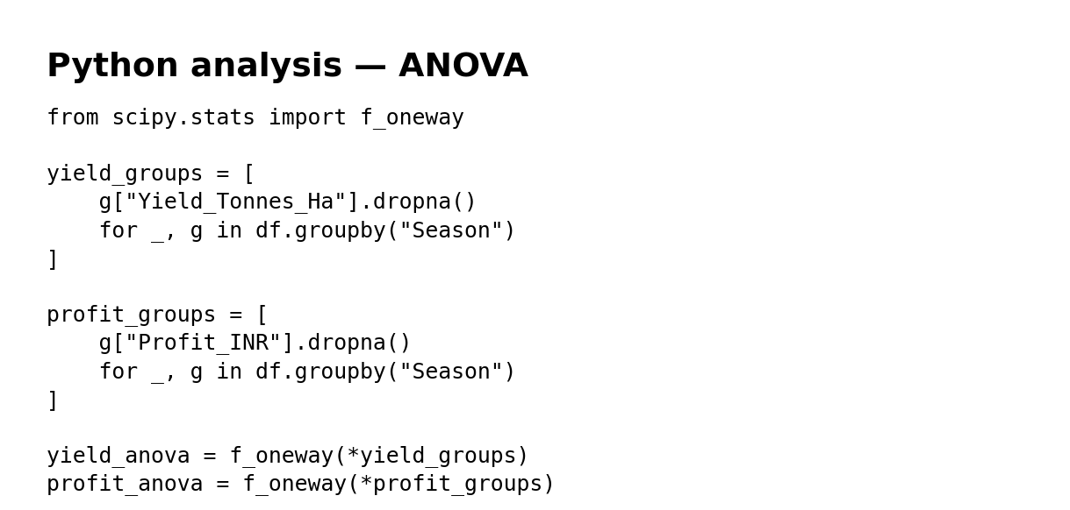
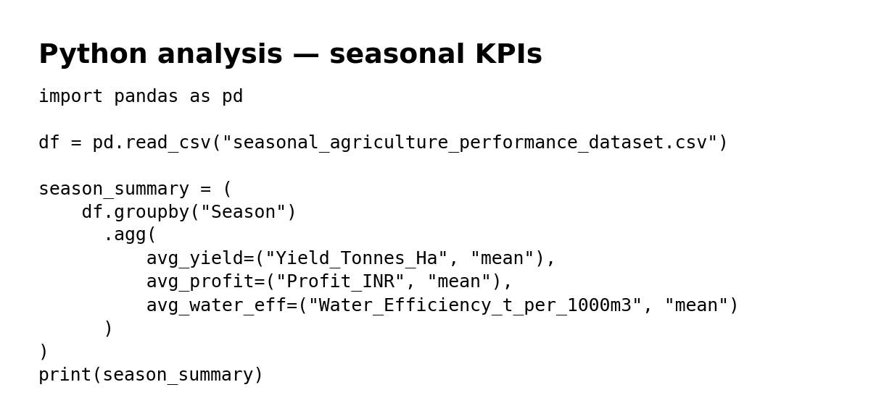
RESULTS
Analysis code: dataset loading, grouping by season/crop/irrigation/state, correlation analysis and ANOVA testing.

Slide 8
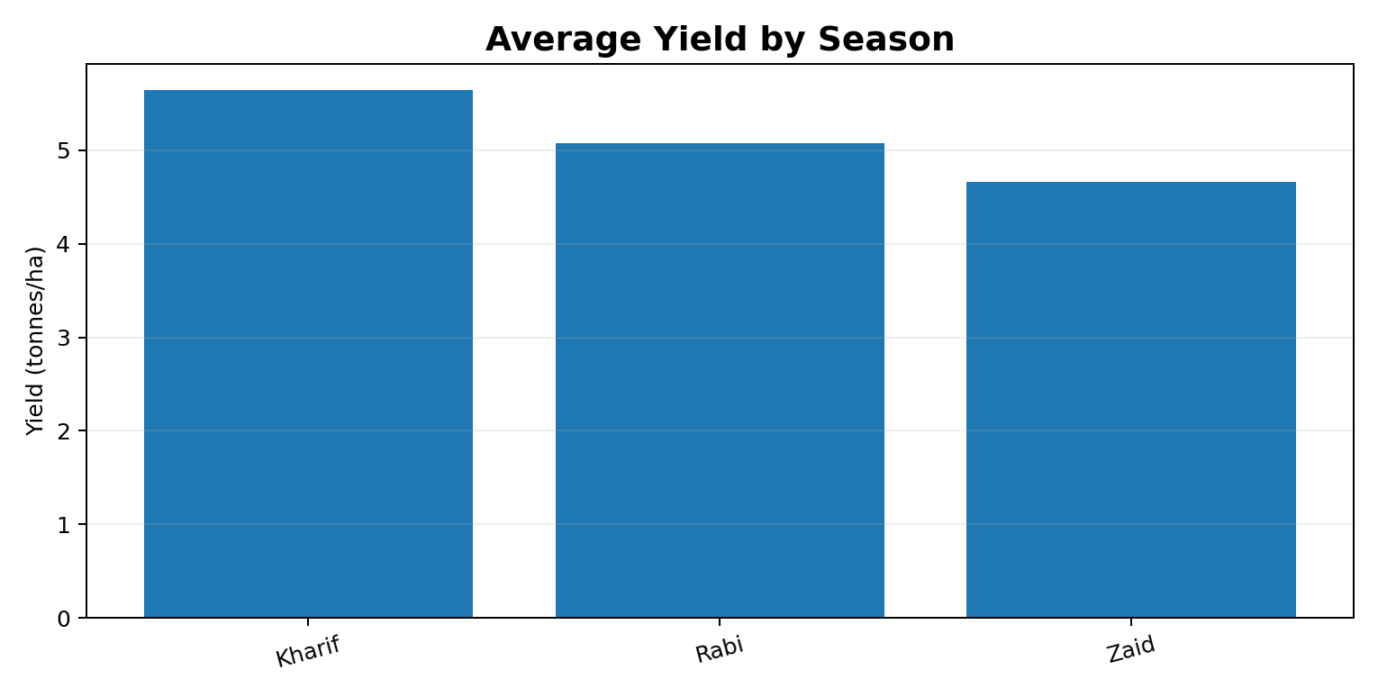
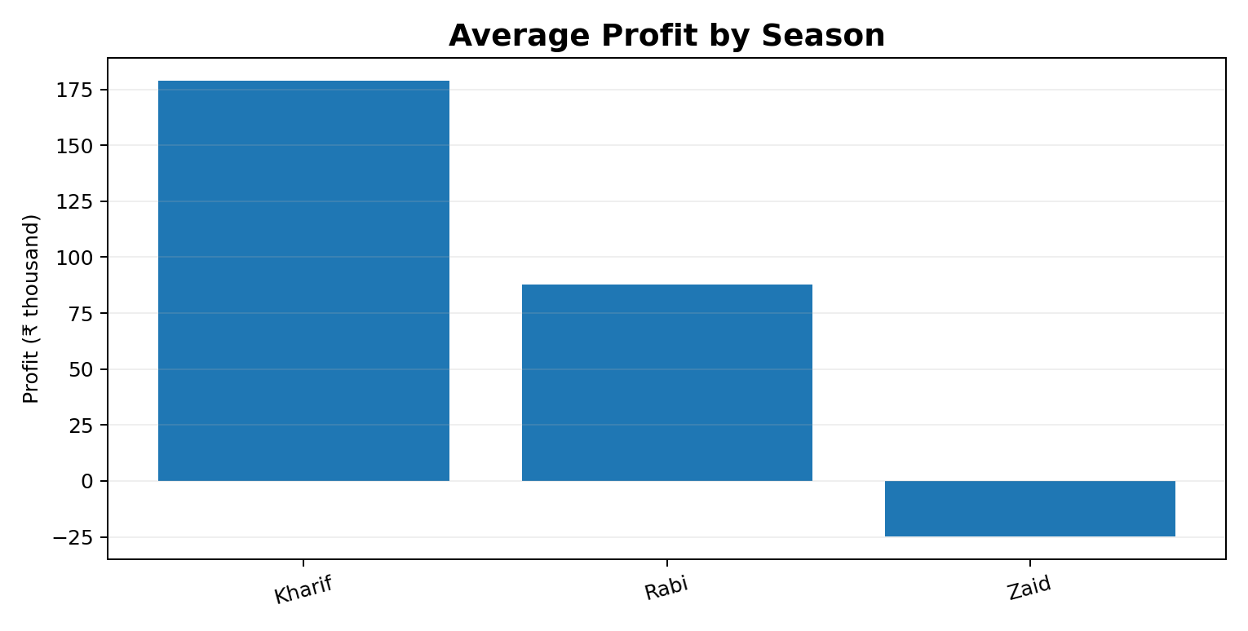
RESULTS
Seasonal result: Kharif leads average yield and profit; Zaid has the lowest average profit in this dataset.

Slide 9
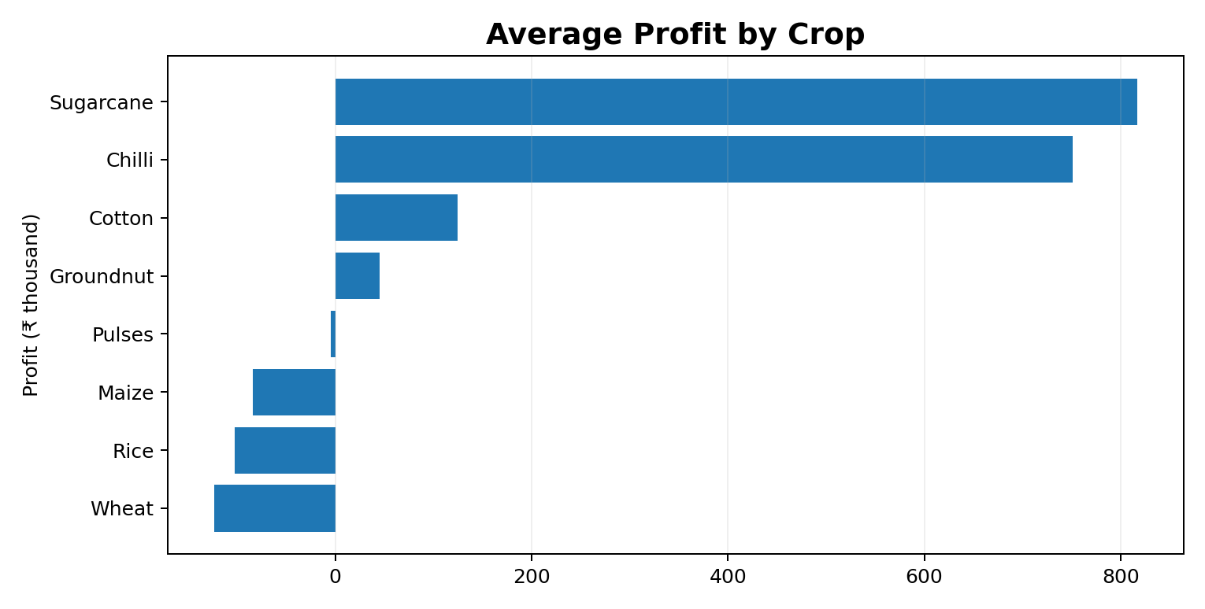
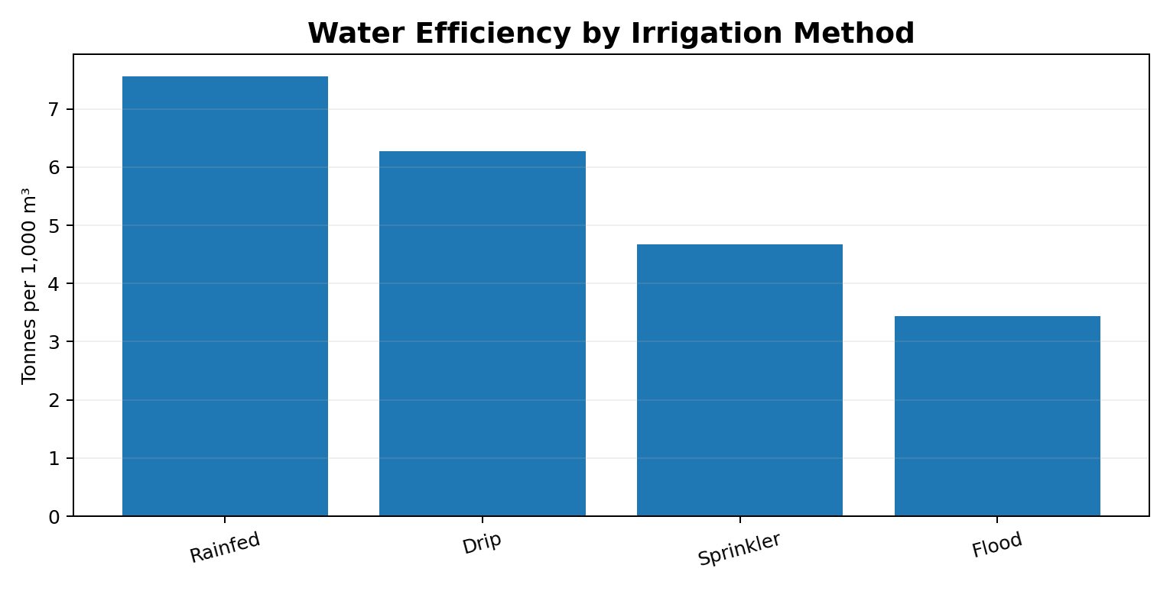
RESULTS
Crop result: Sugarcane has the highest average profit. Irrigation result: Drip has the highest average yield, while Rainfed has the highest water-efficiency metric.

Slide 10
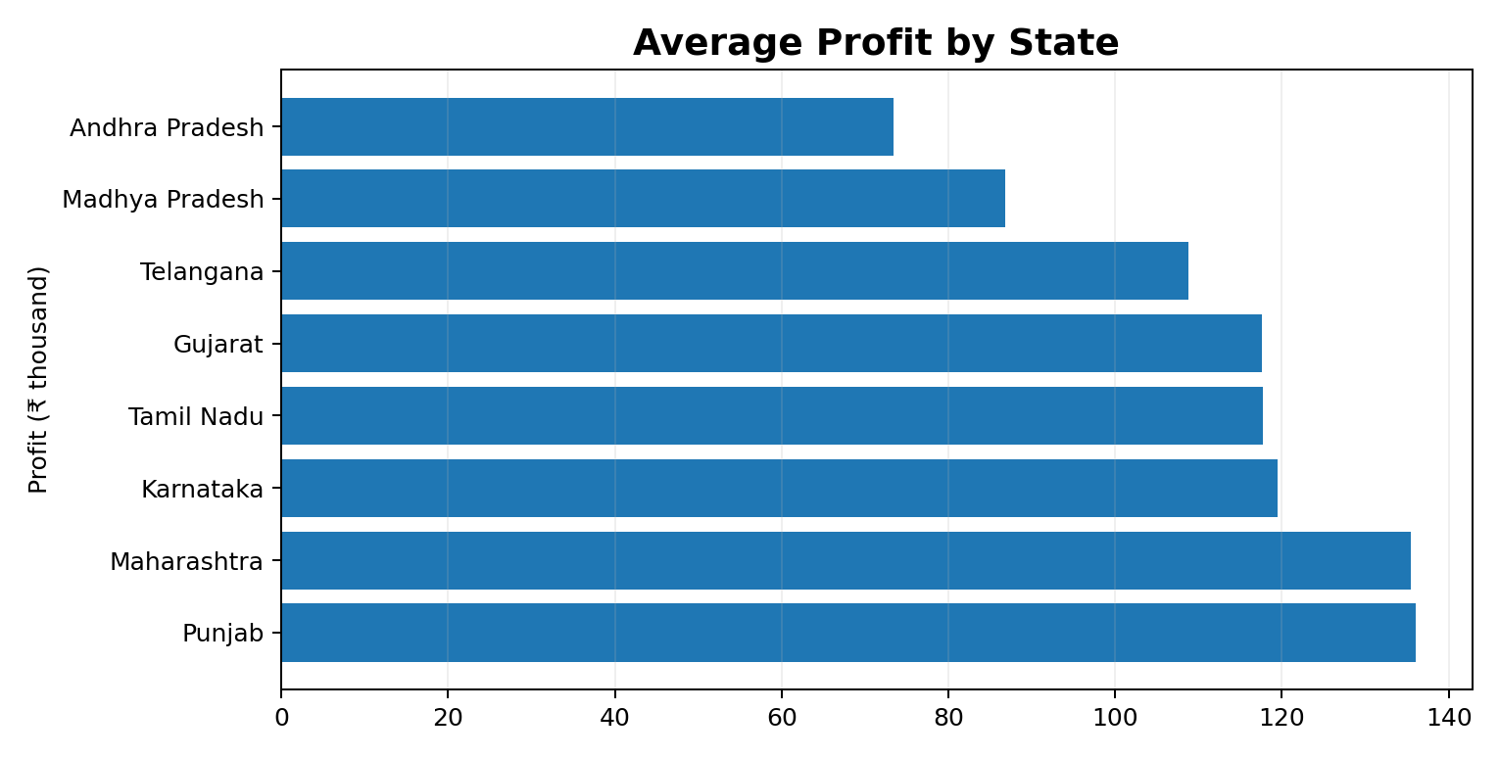
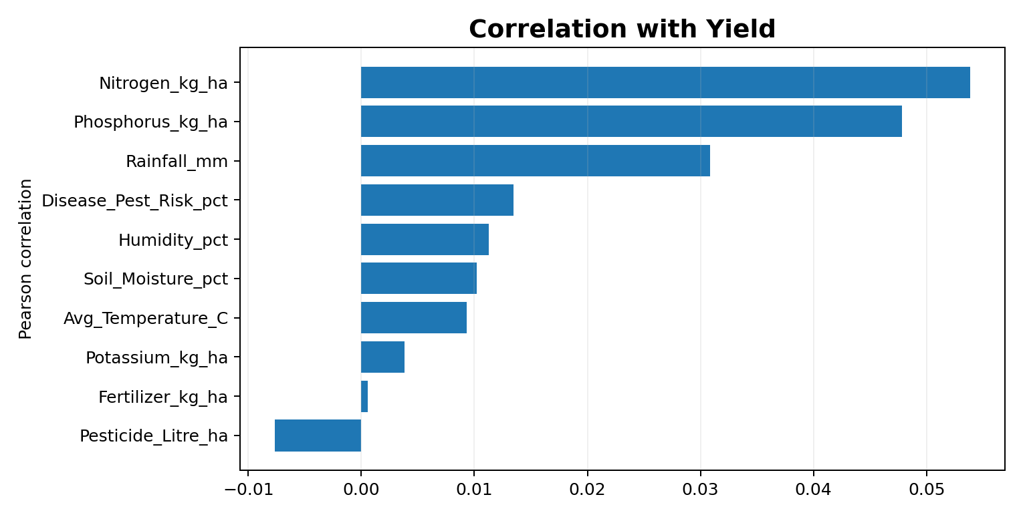
RESULTS
Regional result: Punjab has the highest average profit. Correlations with yield are weak in this dataset, correlation indicates association, not causation.

Slide 11
Future scope
• Build an interactive Power BI / Tableau dashboard.
• Add multi-year data to identify long-term seasonal trends.
• Apply predictive models for yield and profit forecasting.
• Add weather forecasts and market-price data for decision support.
• Include district-level and farm-level drill-down analysis.
• Develop recommendations for crop selection, irrigation and resource planning.

Slide 12
GitHub Link
https://github.com/Vansh0424/Seasonal-Agriculture-Performance-Analysis.git

Slide 13

VOIS Course completion certificate - Course name- Data Visualization

Slide 14
Thank you
.
.

