Slide 1
Project Presentation of CO-OP Project at Industry (Module-2) (22CS421)
On
Cognitive Performance Differences Between Esports Players and Casual Gamers
Team Members
Vansh Duggal : 2210990935
Aditya Chhabra : 2210990063
Pulkit Vashisht : 2210992594
Harkaran Singh : 2210990364
Supervised By
Dr. Rajat Takkar
Department of Computer Science and Engineering,
Chitkara University, Punjab

Slide 2
Introduction
In recent years, esports has grown rapidly into a global competitive gaming industry, attracting professional players, international tournaments, and millions of viewers worldwide.
Professional esports players train for several hours daily and compete in highly challenging environments that require quick decision-making, strong concentration, and precise reactions.
To succeed in competitive gaming, players must develop important cognitive skills such as attention control, working memory, visual processing, and mental flexibility.
In contrast, casual gamers typically play for entertainment or relaxation, without structured practice or competitive pressure.
Because of these differences in gaming experience, researchers are interested in understanding whether competitive gaming can influence or improve cognitive abilities.
Studying these differences can help us better understand the relationship between gaming experience and human cognitive performance.
Therefore, this research compares the cognitive performance of esports players and casual gamers using multiple standardized cognitive tests.

Slide 3
Objective
To analyze and compare the cognitive performance of esports players and casual gamers.
To evaluate key cognitive abilities including attention control, reaction speed, working memory, and cognitive flexibility.
To measure participants accuracy and response time across several cognitive tasks.
To identify which cognitive abilities show the most significant differences between competitive and casual gamers.
To examine how gaming experience may influence mental performance and information processing speed.
To apply a machine learning technique (Random Forest model) to classify players based on their cognitive test results.
To explore whether cognitive performance data can effectively distinguish between esports players and casual gamers.

Slide 4
Methodology / Approach
The study involved 100 participants, including 50 competitive esports players and 50 casual gamers.
All participants completed the experiment in a controlled testing environment using the same computer setup to ensure fairness and consistency.
Each participant performed six different cognitive tests designed to measure important mental abilities required in gaming.
The performance of participants was evaluated using two main measures: accuracy (correct responses) and reaction time (speed of response).
The collected data was analyzed using statistical methods such as t-tests to determine whether the differences between the two groups were significant.
In addition, a Random Forest machine learning model was applied to classify participants based on their cognitive performance.

Slide 5
Cognitive Tests Used
Flanker Task – Measures the ability to focus on a target while ignoring distractions (attention control).
Stroop Test – Measures inhibitory control and the ability to suppress automatic responses.
N-Back Task (2-Back) – Tests working memory and the ability to update information in the mind.
Simple Reaction Time Task – Measures how quickly a participant responds to a visual stimulus.
Task Switching Test – Evaluates cognitive flexibility and the ability to switch between tasks.
Visual Search Task – Measures visual attention and how quickly a target can be found among distractors.

Slide 6
Key Findings
The results of the study show that esports players consistently performed better than casual gamers across all cognitive tests.
Competitive players demonstrated higher accuracy levels, scoring approximately 88–96%, while casual gamers achieved around 75–82% accuracy in the same tasks.
In addition to accuracy, esports players also showed significantly faster reaction times, responding much quicker to visual stimuli and task changes.
The most noticeable difference appeared in the N-Back task, which measures working memory, indicating that esports players have stronger memory and information-processing abilities.
Across tasks measuring attention, cognitive flexibility, visual search, and decision-making, competitive gamers showed clear advantages over casual gamers.
Statistical analysis confirmed that these differences were highly significant (p < 0.001), meaning the results are unlikely to have occurred by chance.

Slide 7
Machine Learning Results
To further analyze the data, a Random Forest machine learning model was used to classify whether a participant was an esports player or a casual gamer.
The model was trained using twelve input features, which included accuracy and reaction time from each of the six cognitive tests.
The dataset was divided into 80% training data and 20% testing data, allowing the model to learn patterns and then evaluate its prediction performance.
The model achieved an overall classification accuracy of approximately 93.5%, indicating that cognitive test scores can strongly predict the type of gamer.
Among all the features, reaction time in the Flanker task and working memory performance in the N-Back task were the most influential factors for classification.
These results suggest that machine learning techniques can effectively analyze cognitive performance data and distinguish between competitive and casual gamers.

Slide 8
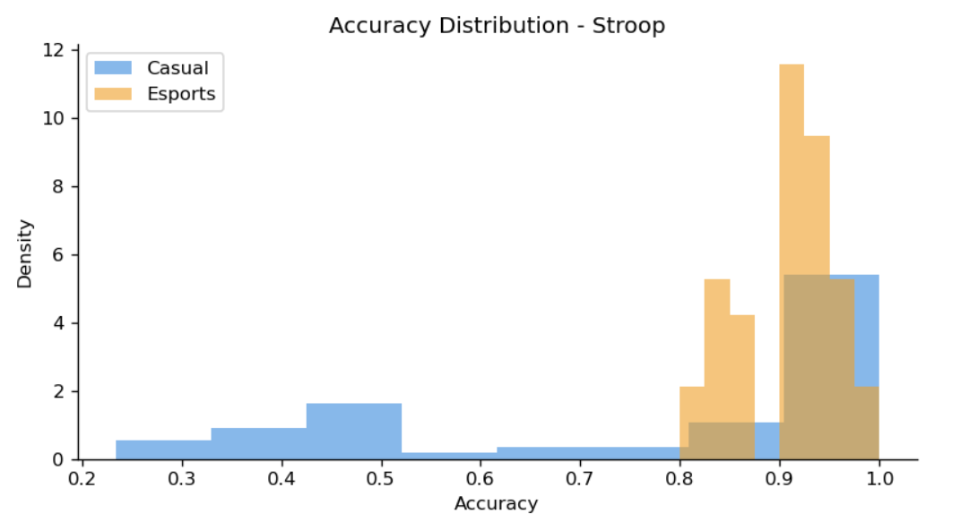
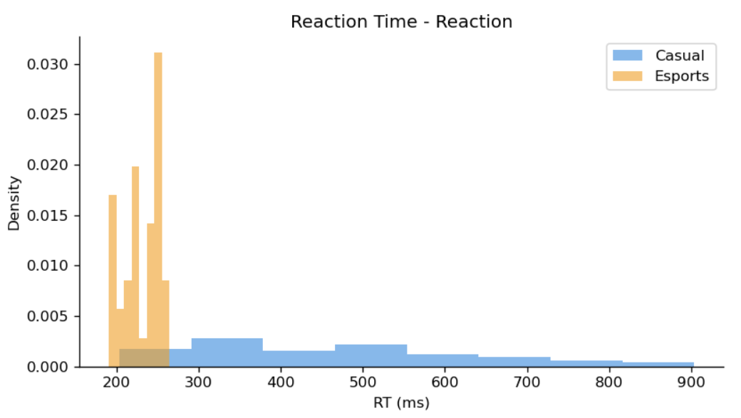
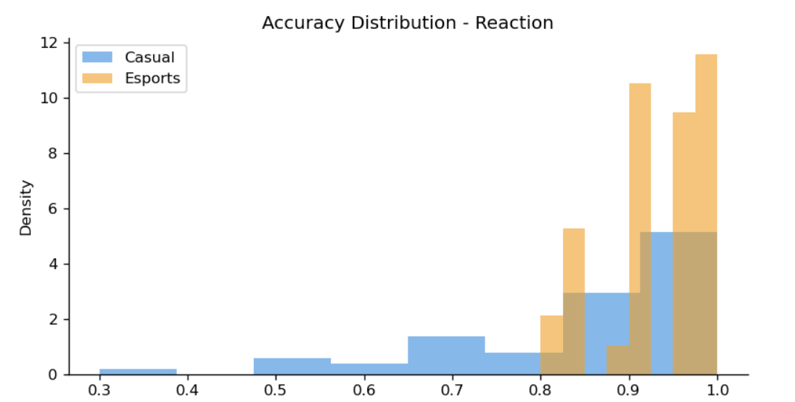
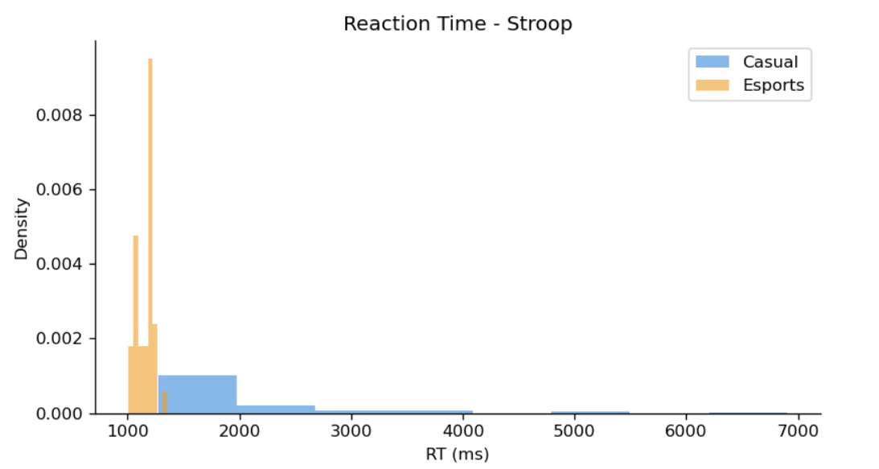
Graph

Slide 9
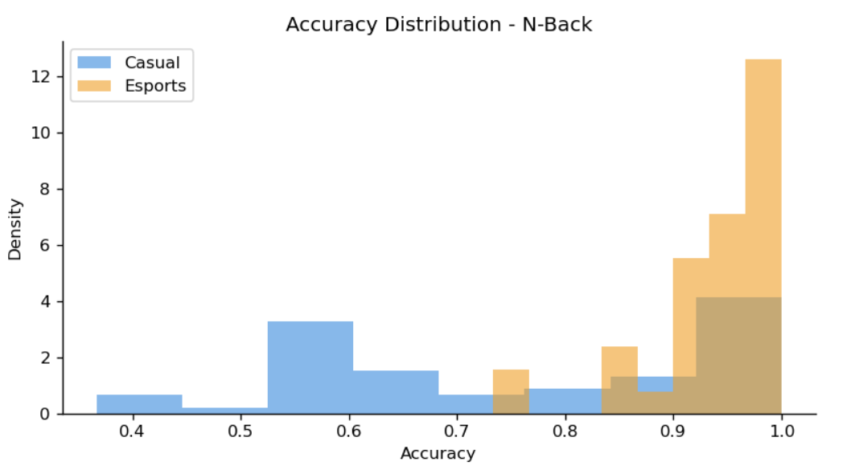
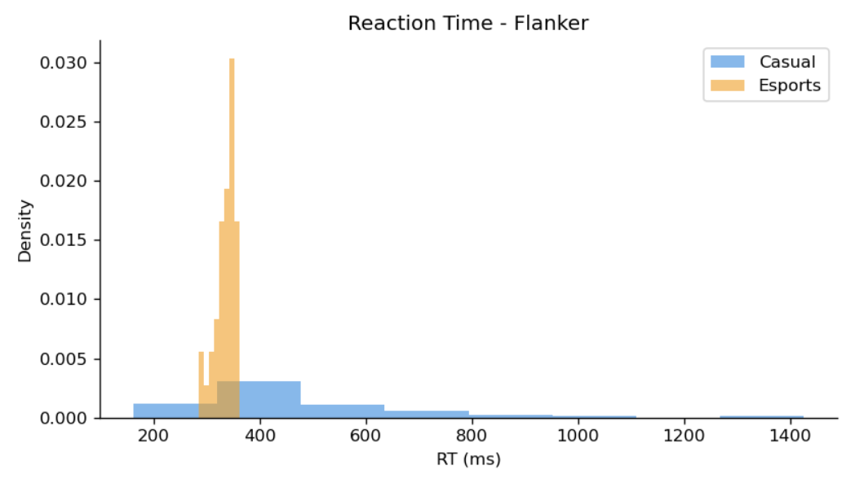
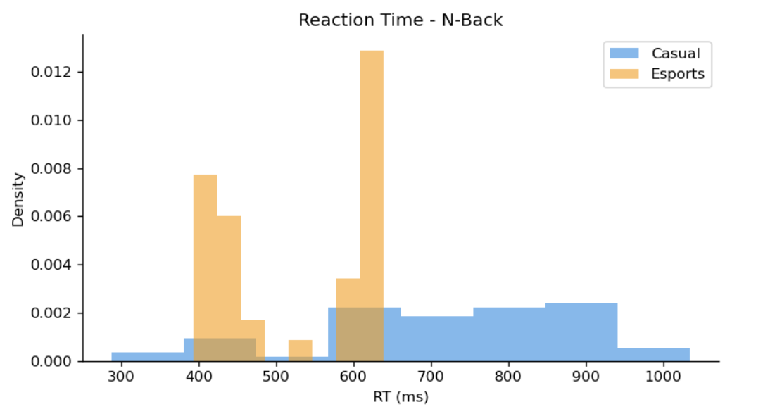
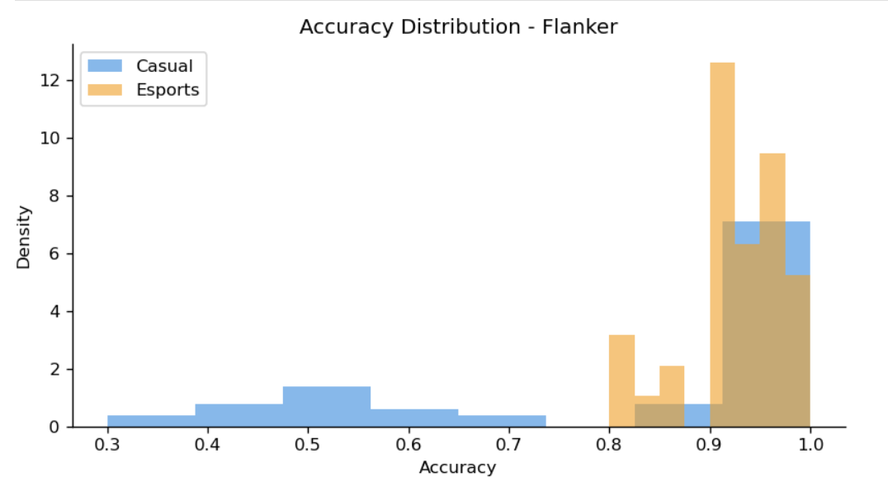
Graph

Slide 10
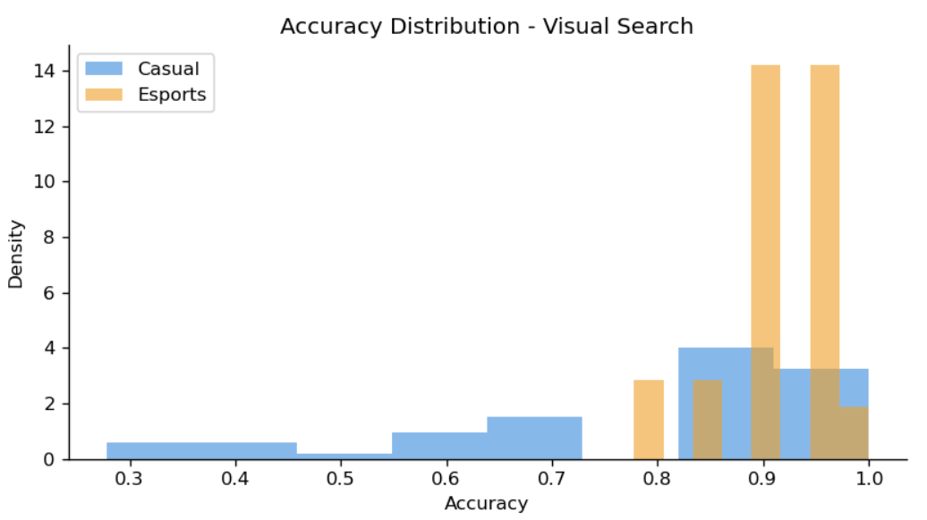
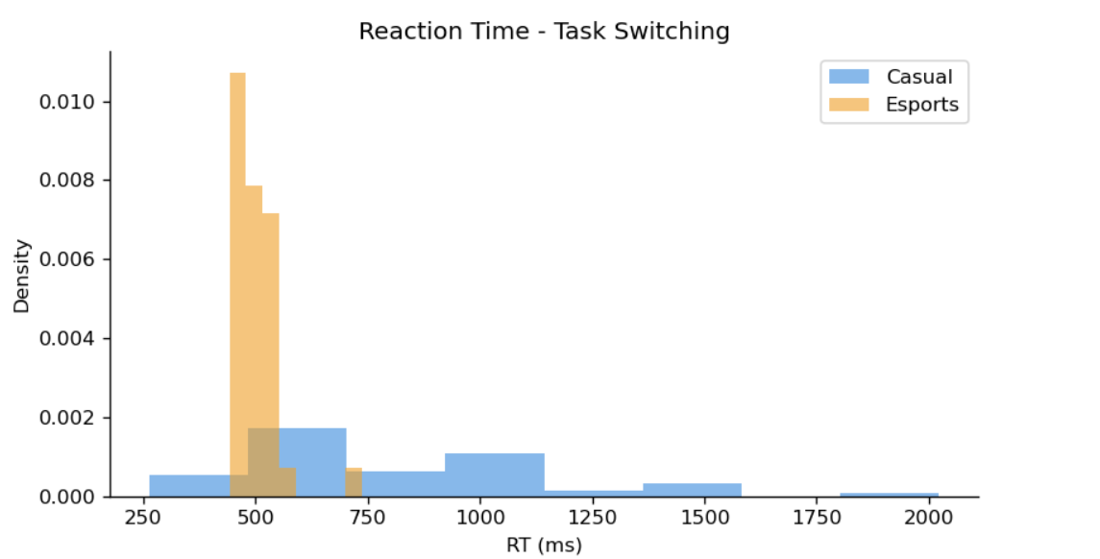
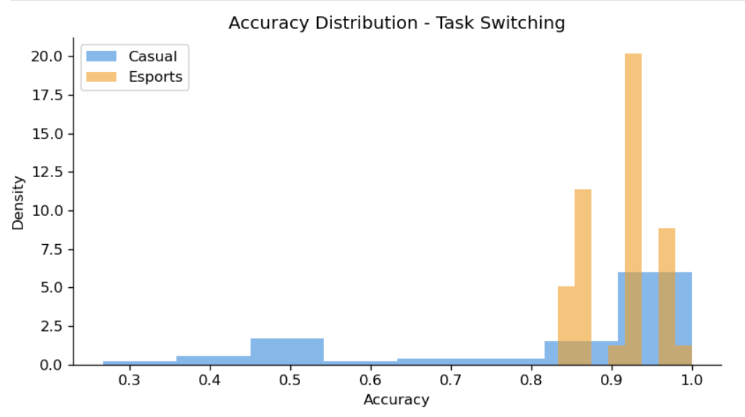
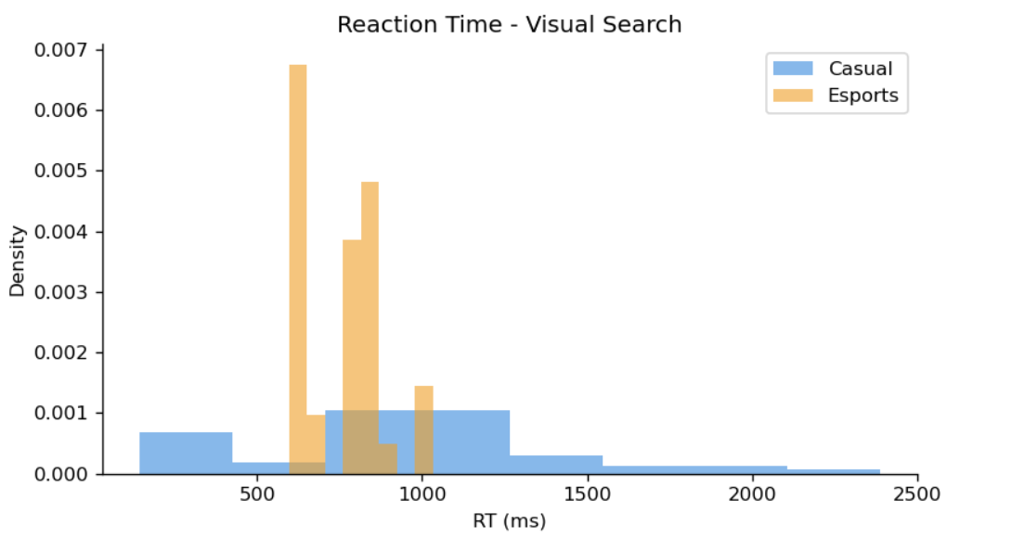
Graph

Slide 11
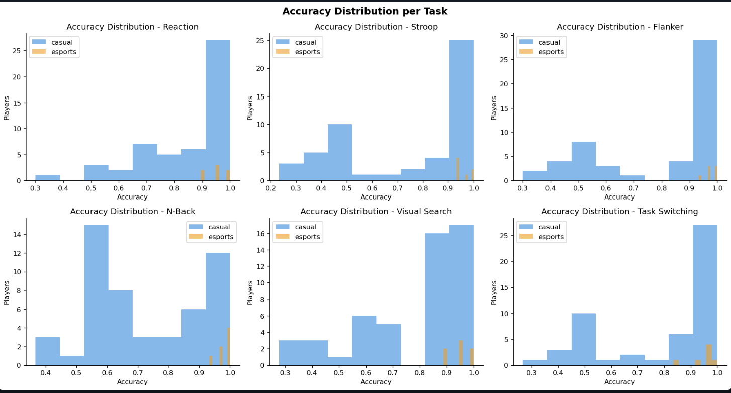
Graph

Slide 12
Conclusion
This study examined the cognitive performance differences between esports players and casual gamers using multiple standardized cognitive tests.
The results showed that esports players consistently performed better across all tasks, demonstrating higher accuracy and faster reaction times compared to casual gamers.
Competitive players showed clear advantages in important cognitive abilities such as attention control, working memory, reaction speed, and cognitive flexibility.
The application of the Random Forest machine learning model further supported these findings by successfully classifying players with an accuracy of approximately 93.5%.
Overall, the results suggest that competitive gaming is associated with enhanced cognitive performance, highlighting the potential mental benefits of structured and competitive gameplay.

Slide 13
Future Scope
Future research could involve a larger and more diverse group of participants to further validate and generalize the findings of this study.
Long-term studies could be conducted to examine how continuous esports training influences cognitive development over time.
Researchers could also include brain-imaging techniques such as EEG or other neuroscience tools to better understand how gaming affects brain activity.
Additional factors such as age, lifestyle, gaming experience, and sleep patterns could be analyzed to understand their influence on cognitive performance.
Advanced machine learning and artificial intelligence models could be applied to explore deeper patterns in cognitive data and improve prediction accuracy.

Slide 14
Thank You
14

