Slide 1

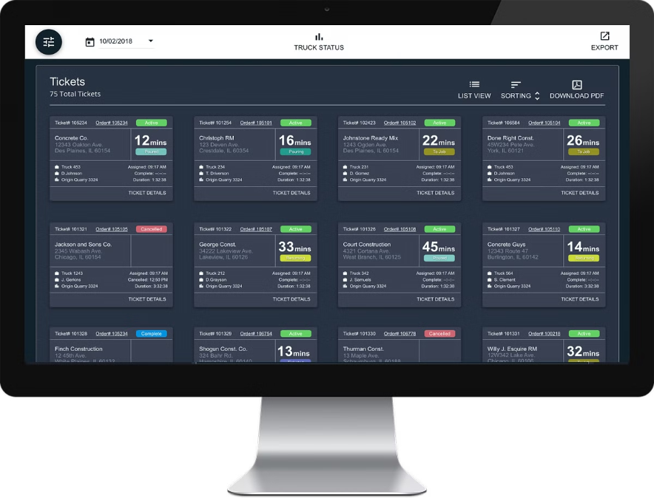

Client Ticketing System
TEAM 5
Vansh Bajaj
Makam Ranga Rakshith
Prithak Gajurel
Duddu Bala Guru Venkata Arjun

Slide 2
ABSTRACT
In the realm of customer service and support, effective management of client inquiries and issues is paramount for organizational success. A client ticketing system serves as a structured approach to streamline this process, ensuring timely resolution and customer satisfaction
The client ticketing system acts as a centralized platform where clients can submit their queries or problems, which are then organized into tickets. Each ticket is assigned a unique identifier and categorized based on priority and type of issue.
The ticket is passed on to the consultancy firm where the manager assigns the issue to the consultant. The consultant needs to update the status of the issue to the manager who is further answerable to the client.
The system works with the help of flask and SQL for database management. By prioritizing efficiency, communication, and data-driven insights, businesses can foster stronger client relationships and achieve operational excellence.

Slide 3


System Overview
1
Purpose
The Client Ticketing System centralizes client inquiries and requests, ensuring efficient tracking, resolution, and communication.
2
Key Features
The system offers features like ticket creation, status updates, automated notifications, and comprehensive reporting for effective management.
3
Motivation
Driven by the need for improved client support processes, the system aims to optimize response times, enhance collaboration, and empower clients.
4
Goals
The system aims to increase client satisfaction, reduce resolution time, improve communication efficiency, and provide valuable insights through data analysis.

Slide 4
Technologies and Tools Used
1
Flask
2
MySQL
The backend of the Client Ticketing System is built using the Flask web framework.
The relational database management system used to store and manage all data related to the Client Ticketing System.
3
Python
4
Pandas, NumPy, Matplotlib
Python is the primary programming language used for the backend development of the Client Ticketing System.
These Python libraries are utilized for advanced data manipulation, analysis, and visualization.
5
Git
6
Thunderclient
The version control system used for collaborative development and code management.
Thunderclient is the tool used for API testing, including sending requests and receiving responses.

Slide 5



Streamlined Ticket Management
Ticket Submission
Clients can easily submit tickets through our website or mobile app. The system automatically captures important details like contact information and issue description.
Ticket Resolution
Agents can manage tickets, update status, and communicate with clients within the system. They have access to relevant knowledge base articles and past tickets.
Ticket Closure
Once resolved, tickets are closed and archived for future reference. The system provides feedback mechanisms to assess customer satisfaction.

Slide 6
Modules
Common Modules
1
register
login
Client Modules
logout
2
change password
raise_ticket
view_tickets
recent_first
Manager Modules
3
manage_tickets
manage_tickets/
assign_ticket/
ticket_logs
update_ticket_status/
4
Consultant Modules
export_tickets
update_ticket_status/
generate_reports
consultant_tickets

Slide 7
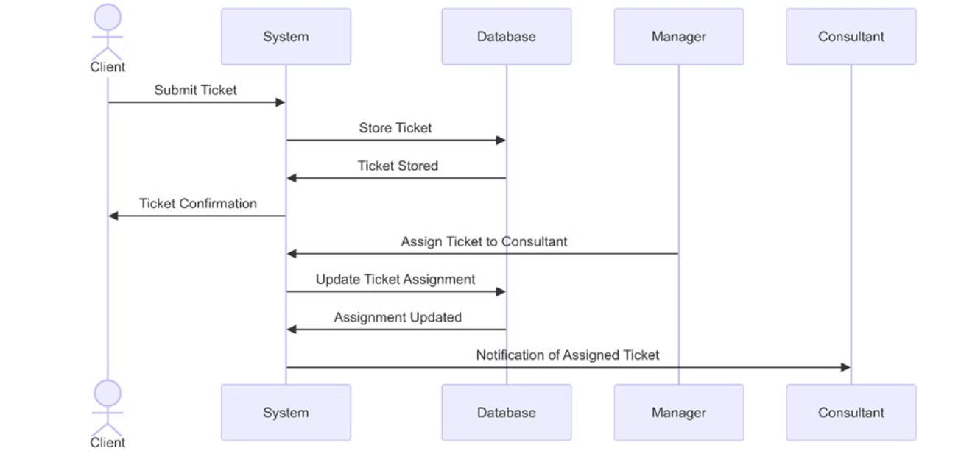
Sequence Diagram:
Raising Ticket and assigning module

Slide 8
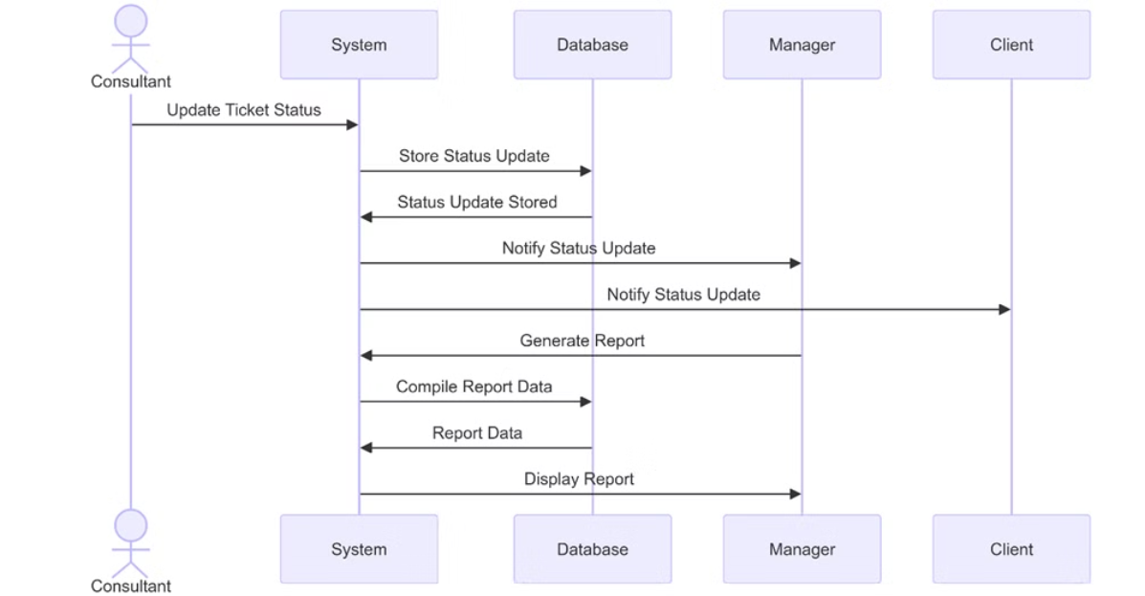
Sequence Diagram:
Updating Status and Notification module

Slide 9


Conclusion
In conclusion, the Client Ticketing System offers a streamlined approach to managing client inquiries and issues, enhancing efficiency and customer satisfaction through effective communication and timely resolution. Powered by Flask and SQL, it stands poised to support organizational success by prioritizing operational excellence and strong client relationships.

