Slide 1
ASTRA
AI-assisted code smell detection
using Abstract Syntax Trees
Compiler Design Project Presentation
Presenter / team: [add your name(s)]
ASTRA / Compiler Design
01
Notes:
Opening: ASTRA analyzes Python structure to identify maintainability concerns. Add presenter names before submission. The included model is an educational starter.

Slide 2
Problem statement
Correct syntax does not guarantee maintainable code.
Long functions and deeply nested decisions make changes harder.
Manual review becomes inconsistent as code grows.
Developers need findings they can trace to source evidence.
ASTRA / Compiler Design
02
Notes:
A code smell is a maintainability concern rather than proof of a bug. Source: analyzer.py and docs/PROJECT_REPORT.md.

Slide 3
Project objectives
Extract structural measurements from Python ASTs.
Identify selected code smells with explainable rules.
Add a trainable function-review classifier.
Present source locations, evidence and improvement suggestions.
ASTRA / Compiler Design
03
Notes:
Explain each objective using a live feature. The tool reads and parses source without executing it.

Slide 4
Project scope
Implemented
Outside the current scope
Python source analysis
Single-file inspection
AST metrics and rule findings
Educational pretrained classifier
Interactive reports and tutorials
Machine-code generation
Complete type checking
Interprocedural dataflow
Automatic code rewriting
Real-world accuracy claims
ASTRA / Compiler Design
04
Notes:
Python supplies tokenize and ast.parse. ASTRA implements visitors, rules, learning and reporting. A fix-code button was discussed but has not been implemented.

Slide 5
Compiler Design connection
Compiler stage | ASTRA implementation
Lexical analysis | Tokens with values and source locations
Syntax analysis | Python parser builds an AST
Scope inspection | Local assignments and lexical reads
Structural representation | Visitors extract function metrics
Static analysis | Rules produce source-mapped diagnostics
ASTRA / Compiler Design
05
Notes:
Lexical analysis uses tokenize. Syntax analysis uses ast.parse. Local binding checks are lexical and do not implement a complete semantic analyzer. Source: server.py, analyzer.py.

Slide 6
Analysis methodology
1 Enter source or upload a Python file.
2 Tokenize and parse the source into an AST.
3 Traverse each function scope and extract measurements.
4 Apply rules and obtain optional ML predictions.
5 Inspect findings and export the report.
ASTRA / Compiler Design
06
Notes:
Describe the sequence without claiming a custom lexer or parser. Source: analyzer.py.

Slide 7
AST representation
Python source
Simplified structural view
def total(items):
amount = sum(items)
return amount
FunctionDef: total
arguments: items
Assign: amount
Call: sum(items)
Return: amount
Visitors measure structure instead of searching for words in raw text.
ASTRA / Compiler Design
07
Notes:
The diagram is expressed as editable text. AST ignores formatting and encodes actual constructs. String contents containing keywords do not become branches.

Slide 8
Code smells and supplementary hints
Finding | What the analyzer examines
Long method / parameter list | Source span and number of inputs
Deep nesting / high complexity | Structured depth and decision counts
Large class | Number of direct methods
Duplicate implementation | Matching AST function bodies
Unused local | Assigned names without detected lexical reads
Magic-number hint | Selected numeric literals in expressions
ASTRA / Compiler Design
08
Notes:
Duplicate implementation compares exact function AST bodies of at least three statements. Large class counts direct methods. Unused-local checks are lexical. Source: analyzer.py.

Slide 9
Function measurements
Measurement | Meaning
LOC | Lines spanned by the function
Parameters | Positional, keyword and variadic inputs
Nesting | Maximum depth of structured statements
Complexity | Supported decisions and boolean alternatives
Additional features | Statements, calls, loops and branches
ASTRA / Compiler Design
09
Notes:
LOC includes comments and blank lines within the source span. Complexity starts at one. Nested function and class bodies are measured independently. Source: analyzer.py metrics().

Slide 10
Rules and the learned classifier
Rule engine
Decision-tree classifier
Explicit thresholds
Specific smell names
Evidence and suggestions
Adjustable analysis settings
Learns feature splits from labels
Predicts function-review need
Uses Gini impurity
Depth limited to five
The hybrid evaluation uses a fixed combination of structural rules and model output.
ASTRA / Compiler Design
10
Notes:
The model target is binary review warranted, not specific smell type. Leaf proportions are not calibrated confidence. Sources: ml.py, data/STARTER_MODEL.md.

Slide 11
Starter data and training
40
Five authored domain modules
Orders, accounts, inventory,
telemetry and scheduling
Binary labels:
0 = acceptable
1 = review warranted
authored Python functions
32 train / 8 held out
Educational examples. Human review and independent repositories are still needed.
ASTRA / Compiler Design
11
Notes:
40 assistant-authored and assistant-labeled functions. Labels reflect design judgments attached before extraction. Related patterns occur across modules. This is not independent human annotation. Sources: prepare_starter_model.py, data/STARTER_MODEL.md.

Slide 12
Evaluation outcomes
Method | Precision | Recall | F1
Structural rules | 100% | 100% | 100%
Decision tree | 100% | 100% | 100%
Hybrid policy | 100% | 100% | 100%
Test support: 4 acceptable functions and 4 review cases
These scores describe eight educational examples only.
They do not establish performance on real-world repositories.
ASTRA / Compiler Design
12
Notes:
Actual values from data/starter_evaluation.json. All three methods get four true negatives and four true positives on eight examples. This small designed corpus provides no evidence of general accuracy or ML superiority.

Slide 13
User interface and guided learning
Code editor with examples, file upload and syntax diagnostics.
Findings include evidence, source navigation and suggestions.
Metrics, AST and compiler artifacts support explanation.
Short tutorial, full walkthrough and contextual hover help.
Optional research controls keep routine analysis focused.
ASTRA / Compiler Design
13
Notes:
The short tour has 10 steps. The full walkthrough covers 23 steps. Research controls remain collapsed. Hover help focuses on unfamiliar concepts. Sources: web/tutorial.js, simplify.js, feature-help.js.

Slide 14
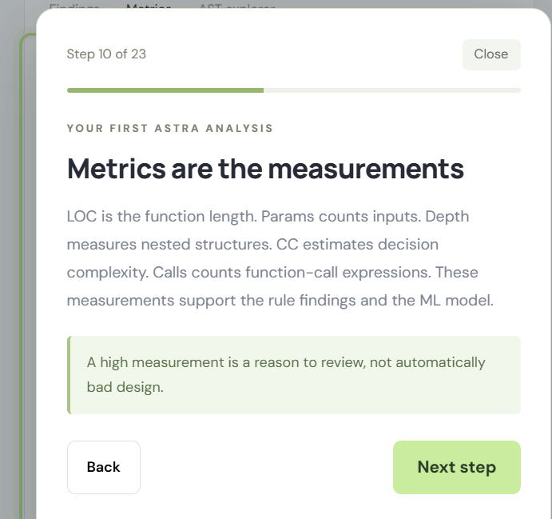
Tutorial refinement from user feedback
Observed issue
The popup covered the feature
it was explaining.
Implemented response
Smaller tutorial panel
Placement based on free space
Bottom dock on narrow screens
Shorter introductory tour
Earlier interface screenshot
ASTRA / Compiler Design
14
Notes:
Screenshot supplied by the user in this conversation: codex-clipboard-08ae2984-13a8-4290-ad8e-27ff8a2486ed.png. It depicts an earlier tutorial layout, not the current final UI. Later code added compact placement and a narrow-screen fallback.

Slide 15
Validation and project outcomes
Implemented a local Python analysis application.
Delivered editable source, reports and reproducible starter training.
Python tests cover scope handling, syntax and HTTP routes.
Training tests cover validation and group-based partitioning.
UI scripts include syntax and tutorial placement checks.
ASTRA / Compiler Design
15
Notes:
Run the current test suite before citing the passing count. Previous verified results were 18 Python tests plus JS syntax and positioning checks. Sources: tests/, web/ and previous run records.

Slide 16
Limitations and future development
Current limitations
Future development
Python and one file at a time
Lexical variable-use heuristic
Exact-body duplicate detection
Educational starter data
Independent reviewed datasets
Repeated grouped evaluation
Control-flow and def-use analysis
Assisted refactoring previews
ASTRA / Compiler Design
16
Notes:
Do not present the proposed fix-code feature as implemented. Real-world evaluation needs independently reviewed Python data. Source: docs/PROJECT_REPORT.md and the current code.

Slide 17
Demonstration and source access
Live demo sequence
Project access
Analyze the smelly example
Expand a finding and jump to source
Inspect metrics and the AST
Compare the clean example
Show model evaluation and export
Local demo:
http://127.0.0.1:8000/
GitHub repository:
Pending publication
[insert repository URL]
Thank you. Questions are welcome.
ASTRA / Compiler Design
17
Notes:
No Git repository or remote is configured in the project workspace. The user confirmed no repository exists yet. Add the real GitHub URL before submission. Localhost works only while server.py runs.

