Slide 1
SmartSage – AI that teaches like a wise mentor
By:- Vansh Gupta

Slide 2
Summary
Our project focuses on AI-driven personalized learning for K-12 students. It predicts assessment scores, determines promotion eligibility, and customizes study material based on student levels. The system leverages data analysis, machine learning, and NLP to curate content dynamically for effective learning.

Slide 3
PROBLEM STATEMENTS
Predict assessment score & promotion decision → Need a model to train on assessment data.
Decide what to keep/skip at different levels → Need clear rules based on grade levels.
Predict study material based on student level → Need a model to map materials to student levels.
Generate adaptive teaching material dynamically → Requires NLP model (Gemini) to simplify/modify content dynamically.

Slide 4
SOLUTIONS
01
03
Develop an AI model to analyze past performance, study time, and IQ to predict assessment scores and determine promotion eligibility.
Identify key topics for each grade level, ensuring an optimized learning path by removing redundant or complex topics based on student understanding.
02
04
Use AI-driven recommendations to match students with the right learning resources, ensuring personalized and effective learning experiences.
Implement NLP-based models to simplify, restructure, and generate adaptive learning materials in real time based on student needs.

Slide 5
STEPS TO ACHIEVE
Step 1: Collect student data (IQ, scores, study time, etc.).
Step 2: Perform Exploratory Data Analysis (EDA) to find patterns.
Step 3: Train AI/ML models for prediction and recommendations.
Step 4: Implement an NLP model to simplify teaching materials.

Slide 6
MODEL USED
Regression Models – Predict student performance.
Recommendation Systems – Suggest study material.
Classification Models – Identify students at risk.
NLP Models (Gemini/GPT) – Simplify learning content.

Slide 7
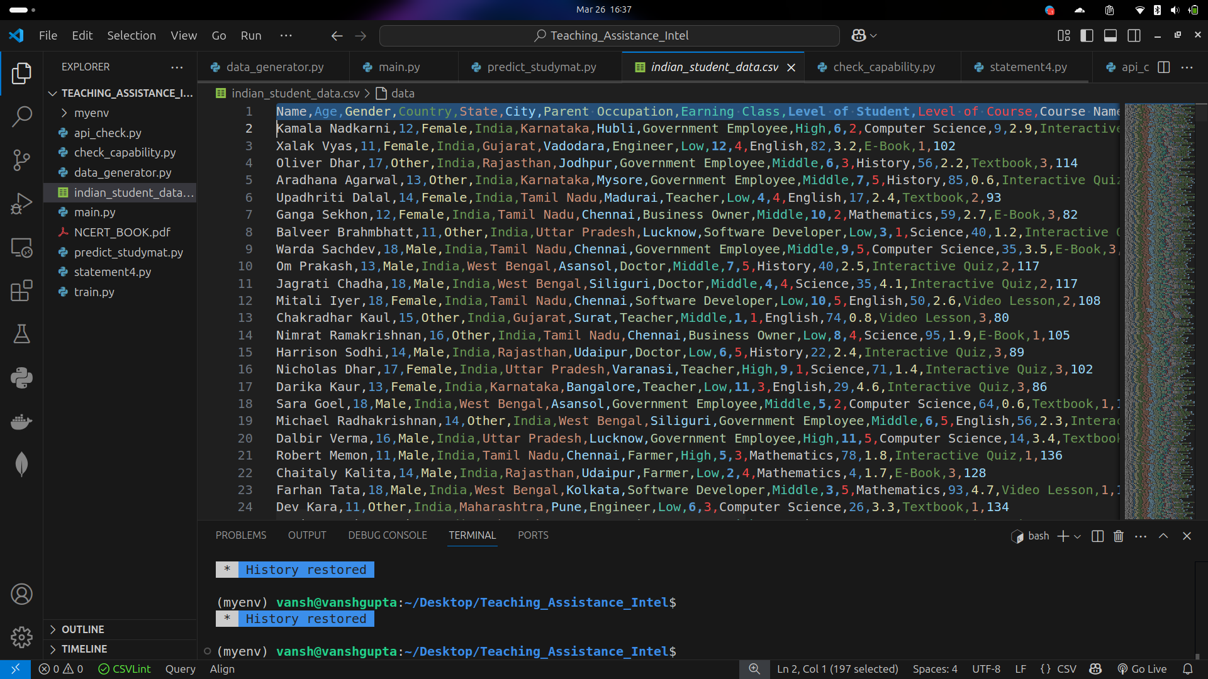

Data

Slide 8
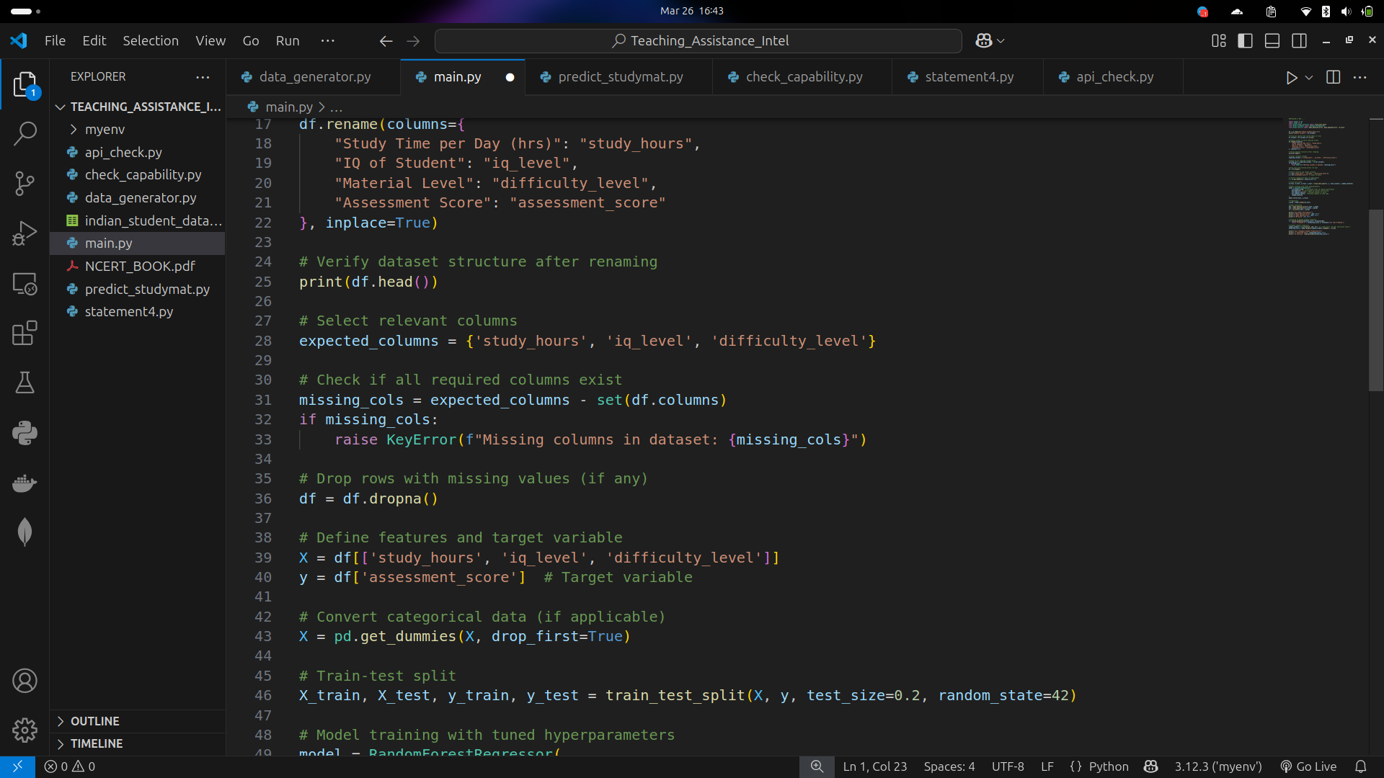
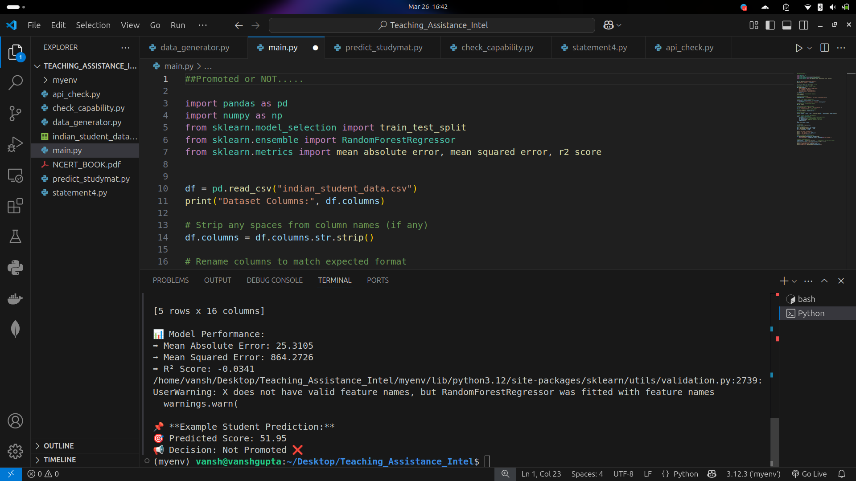
PROMOTED OR NOT

Slide 9
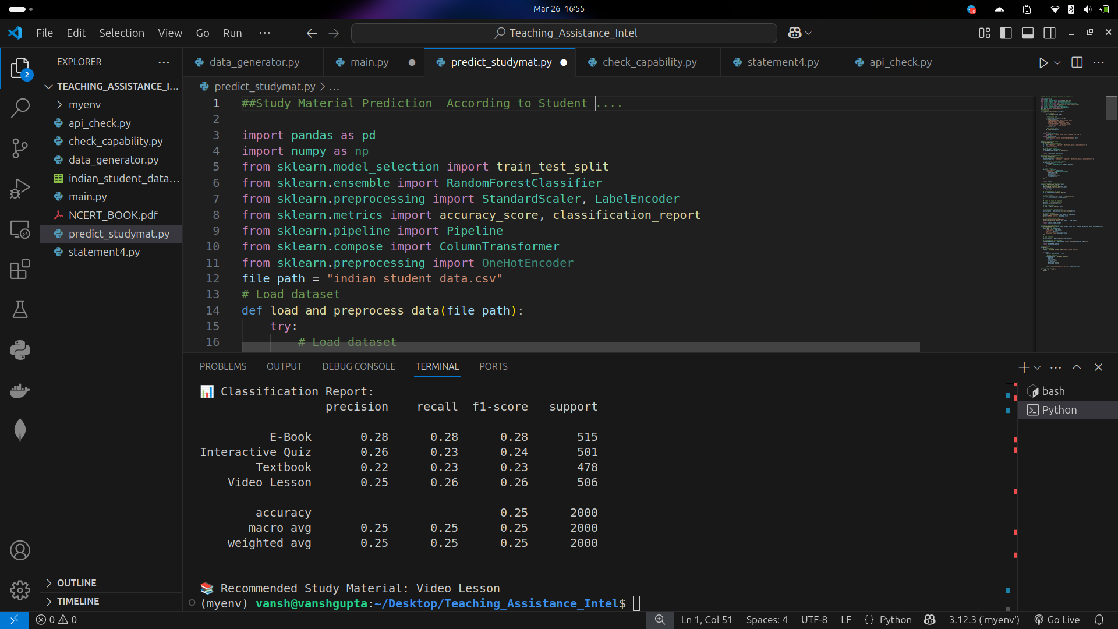
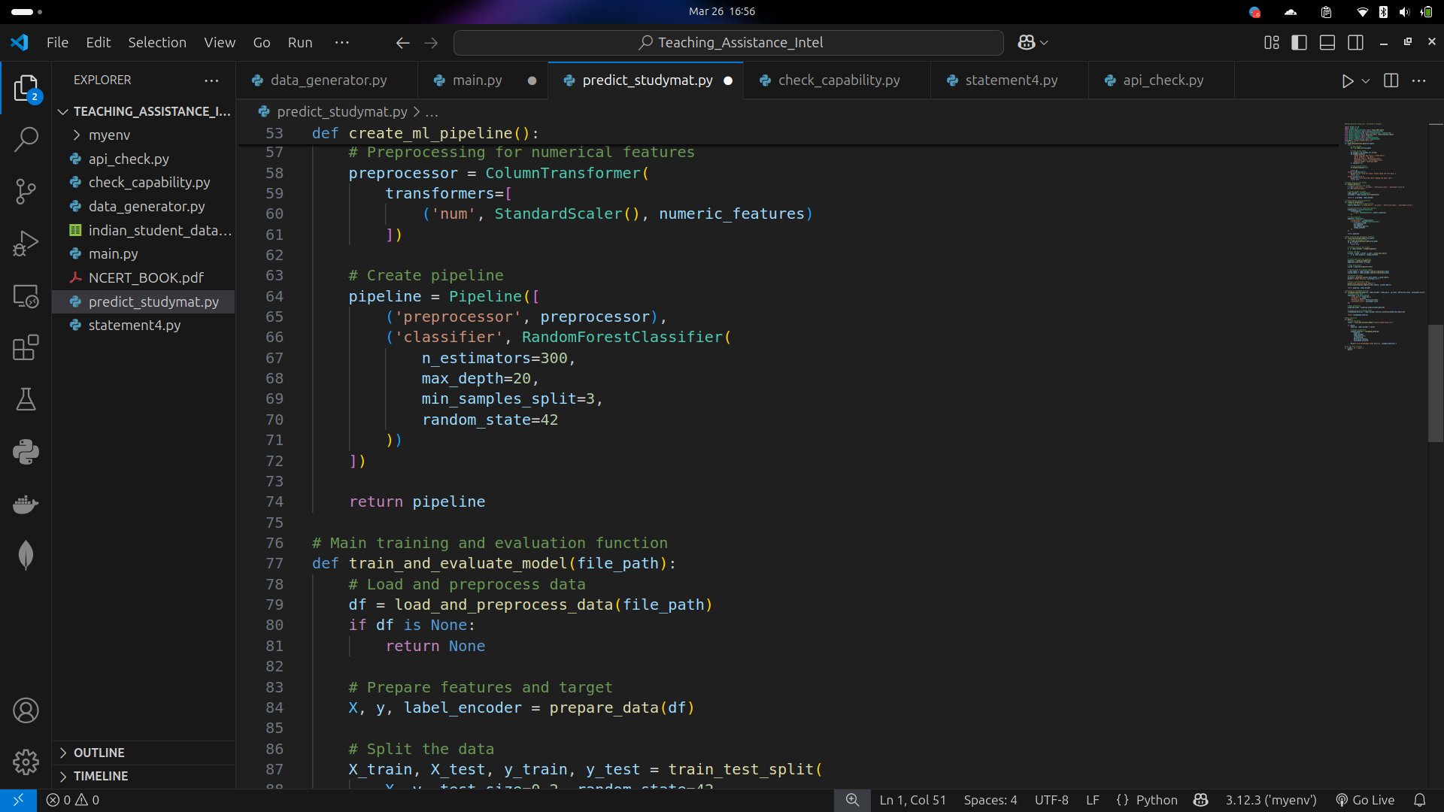
STUDY MATERIAL PREDICTION

Slide 10
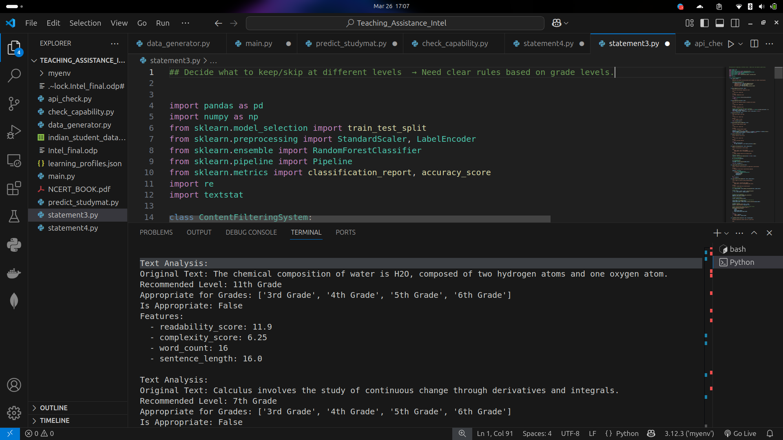
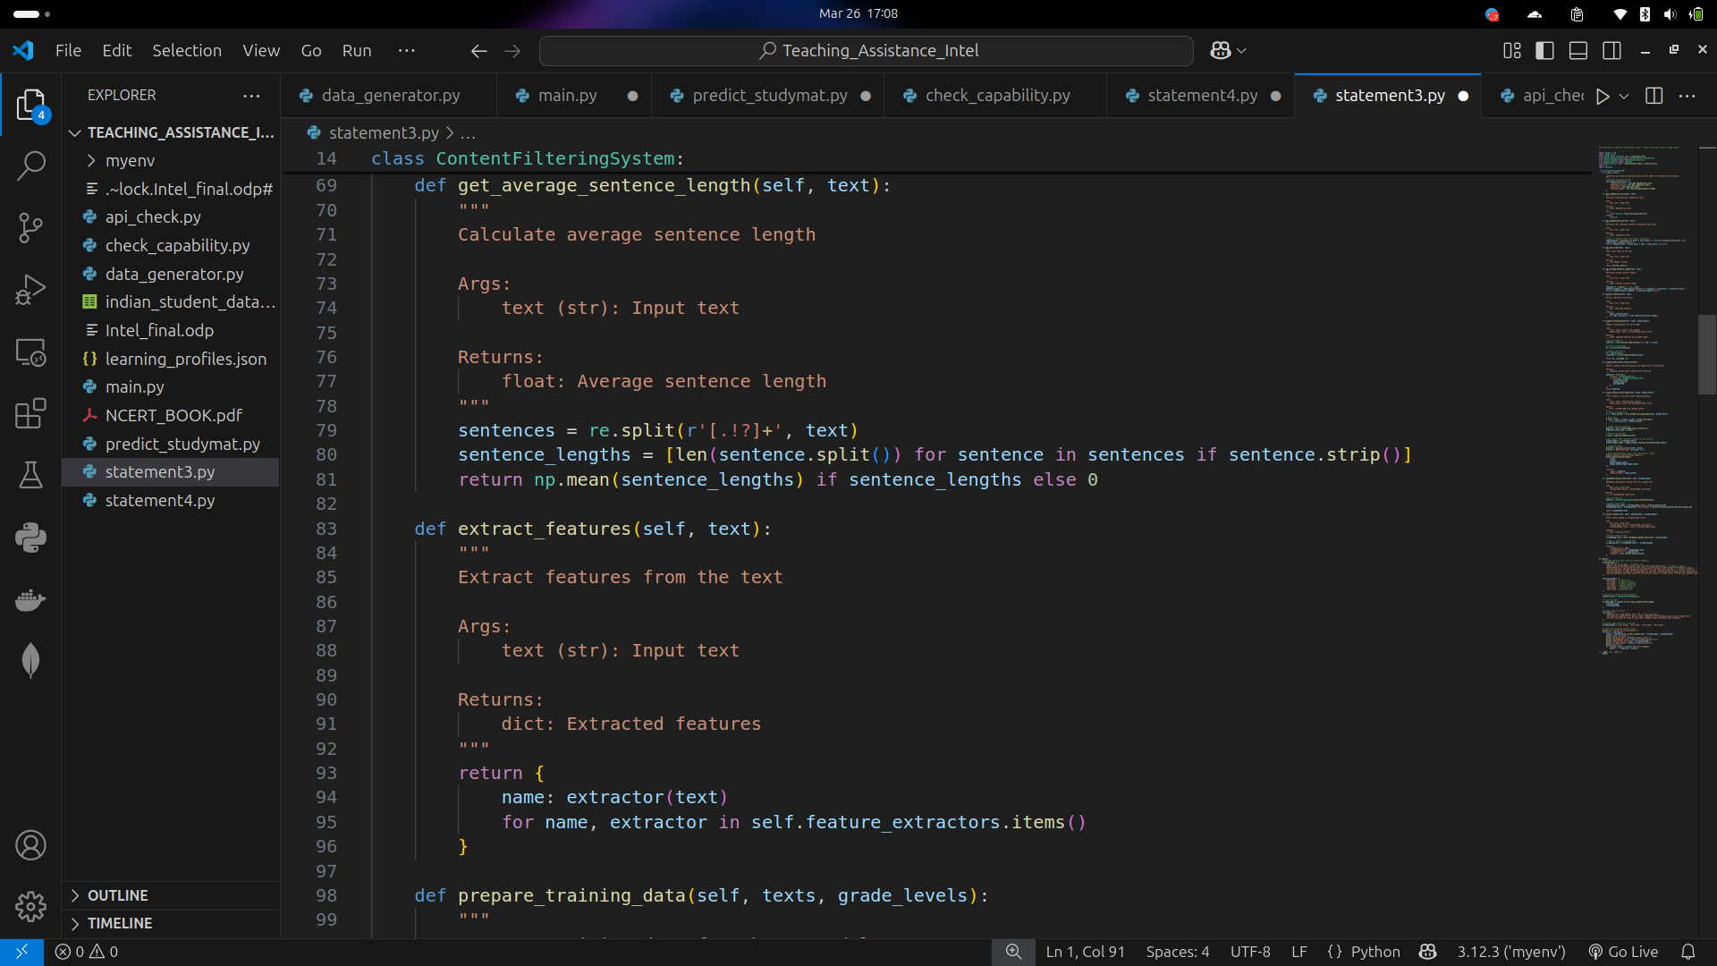
KEEP/SKIP DIFFERNT LEVEL

Slide 11
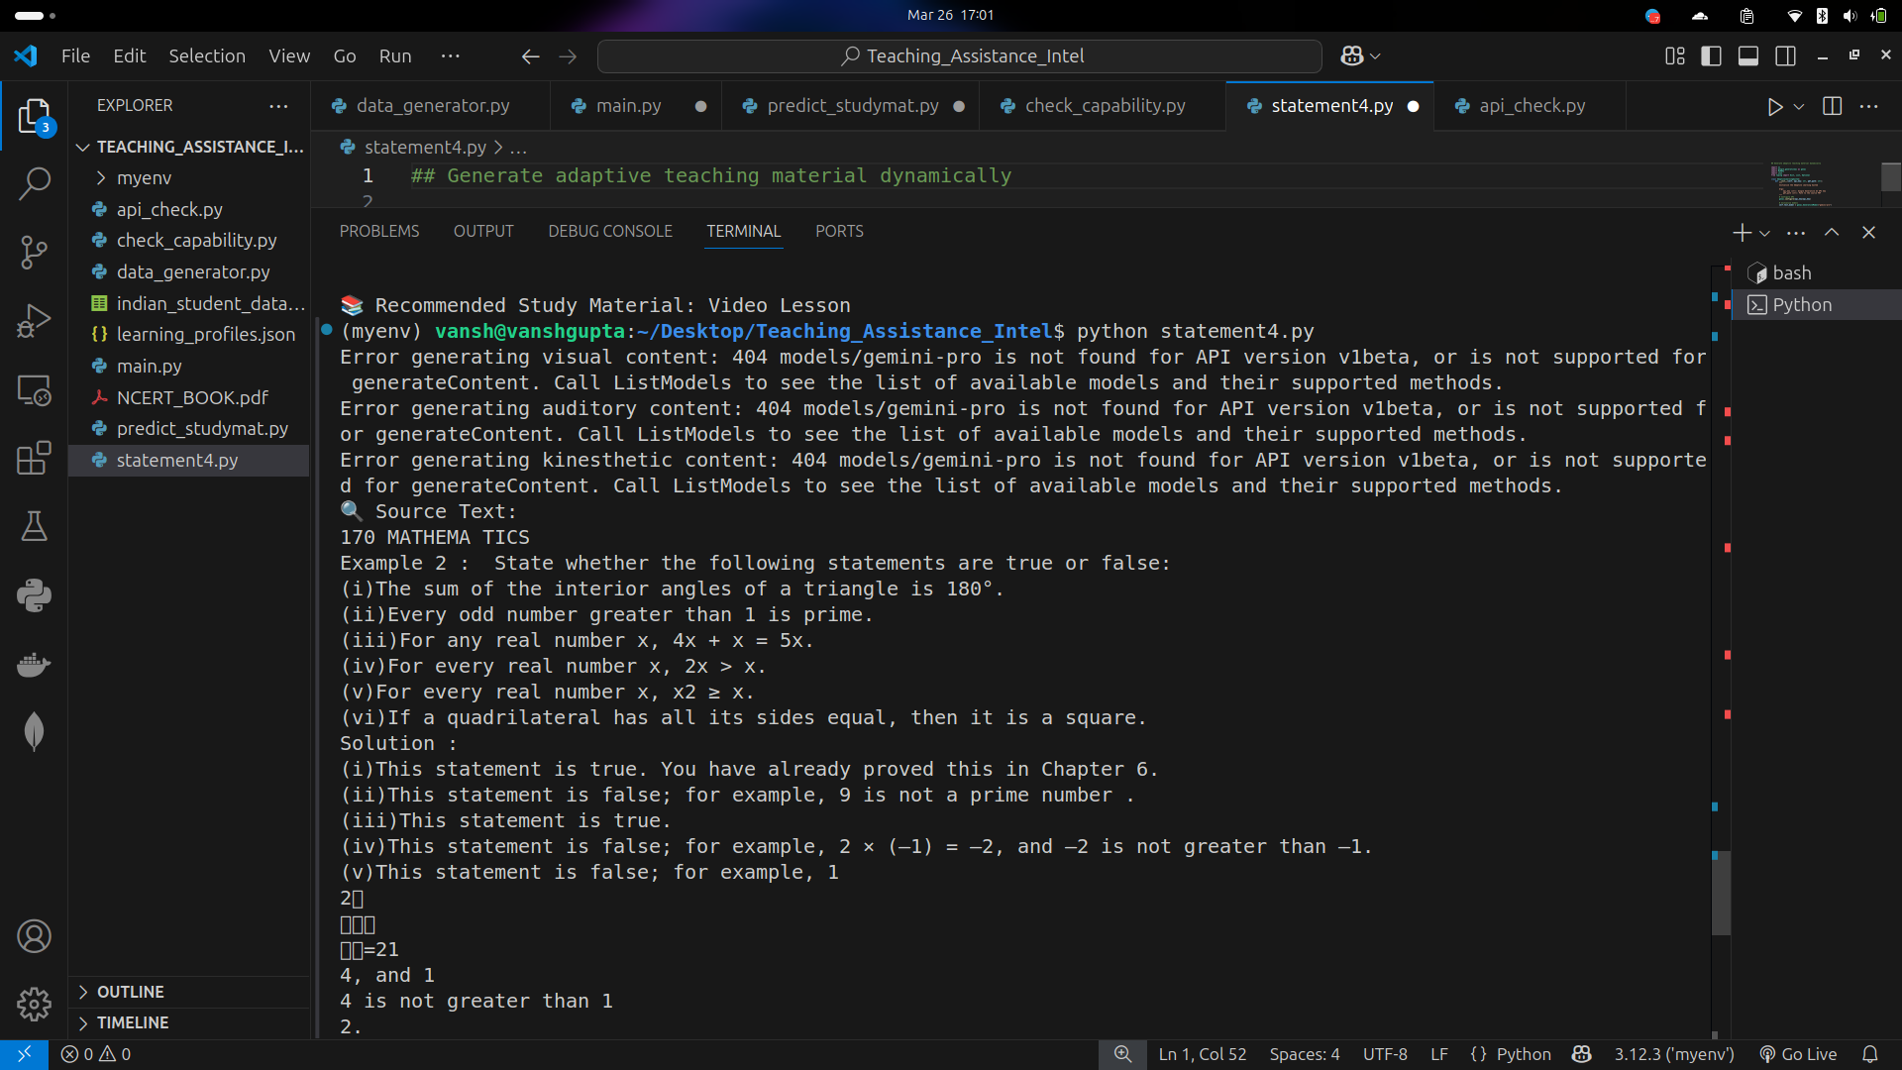
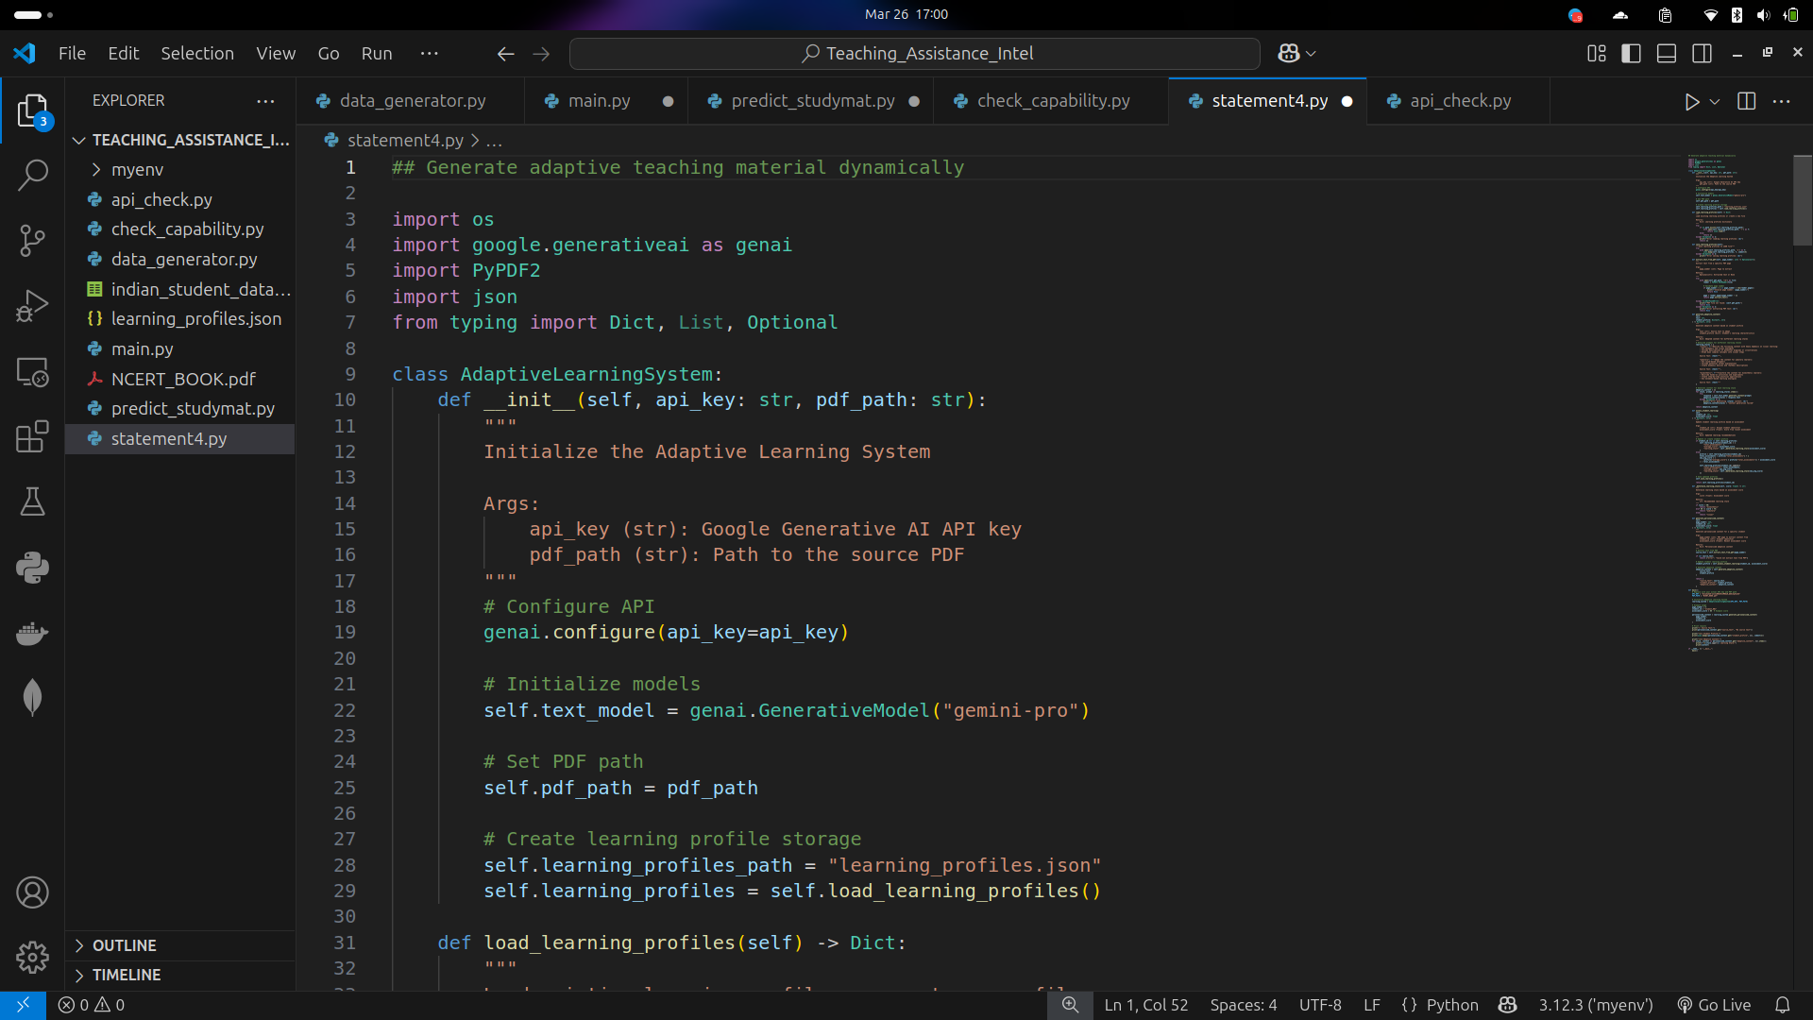
GENERATE TEACHING MATERIAL

Slide 12


