Slide 1
Wine Quality Prediction Using Machine Learning
PREDICTIVE ANALYTICS | KDD METHODOLOGY
End-to-End Predictive Model Development (CA3)
Dataset: UCI Wine Quality, red and white vinho verde
Vansh Gupta
23070521166
Symbiosis Institute of Technology, Nagpur
Notes:
Introduce the project: predicting the quality score of wines from their chemical measurements, built as a regression model and structured by the KDD stages.

Slide 2
Problem Statement
Can a wine's chemistry predict how it tastes?
Quality of vinho verde wines is rated by tasters on a 0-10 scale: slow, costly and subjective
Objective: predict that score from 11 lab measurements (a regression problem)
Second goal: find which properties drive quality
Judged with MAE, MSE, RMSE and R²
6,497
wines in the data
11
chemical inputs per wine
0-10
quality score to predict
Notes:
Wine quality is scored by human tasters, which is slow, costly and subjective. The goal is to predict that 0-10 score from 11 lab measurements using regression, and to find which properties matter most. Success is measured with MAE, MSE, RMSE and R-squared.

Slide 3
Dataset
UCI Wine Quality: two files, eleven measurements per wine
Attribute | Detail
Source | UCI repository (Cortez et al., 2009)
Samples | 1,599 red + 4,898 white = 6,497
Inputs | 11 physicochemical measurements
Target | quality score (3 to 9 observed)
Missing values | None
Duplicates | 1,177 rows; 5,320 kept
11 input features
fixed acidity
volatile acidity
citric acid
residual sugar
chlorides
free sulfur dioxide
total sulfur dioxide
density
pH
sulphates
alcohol
Notes:
Source is Cortez et al. (2009) on the UCI repository. Red has 1,599 wines and white has 4,898, combined 6,497. No missing values, but 1,177 duplicate rows were found and removed later. Target is the integer quality score, observed from 3 to 9.

Slide 4
Understanding and Preparing the Data
Most wines score 5 or 6, so extreme scores are rare
1
Removed 1,177 duplicate rows (5,320 left)
2
Encoded wine type (red/white) as 0/1
3
Stratified 80/20 split: 4,256 train, 1,064 test
4
Capped 226 extreme outliers (3×IQR, train limits)
5
Standardised features inside a pipeline
Notes:
Quality counts: 3 has 30 wines, 4 has 216, 5 has 2,138, 6 has 2,836, 7 has 1,079, 8 has 193 and 9 has 5. About 77% score 5 or 6. Alcohol has the strongest correlation with quality (+0.44). Preprocessing was done so that nothing from the test set leaks into training: the split came first, and outlier limits and scaling are learned on training data only.

Slide 5
Predictive Modelling Approach
Five steps from raw data to an honest test score
1 Split
2 Pipeline
3 Compare
4 Tune
5 Test
80/20, stratified by quality
Outlier cap and scaling
8 models, 5-fold CV
Random search on RF and XGBoost
Score once on unseen wines
Error metrics
MAE
MSE
RMSE
R²
Average miss, in quality points
Average squared miss; big errors count more
√MSE, back in quality points
Share of variation explained (1 = perfect)
Notes:
Every model sits in a pipeline with scaling, compared by 5-fold cross-validation on the training set only. The two strongest families (Random Forest and XGBoost) are tuned with RandomizedSearchCV. The test set is scored once at the end. Metrics: MAE is the average miss in quality points; MSE averages squared misses so big errors count more; RMSE is the square root of MSE in quality points; R-squared is the share of variation in quality the model explains.

Slide 6
Model Development
Tree ensembles beat linear models; tuning added a little more
Model | MAE | RMSE | R²
Tuned XGBoost | 0.524 | 0.678 | 0.407
Tuned Random Forest | 0.524 | 0.679 | 0.405
Random Forest | 0.531 | 0.687 | 0.390
XGBoost (default) | 0.529 | 0.690 | 0.386
Gradient Boosting | 0.538 | 0.694 | 0.379
SVR (RBF) | 0.539 | 0.711 | 0.347
Linear Regression | 0.565 | 0.730 | 0.313
Decision Tree | 0.569 | 0.751 | 0.272
Mean baseline | 0.695 | 0.880 | 0.000
Best: tuned XGBoost
200 trees, max depth 8
Learning rate 0.02, min child weight 5
Subsample and column sample 0.7
Tuning lifted R² from 0.386 to 0.407
Notes:
Test-set results for each model. The dummy model always predicts the average quality and sets the floor. Ridge scored the same as Linear Regression, so it is left off the table. Tree ensembles do better, which shows the chemistry-to-quality link is non-linear. Random Forest and XGBoost end up almost tied after tuning; XGBoost is chosen by a hair.

Slide 7
Evaluation
On unseen wines the model is off by about half a quality point
0.524
0.460
MAE
MSE
0.678
0.407
RMSE
R²
97.3% of predictions land within ±1 point
55.6% exact after rounding
24.5% lower MAE than the mean baseline
Notes:
Final tuned XGBoost scored on the 1,064 held-out wines: MAE 0.524, MSE 0.460, RMSE 0.678, R-squared 0.407. That is a 24.5% lower MAE than always guessing the average (0.695). Rounded to the nearest score it is exactly right 55.6% of the time and within one point 97.3% of the time.

Slide 8
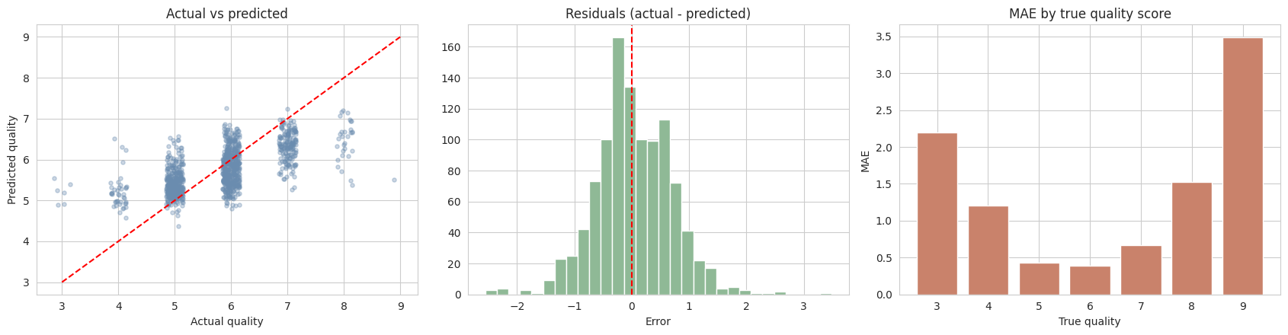
Results and Interpretation
Predictions track the truth, except for the rarest wines
Alcohol drives quality
Extremes are hard
Moderate R²
Most important feature (importance 0.22), then free sulfur dioxide and volatile acidity.
MAE about 0.4 for scores 5-6, but 2.2 for score 3 and 3.5 for score 9.
Taste is subjective; grape type, brand and tasters are not in the data.
Notes:
Left plot: predicted vs actual quality, points near the dashed line are accurate. Middle: errors are centred on zero. Right: error by true score. Average error is about 0.4 for scores 5 and 6 but 2.2 for score 3 and 3.5 for score 9, because those classes are very rare and the model pulls them toward the middle. Permutation importance: alcohol 0.22, free sulfur dioxide 0.11, volatile acidity 0.10. R-squared stays around 0.4 because taste is subjective and grape type, brand and the tasters are not in the data.

Slide 9
Conclusion
What we found
Limits and next steps
Chemistry predicts wine quality moderately: tuned XGBoost reaches MAE 0.52 and R² 0.41
Ensembles beat linear models, so the link is non-linear
Alcohol, free sulfur dioxide and volatile acidity matter most
Imbalanced target: try class weights, SMOTE or ordinal classification
One region only (vinho verde), so results may not transfer
Try SHAP, LightGBM and CatBoost
Data: Cortez, Cerdeira, Almeida, Matos & Reis (2009), UCI Wine Quality, DOI 10.24432/C56S3T
Notes:
Summarise: moderate but useful accuracy, non-linear models win, alcohol is the key driver. Be honest that R-squared is about 0.4 because quality is a subjective score. Mention the limitations and the next steps.

